Slide 1
ISRP Categorical Review
January 17-19, 2012 Portland, OR
Nez Perce Tribe Resident Fish Substitution Program
“Trout Ponds Project”
BPA No. 1995-013-00

Slide 2
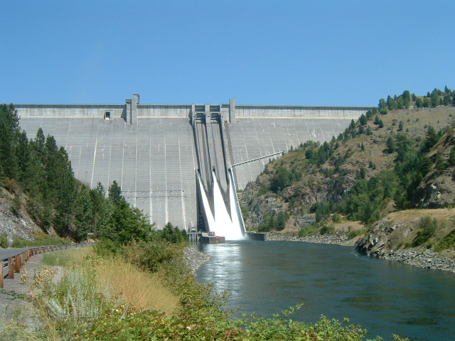
Resident Fish Substitution (2000 FWP)
• Dworshak Dam (1972) N. Fork Clearwater River
• Partially mitigate for lost anadromous fisheries

Slide 3
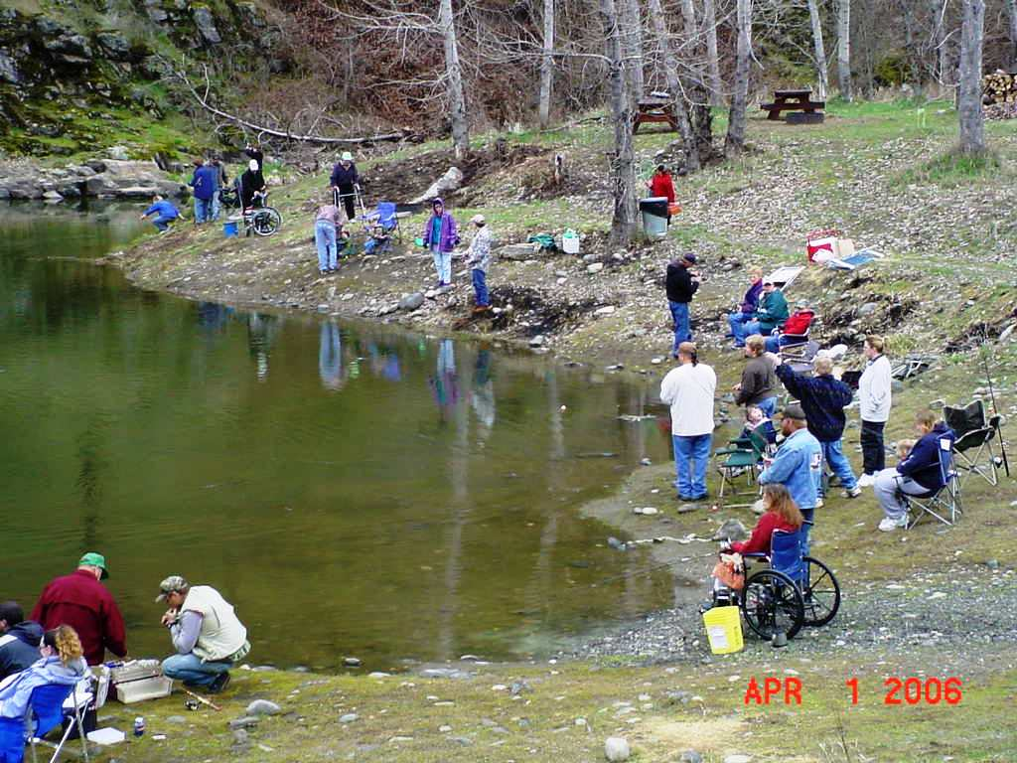
• Increase harvest opportunities
• Hatchery rainbow trout in (3) small, confined ponds
• Reduce harvest pressure on native species

Slide 4
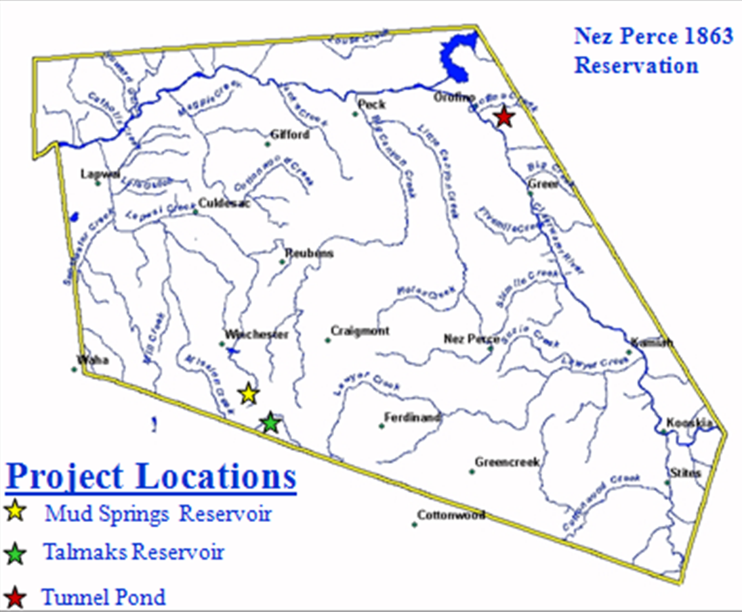
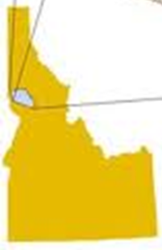
Ponds Located in NPT Reservation, Idaho

Slide 5
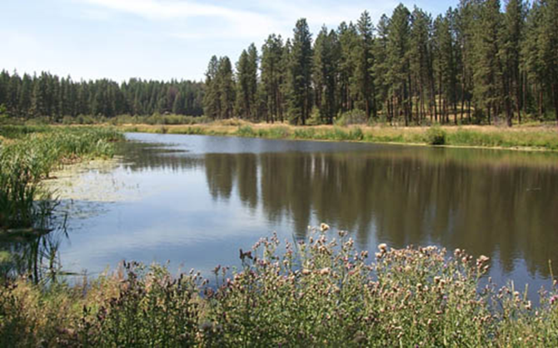
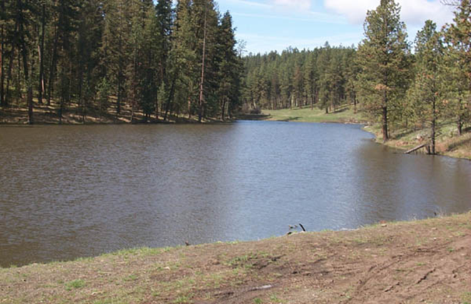
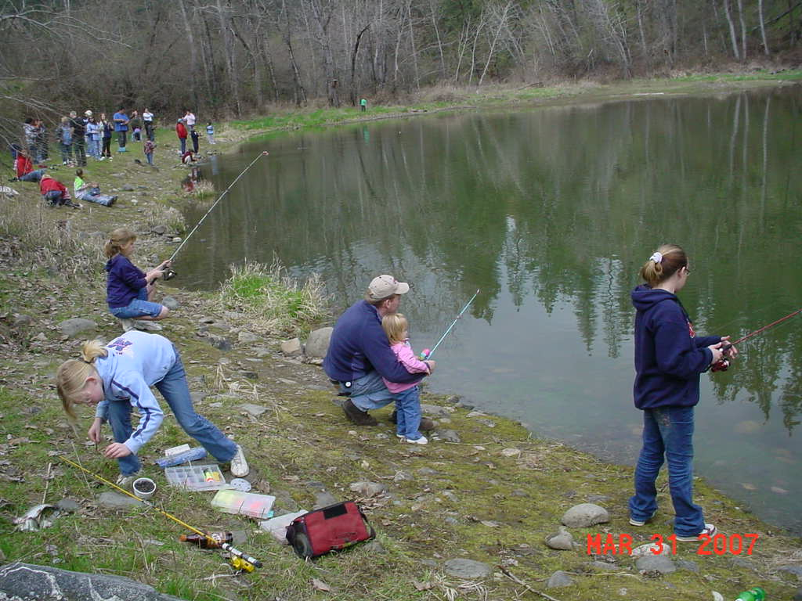
Project Ponds
• Mud Springs Reservoir (BIA 1964)
•Talmaks Reservoir (BIA 1964)
• Tunnel Pond (NPT/BPA 2000)

Slide 6
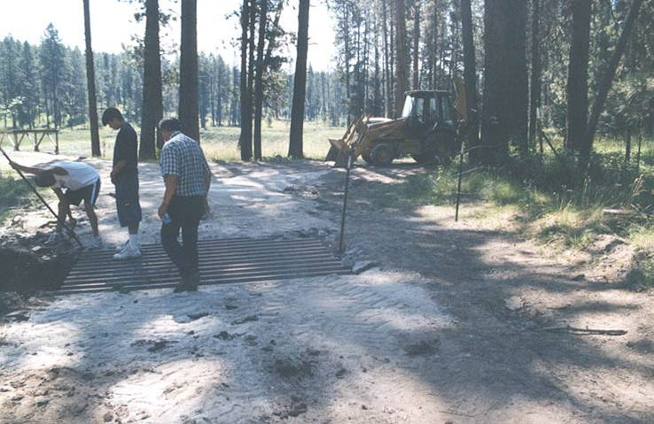
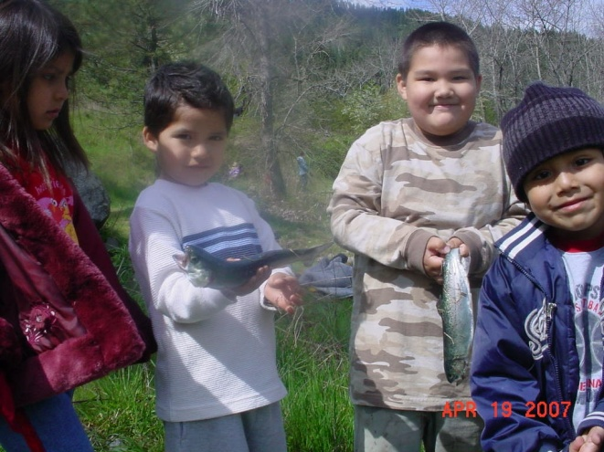
Objectives
Continue O&M work
Sustained harvest of 4,750 kgs.
• Community Outreach and
Education

Slide 7
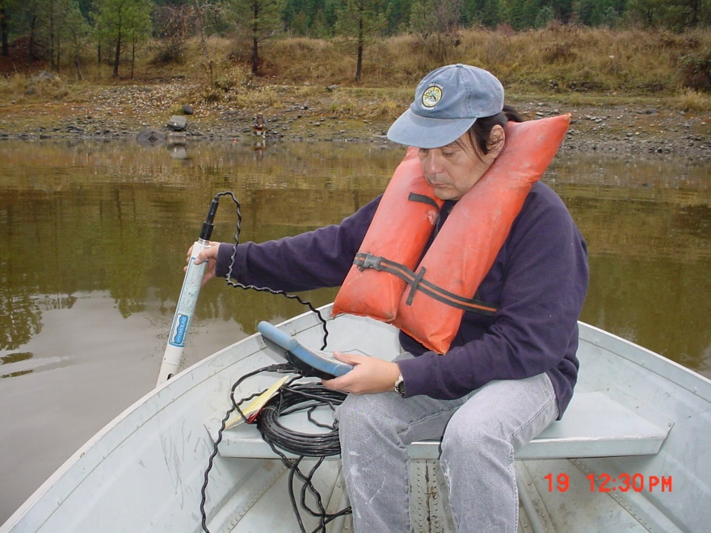
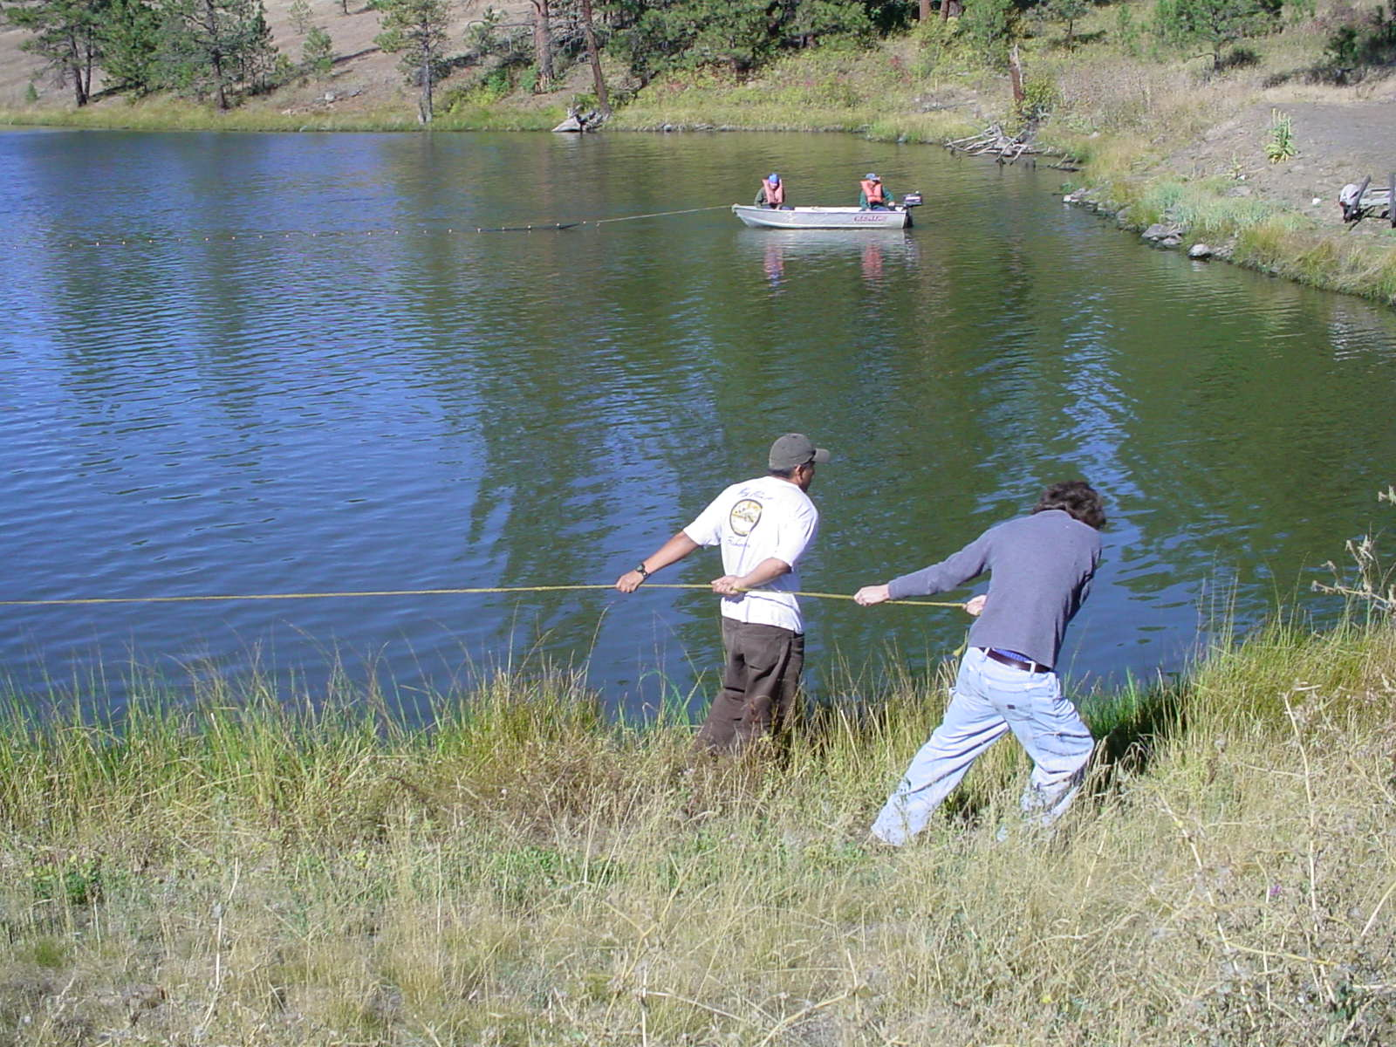
Study Design
Monitor water quality (2x/month per pond)
• Monitor fish health and condition
(2x per year per pond)

Slide 8
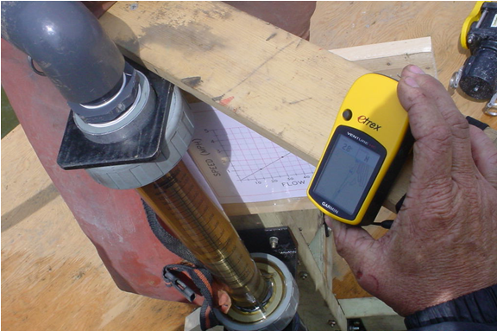
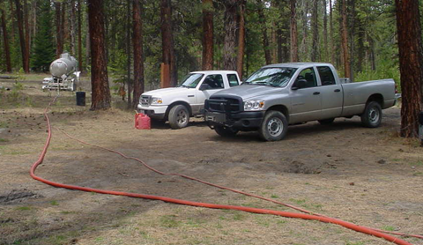
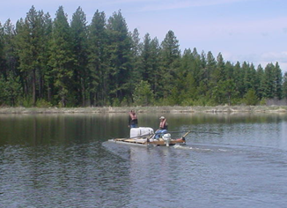
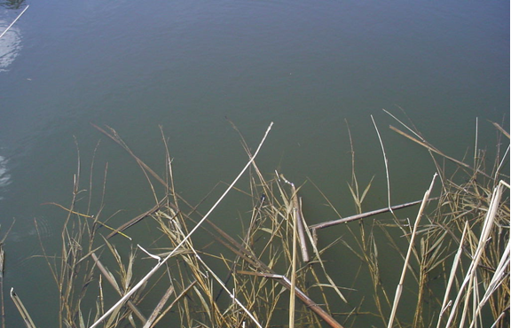
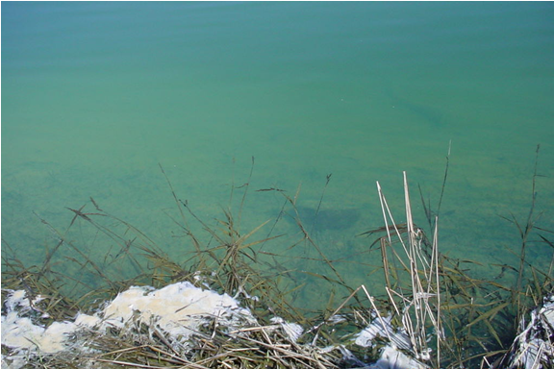
Adaptive Management
• Aluminum Sulfate treatment at Mud Springs (Phosphate removal)
• Pre-treatment
• Post-treatment

Slide 9
Results

Slide 10
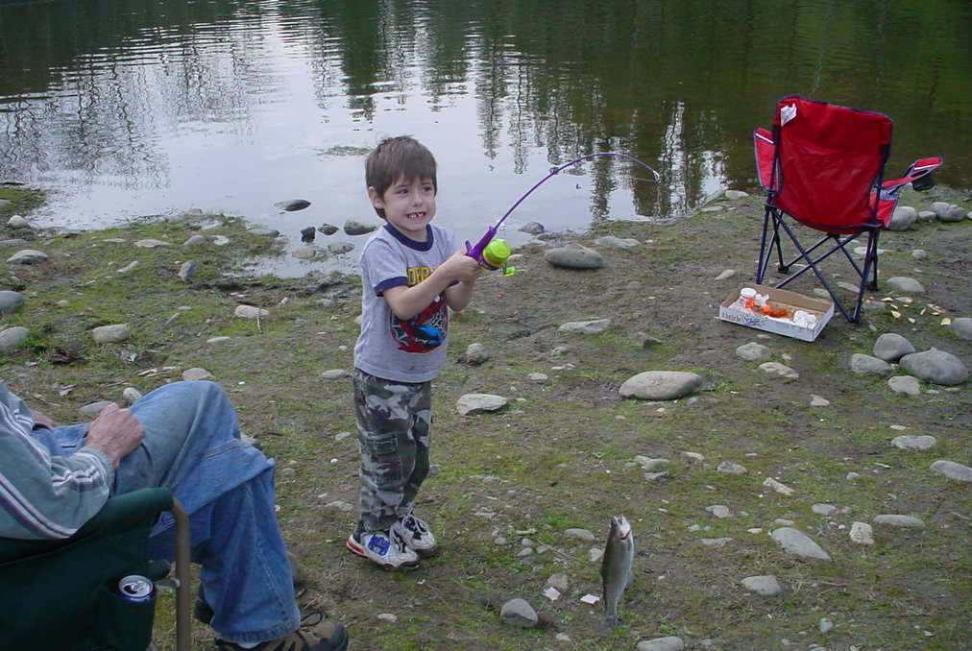
Results:
Investing in Future Generations

