Slide 1
Bull Trout Status and Abundance on Warm Springs Reservation
2007-157-00
Cyndi Baker & Jen Graham

Slide 2
Project History
Began in 1998 to document bull trout life history in WSR and SC and monitor population abundance
Data from 1998 to 2009 summarized in a 2011 report
Study objectives were reviewed, adjusted and/or added in 2011 categorical review project proposal

Slide 3
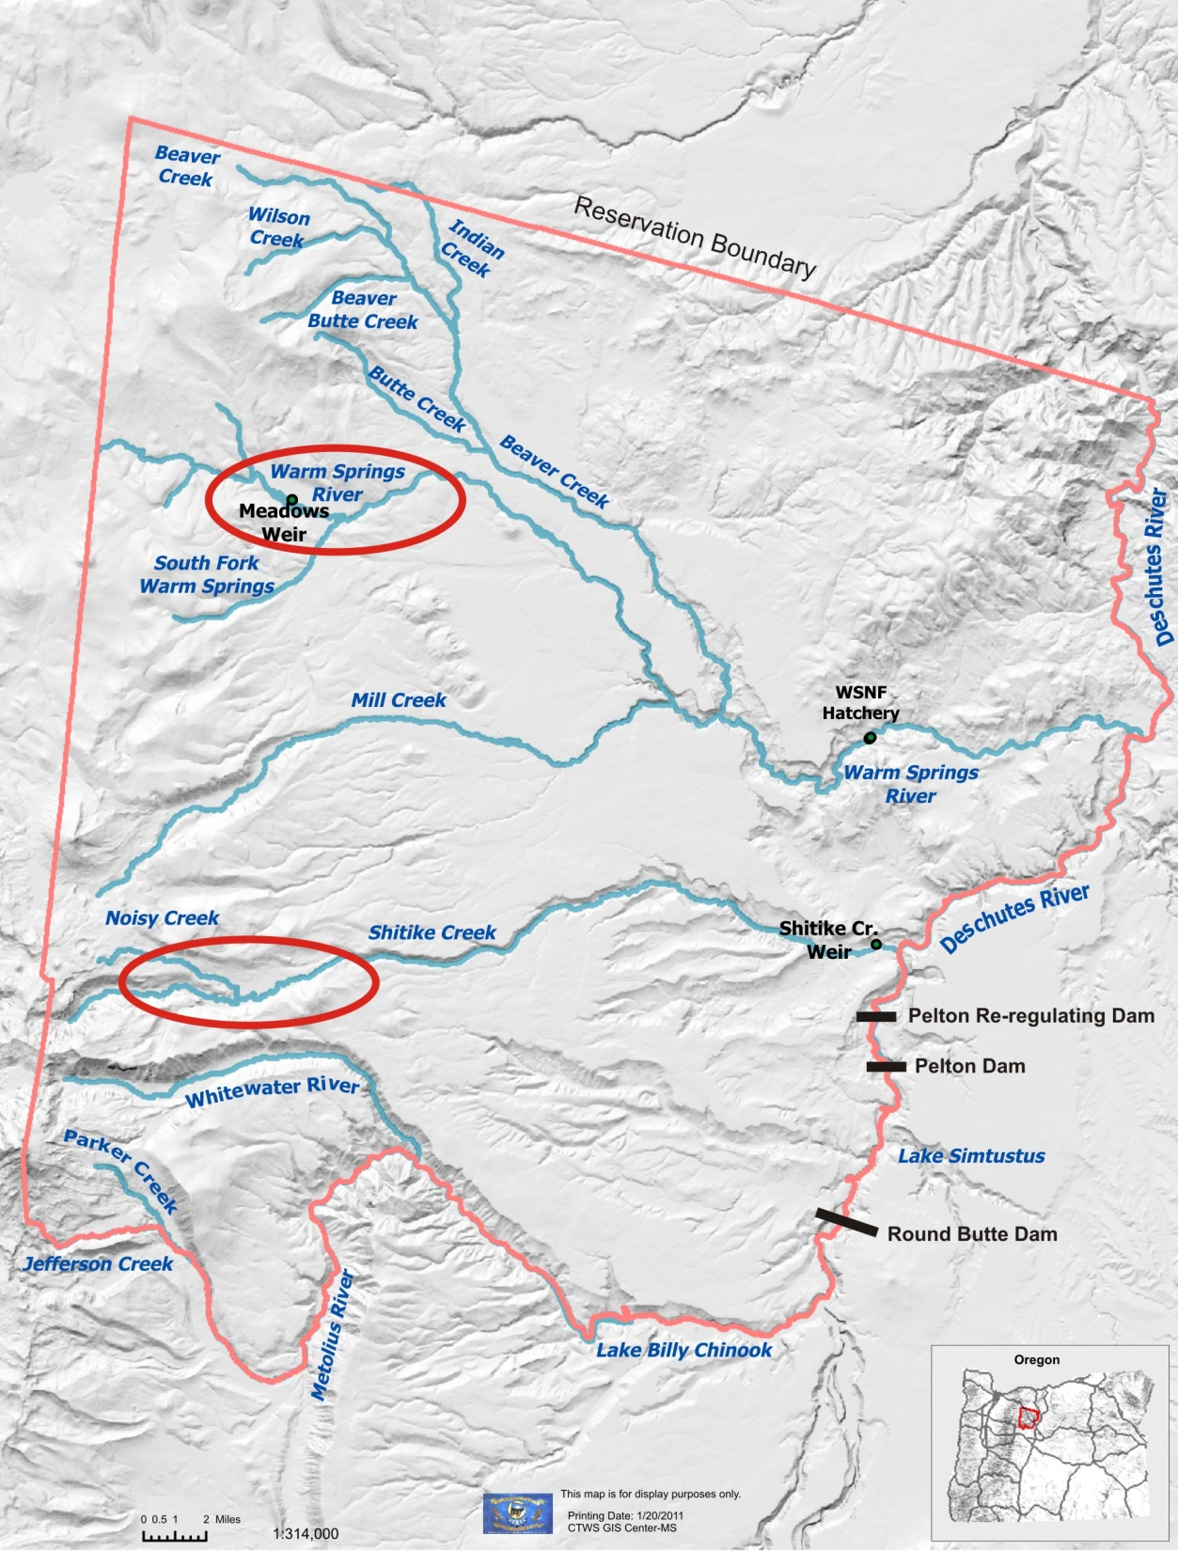
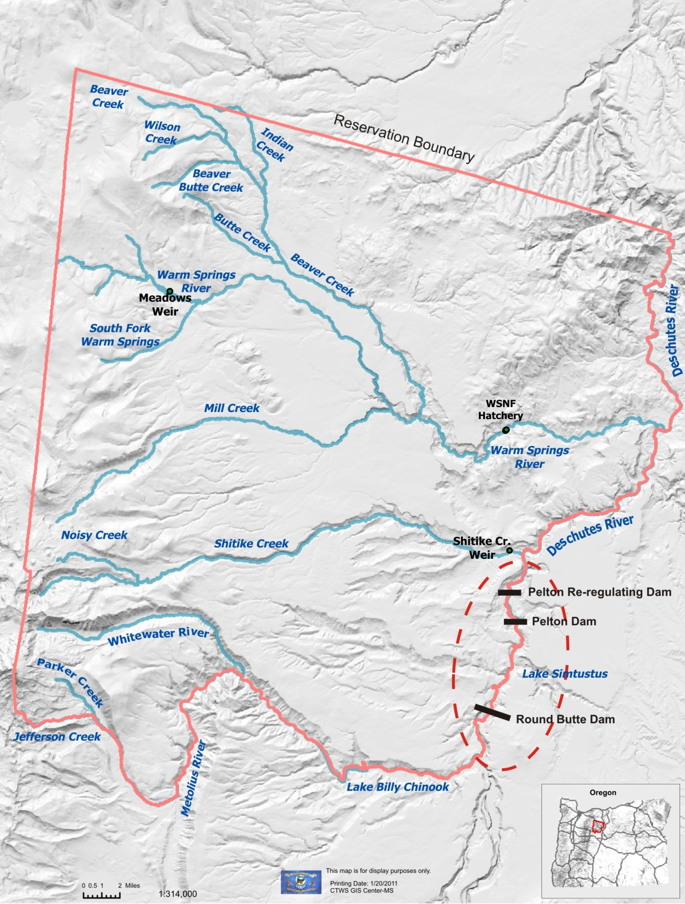
Study Area

Slide 4
Results from data collected 1998-2009
Distribution across Warm Springs Reservation
Relative abundance of juvenile bull trout/brook trout in index reaches in WSR and SC
Spawning distribution and redd counts in index reaches in WSR and SC
Migration timing and patterns
  Document fluvial and resident forms
Hybridization with brook trout

Slide 5
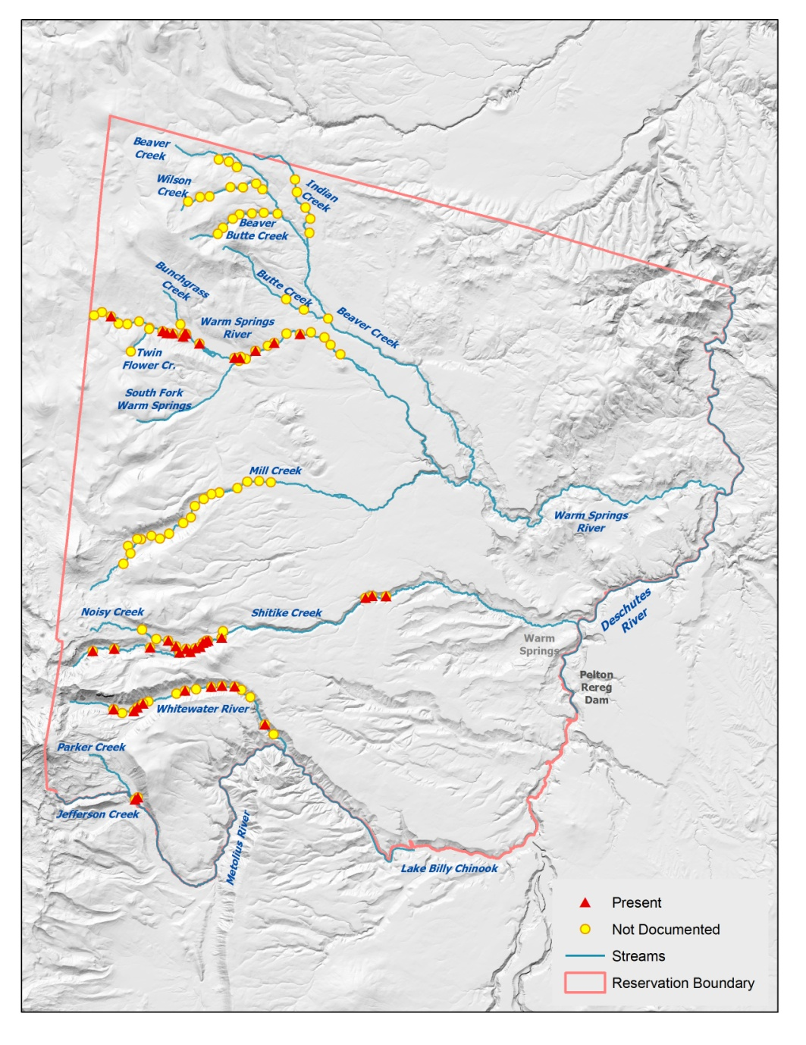
1998 Bull trout distribution

Slide 6
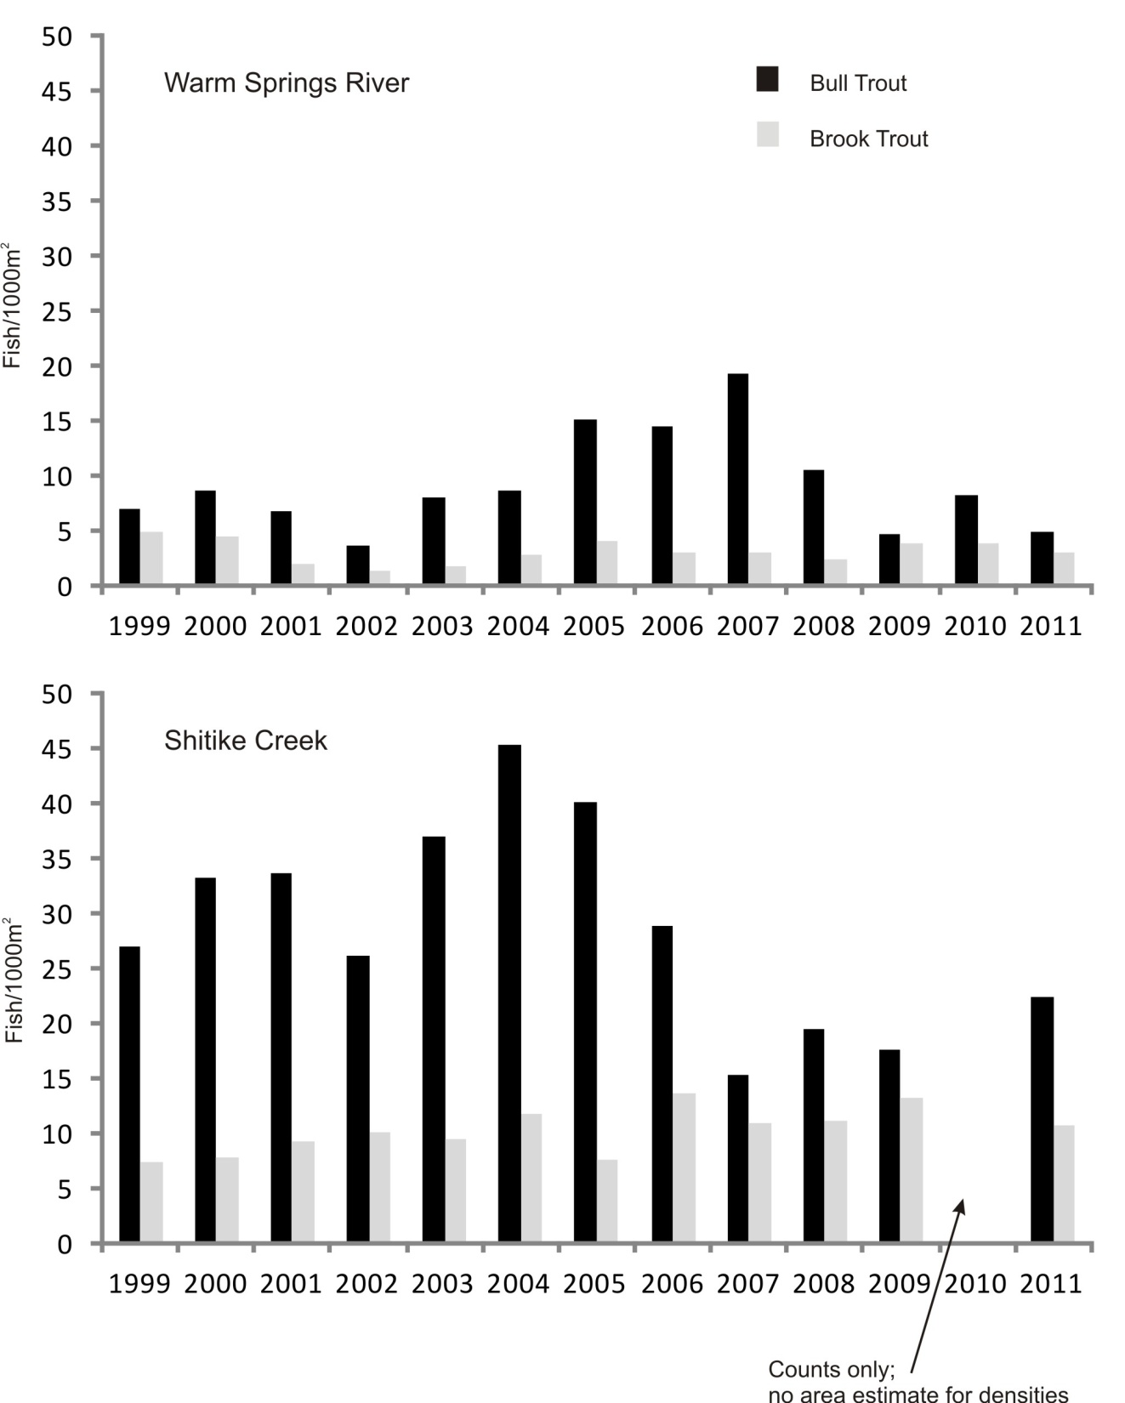
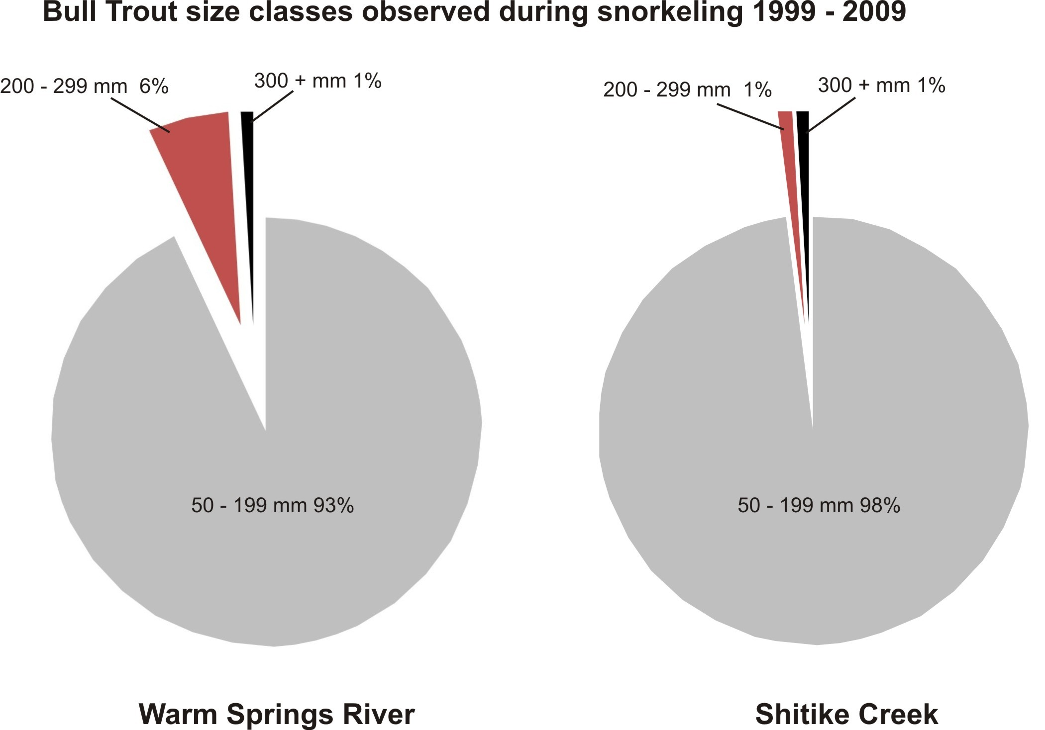
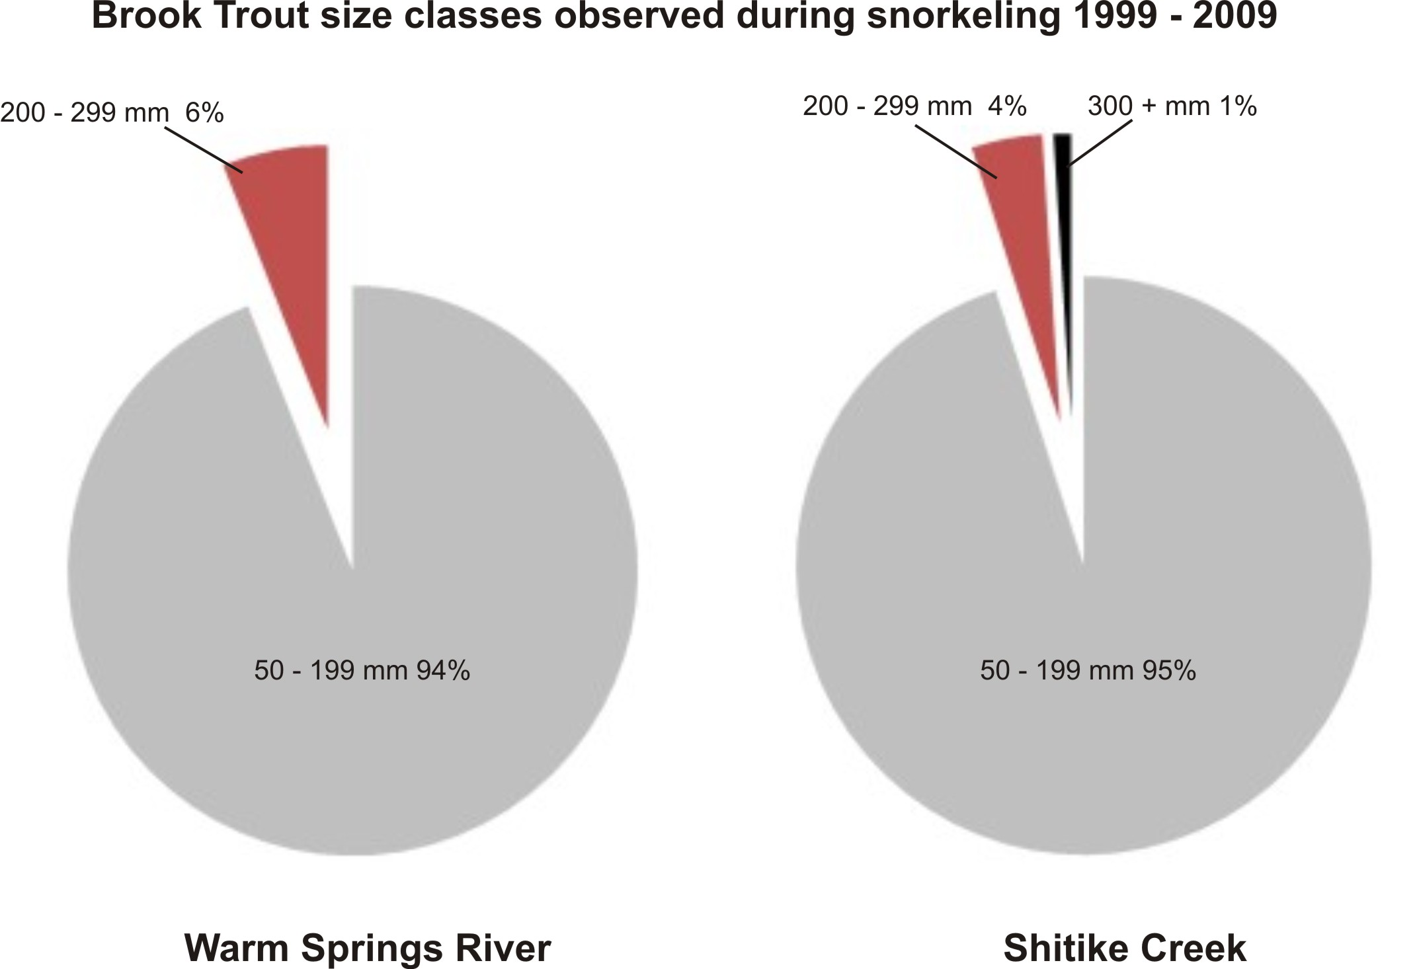
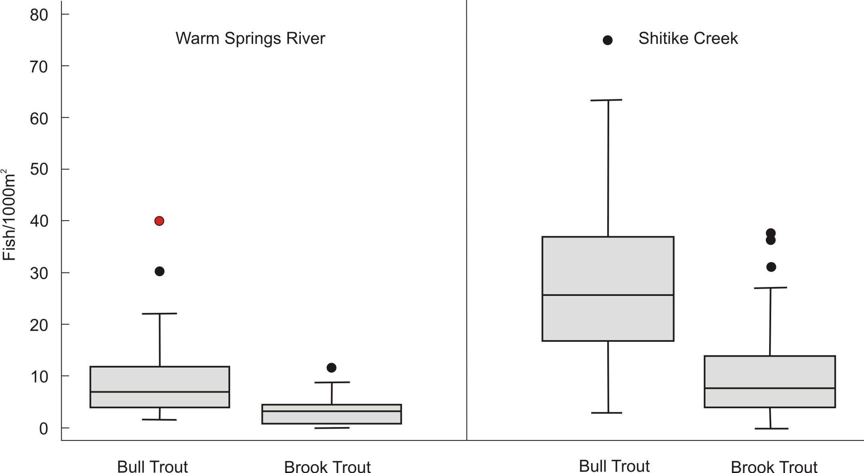
Relative abundance in index reaches
1999 to 2011

Slide 7
Redd counts in index reaches 1998-2011
Notes:
Redds in WSR decline 7.6 per year r2=0.77; redd counts in SC fluctuate around the mean of 104 interannually from 2 to 100

Slide 8
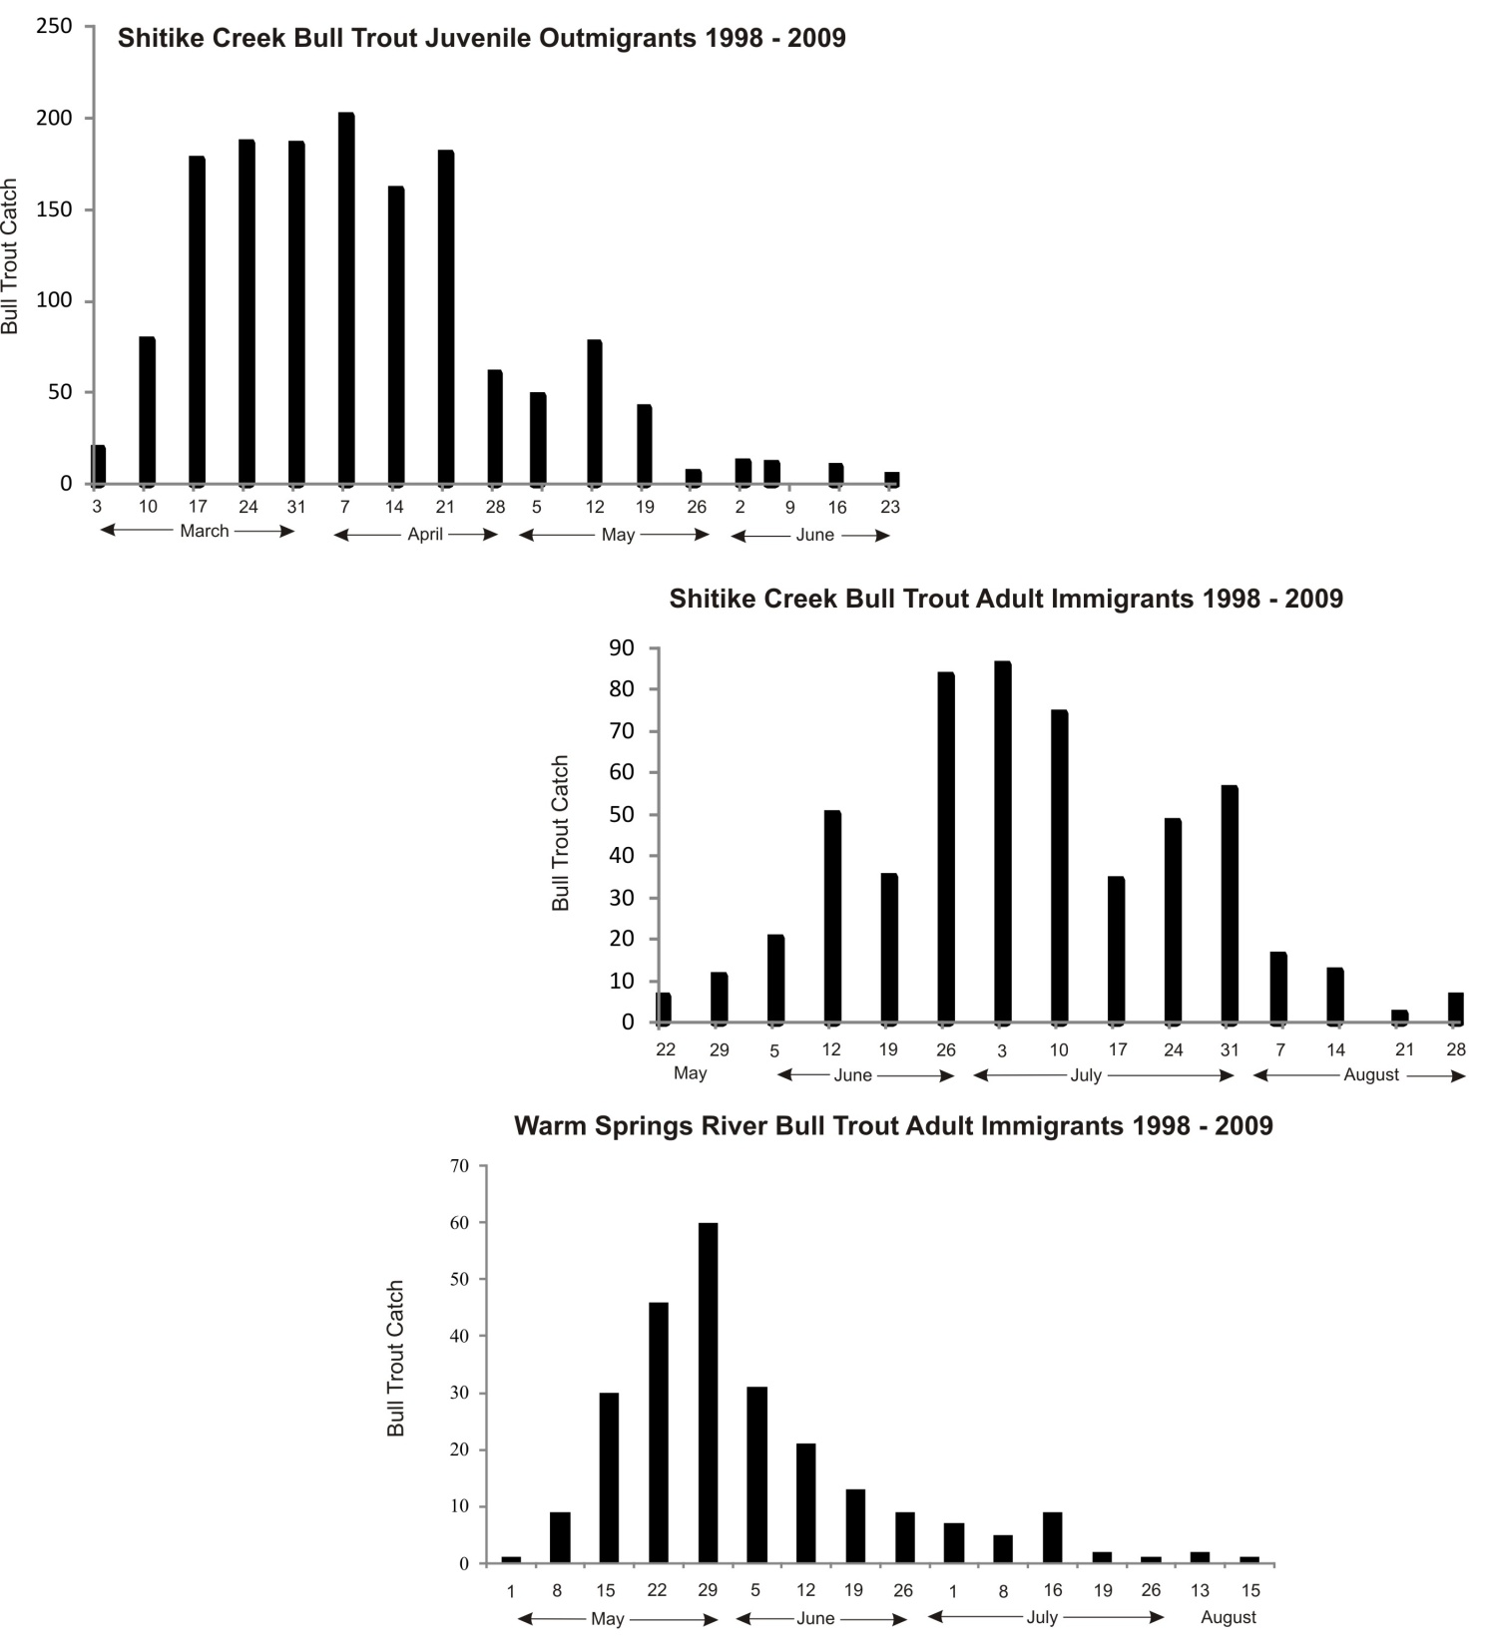
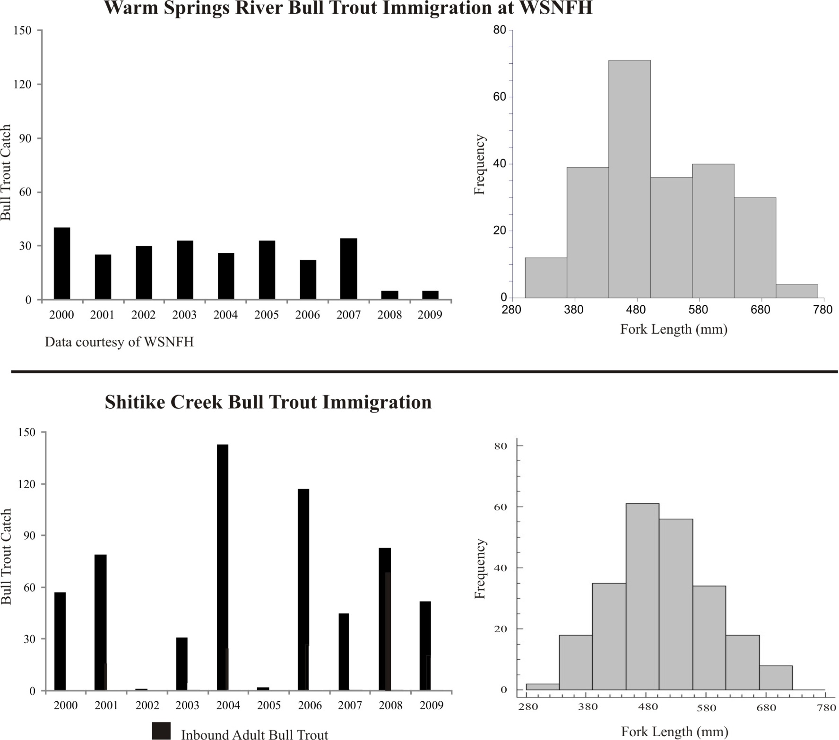
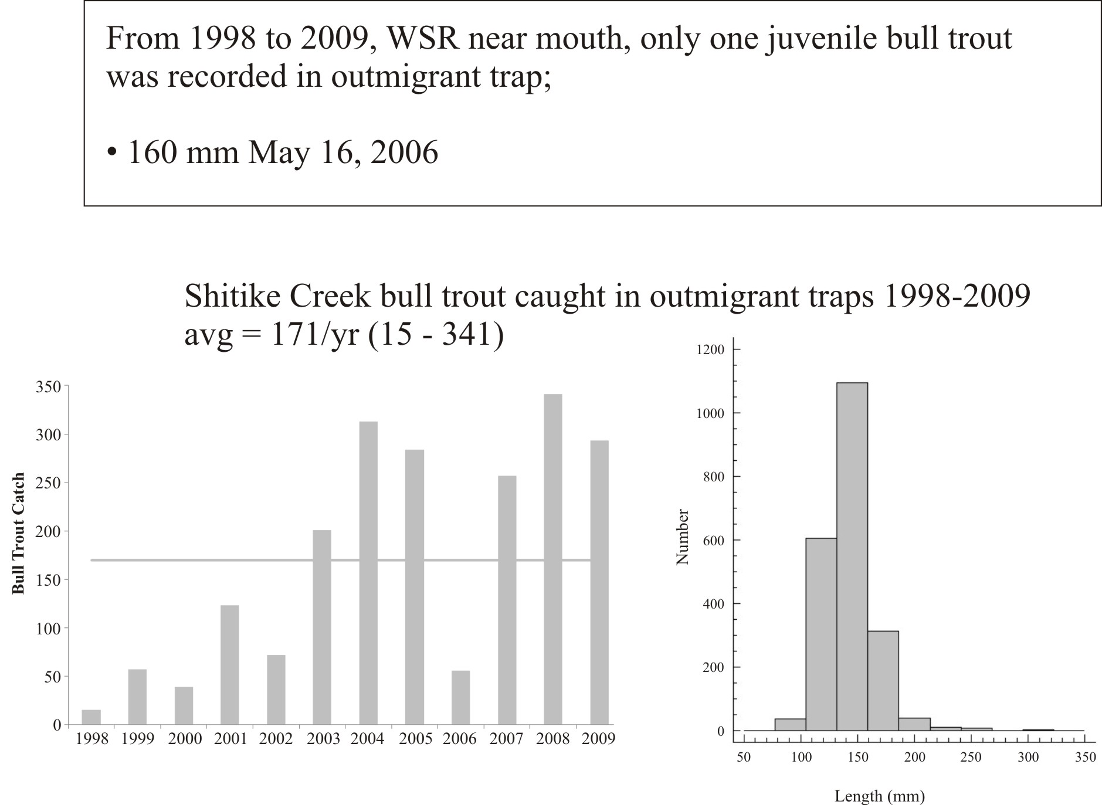
Documenting life history types
Resident vs. fluvial that migrate to Deschutes R.
Emmigration/immigration timing
  Outmigrant traps at mouth of WSR and SC
  Weirs for returning adults at mouth of WSR and SC
Radio Telemetry
  1999-2000
  2007

Slide 9
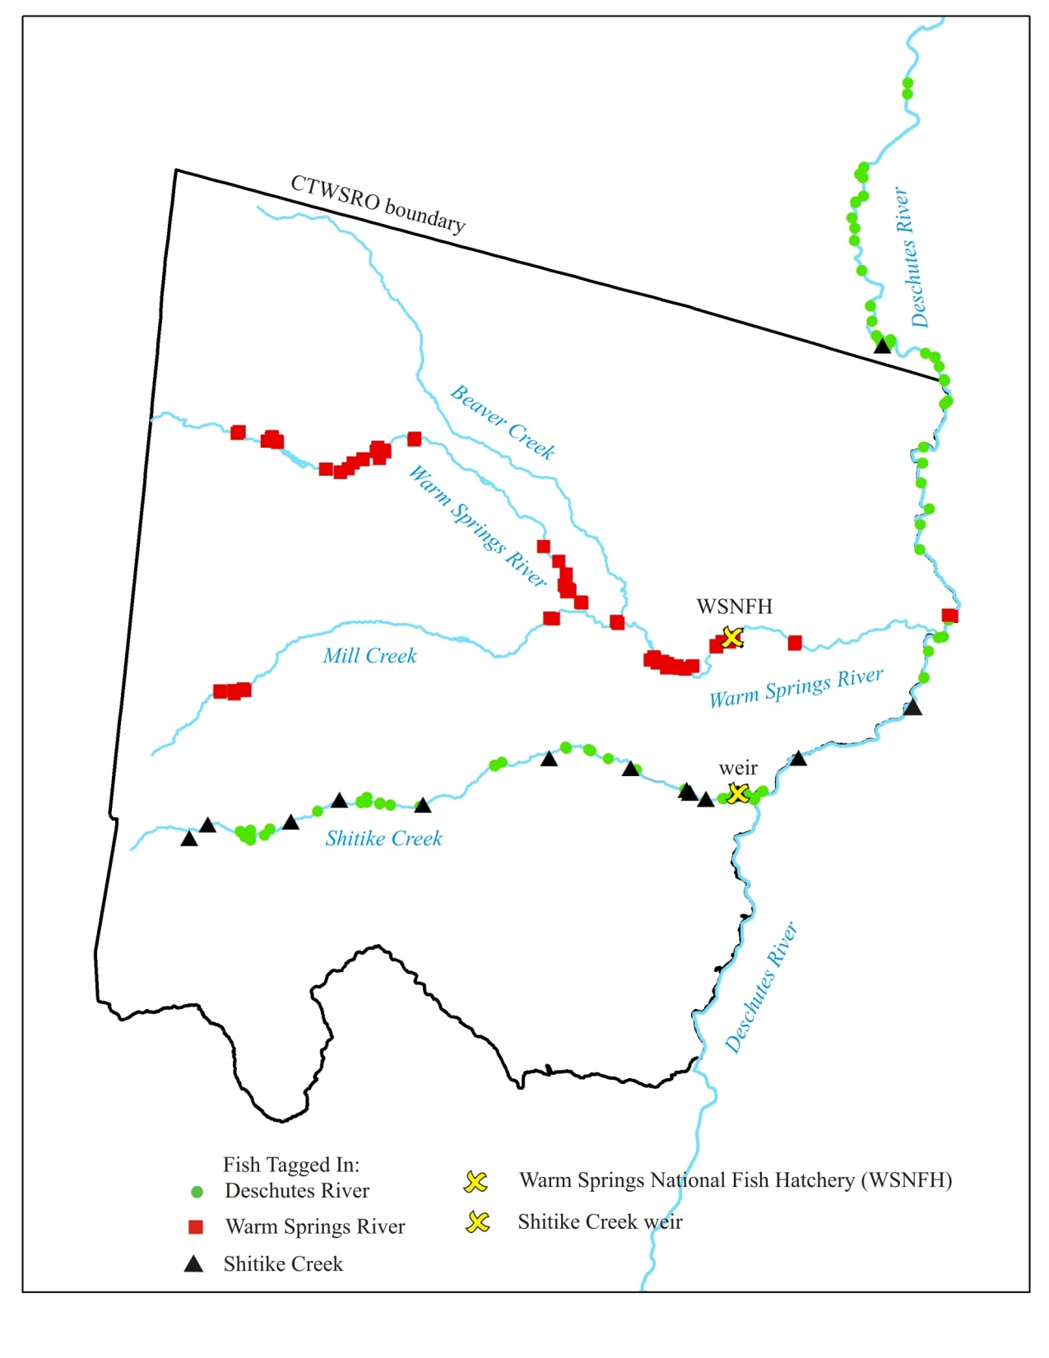
Radio telemetry studies
  1999-2000
    23 implanted with radio tags and released (same vicinity where caught):
      DR (n=9)
      WSR @ hatchery (n=9)
      SC at weir (n=5)
  2007
    23 caught below Round Butte Dam, implanted with radio tags and released in lower Deschutes R.; 2 caught in CR:
      One downstream of John Day Dam
      One at Lone Pine, downstream of Deschutes R. mouth

Slide 10
Hybridization with brook trout
Tissue samples collected 1999 and 2005
  WSR (n = 15 in 1999; 39 in 2005)
  SC (n = 30 in 1999; 40 in 2005)
Univ. Montana (Dr. Spruell) used paired interspesed nuclear element (PINE-PCR) method to amplify markers that differentiate bull – brook trout and allow identification of hybrids
Results - one F1 hybrid identified in SC

Slide 11
What’s proposed
Update bull trout distribution map (last done 1998)
Continue monitoring trends in index reaches in WSR and SC and water temperatures
  relative abundance of bull/brook trout (add WW)
  redd counts (plus Whitewater R. and Jefferson Ck)
Permutation analysis
    determine the probability of detecting a population decline using snorkel counts in index reaches in WSR and SC
Migration patterns to describe life-history patterns
  Continue operating weirs
  Add HDX antennae arrays
Develop bull trout length and age relationships specific to WSR and SC
Develop plan for re-establishment of bull trout in Mill Creek

Slide 12
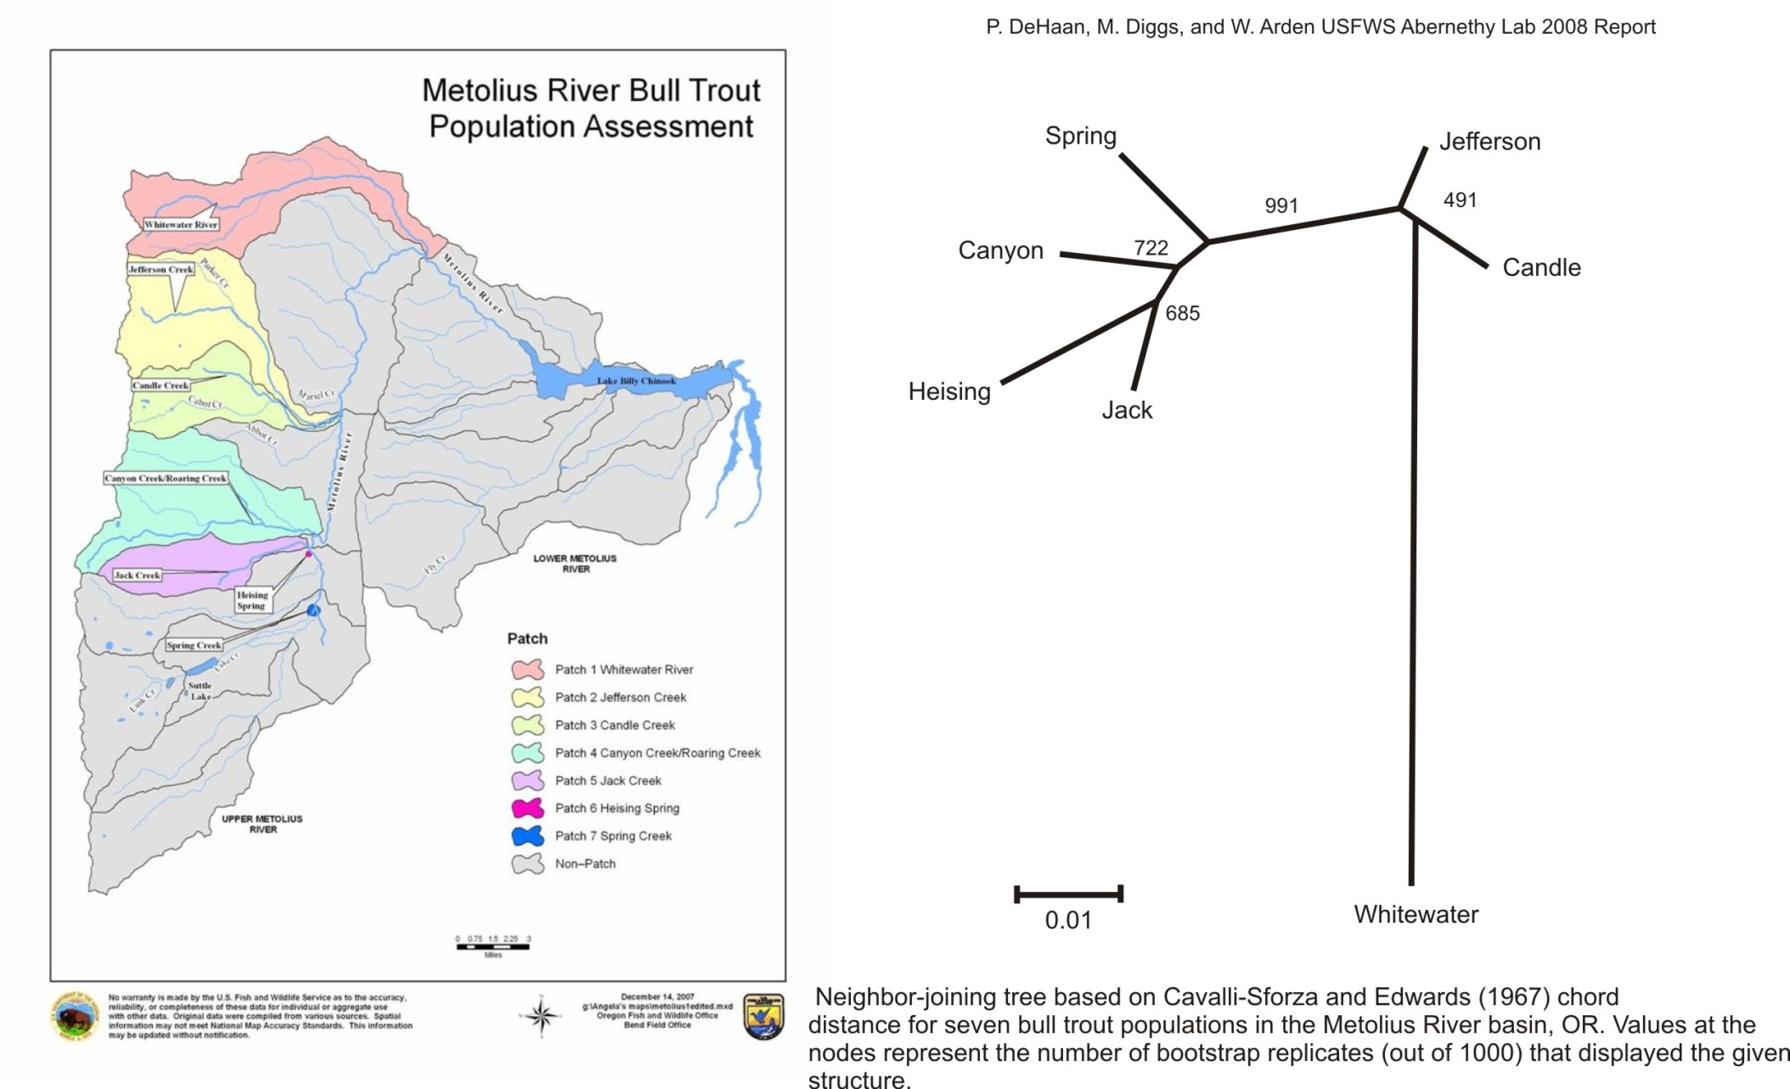
expected outcomes of proposed work
Trends in relative abundance of juveniles and redd counts provide indication of population status over time
  Continue monitoring juvenile abundance and redds in WSR & SC for long-term trends
  Continue monitoring redds in Jefferson Ck. and Whitewater R. in Metolius Basin
  Begin monitoring juvenile abundance in Whitewater R.
Bull trout distribution
  Update distribution map (habitat surveyors reported additional sites)
  Develop plan to re-establish bull trout distribution in Mill Creek
Permutation test will validate whether indices in juvenile abundance have the power to detect 25%, 50% and 75% decline in population over 5, 15, and 30-yr period (using methods of Budy et al. 2006)

Slide 13
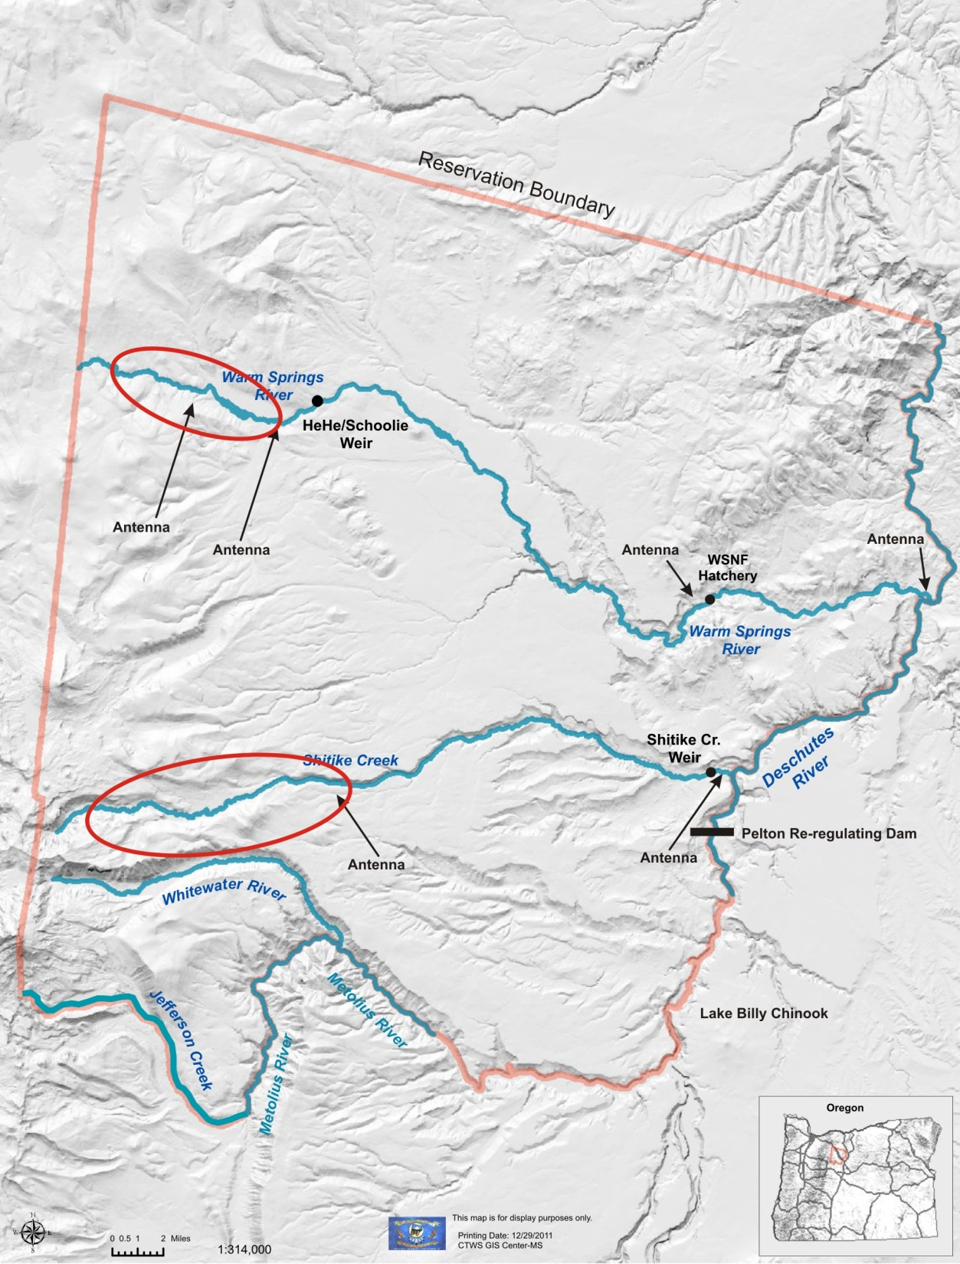
expected outcomes of proposed work
Further documentation of bull trout movement patterns within WSR & SC to define home range of resident forms and migration timing of fluvial forms into spawning grounds
  Continue operating outmigrant traps and weirs
  Install HDX antennae in WSR & SC, PIT tag 50 bull trout/year –year-round monitoring
  Bull trout released from SWW into lower Deschutes R. HDX tagged
Bull trout length and age relationships specific to WSR and SC and by life-history type
  Collect scale samples from fish while PIT tagging and catch at weirs (age structure of population)
  Validate length at age of first spawning (could expand or contract assumed spawning population)

Slide 14
How these results inform management
  Bull trout are listed under the ESA – Monitoring is important to gage recovery (Draft Bull Trout Recovery Plan) and identify management actions
  CTWSRO is a sovereign nation with sole management authority on the Reservation - Monitoring data used to take management actions as identified and recovery planning
    Habitat restoration in Mill Creek and re-establishment of bull trout
    LWD placement in WSR
    Fish passage barriers (e.g. WSNFH)
Management of fish passage through SWW and LBC fishery
  LBC management of prey base (kokanee)
    Release of kokanee downstream of Pelton for sockeye re-establishement
  Manage bull trout fishery in LBC (are Whitewater bull trout part of this fishery?)
  Fish passage through SWW and transported downstream of Pelton
    Releasing bull trout downstream of Pelton may reduce genetically unique populations (e.g., Whitewater)
  Fish passage upstream
    If bull trout are not passed upstream then there could be potential for competition and introgression in SC and WSR
Advancing understanding of life histories of bull trout in Deschutes Basin will aid interpretation of data
  Age at length by life history types
  First age at spawning/frequency of spawning
  Genetic structure of fluvial components with respect to resident populations
  Contribution of fluvial/resident to spawning population
  Whitewater bull trout (adfluvial/resident/fluvial?), what’s the risk of entering the SWW and getting sent downstream?

