Slide 1

State of the System Report for 2015 Test Case for Illustration Only
Steering Committee Meeting
March 9, 2012

Slide 2
Report Contents
Adequacy Level
Green, Yellow or Red
LOLP and other adequacy metrics
Probability curves for:
1) Total curtailed energy and
2) Highest single-hour curtailment
Annual
LOLP & Standby Resource use
Probability curves for:
1) Market purchases and
2) Borrowed hydro generation
Monthly
Probability curves for:
1) Market purchases and
2) Borrowed hydro generation
Hourly
Statistics
Size, frequency, duration of curtailment
Conditions during curtailments

Slide 3
Preliminary Adequacy Assessment for 2015
Supply is adequate
Most critical months are Dec, Jan and Aug
Borrowed hydro used most often during summer
Adequacy depends on fair amount of market purchases
December average = 23% of total market (1,500 MW-mo)
August average = 30% of total market (600 MW-mo)
Full amount of market purchases made under 1% of time
System becomes inadequate when combined increase in load and decrease in efficiency is about 2000 MW

Slide 4
Preliminary Adequacy Assessment for 2015 - GREEN
Metric | Value | Units | Threshold
LOLP | 0.93 | Percent | 5 %
Use of Standby | 1.1 | Percent | N/A
CVaR (energy) | 6968 | MW-hours | N/A
CVaR (peak) | 516 | MW | N/A
EUE | 348 | MW-hours | N/A
LOLH | 0.3 | Hours/year | 0.8 to 2.4 Hours/yr

Slide 5
Adequacy metrics and values
Adequacy Metrics
Metric | Description
LOLP | Loss of load probability = number of games with a problem divided by the total number of games
Use of Standby | Number of games that dispatch standby resources at least once divided by total games
CVaR (energy) | Conditional value at risk = average annual curtailment for 5% worst games
CVaR (peak) | Conditional value at risk = average single-hour curtailment for worst 5% of games
EUE | Expected unserved energy = total curtailment divided by the total number of games
LOLH | Loss of load hours= total number of hours of curtailment divided by total number of games

Slide 6
Total Annual Energy Curtailment Probability Curve*
*Prior to dispatching standby resources
Standby resource energy = 83,000 MW-hours per year
Resulting Energy LOLP (after dispatching standby resources) = 0.07%

Slide 7
Highest Single-Hour Curtailment Probability Curve*
*Prior to dispatching standby resources
Standby resource capacity = 662 MW in winter and 722 MW in summer
Resulting Capacity LOLP (after dispatching standby resources) = about 1%

Slide 8
Monthly LOLP (Months are treated independently)

Slide 9
Standby Resource Use Probability (Months are treated independently)

Slide 10
Market Purchases by Month

Slide 11
Average Monthly Market Purchase Probability

Slide 12
Likelihood of Borrowed Hydro Use

Slide 13
Borrowed Hydro by Month*
*Average of most used per month

Slide 14
Borrowed Hydro by Event

Slide 15
Market Purchases by Hour

Slide 16
Curtailment Events
 |  | Duration | Magnitude | Peak | Hydro | Forced Out | Temp | Wind
Game | Mon | hours | mw-hrs | mw-hrs | (%) | (%) | (%) | (%)
3 | Aug | 5 | 473 | 117 | 94 | 10 | 83 | 18
12 | Aug | 15 | 17647 | 1459 | 88 | 16 | 83 | 17
12 | Aug | 19 | 4911 | 479 | 88 | 17 | 48 | 2
16 | Jan | 8 | 6681 | 2970 | 89 | 8 | NA | 3
72 | Mar | 6 | 355 | 73 | 91 | 21 | 16 | 18
72 | Mar | 29 | 30340 | 2133 | 91 | 20 | 1 | 12
285 | Oct | 11 | 11006 | 1414 | 77 | 19 | 68 | 4
430 | Jan | 19 | 27248 | 1592 | 89 | 8 | NA | 67
781 | Dec | 39 | 44293 | 2125 | NA | 13 | 91 | 31
781 | Dec | 2 | 511 | 336 | NA | 9 | 100 | 61
855 | Aug | 17 | 11594 | 1064 | 94 | 17 | 58 | 3
913 | Jan | 35 | 37111 | 1928 | 84 | 9 | 1 | 22
918 | Dec | 5 | 2616 | 719 | 93 | 11 | 54 | 1
918 | Dec | 14 | 5909 | 554 | 93 | 13 | 54 | 3
918 | Dec | 2 | 1615 | 842 | 93 | 10 | 54 | 16
931 | Jan | 72 | 179994 | 5660 | 87 | 9 | NA | 5
940 | Dec | 8 | 51790 | 7800 | 98 | 11 | 88 | 42
995 | Oct | 3 | 1698 | 624 | 77 | 16 | 55 | 1
995 | Dec | 12 | 30110 | 3583 | 96 | 12 | 80 | 19
1068 | Aug | 1 | 166 | 166 | 94 | 17 | 65 | 62
1068 | Aug | 20 | 7017 | 707 | 94 | 18 | 65 | 42
1203 | Dec | 2 | 235 | 230 | 91 | 5 | 69 | 36
1259 | Jan | 11 | 14409 | 2460 | 79 | 3 | 1 | 7

Slide 17
Curtailment Statistics
Statistic | Value | Unit
Expected Events/year | 0.02 | Events
Average Event Duration | 15 | Hours
Average Event Magnitude | 21206 | MW-hrs
Average Event Peak | 1697 | MW
Expected Curt Hours/year | 0.3 | Hours
% of games With curtailment | 1.1 | %

Slide 18
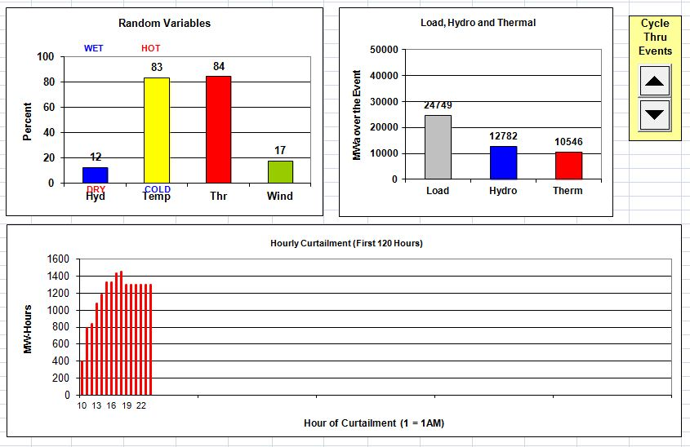
Conditions during August Curtailment Event

