Slide 1

Out of Region Market Assumptions
Resource Adequacy Technical Committee
April 6th, 2011

Slide 2
Canadian Import Assumption
BC policy is to export the Canadian Entitlement (approximately 500 aMW)– but done in spot markets not under long term contracts
BC is winter peaking with approximately half of generation located in Columbia River Valley – lack of complete load/generation diversification with PNW
Canada has been a net importer in the past decade (slide 3)
BC load growth forecast + 24% by FY 2020 – or 1,600 aMW
Conclusion: no import assumption at this time
BC will complete IRP by January 2012 –reevaluate assumption at that time

Slide 3
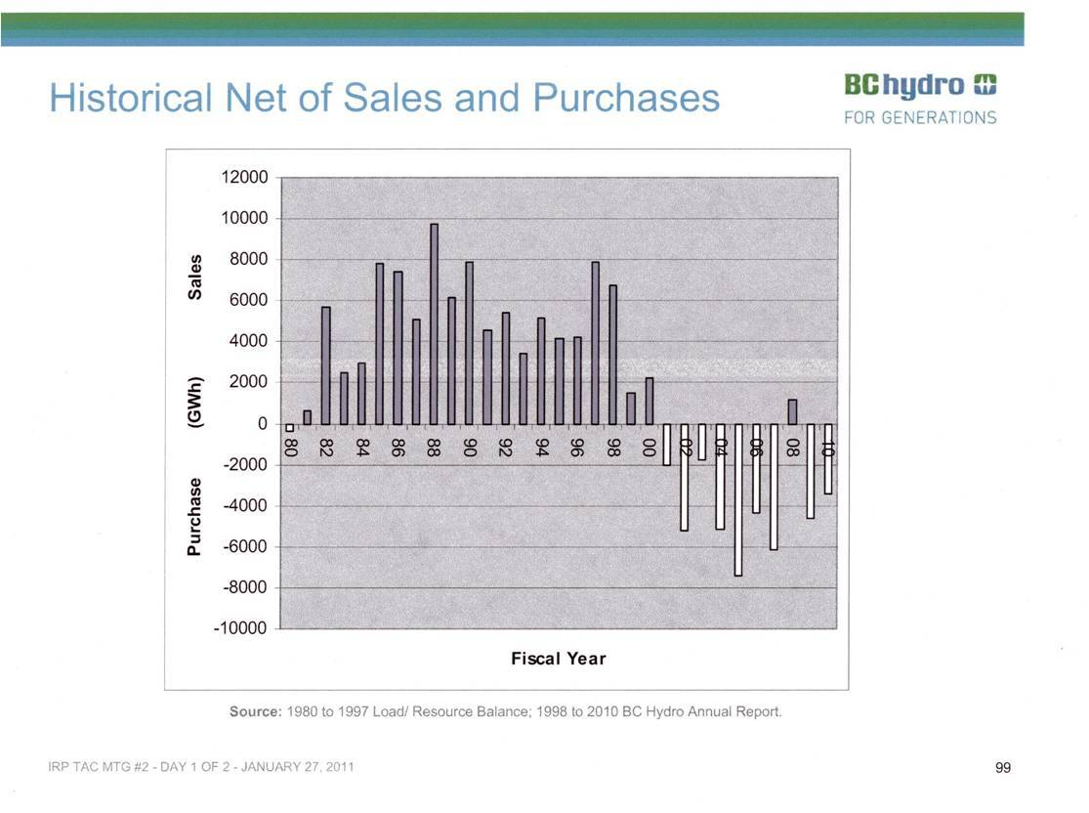

Slide 4
California Import Assumption
The resource adequacy assumption is 3,000 MW of hourly import capability from October through May and 0 MW from June to September
Note that this is not the dispatch in Genesys – just the capability
Is this a reasonable estimate?
  Power plant development in California between 2000 and 2010 (total in state regardless of owner)
  CPUC Resource Adequacy Assessment (January 2011) (owned or capacity under contract)
  Intertie Loadings between 2004 and 2009

Slide 5
Power Plant Development in California
During the past 11 years there as been substantial resource development within the state of California – most of it gas-fired
Chart (page 6) includes all resources built in state regardless of owner
Since not all developers are load serving entities or all generation is dedicated to LSE – no load/resource assessment can be made
Chart (page 7) “net addition” include the impact of plant retirements in the state (but also including Mohave)

Slide 6
 | MW
Natural Gas | 21567
Wind | 1378
Geothermal | 211
Biogases | 219
Hydro | 275
PV | 157
Biomass | 87
Misc. | 21
Source: Ventyx

Slide 7
California Cumulative and Net Resource Additions
Net Additions = cumulative additions – cumulative retirements

Slide 8
CPUC RA Assessment
Assessment includes all IOUs and Community Choice Aggregators
Purpose of RA is mandatory LSE acquisition of capacity to meet load and reserve requirements
Results include unit-contingent, import contracts, DWR contracts, physical resources, and RMR capacity
Only net qualifying capacity is considered based on historical performance and other factors – designed to get the expected value of capacity (GADs data)
Results – excluding demand response programs – California has winter surplus capability (November to March)
Excluding imports - tight margins in the summer and shoulder months (April to October)

Slide 9
CPUC RA Assessment

Slide 10
CPUC 2010 RA Assessment
RA assessment looks backward; does not include these new gas-fired plants that are available for (or under) RA contracts:

Slide 11
The Interties
*A.C. rated at 4,800 MW; average includes line de-rates (Dec 2004 to Dec 2009)
The average physical transfer capability* on the A.C. line S. to N. is 3,100 MW [Genesys 4880]
The average physical transfer capability* on the D.C. line S. to N. is 1,700 MW [Genesys 2850]
Flows on the A.C. line were S. to N. 3.8% of the time with an average flow of 346 MW and a maximum of 1,513 MW
Flows on the D.C. line were S. to N. 18.9% of the time with an average flow of 472 MW and a maximum of 2,045 MW
The maximum coincidental import on both lines was 2,810 MW

Slide 12
Limiting Factors
Interties provide enough physical import capability ~ 4,800 MW – up to 2,810 MW have been imported coincidentally over both lines
Over 16,500 MW of net generation has been built within the state over the past 11 years, but not necessarily under contract with load serving entities
California LSEs are the limiting factor – no meaningful surplus capacity from April to October (pg 9 – column G)

Slide 13
Recommendation
Genesys assumption of 0 import capability from June to September is reasonable
Shoulder months of April, May, and October are also problematic and should be set to 0
With new power plant development in California; 3,000 MW of import capability November to March appears reasonable

Slide 14
Appendix – Intertie Loading

