Slide 1

Power System Research, Inc.
Review of the PNW
Adequacy Standard
Resource Adequacy Technical Committee Meeting
April 6, 2011

Slide 2
Outline
Methodology review
Simple example of adequacy assessment
Prototype of new standard
Next steps

Slide 3
Primary Purposes of Review
Critique the region’s current adequacy assessment methodology
Provide an alternative method, if appropriate
Suggest ways to incorporate the adequacy measure into our long-term resource planning tools

Slide 4
1. Critique of Current Method
Generally OK, similar methods are used by many other regions
Only looks at probability of curtailment
Not clear how threshold is set (currently 5%)
Better if magnitude of curtailment could also be incorporated
Assessing adequacy separately for energy and capacity needs is appropriate
But, no need to separate winter and summer periods, i.e. assess for entire year

Slide 5
2. Proposed Alternative
Conditional Value at Risk (CVaR)
  The average magnitude of the worst curtailment events in the simulation (say worst 5%)
  Combines probability and magnitude into one measure
  Similar to the TVar90 metric used in the Regional Portfolio Model
Can be used in conjunction with LOLP
Forum is evaluating if CVaR would improve our assessment

Slide 6
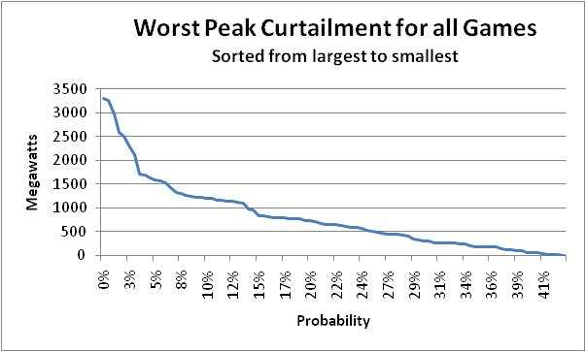
CVaR vs. LOLP
CVaR = Avg of 5% worst curtailment
CVaR = 2400 MW
LOLP = % above 2000 MW threshold
LOLP = 3.3%

Slide 7
3. One Method of Incorporating
Adequacy into Planning Models
Start with a system that is just barely adequate (using LOLP, CVaR or a combination of both)
Calculate static measures
  Annual load/resource balance
  Winter and summer sustained peaking reserves
Values for the “just adequate” case become the minimum adequacy limits
Make sure minimum adequacy limits are not violated in planning models
We are currently doing this with RPM

Slide 8
A simple example of
Adequacy Assessment
100 Game simulation system with thermal and hydro

Slide 9
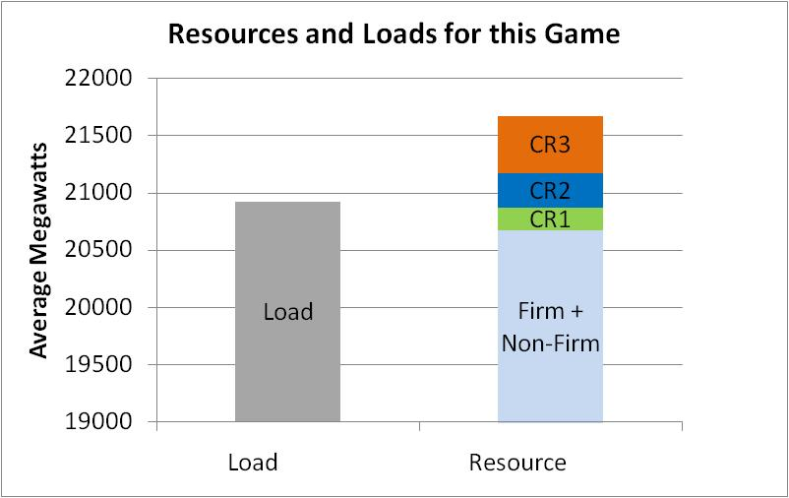
CR1, CR2, CR3 are Contingency Resources
Result: No curtailment but had to use some contingency resources

Slide 10
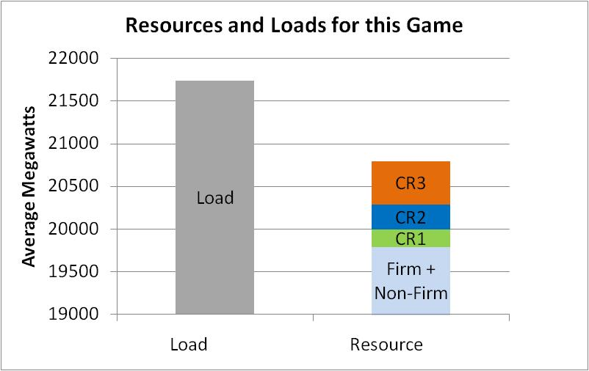
Curtailment
Result: Curtailment after using all contingency resources

Slide 11
Curtailment Histogram
First Few Games

Slide 12
Curtailment Histogram
100 Games
Used for LOLP
Calculation
Used for CVaR Calculation (worst 5%)

Slide 13
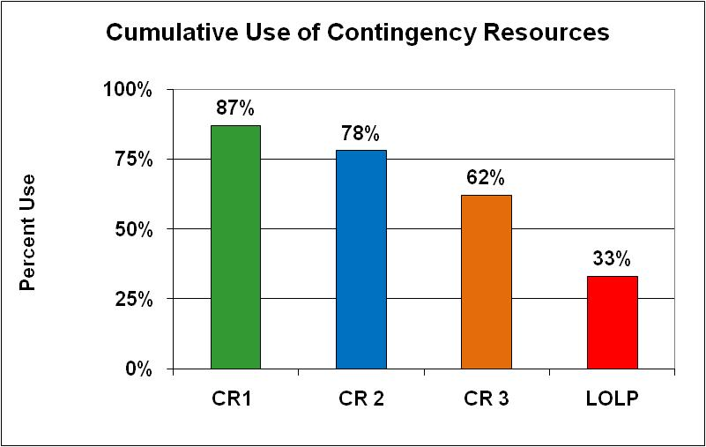
Also keep track of Contingency Resource Use
Indicates economic concerns
Indicates physical limit
i.e. keep the lights on

Slide 14
Summary for Simple Example
LOLP = 33% (current limit is 5%)
Contingency resources are used a lot
  CR 1 = 87%
  CR 2 = 78%
  CR 3 = 62%
Very inadequate supply

Slide 15
Comparison to
PNW Supply (2015)
Energy LOLP = 1.0%
Capacity LOLP = 1.9%
Contingency resources are used over 40% of the time
Supply is deemed to be adequate but may not be economic (assessment includes new conservation but only existing resources)

Slide 16
Prototype for a new standard
Metrics
  LOLP
  CRUP – Contingency Resource Use Probability
  CVaR95 – Average magnitude 5% worst games
Calculated for
  Energy (total annual curtailment energy)
  Capacity (worst annual peak curtailment)

Slide 17
Setting thresholds
Define the region’s tolerance for contingency resource use (CRUP)
Create a power supply that just meets CRUP
From that supply, calculate LOLP and CVaR95 for both energy and capacity – these become the new thresholds

Slide 18
warning
By using CRUP to set thresholds, we change the function of the assessment from a “smoke alarm” to more of an economic measure
However, it may fall more in line with other regional planning tools and reports
An “inadequate” supply would then inform us that the supply is becoming uneconomic
Can opt to keep standard as a “smoke alarm”

Slide 19
Defining tolerance for cr use
Resource | Description | Tolerance for Use
Firm Hydro and Thermal | From lowest to highest operating cost | OK, normal operations
Non-firm | In-region and out-of-region markets, surplus hydro, borrowed hydro | OK, normal operations
Contingency 1 | Non-declared utility resources (diesel generators, etc.) | Once every 10 years?
Contingency 2 | Buy-back provisions on load | Once every 10 years?
Contingency 3 | More expensive non-declared resources or contract provisions | Once every 15 years?
Emergency Action 1 | Governor’s call for conservation | Once every 20 years?
Emergency Action 2 | Rolling black outs or brown outs | Once every 30 years?

Slide 20
Next Steps (tentative schedule)
Spring 2011 Review options for a new standard Propose a revised adequacy standard
Summer 2011 Get Forum approval for new standard
Fall 2011 Present new standard to Council Release for public comment
Winter 2011 Council adoption of new standard

