Slide 1
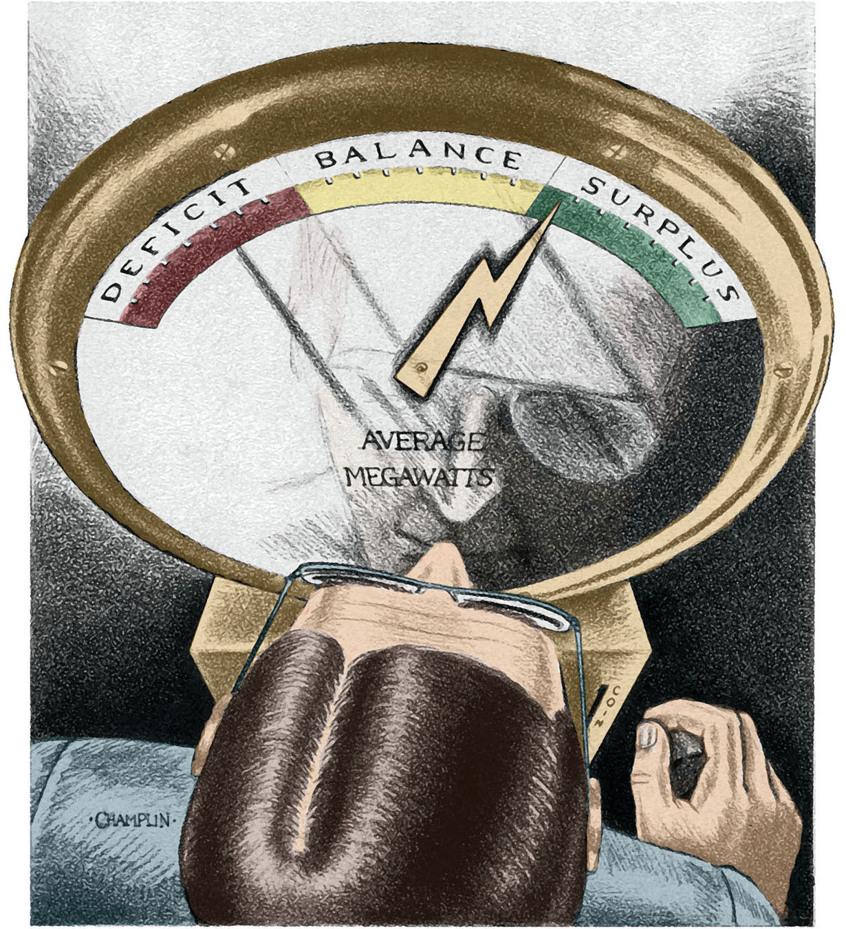
Revising the Pacific Northwest Resource Adequacy Standard
Resource Adequacy Technical Committee June 23, 2011

Slide 2
Outline
Review of Existing Adequacy Standard
Summary of Methodology Peer Review
A Simple Example of Adequacy Metrics
Options for a Revised Standard

Slide 3
Relevant Terms
Metric – a quantity that can be measured, such as loss-of-load probability or expected unserved energy.
Measure – a value for a metric.
Threshold – a limiting value for a metric, for example, a metric with a value greater than a certain threshold would indicate an inadequate resource supply.
Adequacy Level – this refers to providing a specific amount or level of adequacy, for example, changing the 5% threshold for the LOLP metric would change the level of adequacy provided.

Slide 4
Current Standard
Based on probabilistic analysis
Metric used is LOLP
Metric threshold is set at 5 percent for “physical” adequacy
Threshold for “economic” adequacy discussed but not defined

Slide 5
Current Standard
Five percent LOLP threshold for:
Winter energy
Winter capacity
Summer capacity
Note: Need to officially add summer energy if we keep this methodology

Slide 6
Translation to Deterministic Metrics
Translates the winter energy 5% LOLP into an annual load/resource balance
This becomes the threshold for the L/R balance
Translates the winter and summer 5% LOLPs into surplus sustained-peak capability (referred to as the planning reserve margin or PRM)
These become the thresholds for winter and summer PRM

Slide 7
Thresholds
Energy – Annual load/resource balance
Physical = 0 MWa
Economic = not defined
Capacity – Planning reserve margin
Physical Winter = 23%
Physical Summer = 24%
Economic = not defined

Slide 8
Current Energy Assumptions
Out-of-region market (est. from analysis)
About 200 MWa per year
Non-firm hydro (est. from analysis)
About 1,100 MWa per year
Uncommitted IPPs
Dispatched as regional resources at market prices and limited by capacity assumptions
Wind
30 percent of nameplate annually

Slide 9
Current Capacity Assumptions
Out-of-region market
3,000 MW maximum in winter
None available in summer
Non-firm hydro
2,000 MW in winter
1,000 MW in summer
Uncommitted IPPs
Full availability in winter
1,000 MW maximum in summer
Wind
5 percent over the sustained peak period

Slide 10
Methodology Review

Slide 11
Primary Purposes of Review
Critique the region’s current adequacy assessment methodology
Provide an alternative method, if appropriate
Suggest ways to incorporate the adequacy measure into our long-term resource planning tools

Slide 12
Critique of Current Method
Generally OK, similar methods are used by many other regions and countries
Only looks at probability of curtailment
Not clear how threshold is set (currently 5%)
Better if magnitude of curtailment could also be incorporated
Assessing adequacy separately for energy and capacity needs is appropriate
But, no need to separate winter and summer periods, i.e. assess for entire year
Using deterministic metrics is awkward and not needed

Slide 13
Proposed Alternative
Conditional Value at Risk (CVaR)
The average magnitude of the worst curtailment events in the simulation (say worst 5%)
Combines probability and magnitude into one measure
Similar to the TVar90 metric used in the Regional Portfolio Model
Can be used alone or in conjunction with LOLP and other metrics

Slide 14
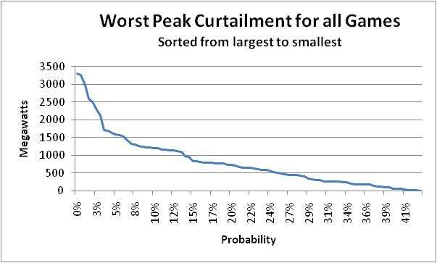
CVaR vs. LOLP
CVaR = Avg of 5% worst curtailments (before CR)
CVaR = 2400 MW
LOLP = % above 2000 MW threshold
LOLP = 3.3%

Slide 15
One Method of Incorporating Adequacy into Planning Models
Start with a system that is just barely adequate
Calculate deterministic measures
Annual load/resource balance
Winter and summer planning reserve margin
Values for the “just adequate” case become the minimum adequacy limits
Make sure minimum adequacy limits are not violated in planning models
We are currently doing this with RPM for the energy metric

Slide 16
An alternative Method
Start with a system that is just barely adequate
Calculate the CVaR value(s)
Make sure the CVaR values are not violated in planning models
We are examining ways to do this in the RPM

Slide 17
A simple example of Adequacy Metrics 100 Game simulation system with thermal and hydro

Slide 18
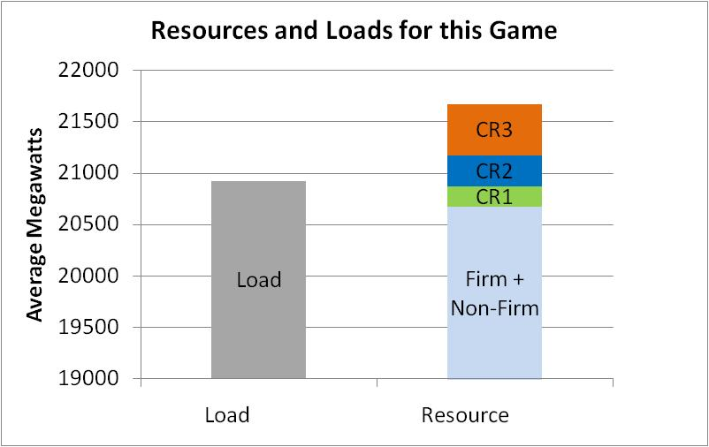
CR1, CR2, CR3 are Contingency Resources
Result: No curtailment but had to use some contingency resources

Slide 19
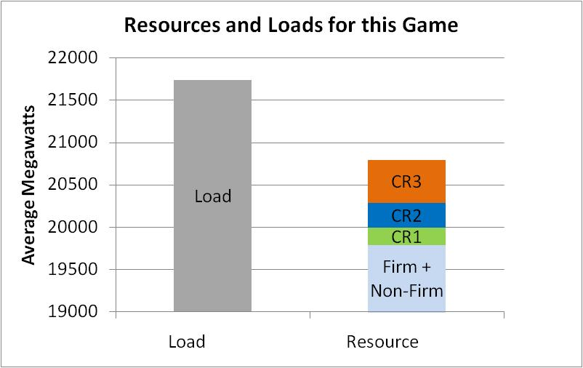
Curtailment
Result: Curtailment after using all contingency resources

Slide 20
Curtailment Histogram First Few Games

Slide 21
Curtailment Histogram 100 Games
Used for LOLP
Calculation
Used for CVaR Calculation (worst 5%)

Slide 22
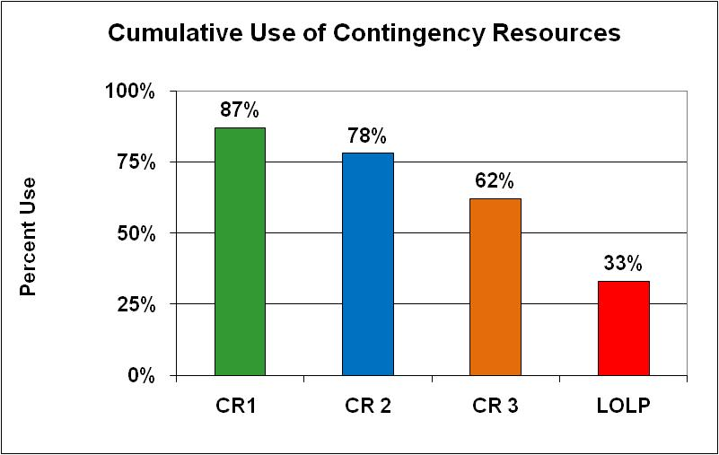
Keep track of Contingency Resource Use
Indicates economic concerns
Indicates physical limit
i.e. keep the lights on

Slide 23
Summary for Simple Example
LOLP = 33% (current limit is 5%)
Contingency resources are used a lot
CR 1 = 87%
CR 2 = 78%
CR 3 = 62%
Very inadequate supply

Slide 24
Options for a New Standard

Slide 25
Options
No change to the standard
No change but add a metric to measure the curtailment size and a metric to measure the use of contingency resources (CR)
Same as option 2 but replace LOLP with a different metric – does not change the adequacy level
Change the adequacy level based on CR dispatch
Define an adequate supply as one in which the likelihood of CR dispatch is within acceptable levels
Change the LOLP threshold according to provision a) above
Add a metric to measure the size of potential problems.

Slide 26
Defining Tolerance for CR Use
Resource | Description | Tolerance for Use
Firm Hydro and Thermal | From lowest to highest operating cost | OK, normal operations
Non-firm | In-region and out-of-region markets, surplus hydro, borrowed hydro | OK, normal operations
Contingency 1 | Non-declared utility resources (diesel generators, etc.) | Once every 10 years?
Contingency 2 | Buy-back provisions on load | Once every 10 years?
Contingency 3 | More expensive non-declared resources or contract provisions | Once every 15 years?
Emergency Action 1 | Governor’s call for conservation | Once every 20 years?
Emergency Action 2 | Rolling black outs or brown outs | Once every 30 years?

Slide 27
Viable Options
Options 1 and 3 should not be considered
That leaves options 2 and 4
Option 2 keeps the adequacy level the same
Option 4 changes the adequacy level

Slide 28
Option 2
Keep the 5% LOLP threshold
Calculate key CR dispatch probabilities
Calculate CVaR metric values
CR dispatch and CVaR values are just additional information – they are not considered in determining the adequacy of the power supply

Slide 29
Option 4
Calculate dispatch probability for a key CR
Set a threshold for that probability based on utility experience and/or contractual obligations
Use a system that just meets the CR dispatch probability threshold to calculate LOLP
That value for LOLP replaces the 5% LOLP used in the current standard
Calculate CVaR metric value as additional info

Slide 30
Key Questions
Should the level of adequacy be changed?
What metric will be used to measure adequacy?
How will the threshold for that metric be set?
What other information should be provided?

Slide 31
Other Considerations
Should we use an annual metric (eliminate the winter and summer assessments)?
Should we keep the energy and capacity assessments?
Should we base the energy assessment on total annual curtailment or on worst-event?
Should we base the capacity assessment on single hour or sustained peak?
Should we keep the deterministic metrics as a part of the standard?

Slide 32
Next Steps
Summer 2011 – Tech Committee Review options for a new standard Propose a revised adequacy standard
Late Summer 2011 Steering Committee approval
Fall 2011 Present new standard to Council Release for public comment
Winter 2011 Council adoption of new standard

