Slide 1
Resource Adequacy Forum
2019 Adequacy Assessment
Overview
PNGC Offices
June 28, 2013

Slide 2
Agenda
Introductions/Announcements
Forum Charter/Schedule
Model Enhancements
Data Requirements/List of key policy assumptions for Steering Committee
Model Versions and Interface Demo
Utility-level version

Slide 3
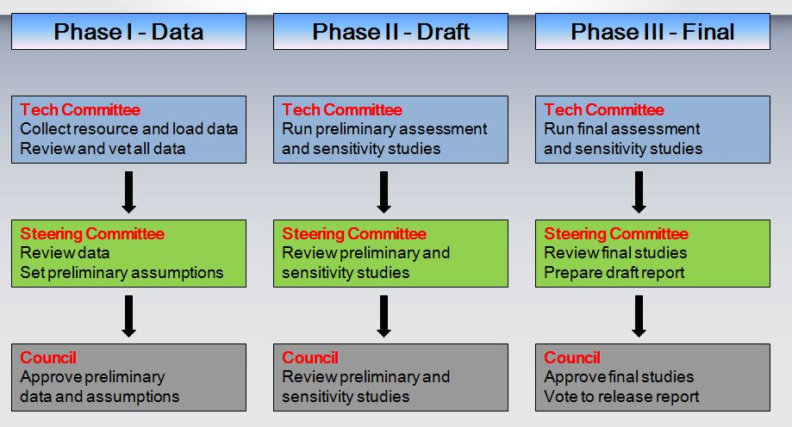
Schedule Overview

Slide 4
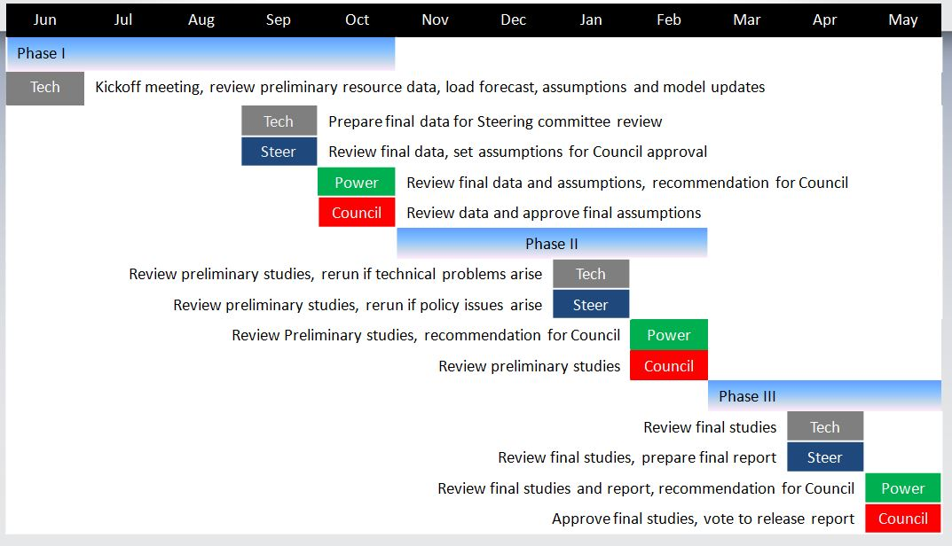
Draft Schedule

Slide 5
Data Requirements
Hourly loads (including EE) – MJ
Contracts – PB
Hydro data – BPA/JF
Peak vs. Energy – JF
INC/DEC – PB
Generating resources – GC/PB
BPA wind – BPA
Non-BPA wind – misc
Transmission nomogram – BPA/JF
SW market supply – RD/JF
Demand response – BK

Slide 6
Model Enhancements
14-Periods (instead of 12 months)
3-Nodes for the NW
Weekly Hydro Shapes
TSR (dynamic Canadian) operation
Unit commitment/ramp up and down rates

Slide 7
Model Versions
V 8.0.0 – used for 2017 assessment
V 8.1.0 – Thermal commitment logic
V 9.0.0 – 14 period logic (current version)
V 9.1.0 – Daily thermal scheduling
V 10.0.0 – Weekly hydro shaping
(based on V 9.0.0)
V 11.0.0 – NW 3-node model
(based on V 9.0.0)

Slide 8
2019 Assessment
Use 3-node version for reference case, if satisfactorily tested
Use 3-node version for long-term load and SW market sensitivity studies
Use current version for reference case sensitivity
Weekly hydro shape version will not be ready for this year’s assessment

Slide 9
Other Discussion Topics
Peak vs. Energy curves too “blunt” for capacity analysis, may need project-level hourly model
Weekly hydro shaping drastically changes results – could lead to revision in standard
Propose not using this version for 2019
3-node version may also change results and lead to reconsideration of standard
Propose running 3-node case as a sensitivity

