Slide 1

Progress on Resource Adequacy Assessment for 2017
Steering Committee Meeting
August 30, 2012

Slide 2
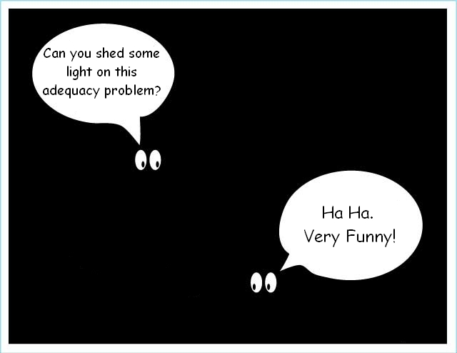

Slide 3
Outline
Assumptions and uncertainties
Current assessment
Changes from last year’s assessment
Tech committee action items
The “Message”

Slide 4
Assumptions
Existing resources (sited and licensed)
6th plan conservation
Markets
  NW: all in winter, 1000 MW in summer
  SW on-peak: 1700 MW winter, 0 in summer
  SW off-peak: 3000 MW year round

Slide 5
Uncertainties
Explicitly modeled
  Water supply
  Temperature load variation
  Wind
  Forced outages
Not modeled
  Economic load growth
  Uncertainty in SW market
  Variations in maintenance schedules
  Systemic variations in wind modeling

Slide 6
Reference Case

Slide 7
Most Positive Case
CGS in service, good wind set, no false positives

Slide 8
Least Positive Case
Bad wind set

Slide 9
Changes from Last Year’s Assessment
Last year (for 2015) LOLP = 1%
Current (for 2017) LOLP = 7%
What happened?
  Data errors
  Modeling changes
  Real life changes

Slide 10
Changes from 2015 to 2017
Loads (mostly data errors)
Base load increase 850 MWa (from original 2015 forecast)
DSI double counting (300)
850 – 300 = 550
Conservation double counting (170)
550 + 170 = 720
Pumping load double counting (130)
720 – 130 = 590
Net load increase 590 MWa

Slide 11
Changes from 2015 to 2017
Resources
New resources 100 MWa (real)
New hydro 270 MWa (real)
100 + 270 = 370
Contract adjustments (-530 MWa)
370 – 530 = -160 MWa (mostly error)
Net resource increase -160 MWa
Net overall change 750 MWa load increase
SW on-peak market down 1,300 MW

Slide 12
LOLP Trace back
Last year: LOLP = 1%
750 MWa load increase +3.4%
LOLP = 1 + 3.4 = 4.4%
1300 MW less SW Market +1%
LOLP = 4.4 + 1 = 5.4%
Temp-correlated wind +1%
LOLP = 5.4 + 1 = 6.4%
Revised model +0.5%
LOLP = 6.4 + 0.5 = 6.9%

Slide 13
Real Changes from 2015 to 2017
Resources
Generating resources up about 100 MW
Wind increases 1,300 MW
Temperature-correlated wind data
Hydro increases by 270 MWa
SW on-peak winter market decreases by 1,300 MW

Slide 14
Real Changes from 2015 to 2017
Loads
Loads increase by about 300 MWa
Average summer peak increases 500 MW
Average winter peak increases 300 MW
Firm contracts about the same
Last year’s assessment was wrong
(should have been higher)

Slide 15
Technical Committee Actions
Review 2017 load and resource data
Explain how conservation is incorporated into the load and at what level
Obtain CEC assessment of loads and resources for 2017 to update the SW on-peak and off-peak market availability
Review south-to-north intertie capacities
Review curtailment records for potential false positives

Slide 16
The Message
Single LOLP value can be misleading
LOLP is likely to be greater than 5%
Does not mean a recurrence of the 2001 crisis
Relying only on existing resources and conservation yields a power supply with a likelihood of curtailment above our tolerance level
The “gap” can be filled by generating resources, demand response or more conservation.
But that is a separate process from an adequacy assessment

