Slide 1

September 28, 2012 Draft Assessment Results
Technical Committee Meeting
September 28, 2012

Slide 2
Other Assumptions
How many games do we need to do?
There are 80 water years (sequential draw) , 77 load years (random draw), and wind year is lock-stepped with load year
Random draws do not cover all unique combinations of water and load/wind unless we do a large number of games
Too few games can produce uneven results
Which wind year set do we use?
There are 20 sets of temperature-correlated wind capacity factors
Look at “instantaneous” LOLP

Slide 3
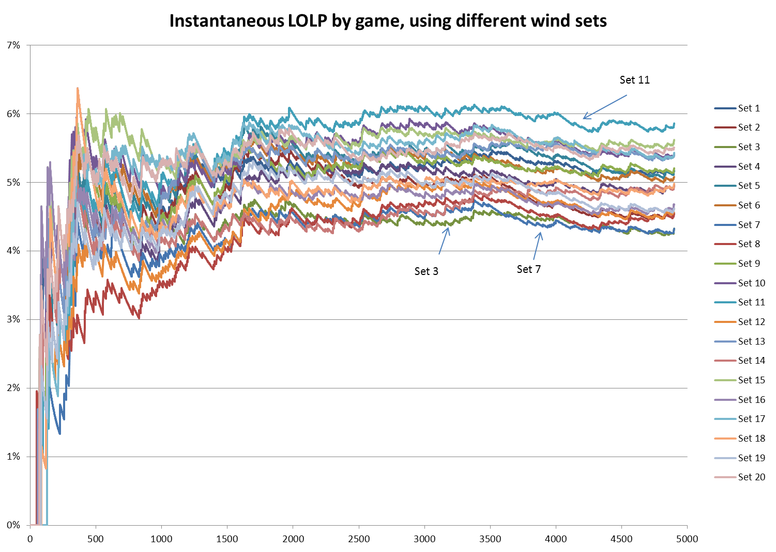

Slide 4
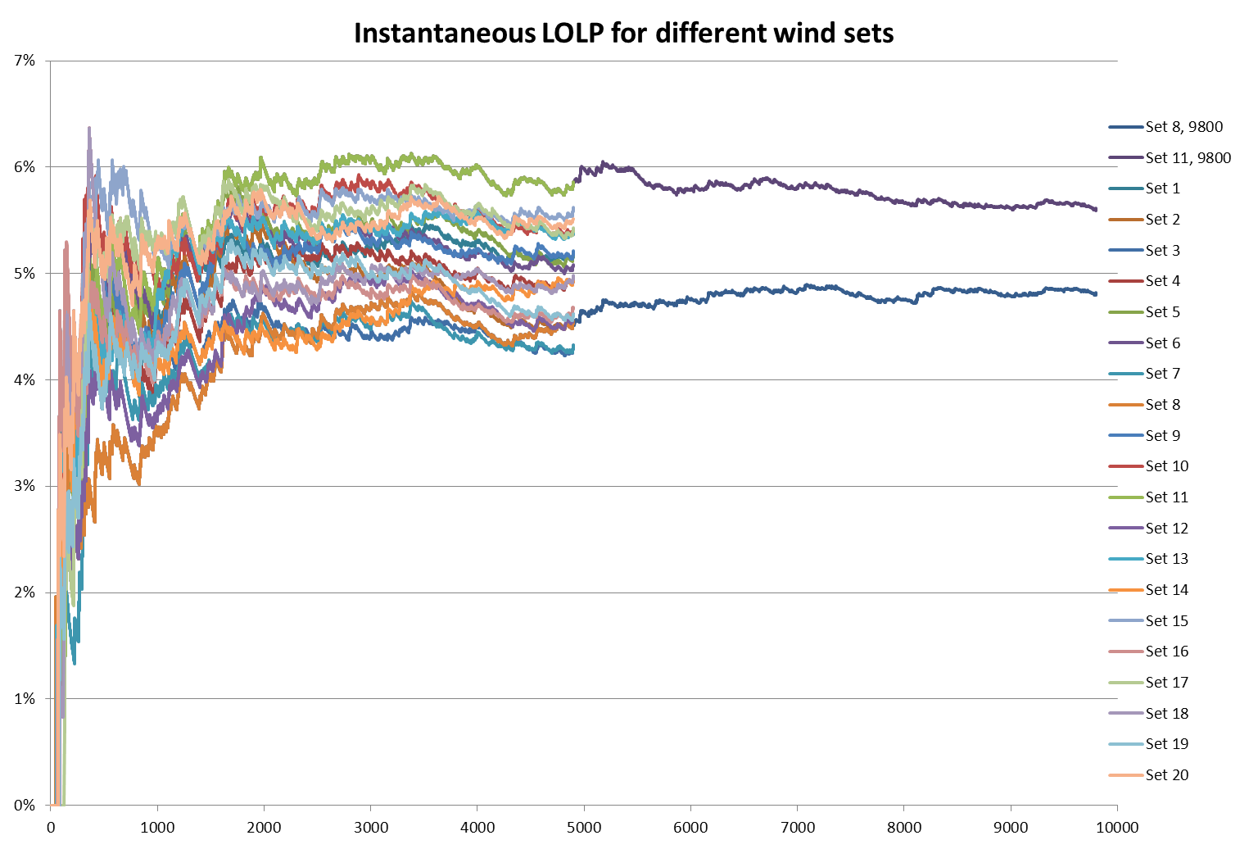

Slide 5
Number of Games
How many games? … (80 x 77 = 6160)
Sequential water pairs uniquely with load/wind by using a cycled sequence for the load years
Game #1 pairs 1929 water with 1929 load, and the run is essentially in lockstep for the first 77 games (game #77 pairs 2005 water and load)
Game #78 pairs 2006 water with 1929 load
Water year 1929 pairs with load year 1929, 1932, 1935, … , and so on

Slide 6
Wind Capacity Sets
Which one?
For now, we selected set #18, which tested at the mid-range for LOLP at 4900 games
The test cases were done using older assumptions (70-year hydro, some differences in wind totals, other resources)

Slide 7
Wind Capacity Sets

Slide 8
Draft Assessment Results

Slide 9
Draft Assessment Results

Slide 14
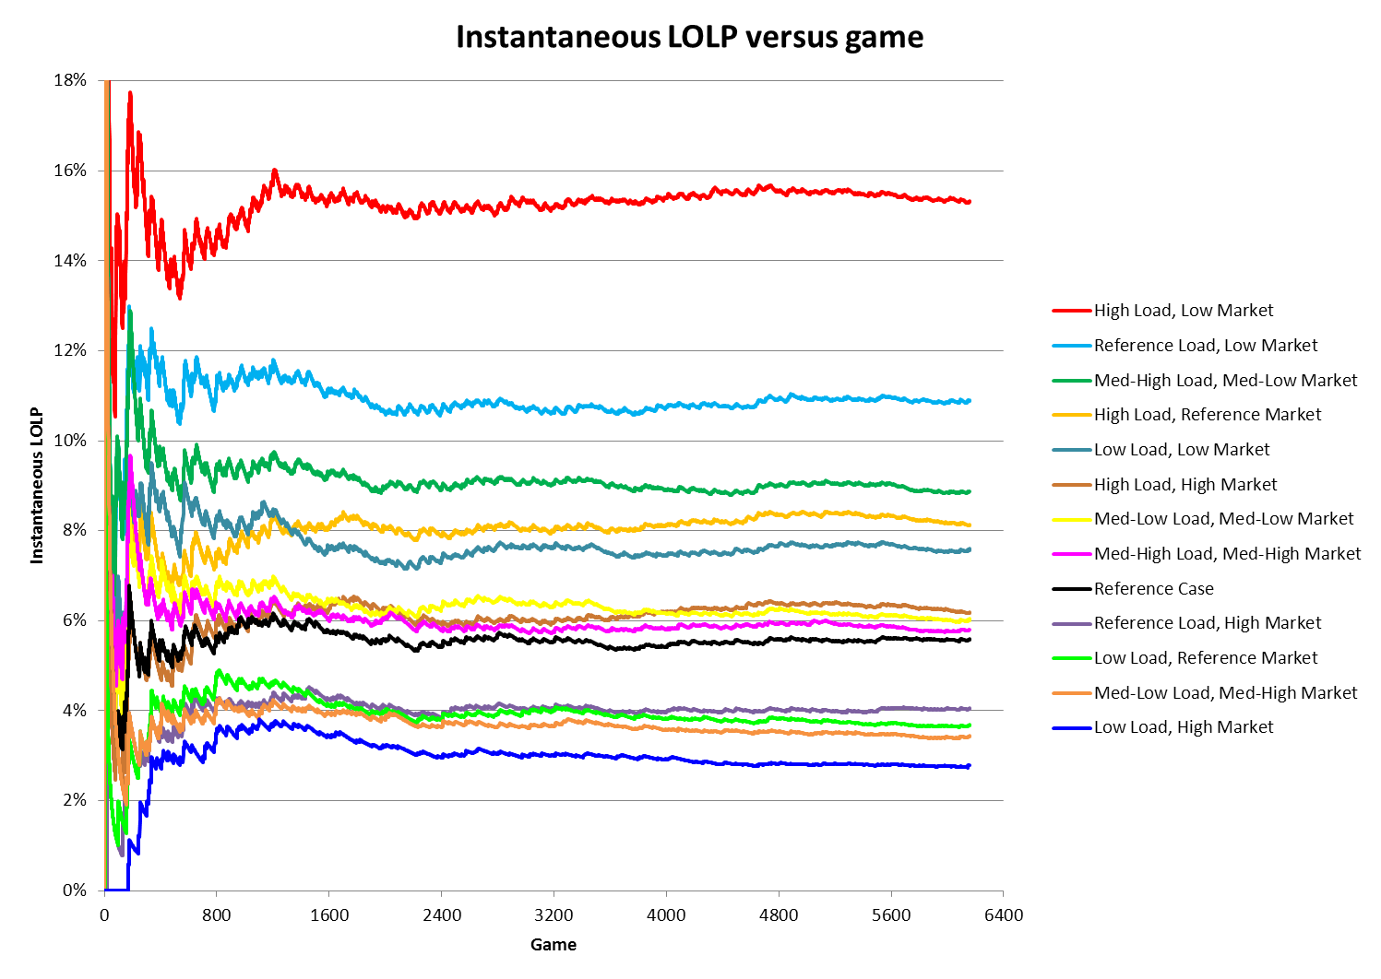

Slide 15

September 28, 2012 Assessment

