Slide 1

Grid-interactive
Renewable Heating
Paul Steffes
Steffes Corporation
psteffes@steffes.com
888-783-3337

Slide 2
Steffes Corporation
“Commitment to Innovation”
Work with approximately 200 Electric Utilities across North America (some for over 20 years)
World leader in innovative electric storage
Notes:
Older people relate this to the heating of a rock to keep their bed warm.
-It is the elderly who really love the heat for the simplicity and "Warm to the Bone" comfort.

Slide 3
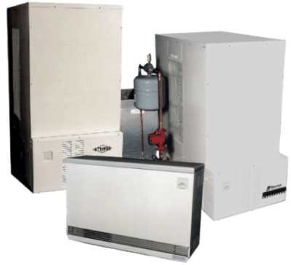
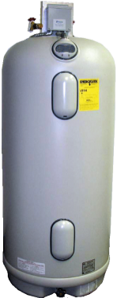
Family of
Electric Storage Products
“Grid-interactive
Controller” for space and water heaters
Adjusts the target temperature up or down in response to power availability (grid signal) - “Battery” charge level
Adjusts the input wattage
Provides Comfort Assurance, so home is always warm and has hot water

Slide 4
Renewable Space and Water Heating System Basics
Direct smart communication link to real-time renewable generation and other critical grid information
Then smart charging for renewable integration, grid optimization and frequency control that gives the electric storage space or water heater a very small carbon footprint while increasing utility margins and lowering consumer costs

Slide 5
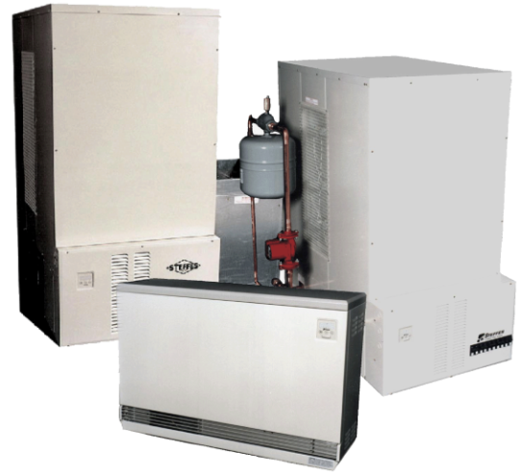
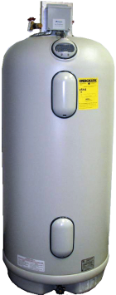
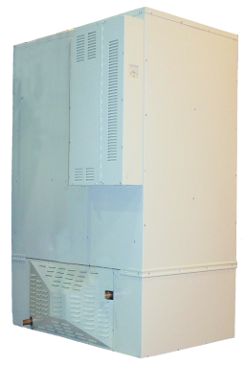

Family of ETS Products
Residential:
Room Heaters, Furnaces, Hydronic
  Up to 240kWh Storage
Interactive Water Heater Controls
  100 Gallon Water Heater stores 26kWh
Commercial & Industrial:
Furnaces and Hydronics
  Up to 960kWh Storage

Slide 6
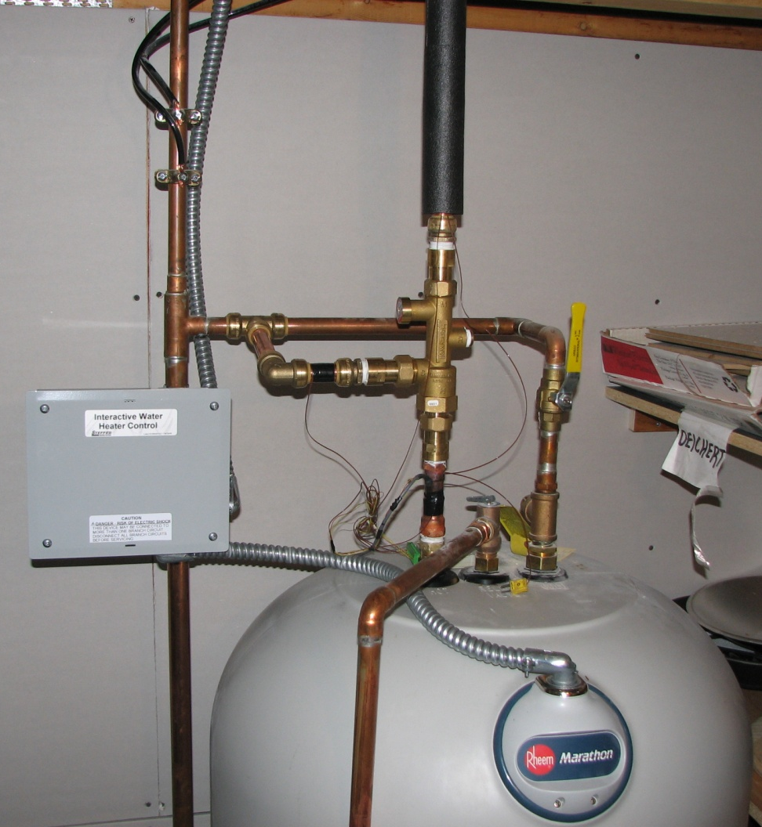

Renewable
Water Heating
Think of a 105 gal. Water Heater as a 26kWh Battery
(nominal two day supply of hot water)

Slide 7
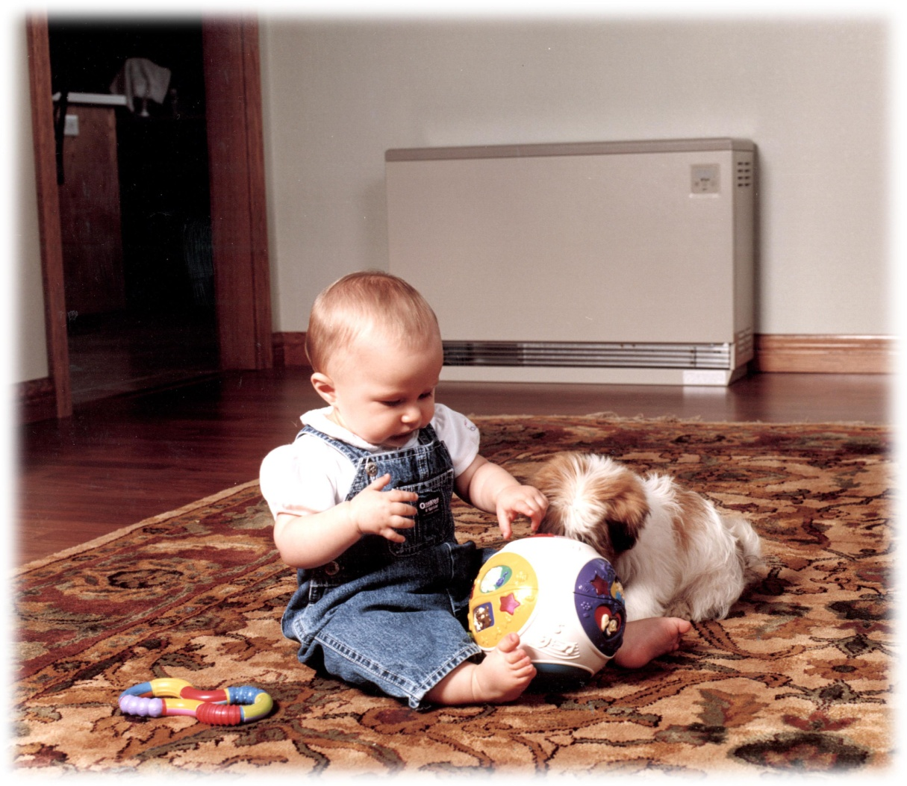
Room Heating Units
14 to 40 kWh storage

Slide 8
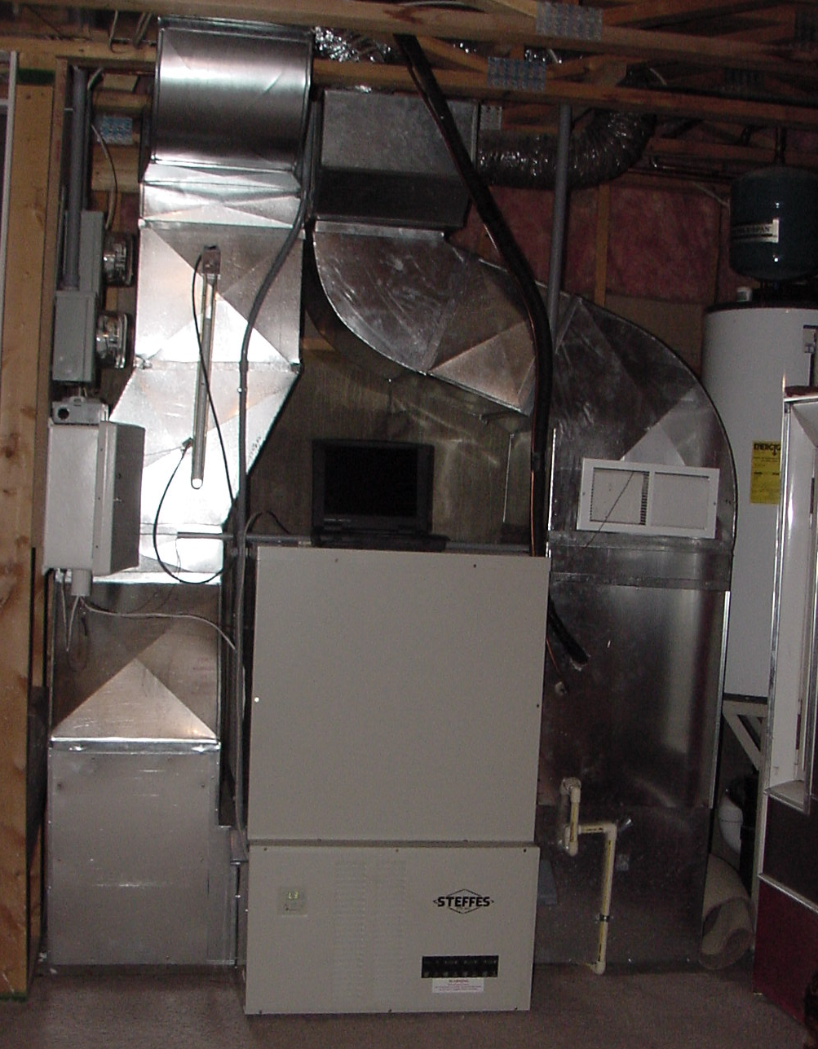
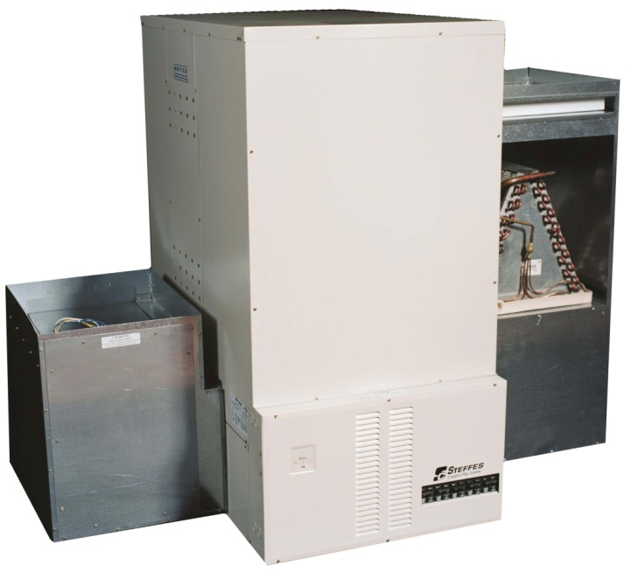
Comfort Plus Forced Air
with or without Heat Pump
120 to 240 kWh storage

Slide 9
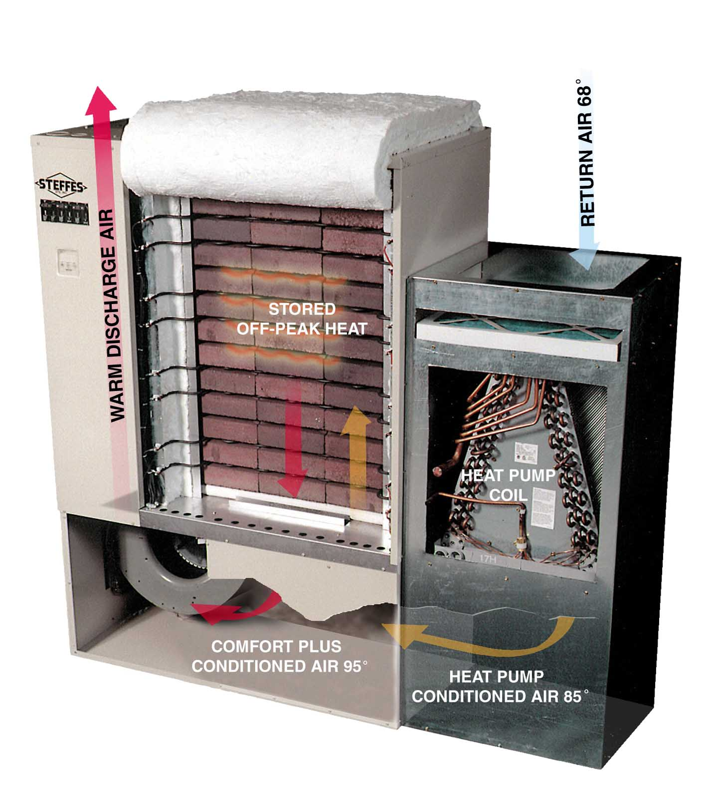
Grid-interactive Renewable Space Heating
(Open View)
20+ years of installations
Maximizing heat pump efficiency, renewable energy and providing total comfort to home.
Stored renewable energy
All heating is accomplished by using renewable or off-peak energy

Slide 10
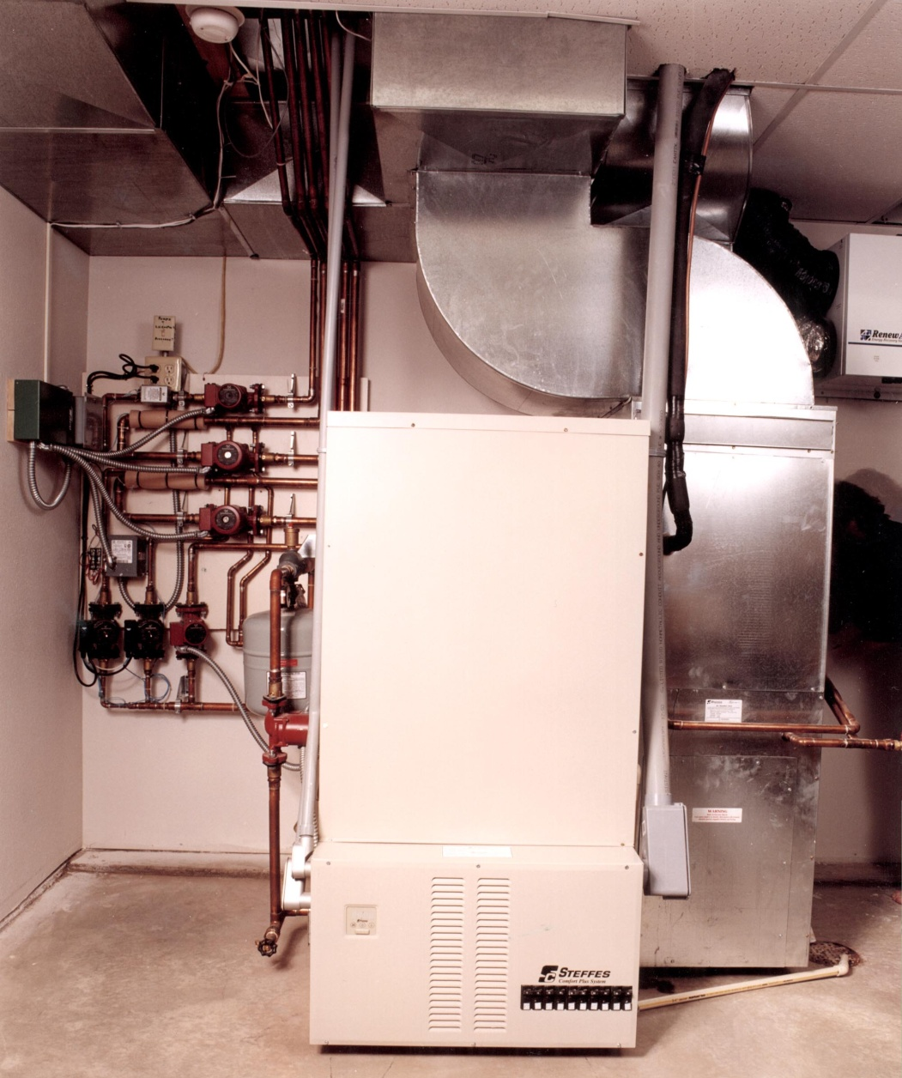
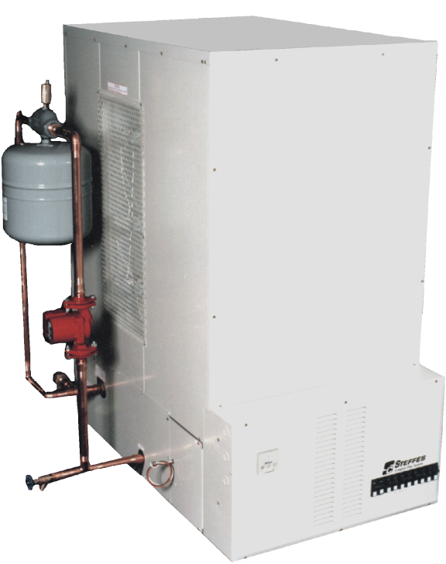
Comfort Plus Hydronic
120 to 240 kWh storage

Slide 11
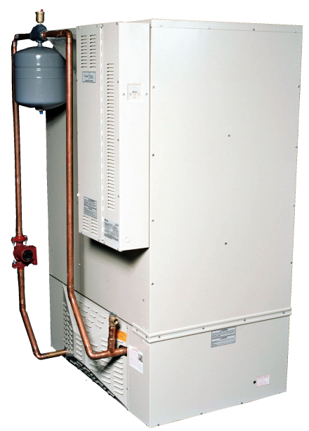
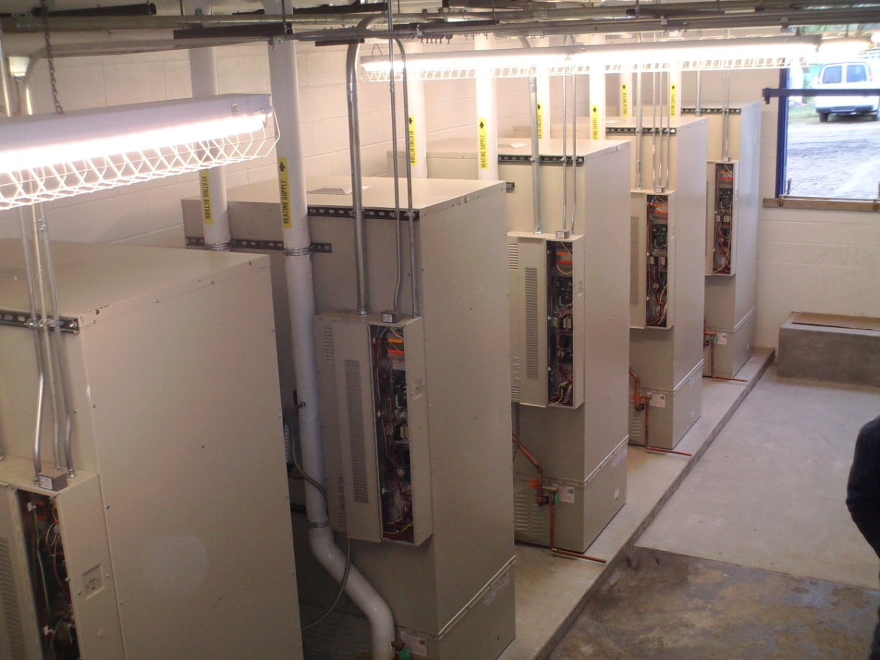
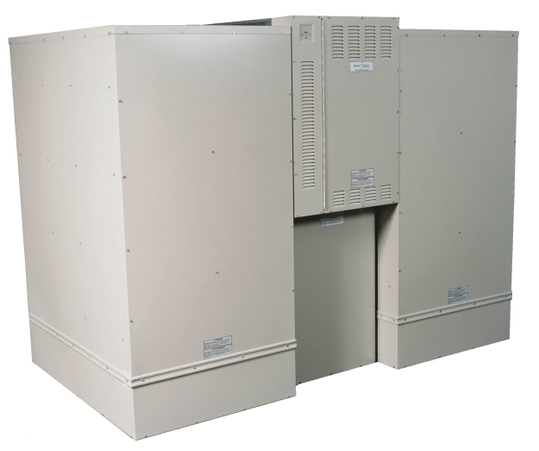
ThermElect
480 kWh
Storage
Hydronic
960 kWh
Storage
Forced Air

Slide 12
Smart Systems with
Renewable Heaters deliver
Renewable Integration
Arbitrage Value
Ancillary Value
Conservation

Slide 13

Renewable Integration
Wind and Solar ramp up & down quickly. Grid interactive controls can ramp just as fast
Allows a higher percentage of Renewable Energy (RE) to be utilized
Enhances RE value
Reduces Carbon footprint
Lowers cost for consumers

Slide 14
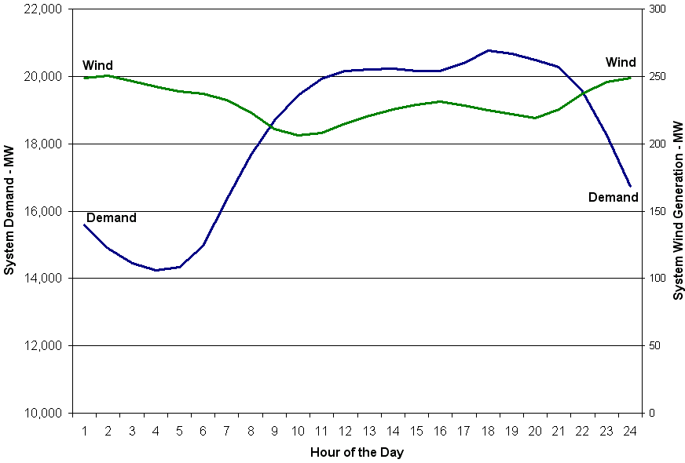
NYISO 2008 Data

Slide 15
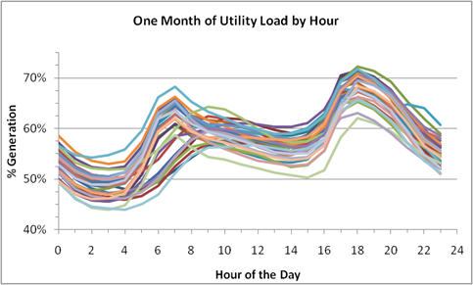
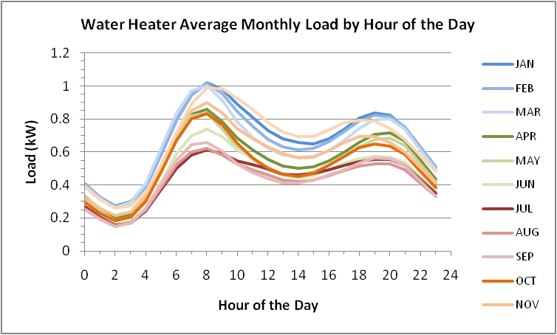
Variability of Electric Load
Water Heater Load

Slide 16
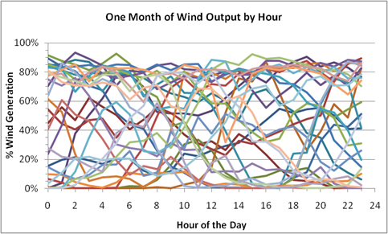
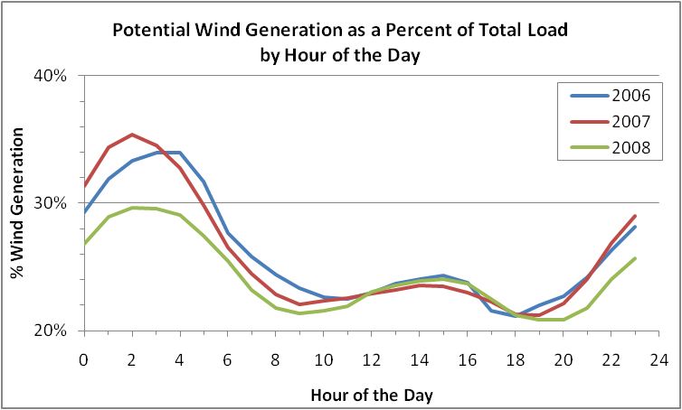
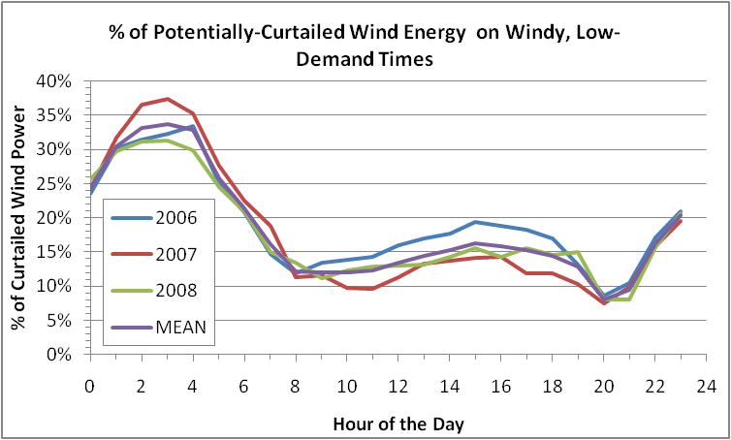
Variability of Renewables
Stable Annual Output

Slide 17
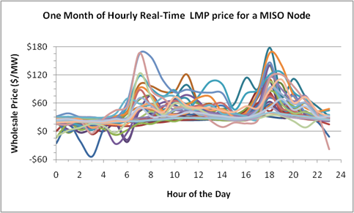
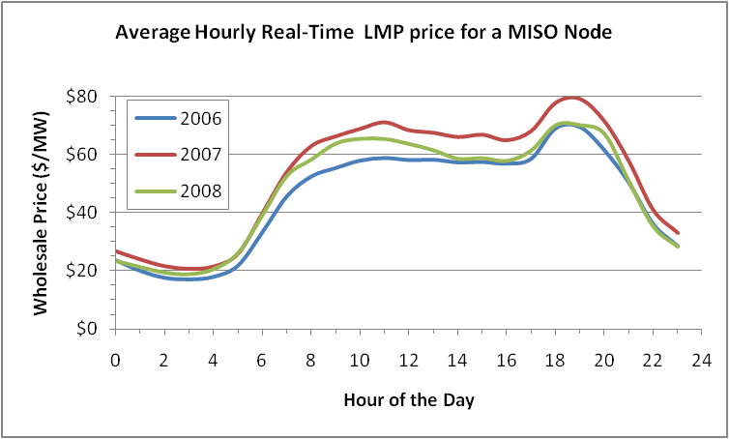
Variable Real Time Price
Stable Annual Average

Slide 18
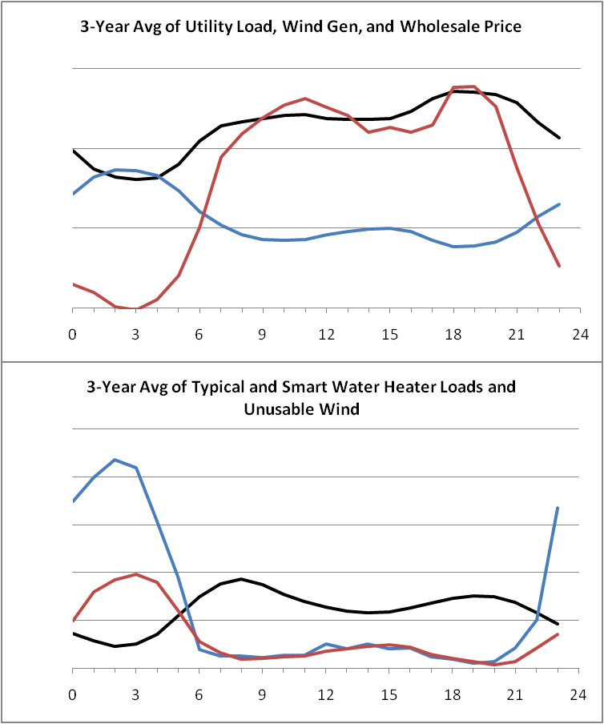
Putting it
Together
Overall Utility Load
Wind Generation
Wholesale Energy Cost
Smart Water Heater Load
Unusable Wind Generation
Typical Water Heater Load

Slide 19
With 25% Wind Energy
This analysis uses three (3) years of actual load, wind scaled to 25% of load, LMP, and EPRI water heater data.
Energy Storage Method | Wholesale Cost ($/y) | Total Energy Used (kW·h/y) | Wind Energy Use (kW·h/y) | Nonwind Energy Use (kW·h/y) | CO₂ Reduction† (lb/y)
55-gal Uncontrolled Storage Water Heater | $251 | 4805 | 1156 | 3649 | Baseline
 | 0% | 0% | 24% | 76%
85-gal Grid-Interactive Storage Water Heater | $133 | 4940 | 2726 | 2214 | 1436
 | -47% | 3% | 55% | 45% | -39%
105-gal Grid-Interactive Storage Water Heater with Smart Signal | $126 | 4974 | 2840 | 2134 | 1515
 | -50% | 4% | 57% | 43% | -42%
Assumes that COP = 2 above 55°F and COP = 1 at or below 55°F
55-gal Heat Pump Water Heater (Zone 1) | $126 | 2407 | 580 | 1828 | 1821
 | -50% | -50% | 24% | 76% | -50%
55-gal Heat Pump Water Heater (Zone 3) | $153 | 2936 | 717 | 2219 | 1430
 | -39% | -39% | 24% | 76% | -39%
55-gal Heat Pump Water Heater (Zone 5) | $187 | 3566 | 880 | 2686 | 964
 | -25% | -26% | 25% | 75% | -26%
55-gal Heat Pump Water Heater (Zone 7) | $205 | 3899 | 972 | 2928 | 721
 | -18% | -19% | 25% | 75% | -20%
†Assumes 1 lb of CO₂ per kW·h of nonwind energy use.
New Dimension of Conservation and Efficiency, charging more when there is renewable energy available and storing more energy to span times without renewable energy
Renewable Integration and Arbitrage Value

Slide 20
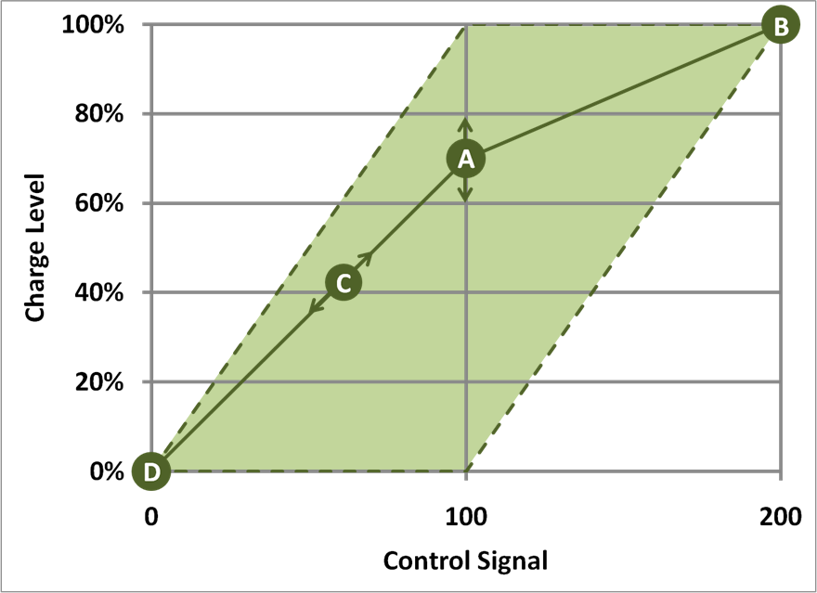
One-way Communication Option
Renewable Integration and Arbitrage Value

Slide 21
Ancillary Value
Grid-interactive
Renewable Electric Heaters
Fast regulation, responding to an Automatic Generation Control (AGC), Renewable following or other signals to:
  Provide frequency control
  Reduce generator fuel consumption
  Improve grid reliability
  Reduce regulation costs
  Reduced system CO2
  Yield ancillary value payments

Slide 22
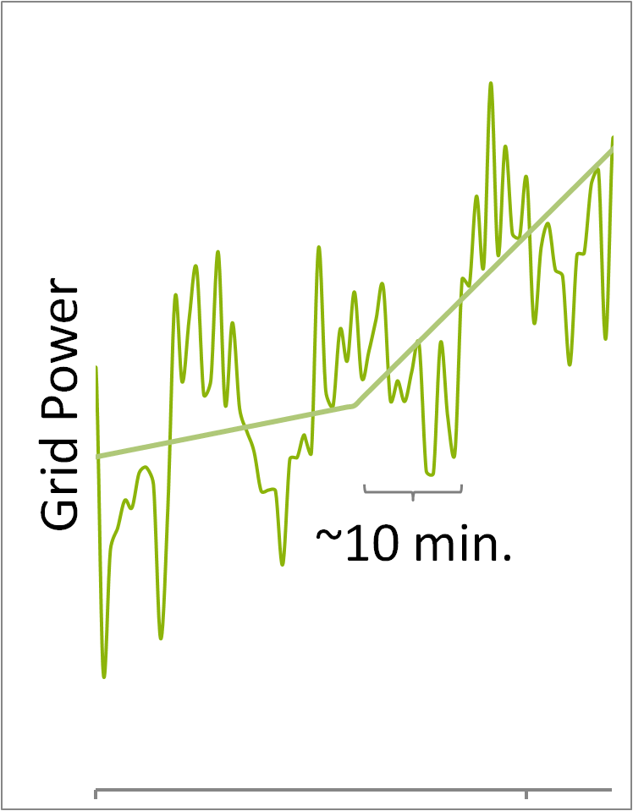
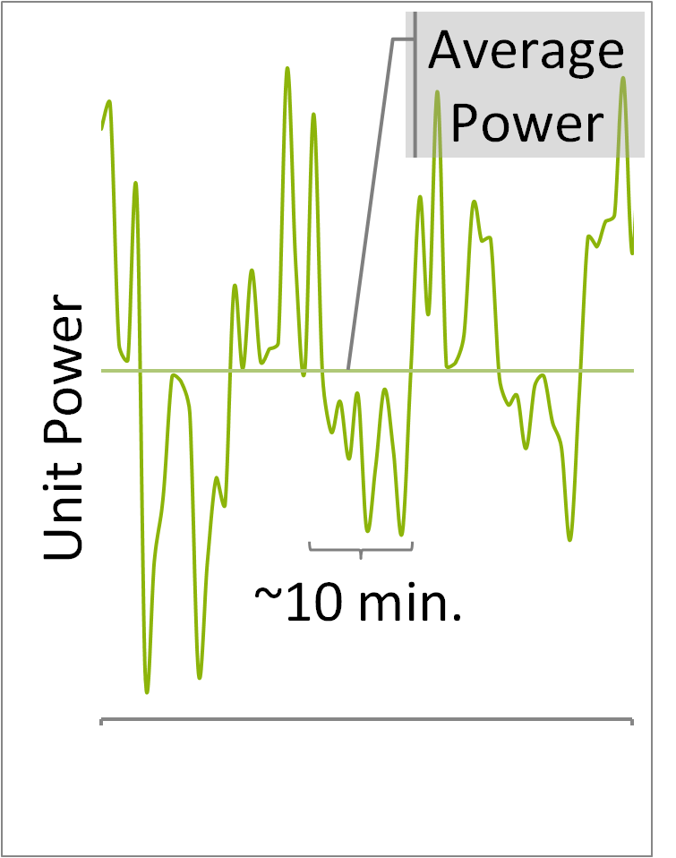
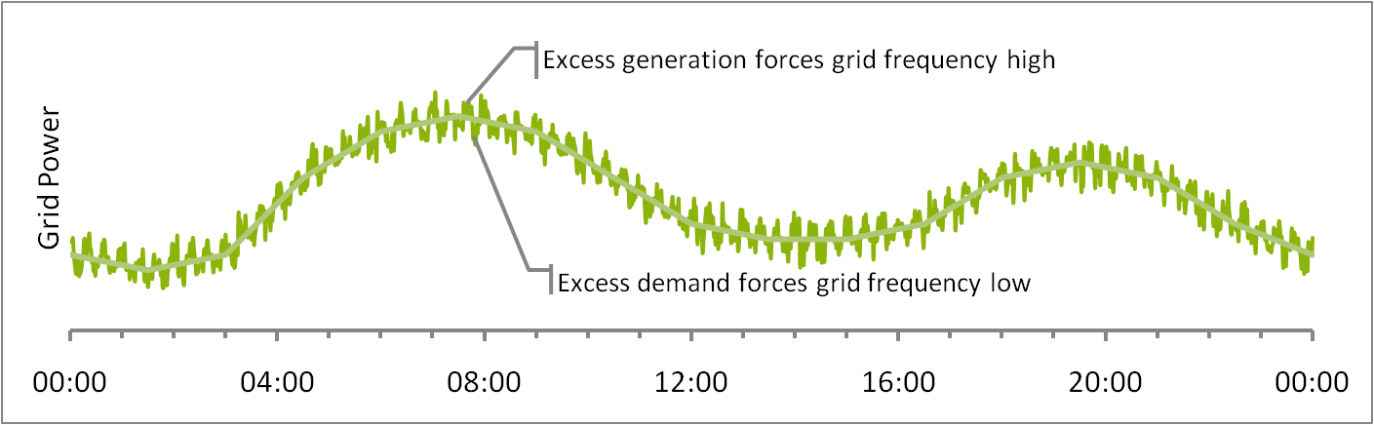
Ancillary Value
Equivalent times and magnitudes above and below nominal
Requires high-speed two-way communication infrastructure
Ancillary Value

Slide 23
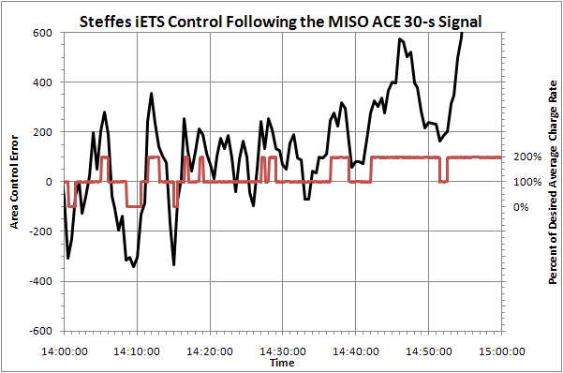
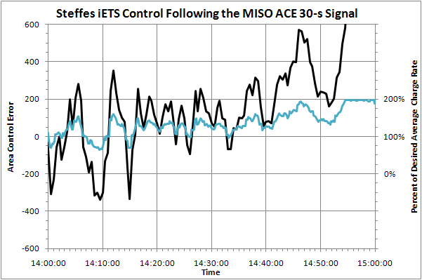
Ancillary Value
Data from Grid-interactive space and water heating (2-way smart communication needed)
3-Step
Continuously-Variable
Ancillary and Other Value

Slide 24
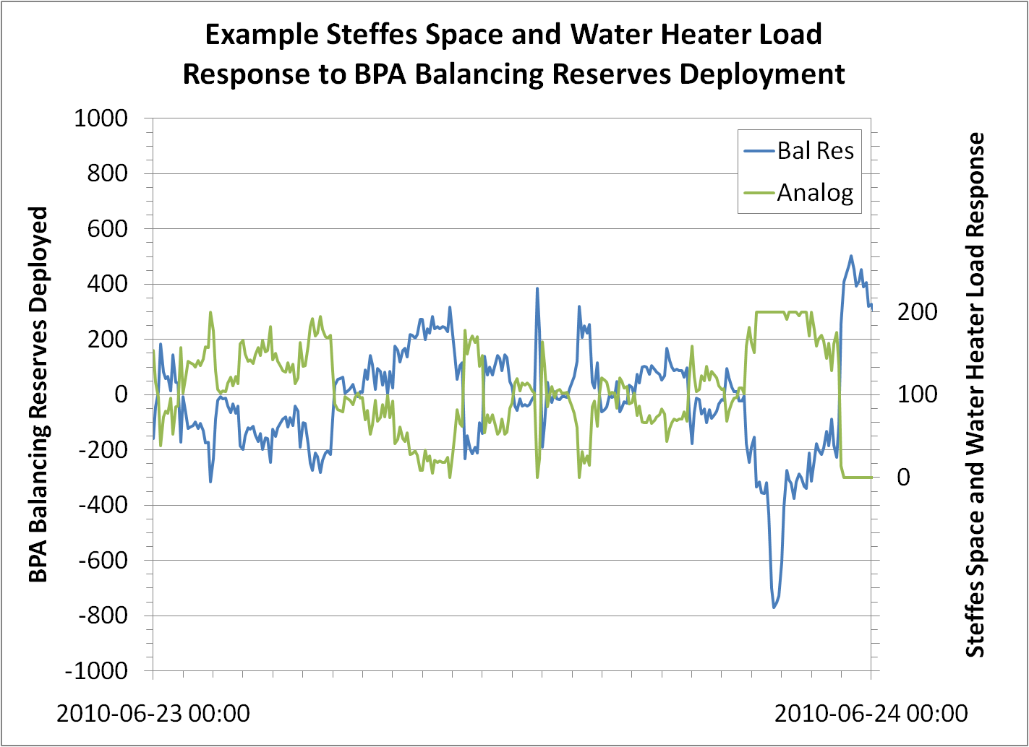
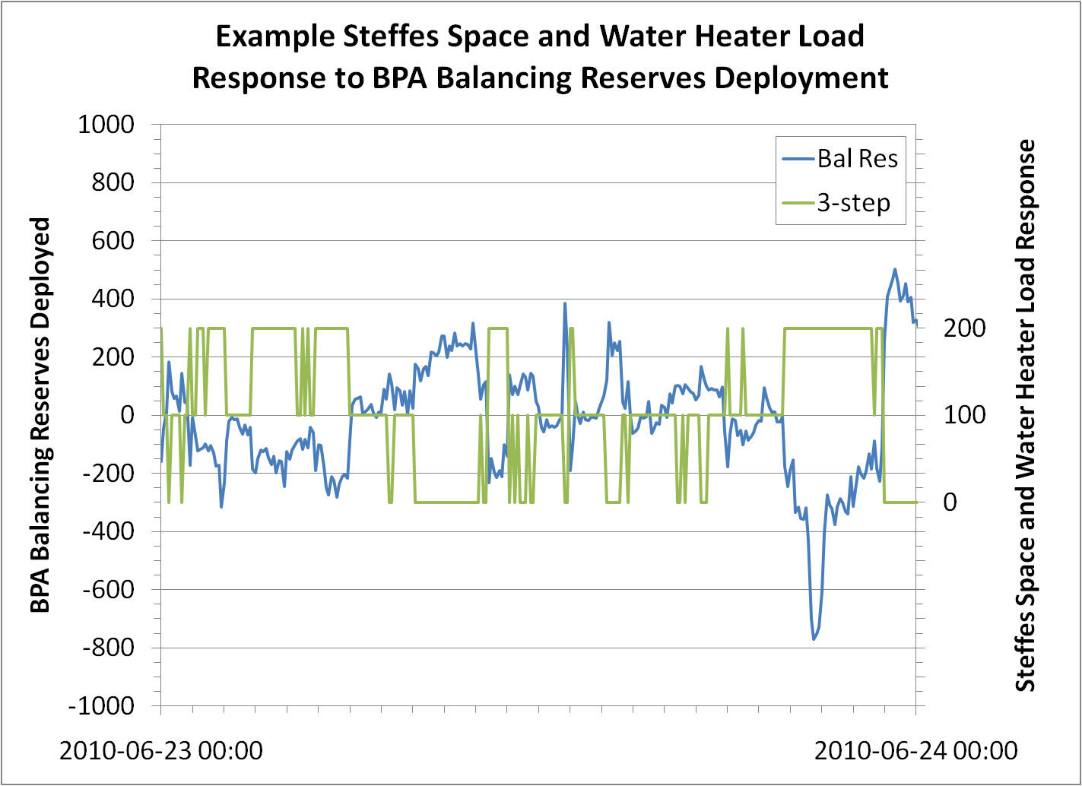
BPA Balancing Reserves Deployment

Slide 25
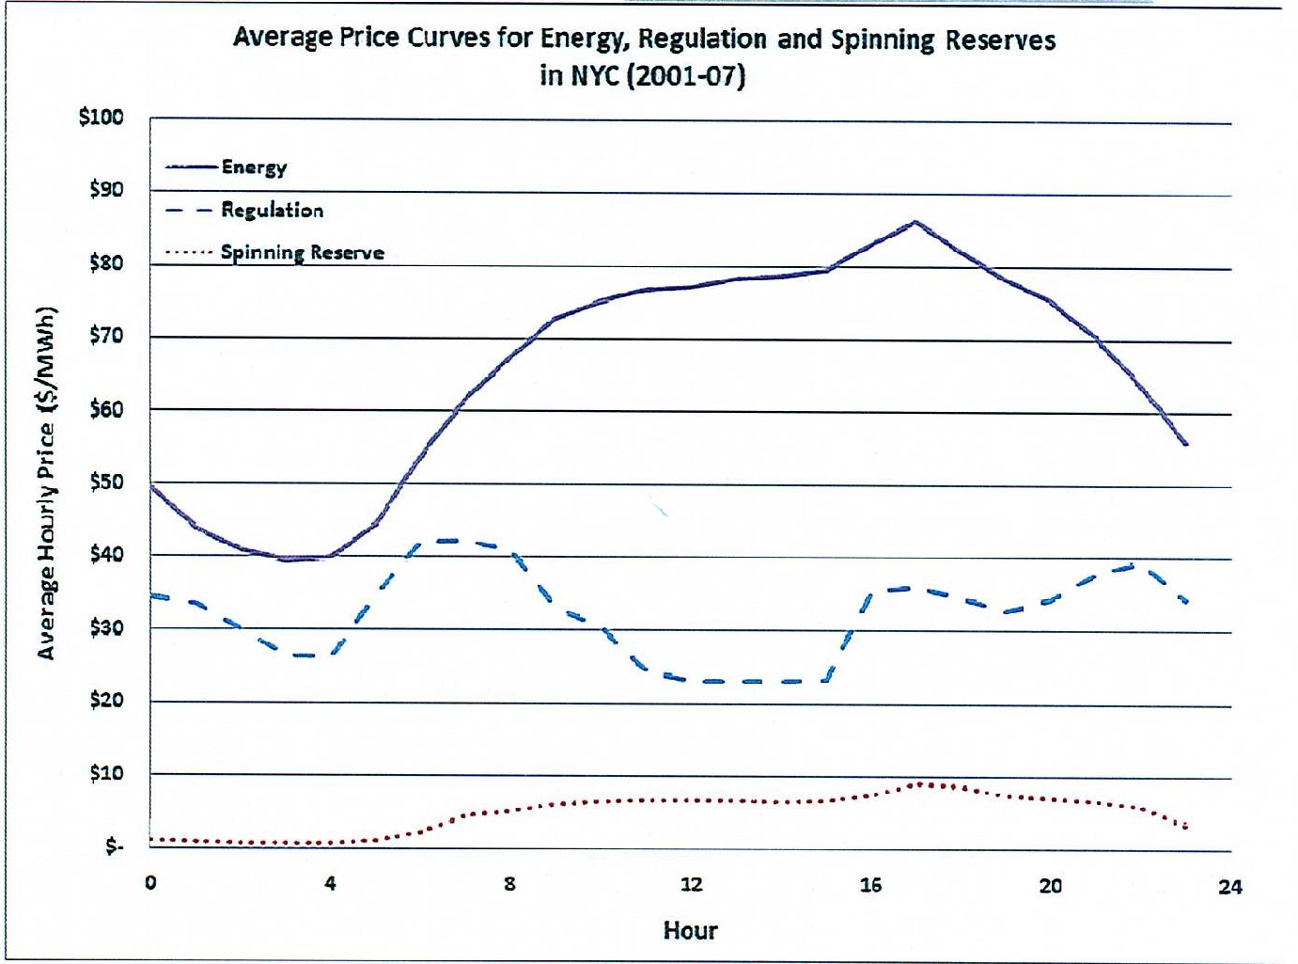
Bonus Economic and Environmental Value
Note the monetary value of Regulation
Regulating with a non fuel consuming resource has a significant carbon reduction (up to 70%)

Slide 26
A Renewable Water Heater is a…
“Thermal Battery”
With smart control, you affect the grid exactly like other electric storage technologies

Slide 27
Low-Cost Electric Storage
To realize the dream of the smart-grid significant storage in needed
CALISO says 4000 Megawatts of variable storage need to balance renewables
Grid-interactive Thermal Storage is a small fraction of cost of other methods
Pursue “Low hanging Fruit”
Fill low-cost window of opportunity first

Slide 28
Grid-Interactive Electric Storage Space and Water Controls can receive various Smart Control Signals
One-Way Dual Relay Control
One-Way Variable Control Signal
Two-Way High-Speed Signal
Other…

Slide 29
A few possible directions for pilot demonstrations and deployments
ETS Room Unit install into a selection of existing homes (single or multiple units)
Install ETS furnace or hydronic unit into a new or existing home. Add an air source heat pump if desired.
Use ThermElects for commercial or district heat, for hot air or hydronic heat

Slide 30
Pilot demonstrations and deployments
Grid-interactive water heater controls can go with all demonstration installations
Steffes is willing to provide you with a complete proposal and work with you to demonstrate this technology on your lines.

Slide 31
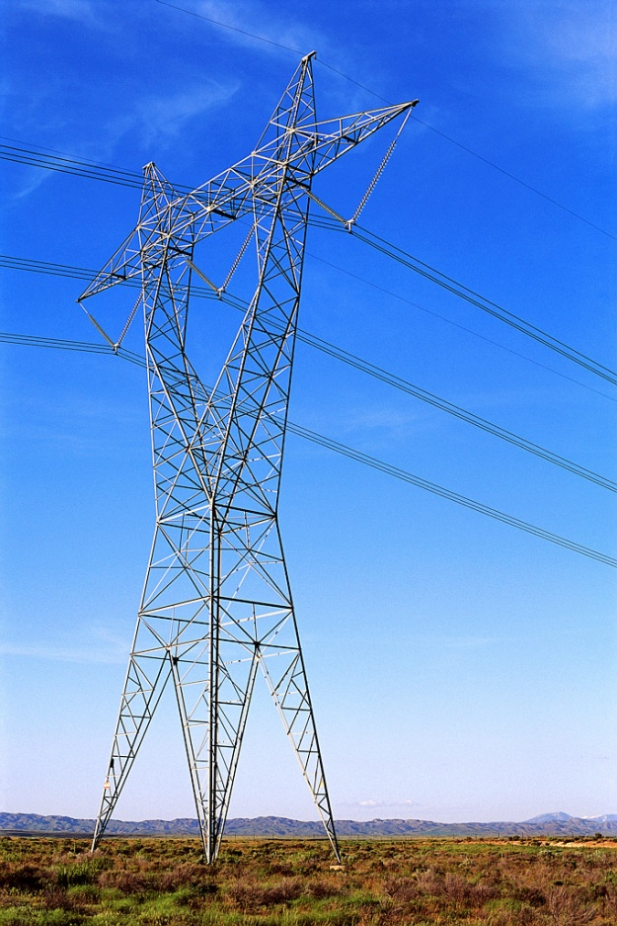
Grid-interactive Renewable Water Heating Systems are good for…
Environment
Consumers
Conservation
Efficiency
The Grid

Slide 32
“If we want to have a zero carbon economy, we must encourage products or technologies that have the potential of getting us there.”
Questions?
Paul Steffes
Steffes Corporation
psteffes@steffes.com
888-783-3337

