Slide 1
BPA FUNDED PIT TAG SYSTEM INVESTMENT
A rough cost estimate of the existing infrastructure for PIT tag data collection for BPA funded and PSMFC maintained sites.

Slide 2
INTRODUCTION
This presentation is a rough estimate of investment that has been funded by the BPA for PIT tag detection and data collection in the Columbia Basin since the switchover from the 400kHz system to the existing ISO 134.2kHz systems. This does not include any projects that are currently in place on the upper Columbia which are funded primarily through various PUD’s.
The following slides will present the overall investment with a breakdown of each individual location that PSMFC currently provides the operation and maintenance (O&M). It will also provide a brief history of each location along with information on the life span of the current technologies that are used in the collection of the PIT tag data. It does not take into account the cost of construction for most of the Juvenile Fish Facilities which were already in existence when the switchover occurred but were modified to accept the new detection systems.

Slide 3
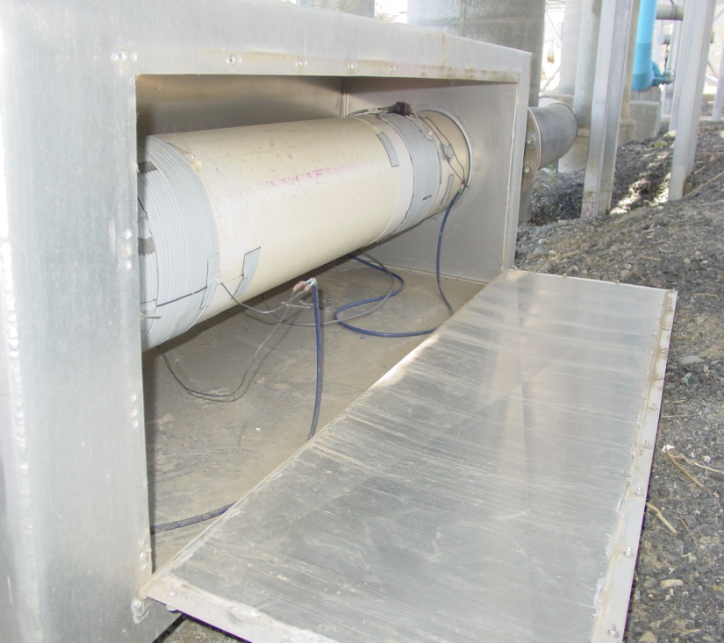
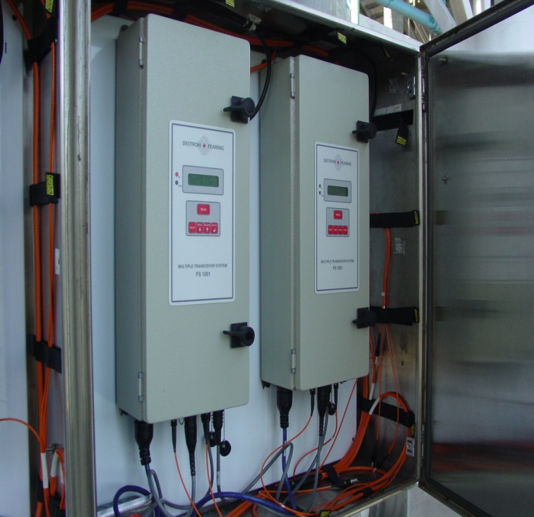
Antenna and Transceiver Association
Typical Juvenile 2 coil Monitor
FS1001 Transceiver
Installed in 2000

Slide 4
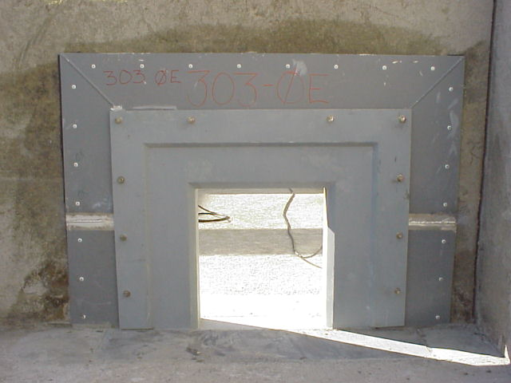
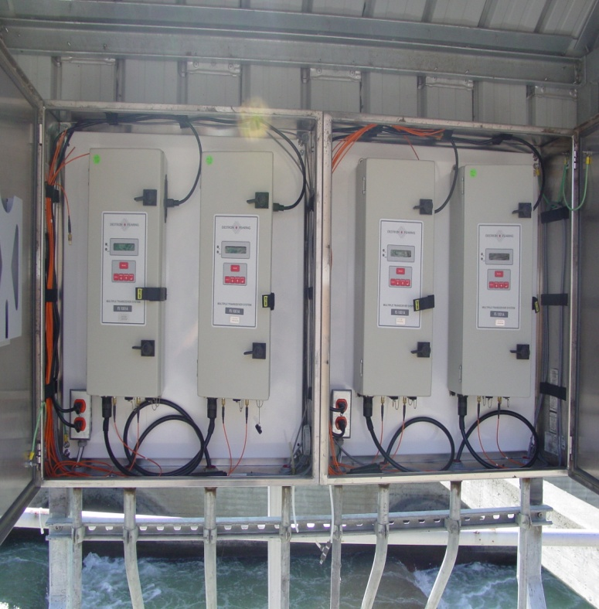
Antenna and Transceiver Association
Original Orifice style Antenna
FS1001A Transceiver
First installed in 2001

Slide 5
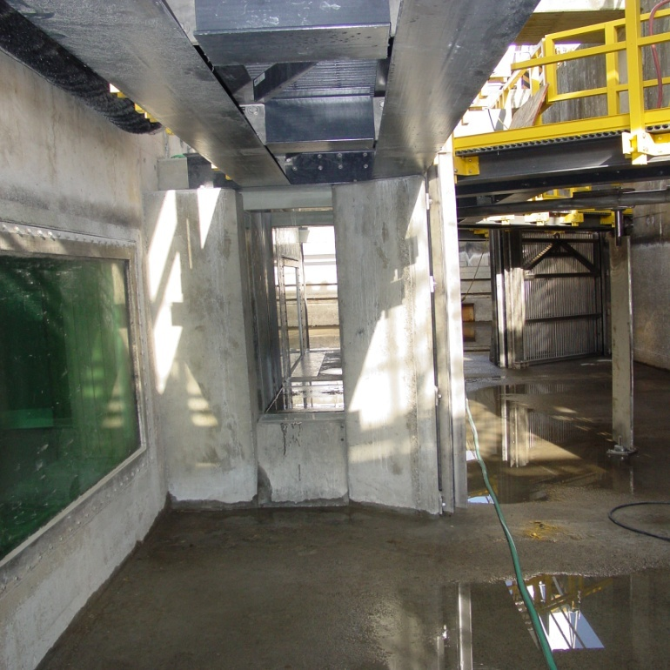

Antenna and Transceiver Association
Counting Window Antenna
FS1001A Transceivers
First Installed in 2002

Slide 6
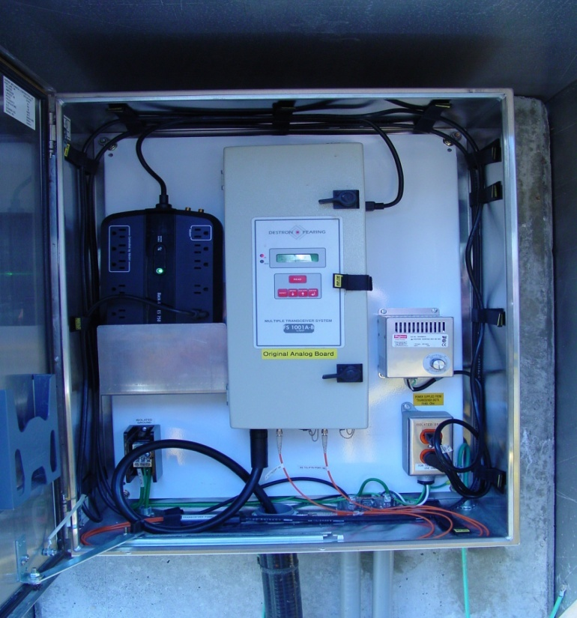
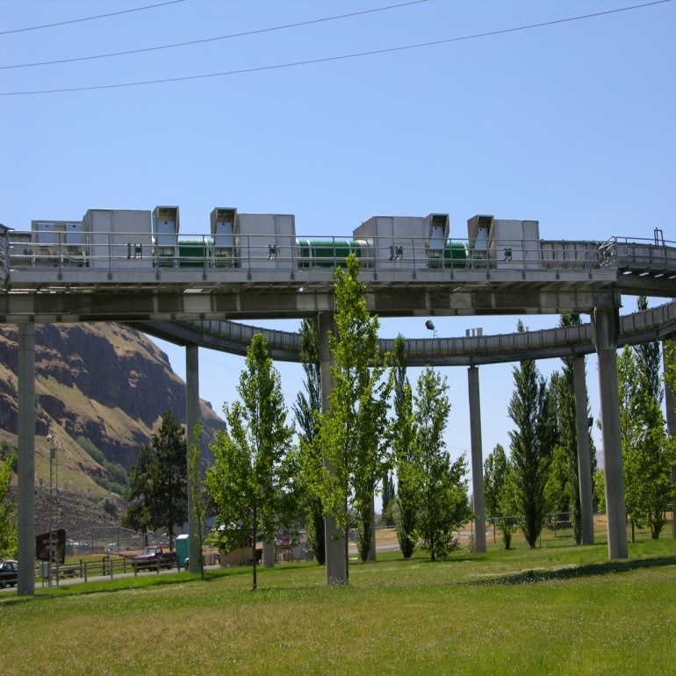
Antenna and Transceiver Association
Full Flow Antennas
FS1001A or FS1001B
First Installed in 2003

Slide 7
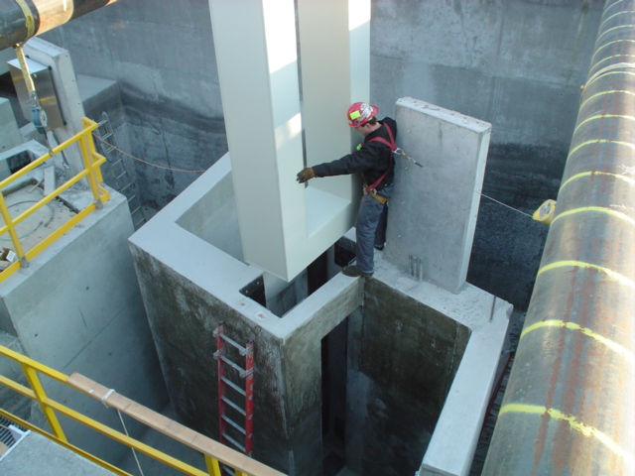
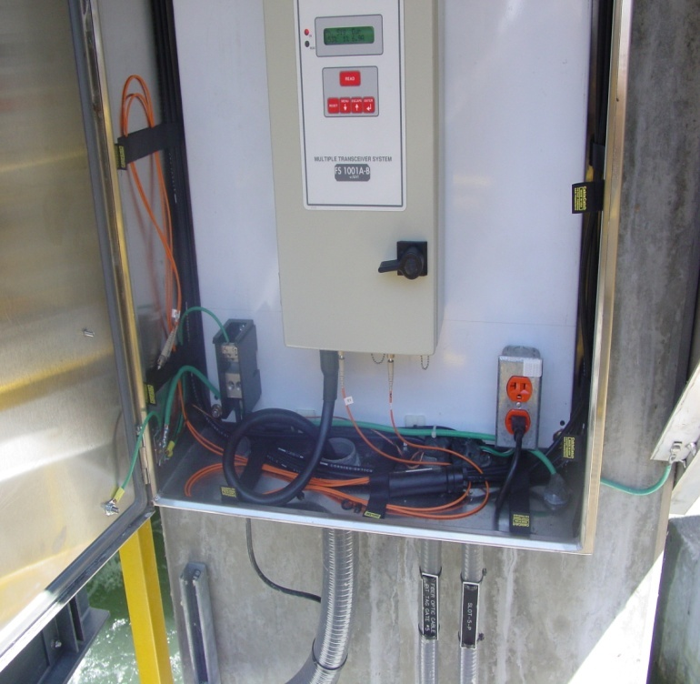
Antenna and Transceiver Association
Large Slot Antenna
FS1001B
First Installed in 2005

Slide 8
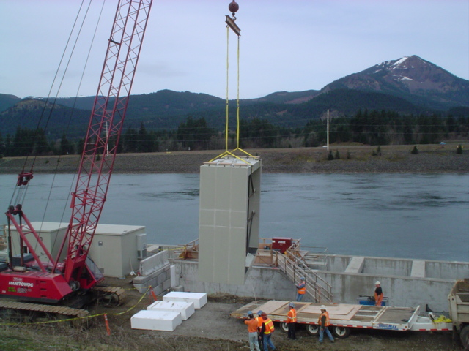
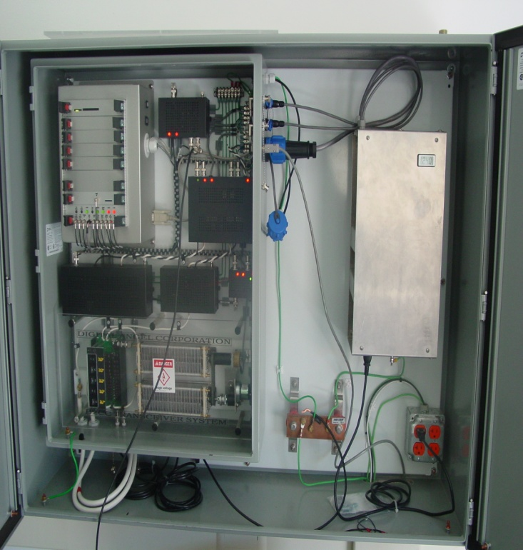
Antenna and Transceiver Association
Bonneville Corner Collector Antenna
15’2” X 15’2” I.D.
BCC Transceiver
Installed in 2006

Slide 9
Project Agencies
Portland District COE – There are seven (7) separate PIT tag interrogation sites located at two (2) hydroelectric dams, Bonneville and John Day, located on the Columbia River. These sites facilitate both Juvenile and Adult detection systems. These dams can be populated by more than one (1) interrogation site.
Walla Walla District COE – There are eight (8) separate PIT tag interrogation sites located at five (5) hydroelectric dams on the Columbia and Snake Rivers, McNary, Ice Harbor, Lower Monumental, Little Goose, and Granite. These sites facilitate both Juvenile and Adult detections. Some dams are populated by more than one (1) interrogation site.
Yakama Nation – There are five (5) separate PIT tag interrogation locations on the Yakima River and one (1) on the North fork of the Teneway River located outside of Cle Elum, WA.

Slide 10
Agency Totals
Portland District – The total for all projects under the Portland District COE is estimated to be $14M. This includes the cost of the corner collector antenna, which is currently the largest PIT tag detecting antenna.
Walla Walla District – The total for all projects under the Walla Walla district COE is estimated to be $10.2M. This includes the Little Goose full flow project which was completed in Spring of 2009.
Yakama Nation – The total for all projects under the Yakama Nation are estimated to be $464K. This estimate does not include the project on the Klickitat river.
These figures were estimated from the time of the changeover from 400kHz to the present ISO PIT tag detection systems. When possible PSMFC used construction figures provided by each COE district and added the cost of the electronics installed.

Slide 11
Portland District Site Description
Bonneville Juvenile Fish Facility (B2J) – including the 48” Full Flow collection channel pipe (B2JFF).
Washington Shore ladder (BO3) – Original orifice style antennas including the Adult Fish Facility (AFF).
Washington Shore ladder exit (BO4) – Large slot antennas located at the exit of the ladder.
Cascade Island ladder (BO2) – Original orifice style antennas.
Bradford Island ladder (BO1) – Original style orifice antennas and the large slot style antennas located at the exit of the ladder.
John Day Juvenile Fish Facility (JDJ) – Including the Full Flow collection channel flume (JDJFF).

Slide 12
Walla Walla District Site Descriptions
McNary Juvenile Fish Facility (MCJ) – Including the 36” Full Flow collection channel pipe (MCJFF).
Oregon Shore Ladder (MC1) – Original style orifice antennas including the counting window slot style antennas.
Washington Shore Ladder (MC2) – Original style orifice antennas including the counting window slot style antennas.
Ice Harbor North and South Ladders (ICH) – Slot and orifice antenna types. Including the 36” Full Flow collection channel pipe.

Slide 13
Walla Walla District Site Descriptions cont.
Lower Monumental Juvenile Fish Facility (LMJ) – Including the 36” Full Flow collection channel pipe.
Little Goose Juvenile Fish Facility (GOJ) – Including the 36” Full Flow collection channel pipe.
Lower Granite Juvenile Fish Facility (GRJ).
Lower Granite Adult Ladder (GRA) – Including the Adult Fish Trap.

Slide 14
Yakama Nation Site Descriptions
Prosser (PRO) – This site combines the Juvenile Fish Facility (JFF), located ~1/2 mile below Chandler Diversion Dam, and the three (3) counting window stations located within Chandler Diversion Dam.
Rosa Dam Ladder (RZF) – Consists of three (3) pass-through style ladder antennas.
Clark Flat Acclamation Pond (CFJ) – This an acclamation facility located West of Thorp, Wa. on the Yakima River.
Easton Acclamation Pond (ESJ) – This an acclamation facility located North of Easton, Wa. on the Yakima River.
Jack Creek Acclamation Pond (JCJ) – This is an acclamation facility located ~15 miles North of Cle Elum, Wa. on the North Fork of the Teneway River. This site is unique in that there is no commercial power or communications. The facility is powered by generators and the data communications are supplied by satellite internet.

Slide 15
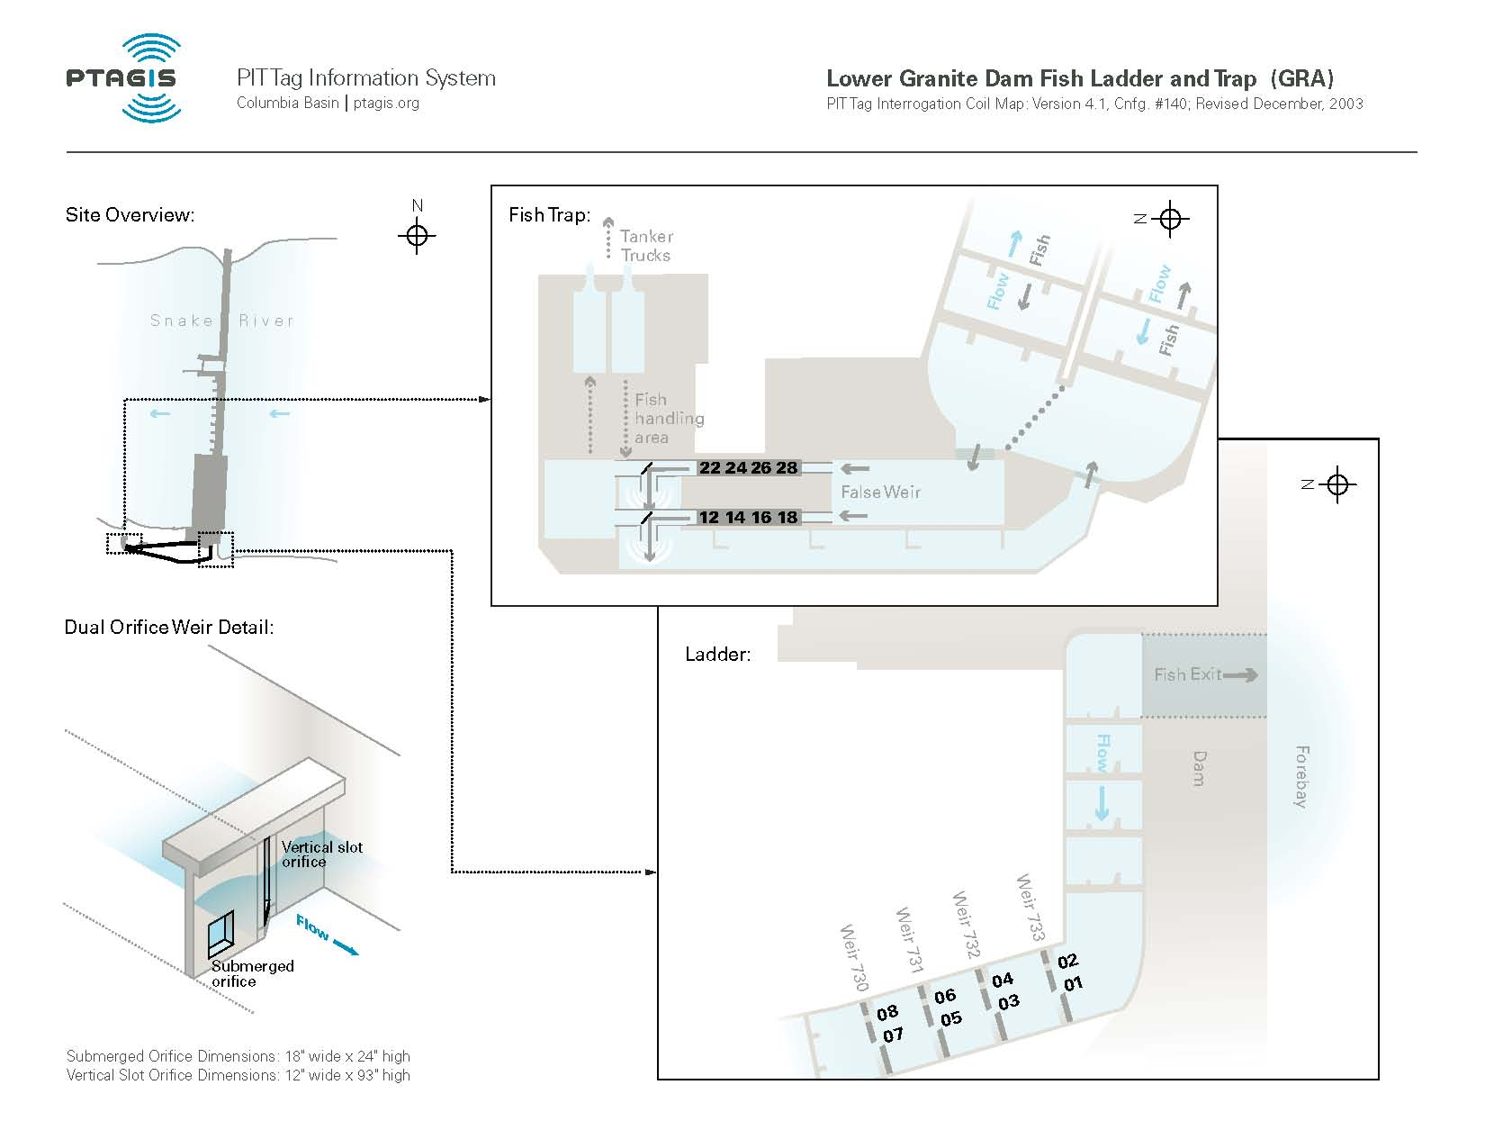
Site Illustration – Granite Adult

Slide 16
Site Breakdown - GRA
Site originally consisted of two (2) five coil monitors located in the adult fish trap.
In 2001, the two monitors were modified to accommodate both 400kHz and 134.2kHz ISO detectors.
In 2003, the fish ladder was modified to accept slot and orifice style antennas in the upper weirs and the fish trap monitors were modified for only 134.2kHz ISO coils and detectors.
Adult Ladder Project cost $1.3M
5 Slot Antennas (Destron-Fearing)@10K ea. $50K
5 Orifice Antennas(Destron-Fearing)@7K ea. $35K
8 FS1001A type transceivers@6K ea. $48K
8 FS1001 transceivers@6K ea. $48K
4 shielded monitor coils@7K ea. $28K
Programmable Logic Controller (PLC) $9K
PIT tag Data Electronics Building $15K
Total ~$1.533M

Slide 17
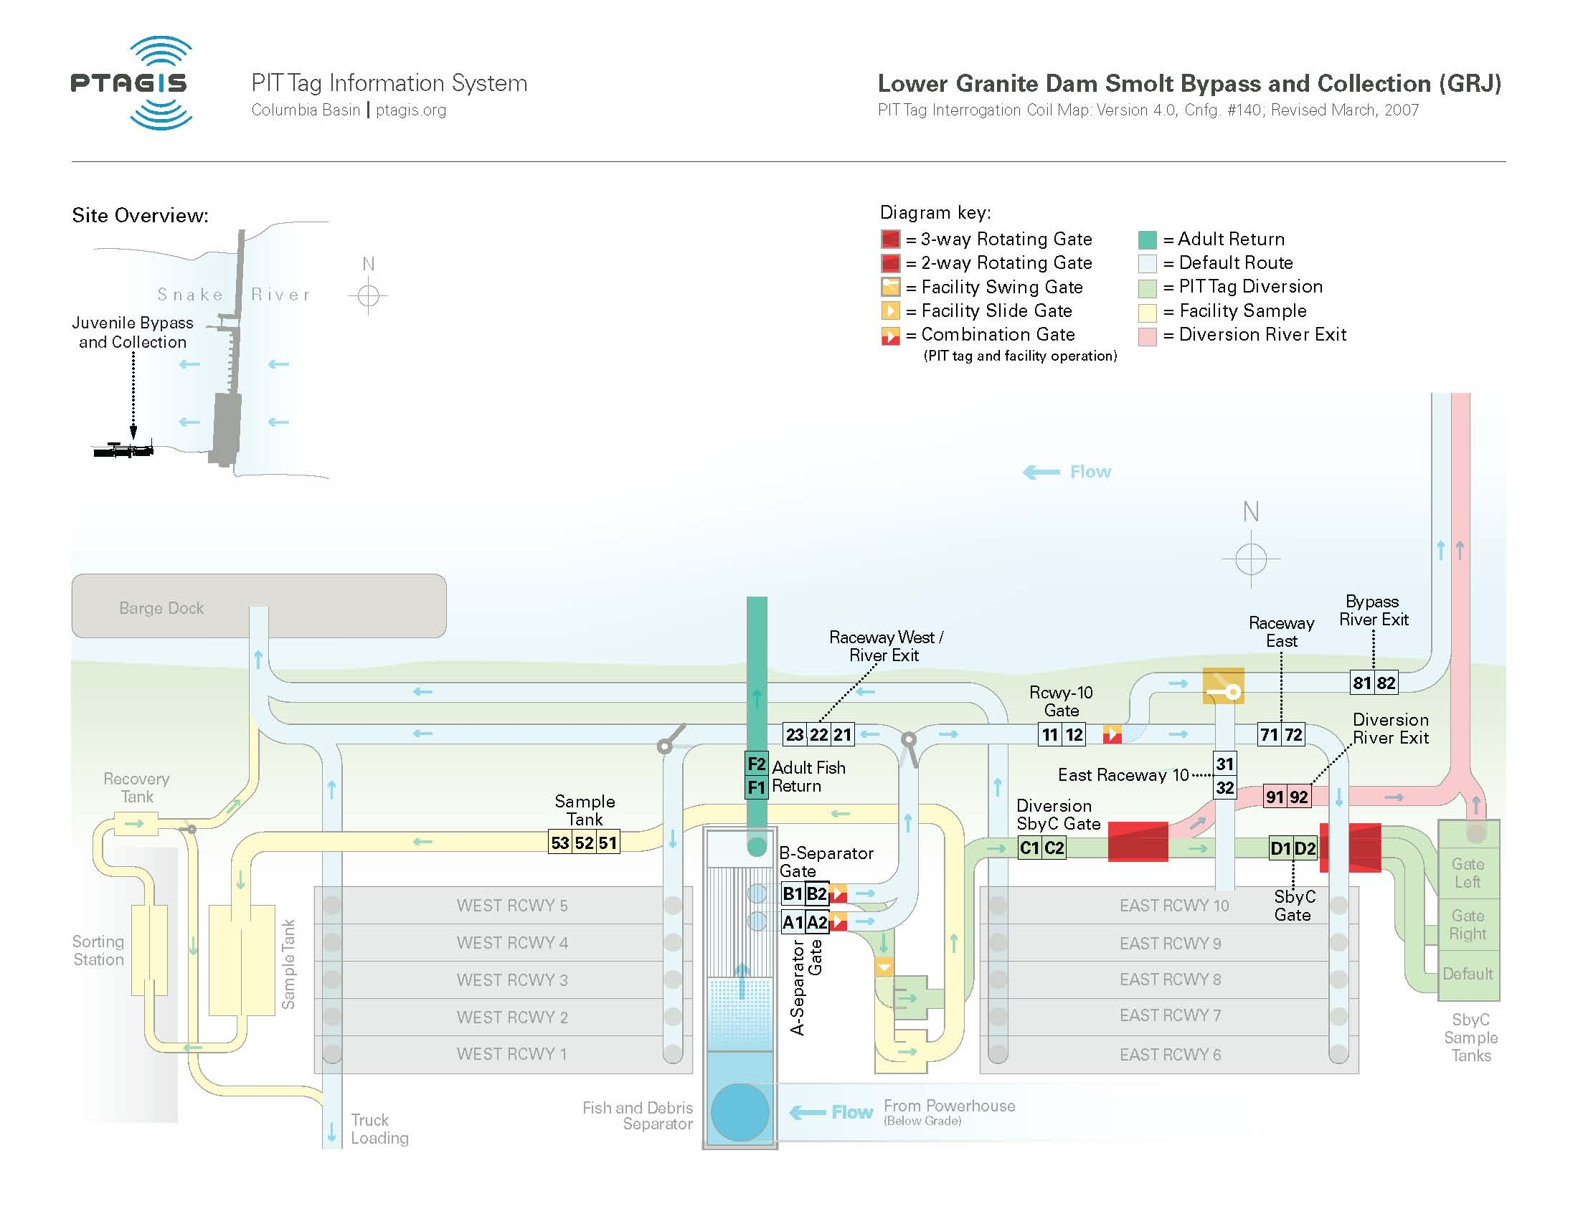
Site Illustration – Granite Juvenile

Slide 18
Site Breakdown - GRJ
This site required no initial construction. There was some modification necessary for the ISO transition.
ISO transition completed in 2000.
14 (2) coil shielded monitors @7K ea. $98K
26 FS1001 @6K ea $156K
Programmable Logic Controller (PLC) $9K
PIT tag Data Electronics Room $15K
Total $268K

Slide 19
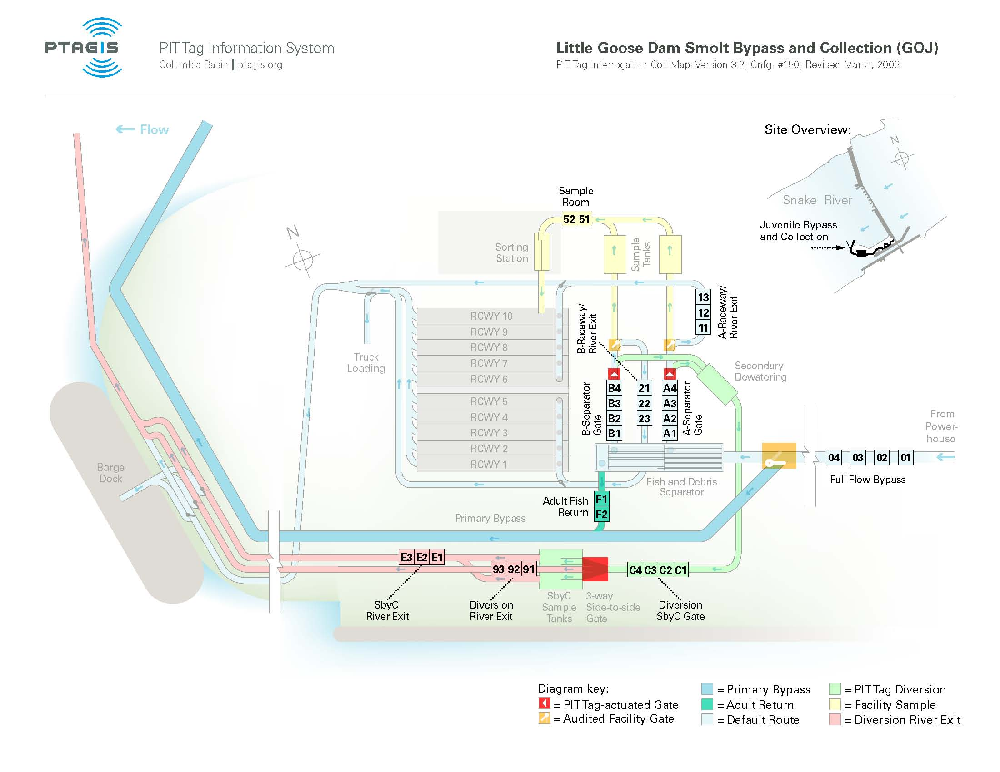
Site Illustration – Little Goose

Slide 20
Site Breakdown – GOJ
In 2000, the Juvenile facility was modified for the ISO transition.
In 2009, a Full Flow Detection system was completed.
16 (2) coil shielded monitors @7K ea. 112K
28 FS1001 Transceivers @6K ea. 168K
Programmable Logic Controller 9K
Full Flow Antenna Project ~1M
4 FS1001A Transceivers @6K ea 24K
PIT tag Data Electronics Room 15K
Total ~1.33M

Slide 21
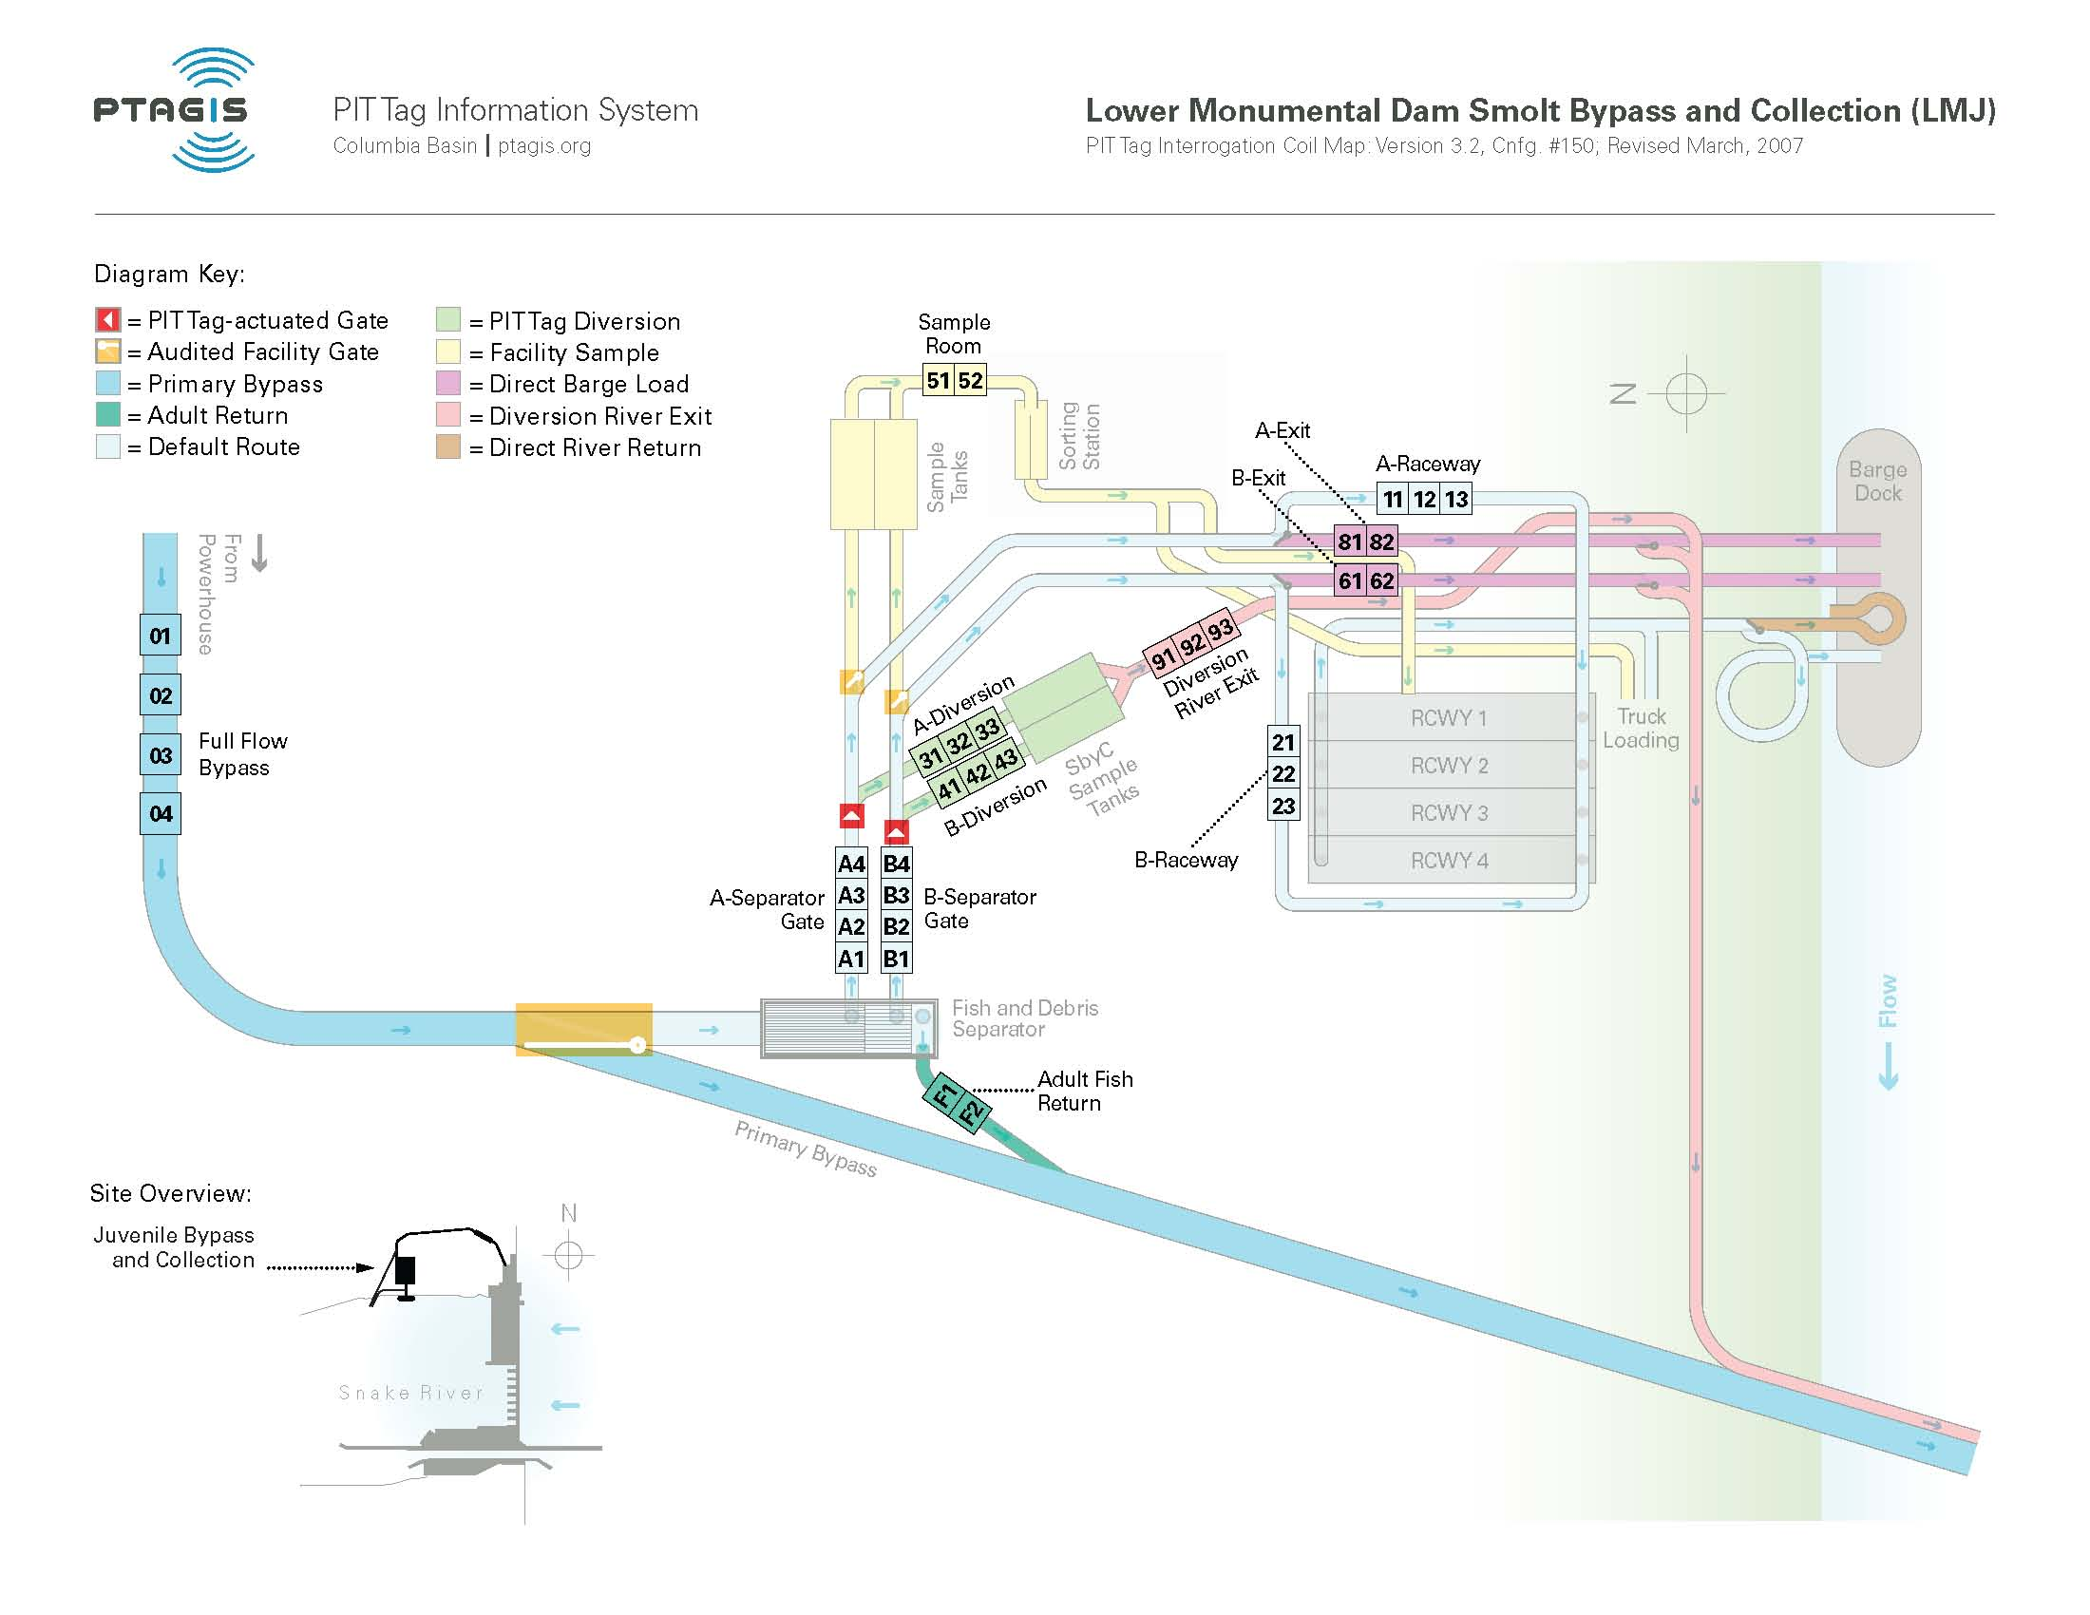
Site Illustration – Lower Monumental

Slide 22
Site Breakdown – Lower Monumental
In 2000, the Juvenile facility was modified for the ISO transition.
In 2006, the Adult Fish return was modified for detection.
In 2007, a Full Flow Detection system was installed.
Full Flow Antenna project 1.13M
18 (2) coil shielded monitors @7K ea. 126K
31 FS1001 transceivers @6k ea. 181K
4 FS 1001A Transceivers @6K ea. 24K
Programmable Logic Controller 9K
PIT tag Data Electronics Room 15K
Total ~1.485M

Slide 23
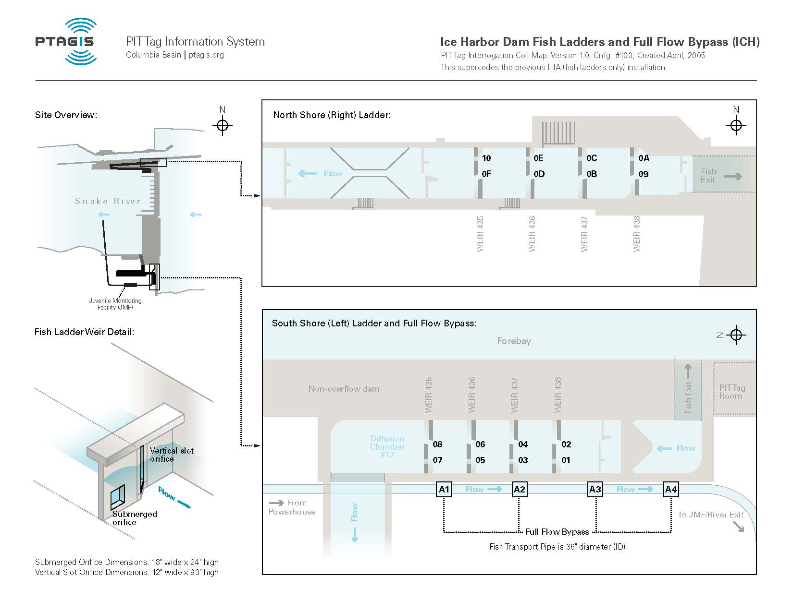
Site Illustration – Ice Harbor

Slide 24
Site Breakdown – Ice Harbor
In 2003, the upper portions of both the North and South ladders were modified for removable slot and orifice antennas.
In 2004, a Full Flow detection system was installed.
Ladder Project Cost 1.3M
Full Flow Project Cost ~1M
10 Small Slot antennas @10K ea. 100K
10 Orifice antennas @7K ea. 70K
20 FS1001A Transceivers @6K ea. 120K
Water Level Detection System 6K
PIT tag Data Electronics Room 15K
Total ~2.6M

Slide 25
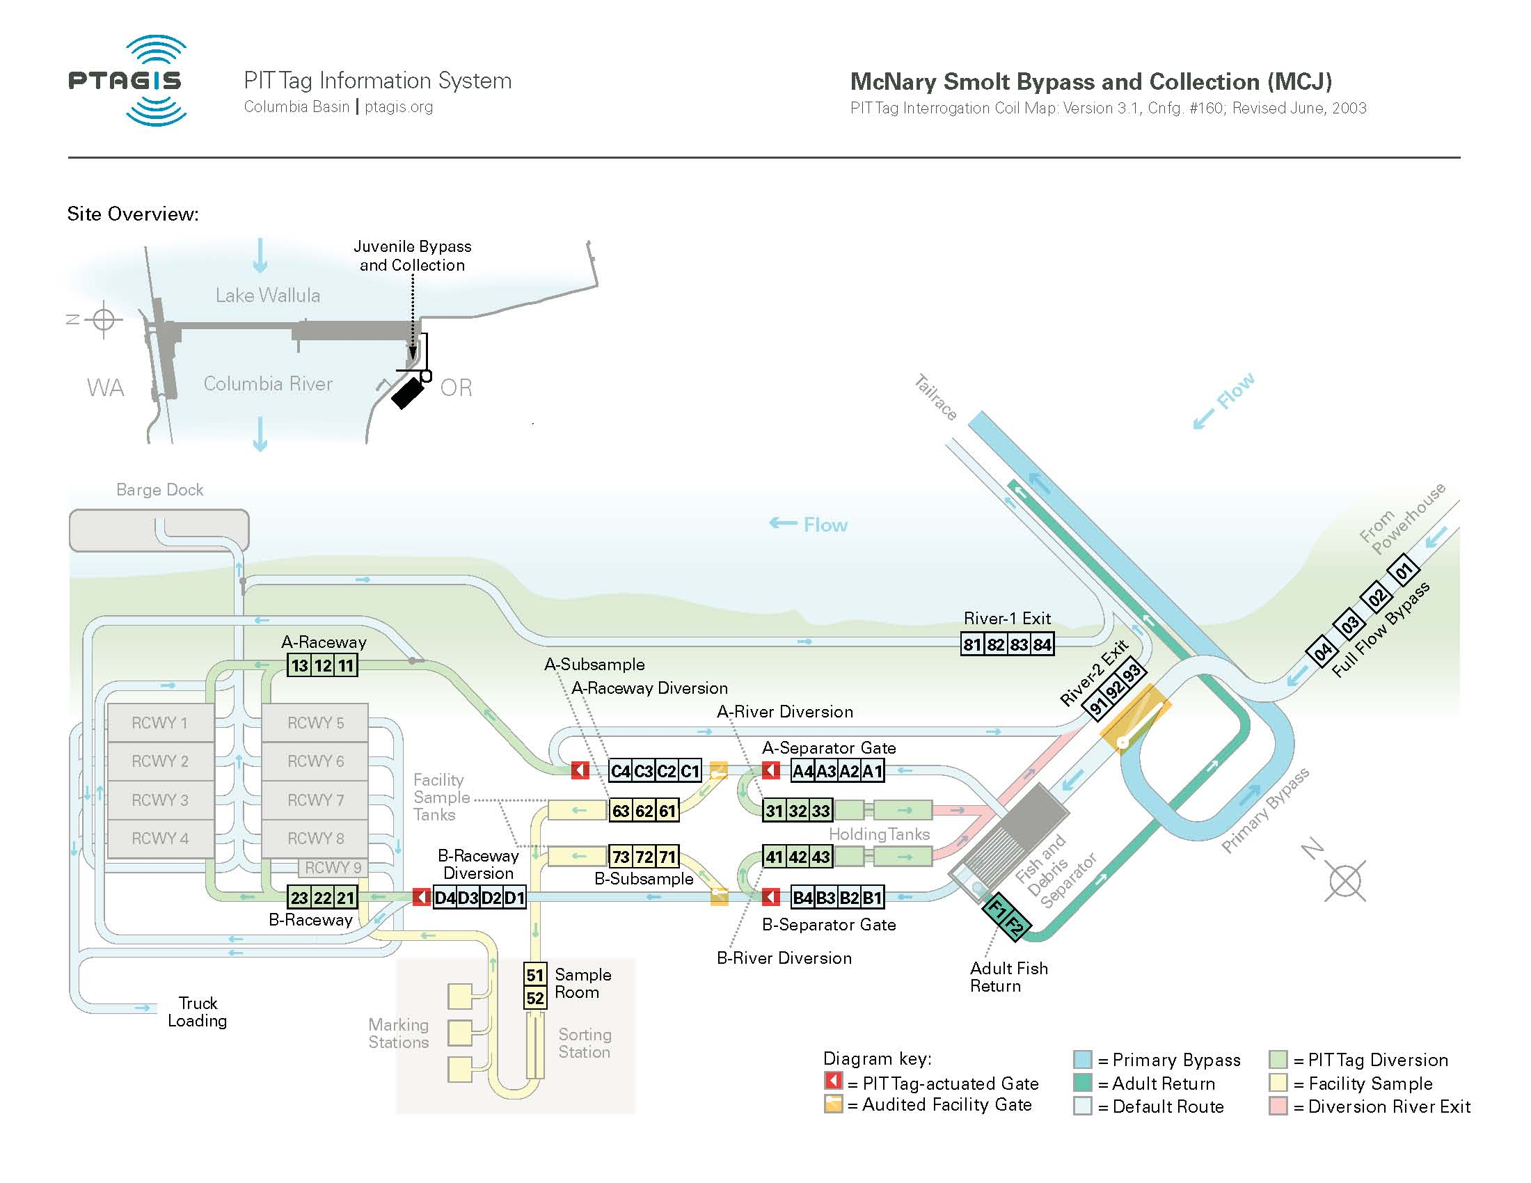
Site Illustration – McNary Juvenile

Slide 26
Site Breakdown – McNary Juvenile
In 2000, the Juvenile facility was modified for the ISO transition.
In 2003, the Adult Fish return was modified for detection.
In 2003, a Full Flow Detection system along with two slide gates were incorporated into PSMFC data collection.
Full Flow Antenna project ~1M
26 (2) coil shielded monitors @7K ea. 182K
45 FS1001 transceivers @6k ea. 270K
4 FS 1001A Transceivers @6K ea. 24K
Programmable Logic Controller 9K
PIT tag Data Electronics Room 15K
Total ~1.5M

Slide 27
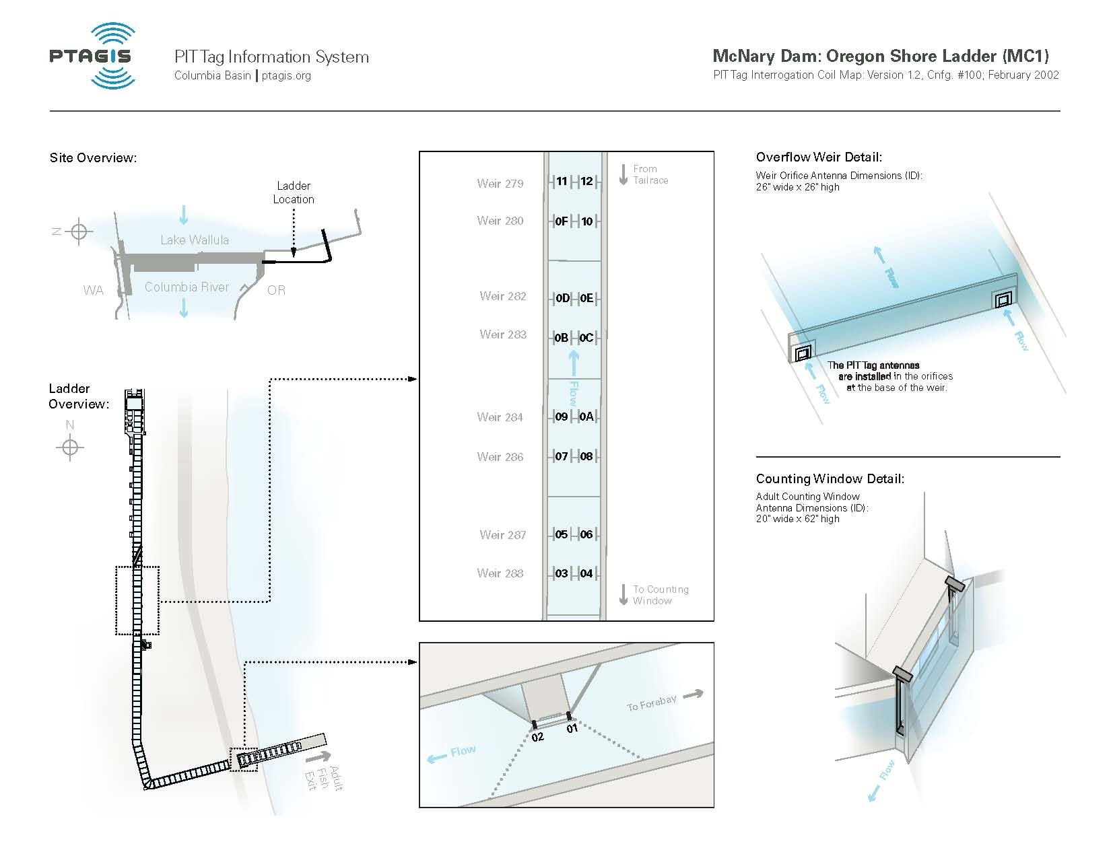
Site Illustration – McNary Oregon Ladder

Slide 28
Site Breakdown – McNary Oregon Ladder
In 2001, the ladder was modified to accept the original style orifice antennas.
In 2001, the Counting Window was modified for two (2) slot antennas.
Ladder Project Cost 241K
Counting window project cost 82K
17 orifice antennas @6K ea. 102K
3 small Slot antennas @10Kea. 30K
18 FS1001A transceivers @6k ea. 108K
PIT tag Data Electronics Room 15K
Total ~578K

Slide 29
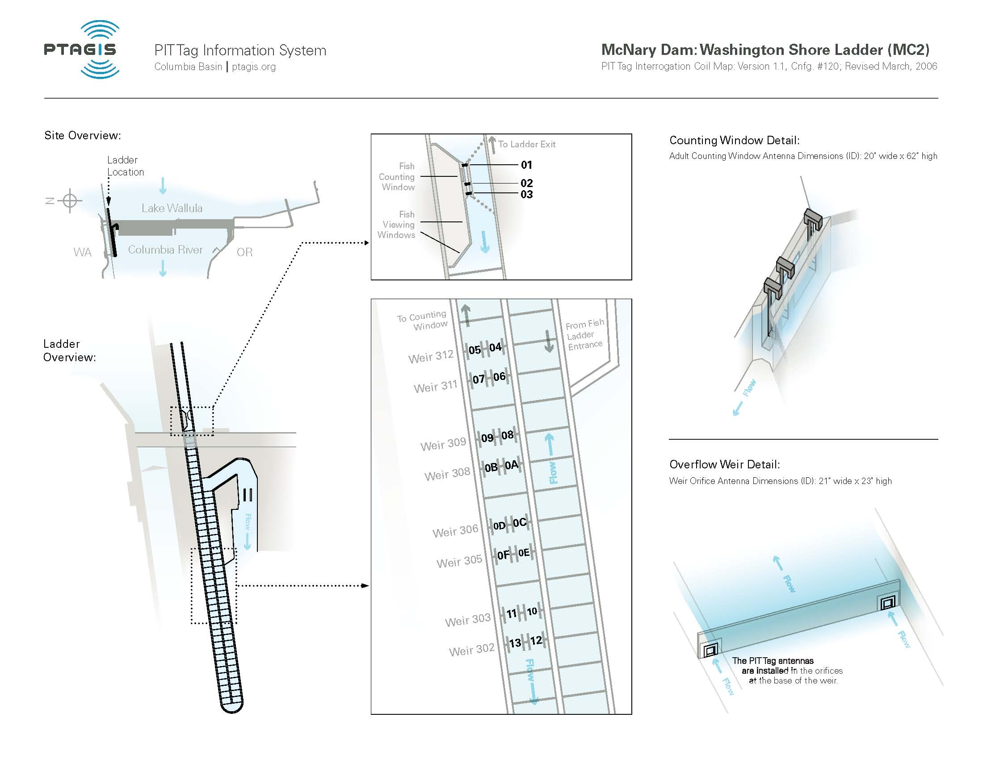
Site Illustration – McNary Washington Ladder

Slide 30
Site Breakdown – McNary Washington Ladder
In 2001, the ladder was modified to accept the original style orifice antennas.
In 2006, the Counting Window was modified for two (3) slot antennas.
Ladder Project Cost 342K
Counting window project cost 220K
17 orifice antennas @6K ea. 102K
4 small Slot antennas @10Kea. 40K
19 FS1001A transceivers @6k ea. 114K
PIT tag Data Electronics Room 15K
Total ~833K

Slide 31
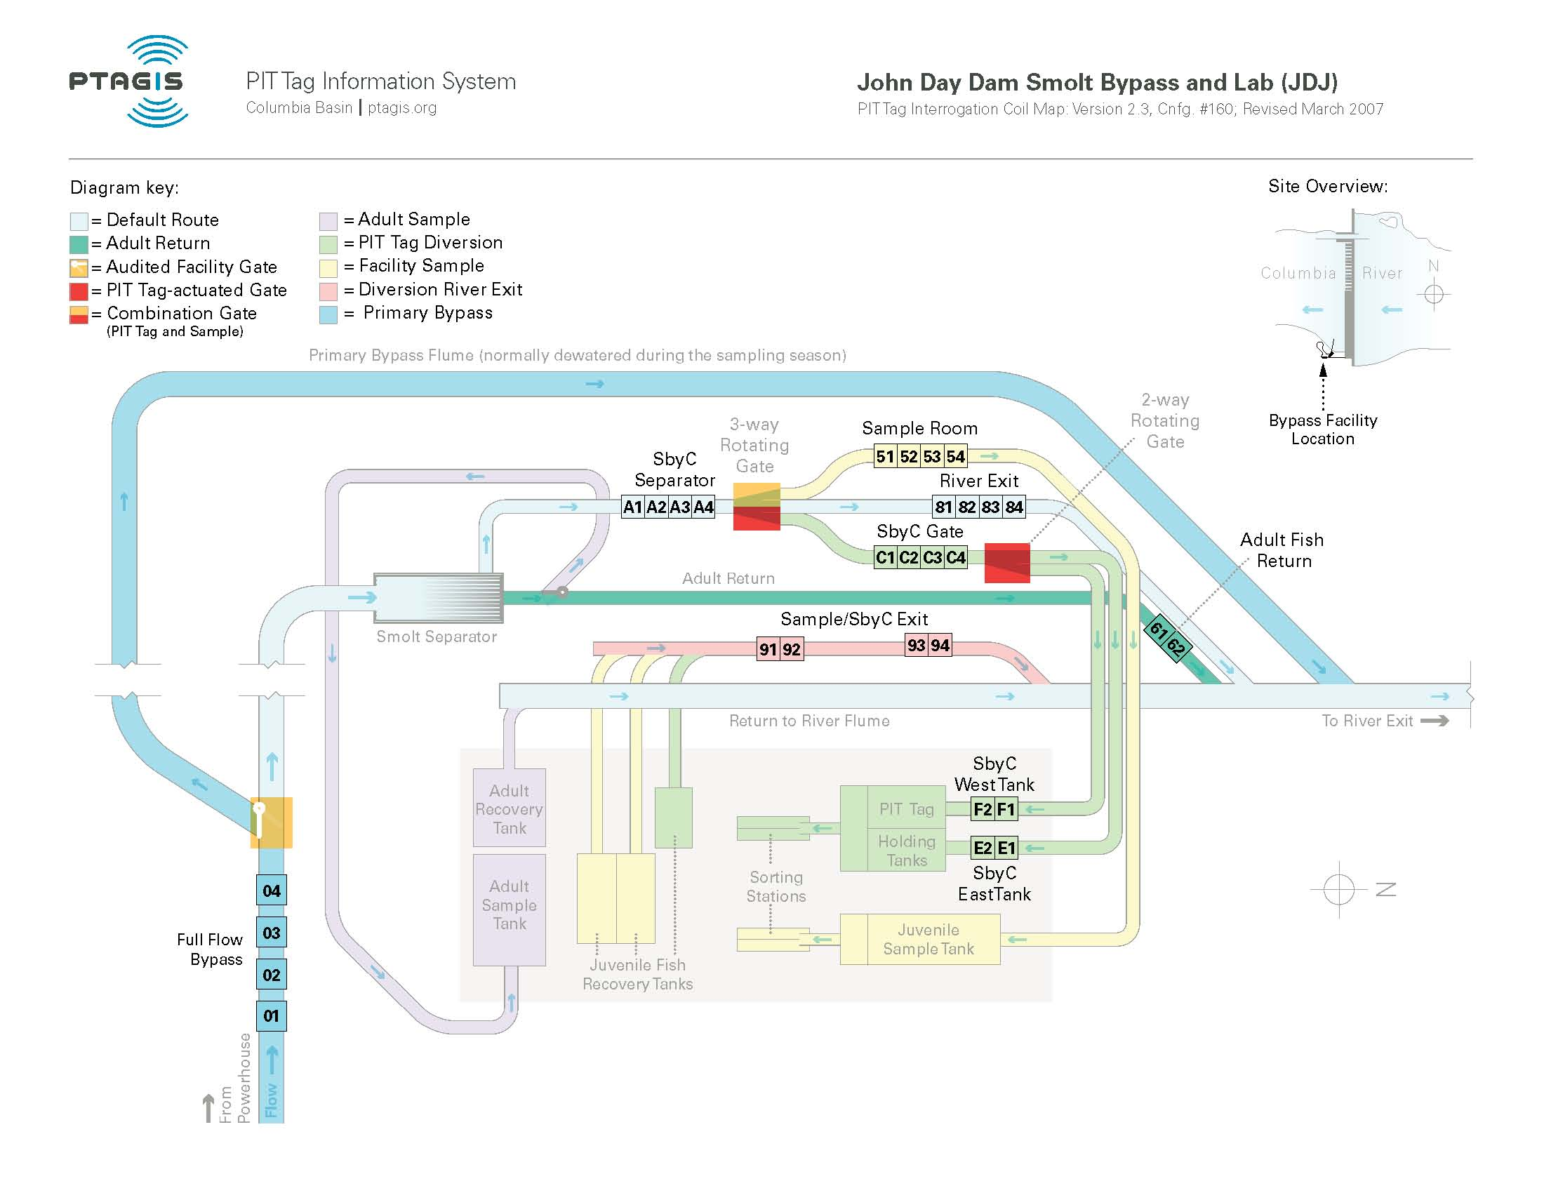
Site Illustration – John Day Juvenile

Slide 32
Site Breakdown – John Day Juvenile
In 2000, the Juvenile facility was modified for the ISO transition.
In 2005, the Adult Fish return was modified for detection.
In 2007, a Full Flow Detection system was installed.
Full Flow Antenna project 1.6M
13 (2) coil shielded monitors @7K ea. 91K
26 FS1001 transceivers @6k ea. 156K
4 FS 1001A Transceivers @6K ea. 24K
Programmable Logic Controller 9K
PIT tag Data Electronics Room 15K
Total 1.624M

Slide 33
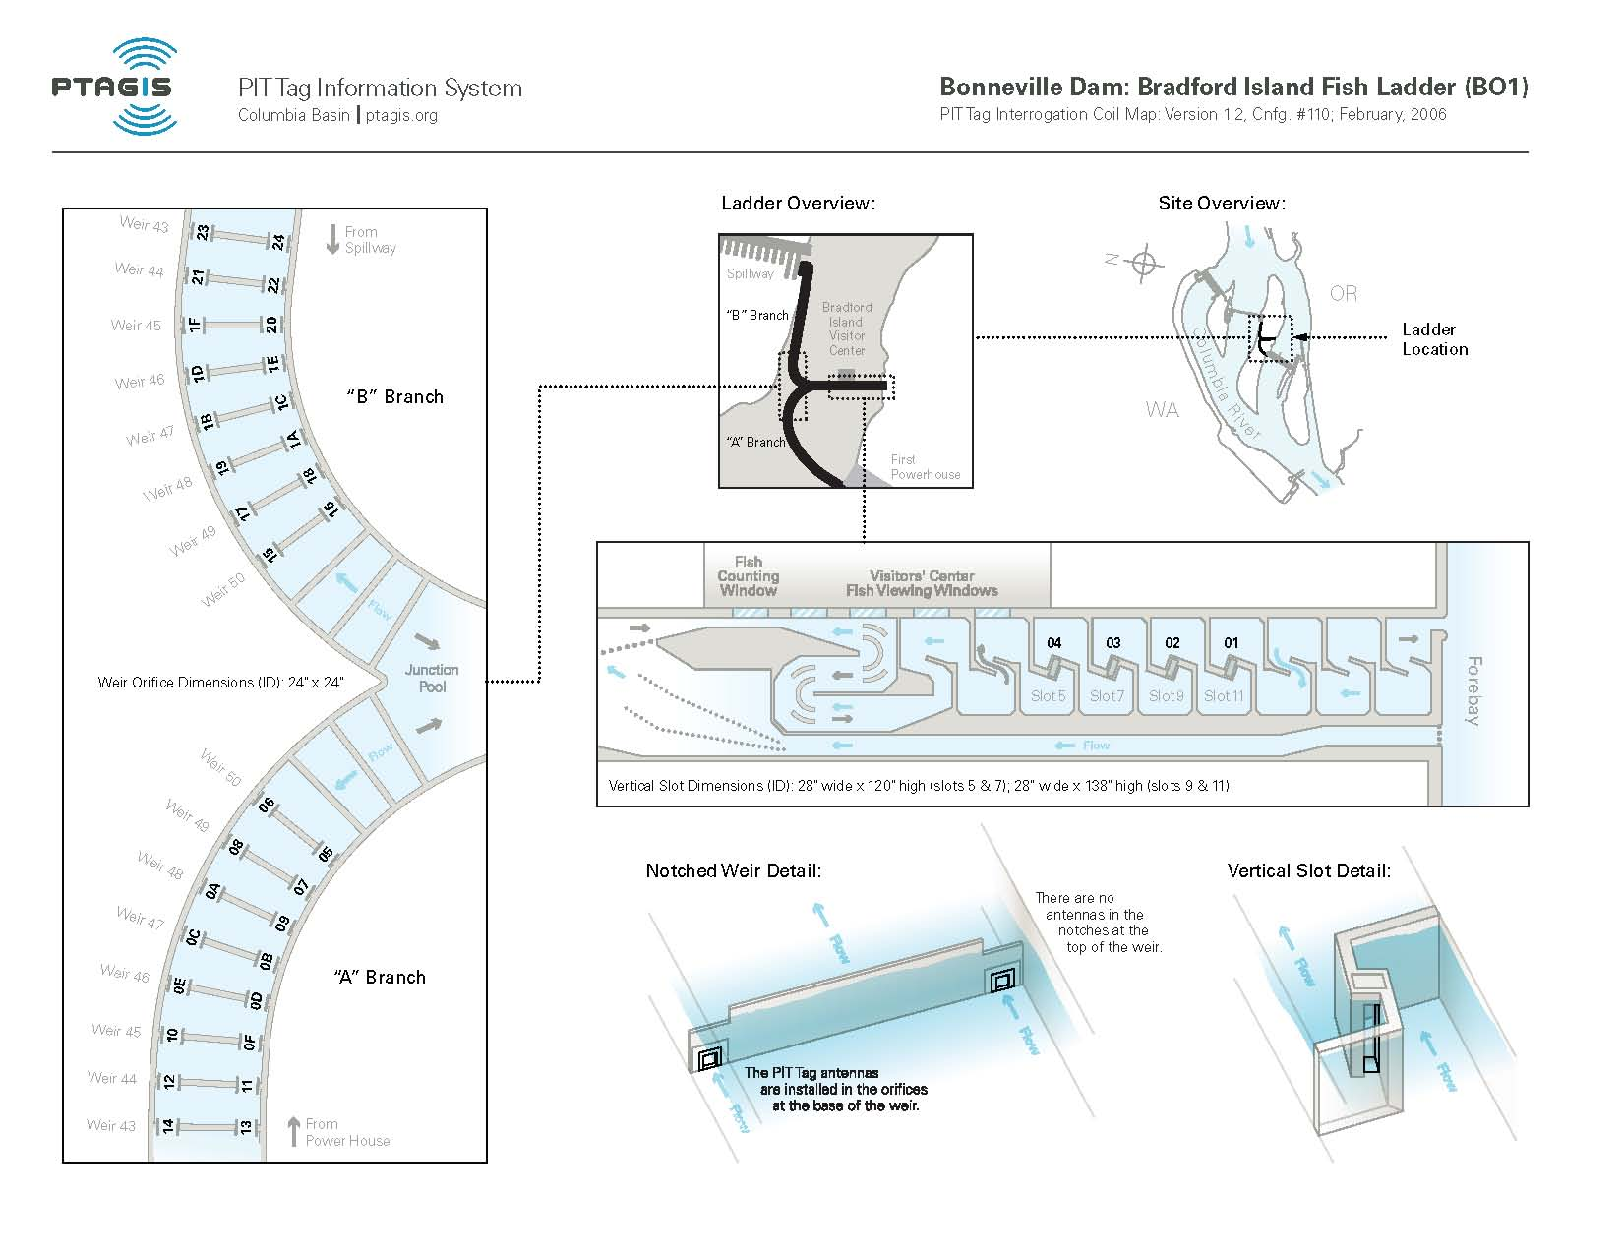
Site Illustration – Bonneville Bradford Island Ladder

Slide 34
Site Breakdown – Bonneville Bradford Island
In 2001, the “A” and “B” branches of the ladder were modified to accept the original style orifice antennas.
In 2006, the upper portion of the ladder was modified to accept four (4) large slot antennas.
Ladder Project Cost 600K
Large Slot Project Cost 1.38M
33 orifice antennas @6K ea. 198K
6 Large Slot antennas @20Kea. 120K
32 FS1001A Transceivers @6k ea. 192K
4 FS1001B Transceivers @6K ea 24K
PIT tag Data Electronics 10K
Total ~2.48M

Slide 35
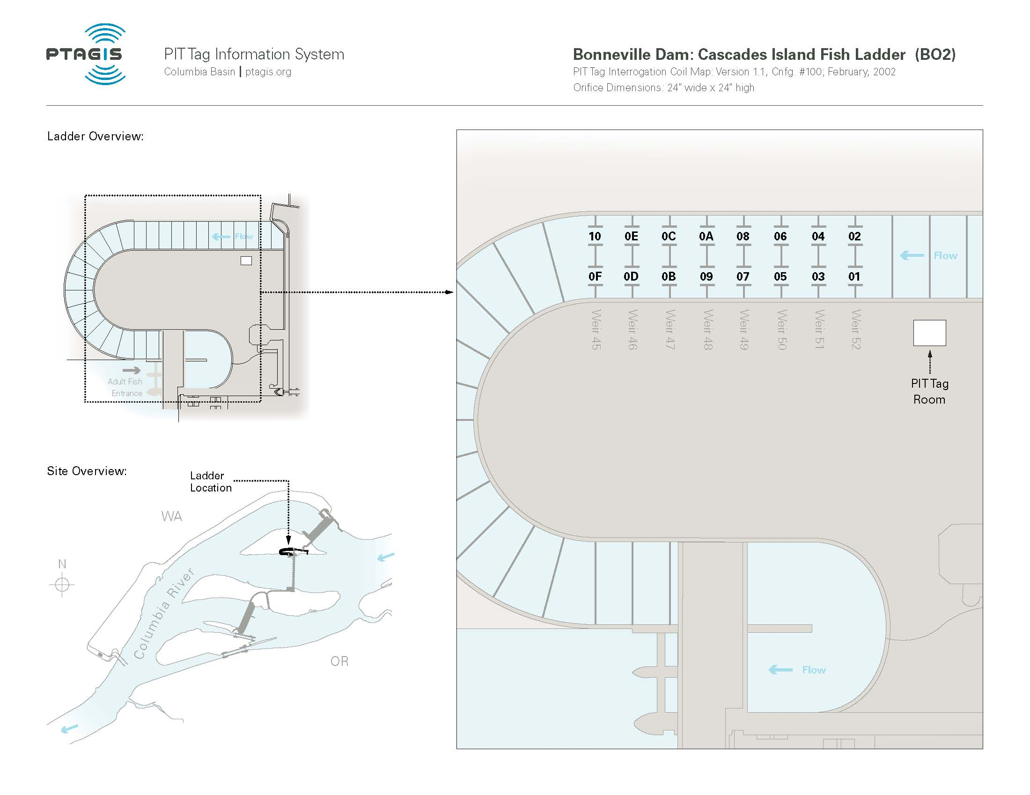
Site Illustration – Bonneville Cascade Island Ladder

Slide 36
Site Breakdown – Bonneville Cascade Island Ladder
In 2001, the ladder was modified to accept the original style orifice antennas.
Ladder Project Cost 600K
17 orifice antennas @6K ea. 102K
16 FS1001A Transceivers @6k ea. 96K
PIT tag Data Electronics 10K
Total 808K

Slide 37
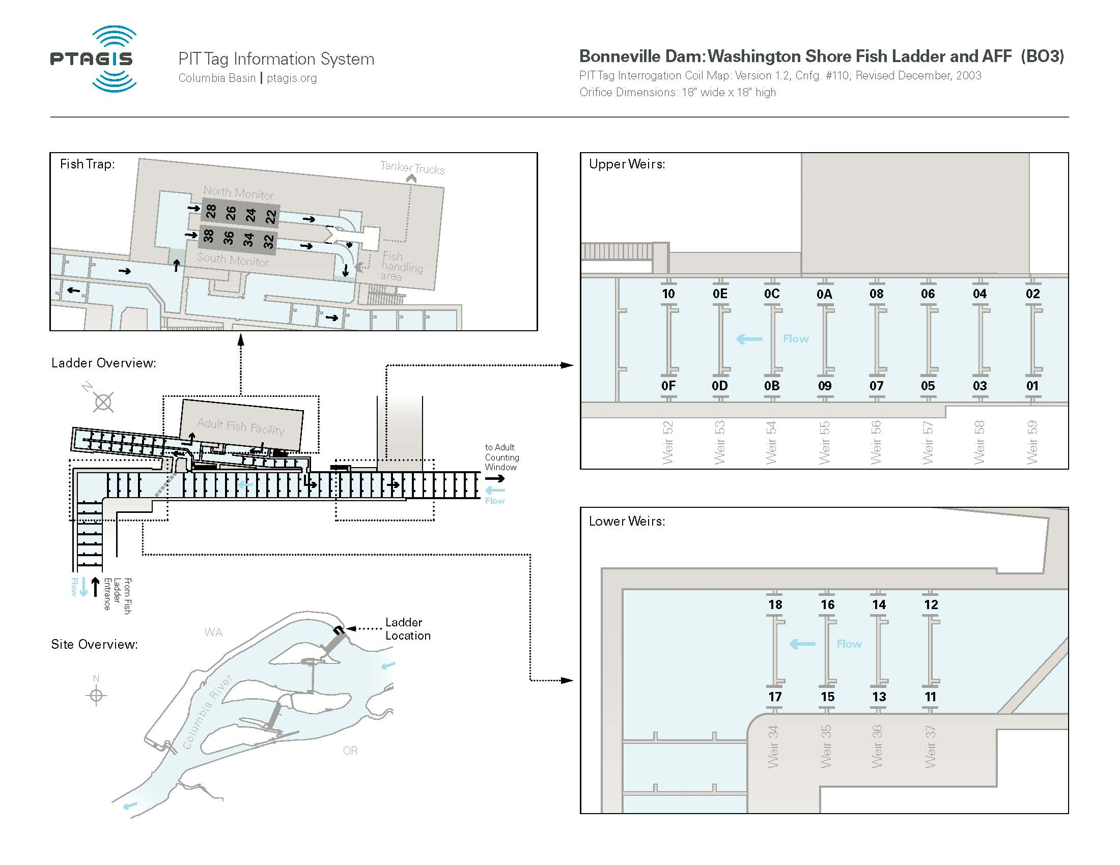
Site Illustration – Bonneville Washington Ladder

Slide 38
Site Breakdown – Bonneville Washington Ladder
In 2001, the Adult monitors in the AFF were modified to accommodate both the ISO system and the 400kHz systems.
In 2001, NMFS installed 20 of the original orifice antennas.
In 2002, these sites were combined into one interrogation site.
In 2003, the 400kHz system was removed and four (4) ISO systems were installed.
Ladder Project Cost 500K
25 Original Orifice Antennas @6K ea. 150K
4 (2) coil shielded monitors @7k ea. 28K
24 FS1001A Transceivers @6K ea. 144K
8 FS1001 Transceivers @6K 48K
PIT tag Data Electronics Room 15K
Total 885K

Slide 39
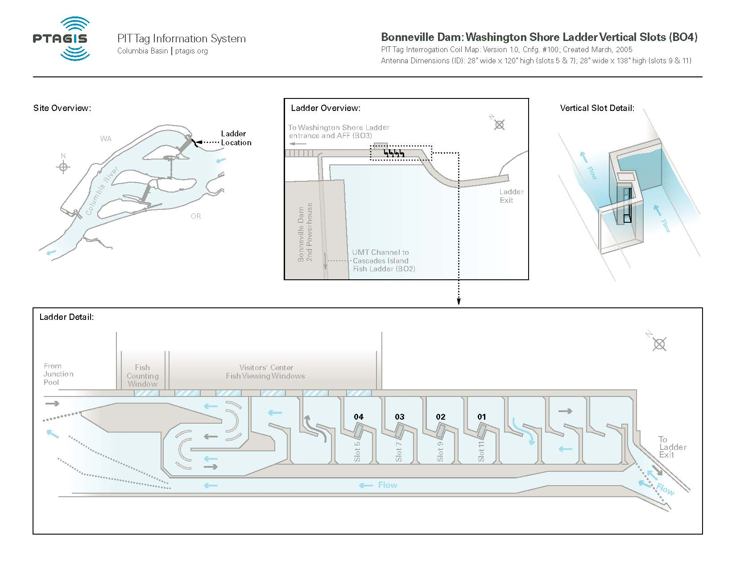
Site Illustration – Bonneville Washington Shore Slot

Slide 40
Site Breakdown – Bonneville Washington Shore Slot
In 2005, the upper part of the ladder was modified to accept 4 large slot style antennas.
Ladder Project Cost 1.3MK
6 Large Slot antennas @20K ea. 120K
4 FS1001B Transceivers @6k ea. 24K
PIT tag Data Electronics 10K
Total 1.45M

Slide 41
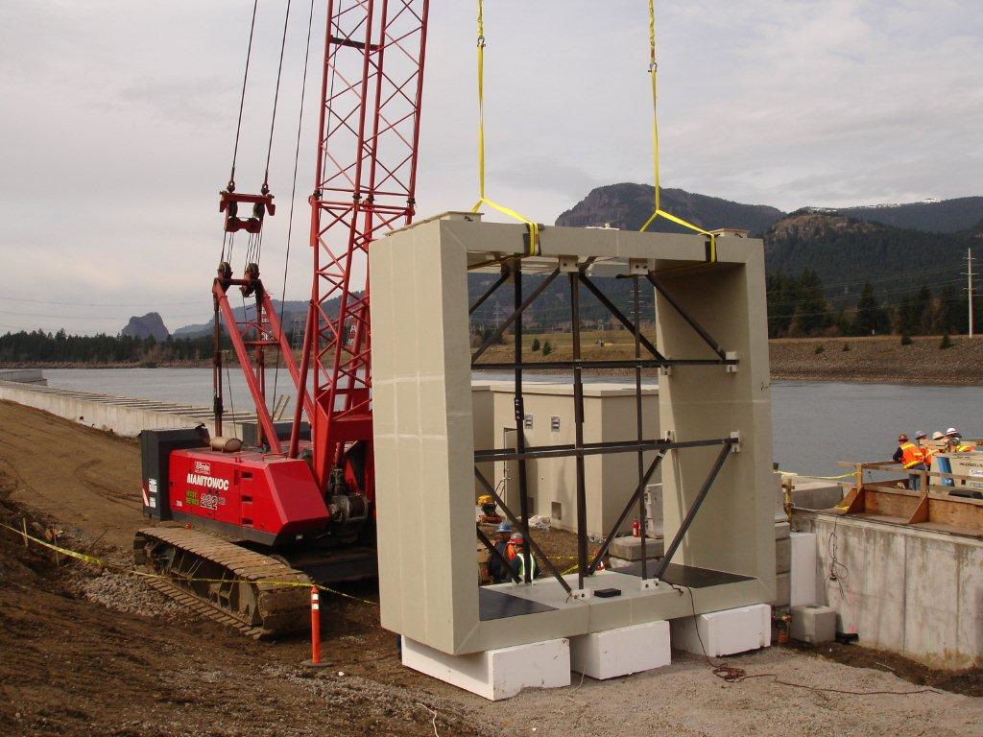
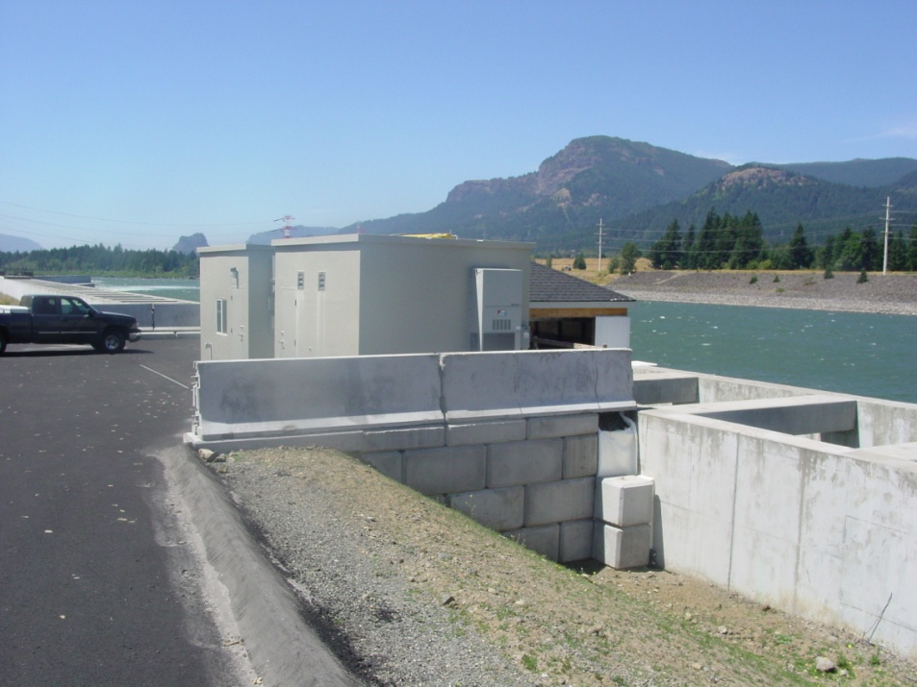
Bonneville Corner Collector
Bonneville Corner Collector antenna install on the left
Completed production image pictured on the right
Installed in 2006

Slide 42
Site Breakdown – Bonneville Corner Collector
Construction began in late 2005 and continued through early 2006.
The Data collection system was placed into production in April of 2006.
This is the largest PIT tag detection system to date.
BCC Project Costs 3.3M
BCC Antenna and Electronics ~1.7M
Total ~5M

Slide 43
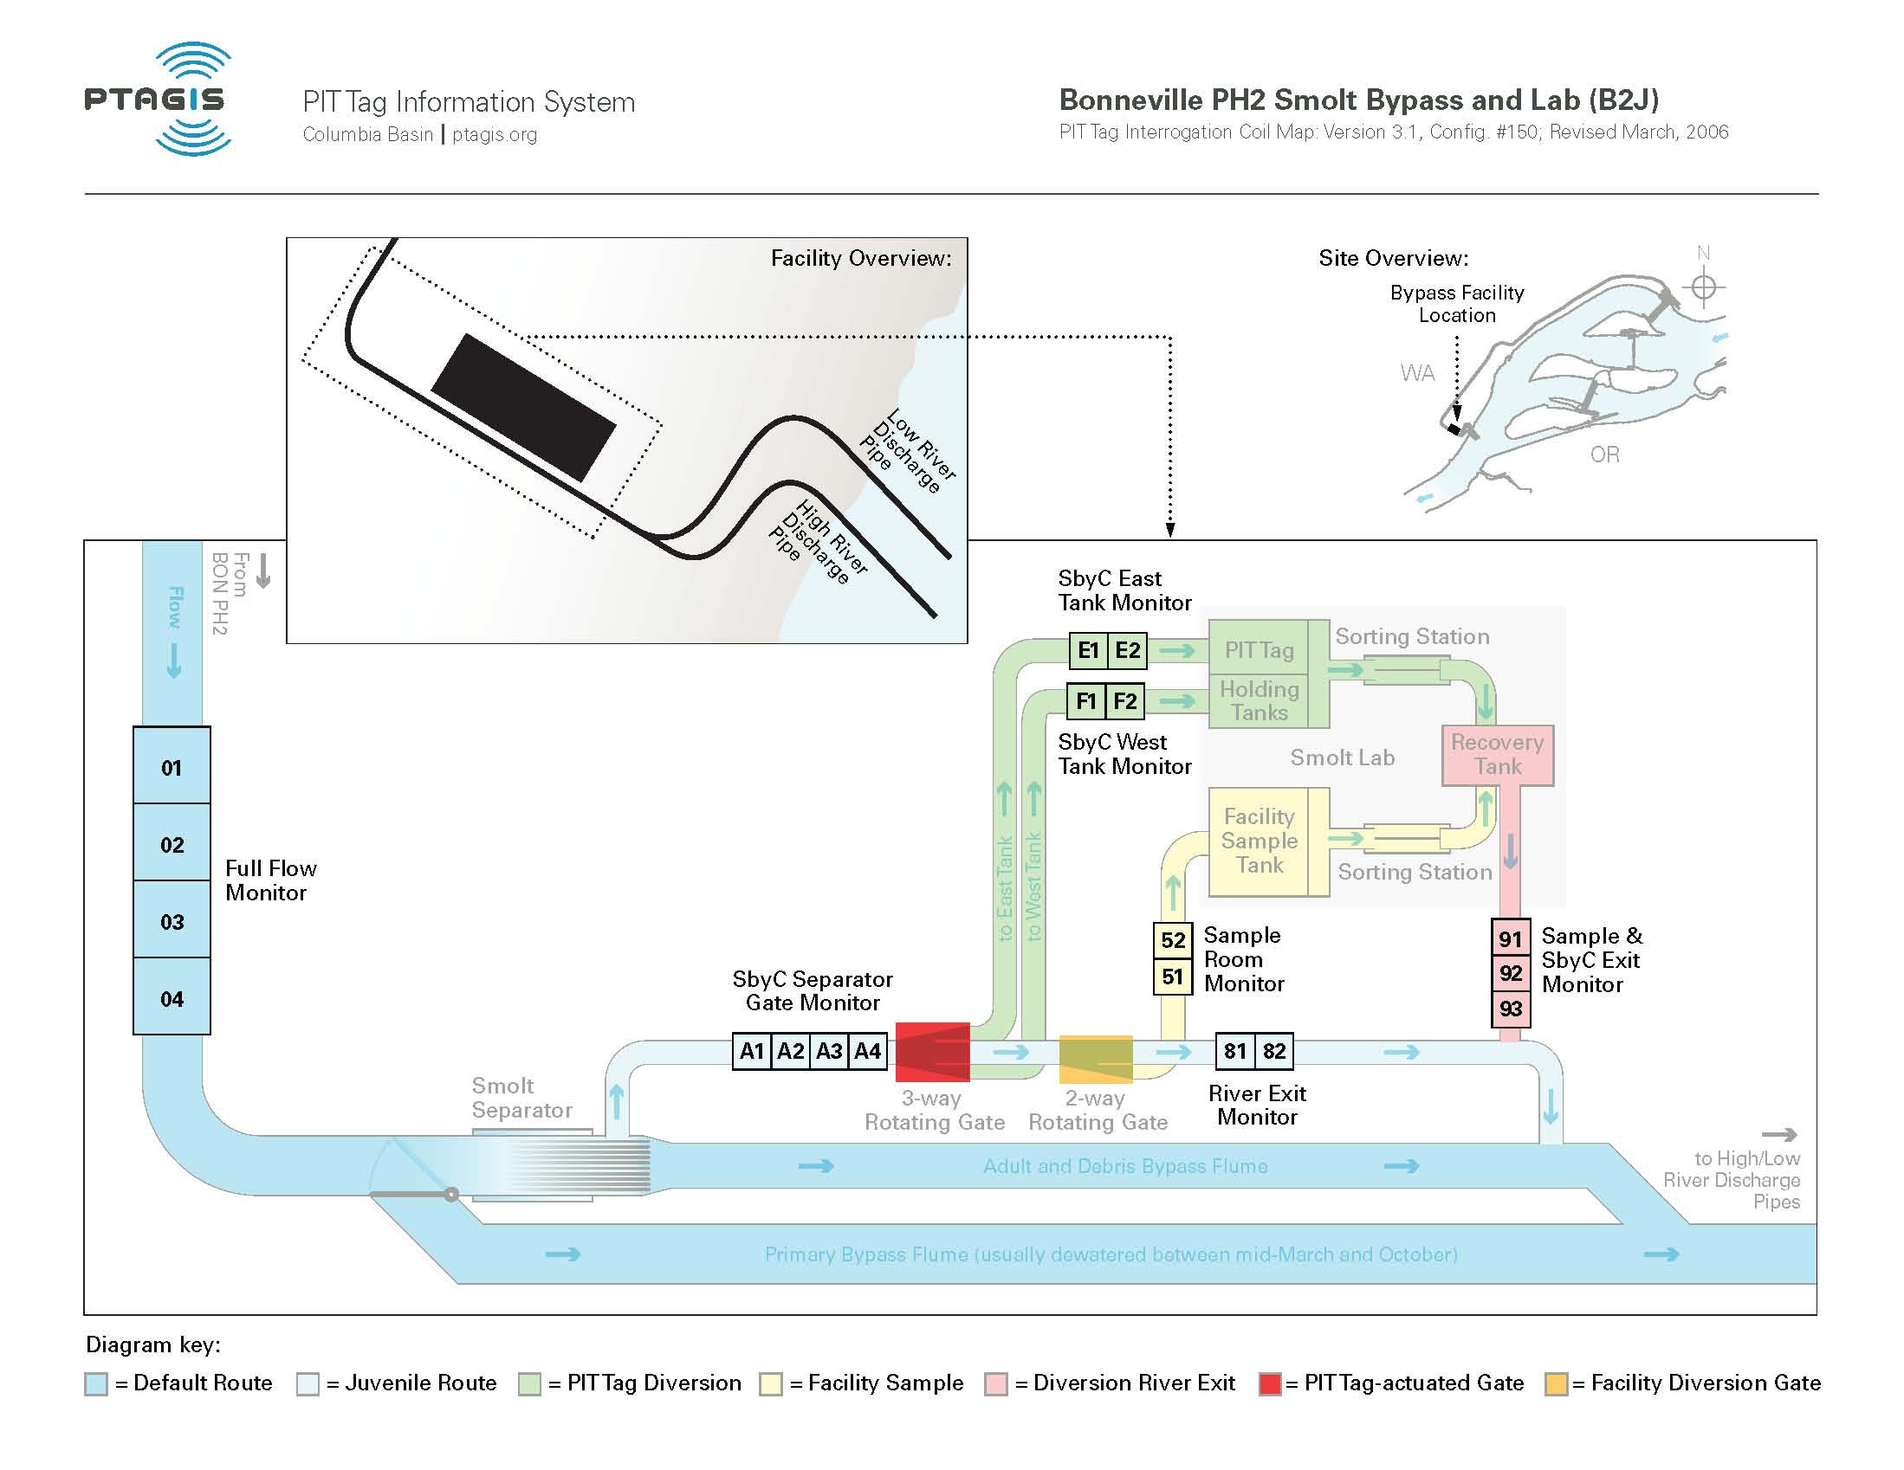
Site Illustration – Bonneville Juvenile

Slide 44
Site Breakdown – Bonneville Juvenile
In 2000, the ISO transition was completed after the Smolt Monitoring Facility was completed.
In 2001, a new Sample monitor was installed.
In 2006, the Full Flow detectors were installed.
Full Flow Project Cost 1.3M
8 (2) coil shielded monitors @7K ea. 56K
15 FS1001 Transceivers @6K ea. 90K
4 FS1001B Transceivers @6K ea. 24K
Programmable Logic Controller 9K
PIT tag Data Electronics Room 15K
Total 1.494M

Slide 45
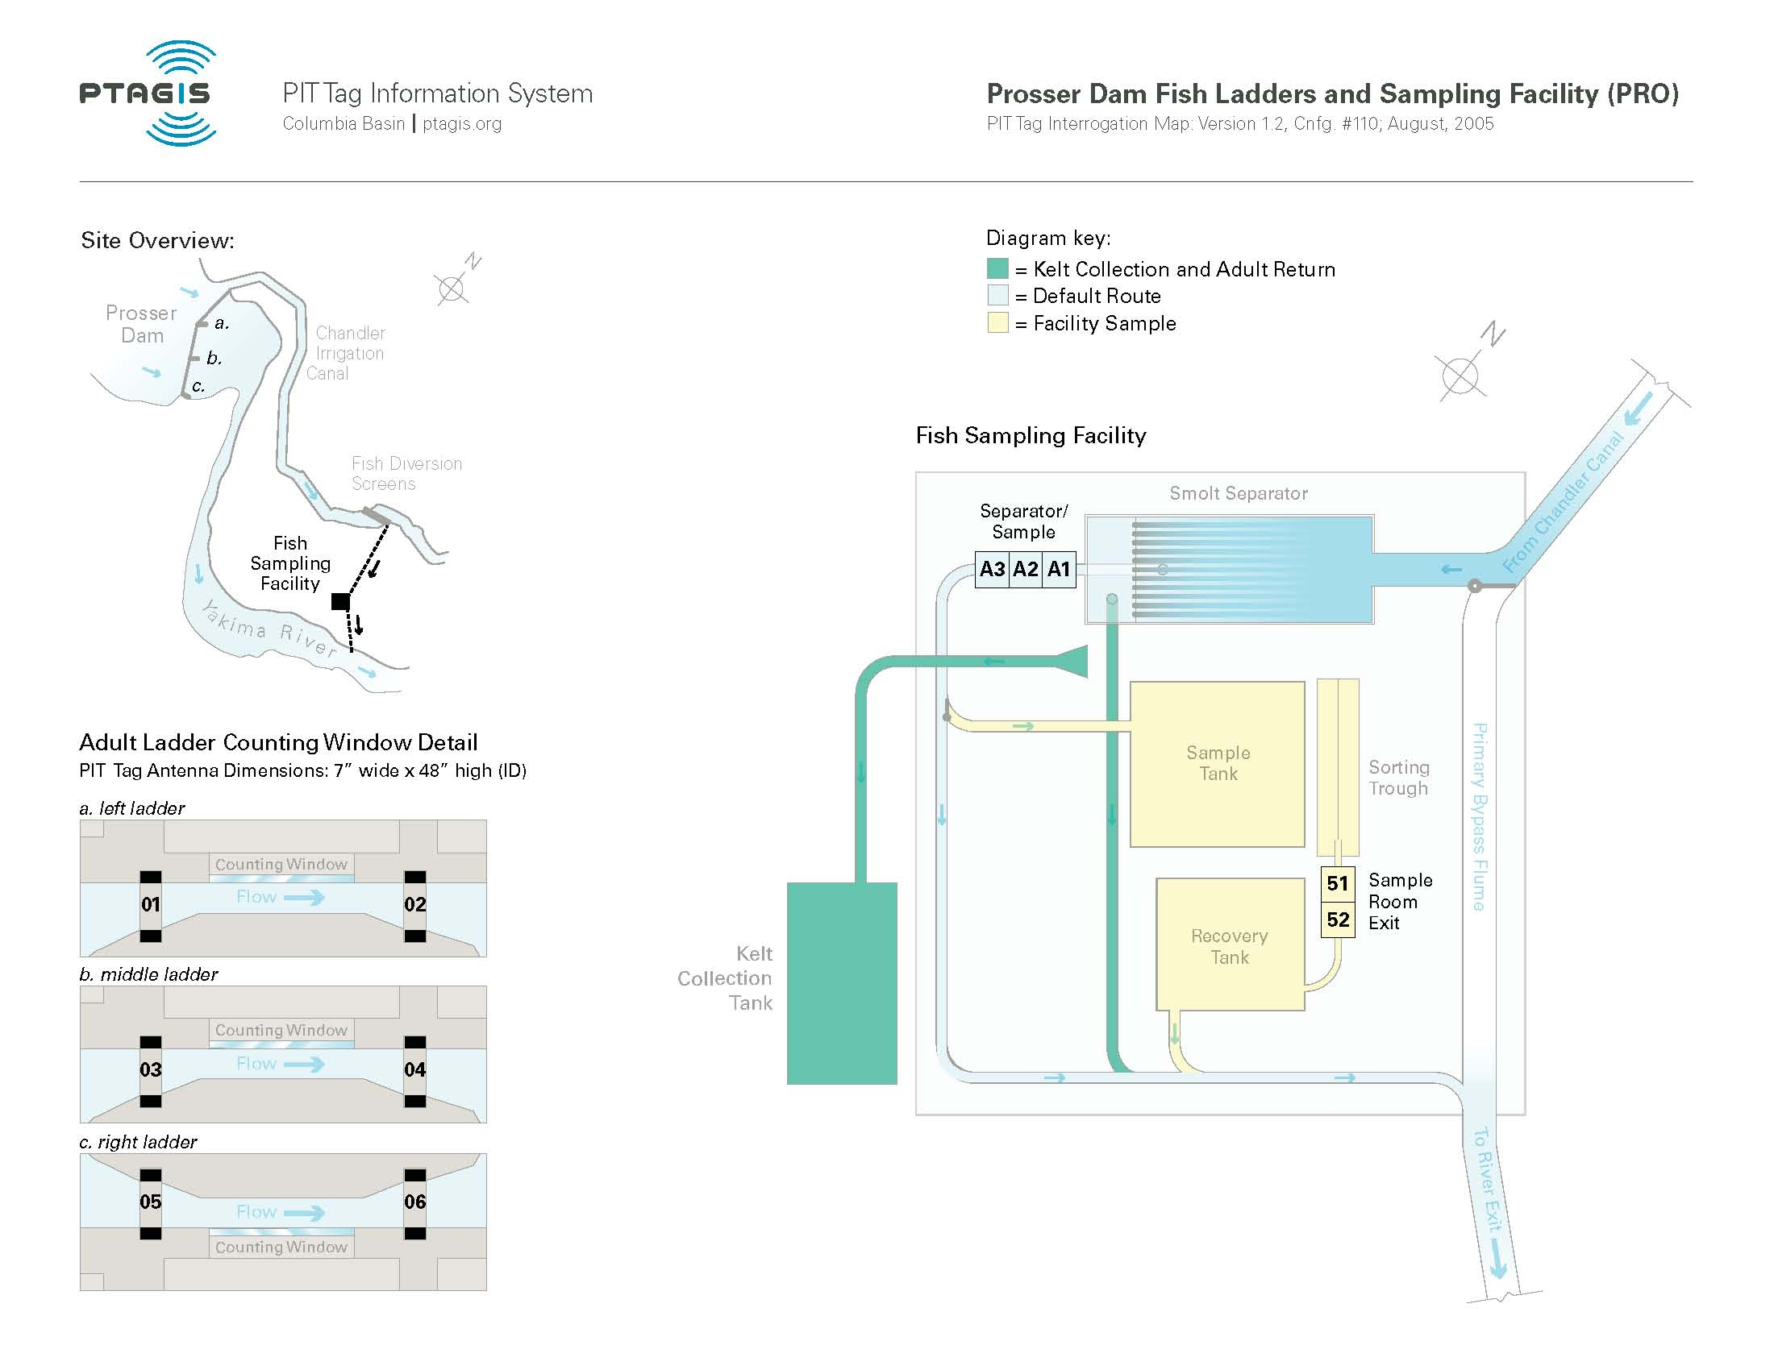
Site Illustration – Prosser

Slide 46
Site Breakdown - Prosser
In late 1999, the Juvenile facility underwent the ISO transition.
In 2004, the Left Bank Ladder Counting Window antennas were installed.
In 2005, the Center and Right Bank Ladder Counting Windows were installed.
Left Bank Ladder Project Cost 70K
Center and Right Bank Project Cost 130K
7 Small Slot Antennas @8K ea. 56K
3 (2) coil shielded monitors @7K ea. 21K
5 FS1001 Transceivers @6K ea. 30K
7 FS1001A Transceivers @6K ea. 42K
6 Electronic Enclosures @5K ea. 30K
14 Freewave Radio Modems w/Antenna @2k ea. 28K
PIT tag Data Electronics Room 15K
Total 422K

Slide 47
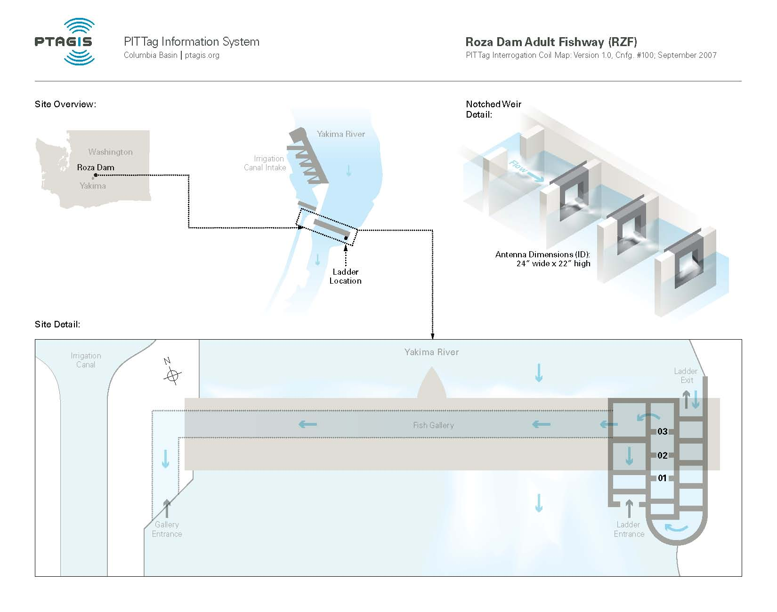
Site Illustration – Rosa Dam

Slide 48
Site Breakdown – Rosa Dam
In 2007, the Yakama Nation installed three (3) pass-through overflow weir antennas.
4 Pass-through Antennas @9.6K ea. 38.4K
4 FS1001A @6K ea. 24K
4 Electronic Enclosures @7K ea. 28K
Satellite Communications @1K ea. 1K
PIT tag Data Electronics Room 15K
Total 106.4K

Slide 49
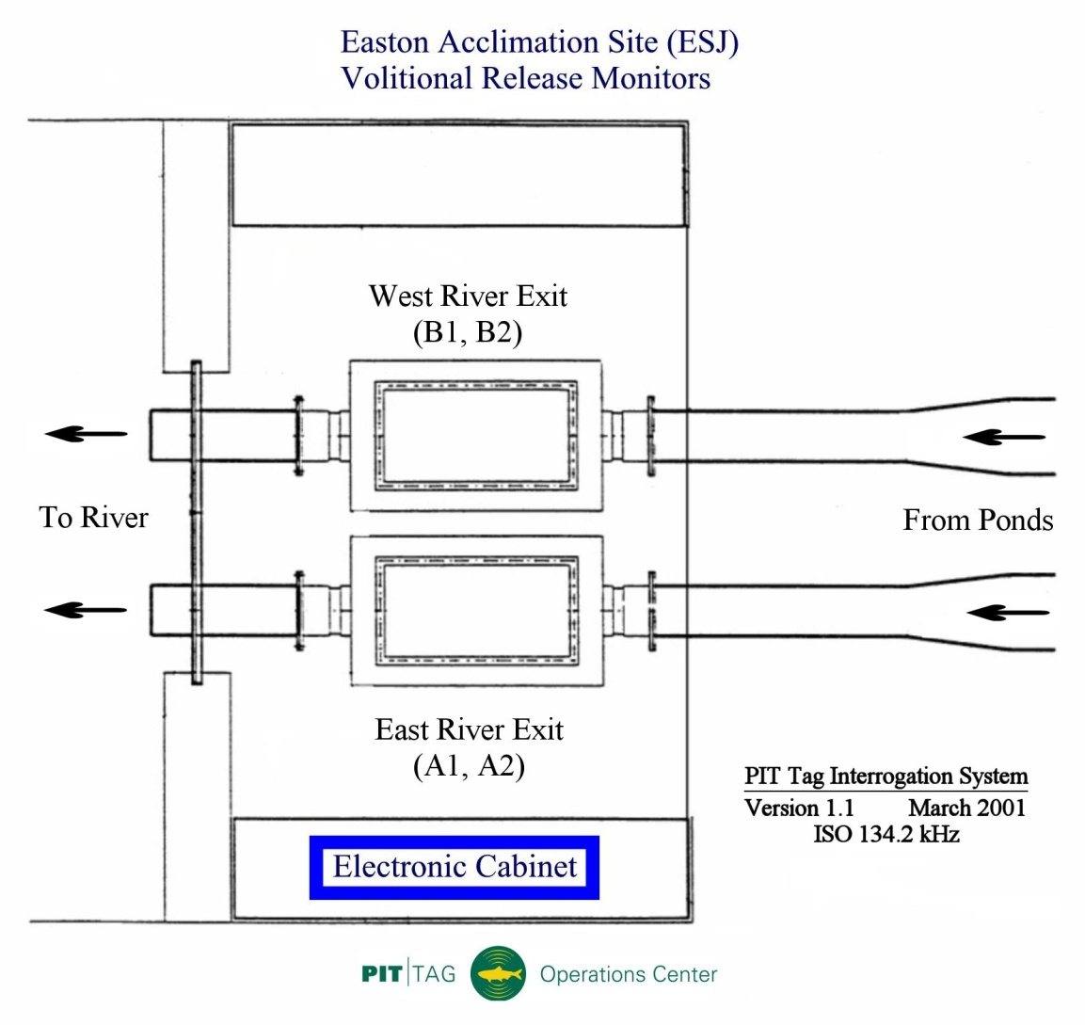
Site Illustration – Easton Acclamation Pond

Slide 50
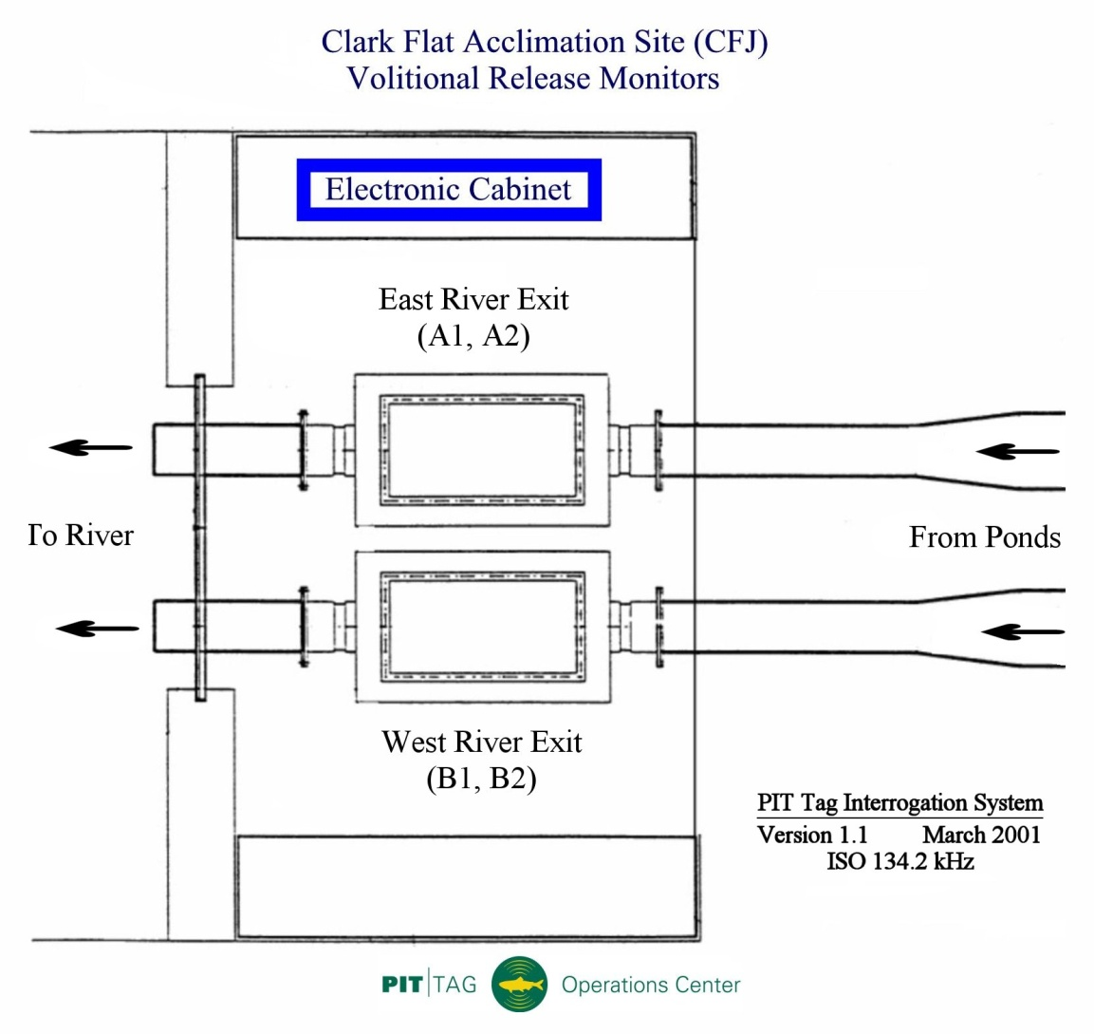
Site Illustration – Clark Flat Acclamation Pond

Slide 51
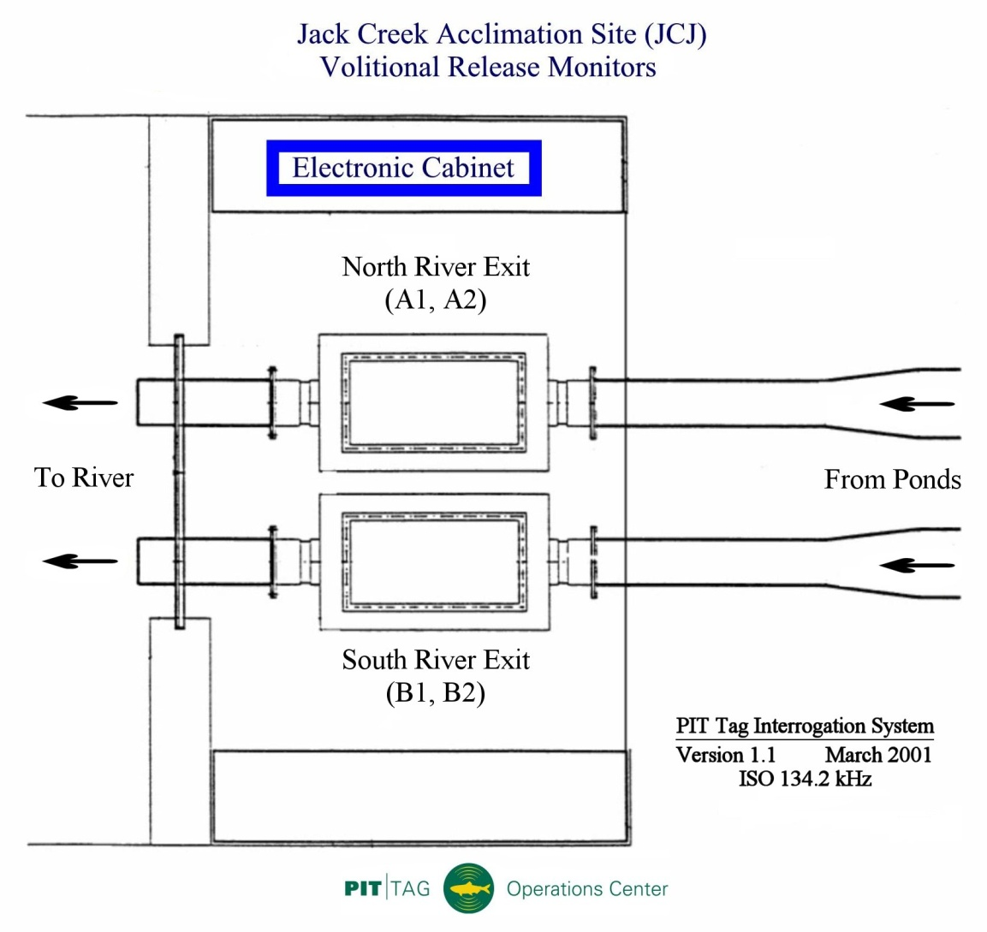
Site Illustration – Jack Creek Acclamation Pond

Slide 52
Site Breakdown – Yakama Acclamation Ponds
In 1999, all three (3) acclamation sites were setup with 400kHz detection equipment.
In 2000, Biomark installed the new ISO detectors.
In 2001, PSMFC was asked to take over O&M of the equipment.
2 (2) coil shielded monitors w/UPS’s @8K ea. 16K
4 FS1001 Transceivers @6K ea. 24K
Satellite Communications 1K
PIT tag Data Electronics 10K
Total for each facility 53K
Total for all three (3) 153K

Slide 53
Portland District Breakdown
Site Project Total($) Project Year
B2J 170K 2000
B2JFF 1.33M 2006
BO1 Ladder 994K 2001
BO1 Slot 1.45M 2006
BO2 802K 2001
BO3 885K 2001
BO4 1.45M 2005
Bonneville Corner Collector 5M 2005
JDJ 271K 2000
JDJFF 1.63M 2007
TOTAL ~14M

Slide 54
Walla Walla District Breakdown
Site Project Total($) Project Year
GRA 1.53M 2001/2003
GRJ 268K 2000
GOJ 304K 2000
GOJFF ~1M 2009
LMJ 331K 2000
LMJFF 1.13M 2007
ICH 1.59M 2003
ICHFF ~1M 2005
MCJ 376K 2000
MCJFF ~1M 2003
MC1 w/Counting Window 578K 2002
MC2 w/Counting Window 833K 2002/2006
Total ~10M

Slide 55
Yakama Nation Breakdown
Site Project Total($) Project Year
Cle Elum Acclamation Ponds 153K 2000
Prosser Juvenile (PRO) 66K 2000
Prosser Ladder (PRO) 356K 2005-2006
Rosa Dam (RZF) 85K 2007
Total 664K

Slide 56
Final Total
These figures were calculated using COE figures when possible but in some instances the figures needed to be approximate to the time frame in which the work was done.
Portland District $14M
Walla Walla District $10M
Yakama Nation $664K
Total ~$24.9M

