Slide 1

CEA 2045: Making Demand Response Cost Effective
Conrad Eustis
Portland General Electric
February 14, 2013

Slide 2
ANSI/CEA 2045
Consumer Electronics Association CEA accredited to create ANSI standards
Approved Dec. 26, 2012 after serious effort started in 2008.
USNAP, PNNL, Whirlpool, PGE, ERPI, NIST and a cast of 100s
Like a USB port for appliances (generically any major electric end-use). Provides:
  AC or DC to power a communication device
  Standard, basic serial data interface to transfer data
  Communication devices can be plugged in by consumer

Slide 3
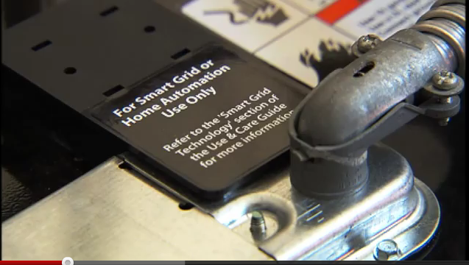
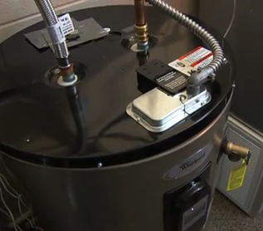
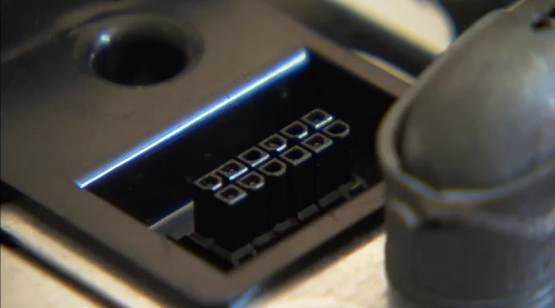
The Smart Water Heater not quite the standard
Available at Lowe’s, Today!
3

Slide 4
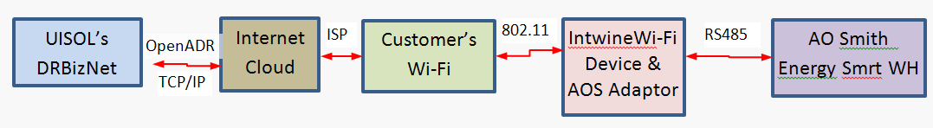
PGE’s Architecture for Pilot
PGE’s DRBizNet application (UISOL)
Wi-Fi Device & AOS Adaptor
Future Alternate:
Use PGE Smart Meter System
FUTURE:
Broadcast receiver would be added
Key Point: Any utility can pick the communication path of their
choice or support multiple options. E.g. FM broadcast provides a
privacy option. (e-Radio has access to 99.9 % of homes, today, through FM RDS)

Slide 5
Why Should you Care?
In a Sentence:
  Reduce cost of DR by at least factor of ten.
Example: Incremental cost at water heater $10 to $20. Communication devices in volume $15. As direct load control about at 0.6 kW contribution on peak; heat pump water heater in heat pump mode about 0.3 kW. Implies $35/.3 or $115/kW (compare to peak plant at $800/kW)
Northwest has 3.4 million electric water heaters and that number will grow as heat pump water heaters reach full stride
Can you say: 2,000 MW of peak load reduction at $100/kW?
But wait there’s more……

Slide 6
Water Heater 101
Top element has priority
Cold water dense, stays on bottom
Basic Idea: Keep top third of tank hot
Cycle heating on bottom element for load control
For Wind response:
  0 to 650 watts available entire 24 hours
For load shift:
  1,200 watts for 6 hours
←Cold Water In
→Hot Water Out
4 kWh to reheat
16 gal.
above
Upper Heat Element
4500 Watts
34 gal.
below
6.4 kWh to reheat
Lower Heat Element
4500 Watts

Slide 7
2,200 MW of Load Following Capability
More than 3,400,000 Water Heaters in Northwest
  Create 60 groups of 50,000 each
  300 watt average means cycle 4 minutes on-duration, and 56 minutes off duration in each hour
  Each group’s “on” time staggered by a minute
  Load of one group on = 50,000 * 4.5 kW = 225 MW
  Normally 4 groups on during any minute: 900 MW total
  However, each group’s actual cycle time can be decreased or increased using broadcast control messages
  Thus, total control range is easily 0 to 2,200 MW
  In back-office, control system software tracks total run time for each group, to ensure enough, and equal, “on” time for each group

Slide 8
21,000 MWh of Shapeable Load, Every Day
3,400,000 water heaters
6.4 kWh added between Midnight and 6am
At 1,200 watt cycle: “on” 16 minutes, “off” 44
Shift 21,000 MWh average load 3,600 MW
Flexibility to create any load shape
Basic principle: broadcast nominal “on” time duration before each group begins on-cycle,
Increase or decrease while “on” to tailor real time response

Slide 9

Manage Shape by Duty Cycle Request
7 min= shower, 6.3 min= Dishwasher, 4.3 min= Disk Sink, 2.4 min = Bath Sink
Before After
Smart Water
Heater operates
to keep top 3rd Hot
Black lines show minutes (left “y” axis) of hot water draw at 1.9 gpm

Slide 10
Call to Action, Now!
AHAM members (e.g. GE and Whirlpool) pushing at federal level for proprietary communications at device, translated with either special hardware, or only via broadband Internet connection.
AO Smith friendly to utilities approaches and CEA 2045 but under pressure to look more like AHAM
OEMs need at least regional scale and $10 to $20 per water heater to make all water heaters show up with CEA 2045. (cover incremental cost in a competitive market.)
Lost Opportunity: Get CEA 2045 sold ASAP, sign-up customers any time in next 15 years. NPV $130 mil with only 9% adoption by 2018 & 28% by 2025

Slide 11

The Numbers
 |  | 1.0038 |  | 1.6 |  |  |  |  |  |  |  | 12% |  | 150 | 6 |  |  | 7.0%
Yr | Year | Smrt WH (1000s) | Cum'l | % HtP WH | Increm & Rebate | Customers on Prgm |  | Prgm Sign-up Incnt | Comm Device | Ann'l Cust Incent | Sunk Cst | Cum'l Carrying cost | Prgrm Cst | MW | MWh | Value $1000s | Annual Cost | Net Benefit
0 | 2013 | 0 | 0 | 0.5% | $0 |  |  | $0 |  |  | $500 | $60 |  |  |  |  | PV=> | $132,199
1 | 2014 | 45 | 45 | 0.8% | $70 |  |  | $75 |  |  | $3,150 | $438 |  |  |  | $0 | $438 | -$438
2 | 2015 | 100 | 145 | 1.3% | $60 | 2% | 3 | $50 | $65 | $50 | $6,000 | $1,158 | $334 | 2 | 17 | $363 | $1,492 | -$1,128
3 | 2016 | 120 | 265 | 2.0% | $50 | 3% | 8 | $40 | $45 | $50 | $6,000 | $1,878 | $574 | 5 | 47 | $994 | $2,452 | -$1,458
4 | 2017 | 180 | 445 | 3.3% | $40 | 5% | 22 | $25 | $35 | $50 | $7,200 | $2,742 | $1,256 | 13 | 132 | $2,772 | $3,998 | -$1,225
5 | 2018 | 213 | 658 | 5.2% | $20 | 9% | 59 | $25 | $30 | $50 | $4,250 | $3,252 | $3,143 | 35 | 349 | $7,336 | $6,395 | $941
6 | 2019 | 213 | 871 | 8.4% | $20 | 14% | 122 | $25 | $25 | $50 | $4,266 | $3,764 | $6,096 | 72 | 715 | $15,017 | $9,859 | $5,157
7 | 2020 | 214 | 1,085 | 13.4% | $20 | 17% | 184 | $25 | $20 | $50 | $4,282 | $4,278 | $8,909 | 107 | 1,072 | $22,513 | $13,187 | $9,326
8 | 2021 | 215 | 1,300 | 17.4% | $20 | 20% | 260 | $25 | $20 | $50 | $4,298 | $4,794 | $12,620 | 150 | 1,497 | $31,428 | $17,414 | $14,015
9 | 2022 | 216 | 1,515 | 22.7% | $20 | 22% | 333 | $25 | $15 | $50 | $4,314 | $5,311 | $15,936 | 190 | 1,899 | $39,873 | $21,247 | $18,625
10 | 2023 | 217 | 1,732 | 29.5% | $10 | 24% | 416 | $25 | $15 | $40 | $2,165 | $5,571 | $16,627 | 234 | 2,337 | $49,079 | $22,198 | $26,881
11 | 2024 | 217 | 1,949 | 35.4% | $10 | 26% | 507 | $25 | $15 | $40 | $2,173 | $5,832 | $20,273 | 281 | 2,811 | $59,029 | $26,105 | $32,924
12 | 2025 | 218 | 2,167 | 42.5% | $10 | 28% | 607 | $25 | $15 | $40 | $2,181 | $6,094 | $24,276 | 332 | 3,316 | $69,632 | $30,369 | $39,263
13 | 2026 | 219 | 2,386 | 51.0% | $10 | 29% | 692 | $25 | $15 | $40 | $2,190 | $6,356 | $27,683 | 372 | 3,718 | $78,081 | $34,039 | $44,042
14 | 2027 | 220 | 2,606 | 61.1% | $10 | 30% | 782 | $25 | $15 | $30 | $2,198 | $6,620 | $24,354 | 412 | 4,121 | $86,542 | $30,974 | $55,568
15 | 2028 | 221 | 2,827 | 65.0% | $10 | 30% | 848 | $25 | $15 | $30 | $2,206 | $6,885 | $26,103 | 439 | 4,389 | $92,170 | $32,988 | $59,182

Slide 12
Timeline & Milestones
2013
  100-home PGE-Customer Pilot
  Regional stakeholder strategy for market transformation
2014
  AO Smith makes CEA 2045 option available
  Find way so only CEA2045 water heaters sold in NW
  Customer education, enroll customer
  Research best control strategy with heat pump water heater
  Develop Customer Programs
  Develop back office control application
2015
  Rheem and others not far behind?!
  Launch Basic control Program at scale

Slide 13
Questions
Conrad Eustis
503 464 7016
Conrad.eustis@pgn.com

