Slide 1

Emerging Technology Update
Presented To
Conservation Resources
Advisory Committee
June 4, 2014
Jack Callahan, P.E.,CMVP
Senior Engineer
Bonneville Power Administration
May 16th, 2014

Slide 2

Emerging Technology Pipeline
“Chasm” between emerging technologies and utility programs
Dashed:
Optimal Cumulative Effect of Successive Technologies
“Chasm” between R&D and emerging technology programs
Green:
Adoption Rate of Single Technology
Time
R&D
Commercial Introduction
ET Field Tests
Programs
1 2 3 4 5 6 7 8 9
U.S. Dept. of Energy
Technology Readiness Levels (TRLs)
1 2 3 4 5 6 7 8 9
Bonneville Power Administration
Measure Readiness Levels (MRLs) [DRAFT]
~3 to 20 years
0 to ~3 years
R&D programs tracked in the National Energy Efficiency Technology Roadmap Portfolio
Emerging technologies programs such as BPA’s Energy Efficiency Emerging Technology (E3T) team and the E3TNW.org database
Utility programs in the residential, commercial, and industrial sectors

Slide 3




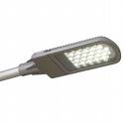
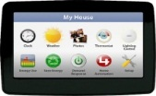
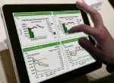

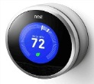
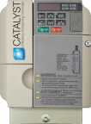
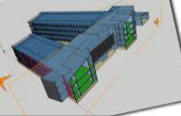
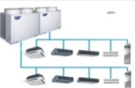
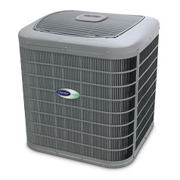


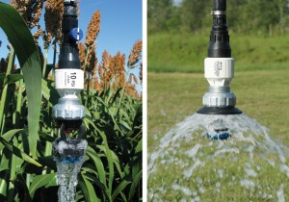
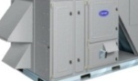
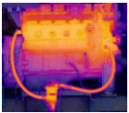
The ET Pipeline in Action
R&D TRL’s
Commercially Available Products – “Measure Readiness Level”
7
8
9
6
5
4
3
2
1
Concept
Lab/ Field testing
Pilot and Programs
200+
BPA Potential 20 Yr. (MWa)
5
3
Notes:
We have projects at various stages of readiness for programs. On the left side of this chart, we start with commercially available products, with a concept for how they might fit into incentive programs.
Over time, products move along the timeline from left to right. At the right side of the chart, some of the products move into utility incentive programs.
The vertical axis of the chart shows the potential for regional energy savings, of the various technologies.
As products move from the ‘concept validation’ column on the left to the ‘lab and field tests’ column in the middle, and then to the ‘pilot program and deployment’ column on the right, this usually involves multiple projects. Before each new project begins, the product is evaluated to make sure it’s still on track, for eventually moving into programs. This process, of frequent evaluation between short projects, emulates the Technology Innovations best practice of stage gates. Some products don’t make the cut, so they are dropped from further projects, before ever reaching programs. This process emulates the Technology Innovations best practice of pruning. Here’s an animation to show how the process worked in 2013…

Slide 4
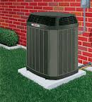
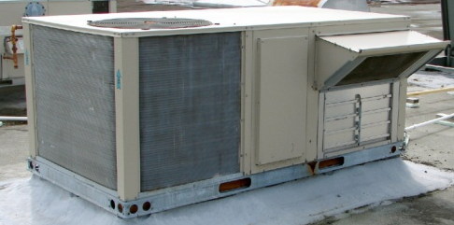
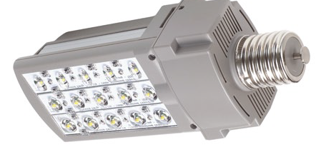
BPA Emerging Tech Focus Areas
  VCHP - Variable Capacity Heat Pump
  RTU - Rooftop Unit (HVAC)
  EM - Energy Management
  LED - LED Lighting & Advanced Controls
Notes:
These are the areas that we are focusing our emerging technology efforts on because we see the greatest potential here.

Slide 5
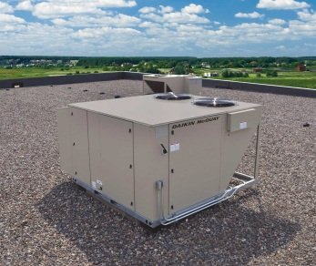
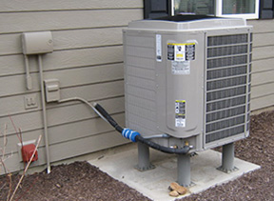
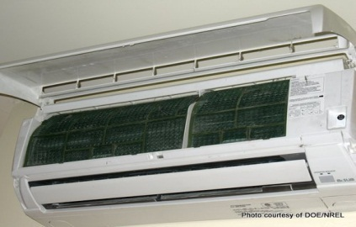
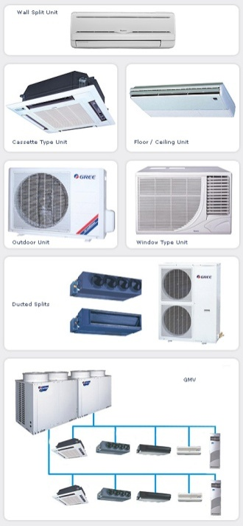
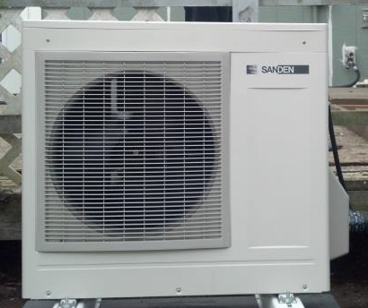

1. Variable Capacity Heat Pumps
Residential Variable Capacity Heat Pump
Advanced Rooftop Unit
Ductless Heat Pumps
Manufactured homes
Forced Air Homes
Cold Climates
CO2 Heat Pump Water Heater
VRF Systems

Slide 6
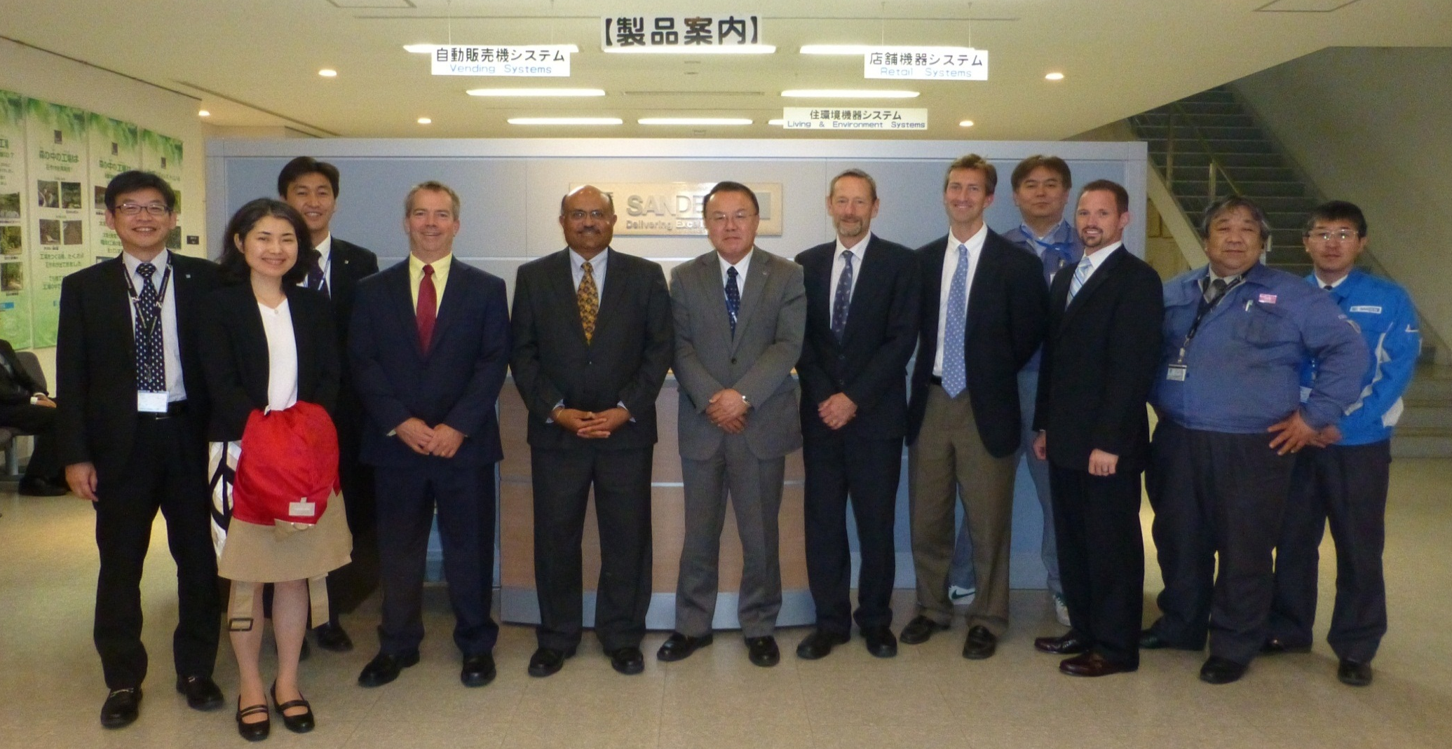
EPRI / BPA / Duke Energy / Southern Company
Energy Efficient Technology Review Trip to Japan
Daikin, Mitsubishi, Mayekawa, Sanden
April 14-19, 2014
Notes:
Sponsored by EPRI – Bring Japanese Manufacturers and US Utilities together
Gain knowledge on new technology
Expand relationship with world class vendors who manufacture energy efficient products.
Influence new product design to meet the particular needs of the BPA region.
Bring new energy efficient technology to BPA territory.

Slide 7
Personal Observations on
Japanese HVAC Manufacturers
Environmental responsibility
Energy efficiency
Global markets: Many international products not available in the US.
Expecting more Japanese HVAC technologies in the US HVAC market.
Products must match market needs.
Notes:
Products are introduced to US when a clear market need is identified, understood, and a suitable product developed.
Good examples are Eco Cute for Japanese homes, and Daikin Altherma for European homes.

Slide 8
Some Key Japanese HVAC Technologies
Inverter driven heat pumps
EcoCute Transcritical CO2 Cycle Heat Pump Water Heaters
Low GWP Refrigerants – CO2, R 32, Ammonia
Innovative Technology
  Improving Compressors and Heat Exchangers
  Adaptive control with occupancy and infrared sensors

Slide 9
Some Products of Interest for EE
2015
Sanden EcoCute CO2 residential split-system HPWH
Residential forced air inverter heat pump (Daikin/Goodman, Carrier, Trane, Lennox)
Commercial/Industrial Eco Cute (air-to-air, and water-to-water)
Mitsubishi Hyper Heat (100% Capacity 5 degrees F)
Packaged Ammonia/CO2 Supermarket Refrigeration
Hybrid VRF / water loop fan coil
Residential DHW / DHP combo unit
Notes:
Mega Q
Utilizes dual refrigerant pipes that maximize the characteristics of two types of HFC refrigerant, R410A and R134a. Achieves COP 4.0 for boiling and COP 3.0 during circulation and heat retention.
22% less energy required per year for water heating and heat retention (compared to previous model).
Heat source device has circulation and heat retention functions so the new MEGA-Q requires no reheating unit for pipe heat retention and no electric heater for tank heat retention.
Operates at a wider temperature range; at outside temperatures as low as -20°C (for extremely cold regions).

Slide 10
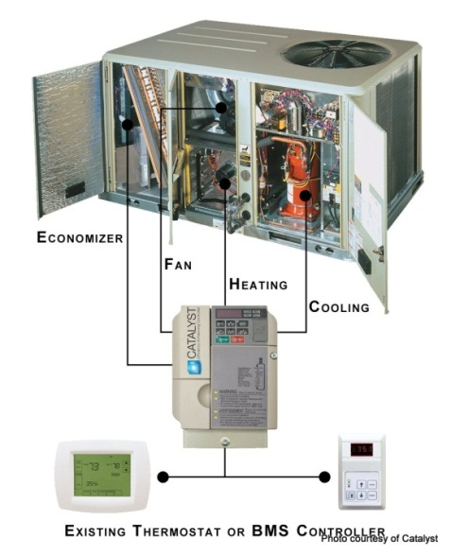
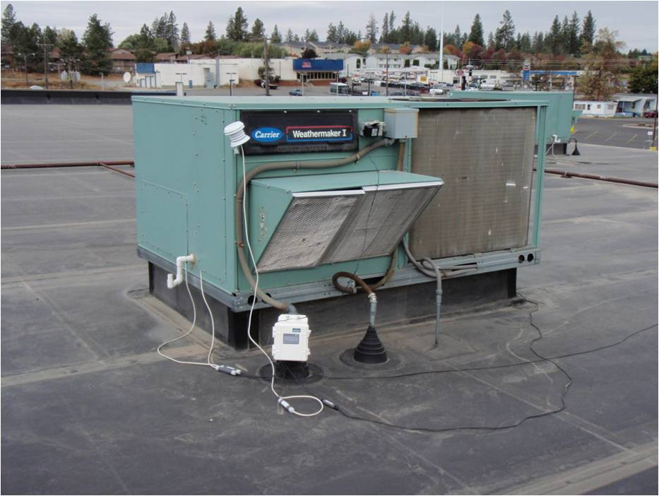
2. Rooftop Units (RTUs)
Why we chose this focus area
  RTUs serve >50% of the conditioned commercial space in the PNW
Technology
  Advanced Retrofit Controller
    Commercially successful
    Remote monitoring and M&V
    Saves ~ 50%
  Advanced Rooftop Units
    Variable Capacity
    IEER > 18
    Diagnostics
    Multiple Manufacturers

Slide 11
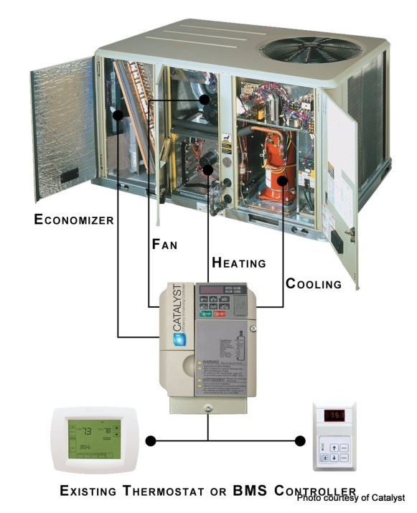
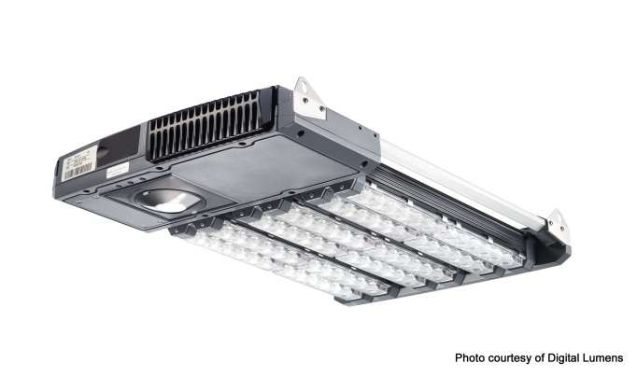
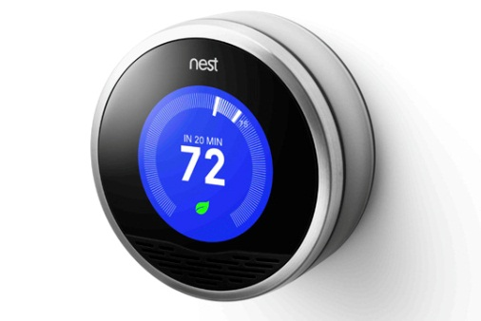
3. Energy Management: Smart Connected Devices
Low cost, high resolution, real-time, large scale performance data.
Feedback used by manufacturers and providers for performance improvements.
Notes:
Leverage the powerful wireless and Internet data aggregation capabilities providing high resolution, large scale performance data at very low cost.

Slide 12
Smart Thermostats
The Hype
Intelligent, internet connected thermostats promise deeper and more persistent energy savings.
  …but will these savings occur in the real world?
  …and how will we know?
The Hope
Collect high resolution real-time data at low cost
Aggregate large data sets and analyze
Use data to verify & improve thermostat performance.
Notes:
For definition, characteristics of “smart thermostats” include digital technology with sufficient sensors and processing to perform advanced functions, such as adaptive control of temperature set points. We believe there is a key factor that differentiates this generation of smart thermostats from earlier programmable thermostats: It is now possible for a vendor to actively collect real-time performance data and use this data to measure and improve as-installed thermostat performance. This unprecedented data allows rapid testing and improvement of optimization algorithms and other control features. Compare this to previous products, where large scale field testing of product performance was not at all practical. Indeed, after more than a decade, the actual performance of programmable thermostats is still an open question. With Internet connected smart thermostats, new software-based improvements can be downloaded to existing smart thermostats rapidly and cheaply.

Slide 13
Aggregated Thermostat Data
for 900 networked thermostats in the Pacific Northwest
by hour of day, 2/1/14 to 2/28/14
Preliminary Analysis

Slide 14

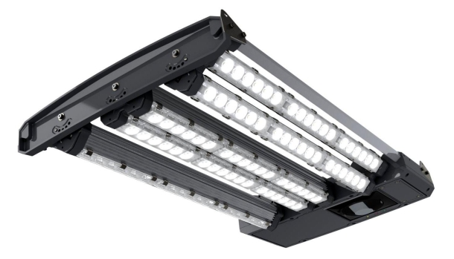
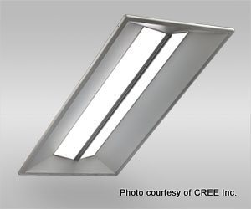
4. LED Lights ramping up in Programs since 2013
PAR lamps
Streetlights / Parking lot lights
High Bay
Office ambient
Exterior: Wallpack, Yard lights

Slide 15
LED Lighting, Future Attractions
Fixture efficacy of 200+ lumens per watt will replace fluorescents & remaining HID
Costs Declining
Advanced Lighting Controls
  Networked, multi-function, fixture level control
  Cheaper, more reliable controls will save 30% to 90%, someday

Slide 16
Conclusions
Many promising new technologies for energy efficiency.
BPA emerging technology focus areas include:
  Energy Management: Smart Connected Devices
  Variable Capacity HVAC
  Advanced Rooftop Unit HVAC (RTU)
  LED Lighting
A long & uncertain path to regional energy savings
  Technical Potential – 35%
  Market Potential – 26%
  Program Delivery Potential – 25%

Slide 17
Contact Info
Jack Callahan, P.E., CEM, CMVP
Senior Engineer
Bonneville Power Administration
jmcallahan@bpa.gov
503-230-4496
www.bpa.gov/energy/n/emerging_technology/
www.e3tnw.org

