Slide 1

CWTs and the Chinook Fishery Regulation Assessment Model (FRAM)
Pete McHugh
Washington Dept. of Fish & Wildlife
10 May 2012
Notes:
Intro…caveat my presentation briefly based on my experience and knowledge lying primarily in Puget Sound, although I’m growing out my info base on Columbia River, Chinook primarily—but highlight coho…

Slide 2
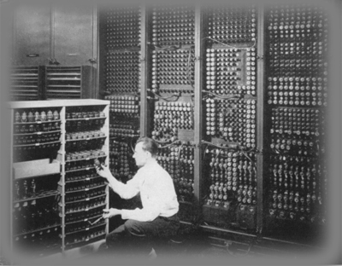
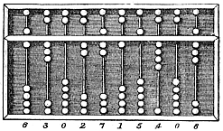
What is FRAM?
Fishery impact assessment tool:
  Used in annual ocean salmon season-setting process (PFMC)
  Forecasts & fishing plans
  Post-season use, e.g., to estimate impacts for ESA-listed stocks
  Other uses
Uses ‘74-79 CWT data for core stocks, plus recent data for stocks not tagged in early years
  N _{t} = abundance scalar x N _{bp}
  C _{t} = effort scalar x N _{t} x ER _{bp}
Notes:
Other uses, e.g., effects of hatchery production changes
SRKW application
MSF evaluations
Major model inputs:
Stock specific exploitation rates derived from recoveries of coded-wire tags during the base period (1974-1979 brood years); modified to account for stocks not tagged in the base period
Non-landed Mortality Rates
Natural Mortality Rates
Maturation Rates
Growth Parameters
Major assumptions:
Geographic distribution of stock is constant and equal to base period
Hatchery and natural stock components are equally catchable
Tagged fish accurately represent modeled stock
Growth rates and maturation rates are constant from year to year
A single pool of fish exists for each stock which can contribute to all fisheries
Natural mortality rates are constant from year to year
40K+ units of estimation for a given annual simulation

Slide 3
What does FRAM do?
Computes impacts of 68 mixed-stock marine fisheries on 38 stock aggregates, by age:
  Landed catch
  Non-landed fishery mortality
  Exploitation rates (w/o FW)
  Run sizes
Facilitates fishery planning under complex, multi-stock objectives
Notes:
Can obtain estimates of impacts by stock, age, fishery, & time step—important to identify age, as this is a key piece of info that you can get from CWTs but not GSI (w/o error).

Slide 4
FRAM’s role in the coast-wide fishery planning process
Pacific Salmon Commission’s
CTC Chinook Model
Inputs for FRAM’s Alaska & Canada fisheries
FRAM
Terminal run sizes
Terminal Fishery Models
Notes:
Describe CTC Chinook model—based on similar data, lots of overlap in CWT groups used to develop model BUT is a very different model...
Worth mentioning that there’s a range of sophistication with how FRAM interacts with terminal models, e.g., Puget Sound is very tight, WA Coast is footloose and fancy free, Columbia is okay for some stocks (e.g., Coweeman spreadsheet)…

Slide 5
FRAM & Columbia R. Chinook
Includes 10 Columbia stocks: Lower river hatch. & nat. tules, Upriver brights (Snake fall), Upriver summers, Lower river springs & brights
Provides river mouth returns (or ocean catch) for US v Oregon TAC’s fishery planning
Specialized reporting tools (e.g., Coweeman)
Notes:
Upriver brights, mention Snake; Lower River springs, mention Willamette?
Specialized reporting—SRFI and Coweeman…

Slide 6

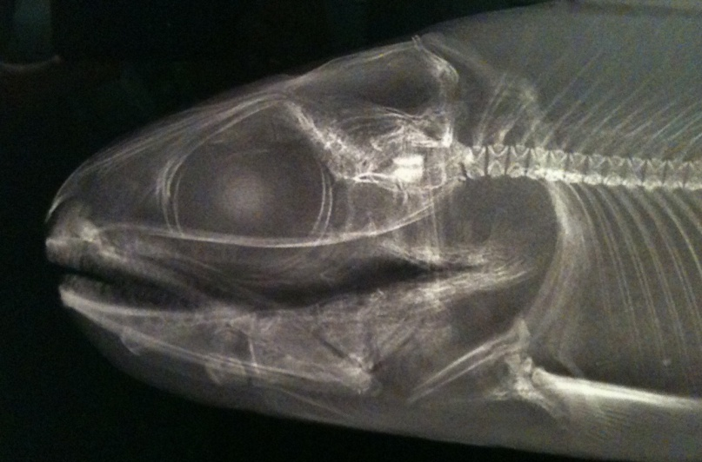
FRAM’s reliance on CWT data
Direct links
Historic tag data
Addition of new stocks/splits
Calibration runs
Indirect links
CTC Chinook Model output
Prep. fishery & stock inputs
Ad hoc analyses
Notes:
Ad hoc analysis includes informal validations of results, e.g., impacts of a particular fishery on a particular stock, stock comp of a particular stock…etc.
All of these, although not all done annually, require continuous tagging
Point out that the recent addition of a new stock for Columbia, e.g., LCN Natural Tules.

Slide 7
Calibration
Pacific Salmon Commission’s
CTC Chinook Model
Addition of new stocks
FRAM
Stock abundance (= forecast)
Terminal Fishery Models
Catch inputs
Notes:
Describe CTC Chinook model—based on similar data, lots of overlap in CWT groups used to develop model BUT is a very different model...
Worth mentioning that there’s a range of sophistication with how FRAM interacts with terminal models, e.g., Puget Sound is very tight, WA Coast is footloose and fancy free, Columbia is okay for some stocks (e.g., Coweeman spreadsheet)…
Development of catch inputs based on past ER data, often derived directly from CWT data. Also, often dependent terminal run reconstructions

Slide 8
The future of fishery planning models
Status quo?
Genetic stock ID?
Parentage-based tagging?
PIT tags?
Expanded CWT effort?
A combination?

