Slide 1
Uncle Paul’s HEP Process Pyramid –his latest attempt at immortality
Applies to All Tiers and Entities
Policy/Negotiation
Tier 3
Tier 2
Consistency
Tier 1

Slide 2
Policy/Negotiation
Policy level resolution required
Sub-regional issues with policy implications
Consistency
Technical HEP w/ little or no policy implications
?

Slide 3
Tier 1
Basic HEP SOPs
Loss Assessment Matrices
HU Stacking Procedures
Crediting Dissimilar Cover Types
Use of Appropriate HEP Models
Proper use of HEP Models
  Model Equations
  Model Modifications
?

Slide 4
Sources of Variation in crediting due to HEP methods
Cover Typing - Delineation of cover type boundaries
Similarity (or lack thereof), between habitats characterized in losses and compensation lands
Choice of HEP species- for original losses and compensation lands
  Should be a good representation of habitat quality
Lack of peer review or consistency of HEP models chosen for losses or compensation lands.
Choice of substitute HEP species when out of kind-
  Covering same habitat attributes with same number of species
Modification or lack of suitable modification of HEP models.
  Appropriate/inappropriate selection of model
  Use of updated models for mitigation while losses are static with old models.
  Appropriate/inappropriate alteration of equations to address site specific realities.
  Real world differences in application of model from original area
Field Data Collection techniques-
  Changes in Techniques and intensity of survey
  Changes in survey staff
  Season of survey/phenology
  Under represented or over represented cover types

Slide 5
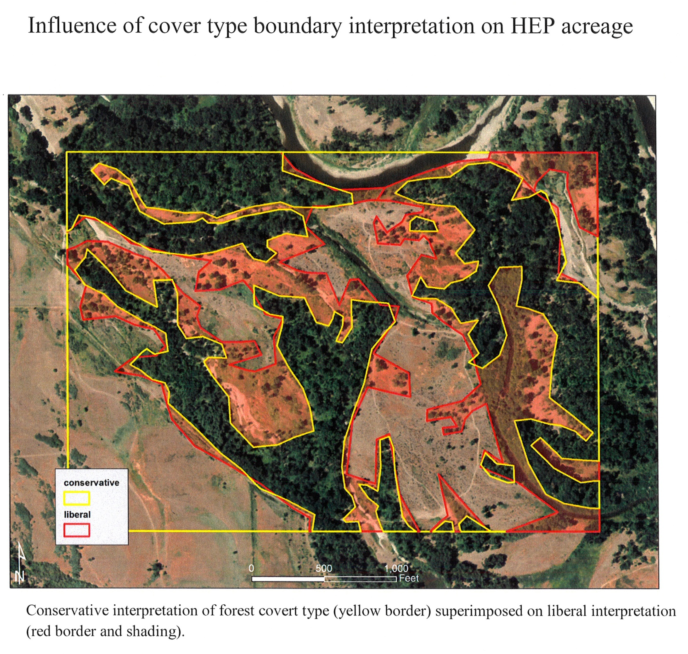

Slide 6
Variation Standard Operating Procedures (SOP’s)
Use tools, models, and methods that most accurately reflect the quality and quantity of the habitats being protected and managed.
HEP methods used should reflect the site specific habitat parameters and management goals of the property and may differ from the HEP methods used in determining the losses.
When disagreements arise, the project proponent should seek resolution through consultation with BPA, HEP team, and sub-basin or provincial co-managers to assure consistency and accuracy.
Consider validating new or significantly modified models with appropriate testing and review.

Slide 7
Species Stacking
Stacking occurs when multiple species are used to characterize the quality of a single cover type. It becomes a crediting issue when the same number of species used to assess losses are not in turn used to characterize the compensation lands.
  Stacking is an issue of how you adjust the credits of the mitigation sites to be in balance with the number of species used to characterize the losses.
  Loss assessments are what they are and should not be revised or replaced to address stacking issues.

Slide 8
Stacking SOP’s
Use the same number of species to characterize the out of kind cover types as were used to characterize the loss assessment cover types.
If using fewer species to characterize the mitigation site cover type than were used to characterize the losses, average the HSIs of the out of kind mitigation cover types and multiply by the number of species used in the losses. However, species selection must be peer reviewed and approved by the regional HEP team, BPA and the project proponent.
If incidental out of kind cover types (inclusions) are associated with a mitigation acquisition, assume the same HSI as the adjacent cover type.
Willamette crediting will use the CHAP methodology to address stacking issues.
Do not credit the same acres of a given cover type between two or more hydro projects with a combination of species from both.

Slide 9
Tier 2
Distribution of Lower Columbia HUs
Crediting Mitigation Lands not Acquired by BPA e.g., BLM & DNR Lands
Albeni Falls Matrix

Slide 10
Crediting public lands actions, trust lands, and non-permanent or unsecured lands mitigations
How to credit BLM lease for range lands.
How to credit State DNR Land mitigations.
How to credit BIA Trust lands leases or easements
How to credit leases or easements on fee lands
How to credit areas where BPA contributed to but did not fully provide protection or operations and maintenance funding.
How to credit BPA where they were not involved in the protection of the habitat but provide all or part of the O&M and enhancements.

Slide 11
Crediting SOP’s
Project proponents must provide minimum irreducible HU letter for each compensation site including statements on each of the following issues:
  Hydro project being mitigated
  Cover type(s) and target species used to characterize habitat quality on the compensation site
  Commitment to follow SOPs to quantify and qualify habitat
  Minimum number of habitat units being credited from the site

Slide 12
Crediting SOP’s
Crediting of Non-permanent protection- The subcommittee recommends that the region have a Crediting SOP covering sites without permanent protection. The specific operating procedure adopted needs to be further defined and agreed to.
Partial purchase- credit for proportion of protection funding provided
Partial O&M or enhancements- credit for HU increases proportional to 10 year average investment.

Slide 13
Crediting SOP’s
Credit for leases that may not provide permanent protection- credit against operational or secondary losses or normal full credit when the protection and credit from a non-permanent compensation site gets rolled over to another non-permanent site with an equal or greater amount of habitat value
Credit for lands protected with partial lease such as the purchase of an annual grazing lease on Indian trust lands or a federal grazing allotment - receive credit for cover types enhanced by the annual protection and O&M. Assumption of replacement with similar lease if lease terminated.

Slide 14
Tier 3
Policy level resolution required
Mitigation Project Specific
YN Enhancement Crediting
“Gov” to “Gov” Issues
Settlements

Slide 15
Tier 3 ISSUES
Socio-political issues of crediting projects that are out of kind and out of place from impacts.
Allocation HUs among resource managers.
  Crossing political boundaries with mitigation actions.
  Crossing ecological/population boundaries.
Crediting of fish projects against construction and inundation wildlife losses.
Crediting non-permanent or unsecured lands
How to deal with “over mitigation”?

Slide 16
Where do we go from here?
Regional Agreements on SOPs after vetting through all Forum members.
Direct the HEP team to work with project managers at each compensation site to address technical shortcomings identified above.
  For new projects, do this with baseline HEPs.
  For existing projects, do this with follow-up HEPs.
  Consider adding to HEP team’s contract an express mandate and responsibility to identify inconsistencies in technical HEP applications throughout the region.
Incorporate fish credit findings and recommendations as appropriate.
Reassign credits within lower four mainstem Columbia River dams.
  Unlike other areas in the basin, the lower four crediting can be reassigned based on existing HEP reports, so no need to wait or gather additional data.
Develop draft ledger for recommendation to Council for review and approval.
  The ledger will report HUs protected and enhanced through the Council’s Fish and Wildlife Program.

