Slide 1
Emerging Technologies & Energy Trust’s Resource Assessment

Slide 2

New Approach
Consider range of emerging technologies
Predict future improvements in cost & savings
Be realistic about odds of fruition
Define incrementally to conventional measures

Slide 3
 | ET Risk Factor
Risk Category | 10% | 30% | 50% | 70% | 90%
Market Risk (25% weighting) | High Risk: Requires new/changed business model Start-up, or small manufacturer Significant changes to infrastructure Requires training of contractors. Consumer acceptance barriers exist. |  |  | Low Risk: Trained contractors Established business models Already in U.S. Market Manufacturer committed to commercialization
Technical Risk (25% weighting) | High Risk: Prototype in first field tests. A single or unknown approach | Low volume manufacturer. Limited experience | New product with broad commercial appeal | Proven technology in different application or different region | Low Risk: Proven technology in target application. Multiple potentially viable approaches.
Data Source Risk (50% weighting) | High Risk: Based only on manufacturer claims | Manufacturer case studies | Engineering assessment or lab test | Third party case study (real world installation) | Low Risk: Evaluation results or multiple third party case studies

Slide 4
Risk Considerations
How developed is the market?
Are there manufacturers?
Is the public likely to accept the product?
Is there a contractor/installer network?

Slide 5
Risk Considerations
Is the technology proven?
Single lab/field tests
Small volume manufacturer
New product but broad appeal
Proven technology, but different market or application
Proven technology in target application

Slide 6
Risk Considerations
How confident are we in the data?
Manufacturer’s claims/case studies
Lab/field test
3rd party lab/field test
Multiple tests or evaluations

Slide 7
Example Emerging Technologies
LEDs
Advanced HVAC controls
Advanced refrigeration controls
Advanced solar water heater
Heat recovery ventilation
CO2 heat pump water heaters
Gas absorption heat pump water heater

Slide 8
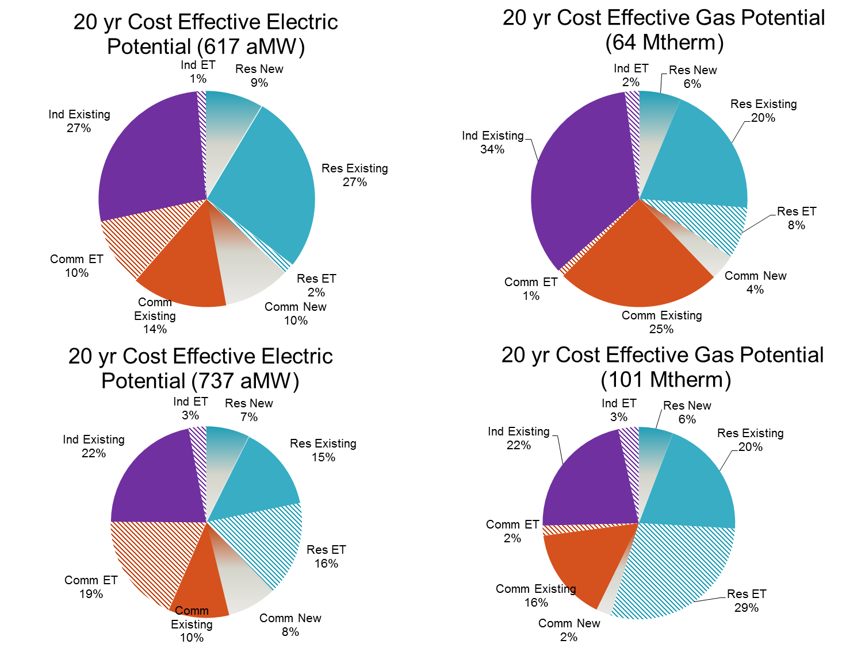
Results

Slide 9
Room for Improvement
Are we evaluating the right risks?
Are the risk factors appropriately scaled?
Include more emerging technologies

Slide 10
Thank You
Ted Light
Sr. Planning Project Manager
ted.light@energytrust.org
503-445-7643

