Slide 1
Flexibility Metric Roundtable
8:30 - 9:00 AM - Welcome and introduction - Ben Kujala (NWPCC)
9:00 - 9:30 AM - Avista's flexibility overview - James Gall (Avista)
9:30 - 10:00 AM - Methods and metrics to assess power system flexibility - Aidan Tuohy (EPRI)
10:00 - 10:30 AM - Roundtable discussion on flexibility metrics in utilities
^{10:30 - 10:45 AM - Break}
10:45 - 11:15 AM - Optimizing flexibility in the short-term and the long-term - Daniel Kirschen (UW)
11:15 - 11:45 AM - Path Union CRDC: A new approach to assessing flexibility requirements - Michael Schilmoeller (NWPCC)
11:45 - 12:30 PM - Roundtable discussion on flexibility metrics in research

Slide 2
Defining the Problem
Advantages and disadvantages of common metrics
LOLP consistency or lack thereof
Common Language and Intent
Context helps
System planning vs. plant characteristics
Academic/research vs. operation and utility planning

Slide 3
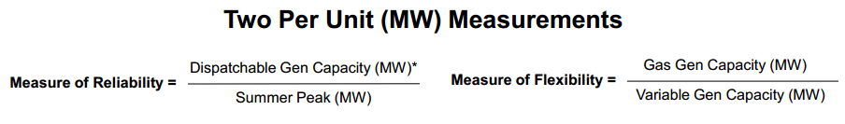
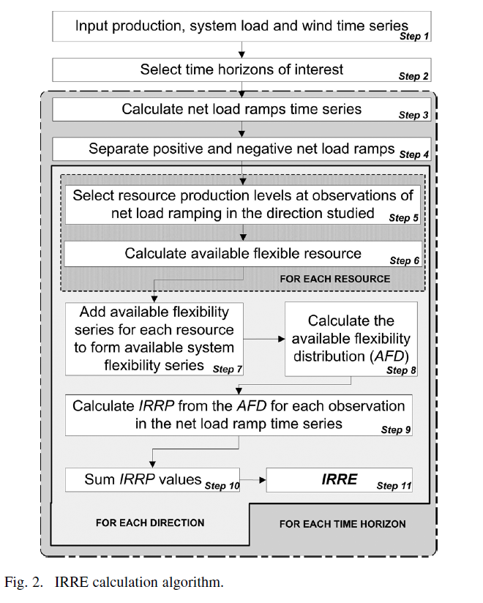
Measures in Planning
Disconnect from theory to practice:

Slide 4
Supply and Demand
System Balancing
Matching generation to load requires flexibility
System Changes that Impact Flexibility
Variable Generation
Requires flexibility to integrate to current scheduling and marketing practices
Can supply decs and reduce ramps
Demand Response
Can supply incs and decs

Slide 5
Long-term Planning for Flexibility
Conservation
Resource Portfolio Planning
Demand Response
Smart Grid

Slide 6
9:00 - 9:30 AM - Avista's flexibility overview - James Gall (Avista)
9:30 - 10:00 AM - Methods and metrics to assess power system flexibility - Aidan Tuohy (EPRI)

Slide 7
Flexibility Metrics in Utilities
What are utilities using for planning/IRP purposes?
Do utilities anticipate a change in upcoming planning/IRP activities with regard to flexibility?
What do utilities need from a metric? Who are the audiences these metrics will be presented to?

Slide 8
^{10:30 - 10:45 AM - Break}
10:45 - 11:15 AM - Optimizing flexibility in the short-term and the long-term - Daniel Kirschen (UW)
11:15 - 11:45 AM - Path Union CRDC: A new approach to assessing flexibility requirements - Michael Schilmoeller (NWPCC)

Slide 9
Flexibility Metrics in Research
What is the state of the art in research flexibility metrics?
Is there a stand out standard along the lines of LOLP metrics?
Are the metrics adaptable and implementable in practice?

Slide 10
Closing
Going forward
Was this meeting helpful? Would a follow up meeting be appropriate?
Is there an interest in a mailing list for this subject?
Are there upcoming planning processes that could leverage a broader effort on flexibility? Can we all mutually benefit from a collaborative effort?
Thank you for attending!

