Slide 1
A New Approach to Assessing
Resource Flexibility
Michael Schilmoeller
Northwest Power and Conservation Council
May 2, 2013
Portland, Oregon

Slide 2
Overview
What are we talking about?
Why does it matter?
First step: increasing response
Second step: response and recovery

Slide 3
Deviations from Schedule

Slide 4
What are we talking about?
We want to characterize this requirement:
We would like to know what kinds of resources are necessary to provide this service (whether a given resource ensemble suffices)

Slide 5
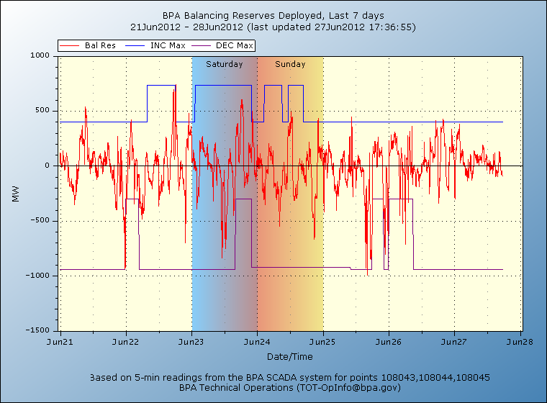
Why does it matter?
For some systems, it may not matter today
If you have large amounts of fast-ramping hydrogeneration and opportunity costs are small, all you need to know is the size of the excursion

Slide 6
A typical assessment treats excursions as “noise”

Slide 7
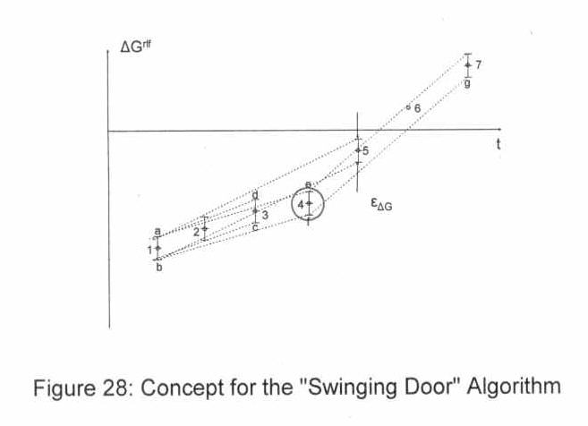
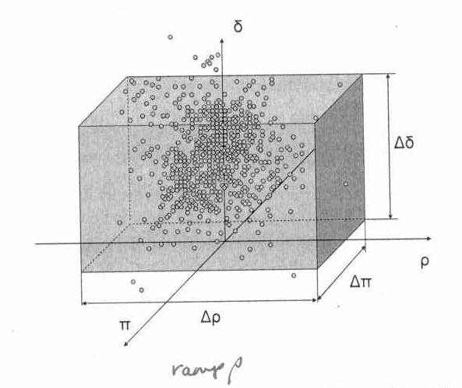
A more sophisticated tool
Source: California ISO 2010, Technical Appendix on Renewable Integration Studies, pages 56,57

Slide 8
Why is a New Approach Needed?
Other approaches treat this pattern like a noise signal
  They only tell us the maximum capacity and ramp rate requirements over periods
  Therefore, they do not provide insight into how resources with lower ramp rates can participate
Consequently, they provide little information that would help us find least-cost solutions
They may also miss operating constraints that arise from the order of events

Slide 9
Analogy
Existing metrics tell us how many Formula-1 race cars the ACME delivery company should have in its fleet
… but Formula-1 race cars are expensive, and some needs can be met with other, less costly vehicles
We need a metric that tells us how many vans, sedans, bicycles, Segways, and … yes … race cars would also meet the ACME delivery company’s requirement
A diversified fleet of vehicles can save ACME a lot of money

Slide 10
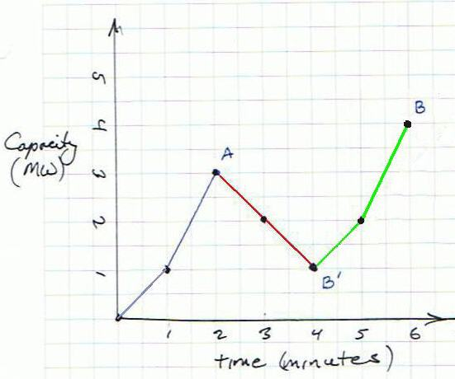
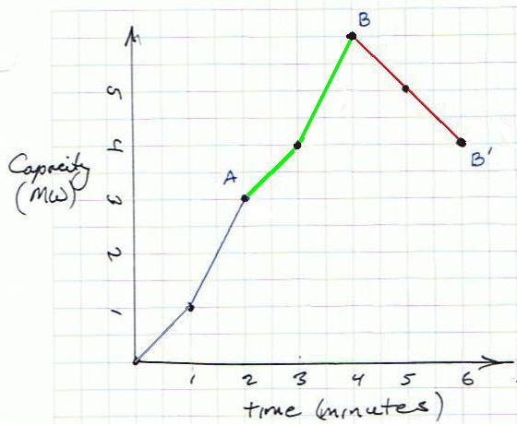
The order of response and recovery matters
The statistics obtained by other methods ignore this information.

Slide 11
Why is another approach needed?
Limitations of the hydrogeneration system
Higher penetration of variable generation resources (wind and solar)
The need for a more nuanced description of imbalance requirement to helps us to value of a broader array of solutions and meet requirements at least cost
OPUC Order 12-013, UM 1461, Sec II. D. Integrated Resource Planning Flexible Resources Guidelines

Slide 12
A peek ahead
Requirement
Supply
Notes:
The horizontal axis has changed: it no longer is time, but duration.
Corresponds to inc excursions in slide 4
We can determine the sufficiency of a given supply ensemble about creating and comparing a similar CRDC for the system’s resources: “The imbalance supply is sufficient to meet a system imbalance requirement if and only if the CRDC of supply lies above that of the CRDC of requirements”

Slide 13
A peek ahead alternative spectral representation
Notes:
This is an alternative, less helpful perspective that may be more familiar to some.

Slide 14
Overview
What are we talking about?
Why does it matter?
First step: increasing response
Second step: response and recovery

Slide 15
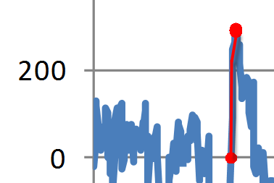
First step
Increasing “up” requirements only
All imbalance resources start out at “standby”, without power deployment
Notes:
At the beginning of deployment, all resources at their nominal operating point. That is, there is no deployment for balancing reserves.

Slide 16
Increasing “up” requirement

Slide 17
Sorting the ramp events
We will call this the Ramping Duration Curve (RDC)
It tells us how much power we need
Notes:
One key purpose of this exercise is to evaluate whether a given set of resources are sufficient to meet our requirements. The ramping duration curve is a tool that will permit us to do this.
Note that the horizontal axis, while still denominated in units of time, has again taken a new interpretation. It now indicates how long a given ramp rate requirement occurs

Slide 18
“Minimally sufficient” ensemble of fuel-limited resources
2 MW
5 MW
7 MW
Area under the RDC corresponding to each blocks is power = ramp rate x duration
Makes it evident that the order of ramps here does not matter – we just need the MW

Slide 19
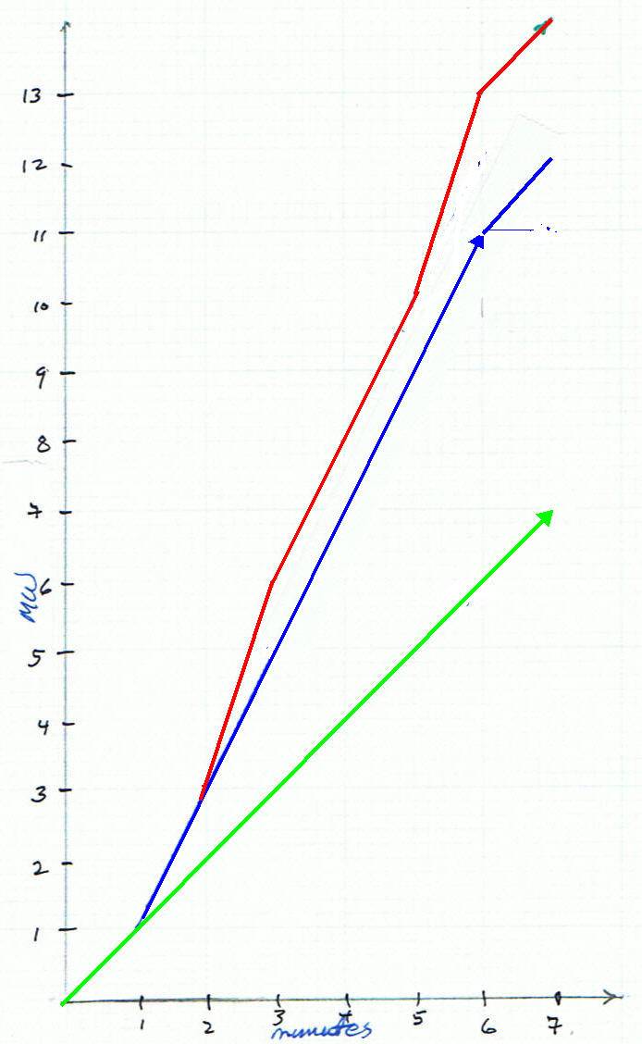
Making the “round trip”
2 MW
5 MW
7 MW

Slide 20
RDCs for Resources
6 MW
6 MW
2 MW
Dispatching sequentially requires units with higher ramp rates

Slide 21
Comparing requirement and resources RDCs is inadequate
requirement
candidate
resource
Notes:
The RDC is help in telling us whether the highest ramp rate resource is adequate to meet our needs, but is less helpful in evaluating the second highest ramp rate resource. If the second resource was faster than the remaining requirements, it will suffice, but is it necessary? At what duration would the second resource provide an adequate system?

Slide 22
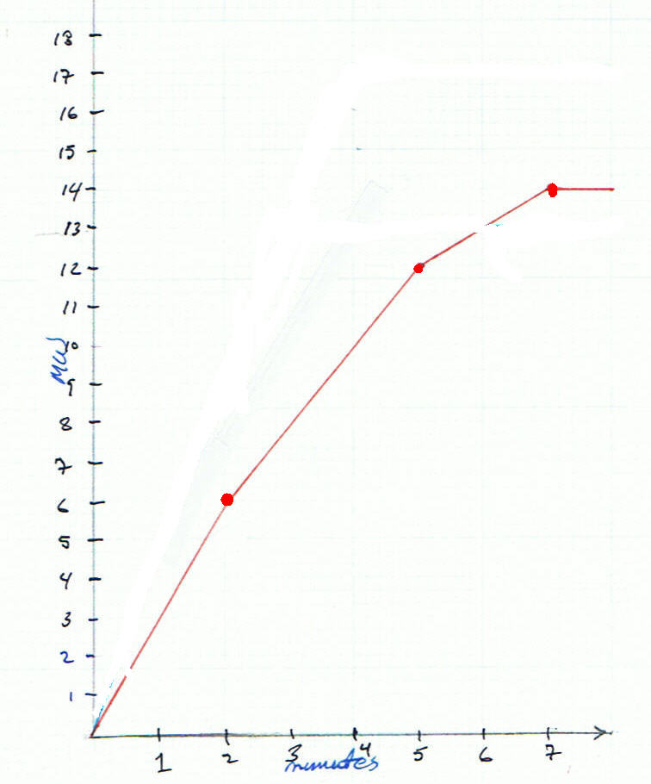
The CRDC
Cumulative Ramping Duration Curve (CRDC) is the cumulative power, summing from higher to lower ramp rate

Slide 23
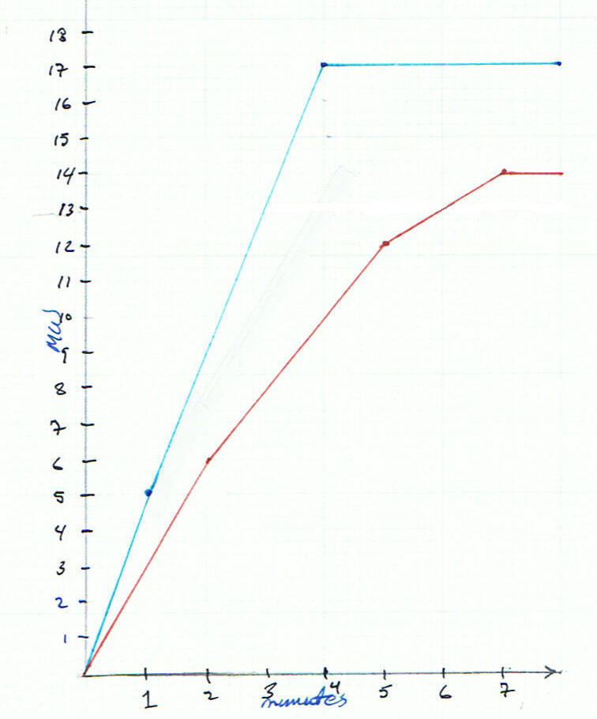
Supply and Demand CRDCs
The CRDC helps us more easily visualize whether one ensemble can meet the same requirements as another

Slide 24
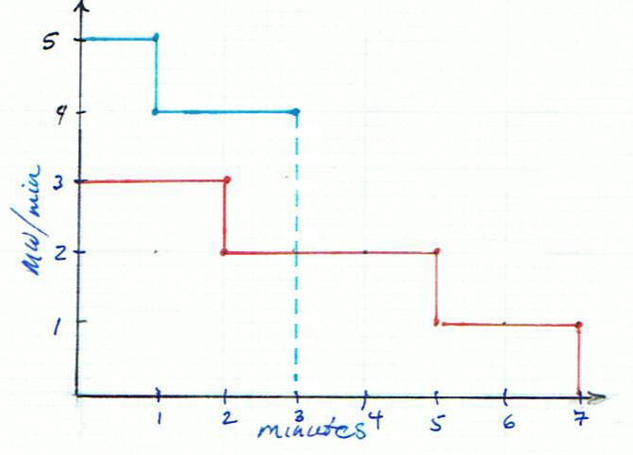
Inadequate Supply and Demand CRDCs

Slide 25
Overview
What are we talking about?
Why does it matter?
First step: increasing response
Second step: response and recovery

Slide 26
Key concept: the “path”
A path is an initial condition (net machine power deployed after recoveries) and a response. There can be many prior responses and recoveries.
A path captures all of the power recovery practices, back to the beginning on an excursion

Slide 27
Recovery creates two paths
Step through slowly to figure out the initial condition B´ for path “B”
Notes:
Stop and go through this slowly. Ask ourselves, what kind of imbalance resource we need to meet this requirement.

Slide 28
CRDCs of the two responses
Notes:
Note that for path A, the order of the ramps is reversed. This is required by the sorting requirement for CRDCs.

Slide 29
The Path Union CRDC satisfies both paths

Slide 30
Does that really work?

Slide 31
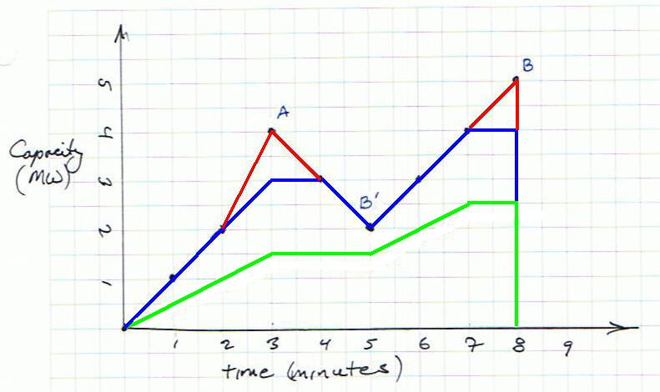
Huh! (There is a proof, too)

Slide 32
Intuitive argument for the union
The path union captures ramp requirements with higher rates or greater power requirement at a given ramp rate
The path union avoids double-counting requirements when recoveries take place

Slide 33
Amp-ing it up

Slide 34
But what about…?
Alternative assumptions for recovery
Representations of “down” or DEC excursions
  Do the responses and recoveries change roles?
The diversity of practices among operators and of the resources available
How would planners and operators use it?
Energy-limited resources (e.g., batteries)

Slide 35
Summary
The Path-Union CRDC tells us how resources and measures can be combined to meet power system balancing needs
This approach is an improvement
  Tracks ramp rates as well as the magnitude of the excursions
  Tracks the order of requirements, reflecting the loading and substitution of machines to provide imbalance services
  Helps identify cost-effective solutions

Slide 36
Summary
Allows any portfolio of resources to be tested to see if it meets intra-hour power system flexibility needs
  reveals sufficiency or insufficiency
The new metric is fast to compute
  can be used to address power system flexibility needs in multi-year studies and utility Integrated Resource Plans (IRPs)

Slide 38
The main theorem
“The imbalance supply is sufficient to meet a system imbalance requirement if and only if the CRDC of supply lies above (weak sense) that of the CRDC of requirements”

Slide 39
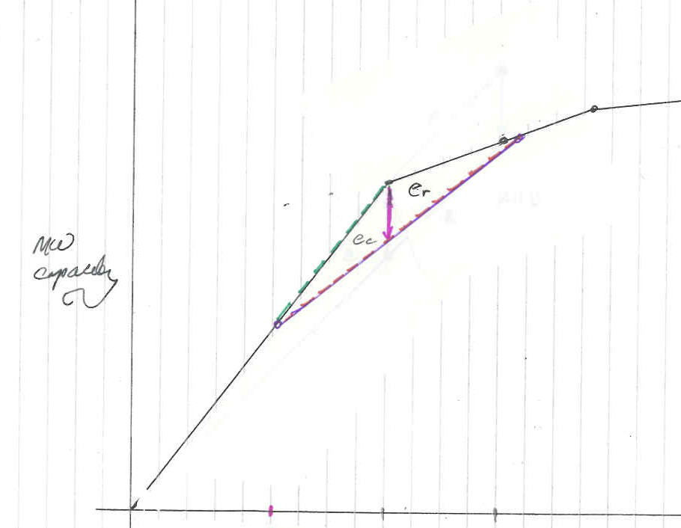
Valuing Storage

