Slide 1
Customer Engagement through
Dynamic Pricing
Provide the monetary incentive – and leave customers to their own devices
Karen Herter, Ph.D.
Pacific Northwest Demand Response Project
July 15, 2010

Slide 2
SmartGrid Enables Integration of Real-Time Tools
Utility
  Incentives – i.e. dynamic pricing
  Notification – of impending high prices
Customer
  Information – about electricity pricing and use
  Controls – for discretionary end uses
Notes:
Utility
Dynamic pricing, unlike information campaigns, provides economic incentives for customers to be involved -- and unlike static pricing, provide the opportunity for regular interaction with the customer through price event notification.
Customer
Dynamic pricing increases the value of personalized electricity use information – so customers are not only involved, but educated – and improves the cost-effectiveness of appliance controls – so customers are not only involved and educated, but empowered.

Slide 3
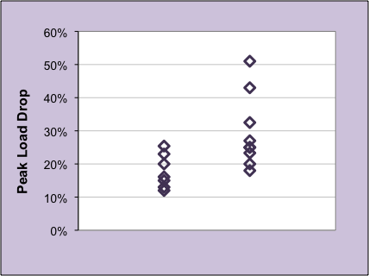
Response to Dynamic Pricing
Residential customers, 2004-2010
Without controls
With controls
Notes:
17 CPP programs
1 RTP

Slide 4
Electricity Pricing Strategies

Slide 5
Flat Rate
Same rate every hour and every day
Notification: none
Effect: (Not applicable)
0.3
0.2
$
0.1
0 5 10 15 20 25 30
Days in a Month
Notes:
This is the rate against which others are compared

Slide 6
Tiered Rate
Rate increases as kWh thresholds are reached
Notification: none
Effect: unknown
0.3
0.2
$
Tier 2
0.1
Tier 1
0 5 10 15 20 25 30
Days in a Month
Notes:
Behavioral economics suggests that tiers are likely to reduce consumption for those likely to go beyond the threshold, and increase consumption for those who don’t. Does the reduction in Tier 2 use make up for the increase in Tier 1? Unknown.

Slide 7
Time of Use (TOU) Rate
Rate lower off peak, higher on peak
Notification: none
Effect: reduce daily peaks
0.3
0.2
$
Peak
0.1
Off Peak
0 4 8 12 16 20 24
Hours in a Day
Notes:
Daily notification not practical, unlikely to be effective, likely to be annoying

Slide 8
Critical Peak Pricing (CPP)
Flat or TOU rate with as-needed high price events
Notification: each event
Effect: reduce critical and daily (w/TOU) peaks
Critical
Price
1 - 15 days/yr as needed
0.3
0.2
$
Peak
0.1
Off Peak
0 4 8 12 16 20 24
Hours in a Day
Notes:
Residential: San Diego, Baltimore Gas & Electric
Small commercial: SMUD, SCE
Large commercial and industrial:

Slide 9

Variable Peak Pricing (VPP)
TOU or CPP rate with market-based or critical peak prices
Notification: high prices
Effect: reduce critical and daily (w/TOU) peaks
0.3
0.2
$
Peak
0.1
Off Peak
0 4 8 12 16 20 24
Hours in a Day

Slide 10
Real Time Pricing (RTP)
Rate changes with market
Notification: high prices
Effect: reduce critical and daily peaks
0.3
0.2
$
0.1
0 4 8 12 16 20 24
Hours in a Day
Notes:
SDG&E
Baltimore Gas & Electric (res)

Slide 11
Customer Engagement

Slide 12
Customer View of Dynamic Pricing
  Engage customer
  Provide $ incentive
  Real-time
  Customer-specific
  Central interface
  Automated response

Slide 13
Customer View of Dynamic Pricing
  Engage customer
  Provide $ incentive
  Real-time
  Customer-specific
  Central interface
  Automated response

Slide 14
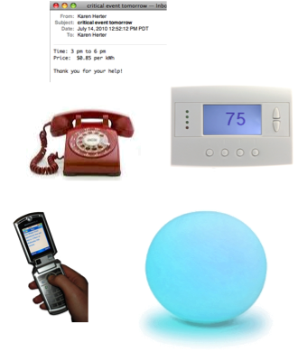
Event Notification
What
  Event timing
  Expected price per kWh during event
  Recommendations for action
  How
  Phone
  Email
  Text or Internet messaging
  Thermostat display
  Energy device display
  Dedicated notification display
  [many other options]
Notes:
Each event notification provides an opportunity for customer engagement
Some media are more

Slide 15
Customer View of Dynamic Pricing
  Engage customer
  Provide $ incentive
  Real-time
  Customer-specific
  Central interface
  Automated response

Slide 16
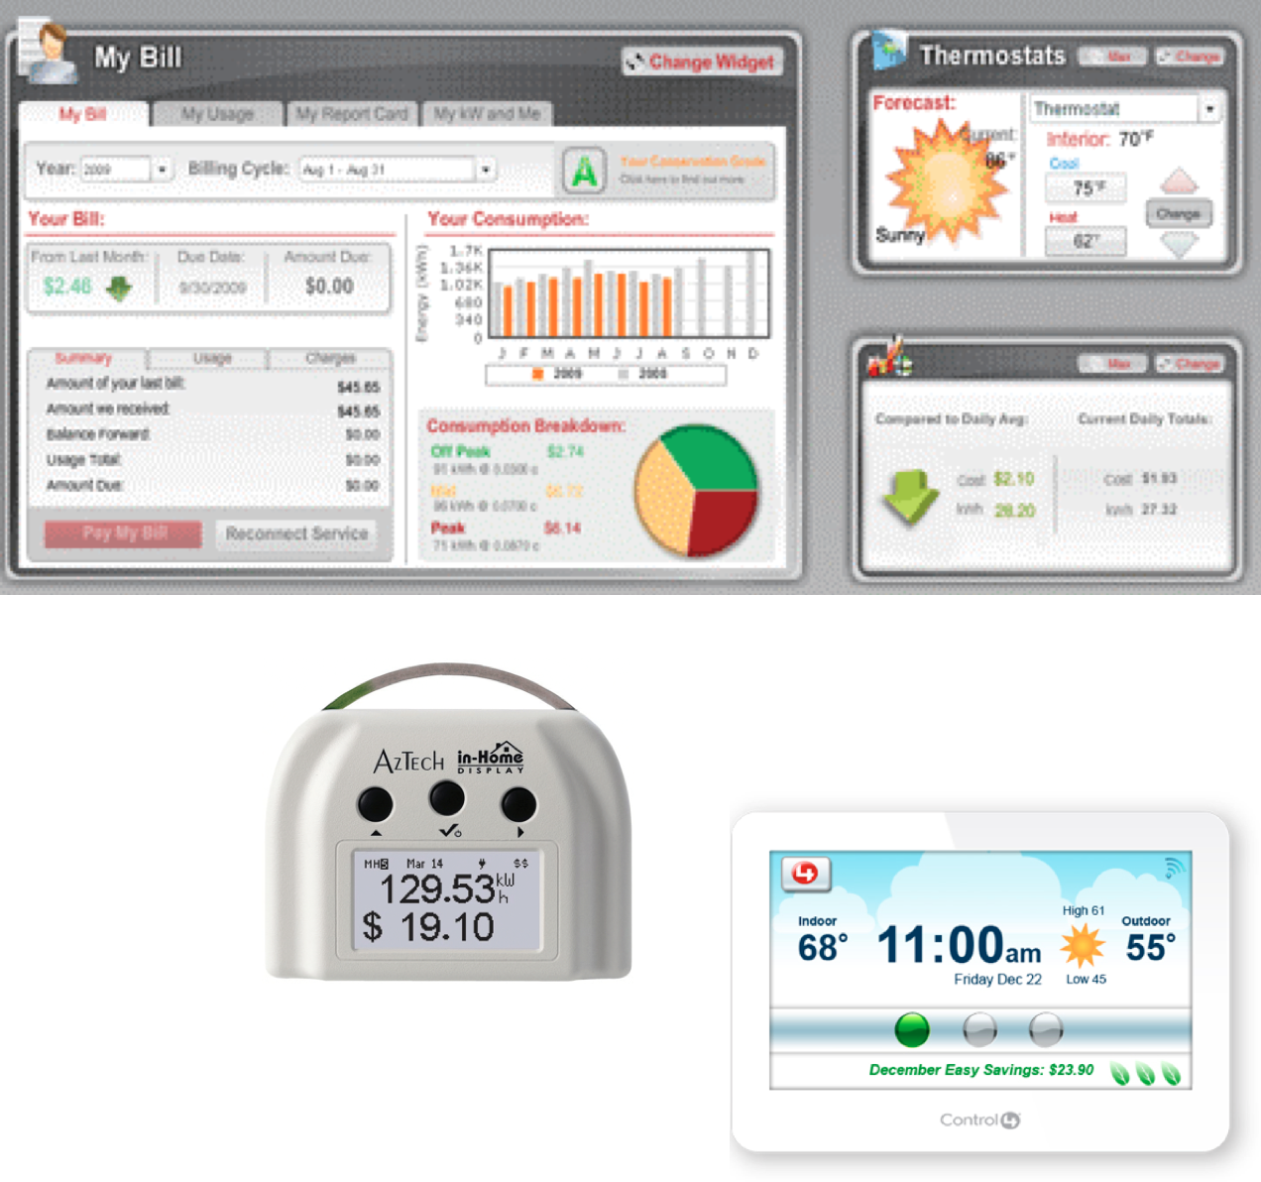
Energy Information
What
  Electricity kW and kWh
  Electricity pricing
  Electricity bill
  Utility messaging
  Weather
How
  Site, room, or appliance level
  Real-time or delayed
  Comparisons to historical, goal, or other users
  Graphs, charts, text, pictograms, etc.

Slide 17
Customer View of Dynamic Pricing
  Engage customer
  Provide $ incentive
  Real-time
  Customer-specific
  Central interface
  Automated response

Slide 18
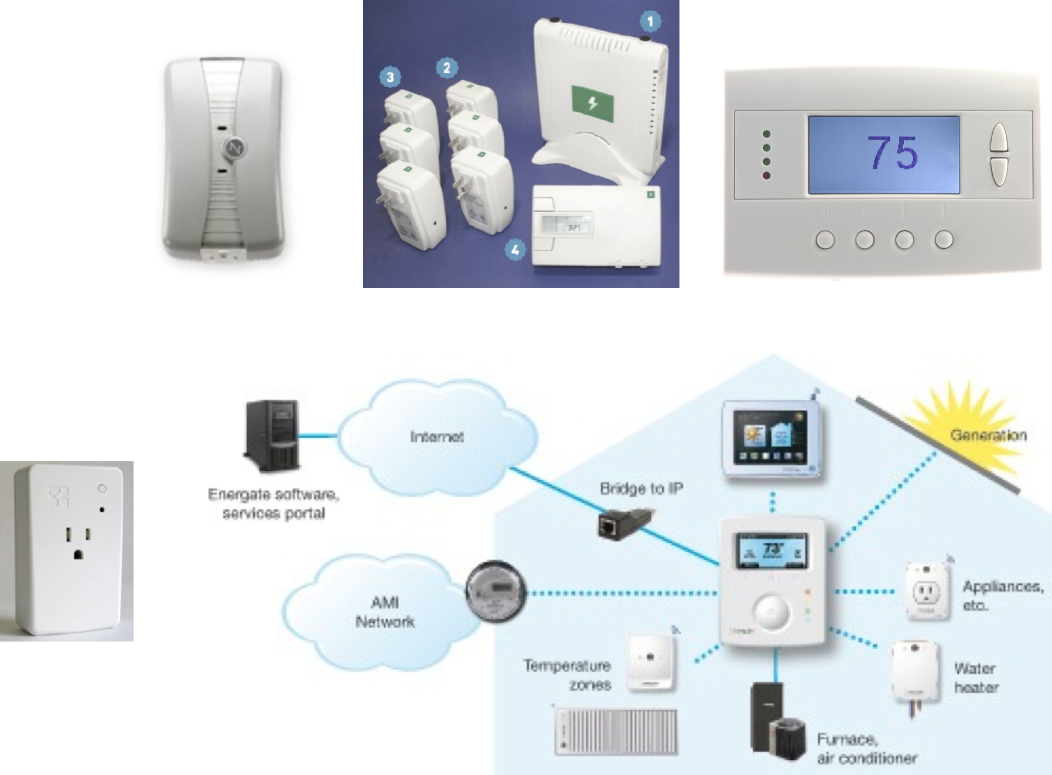
Appliance Controls
What
  Air-conditioning
  Electric water heating
  Pool pumps
  White goods
  [many more options]
Who
  Customer
  Utility
  Third-party
Notes:
Some customers will prefer to control their own devices
Manually reduce or shift energy use
Purchase and program controls systems to automate response
Others will give permission for utilities to engage on their behalf
Wifi, ZWave, Zigbee, FM radio, RDS, powerline, etc.

Slide 19
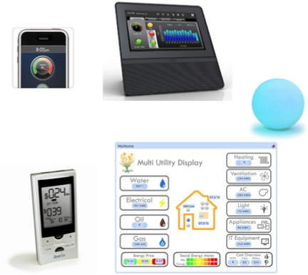
Customer Interface
What
  Mobile phone
  Personal computer
  Thermostat
  Dedicated energy management device
  Website
  [many other options]
How
  Menus
  Graphics
  Colors
  Fonts

Slide 20
Lessons Learned

Slide 21
What affects peak response?
Notification - Yes
Price + notification - YES
Number of Notifications – YES
Method of notification – Not so much
Magnitude of Price – Not so much
Appliance controls - YES
Information – unknown
Interface – unknown
Notes:
Notification: Delaware 2010
Number of Notifications: George 2010
Method of Notification: Australia 2010
Magnitude of Price: Herter 2010; Australia 2010

Slide 22
Decisions to be made by the utility
Rate design
Event triggers
Notification methods to be offered
Timing and magnitude of events
How to help customers choose rates & technologies

Slide 23
Decisions to leave to the customer
(but a little help would be nice)
If and how to receive notification of events
What information display to use (if any)
Who controls their appliances (if anyone)
If the customer chooses to control their own appliances
  What appliances to control
  What control system to use
  Whether and how to respond to events

Slide 24
What customers want to know…
What rates are available and which are most likely to benefit me personally?
What technologies are available, what do they cost, and how are they likely to benefit me?
How will the new rates and technologies benefit the system/community/society as a whole?

Slide 25
Ideas for Engaging Customers
Provide customer-specific information
  Electricity use and costs
  Recommendations and potential bill effects of…
    Efficiency improvements
    Behavioral response to peak events
    Appliance controls
  Recommendations for making sense of information – not bill effects
Create sub-communities of customers
  …by rate, control technology, energy use, or geographic area
  Provide comparisons
  Competition possibilities are endless (e.g. critical peak sports)
Involve customers in system cost-benefit estimates
Notes:
CAUTION: Avoid providing potential bills effects of information alone – these are less likely to be accurate at a customer-specific level than engineering estimates of appliance interaction

Slide 26
Karen Herter, Ph.D.
916.397.0101
Karen@HerterEnergy.com

