Slide 1
Stakeholder Workshop on Redeveloped GENESYS
RAAC/SAAC Technical Workshop
August 4th, 2021
John Fazio, Dan Hua and John Ollis

Slide 2
Agenda Topics
Purpose of GENESYS Redevelopment
Review model setup, data structure and presentation to provide context
Climate change inflows and temperature (load)
For the Columbia and major tributaries, compare the following for :
Outflow – average and range
Generation – average and range
Ending elevation – average and range
Spill – average and range
Exploration of other Questions/Notes in the model:
Hourly hydro flexibility
Market interactions on thermal unit commitment
Market and transmission utilization
Role of reserves
Next steps list:
What is in the queue to enhance/improve the modeling?
What have we missed?

Slide 3
Planned Timing for Each Day
9:00 am – 9:15 am: Introduction
9:15 am – 10:30 am: Work Session 1
10:30 am – 10:45 am: Break
10:45 am– 12:00 pm: Work Session 2
12:00 pm – 12:45 pm: Lunch
12:45 pm – 2:00 pm: Work Session 3
2:00 pm – 2:15 pm: Break
2:15 pm – 3:30 pm: Work Session 4

Slide 4
Rules/Goals For the Work Sessions
These meetings are for stakeholders to ask questions to better understand the current state of the redeveloped GENESYS model and what is possible.
We will be focused first on understanding the current state, and then
On cataloguing next steps for improving the model in the near and long term.
We recognize different stakeholders have used GENESYS for a number of different reasons, which means that we value diverse feedback
Council staff will use the redeveloped model as one of the main tools to understand adequacy and hydro operational issues
Other stakeholders may still use the classic GENESYS or utilize information from this model to support their adequacy/planning work.

Slide 5
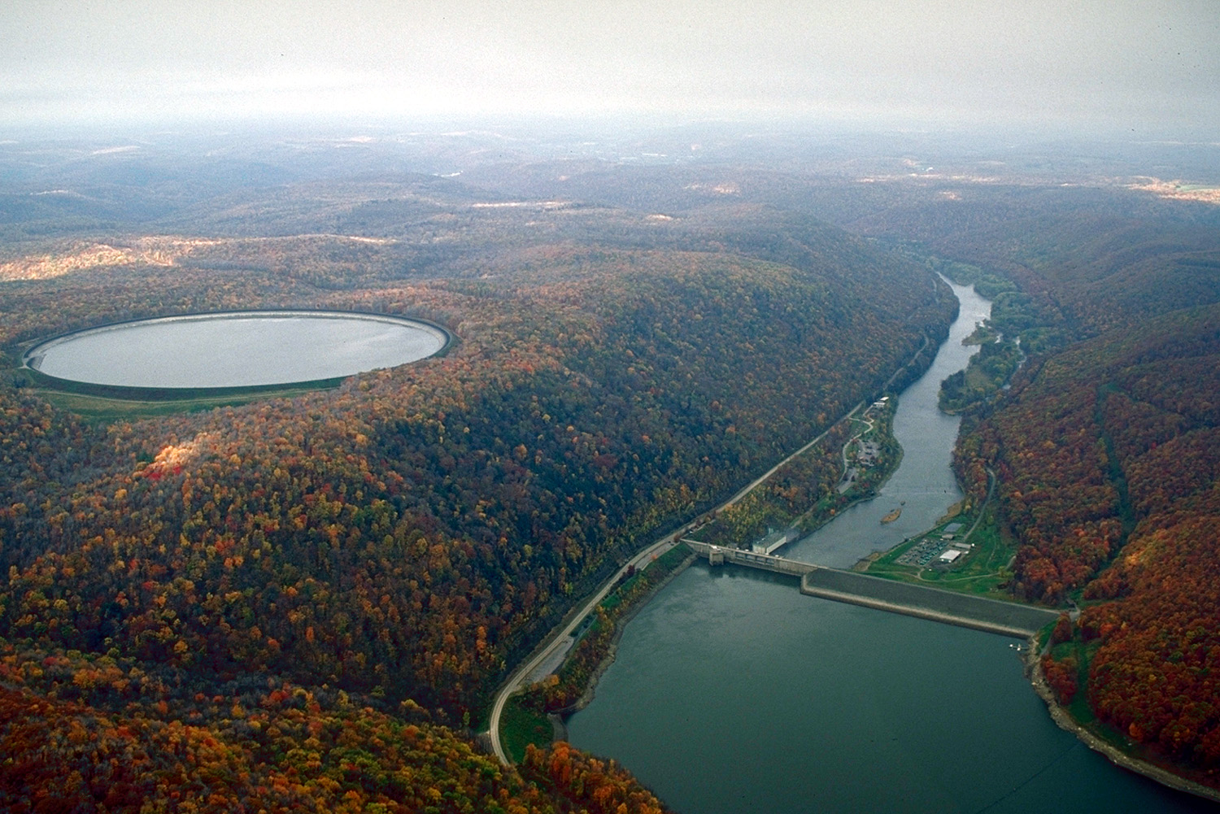
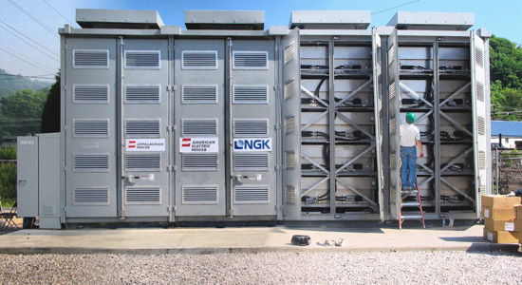
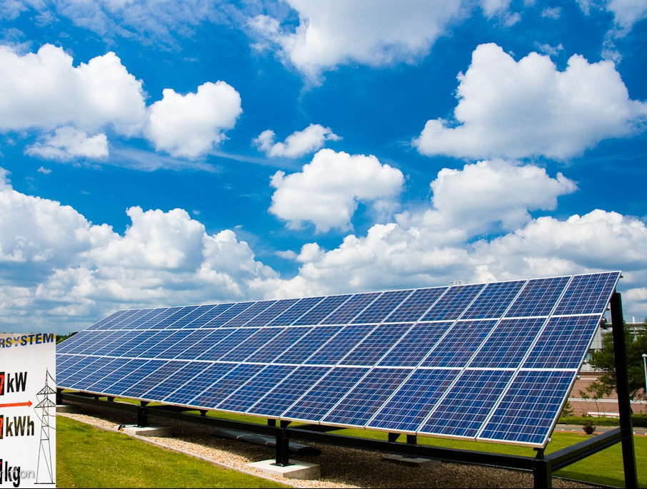
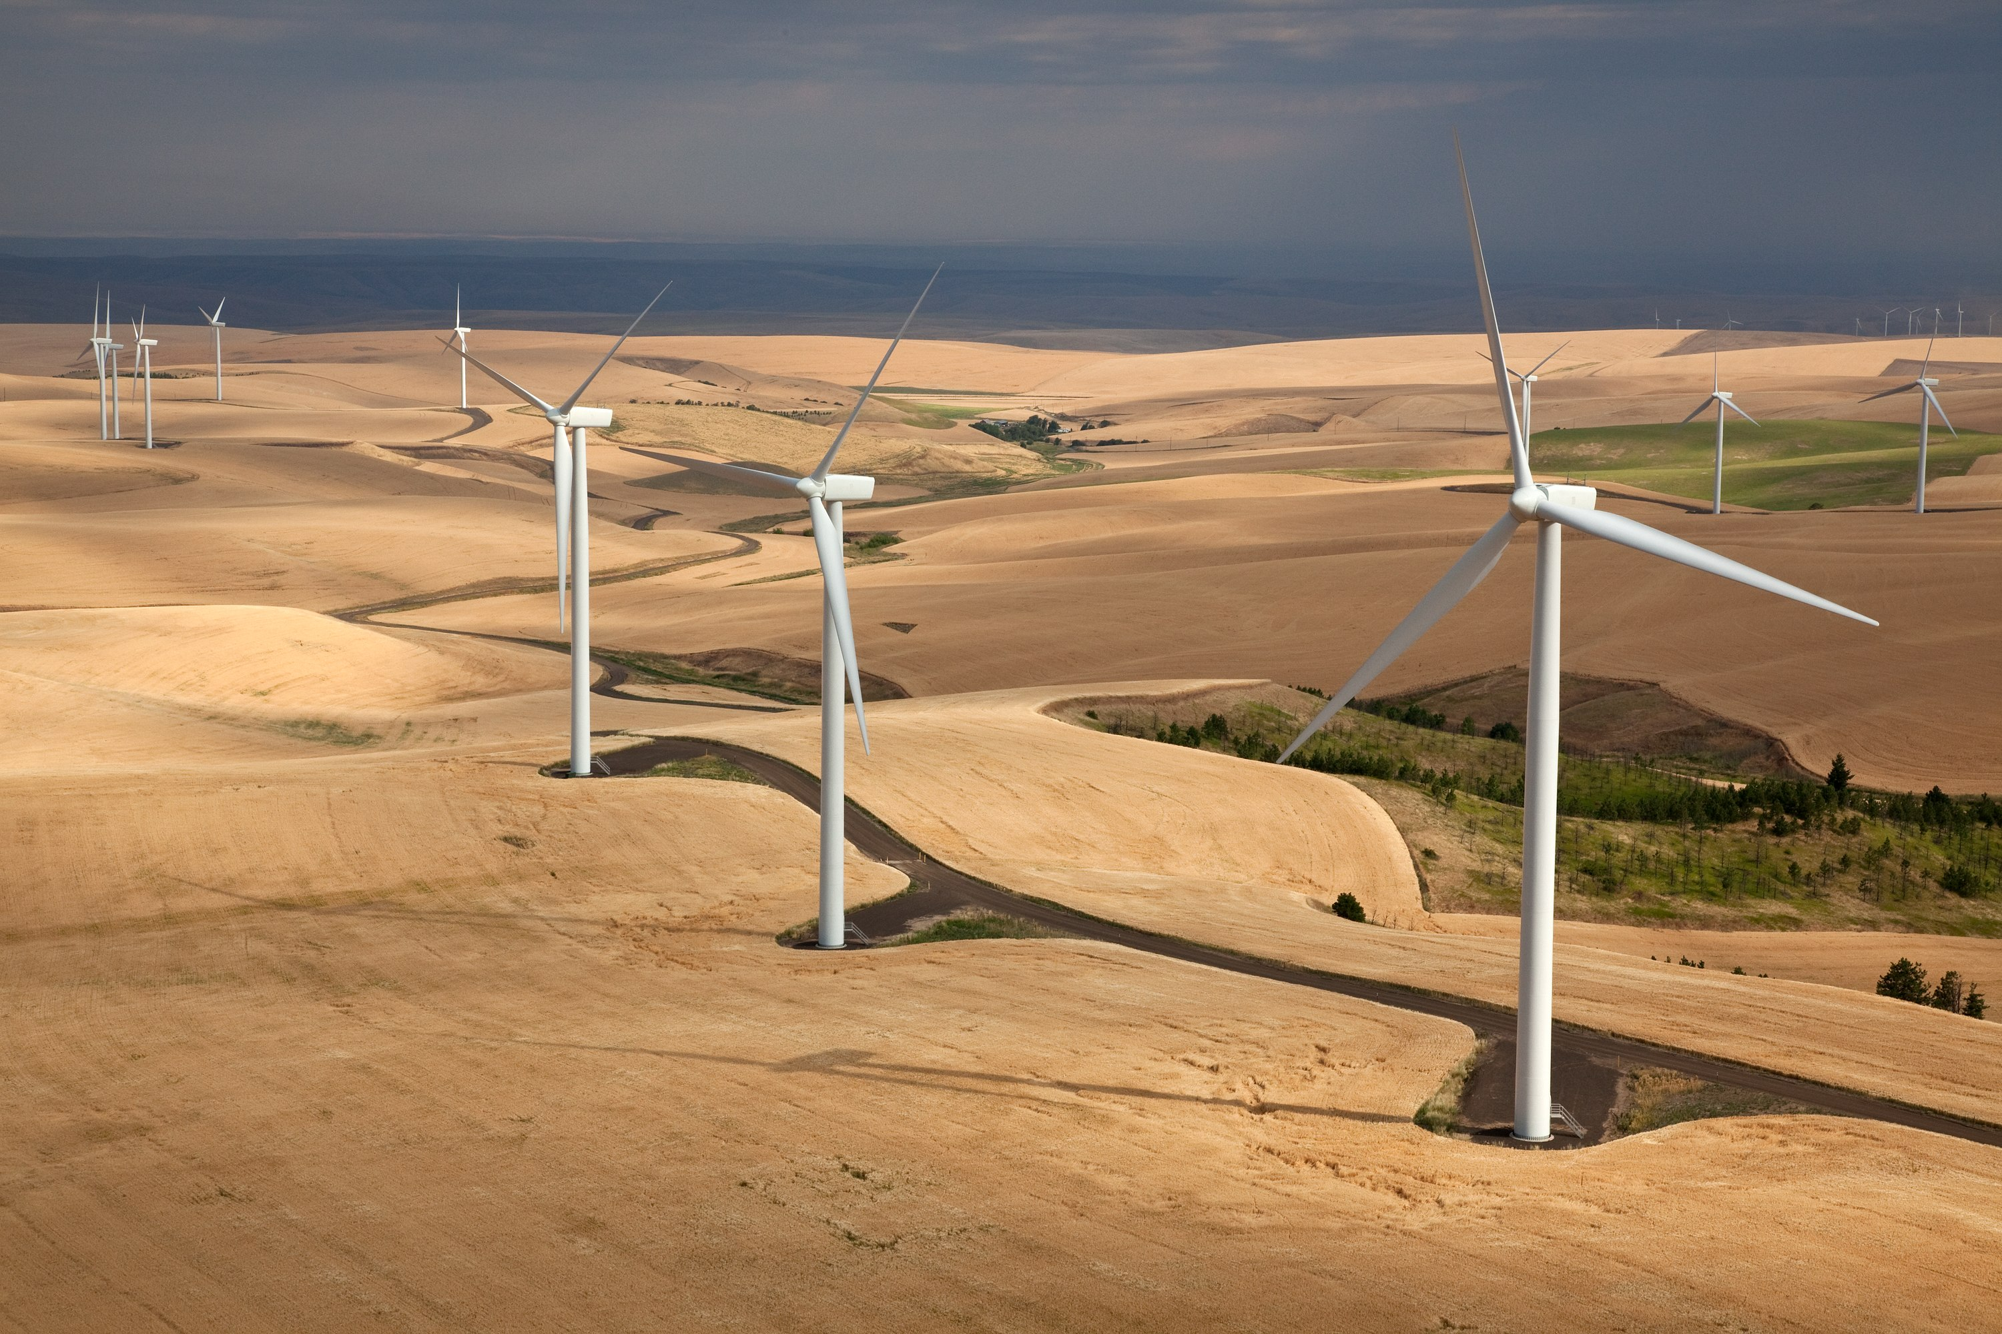
Guiding Principles for Redevelopment
This Photo by Unknown Author is licensed under CC BY-SA
This Photo by Unknown Author is licensed under CC BY-SA-NC
Post 7th plan it was clear risks on the power system were changing, what was needed to understand these risks?
Policies and goals veering towards more clean and renewable grid.
Adding resources that fulfilled those policies have different characteristics and risks associated than with traditional baseload resources and hydro
Reexamine assumptions and simplifications in modeling to get the best answer we can.
https://www.nwcouncil.org/energy/energy-advisory-committees/system-analysis-advisory-committee/genesys-%E2%80%93-generation-evaluation-system-model
This Photo by Unknown Author is licensed under CC BY
This Photo by Unknown Author is licensed under CC BY-SA

Slide 6
Review: Goals of Redevelopment
Serve Needs of Multiple Users and Uses
Currently used by the Council, BPA and other regional stakeholders.
Used for annual regional adequacy assessments, regulated hydro flow studies, and analysis of change in revenue due to differing hydro operations.
Maintain all necessary current functionality.
Answer new questions that previous model could not answer.
Notes:
Needs to be discussed out explicitly
1) Prevent leaving important functionality behind.
2) Challenging because different users use the model to support a variety of analytics.
Multiple Users – Currently used by the Council, BPA and other regional stakeholders.
Multiple Uses – Used for annual regional adequacy assessments, regulated hydro flow studies, and analysis of lost revenue due to hydro dispatch change.

Slide 7
Review: Goals of Redevelopment
Improve Model Accuracy
Co-optimize energy and reserve requirements by cost.
Better reflect forecast error and market economic effects on regional portfolio dispatch.
Incorporate future value of resources with storage into scheduling.
Incorporate emergency resources into dispatch.
Move from aggregate hydro to plant specific hourly dispatch.
Notes:
Cannot study adequacy without consideration of economics in our region.
Time-dependent nature of the hourly hydro capability – model cascading of multiple dams as part of the system dispatch
Interaction between assignment of reserves and system capacity – incorporate reserves into an optimized dispatch
Trade-off between decisions for economics and adequacy – improved market representation
Representation of limitations on operators in dispatching the system – add fuel accounting and forecast error

Slide 8
Review: Goals of Redevelopment
Improve Model Usability
Currently, model inputs, execution and output processing all are via FORTRAN.
Potentially keep FORTRAN for execution of code and structure, but incorporate an easier input and output processing interface.
Notes:
Model support is currently by FORTRAN experts.
Input and output data management is challenging.

Slide 9
What Are Similarities between the Models
Perform hourly simulation of regional hydro and thermal resource generation under varying stochastic inputs:
Temperature variation (load)
Wind and solar generation
Water supply
Thermal forced outages.
Incorporate all appropriate constraints of the Columbia River Basin and west-side hydro projects to replicate reasonable system operation on a period, daily and hourly basis.
Notes:
The dispatch of resources is actually accomplished using resource stacking instead of evaluating each resource against a set electricity market price.

Slide 10
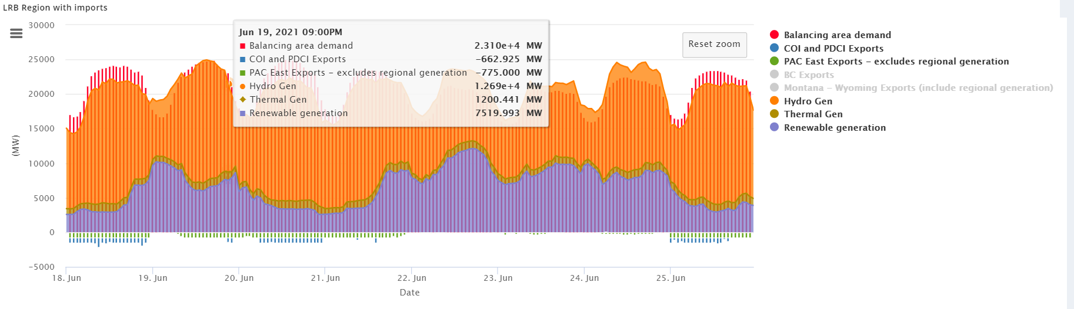
Comparison – Model Usability
Attribute | Classic GENESYS | Redeveloped GENESYS
Model Interface | Fortran code, text and executable files | Web based GUI
Data Input/Output | Text files and sub routines to extract data (input/output) | Excel/GUI (input) and image/text/spreadsheet (output)
Data Storage | Local server/workstation | Cloud and local storage possible
Data Processing | Local server/workstation | Cloud and local capabilities

Slide 11
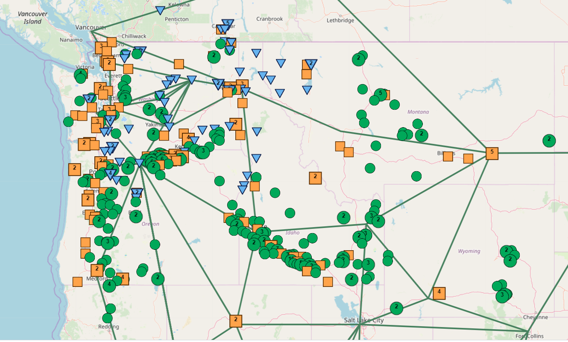
Comparison – Model Functionality
Attribute | Classic GENESYS | Redeveloped GENESYS
Hydro Resources | Modeled in aggregate hourly, modeled individually monthly | Modeled individually for all stages
Topology | Regional resources and demand in two nodes and external market supply is one node | Multiple market and regional nodes with loads, resources and seasonal transfer limits
Energy and Reserves | Balancing reserves on hydro system only. Contingency reserve check | Co-optimized dispatch of energy and all reserves
Forecast Error | No error other than Thermal FOR | Forecast error for load and renewable resources affects unit commitment and market position, and thermal FOR
Value of Hydro | Input by user. Hydro block pricing relative to operating costs of specific resources | Future value of hydro explicitly calculated
Fuel Accounting | Modeled in aggregate hourly per sustained peaking limits, modeled individually monthly | For hydro, battery and gas plants on an individual basis.
Emergency Resources | Modeled in aggregate | Modeled individually

Slide 12
Ongoing Work
Stakeholder Conference and Beyond
Continue to vet and communicate validated weekly constraints to stakeholders
Continue to incorporate and validate hourly constraints on the river system.
Continue to vet hourly simulated river operations with BPA and other stakeholders to ensure reasonable river operation with planning level data.

Slide 13
Learnings So Far
Maintaining consistency with HYDSIM and hourly operational modeling assumptions is a challenge
Simulating operations with planning level data can sometimes create a disconnect, but seems to be OK for adequacy purposes
Incorporating market fundamentals helps close a disconnect between day to day planning and adequacy studies, but raises more questions about risk
As with all modeling exercises, this will continue to require reexamination of simplifications and assumptions

Slide 14
River Operations on the Columbia and Tributaries
Review data sources, assumptions and structure
Individual plant operations: generation, spill, reservoir elevations, total flow

Slide 15
The Two Adequacy Models and Historical Data
Comparisons of hydro-project data between:
Classic GENESYS vs Redeveloped GENESYS
Classic GENESYS vs Historical data
Redeveloped GENESYS vs Historical data
For each hydro-project upstream of Bonneville, compare the four types of data:
Total Outflow - spilled and turbined flow
Generation – generation from the plant
Elevation – elevation of the forebay of the reservoir
Spill – flow through or over the plant not used for power generation

Slide 16
The Hydro Projects

Slide 17
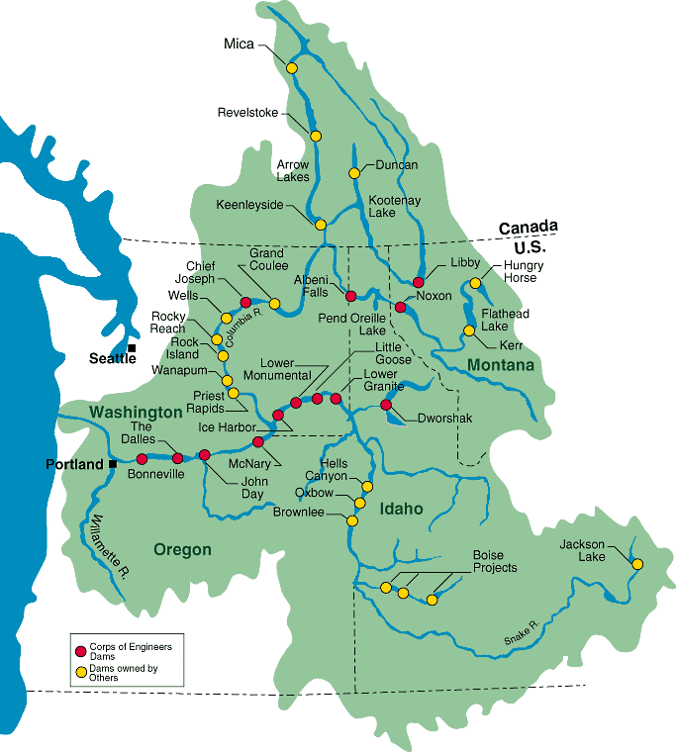
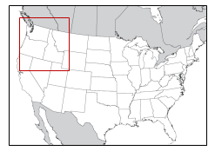
The Hydro-Projects
GENESYS model operations for the same 76 HDYSIM hydro-projects
Some of the major reservoirs are shown in map

Slide 18
The 55 Projects Upstream of Bonneville
U.S. Projects
Canadian Projects

Slide 19
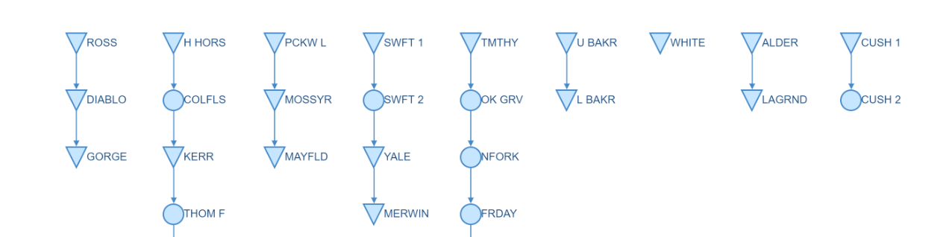
The GENESYS 55 Hydro Projects (I)
reservoir
(SKQ)
run-of-river

Slide 20
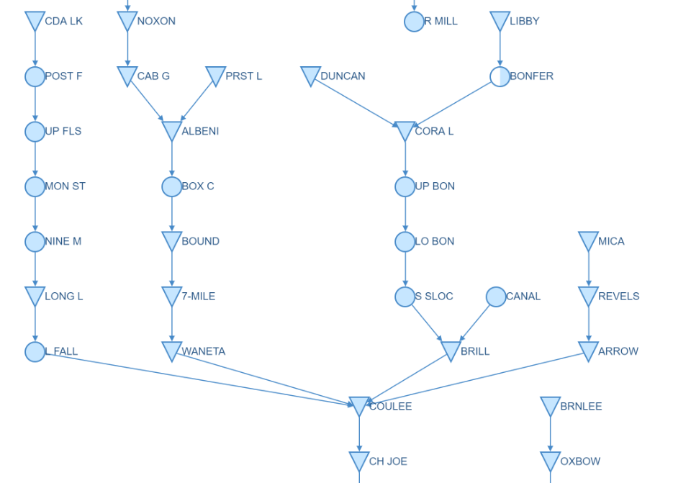
The GENESYS 55 Hydro Projects (II)
from Thompson Falls
gauging station

Slide 21
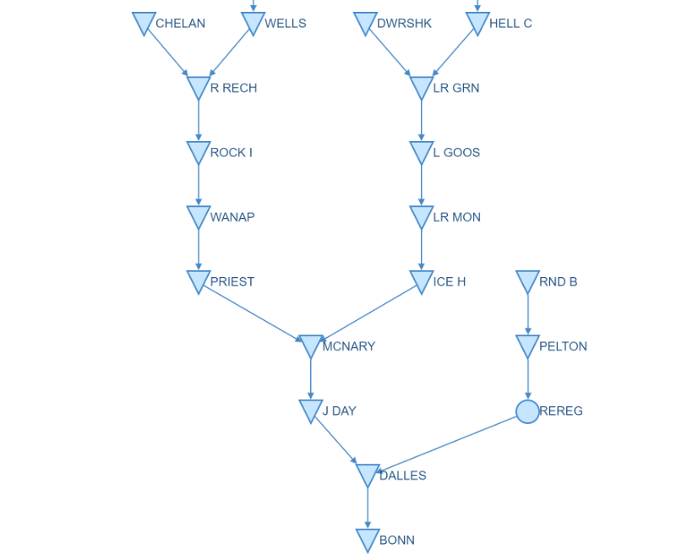
The GENESYS 55 Hydro Projects (III)
from Chief Joseph
from Oxbow

Slide 22
Running the Two Adequacy Models

Slide 23
Modeling the Northwest Power System
The two adequacy models are run to simulate the Northwest power system for the year 2025

Slide 24
Data for Two Models
Both the Classic and Redeveloped GENESYS models are run with climate data for the three climate scenarios:
A: CanESM2_RCP85_BCSD_VIC_P1
C: CCSM4_RCP85_BCSD_VIC_P1
G: CNRM-CM5_RCP85_MACA_VIC_P3
more details available in the River Management Joint Operating Committee (RMJOC) report: https://www.bpa.gov/p/Generation/Hydro/hydro/cc/RMJOC-II-Report-Part-I.pdf )
The models are run with the climate data (streamflow, temperature and wind) for 2020 – 2029 using one historical hourly wind-profile

Slide 25
Classic GENESYS
BPA provided modified streamflows, flood control rule curves and constraints for the 3 climate scenarios to run the HYDSIM hydro-regulation model in classic GENESYS
HYDSIM output contains 14 end-of-period (Oct, Nov, …, Apr_1, Apr_2, …, Aug_1, Aug_2, Sep) storages for the reservoir projects
These HYDSIM regulations for the projects satisfy all the input constraints according to a priority list

Slide 26
Redeveloped GENESYS (I)
These 14 end-of-period HYDSIM storages are interpolated into weekly time-steps to regulate the GENESYS weekly reservoir storages
For the weekly time-steps, the GENESYS reservoir regulations should also satisfy the same constraints as HYDSIM
However, there are also some deviations from following HYDSIM

Slide 27
GENESYS (II)
U.S. Projects
Canadian Projects
HYDSIM run-of-river projects become Redeveloped GENESYS reservoirs
Redeveloped GENESYS has different regulations for these reservoirs

Slide 28
Properties of the 3 Selected Climate Scenarios

Slide 29
Climate Scenarios vs Historical Data
From the RMJOC report:
Temperatures have already warmed about 1.5°F in the region since the 1970s.
They are expected to warm another 1 to 4°F by the 2030s (2020 to 2049).
Future precipitation trends are more uncertain, but a general upward trend is likely for the rest of the 21st century, particularly in the winter months.
Already dry summer months could become drier.
By the 2030s higher average fall and winter flows, earlier peak spring runoff, and longer periods of low summer flows are very likely.

Slide 30
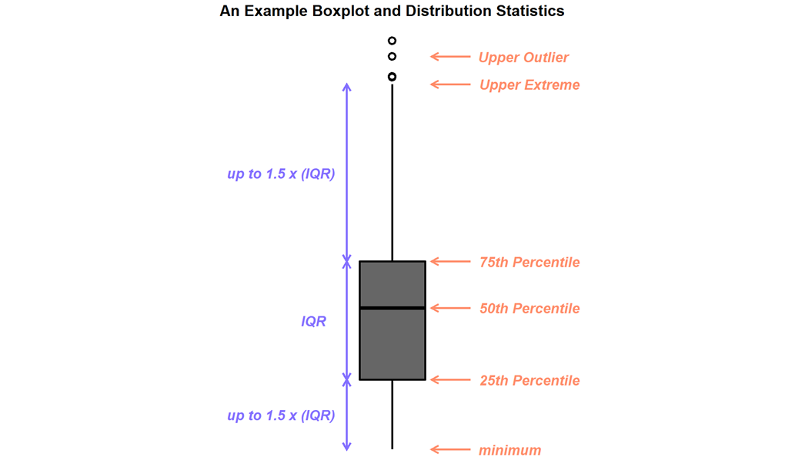
The Box-and-Whiskers Plot

Slide 31
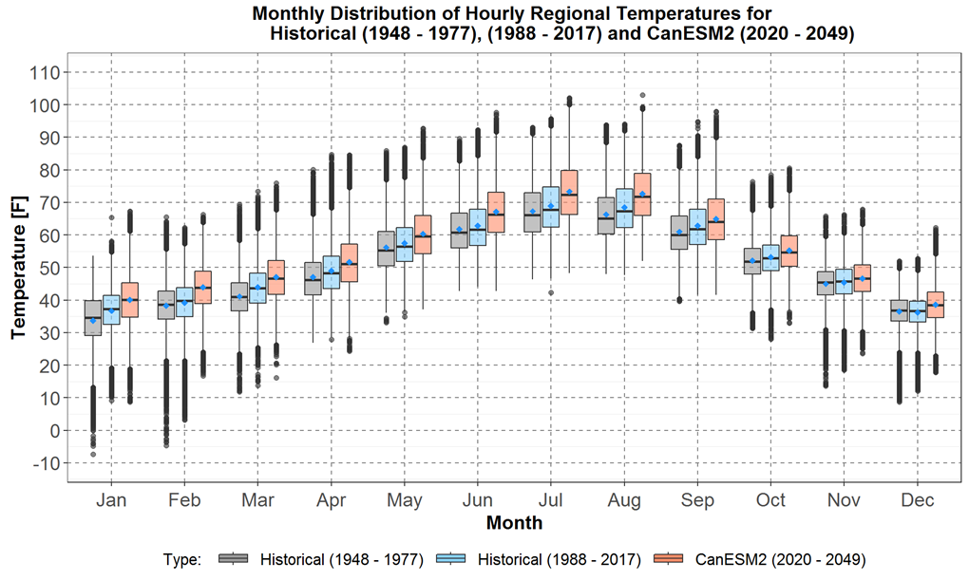
Historical and Climate Scenario A Regional Temperatures

Slide 32
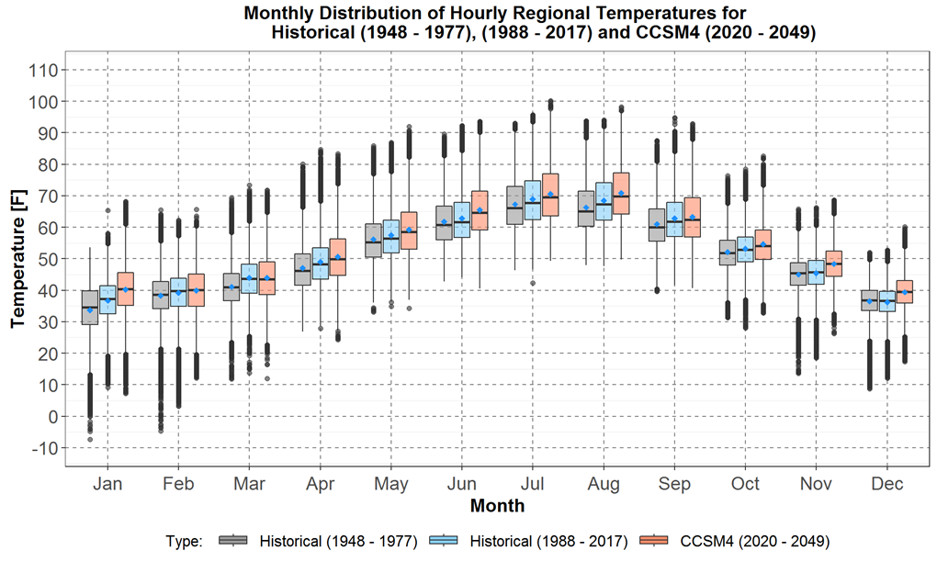
Historical and Climate Scenario C Regional Temperatures

Slide 33
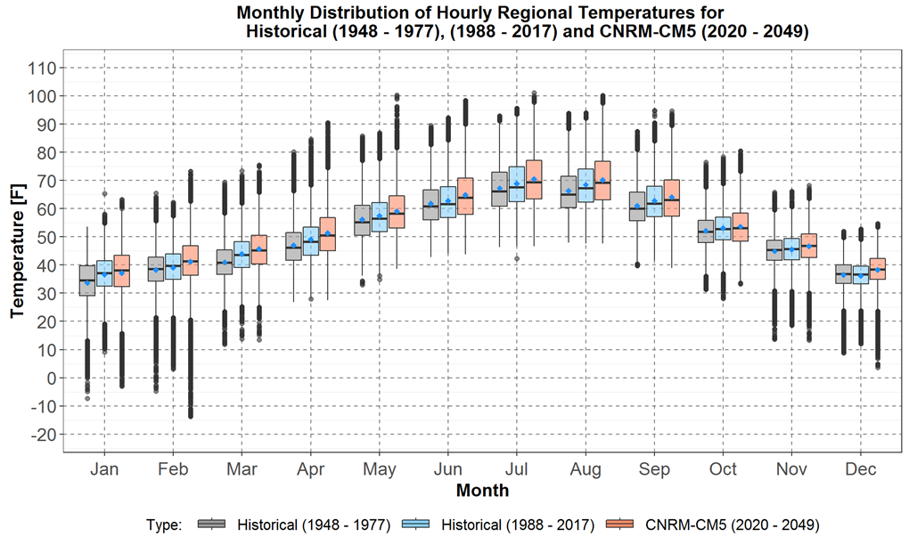
Historical and Climate Scenario G Regional Temperatures

Slide 34
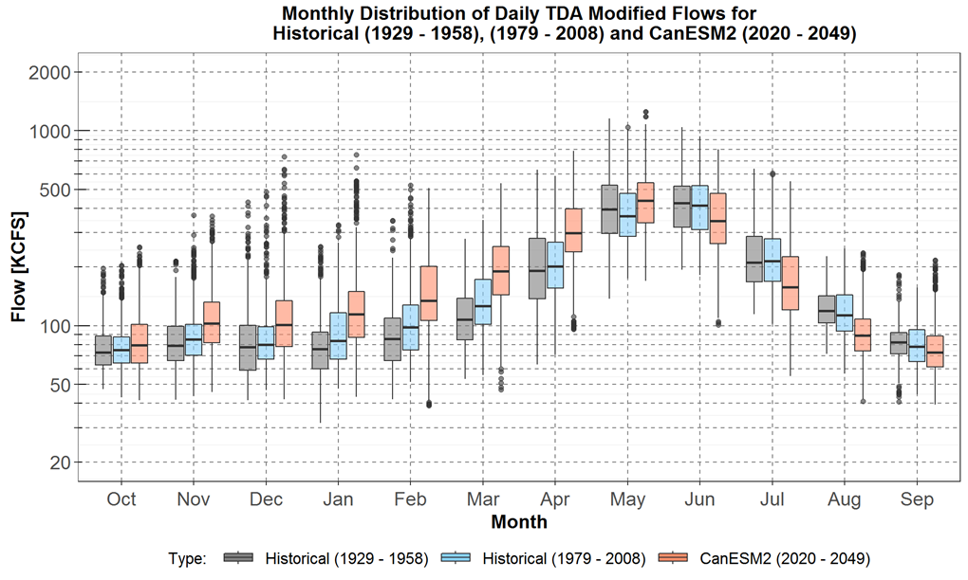
Historical and Climate Scenario A Modified Flows at the Dalles

Slide 35
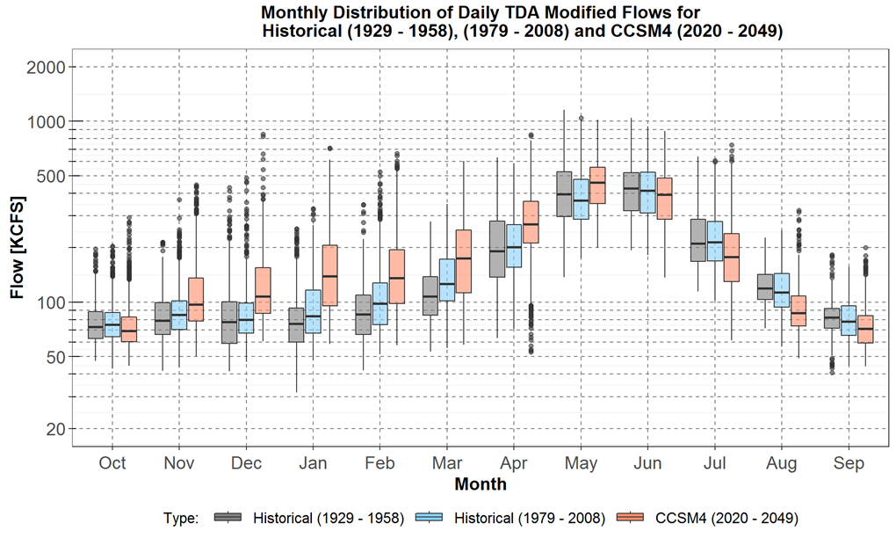
Historical and Climate Scenario C Modified Flows at the Dalles

Slide 36
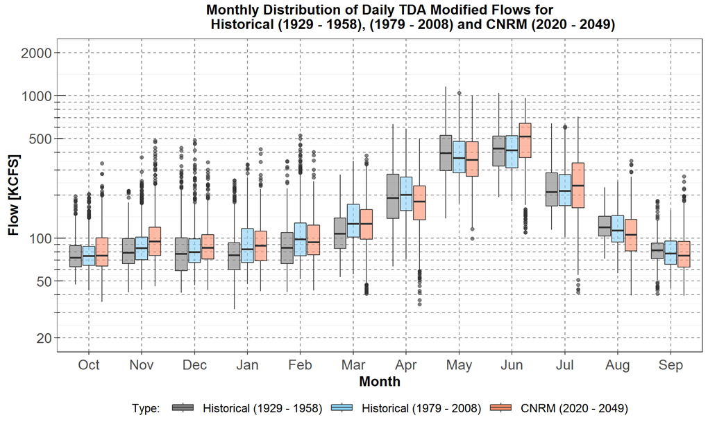
Historical and Climate Scenario G Modified Flows at the Dalles

Slide 37
The Historical Data

Slide 38
Historical Hydro Project Data Sources
The Corps of Engineers website
https://www.nwd-wc.usace.army.mil/dd/common/dataquery/www/
Data for 25 U.S. projects (upstream of Bonneville) available
Recent 10 years 2010 to 2019*
Mostly hourly data, with some daily data
All 4 types of data are mostly available
The Canadian Historical Hydrometric Data website
https://wateroffice.ec.gc.ca/search/historical_e.html
Data for 4 Canadian projects (upstream of Bonneville) available
Recent 10 years 2009 to 2018
Only daily data, and only 1 or 2 types of data available

Slide 39
Comparisons between GENESYS and Historical Data

Slide 40
Comparing Data (I)
GENESYS output are for 10 years of simulated hourly data using climate data
Historical data include 10 years of hourly and daily data
Comparisons of GENESYS with historical data are in terms envelopes and averages
For hourly Data: as example, for Oct 1, 0th hour
upper envelope for GENESYS data x is calculated by
max( x_{10/1/2020 00:00:00}, x_{10/1/2021 00:00:00}, …, x_{10/1/2029 00:00:00} )
lower envelope for GENESYS data x is calculated by
min( x_{10/1/2020 00:00:00}, x_{10/1/2021 00:00:00}, …, x_{10/1/2029 00:00:00} )
average for GENESYS data x is calculated by
average( x_{10/1/2020 00:00:00}, x_{10/1/2021 00:00:00}, …, x_{10/1/2029 00:00:00} )

Slide 41
Comparing Data (II)
For daily Data: as example, for Oct 1
upper envelope for GENESYS data x is calculated by
max( x_{10/1/2020 00:00:00}, x_{10/1/2020 01:00:00}, …, x_{10/1/2020 23:00:00},
x_{10/1/2021 00:00:00}, x_{10/1/2021 01:00:00}, …, x_{10/1/2021 23:00:00},
…,
x_{10/1/2029 00:00:00}, x_{10/1/2029 01:00:00}, …, x_{10/1/2029 23:00:00} )
lower envelope for GENESYS data x is calculated by
min( x_{10/1/2020 00:00:00}, x_{10/1/2020 01:00:00}, …, x_{10/1/2020 23:00:00},
x_{10/1/2021 00:00:00}, x_{10/1/2021 01:00:00}, …, x_{10/1/2021 23:00:00},
…,
x_{10/1/2029 00:00:00}, x_{10/1/2029 01:00:00}, …, x_{10/1/2029 23:00:00} )

Slide 42
Comparing Data (III)
For daily Data: as example, for Oct 1
average for GENESYS data x is calculated by
average( x_{10/1/2020 00:00:00}, x_{10/1/2020 01:00:00}, …, x_{10/1/2020 23:00:00},
x_{10/1/2021 00:00:00}, x_{10/1/2021 01:00:00}, …, x_{10/1/2021 23:00:00},
…,
x_{10/1/2029 00:00:00}, x_{10/1/2029 01:00:00}, …, x_{10/1/2029 23:00:00} )

Slide 43
Topology Split in 3 parts

Slide 46
Plant by Plant Presentations and Notes
Structured Exploration
Order – where did we start, where did we end up
Classic* versus Historical (link)
Classic* versus New (link)
New versus Historical (link)
Description of
Spreadsheet (monthly)
(2) Envelope graphs (daily/hourly)
Free-Form Exploration
Observations from previous conversations
Questions from stakeholders
Go into GENESYS live (if necessary) – hourly simulated data
Go into the Army Corp site live (if necessary) – hourly historical data
*Classic GENESYS has HYDSIM as a module, sometimes the results are referred to interchangeably
Not reviewed yet
Review Started But Incomplete
Review Completed

Slide 47
Mica
Outflow – average and range
Generation – average and range
Ending elevation – average and range
Spill– average and range

Slide 48
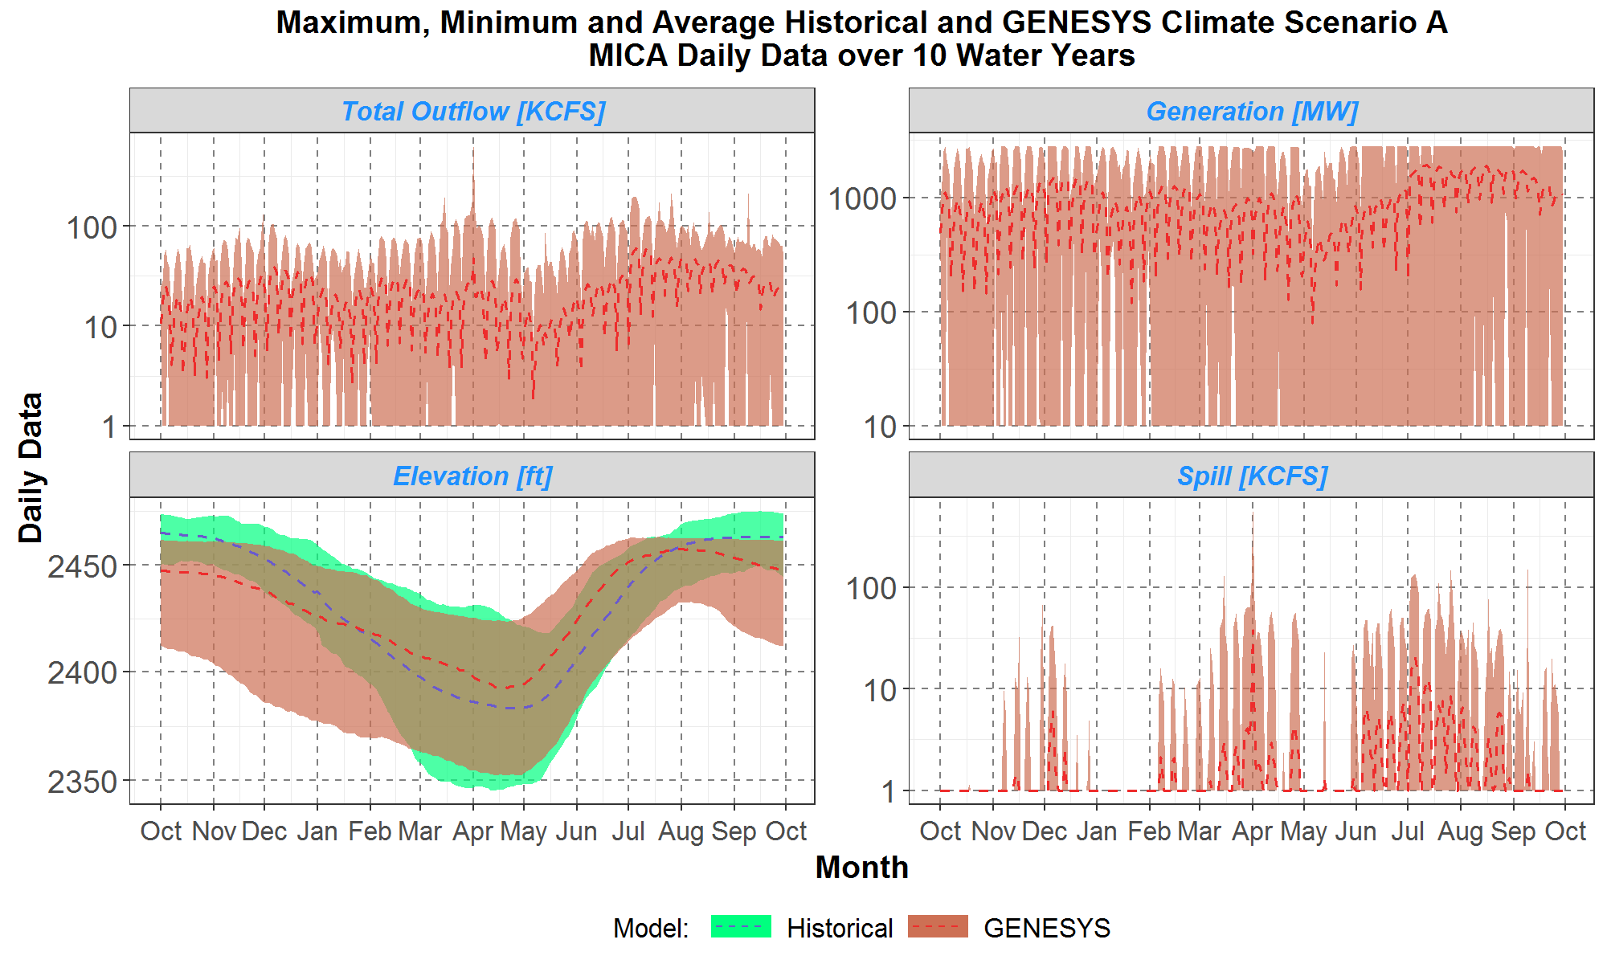
Mica Scenario A

Slide 49
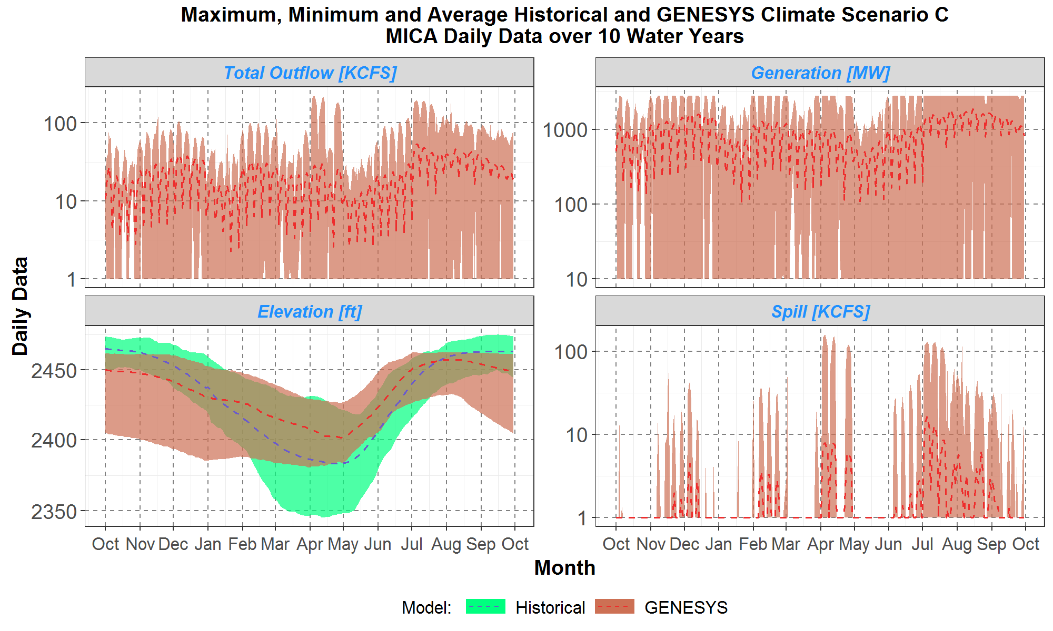
Mica Scenario C

Slide 50
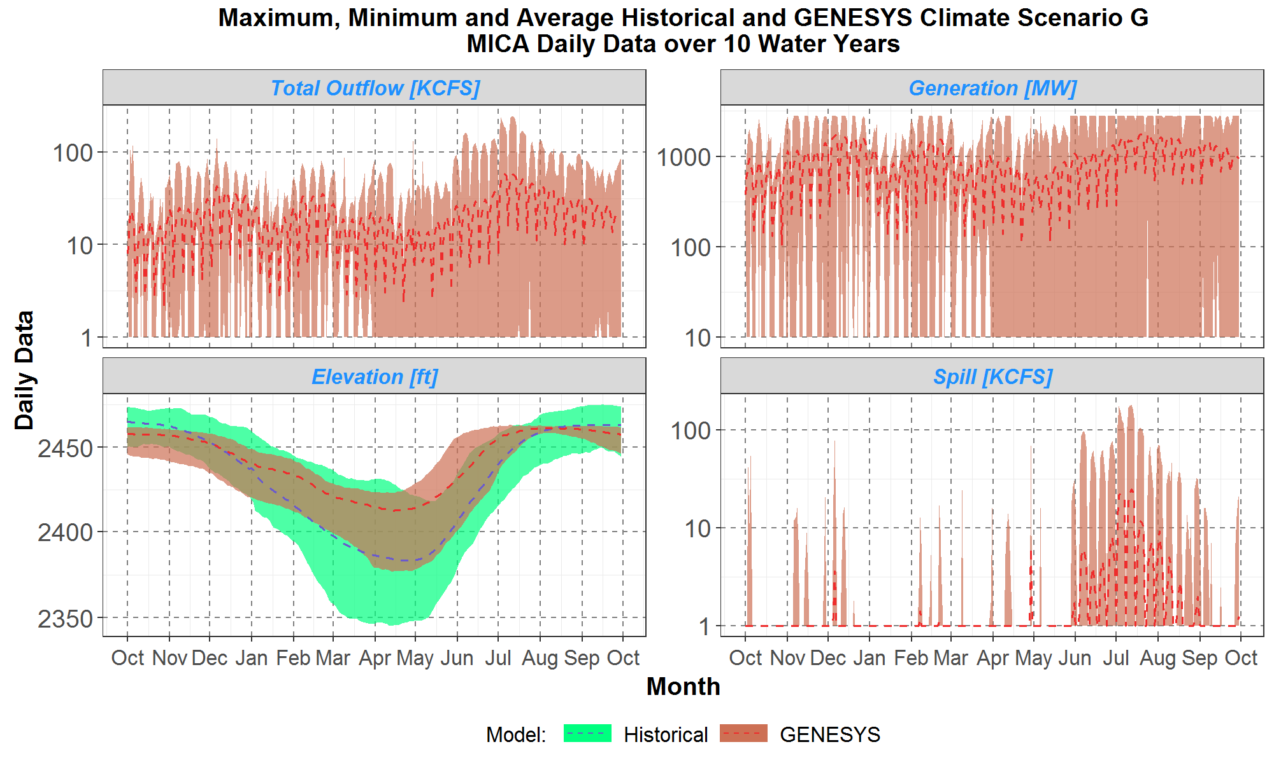
Mica Scenario G

Slide 51
Questions/Notes on Mica
Notes:
Investigate whether storage versus elevation table needs more data points (or different datapoints) to improve efficiency curves translation of net head to energy
Why is the elevation higher in the classic model versus new model?

Slide 52
Revelstoke
Outflow – average and range
Generation – average and range
Ending elevation – average and range
Spill– average and range

Slide 53
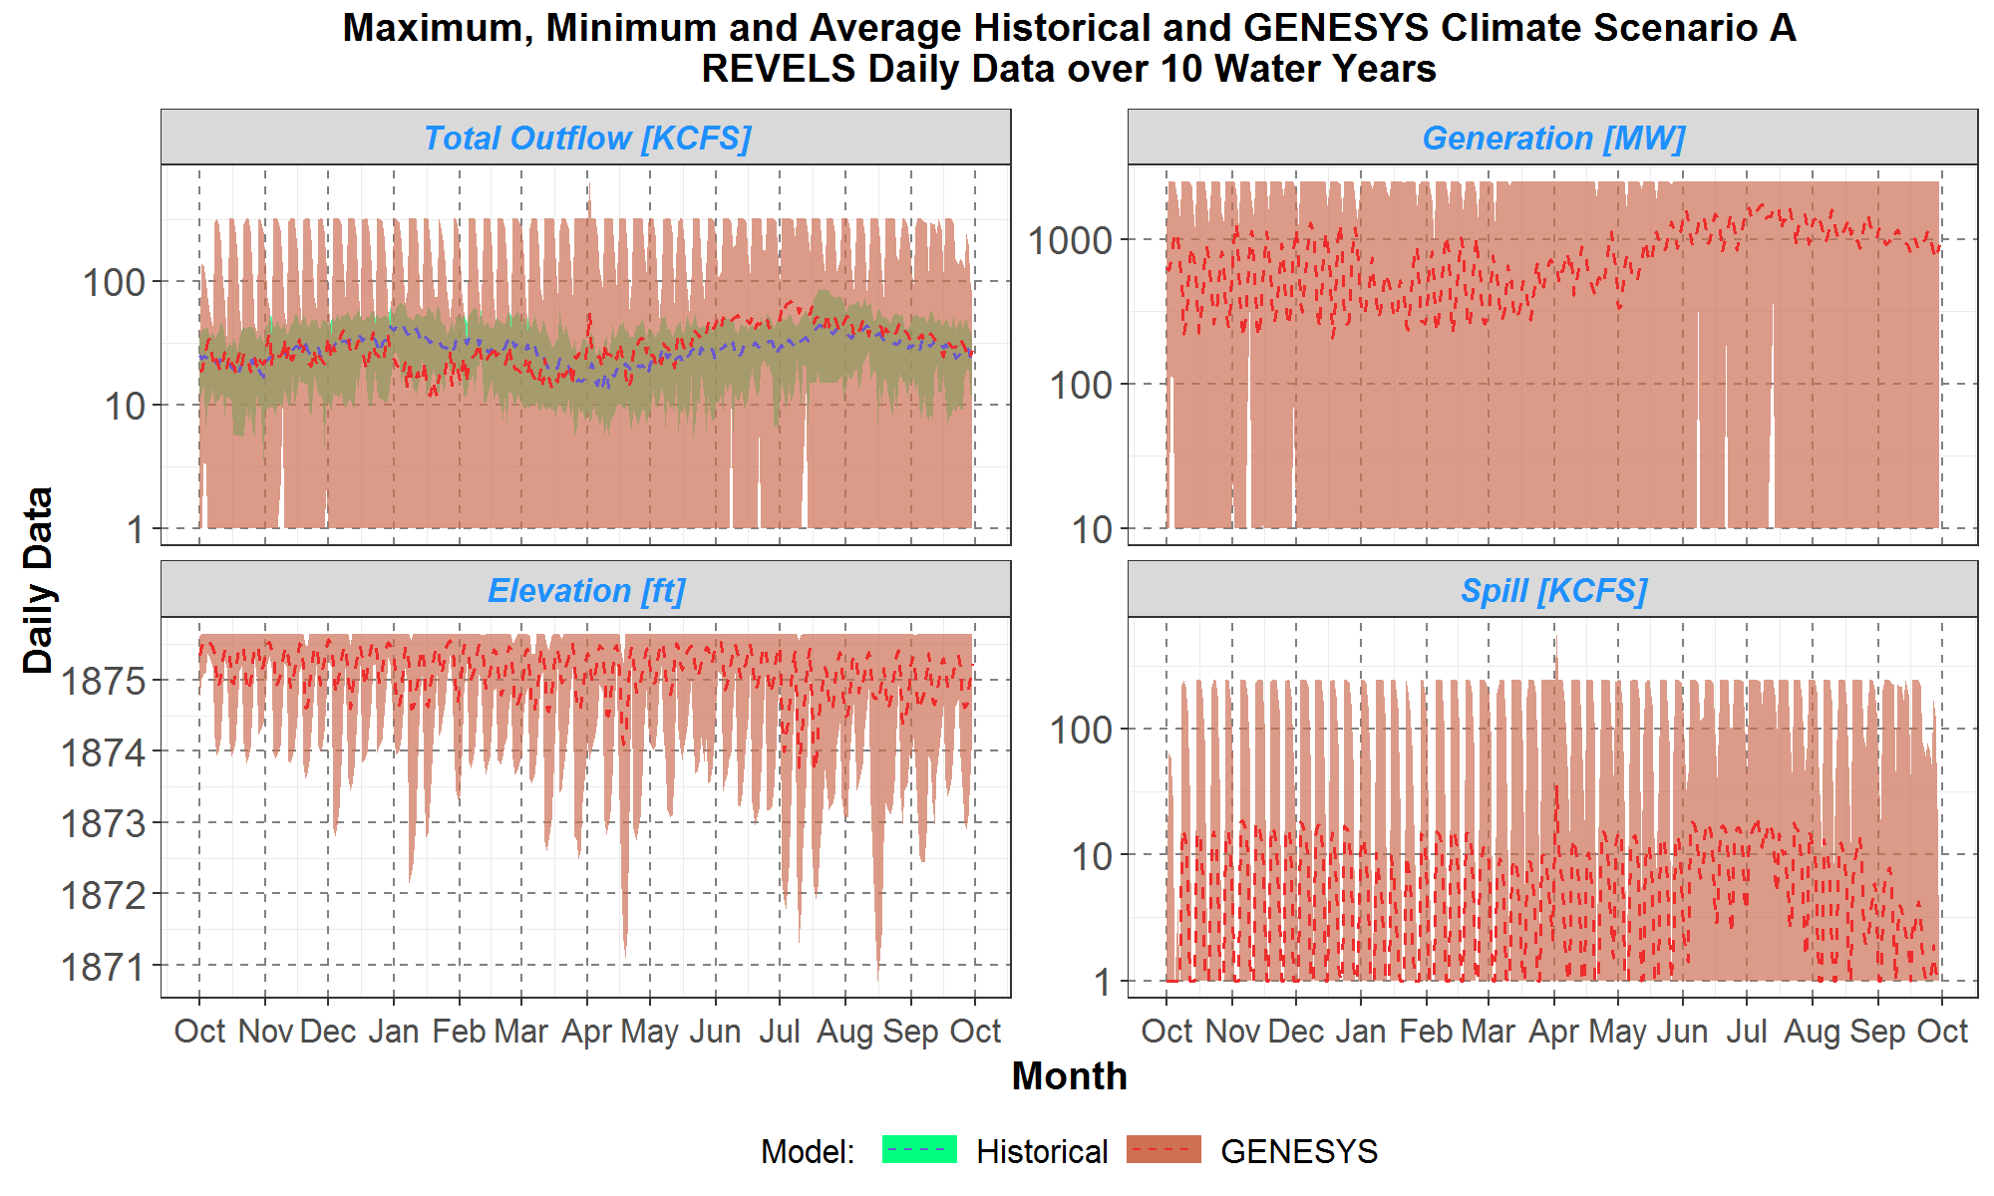
Revelstoke Scenario A

Slide 54
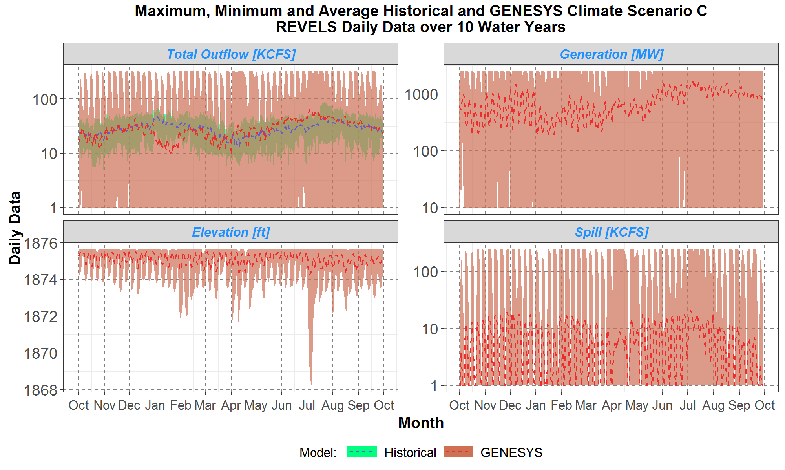
Revelstoke Scenario C

Slide 55
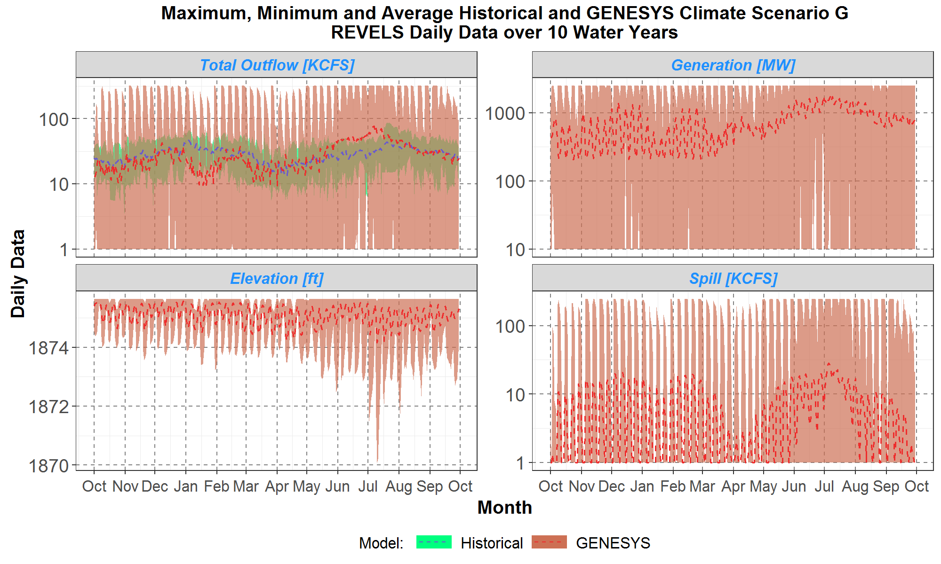
Revelstoke Scenario G

Slide 56
Questions/Notes on Revelstoke
Notes:
BPA notes daily flexibility at Revelstoke (operating within a meter and a half for normal operating range)
Unlikely that Revelstoke could voluntarily drawdown without spilling
Further investigation on the Mica – Revelstoke coordinated operation should be conducted

Slide 57
Arrow
Outflow – average and range
Generation – average and range
Ending elevation – average and range
Spill– average and range

Slide 58
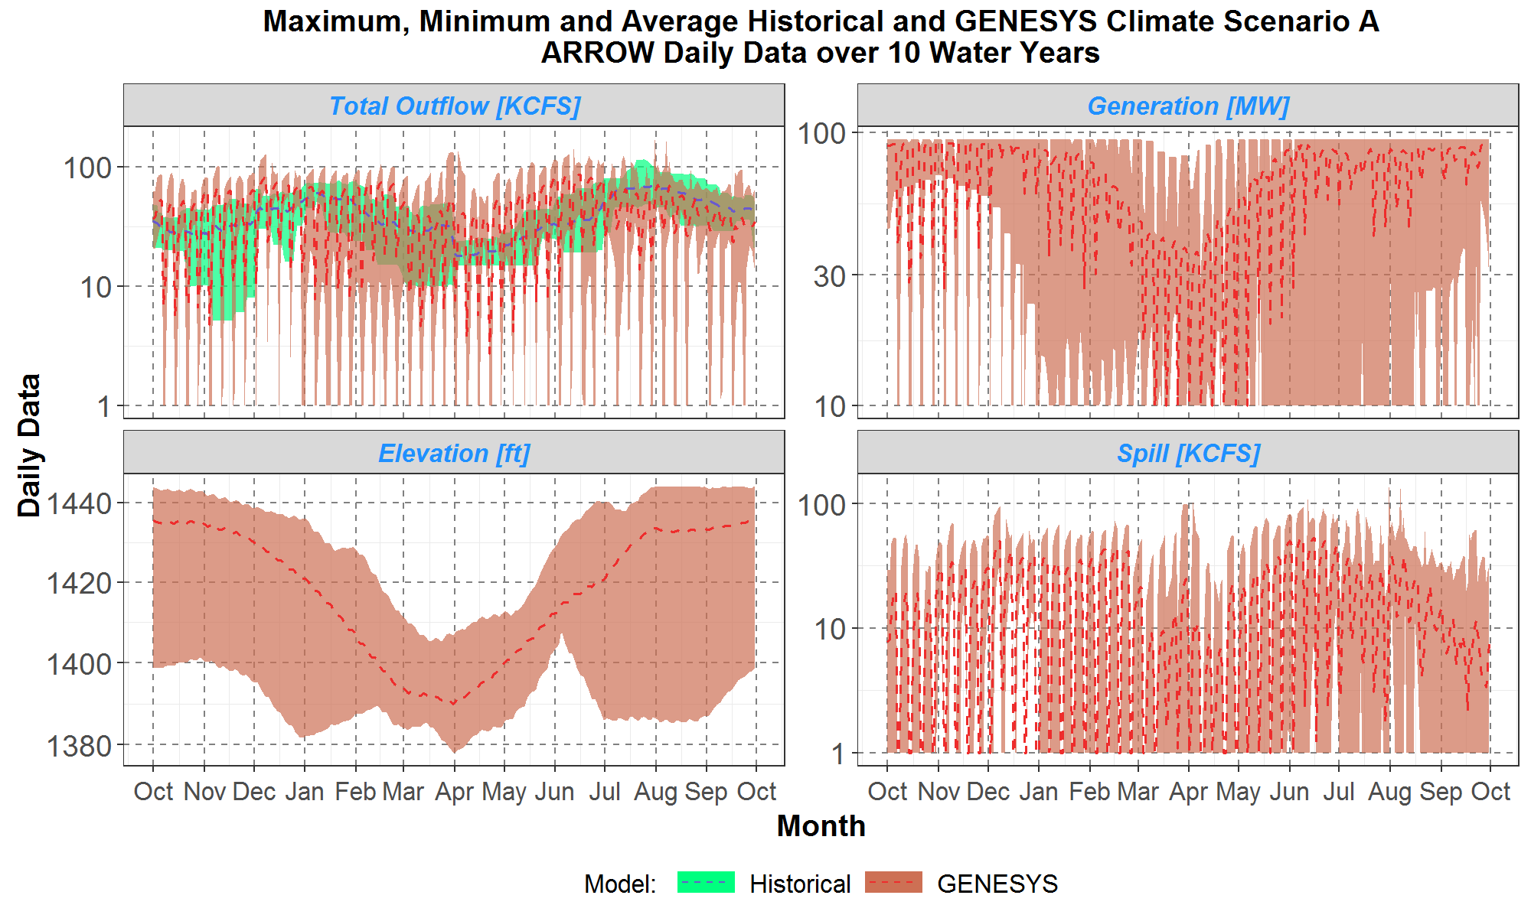
Arrow Scenario A

Slide 59
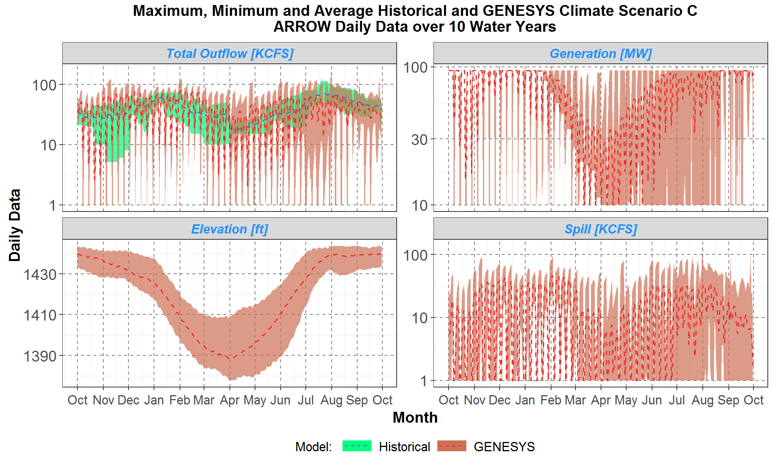
Arrow Scenario C

Slide 60
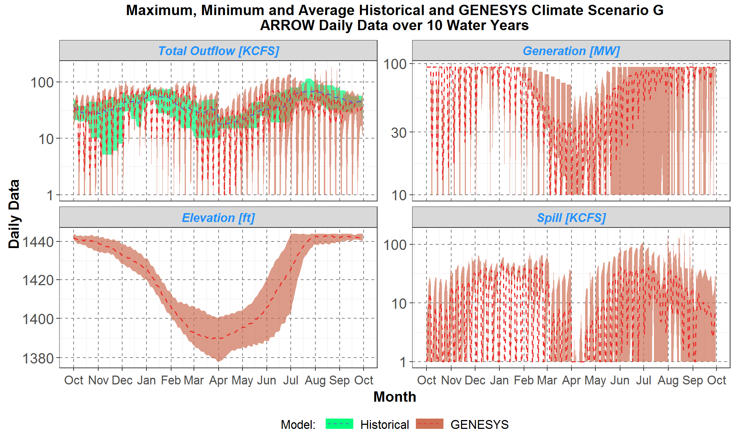
Arrow Scenario G

Slide 61
Questions/Notes on Arrow
Notes:
Why is the generation in the fall and the summer so much higher in the classic GENESYS? Investigate maximum turbine flow in classic.
No discharge rate in classic GENESYS?
H/k table difference?

Slide 62
Duncan
Outflow – average and range
Generation – average and range
Ending elevation – average and range
Spill– average and range

Slide 63
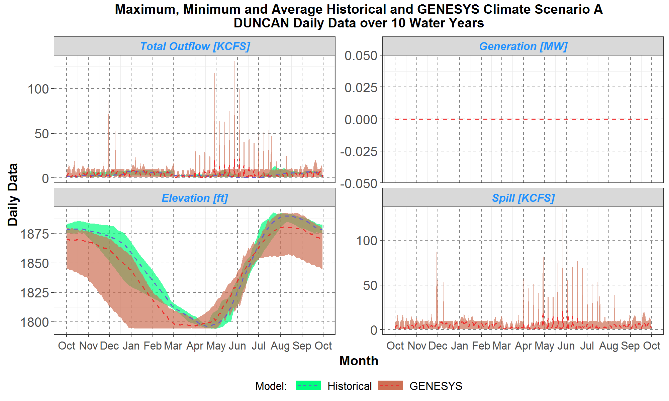
Duncan Scenario A

Slide 64
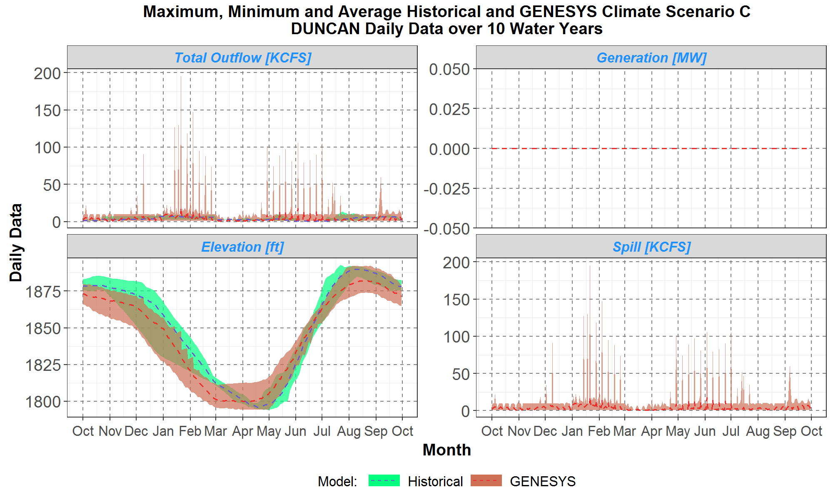
Duncan Scenario C

Slide 65
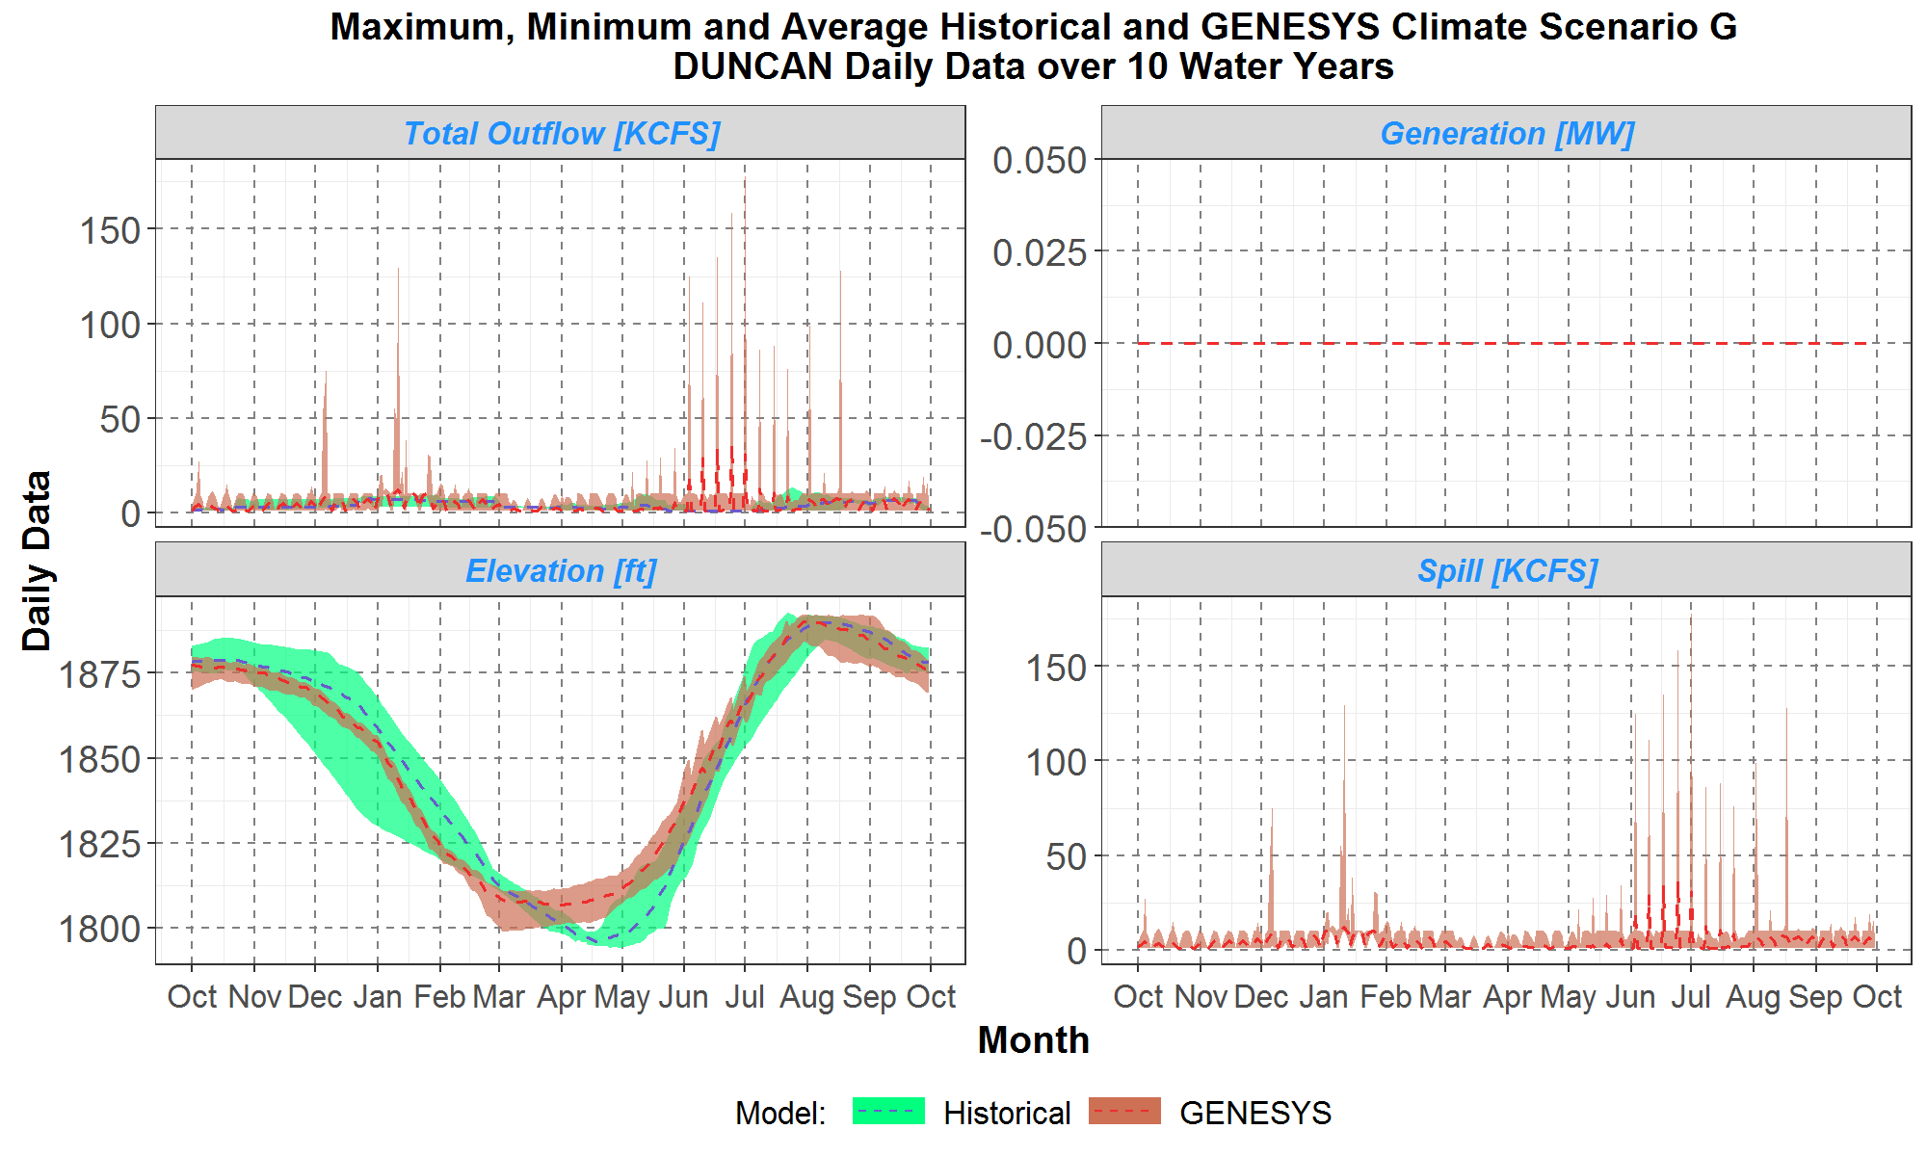
Duncan Scenario G

Slide 66
Questions/Notes on Duncan
Notes:

Slide 67
Libby
Outflow – average and range
Generation – average and range
Ending elevation – average and range
Spill– average and range

Slide 68
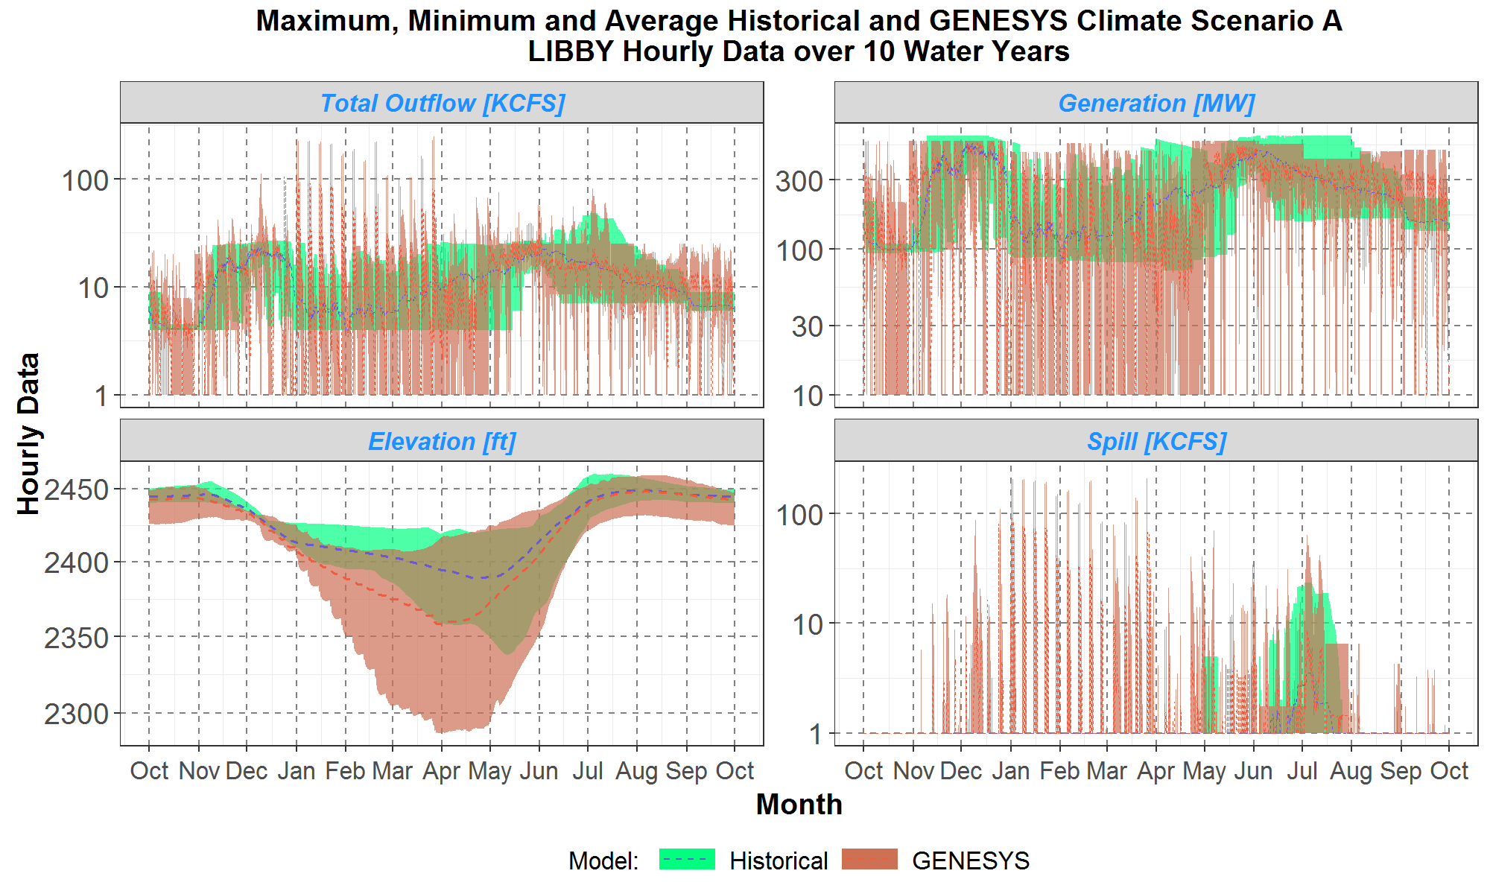
Libby Scenario A

Slide 69
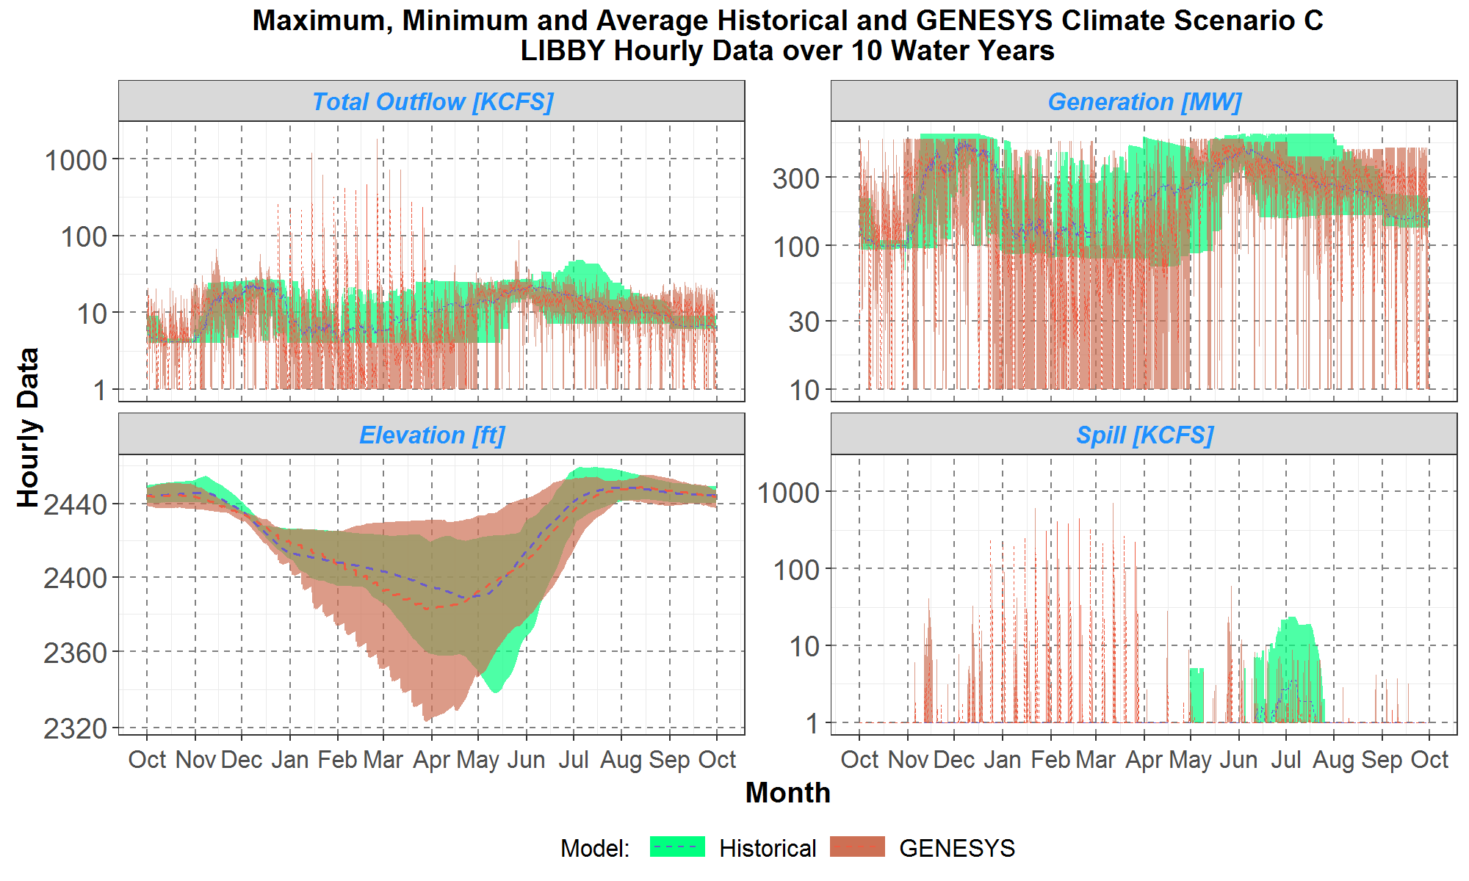
Libby Scenario C

Slide 70
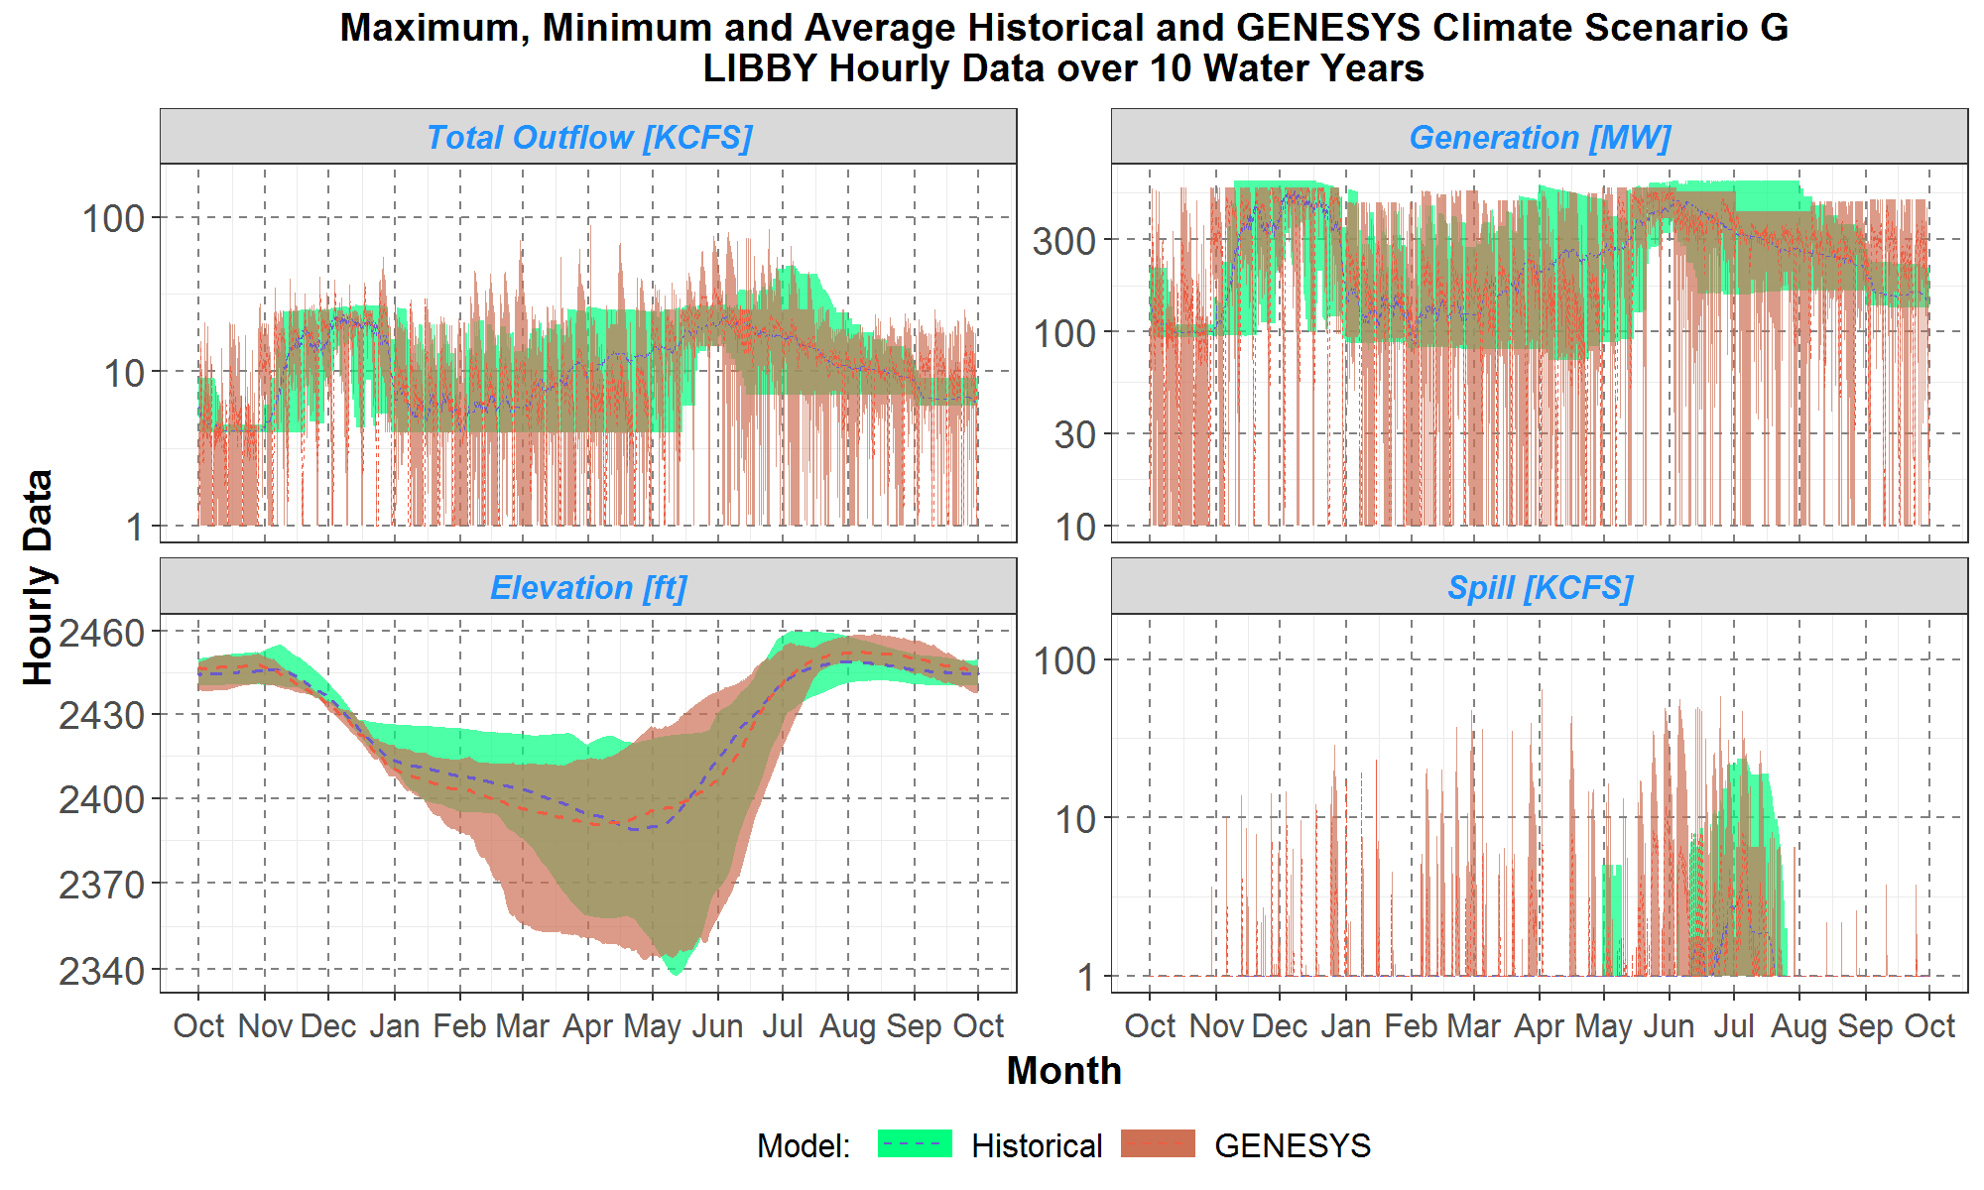
Libby Scenario G

Slide 71
Questions/Notes on Libby
Notes:
Why is Libby spilling in the overnight morning in the winter? Is this the max generation for the net head?
Looks like Libby is at hydraulic capacity (i.e. max turbine flow) and thus any spill is actually probably disadvantageous for Libby itself. Probably this behavior for downstream concerns.

Slide 72
Bonner’s Ferry
Outflow – average and range
Generation – average and range
Ending elevation – average and range
Spill– average and range

Slide 73
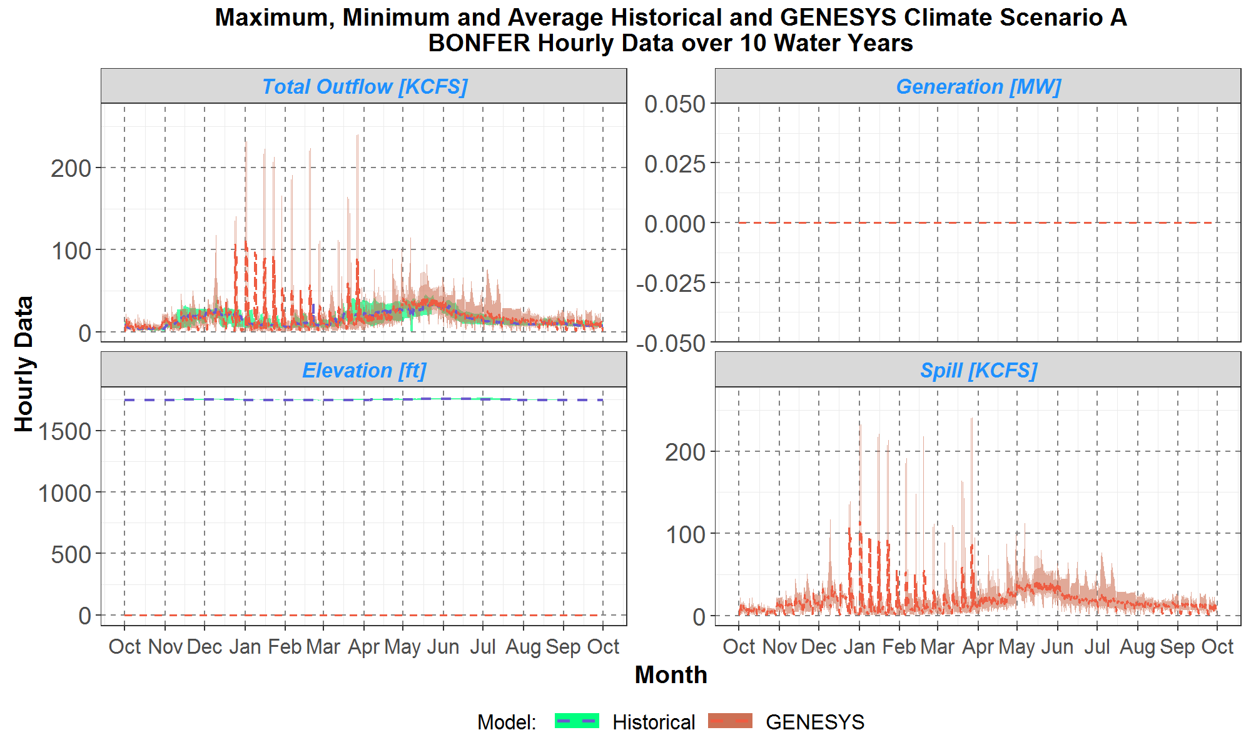
Bonners Ferry Scenario A

Slide 74
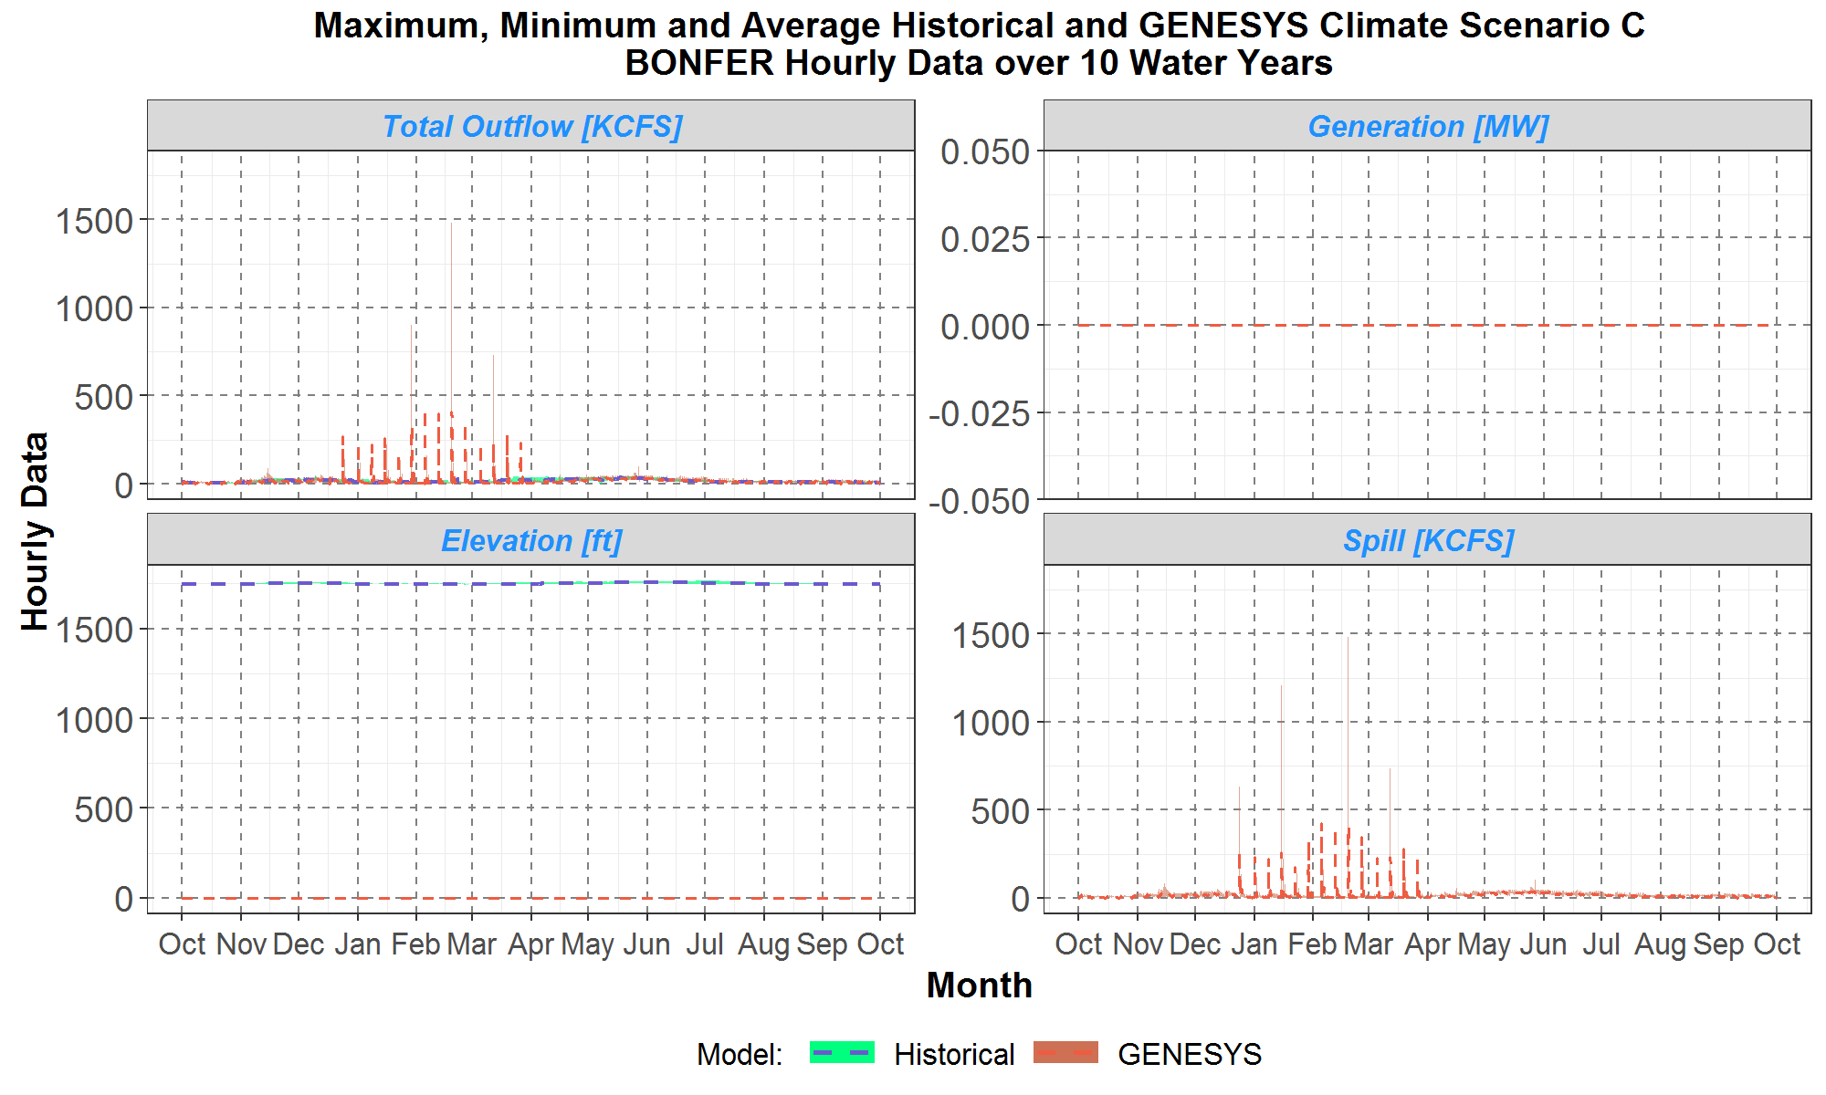
Bonners Ferry Scenario C

Slide 75
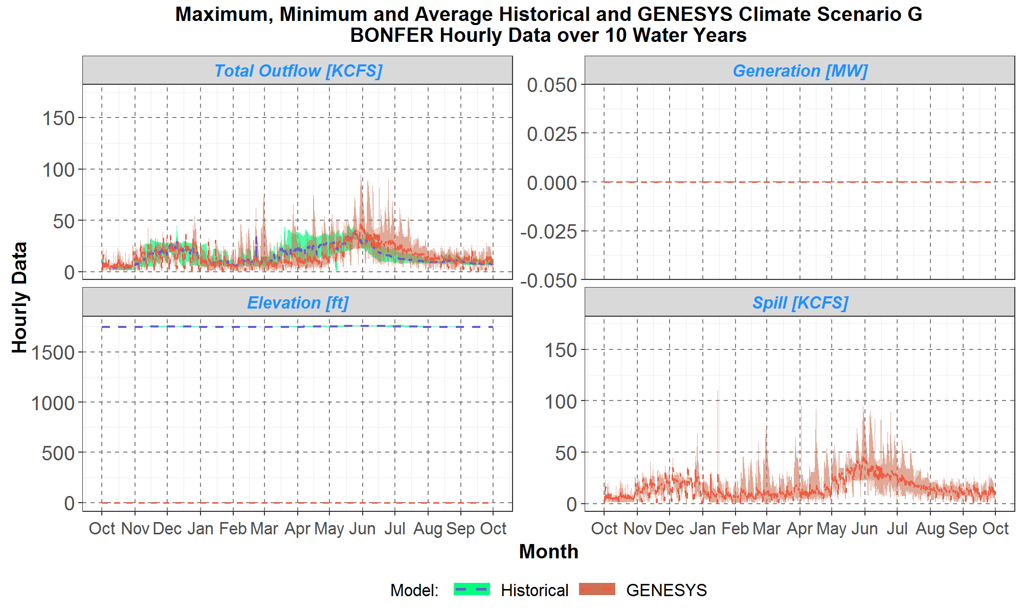
Bonners Ferry Scenario G

Slide 76
Questions/Notes on Bonner’s Ferry
Notes:
Gauging station, not a dam

Slide 77
Cora Linn
Outflow – average and range
Generation – average and range
Ending elevation – average and range
Spill– average and range

Slide 78
Questions/Notes on Cora Linn
A developer of HYDRO6 (a precursor to HYDSIM) stated that the way to solve the hydro modeling of Cora Linn and Canal is with dynamite.
Notes:
At Cora Linn, a canal was built to divert water to the Canal hydro project, which has a higher production factor than Cora Linn and the river plants below Cora Linn (Upper Bonnington, Lower Bonnington, South Slocan). A minimum flow of 5 kcfs is kept going through Cora Linn and the river plants, but water above this goes through Canal, up to full gate flow. Flows above full gate go through the river projects. The flows through Canal meet back up with the river flows at Brilliant.
Unfortunately, the new Genesys as currently configured cannot currently handle splitting the turbine or spill outflows from a project between two downstream projects and then having the flows meet back up again. What it does allow is for the turbine flows to be directed separately from the spill flows. So, currently, the way we are modeling it is that the turbine flows at Cora Linn are directed down through the river projects and the spill flows are directed through the Canal project.

Slide 79
Kootenay Canal
Outflow – average and range
Generation – average and range
Ending elevation – average and range
Spill– average and range

Slide 80
Questions/Notes on Kootenay Canal
Notes:
See previous notes on Cora Linn

Slide 81
Upper Bonnington
Outflow – average and range
Generation – average and range
Ending elevation – average and range
Spill – average and range

Slide 82
Questions/Notes on Upper Bonnington
Notes
See previous notes on Cora Linn

Slide 83
Lower Bonnington
Outflow – average and range
Generation – average and range
Ending elevation – average and range
Spill – average and range

Slide 84
Questions/Notes on Lower Bonnington
Notes:
See previous notes on Cora Linn

Slide 85
South Slocan
Outflow – average and range
Generation – average and range
Ending elevation – average and range
Spill – average and range

Slide 86
Questions/Notes on South Slocan
Notes:
See previous notes on Cora Linn

Slide 87
Brilliant
Outflow – average and range
Generation – average and range
Ending elevation – average and range
Spill – average and range

Slide 88
Questions/Notes on Brilliant
Notes:
Modeled as ROR in HydSim, modeled as storage in new model
Can Brilliant actually have this volatile an operation? Is the extra flexibility significant in changing overall adequacy results?

Slide 89
Hungry Horse
Outflow – average and range
Generation – average and range
Ending elevation – average and range
Spill – average and range

Slide 90
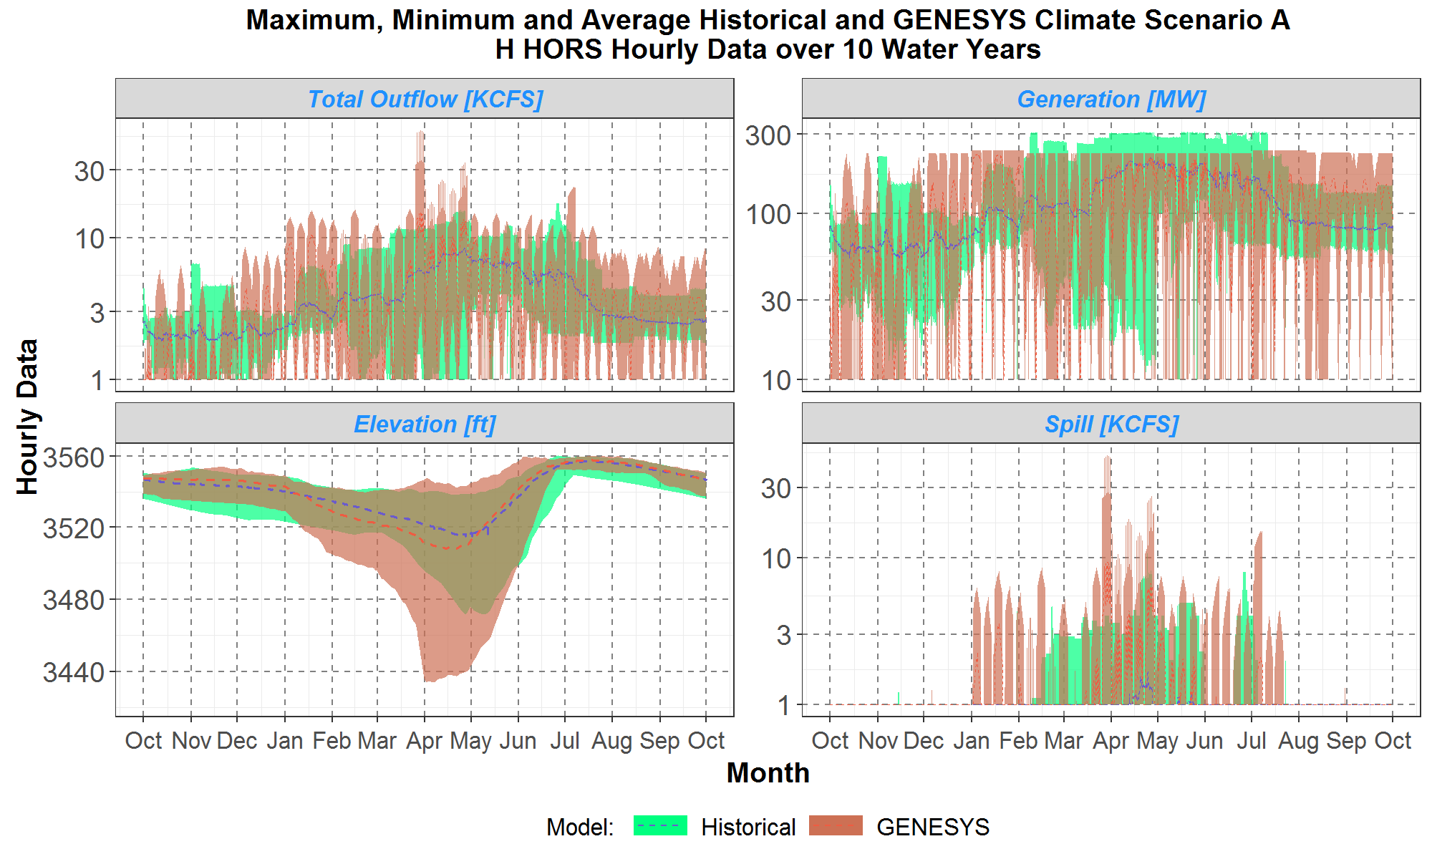
Hungry Horse Scenario A

Slide 91
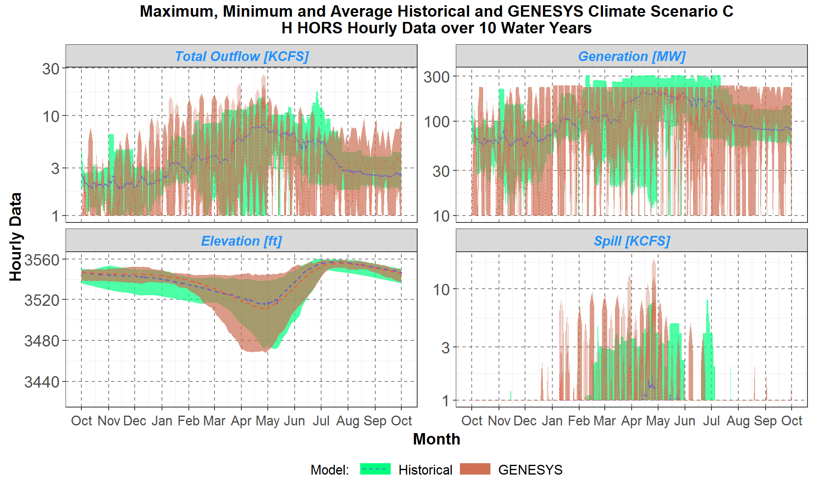
Hungry Horse Scenario C

Slide 92
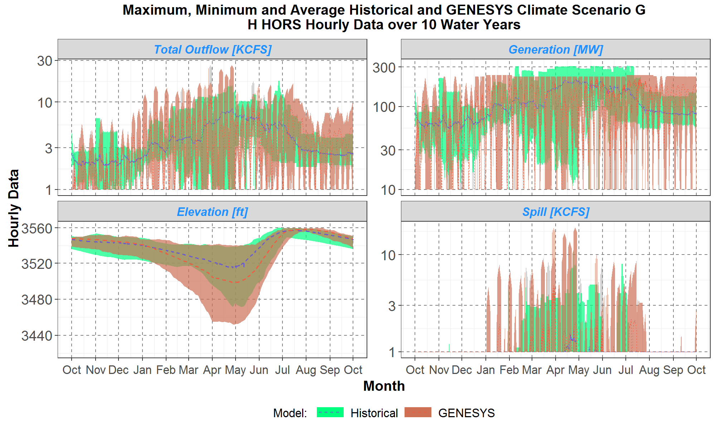
Hungry Horse Scenario G

Slide 93
Questions/Notes on Hungry Horse
Notes:
Why does generation seem to peak higher in historical than in redeveloped? Investigate H/K table compared to classic

Slide 94
Columbia Falls
Outflow – average and range
Generation – average and range
Ending elevation – average and range
Spill – average and range

Slide 95
Questions/Notes on Columbia Falls
Notes:
Gauging station not a dam

Slide 96
SE¿LIŠ KSANKA QLISPE¿ Dam (will be referred to as SKQ)
Outflow – average and range
Generation – average and range
Ending elevation – average and range
Spill – average and range

Slide 97
Questions/Notes on SE¿LIŠ KSANKA QLISPE¿ Dam (will be referred to as SKQ)
Note:
For reference, this was formerly called Kerr Dam before the change in ownership in 2015.
Sounds like there are flow limits seasonally (PNCA), need a public source

Slide 98
Thompson Falls
Outflow – average and range
Generation – average and range
Ending elevation – average and range
Spill – average and range

Slide 99
Questions/Notes on Thompson Falls
Notes:

Slide 100
Noxon
Outflow – average and range
Generation – average and range
Ending elevation – average and range
Spill – average and range

Slide 101
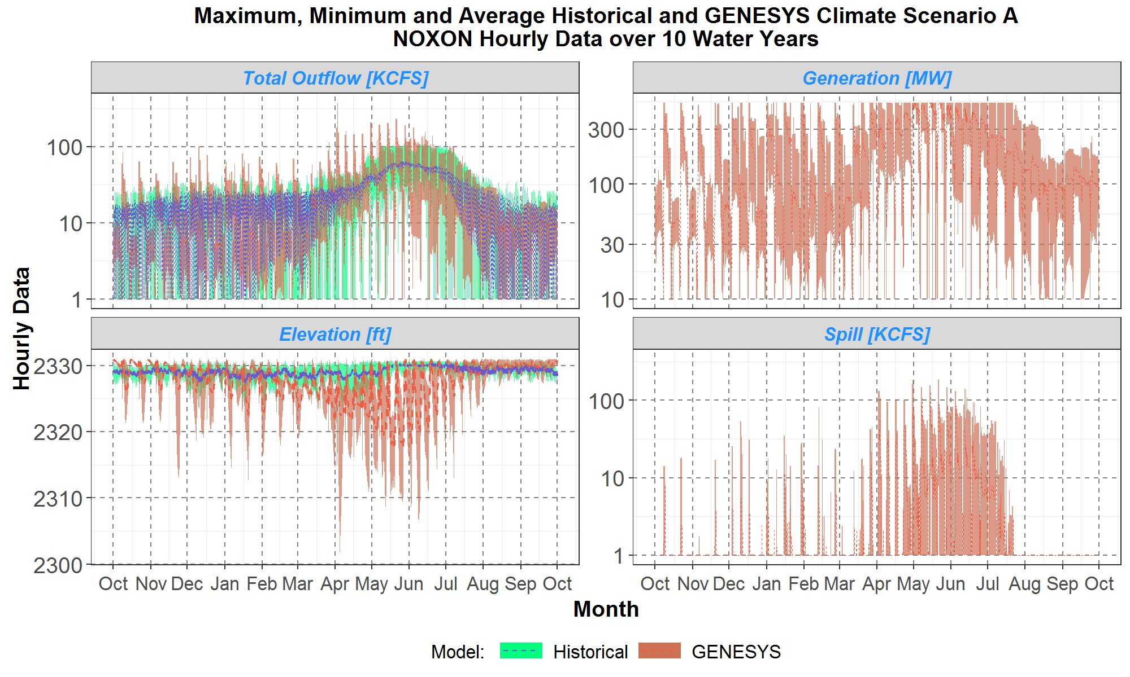
Noxon Scenario A

Slide 102
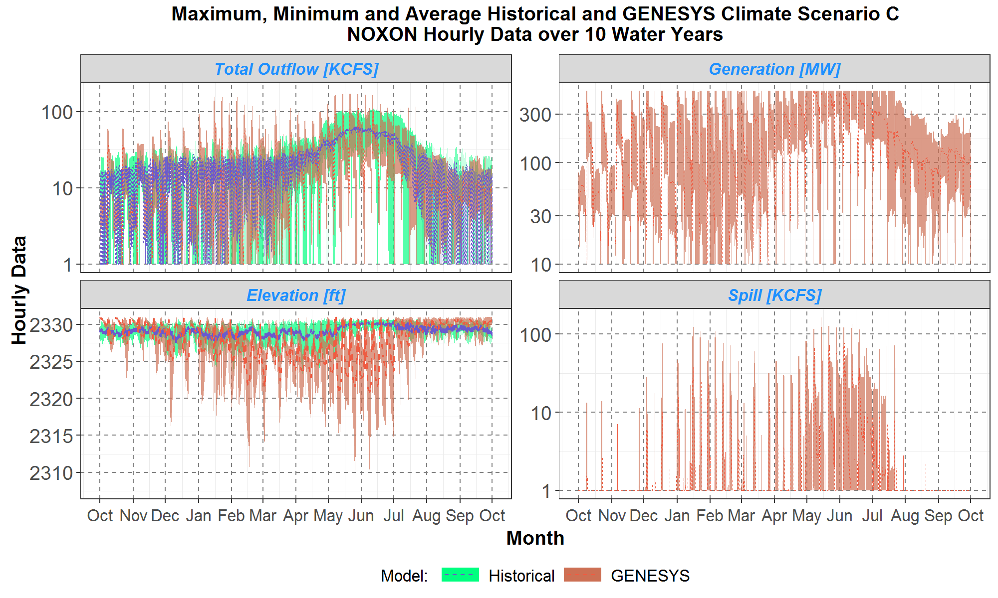
Noxon Scenario C

Slide 103
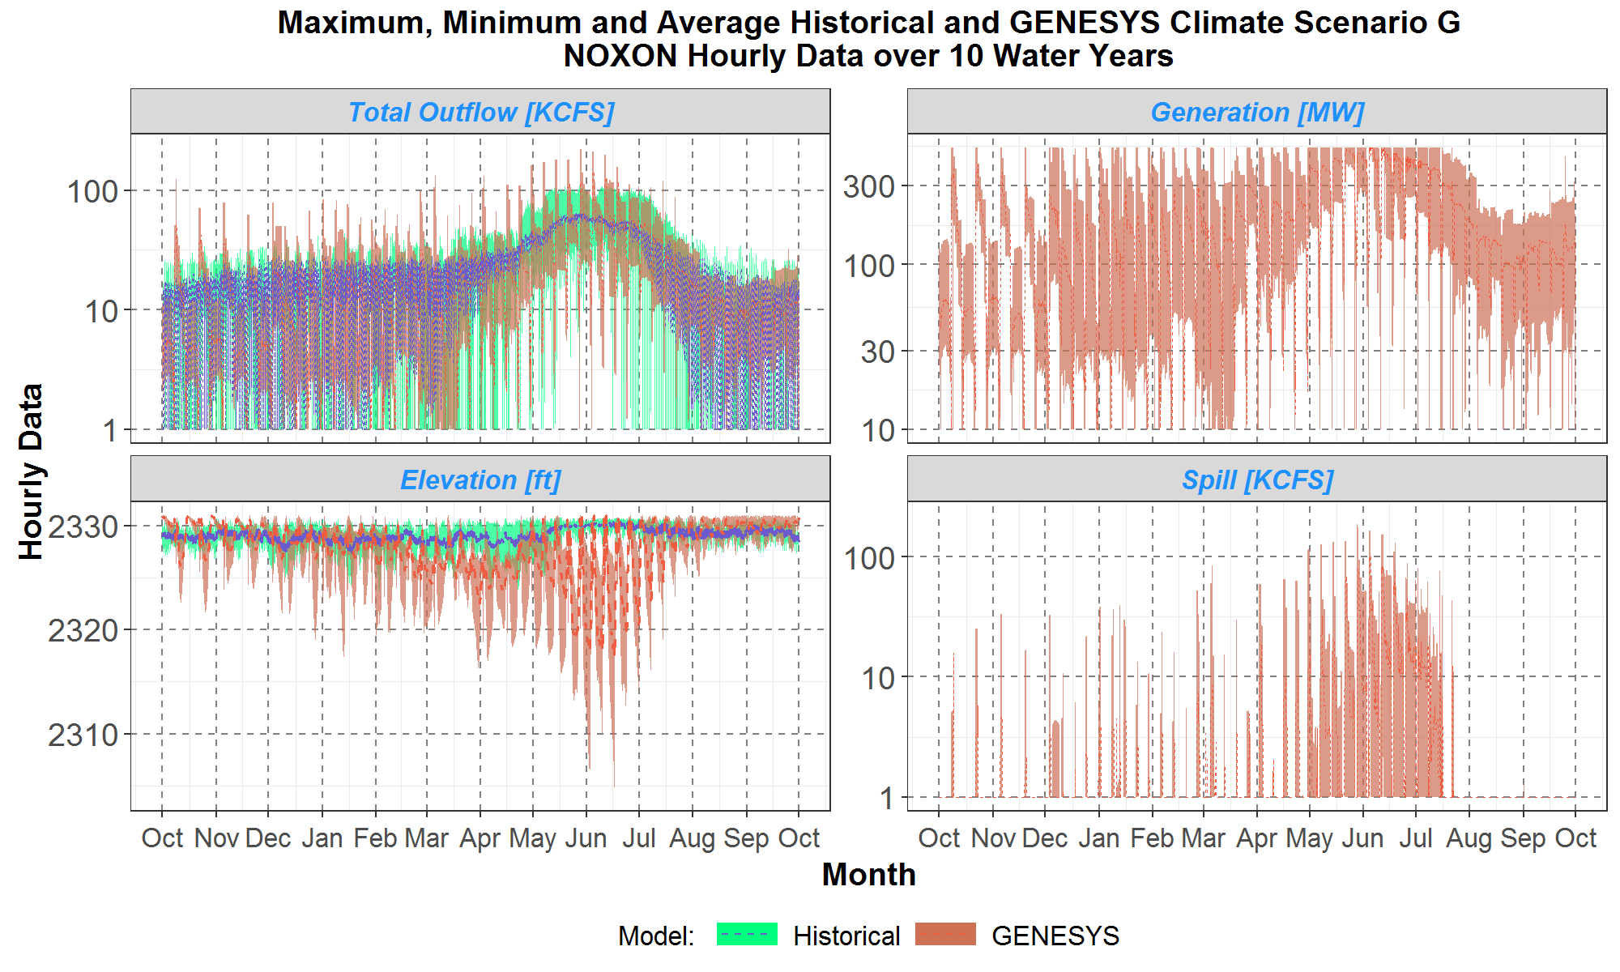
Noxon Scenario G

Slide 104
Questions/Notes on Noxon
Notes:
More movement in redeveloped GENESYS than we would expect per operations. Investigate implementation of Noxon forebay elevation ramp limitation modeled as a discharge rate.
Look at inflows, if they are highly variable than discharge rate limitation will not necessarily be as useful in limiting forebay elevation.
Investigate H/K table interpolation, maximum generation is lower than classic consistently

Slide 105
Cabinet Gorge
Outflow – average and range
Generation – average and range
Ending elevation – average and range
Spill – average and range

Slide 106
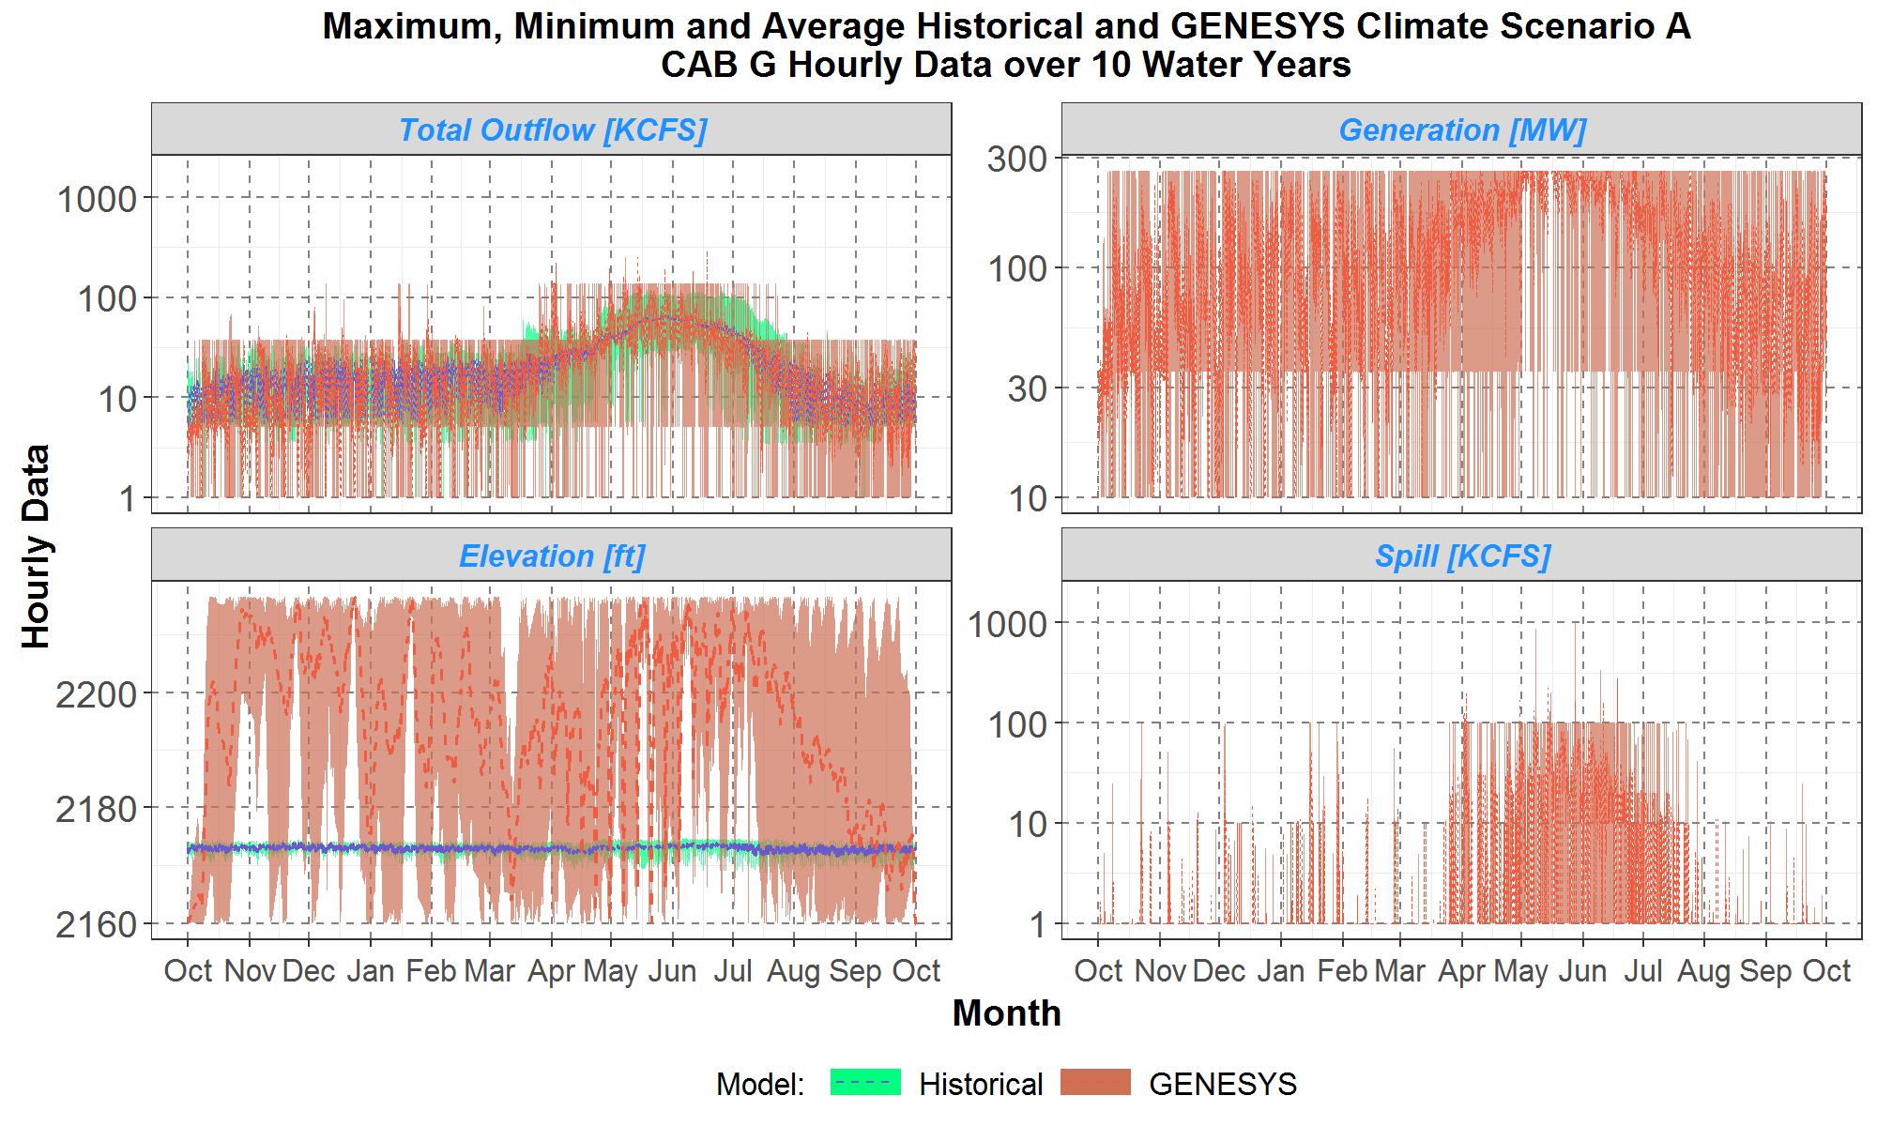
Cabinet Gorge Scenario A

Slide 107
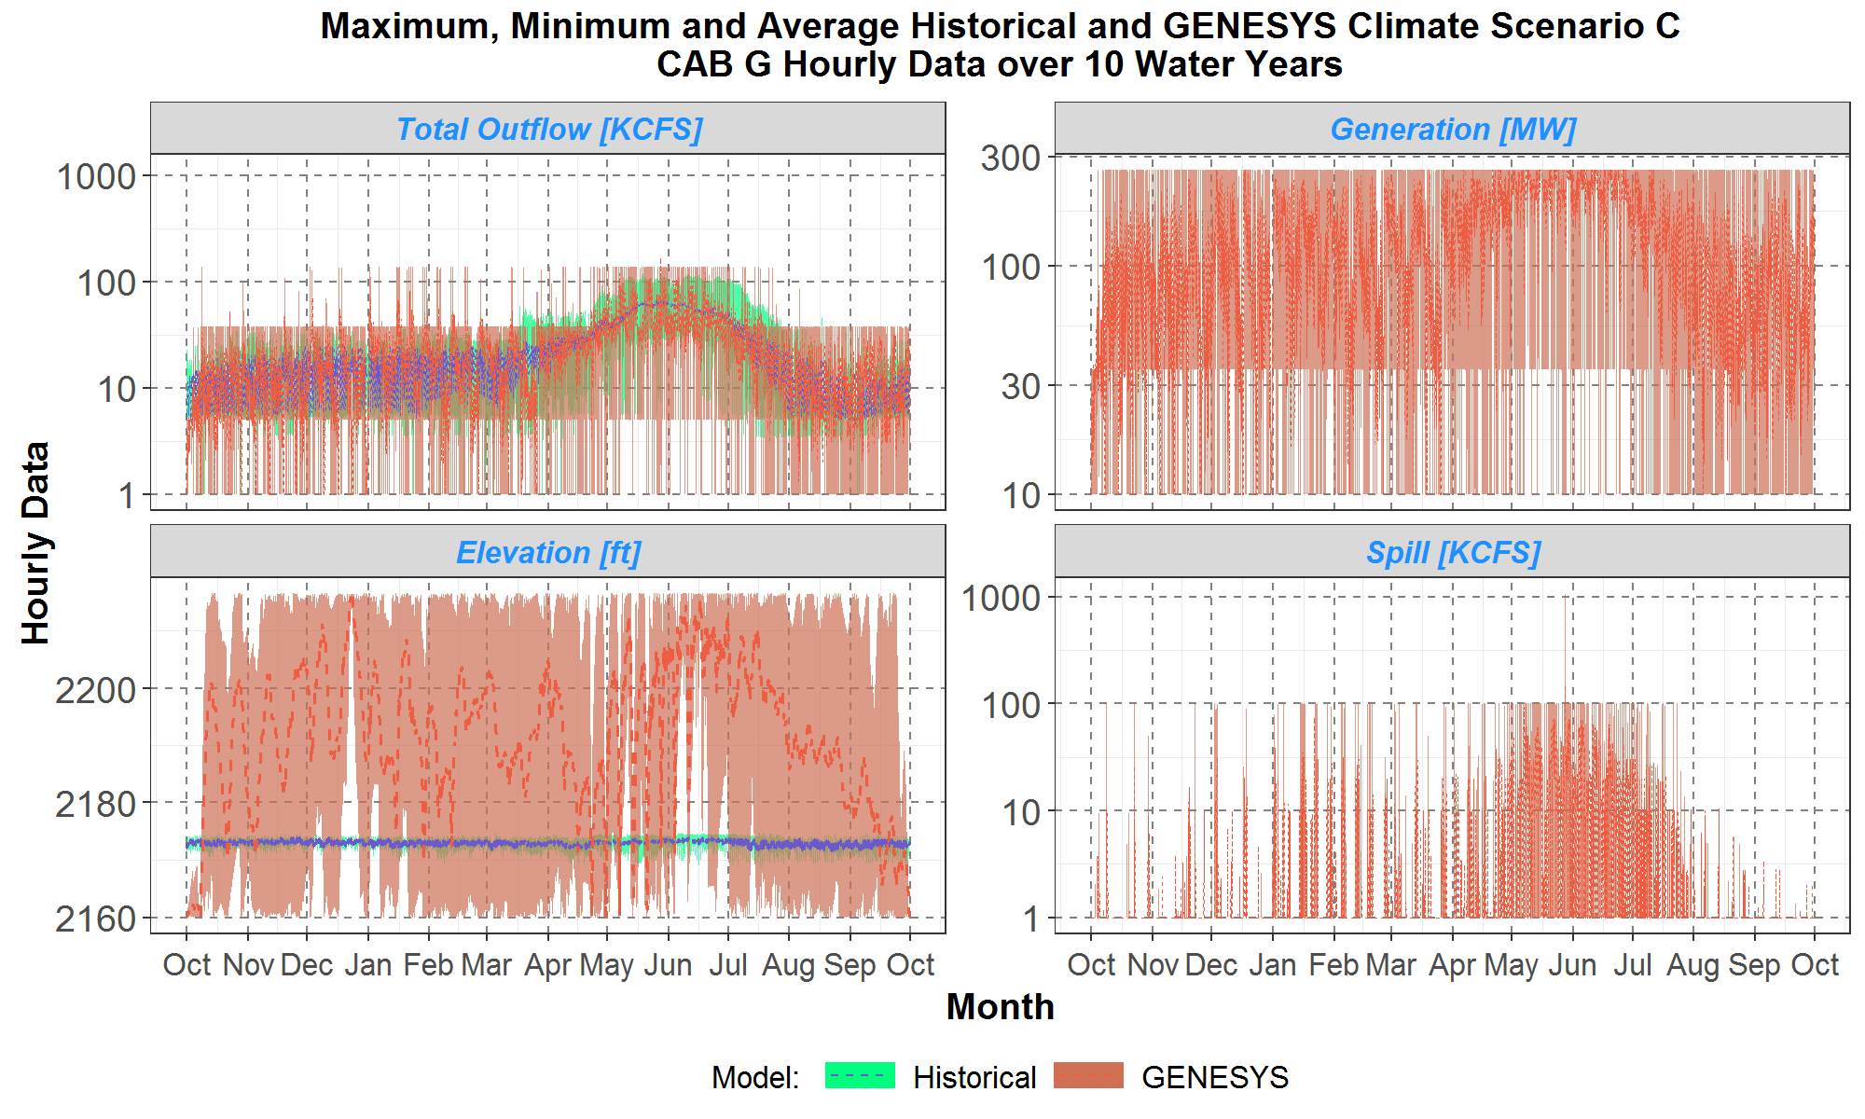
Cabinet Gorge Scenario C

Slide 108
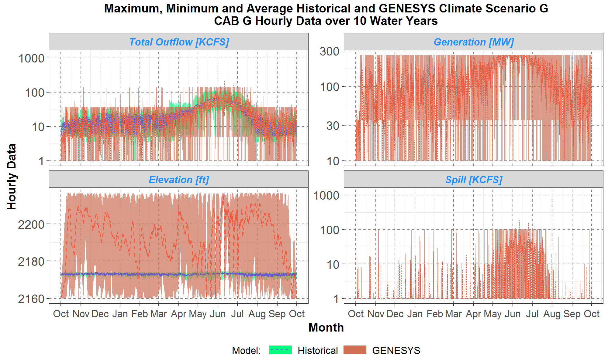
Cabinet Gorge Scenario G

Slide 109
Questions/Notes on Cabinet Gorge
Notes:
Modeled as ROR in HydSim, modeled as storage in new model
More movement in redeveloped GENESYS than we would expect per operations. Do we have the correct operative storage limits?

Slide 110
Priest Lake
Outflow – average and range
Generation – average and range
Ending elevation – average and range
Spill – average and range

Slide 111
Questions/Notes on Priest Lake
Notes:

Slide 112
Albeni Falls
Outflow – average and range
Generation – average and range
Ending elevation – average and range
Spill – average and range

Slide 113
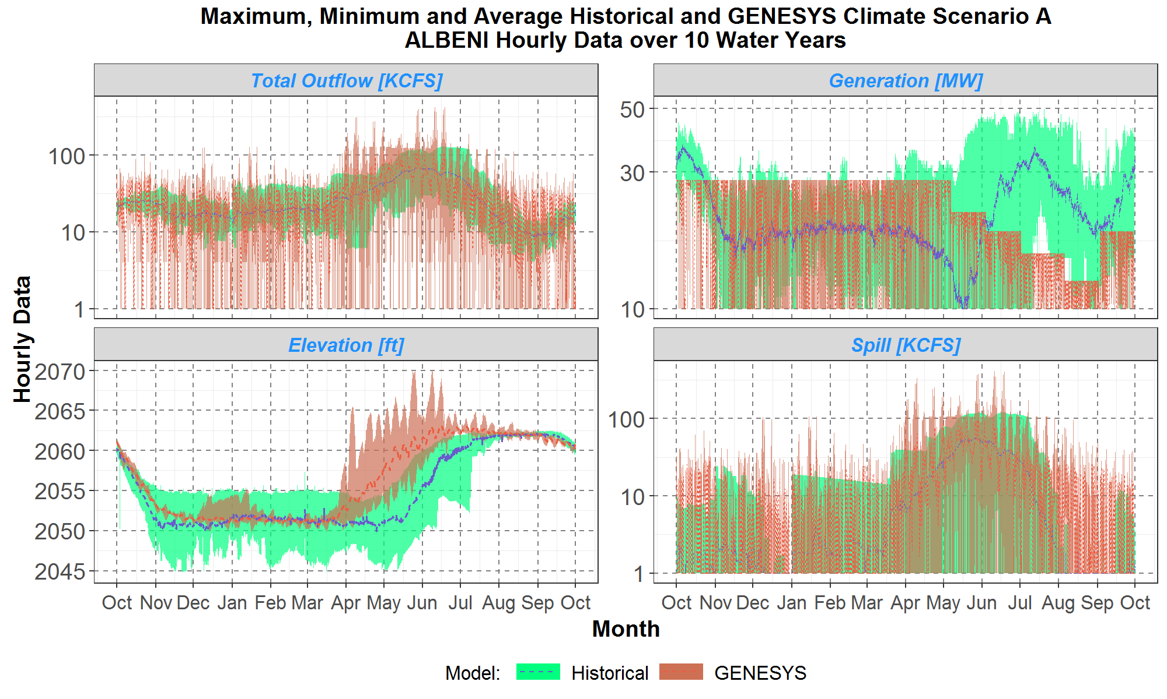
Albeni Scenario A

Slide 114
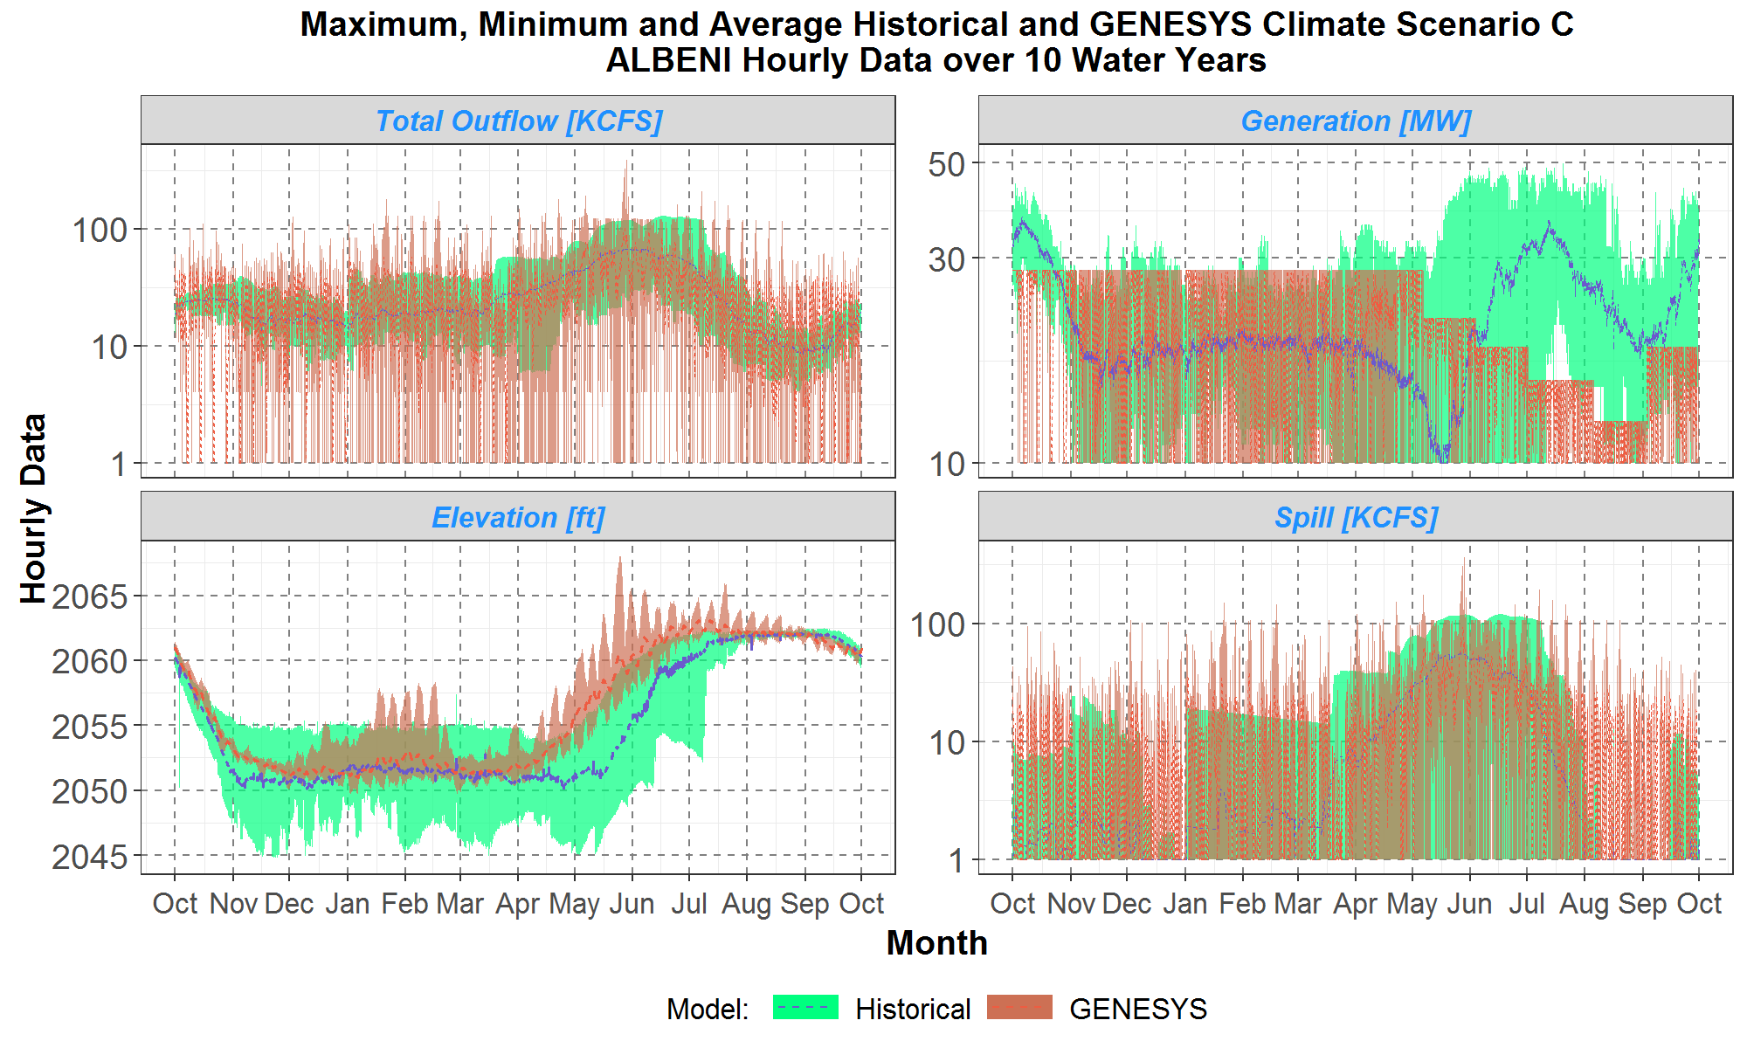
Albeni Scenario C

Slide 115
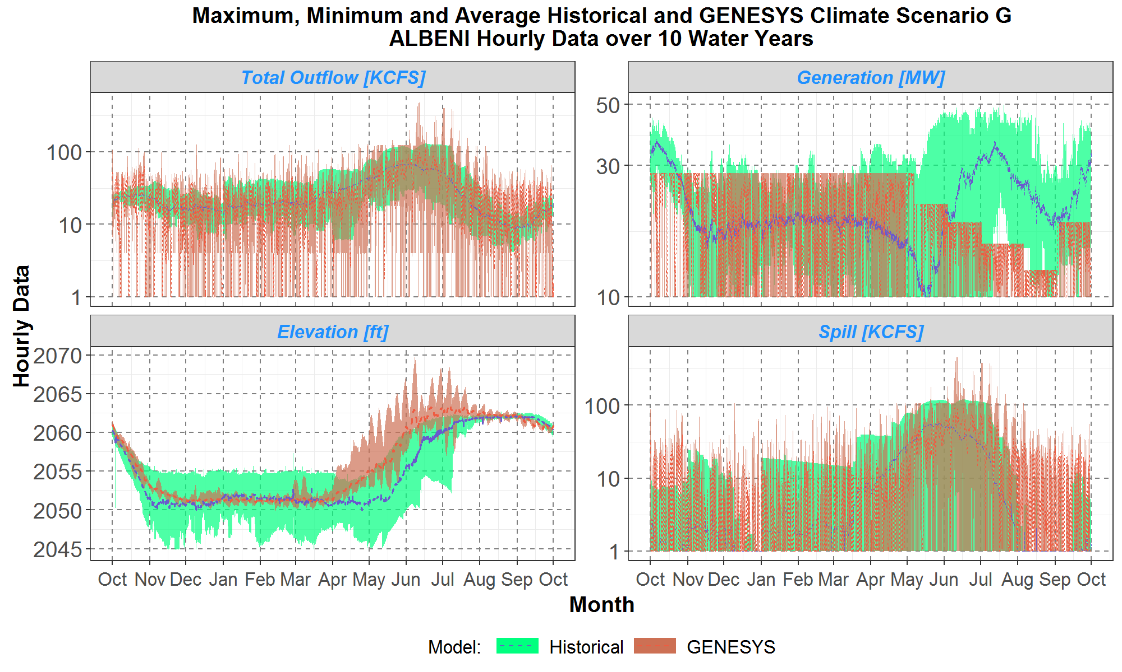
Albeni Scenario G

Slide 116
Questions/Notes on Albeni Falls
Notes:
Check Excel sheet data on total outflow
Investigate H/K table interpolation, maximum generation is lower than classic consistently

Slide 117
Box Canyon
Outflow – average and range
Generation – average and range
Ending elevation – average and range
Spill – average and range

Slide 118
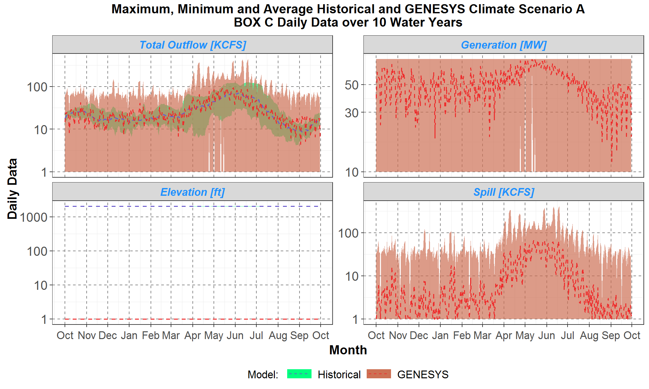
Box Canyon Scenario A

Slide 119
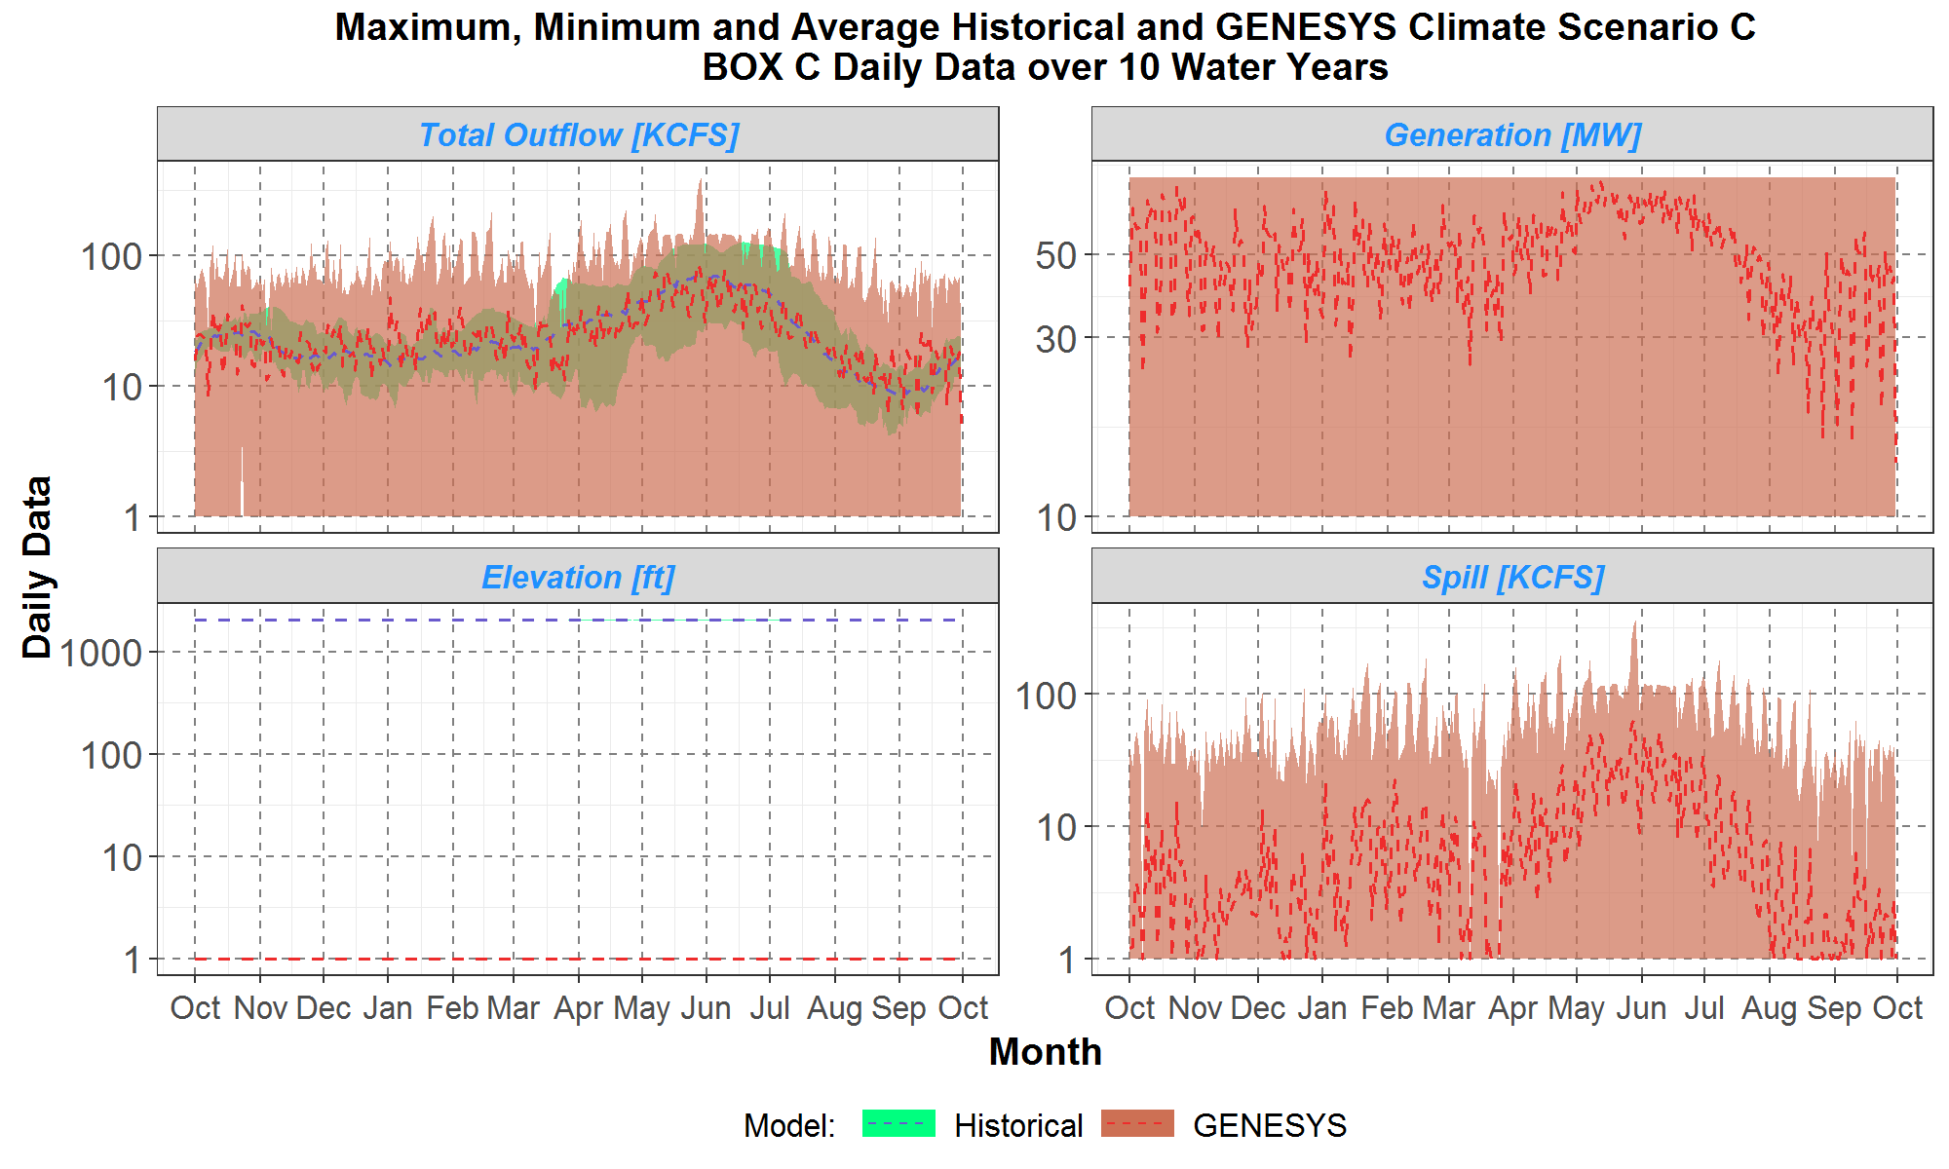
Box Canyon Scenario C

Slide 120

Box Canyon Scenario G

Slide 121
Questions/Notes on Box Canyon
Notes:
Look into why generation lower in classic versus redeveloped in spring

Slide 122
Boundary
Outflow – average and range
Generation – average and range
Ending elevation – average and range
Spill – average and range

Slide 123
Questions/Notes on Boundary
Notes:
Modeled as ROR in HydSim, modeled as storage in new model

Slide 124
Seven Mile
Outflow – average and range
Generation – average and range
Ending elevation – average and range
Spill – average and range

Slide 125
Questions/Notes on Seven Mile
Notes:
Modeled as ROR in HydSim, modeled as storage in new model

Slide 126
Waneta
Outflow – average and range
Generation – average and range
Ending elevation – average and range
Spill – average and range

Slide 127
Questions/Notes on Waneta
Notes:
Modeled as ROR in HydSim, modeled as storage in new model

Slide 128
Couer D’Alene
Outflow – average and range
Generation – average and range
Ending elevation – average and range
Spill – average and range

Slide 129
Questions/Notes on Couer D’Alene
Notes:

Slide 130
Post Falls
Outflow – average and range
Generation – average and range
Ending elevation – average and range
Spill – average and range

Slide 131
Questions/Notes on Post Falls
Notes:

Slide 132
Upper Falls
Outflow – average and range
Generation – average and range
Ending elevation – average and range
Spill – average and range

Slide 133
Questions/Notes on Upper Falls
Notes:

Slide 134
Monroe Street
Outflow – average and range
Generation – average and range
Ending elevation – average and range
Spill – average and range

Slide 135
Questions/Notes on Monroe Street
Notes:

Slide 136
Nine Mile
Outflow – average and range
Generation – average and range
Ending elevation – average and range
Spill – average and range

Slide 137
Questions/Notes on Nine Mile
Notes:

Slide 138
Long Lake
Outflow – average and range
Generation – average and range
Ending elevation – average and range
Spill – average and range

Slide 139
Questions/Notes on Long Lake
Notes:
Use of H/K table may get slightly better results but under 10 MW difference.

Slide 140
Questions/Notes on Little Falls
Outflow – average and range
Generation – average and range
Ending elevation – average and range
Spill – average and range
Notes:
Modeled as ROR in HydSim, modeled as storage in new model

Slide 141
Questions/Notes on Little Falls
Outflow – average and range
Generation – average and range
Ending elevation – average and range
Spill – average and range
Notes:
Modeled as ROR in HydSim, modeled as storage in new model

Slide 142
Grand Coulee
Outflow – average and range
Generation – average and range
Ending elevation – average and range
Spill– average and range

Slide 143

Grand Coulee Scenario A

Slide 144

Grand Coulee Scenario C

Slide 145

Grand Coulee Scenario G

Slide 146
Questions/Notes on Grand Coulee
Notes:
Check minimum flow constraints at downstream projects in low water years to see how it effects operations.

Slide 147
Chief Joseph
Outflow – average and range
Generation – average and range
Ending elevation – average and range
Spill – average and range

Slide 148

Chief Joseph Scenario A

Slide 149

Chief Joseph Scenario C

Slide 150

Chief Joseph Scenario G

Slide 151
Questions/Notes on Chief Joseph
Notes:
Chief Joseph has wider operating range than in historical operations. Investigate whether updated operating ranges on Lower Snake and Columbia plants effects operating range on Chief Joe before changing constraints.
Check max pool and full pool at Chief Joseph
Mismatch between HydSim range and historical operation

Slide 152
Wells
Outflow – average and range
Generation – average and range
Ending elevation – average and range
Spill – average and range

Slide 153

Wells Scenario A

Slide 154

Wells Scenario C

Slide 155

Wells Scenario G

Slide 156
Questions/Notes on Wells
Notes:
Traditionally, been operated at a higher head to prioritize generation
Look at using/developing a more detailed H/K table to better capture encroachment

Slide 157
Chelan
Outflow – average and range
Generation – average and range
Ending elevation – average and range
Spill – average and range

Slide 158
Questions/Notes on Chelan
Notes:

Slide 159
Rocky Reach
Outflow – average and range
Generation – average and range
Ending elevation – average and range
Spill – average and range

Slide 160

Rocky Reach Scenario A

Slide 161

Rocky Reach Scenario C

Slide 162

Rocky Reach Scenario G

Slide 163
Questions/Notes on Rocky Reach
Notes:
Look at using/developing a more detailed H/K table to better capture effects of different head
Operating within full range of the plant’s storage may not allow for inflow uncertainty. Explore adding uncertainty or operating in a tighter pool without penalty and a broader pool with some penalty.
Research or get any further necessary max and total volume spill limitations that adhere to total dissolved gas limits

Slide 164
Rock Island
Outflow – average and range
Generation – average and range
Ending elevation – average and range
Spill – average and range

Slide 165

Rock Island Scenario A

Slide 166

Rock Island Scenario C

Slide 167

Rock Island Scenario G

Slide 168
Questions/Notes on Rock Island
Notes:
Look at using/developing a more detailed H/K table to better capture effects of different head
Operating within full range of the plant’s storage may not allow for inflow uncertainty. Explore adding uncertainty or operating in a tighter pool without penalty and a broader pool with some penalty.
Research or get any further necessary max and total volume spill limitations that adhere to total dissolved gas limits

Slide 169
Wanapum
Outflow – average and range
Generation – average and range
Ending elevation – average and range
Spill – average and range

Slide 170

Wanapam Scenario A

Slide 171

Wanapam Scenario C

Slide 172

Wanapam Scenario G

Slide 173
Questions/Notes on Wanapum
Notes:
Look at using/developing a more detailed H/K table to better capture effects of different head
Operating within full range of the plant’s storage may not allow for inflow uncertainty. Explore adding uncertainty or operating in a tighter pool without penalty and a broader pool with some penalty.
Research or get any further necessary max and total volume spill limitations that adhere to total dissolved gas limits
Maximum generation is a little low (follow-up with GCPUD)
Follow up with GCPUD about seasonal reductions in turbined flow (hydraulic capacity)

Slide 174
Priest Rapids
Outflow – average and range
Generation – average and range
Ending elevation – average and range
Spill – average and range

Slide 175

Priest Rapid Scenario A

Slide 176

Priest Rapid Scenario C

Slide 177

Priest Rapid Scenario G

Slide 178
Questions/Notes on Priest Rapids
Notes:
Increase priority of constraint and modify modeling to better enforce minimum outflows
Look at using/developing a more detailed H/K table to better capture effects of different head
Operating within full range of the plant’s storage may not allow for inflow uncertainty. Explore adding uncertainty or operating in a tighter pool without penalty and a broader pool with some penalty.
Research or get any further necessary max and total volume spill limitations that adhere to total dissolved gas limits
October and November maximum discharge limit during daytime
Stranding bands and TDG% issues seem to be mitigated by some of the minimum outflow constraints (follow-up with GCPUD)
There may be to model this that has less upstream effects

Slide 179
Brownlee
Outflow – average and range
Generation – average and range
Ending elevation – average and range
Spill – average and range

Slide 180

Brownlee Scenario A

Slide 181

Brownlee Scenario C

Slide 182

Brownlee Scenario G

Slide 183
Questions/Notes on Brownlee
Notes:
Investigate whether storage versus elevation table needs more data points (or different datapoints) to improve efficiency curves translation of net head to energy
Total outflows are higher during some periods, is this an issue at the frequency that they occur in the model?

Slide 184
Oxbow
Outflow – average and range
Generation – average and range
Ending elevation – average and range
Spill – average and range

Slide 185
Questions/Notes on Oxbow
Notes:
Modeled as ROR in HYDSIM, but has usable storage in redeveloped model
Investigate whether it is necessary to use an H/K table versus average H/K

Slide 186
Hells Canyon
Outflow – average and range
Generation – average and range
Ending elevation – average and range
Spill – average and range

Slide 187

Hells Canyon Scenario A

Slide 188

Hells Canyon Scenario C

Slide 189

Hells Canyon Scenario G

Slide 190
Questions/Notes on Hells Canyon
Notes:
Modeled as ROR in HYDSIM, but has usable storage in redeveloped model
Investigate whether it is necessary to use an H/K table versus average H/K
Investigate whether it uses all of usable storage or allow for buffer to account for inflow uncertainty

Slide 191
Dworshak
Outflow – average and range
Generation – average and range
Ending elevation – average and range
Spill – average and range

Slide 192

Dworshak Scenario A

Slide 193

Dworshak Scenario C

Slide 194

Dworshak Scenario G

Slide 195
Questions/Notes on Dworshak
Notes:
Investigate whether storage versus elevation table needs more data points (or different datapoints) to improve efficiency curves translation of net head to energy

Slide 196
Lower Granite
Outflow – average and range
Generation – average and range
Ending elevation – average and range
Spill – average and range

Slide 197

Lower Granite Scenario A

Slide 198

Lower Granite Scenario C

Slide 199

Lower Granite Scenario G

Slide 200
Questions/Notes on Lower Granite
Notes:
Operating ranges on Lower Granite in operations have different floor depending on flow into the plant. Explore modifying MOP range by floor (look at min flow constraint at Dworshak and modify floor on MOP)
See how any changes impact Little Goose
Follow-up to see how/if temperature limits are incorporated in the modeling. If not, see what we can do to approximate (follow with technical management team)

Slide 201
Little Goose
Outflow – average and range
Generation – average and range
Ending elevation – average and range
Spill – average and range

Slide 202

Little Goose Scenario A

Slide 203

Little Goose Scenario C

Slide 204

Little Goose Scenario G

Slide 205
Questions/Notes on Little Goose
Notes:
Check 2022 C Bypass spill constraints

Slide 206
Lower Monumental
Outflow – average and range
Generation – average and range
Ending elevation – average and range
Spill – average and range

Slide 207

Lower Monumental Scenario A

Slide 208

Lower Monumental Scenario C

Slide 209

Lower Monumental Scenario G

Slide 210
Questions/Notes on Lower Monumental
Notes:

Slide 211
Ice Harbor
Outflow – average and range
Generation – average and range
Ending elevation – average and range
Spill – average and range

Slide 212

Ice Harbor Scenario A

Slide 213

Ice Harbor Scenario C

Slide 214

Ice Harbor Scenario G

Slide 215
Questions/Notes on Ice Harbor
Notes:

Slide 216
McNary
Outflow – average and range
Generation – average and range
Ending elevation – average and range
Spill – average and range

Slide 217

McNary Scenario A

Slide 218

McNary Scenario C

Slide 219

McNary Scenario G

Slide 220
Questions/Notes on McNary
Notes:
No target storages used, only seasonal operating pool constraints
Per observed elevations, remove MOP constraints in the summer align with normal operating range year round

Slide 221
John Day
Outflow – average and range
Generation – average and range
Ending elevation – average and range
Spill – average and range

Slide 222

John Day Scenario A

Slide 223

John Day Scenario C

Slide 224

John Day Scenario G

Slide 225
Questions/Notes on John Day
Notes:
No target storages used, only seasonal operating pool constraints
Per observed elevations, retain MOP constraints in the summer align with normal operating range year round
Check H/K table interpolation

Slide 226
Round Butte
Outflow – average and range
Generation – average and range
Ending elevation – average and range
Spill – average and range

Slide 227
Questions/Notes on Round Butte
Notes:
Fish collection facility means they have limited elevation range they can operate in.

Slide 228
Pelton
Outflow – average and range
Generation – average and range
Ending elevation – average and range
Spill – average and range

Slide 229
Questions/Notes on Pelton
Notes:

Slide 230
Reregulating Dam
Outflow – average and range
Generation – average and range
Ending elevation – average and range
Spill – average and range

Slide 231
Questions/Notes on Reregulating Dam
Notes:

Slide 232
The Dalles
Outflow – average and range
Generation – average and range
Ending elevation – average and range
Spill – average and range

Slide 233

The Dalles Scenario A

Slide 234

The Dalles Scenario C

Slide 235

The Dalles Scenario G

Slide 236
Questions/Notes on The Dalles
Notes:
No target storages used, only seasonal operating pool constraints
Per observed elevations, remove MOP constraints in the summer align with normal operating range year round

Slide 237
Bonneville
Outflow – average and range
Generation – average and range
Ending elevation – average and range
Spill – average and range

Slide 238

Bonneville Scenario A

Slide 239

Bonneville Scenario C

Slide 240

Bonneville Scenario G

Slide 241
Questions/Notes on Bonneville
Notes:
No target storages used, only seasonal operating pool constraints
Per observed elevations, remove MOP constraints in the summer align with normal operating range year round
Increase priority of constraint and modify modeling to better enforce minimum outflows

Slide 242
System Flexibility and Market
Market risk and structure, transmission

Slide 243

Placeholder for System Flexibility and Market Info
Review of Model Stages
Market and transmission utilization
Hourly hydro flexibility
Market interactions on thermal unit commitment
Low thermal commitment
Role of reserves
This Photo by Unknown Author is licensed under CC BY-NC

Slide 244
Example: How Does Redeveloped GENESYS Simulate Hourly Operation?
October
Commit for Monday, Plan for Tuesday through Sunday
Account for energy, reserves, and for fuel usage in Hour 1
Commit for Hour 2, Plan for Hours 2 through 24 and Hour 1 of next day.
Commit for Tuesday, Wednesday through Sunday.
Weekly Forecast
Day-Ahead Commitment
Hour-Ahead Commitment
Deployment (True-Up)
...
Commit for Hour 24, Plan for Hours 1 through 23 of next day
Account for energy, reserves, and for fuel usage in Hour 2.
…
Account for energy, reserves, and for fuel usage in Hour 24.
Commit for Hour 1, Plan for Hours 2 through 24
Cost Optimization
Accounting
Notes:
This is an example for October.

Slide 245

Expanded External Market Modeling Capability
More detailed transmission topology
Each “bubble” represents a balancing authority, multiple balancing authorities or part of a balancing authority depending on transmission constraints.
Hourly loads for each bubble.
Resources in each bubble represented by bins of the amount of market resource available at a price (hourly) OR as a individually modeled resource.
Currently, most of the resources in the region are represented as individual resources and most external to the region are represented as bins of market resource.

Slide 246
18.4% More Useable Storage in US in Redeveloped GENESYS
Plants with reservoirs in new model and modeled as run-of river in HYDSIM and classic GENESYS:
Alder
Boundary
Cabinet Gorge
Diablo
Gorge
Hells Canyon
Mayfield
Oxbow
Pelton
Priest Rapids
Rock Island
Rocky Reach
Wanapum
Wells
Units of Useable Storage | Classic GENESYS | Redeveloped GENESYS
Net (KSFD) | 13,132 | 15,553
Net (MAF) | 26.0 | 30.8

Slide 248
Mid-Columbia plants operated as run-of-river in HydSim (i.e. no daily flexibility)

Slide 249
Next Steps on Hydro Operations
Changes between Draft and Final, changes after the plan…

Slide 250
General Notes/Requests
Show a graph that compares monthly average imports between the new and the classic
Interest in a scenario where a transmission line is taken out for month or so (proxy for wildfire) and what the implications are for adequacy?
COI or PDCI or something internal?

Slide 251
Since Initial Stakeholder Comments
Major changes:
Imposed maximum spill limits on most plants to not be violated for economic purposes
Based on physical limits in most cases and operations where available
Modified penalties on some plant constraints
PSR fixed model to override inconsistencies between hourly discharge rate penalties and target storage to ensure water balance
Tightened target storage tolerance on Mica and Dworshak
Increased Mica useable storage to better align with HYDSIM per hydro experts
Moved from average H/K to H/K tables for many reservoirs.

Slide 252
Next Steps
Incorporate stakeholder feedback, if and as possible
Investigate whether storage versus elevation table needs more data points (or different datapoints)
Update MOP constraints on Lower Granite to estimate the variable flow floor modifying MOP range (look at min flow constraint at Dworshak and modify floor on MOP)
Remove MOP constraints on McNary, The Dalles, Bonneville, return to normal operating range year round
Check MOP effective date ranges per the Biological Assessment (some dates seem slightly off)
Return to normal operating storage on John Day when MOP not in effect
Investigate whether updated MOP on above plants effects operating range on Chief Joe
Increase priority of constraint and modify modeling to better enforce min outflows at Priest rapids and Bonneville
Investigate implementation of Noxon forebay elevation ramp limitation modeled as a discharge rate (more movement in redeveloped GENESYS than we would expect)

Slide 253
Comparisons between GENESYS and Historical Data
August 4 – 6, 2021

Slide 254
Extras

Slide 255

Chief Joseph

Slide 256

Rock Island

