Slide 1
Metrics and Methods to Assess Power System Flexibility
Aidan Tuohy Sr. Project Engineer
NWPCC Flexibility Metric Roundtable April 2013

Slide 2
Contents
Strategic and flexible planning project (P40.019)
Work to date
Current work
Flexibility assessment metrics
System flexibility metrics
Refinements required

Slide 3
Strategic and flexible planning project (P40.019)
Multi - year research project (Y3)
Measurement of variability focused on in Y1
Characterization of variability of wind and PV (VG) combined with demand → Net load variability
Uncertainty and variability have two separate effects
Demand is highly variable, but extremely predictable
VG is currently less variable, but far less predictable
Net load variability and predictability will change as the VG penetration changes

Slide 4
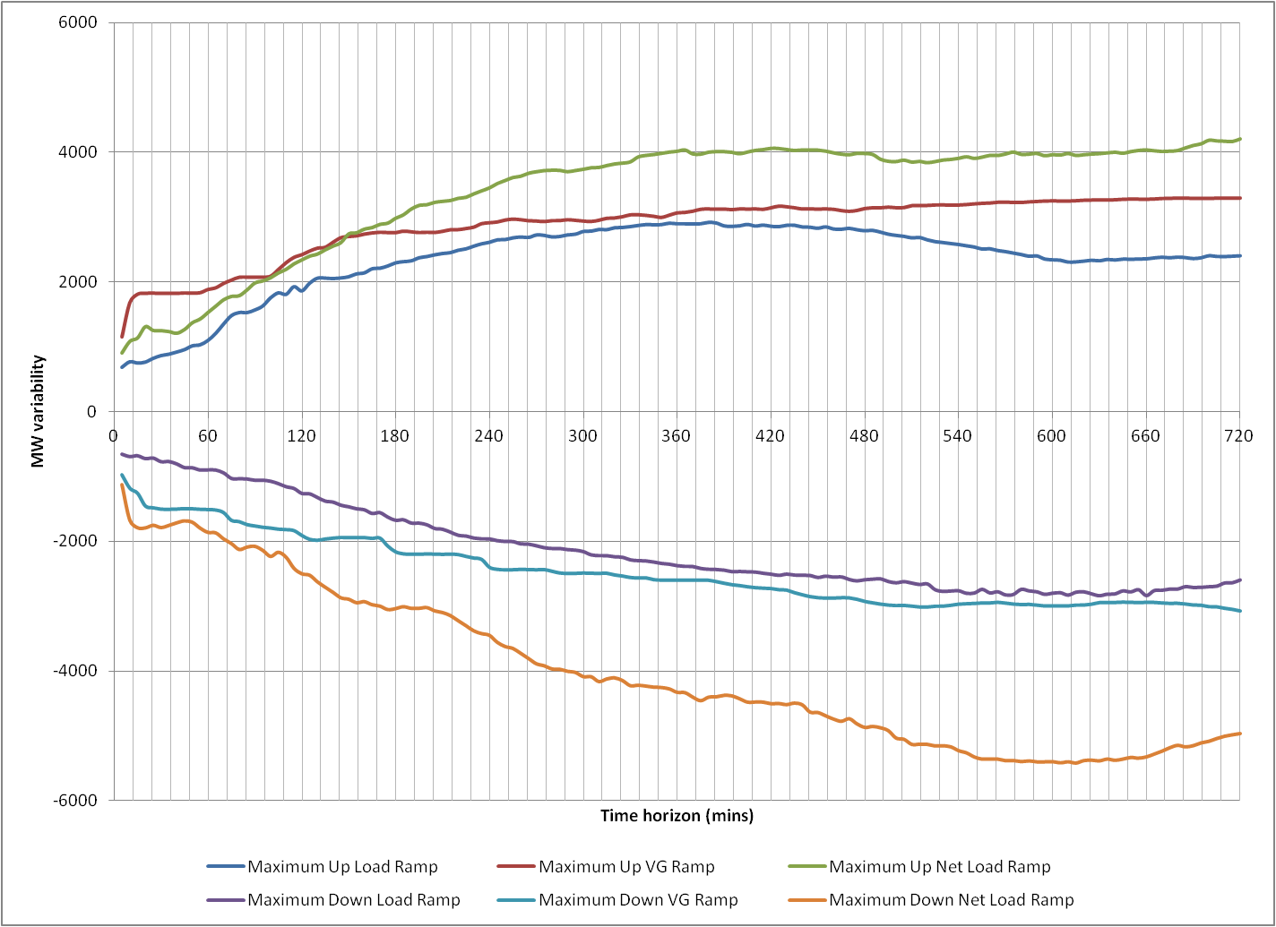
Work To Date: Measuring Variability

Slide 5
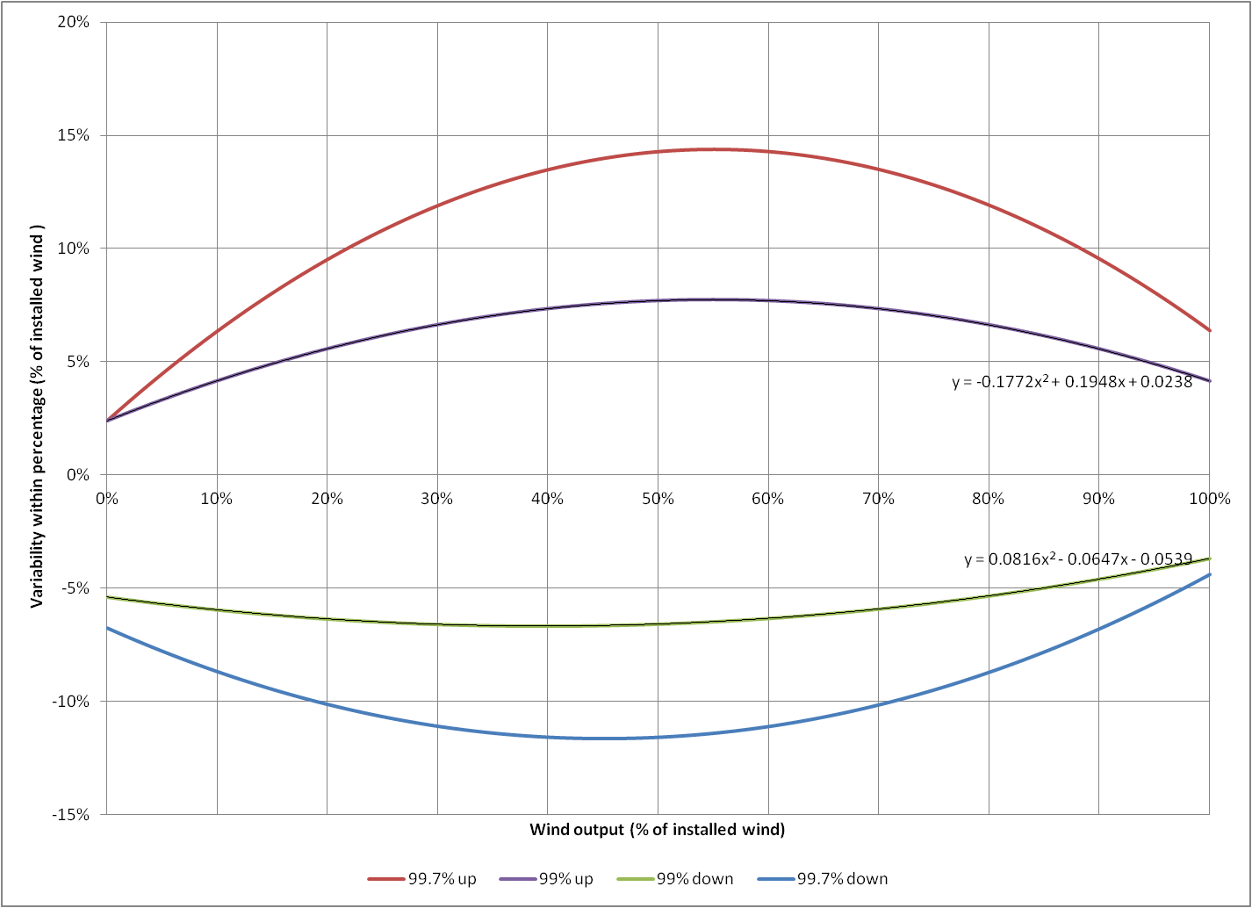
Work To Date: How Much Flexibility is Required?
At wind output 50% of installed capacity, system needs to ramp at 14 % of installed wind to meet 99.7% of ramps, or ~8% of installed wind to meet 99% of ramps

Slide 6
Work To Date: Flexibility Screening Tool
System flexibility in screening tool (Y2)
Rough assumptions about worst case scenario ramps (e.g. 99th percentile ramps)
Flexibility generator states
Without real time limitations, assumptions are required
Shows key time horizons for flexibility issues

Slide 7
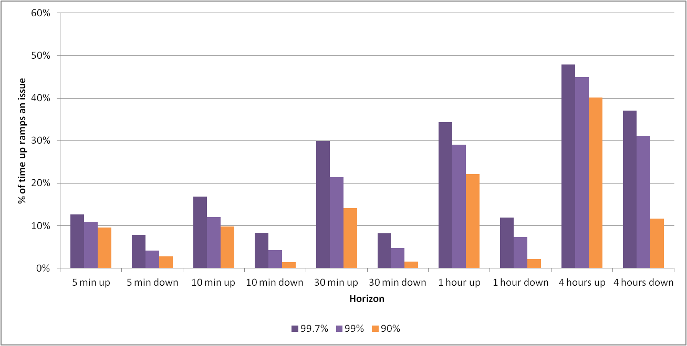
Current Work – Detailed Flexibility Assessment
Improve representation of flexible resources
Energy limited resource deployment
Import/Export resources
Realistic thermal resource capabilities
Probabilistic representation of VG outputs
Simulating many scenarios
More detailed flexibility metrics

Slide 8
Flexibility Metrics

Slide 9
Flexibility Metric Options
Duration curve approach: Ramp Percentile Deficit (%)
Historical / simulated production & net load data
Calculate available flexibility time series for each resource
Sum available flexibility to a system level
Calculate the x^{th} percentile of net load ramps
Determine the number of hours the net load ramps exceed the flexibility available
For both directions
For all time intervals

Slide 10
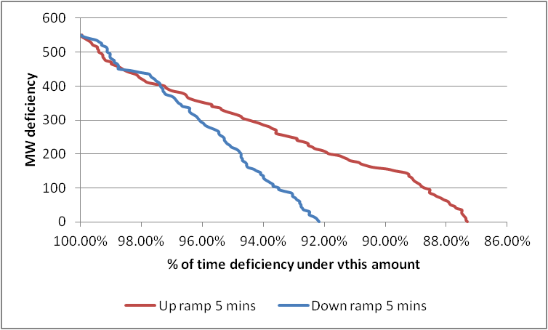
Ramp Percentile Deficit
8% (Down, 5 min, 99 Pctle.)
13% (Up, 5 min, 99 Pctle.)

Slide 11
Flexibility Metric Options
Reliability type metrics: Insufficient Ramping Resource Expectation (IRRE)
Historical / simulated production & net load data
Separate +ve and -ve net load ramps
Calculate available flexibility time series for each resource
Sum available flexibility, create distribution of available flexibility
Calculate probabilities of meeting each net load ramp
Determine expected value
For both directions
For all time intervals

Slide 12
Insufficient Ramp Resource Expectation
IRRE UPWARD FLEXIBILITY RESULTS
6 UNIT TEST SYSTEM

Slide 13
Current Development
Better representation of resources in probabilistic models
Operational time frame resource model
Logic module for hydro and energy limited resources
Transmission representation in the assessment of flexibility
What impact does congestion have on flexibility?
Can you deploy all the resources you think you can?
Where should new flexible resources be placed?
Traffic light system
Define acceptable risk zone. Measure excursions.

Slide 14
Ramping Well-Being Metrics

Slide 15
Together…Shaping the Future of Electricity

