Slide 1
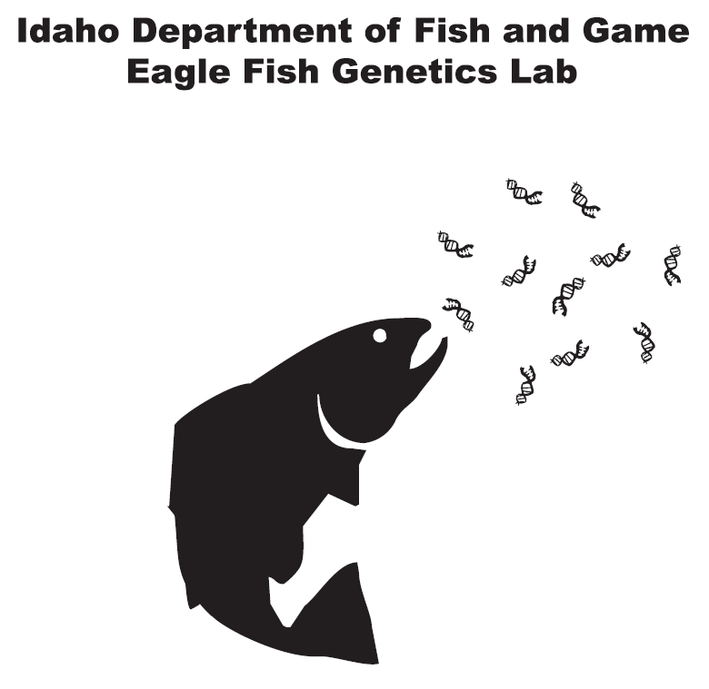


New genetic technology for the management of Columbia River salmon and steelhead
Proposal 201003100: Parentage Based Tagging
Matthew Campbell
Idaho Department of Fish and Game
NPCC Council Meetings
Hampton Inn and Suites
495 S. Capitol Blvd.
Wednesday, April 14, 2010

Slide 2
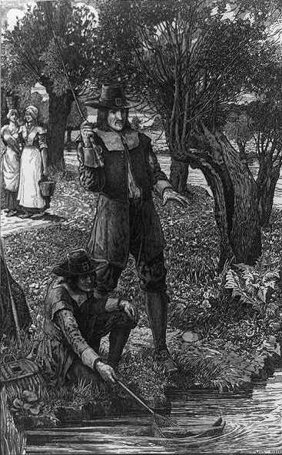
“by tying a ribbon or thread to the tails of young salmon which were swimming toward salt water and catching them again when they came back to the same place upon their return from the sea”
Notes:
Fishing enthusiasts have been using mechanical tags for the purpose of studying fish since as early as the mid-1650’s. Izakk Walton wrote in The Complete Angler (1653) that homing was observed in Atlantic Salmon:

Slide 3
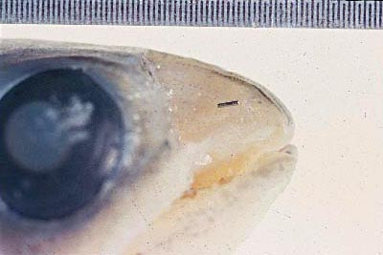

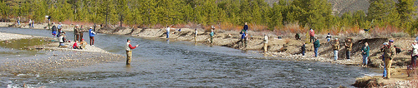
In the Snake River basin, CWT recoveries are one of the primary tools used by managers in Oregon, Washington, and Idaho to:
Estimate the number of hatchery salmon and steelhead contributing to fisheries in the Columbia River basin
Estimate run-timing and harvest of individual hatchery stocks
Notes:
For over forty years, researchers and managers in the Columbia River basin have used coded-wire tags (CWTs) to monitor and assess the harvest patterns and survival rates of salmon and steelhead in the Columbia River basin

Slide 4
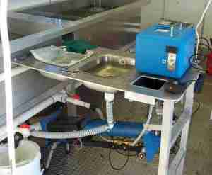


Despite its’ predominance in addressing these management questions, CWT technology has several limitations:
The process of physically tagging hundreds of thousands of juveniles from different hatchery stocks is
  logistically difficult
  labor intensive
  expensive
  potentially increases physiological stress

Slide 5
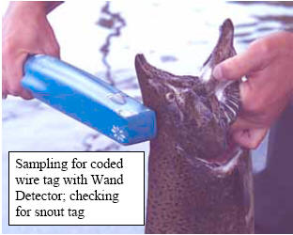
  All of these restrictions ultimately limit the total number of juveniles that get tagged each year, which in turn limits the number of CWT recoveries
  For example, only 500-800 coded-wire tags have been recovered annually (2005-2007) from statewide fisheries in Idaho (insufficient to estimate stock contributions)
http://www.s-union.com.tw/Tag%20detector_1.htm
Notes:
The resulting small sample sizes greatly reduce manager’s statistical power to estimate stock contributions (especially from smaller mark groups)

Slide 6

Parentage-based genetic tagging - PBT
(Anderson and Garza 2005)
Parentage-based tagging uses similar DNA techniques as those used in human parentage testing
Notes:
Parentage-based genetic tagging offered as an alternative to CWTs for the management of Pacific salmon fisheries.
(Anderson and Garza 2005)-Theoretical Assessment

Slide 7
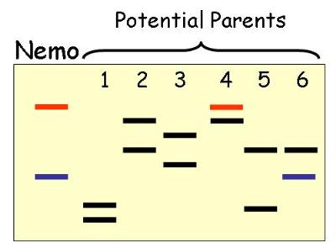
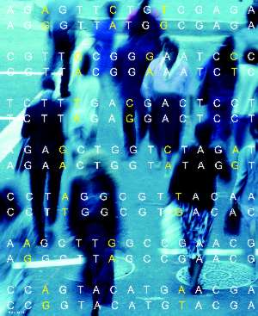
Parentage-based genetic tagging - PBT
Child
Every person receives a unique set of genetic information from their parents!
If your parents have been genetically screened they can easily be identified from thousands of possible candidates!

Slide 8
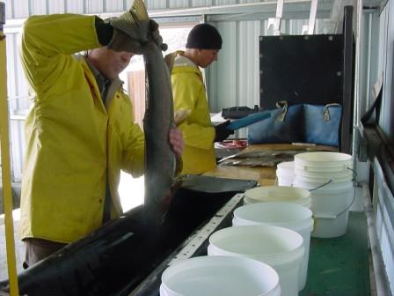
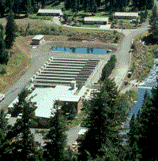
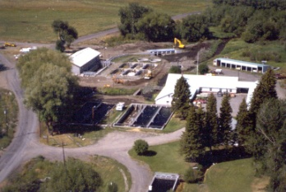
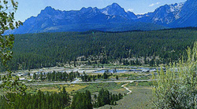
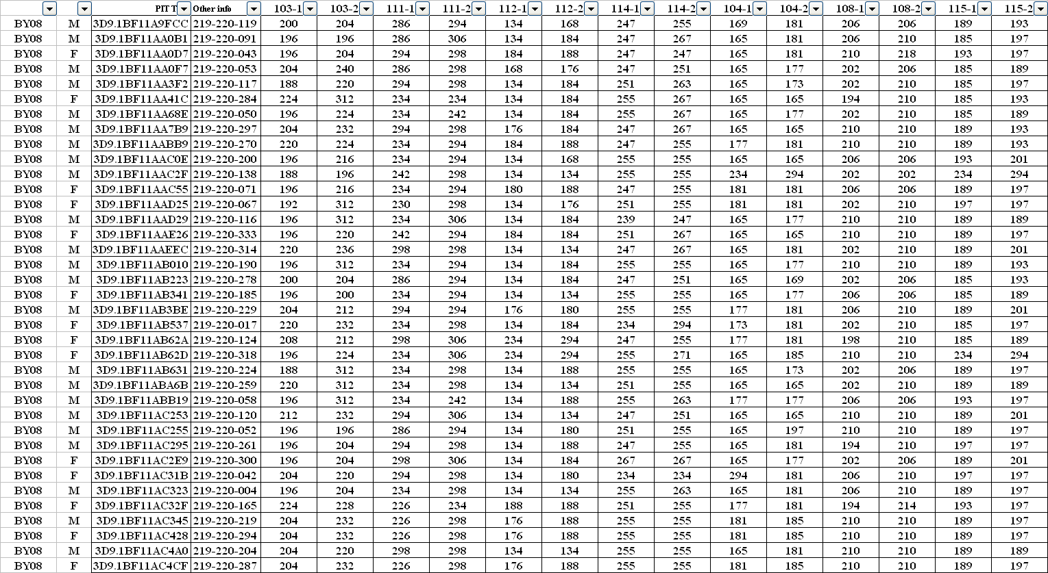
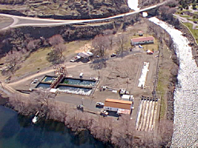
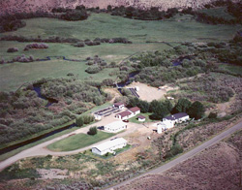

Genetic information can be obtained from all hatchery fish (broodstock) that are spawned
Wallowa
Lookinglass
Sawtooth
Oxbow
Pahsimeroi
Dworshak/Clearwater

Slide 9

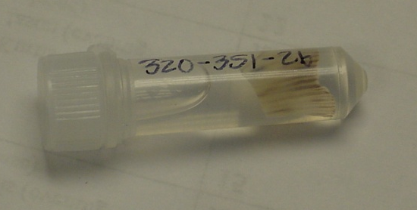
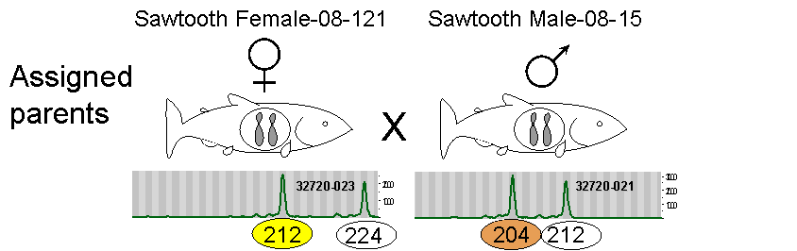
Offspring from any of these parents (either collected as juveniles or returning adults), if genotyped, could be assigned back to their parents, thus identifying the hatchery they originated from and exact brood year they were produced in
Sawtooth BY2008

Slide 10
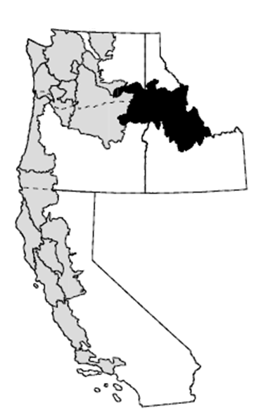
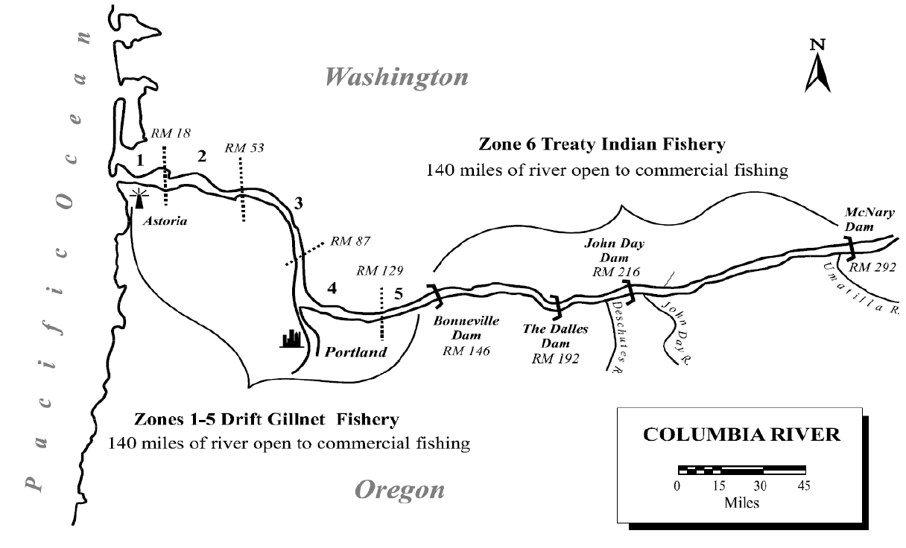
Any Snake River hatchery Chinook salmon or steelhead encountered in the basin (juvenile or adult) could be sampled, genotyped and its sex, exact age, and stock of origin could be determined
Snake River ESU

Slide 11
While between 500-800 coded-wire tags have been recovered annually (2005-2007), ~ten times that many (~6,000) adults have been physically examined each year (Hansen 2007)
Potentially, under a PBT program, the hatchery origin and brood year of a much higher number of these adults could have been determined. This increase in sample size would have undoubtedly improved contribution estimates, especially from smaller mark groups
<
6,000
500-800

Slide 12
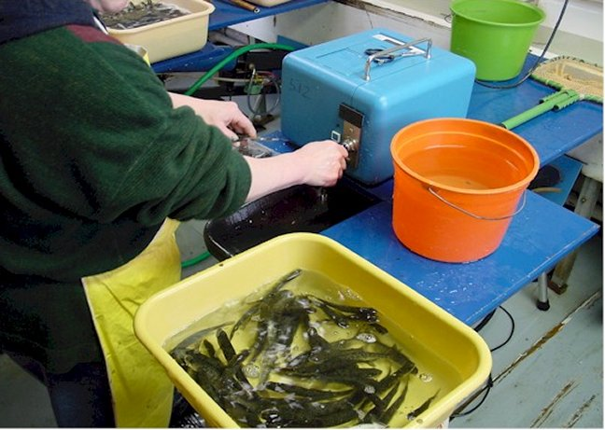
Benefits of PBT
Provides same information as CWTs (stock and cohort)
Run reconstruction (age, sex, stock of returning adults)
Harvest estimates
Additionally, many issues associated with tagging studies all but go away
Representative tagging
Tag loss
Tag detectability
Differential mortality

Slide 13
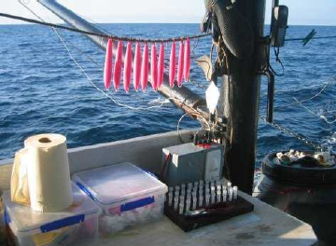
Additional benefits of PBT
PROS:
It is a passive mark (no handling of juveniles needed)
“Tagged” fish can be non-lethally interrogated
Fin-clip
Scales
Biopsy hook
“Genetag hook”
“The hollow stainless steel tip of the hook collects a small amount of tissue as the fish strikes, and a special rasp holds the sample in place while the hook is in the water”

Slide 14

Versatility of PBT
PROS:
Can potentially provide much more information than stock and cohort of origin
Can be used to address many different RM&E strategies called for under NOAA’s Fisheries Federal Columbia River Power System Biological Opinion (BiOp)

Slide 15
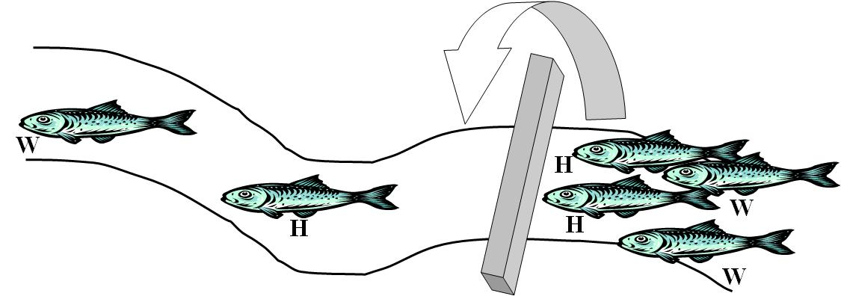
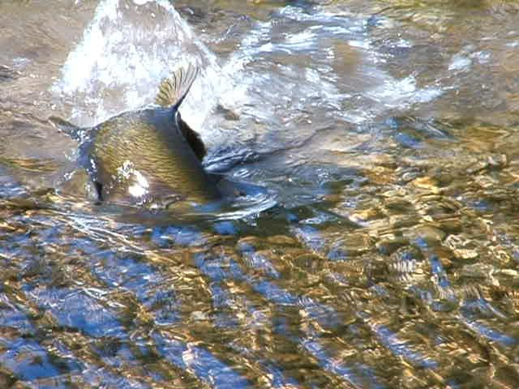
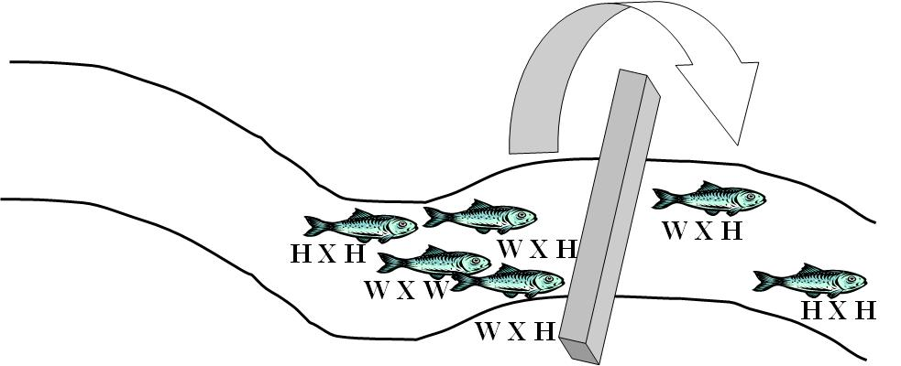
Versatility of PBT
• Hatchery reform
What is the reproductive success of hatchery-origin/wild-origin spawners?

Slide 16
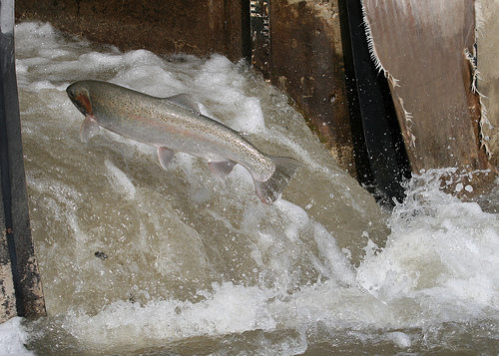
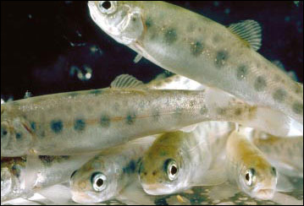
Versatility of PBT
• Hatchery reform
Concern that straying hatchery fish reduce the fitness of wild populations
PBT technology can identify where straying hatchery fish were released, their stock of origin, and age

Slide 17
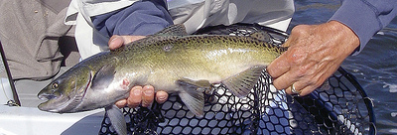
Versatility of PBT
• Heritability estimates
To what extent are physical or behavioral traits (e.g. size and age of returning adults) controlled by genetics, environment or interactions between the two?
Concern that hatchery spawning practices may be selecting for younger age at maturity in hatchery Chinook salmon populations
Notes:
Allows us to investigate a host of other conservation and management questions. For example, are hatcheries selecting for younger, smaller adults? PBT can estimate the heritability of different traits.
Heritability is the proportion of phenotypic variation in a population that is attributable to genetic variation among individuals.
How much of the variation in size and age of returning adults is due to underlying genetic variation among individuals and how much is due to environmental variation?

Slide 18
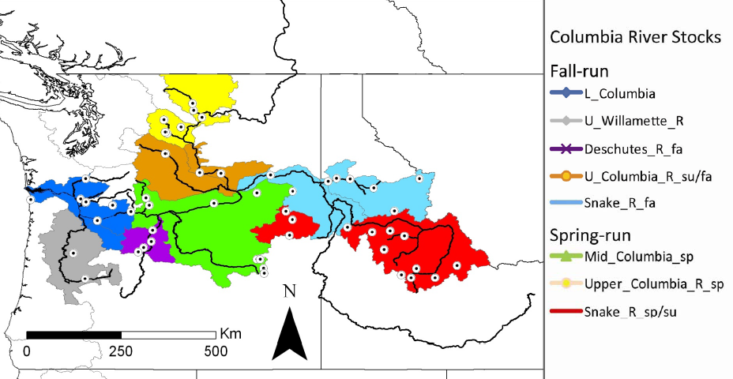
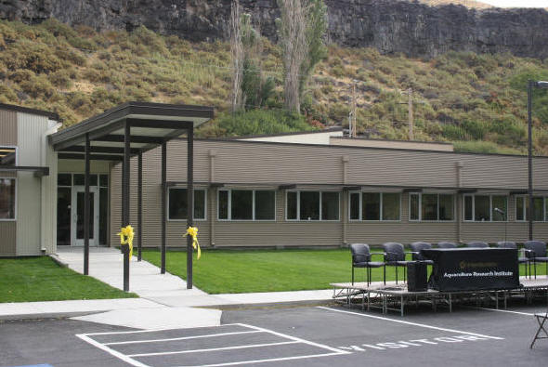


Versatility of PBT
• PBT program can easily be integrated into existing sampling/genetic programs at Bonneville Dam and in lower Columbia fisheries (CRITFC)
Bonneville Chinook weekly stock composition
(2004-2006)
Collaborative Center for Applied Fish Science
Notes:
• The parent database can easily be integrated into the genetic stock identification (GSI) program at Bonneville Dam overseen by CRITFC at the Hagerman Fish Culture Experiment Station.
Genetic Stock Identification techniques will allow the segregation of adult wild runs by origin (major group population or finer scale), and PBT technologies will identify the stock and age of sampled hatchery fish.

Slide 19
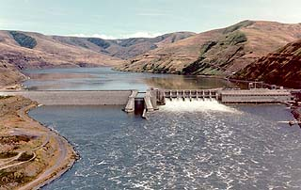
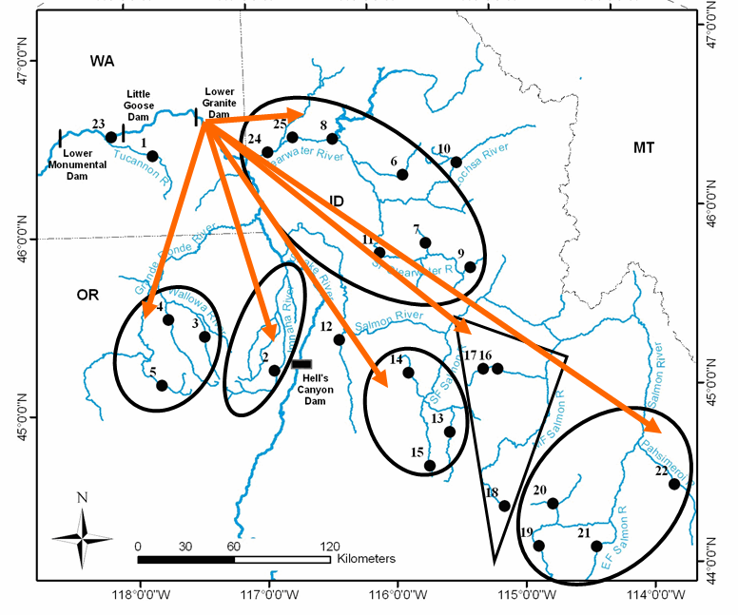
Versatility of PBT
Genetic Stock Identification
Easily integrated into IDFG’s GSI program at LGR dam

Slide 20

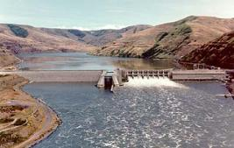
Versatility of PBT
• This could provide unprecedented genetic tools for managing wild and hatchery stocks in the basin. Genetic Stock Identification techniques will allow the segregation of adult wild runs by origin (major group population or finer scale), and PBT technologies could identify the stock and age of sampled hatchery fish

Slide 21
PBT sounds great!!!....
However, it has been largely theoretical up to this point…
Needs to be empirically tested and validated on a large scale
In addition, a thorough evaluation of the relative costs of implementing PBT and the sampling necessary to provide equivalent tag recovery data is also needed

Slide 22

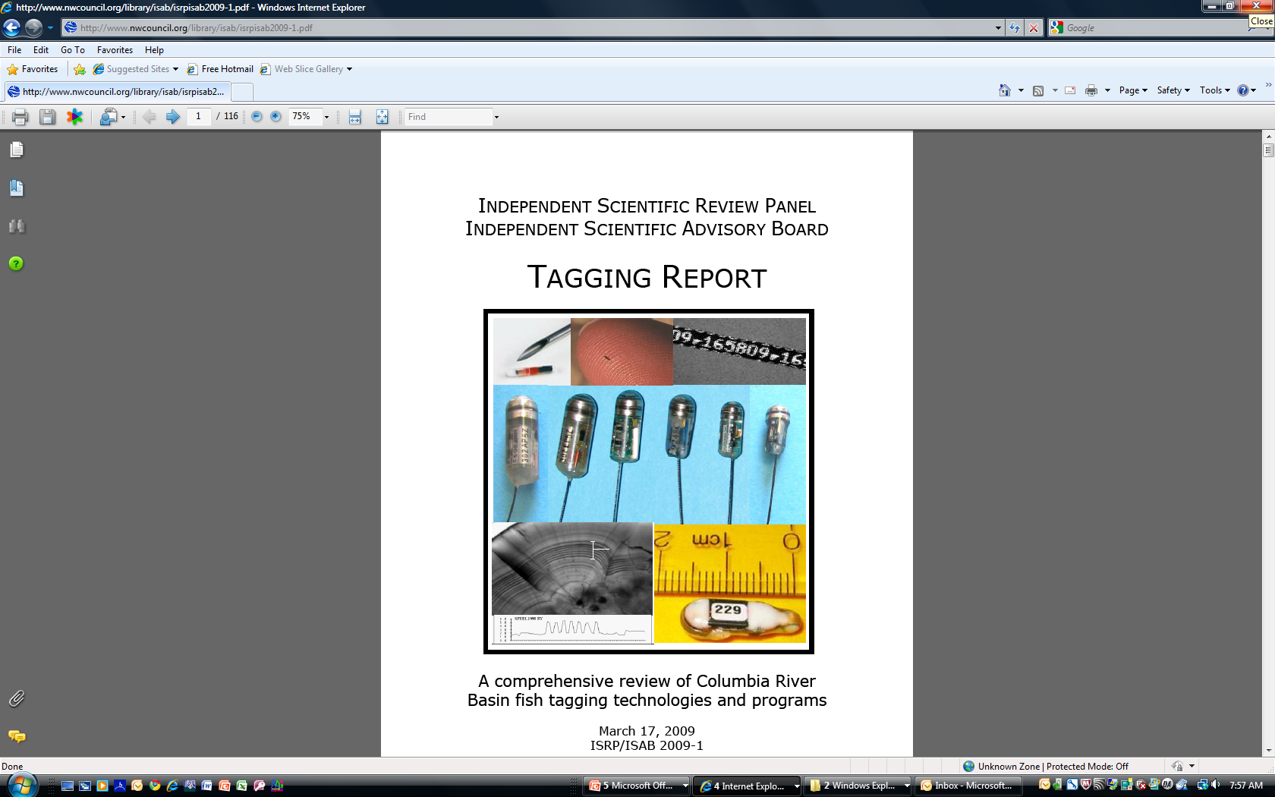
These types of evaluations have been directly called for by both the Pacific Salmon Commission and the Independent Scientific Review Panel and Advisory Boards

Slide 23
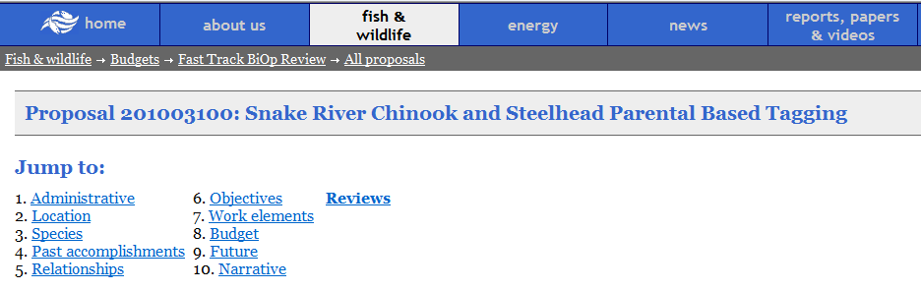
Snake River Chinook and Steelhead Parentage Based Tagging-Proposal #201003100
Perfect timing to conduct a large-scale test of this technology in the basin….

Slide 24
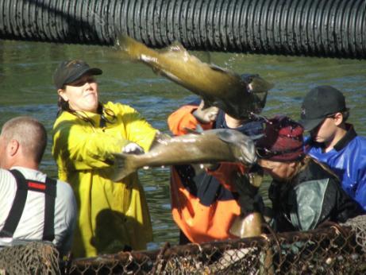
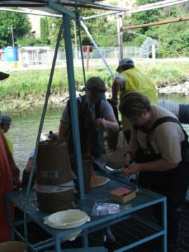
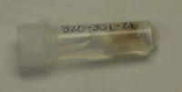
Support from hatchery managers (ID, WA, OR):
Sampled hatchery broodstock from all Snake River hatcheries (8 hatcheries, >30,000 samples in 2008 and 2009.
(Both species-steelhead and spring/summer Chinook salmon)
>30,000 samples !!!

Slide 25
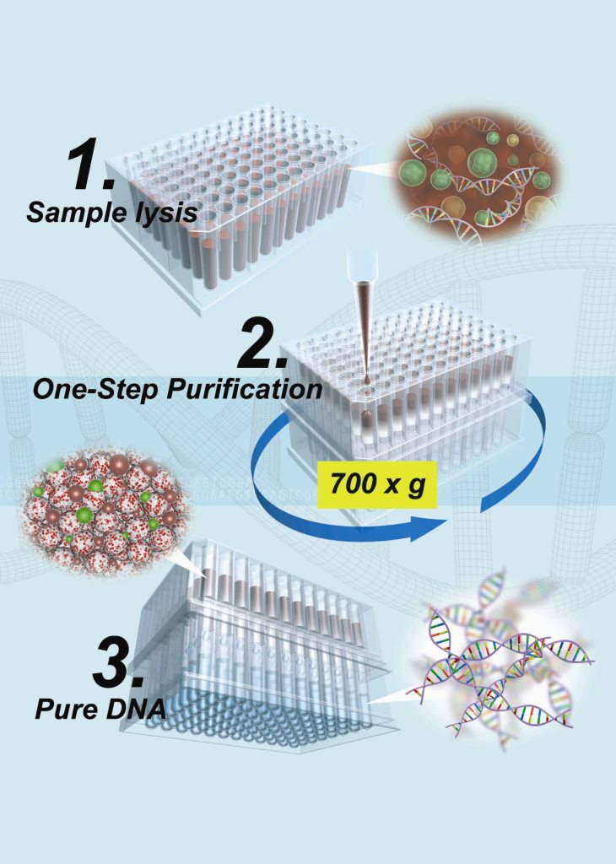
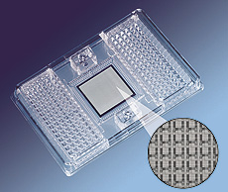

Advancements in genetic technology:
New genetic instruments and techniques allow more samples to be run at a quicker rate and for lower costs
96 samples in one run!
Notes:
Genetic advancements allow us to sample and screen fish much faster and at a reduced cost

Slide 26



Strong collaboration among labs and the ability to standardize genetic marker sets:
Allows multiple labs to process samples and share data
Dr. Shawn Narum
Collaborative Center for Applied Fish Science
Hagerman, ID
Dr. Jon Hess

Slide 27
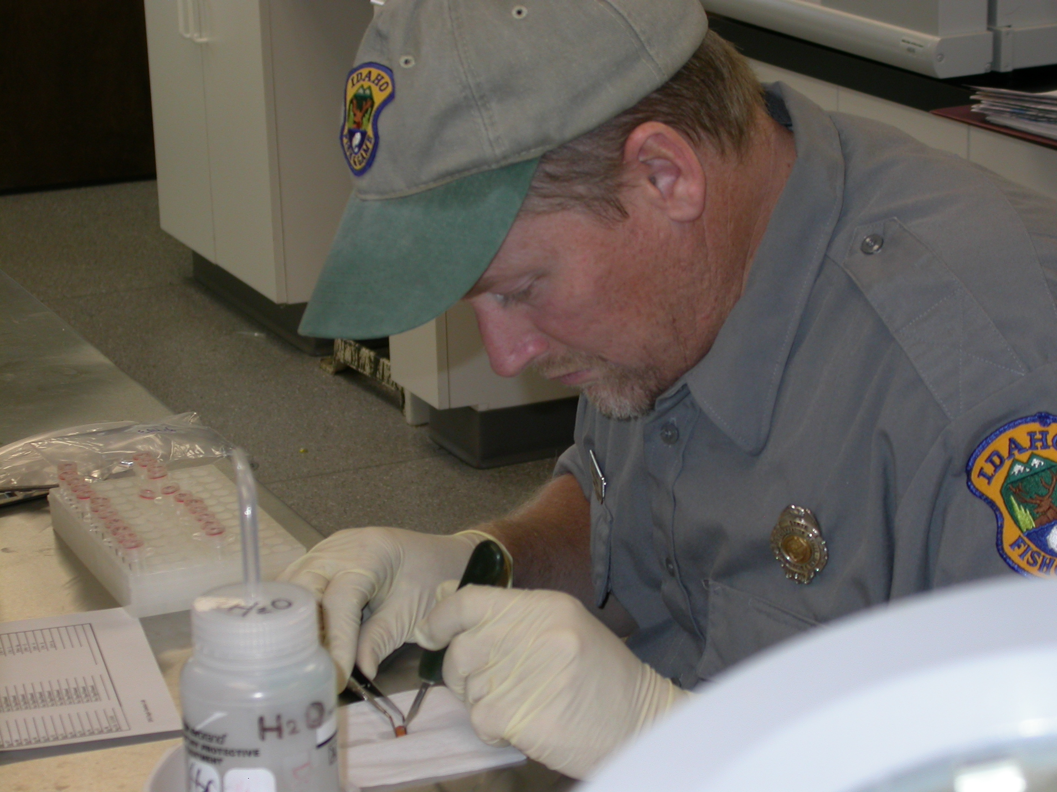
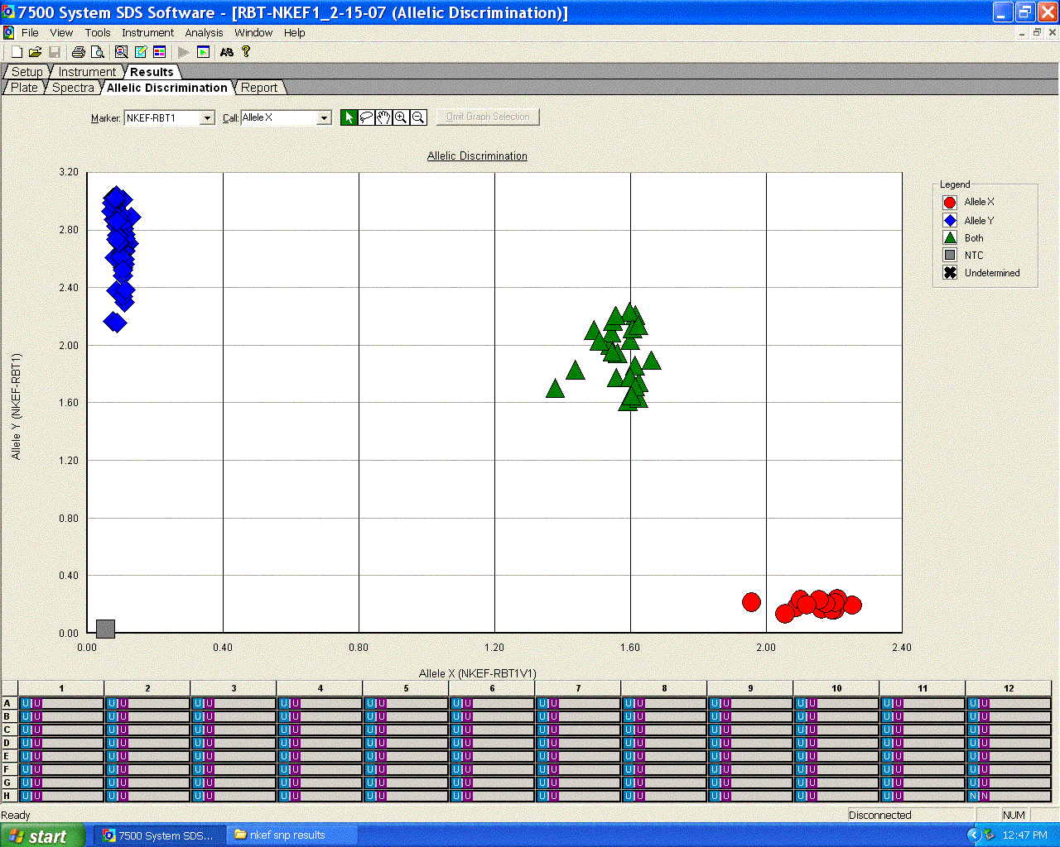
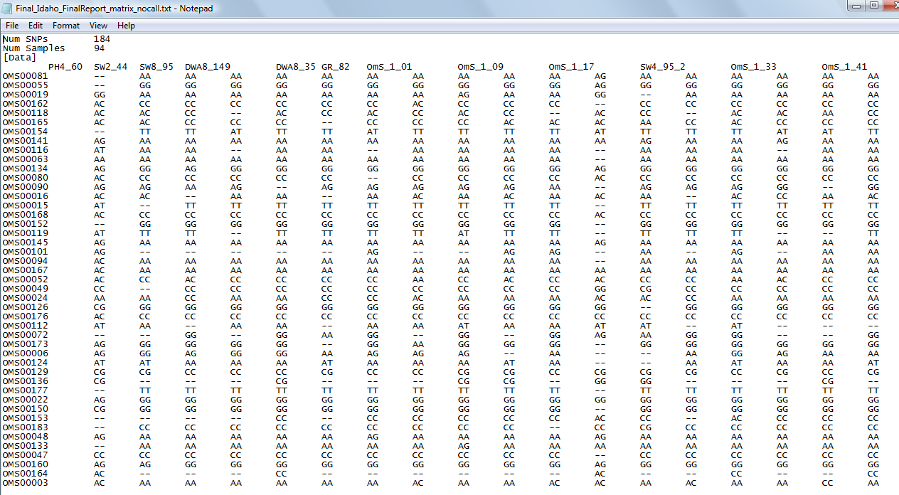
The plan (if funded):
Genetically screen samples collected in 2008, 2009, and 2010, creating the first parental genetic baselines for hatchery steelhead and Chinook salmon in the Columbia River basin
Parent Database

Slide 28
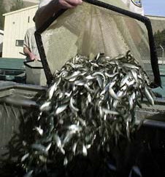
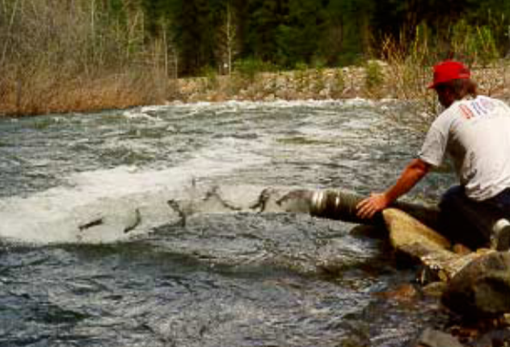
This will effectively, permanently genetically ‘tag”
~18 million Snake River basin smolts, per year
 | Total Columbia | Snake River Releases | Proportion
Spring/Summer Chinook | 24,000,000 | 10,000,000 | 42%
Summer Steelhead | 12,000,000 | 8,000,000 | 67%
TOTALS | 36,000,000 | 18,000,000 | 50%

Slide 29
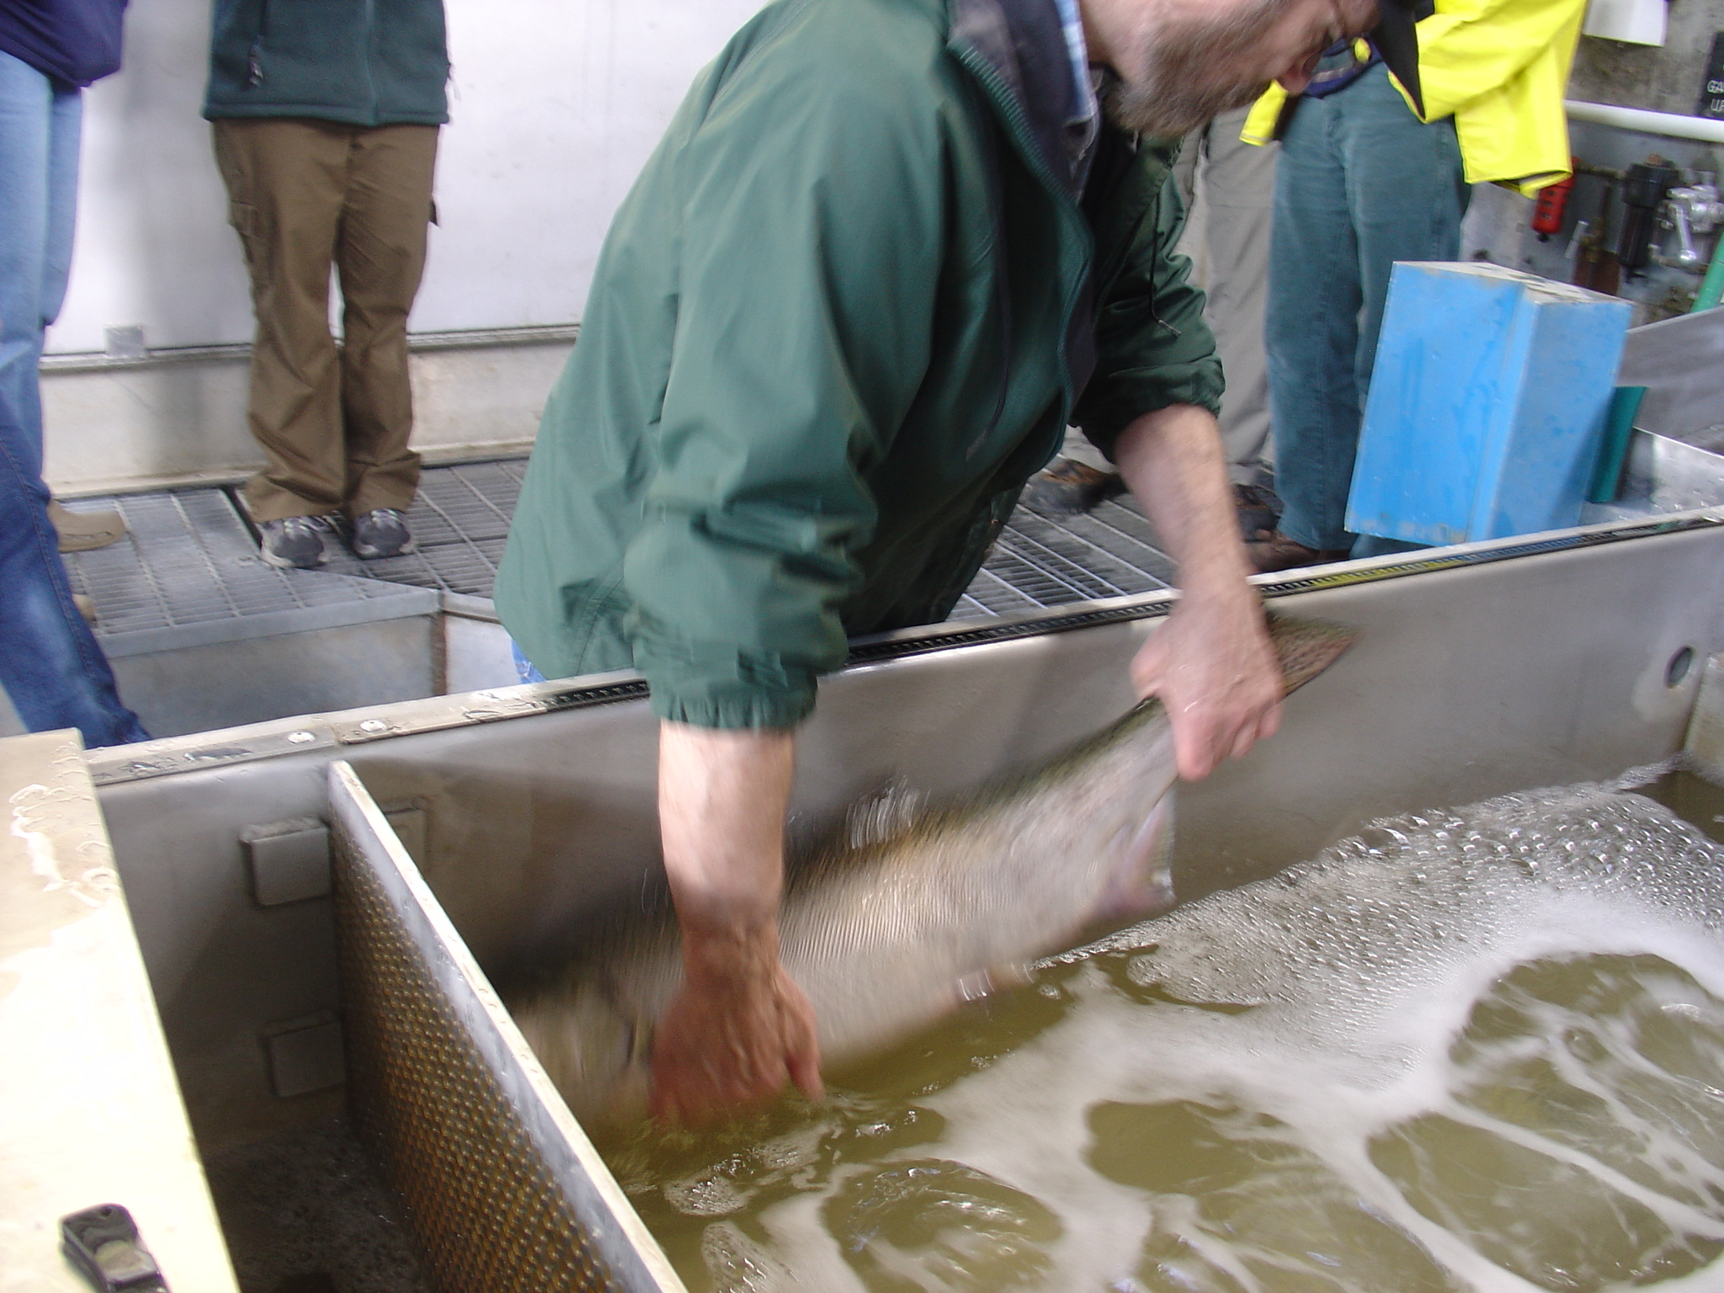
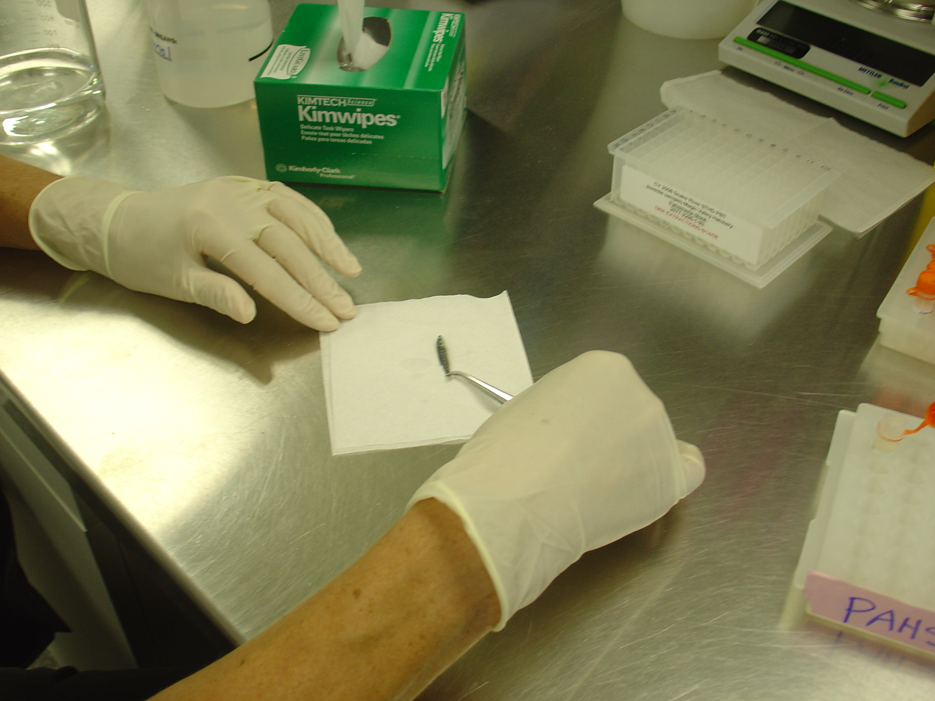
The plan (if funded):
We intend to demonstrate the applications of this technology through three sampling/genotype projects that will provide evaluations of both the accuracy and relative costs of PBT technology in providing equivalent CWT recovery data:

Slide 30

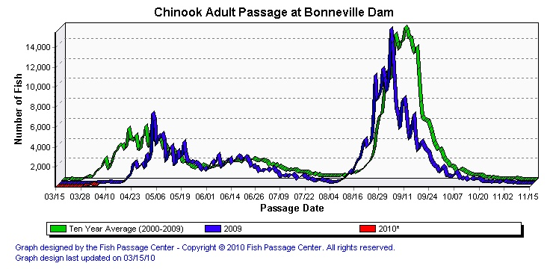
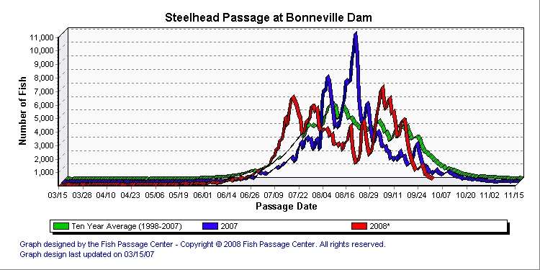
Assessment of the stock composition and run timing of Snake River hatchery salmon and steelhead passing Bonneville Dam and harvested in mainstem Columbia River fisheries
Notes:
The inclusion of PBT technology in CRITFC’s efforts will allow the differentiation of closely related hatchery stocks that cannot be distinguished using GSI technology. This will allow the validation of GSI assignments and will improve stock composition estimates by identifying Snake River hatchery fish in the mid-Columbia River reporting groups (for both Chinook and steelhead).

Slide 31
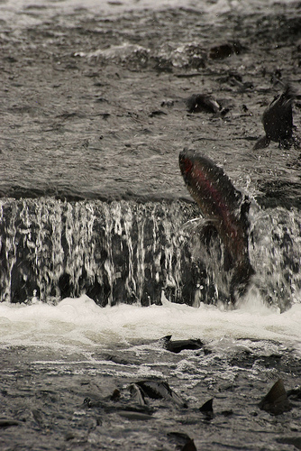
2. An assessment of the origin of straying hatchery steelhead in the Salmon River basin
Notes:
This type of information is of use throughout the Columbia River basin for both hatchery steelhead and Chinook salmon (ISRB/ISAB 2009)
Particularly useful in steelhead hatchery risk assessments in the Snake River basin, where the use of inter-basin stock transfers and off-site releases are under increased scrutiny
We will demonstrate the utility of PBT technology in addressing straying issues through the genotyping of hatchery adults captured in wild spawning tributaries in the Salmon River

Slide 32

3. A paired CWT and PBT recovery experiment as part of existing LSRCP hatchery evaluations in Idaho;
CWT
PBT
Demonstrate accuracy of PBT in providing stock and age
Notes:
We propose in this project to demonstrate the utility and accuracy of PBT technology, in addressing the LSRCP objectives described previously, through genotyping a subset of steelhead and Chinook salmon adults recovered with CWTs from creel and check stations in Idaho (~100-500 samples annually, beginning in the fall of 2010). We also propose to provide a thorough comparison of the relative costs associated with both the front-end costs (CWT marking versus adult broodstock genotyping) and back-end costs (removing and reading CWTs from snouts versus adult (offspring) genotyping.

Slide 33
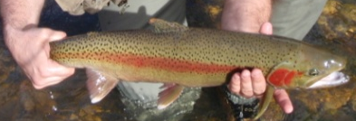




Ultimate goal:
Identify parents
Stock and age
Where it incubated
Where it reared
Where and when it was released
Diet
Disease
Rearing density
Temperature
Sawtooth Fish Hatchery
This information will be available for all hatchery broodstock every year

Slide 34
Questions???

