Slide 1
Note: this PowerPoint is supplemental information that has been shared by a participant of the Fish Tagging Forum to be posted as part of the March 2012 Fish Tagging Forum web-documents, but was not presented to the whole forum during the March 2012 meeting

Slide 2
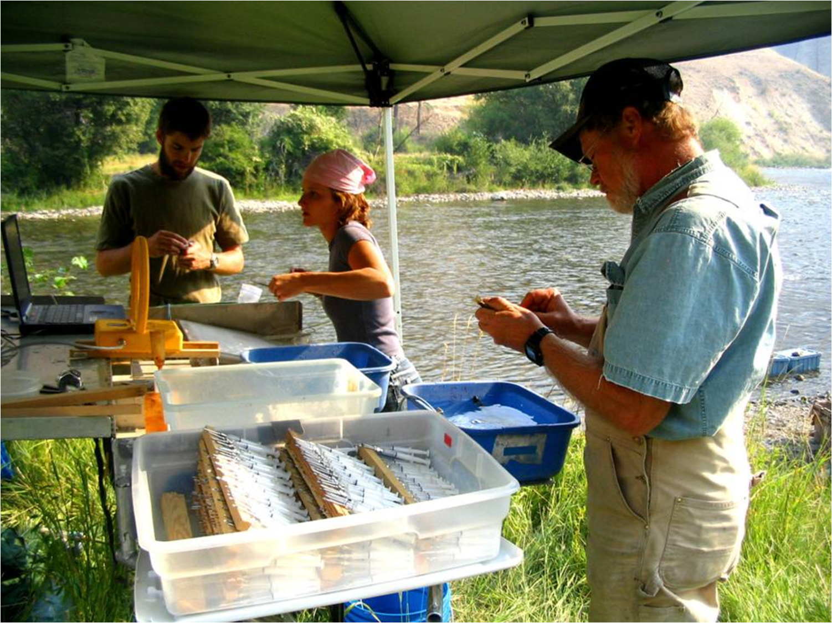
An Overview of PIT Tag Use in the
Columbia Basin
An Adjunct Presentation for the
Northwest Power and Conservation Council’s
Fish Tagging Forum
Dave Marvin
April 2012
Notes:
This overview contains portions of two presentations delivered at the PSMFC PIT Tag workshop (January, 2011) a third presentation at the AFS National meeting in Seattle (September, 2011), and a couple of figures from an AFS publication currently in press.
Details of the slide contents are contained in their respective reviewer’s notes panel.

Slide 3
Typical Uses of PIT Tags in the Columbia Basin
Parr & smolt monitoring and survival studies
  Travel time to dams and through river reaches
  Arrival timing and passage distributions at dams
  Smolt condition and physiology evaluations
  Smolt transportation evaluations
  Smolt and smolt to adult return (SAR) survival studies
Adult research and monitoring
  Migration duration and timing
  Stock identification
  Straying behavior
Sub-basin habitat evaluations
Multi-mark (secondary/shared) tagging
  External tags and marks
  Radio, acoustic (HTI, JSATS & Vemco-POST) tags
  Recovery of archival data storage tags using SxC
Notes:
PIT tags are used with juvenile fish to monitor their condition, disposition, and survival downstream through the hydrosystem, and upstream as adult returns.
Studies of adult returns utilize fish previously tagged as juveniles, as well as new marking activities to track fish ascending the Columbia and Snake rivers.
Use of multiple marks expands the scope and improves the precision of migration tracking; SxC provides easy and efficient recovery of archival DS tags

Slide 4
Mark, Release,
& Recovery
Locations

Slide 5
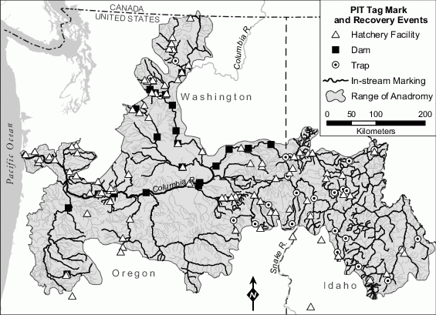
Notes:
Location of PIT tag marking and recovery activities in the Columbia Basin. These activities occur on or at more than 550 rivers and streams, dams, traps, and hatchery rearing and release facilities throughout the Basin within the range of anadromous salmon and steelhead, including the Okanogan River in British Columbia above Osoyoos Lake.

Slide 6
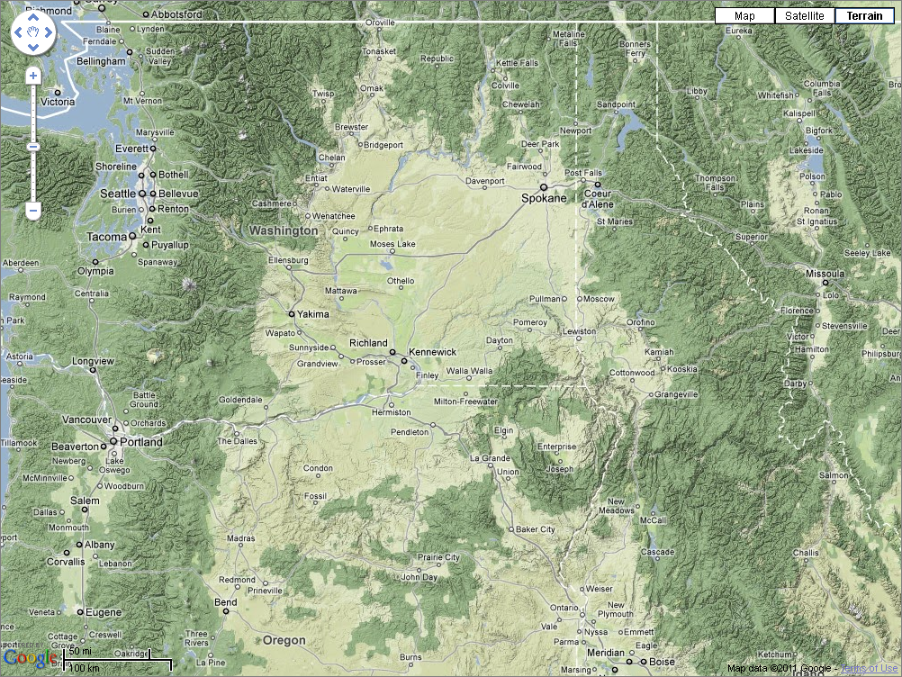
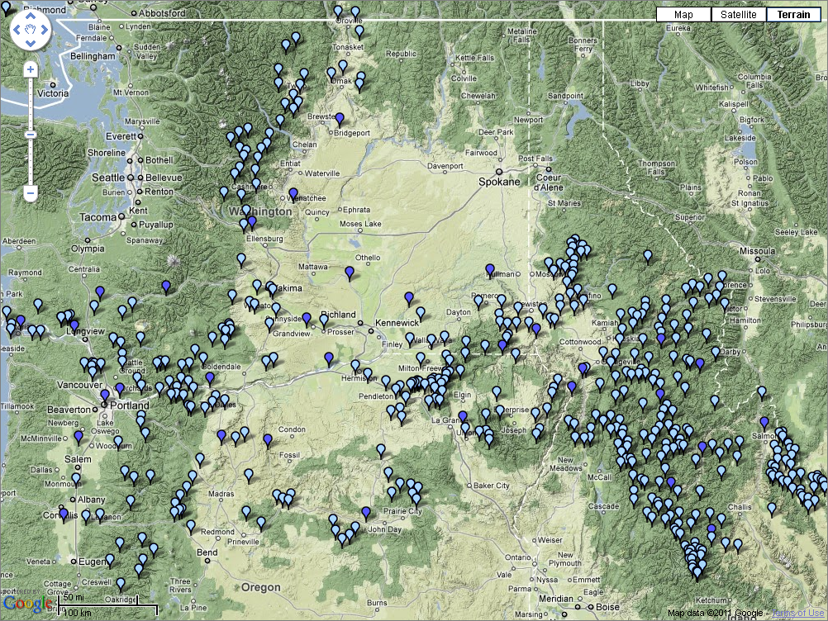
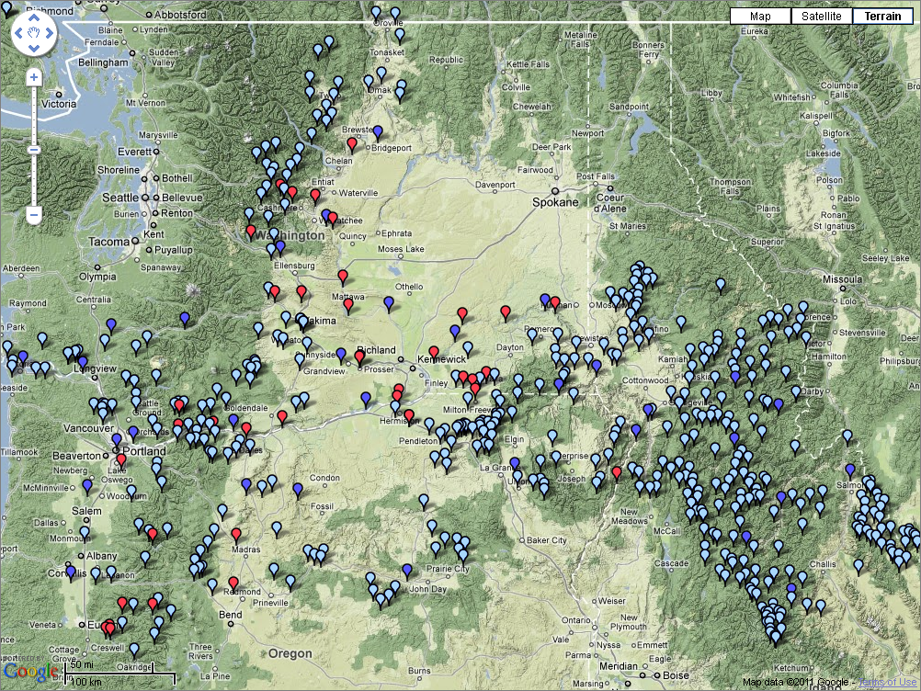
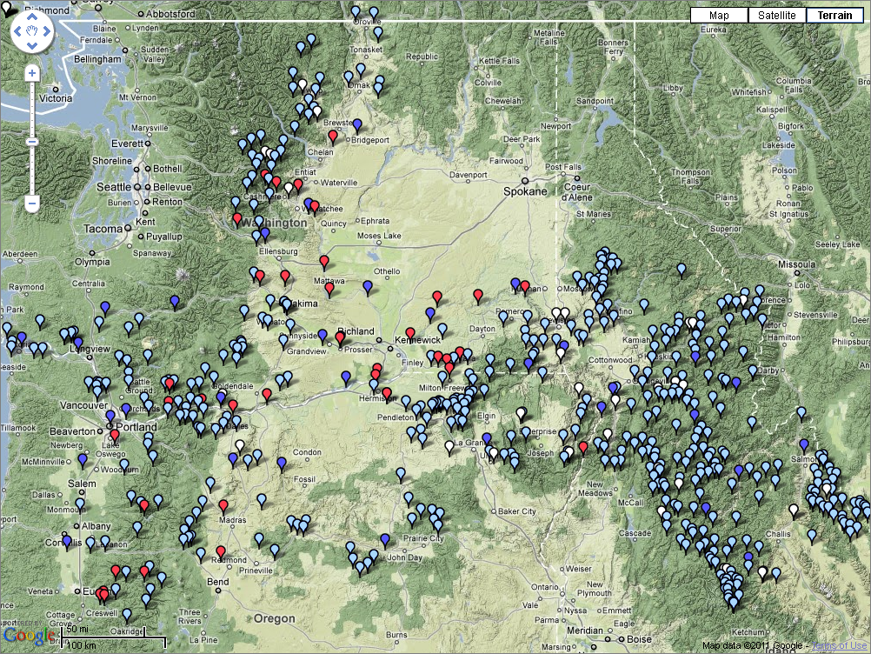
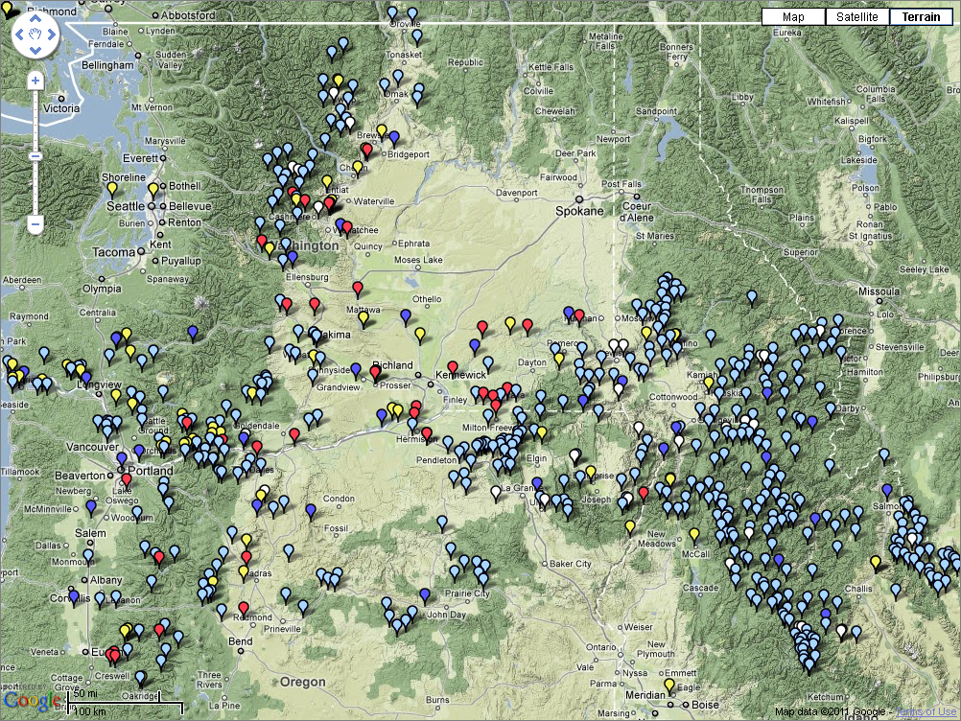

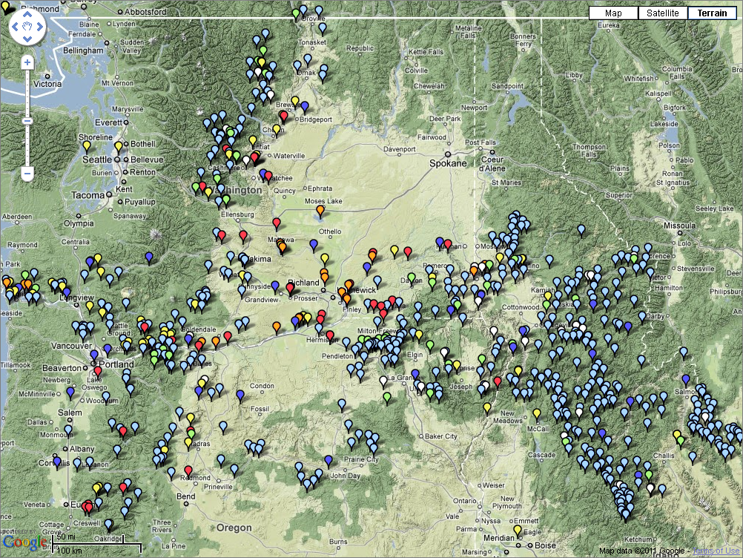

Notes:
PIT Tag marking, release, and recovery locations
Blue – Rivers and tributaries
Red – Dams
White – Traps & Weirs
Yellow – Hatcheries
Green – Acc. Sites
Orange – Avian Pred. Colonies
Purple – Other

Slide 7
Mark &
Release

Slide 8
Notes:
See John Tenney’s Fish Tagging Forum presentation (22-Mar-12) for a current audit of PIT tag marking activity.
Cumulative marking milestones:
1994: 1M
1996: 2M
1999: 5M
2002: 10M
2007: 20M

Slide 9
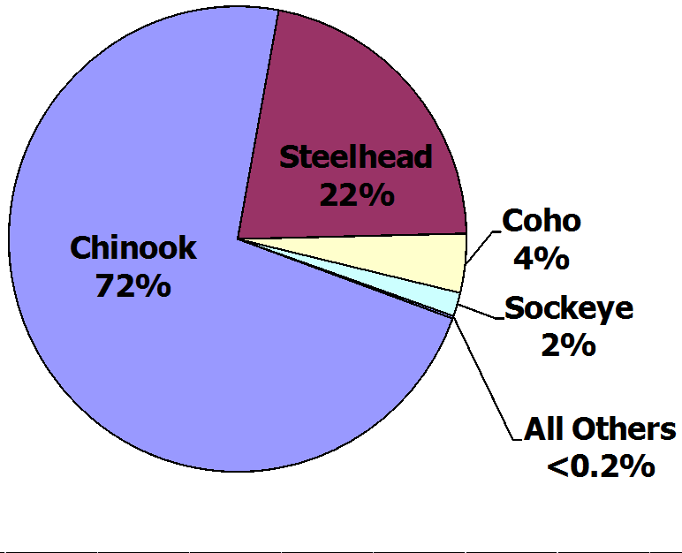
Numbers of Fish in the Columbia Basin*
Marked with PIT Tags
1987 - 2010
Chinook | 19,504,371
O. mykiss | 5,866,144
Coho | 1,105,175
Sockeye | 445,499
Bull Trout | 17,517
Cutthroat | 12,780
No. Pikeminnow | 8,380
Other | 3,441
Shad | 2,939
Pacific Lamprey | 1,966
Brook Trout | 1,071
White Sturgeon | 966
Whitefish | 504
Total | 26,970,753
*Includes all PIT-tagged fish reported to the
Columbia Basin PIT Tag Information System
Notes:
Total other species=49,564. (Does not include ~80k white sturgeon marked by ODFW between 1995-2010 but reported to PTAGIS in 2011.)
Tagging Summary by Species
Since 1987: 72% Chinook, 22% O. mykiss, 4% coho, 2% sockeye. Less than 0.2% all other species. (Less than 0.5% with ODFW sturgeon.)
Chinook: 70-74%
O. mykiss: 18-26%
Sockeye: 0-5%
Coho: 1-6%, since 1991

Slide 10
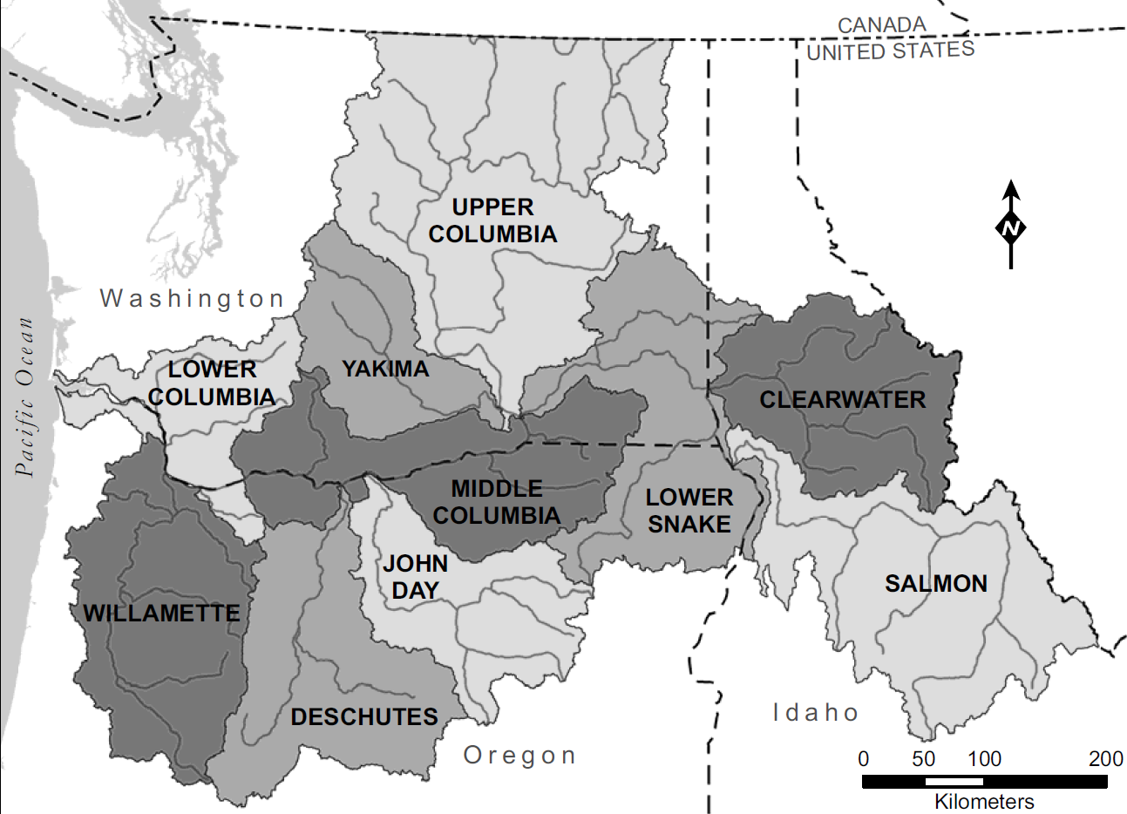

Slide 11
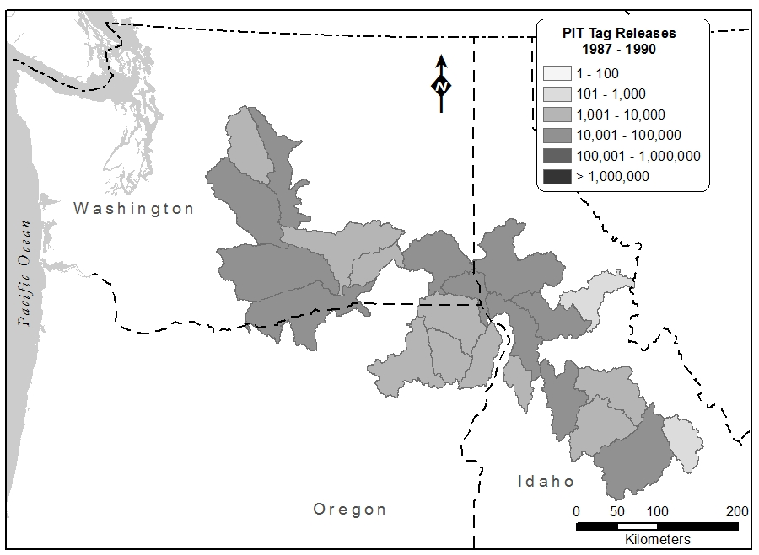
Notes:
87-90: 24 HUCs, 61 Release Locations, 50% in 4 HUCs and 6 locations, DWOR=15%
DWOR COLR SAWT SNKTRP CLELMR LGR
330k tags

Slide 12
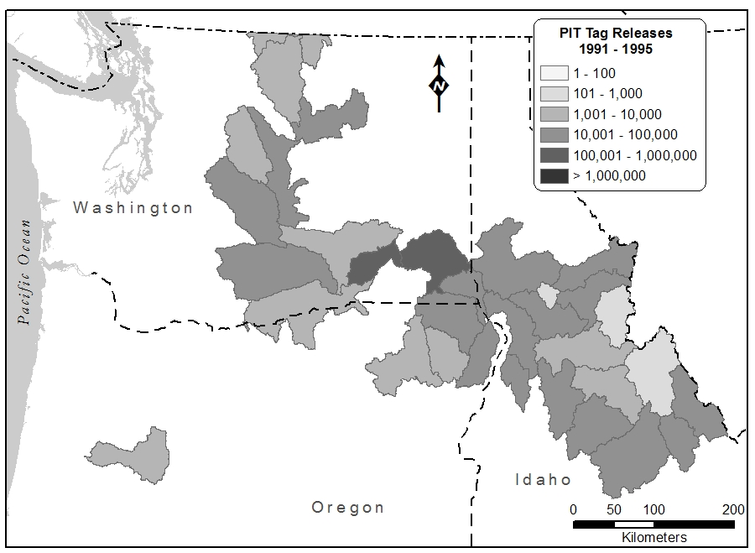
Notes:
91-95: 34 HUCs, 179 Release Locations, 50% in 4 HUCs and 8 locations, with ~25% of the effort centered at LGR.
LGR SNAKER RIS LGS SNKTRP CLELMR DWOR LMN
1.4M tags

Slide 13
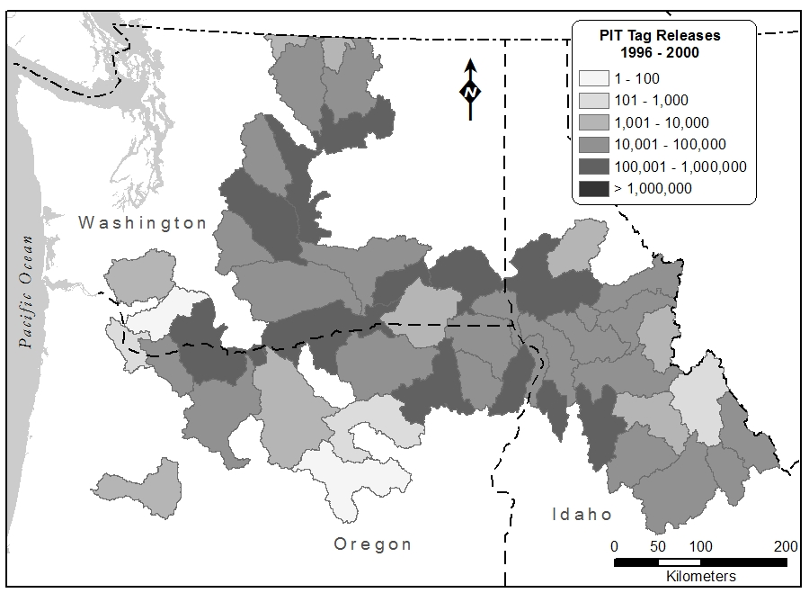
Notes:
96-00: 49 HUCs, 303 Release Locations, 50% in 5 HUCs and 10 locations, 17% at TDA, 13% at LGR.
LGR KNOXB RAPH SNAKER RIS DWORNF TDA CLWR RRE IMNAHW
4.9M tags

Slide 14
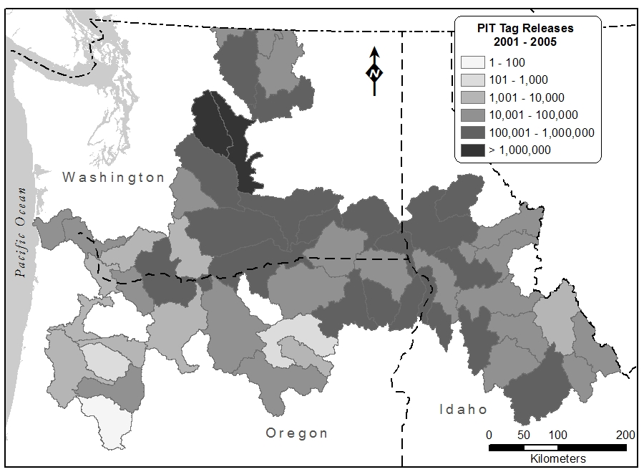
Notes:
01-05: 55 HUCs, 367 Locations, 50% in six HUCs and 18 locations, 9% at LEAV – focus on mid-Col hatchery releases.
LEAV RAPH LGR KNOXB SNAKE3 RINH METHR WINT ENTH RIS DWORNF RRE TWISPR NASONC PRD BCCAP CHEWUR COLR
9.3M tags

Slide 15
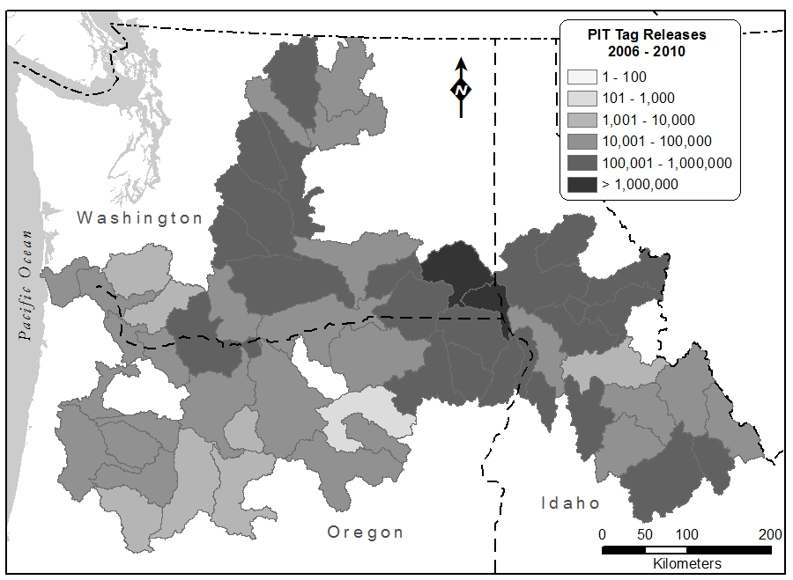
Notes:
06-10: 59 HUCs, 403 Locations, 50% in seven HUCs and 15 locations, 12% at LGR.
SNAKE3 LGR BCCAP RAPH DWORNF KNOXB SNAKE4 NATCHR CJRAP PLAP YAKIM1 IHR SAWTRP LEAV WENATR LWSH
10.8M tags

Slide 16
Recaptures
& Mortalities

Slide 17
Recaptures
  Recapture events are generally ancillary to marking activities.
  Marking projects often recapture other researchers’ tagged fish.
  Recaptures provide a unique opportunity to record changes in morphology and physiology of specific fish.
  800k+ tagged fish have been recaptured one or more times.
  Recapture events are recorded throughout the CB, but 40% have been reported from just 20 trap and dam locations.
  Specific smolts can be targeted for recapture at the LGR, LGS, MCN, JDA, and BON bypasses, as can adults at the LGR adult trap and BON adult fish facility (AFF), using SxC.
Notes:
All Years/Species 818,984
Chinook: 552,580: 67%
Steelhead: 149,148: 18%
Top 20 sites: 331,642: 40%
IMNTRP JOHTRP CATHEC MARTRP RIS FISTRP LOSTIR RRE LAKEC LGR SFSTRP GRAND2 CFCTRP PAHTRP LSFTRP KNOXB NEWSOC METTRP REDTRP

Slide 18
Mortalities
  994k mortality events from the recovery of host fish or bare tags:
  Tags detected in marked Northern Pikeminnow recovered in the Sport Reward Fishery, and from NPM prey
  Tags detected in sport and commercial harvests
  Tags detected in hatchery spawners
  Bare tags retrieved from bypass systems at dams
  924k (93%) detected in situ from colonies of avian piscivores (terns, cormorants, pelicans, gulls)
  574k (58%) reported from colonial sites in the Columbia River estuary
Notes:
994k total
93% (924k) from 20 avian colony sites
58% from ESANIS/RICEIS (estuary)

Slide 19
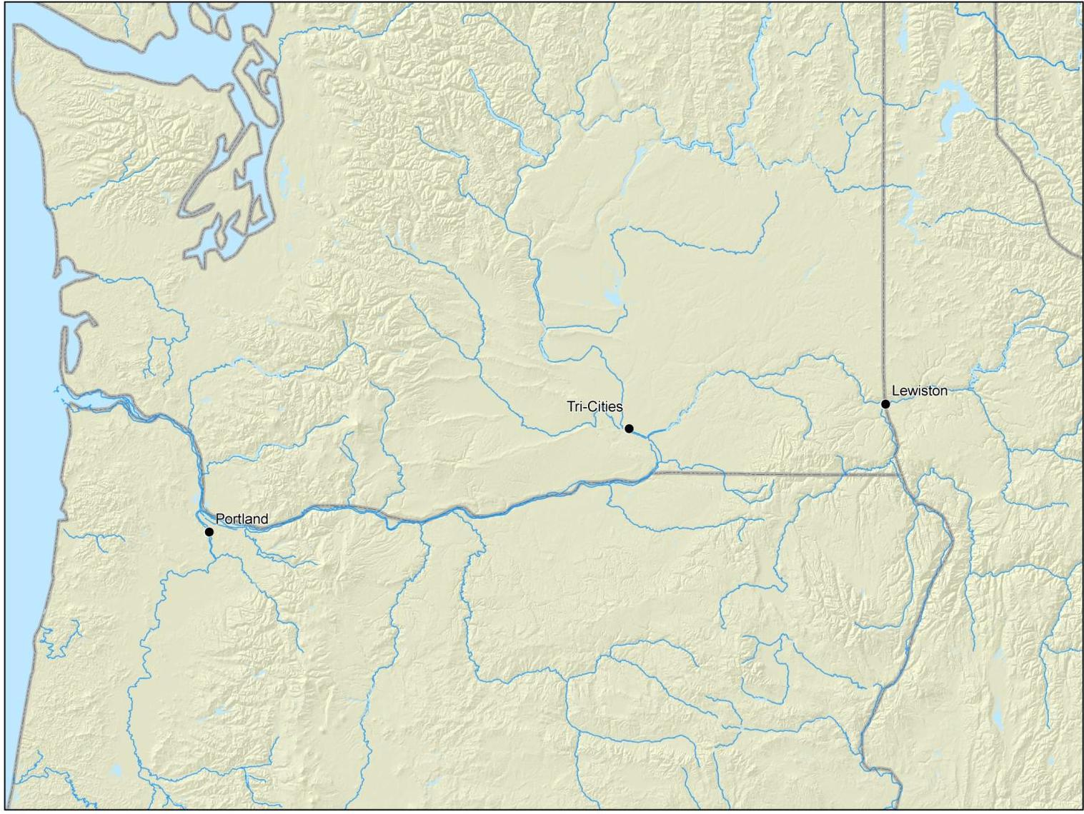
PIT Tags “Recovered” at Avian Predator Colonies 1996 - 2010
<1k
1k
RIS
30k
<1k
10k
<1k
IHR
1k
574k
43k
MCN
244k
JDA
22k
Notes:
62% of avian predation recovers in estuary
26% in Wallula reach to Snake confluence
12% (100k) other

Slide 20
PIT Tag
Detection

Slide 21
Notes:
21
This graph shows the number of individual PIT-tagged fish detected by year. Many of these fish were detected at two or more sites. Tagged fish are generally “interrogated” multiple times as they pass through a monitored smolt bypass or adult ladder.
See John Tenney’s Fish Tagging Forum presentation (22-Mar-12) for a current audit of PIT tag detection activity.

Slide 22
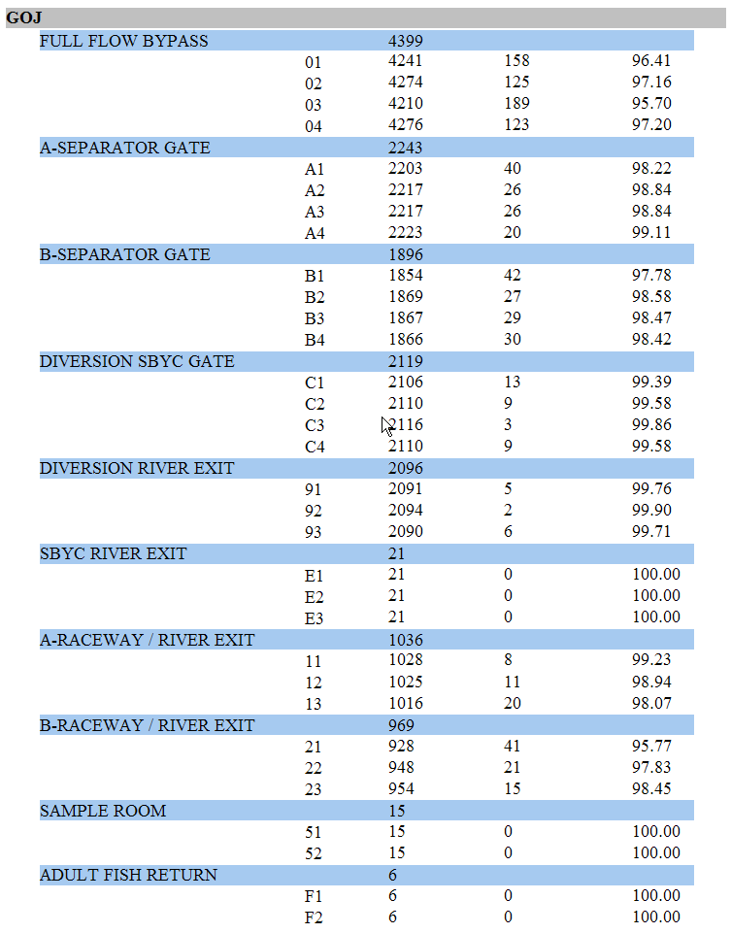
Detection Efficiency
FULL FLOW BYPASS: 4399 tags
Tags detected on 1 ant. = 13
Tags detected on 2 ant. = 45
Tags detected on 3 ant. = 466
Tags detected on 4 ant. = 3875
Estimated detection probability:
99.9877% ± 0.000039 % (95% CI)
A-SEPARATOR GATE: 2243 tags
Tags detected on 1 ant. = 7
Tags detected on 2 ant. = 8
Tags detected on 3 ant. = 75
Tags detected on 4 ant. = 2153
Estimated detection probability:
99.9997% ± 0.000002% (95% CI)
Notes:
Detection efficiencies at the Little Goose Dam JFF; May 2, 2009.
>99.98% DE at 36” full flow antennas provides confidence in detecting essentially all tagged fish even when the facility is in primary bypass.
>99.999% DE at separator gate provides confidence in detecting SxC targets.
Detection efficiency methodology from Ben Sanford, in Prentice et al. 1993. 1989 annual report to BPA.

Slide 23
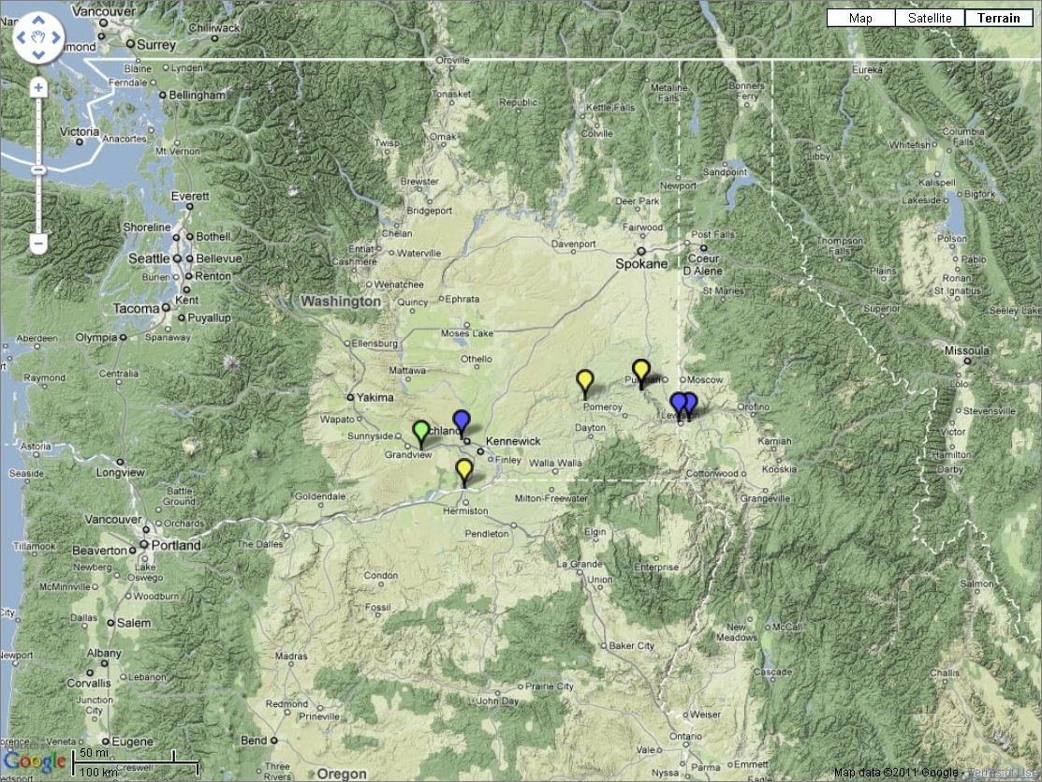
PIT Tag Detections
1987 - 1990
> 1,000,000
100,001 – 1,000,000
10,0001 – 100,000
1,001 – 10,000
101 – 1,000
< 100
Notes:
Obs Sites 1987-1990: Eight (can’t see GRA)
87-90: 121k detections at 8 sites of 115k tags; all but 800 detected at 4 smolt bypasses

Slide 24
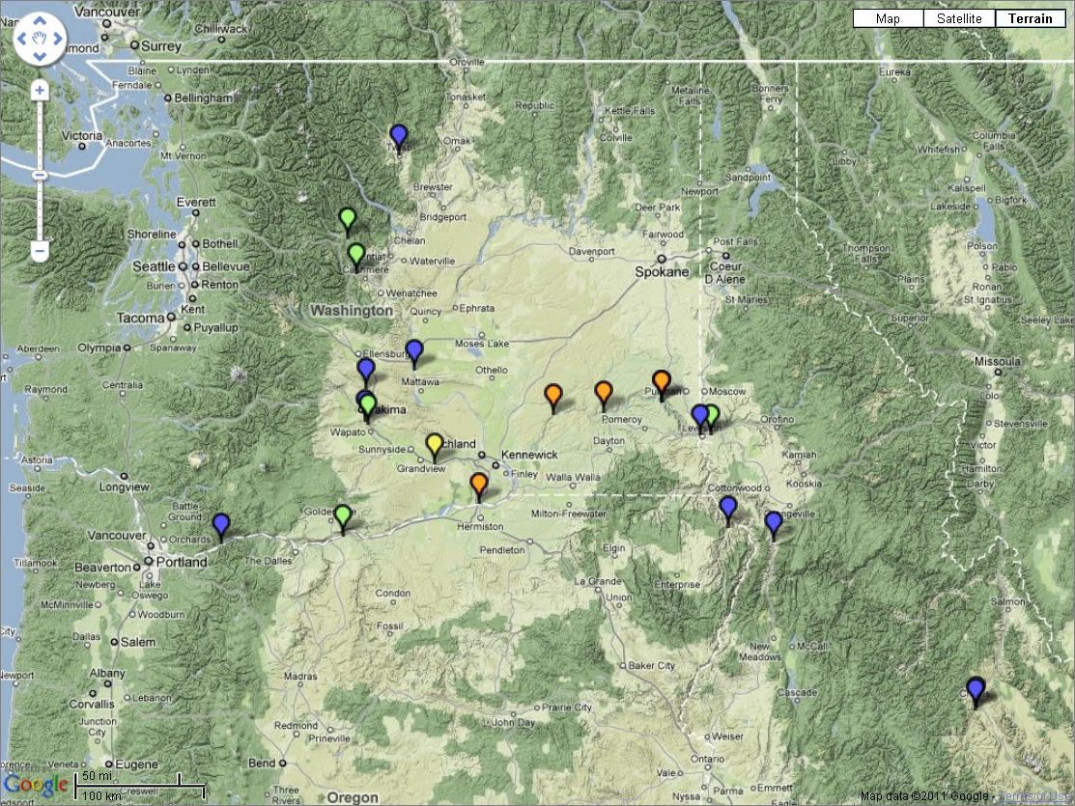
PIT Tag Detections
1991 - 1996
> 1,000,000
100,001 – 1,000,000
10,0001 – 100,000
1,001 – 10,000
101 – 1,000
< 100
Notes:
Obs Sites 1991-1995: 21 sites
91-95: 1.1M detections at 21 sites of 582k tags (return to river starting in 1993, no or low spill) ; 10 sites detected < 1000 tags

Slide 25

PIT Tag Detections
1996 - 2000
> 1,000,000
100,001 – 1,000,000
10,0001 – 100,000
1,001 – 10,000
101 – 1,000
< 100
Notes:
Obs Sites 1996-2000: 25 sites
96-00: 3.0M detections at 25 sites of 2.0M tags; 3 sites detected < 1000 tags

Slide 26
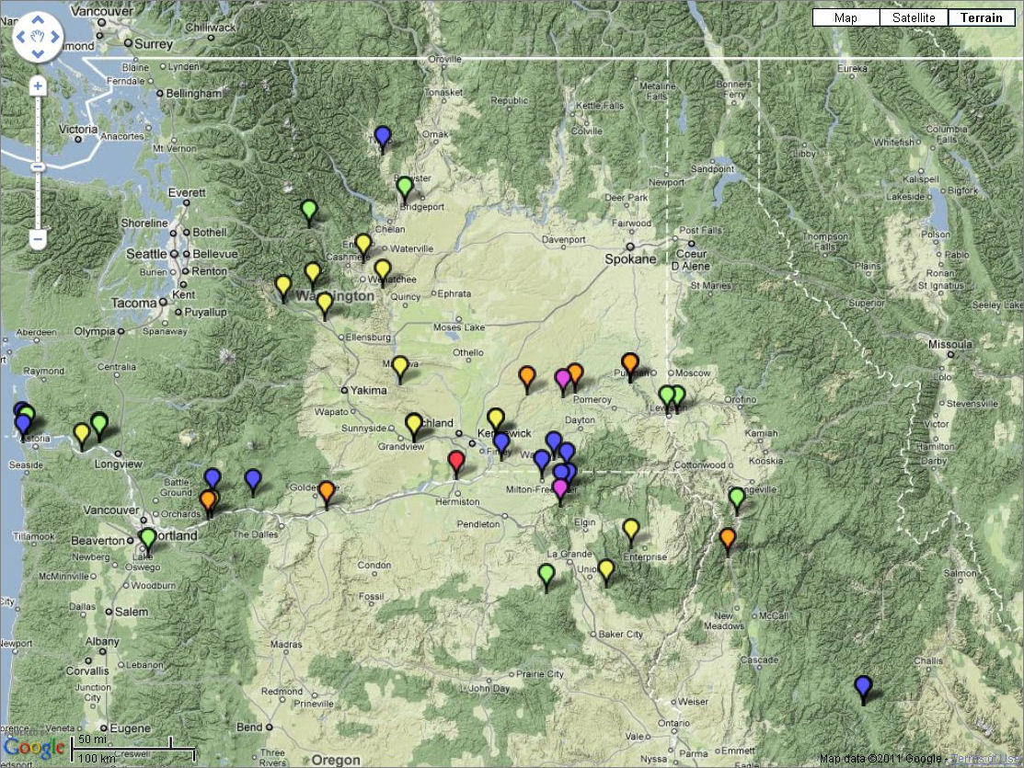
PIT Tag Detections
2001 - 2005
> 1,000,000
100,001 – 1,000,000
10,0001 – 100,000
1,001 – 10,000
101 – 1,000
< 100
Notes:
Obs Sites 2001-2005: 51 sites
01-05: 5.7M detections at 51 sites of 3.7M tags; 17 sites detected < 1000 tags

Slide 27
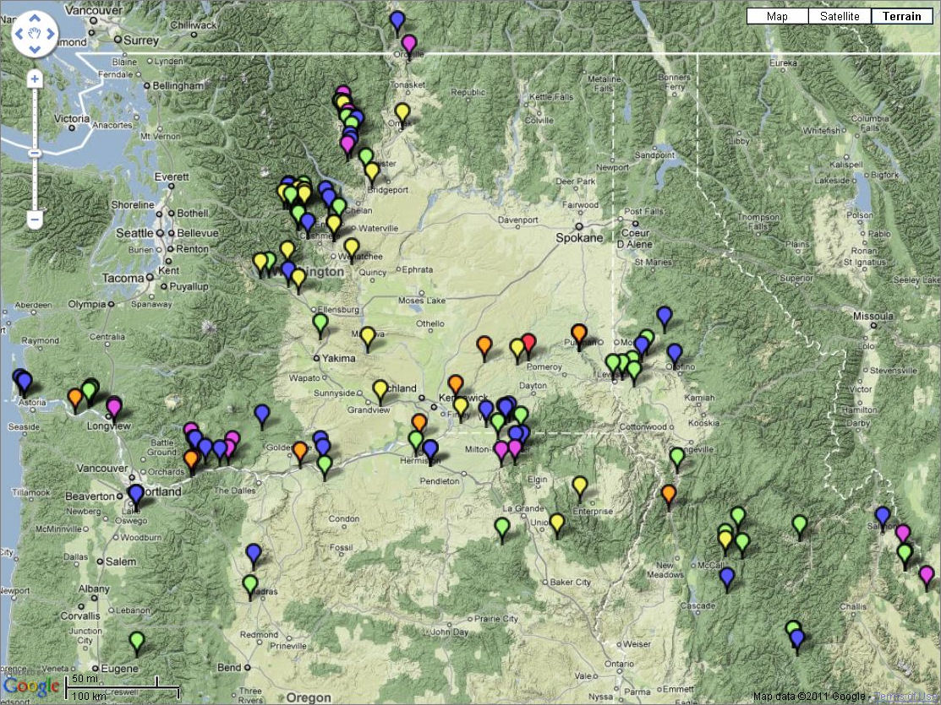
PIT Tag Detections
2006 - 2010
> 1,000,000
100,001 – 1,000,000
10,0001 – 100,000
1,001 – 10,000
101 – 1,000
< 100
Notes:
Obs Sites 2006-2010: 125 sites; 21 new sites in 2010 alone.
06-10: 6.7M detections at 125 sites of 4.5M tags; 50 sites detected < 1000 tags

Slide 28
Juvenile Bypass Systems and Adult
Fishways

Slide 29
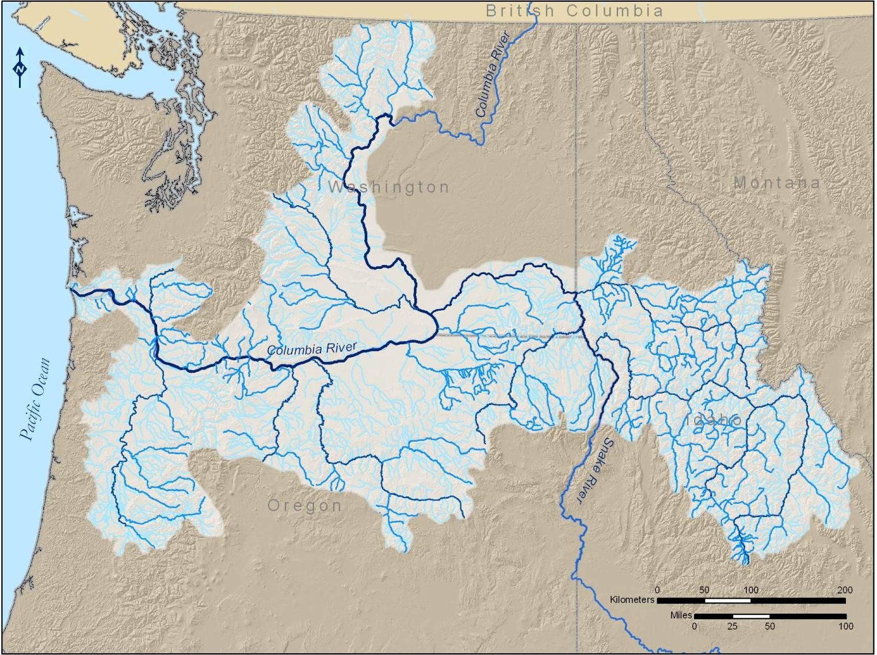

ZSL
WEL
RRH
RIS
WAN
PRD
LMN
LGS
LGR
PRO
IHR
MCN
BON
TDA
JDA
WLF
Notes:
PIT-tagged smolts emigrating from Idaho, Southwest Washington, or Northwest Oregon can be detected as they pass through the smolt bypass systems at Lower Granite, Little Goose, Lower Monumental, Ice Harbor, McNary, John Day, and Bonneville Dams. Smolts can also be detected during their downstream migrations at Rocky Reach Dam in the mid-Columbia, at Prosser Dam in the lower Yakima River, and at Sullivan Dam at Willamette Falls on the Lower Willamette River.

Slide 30
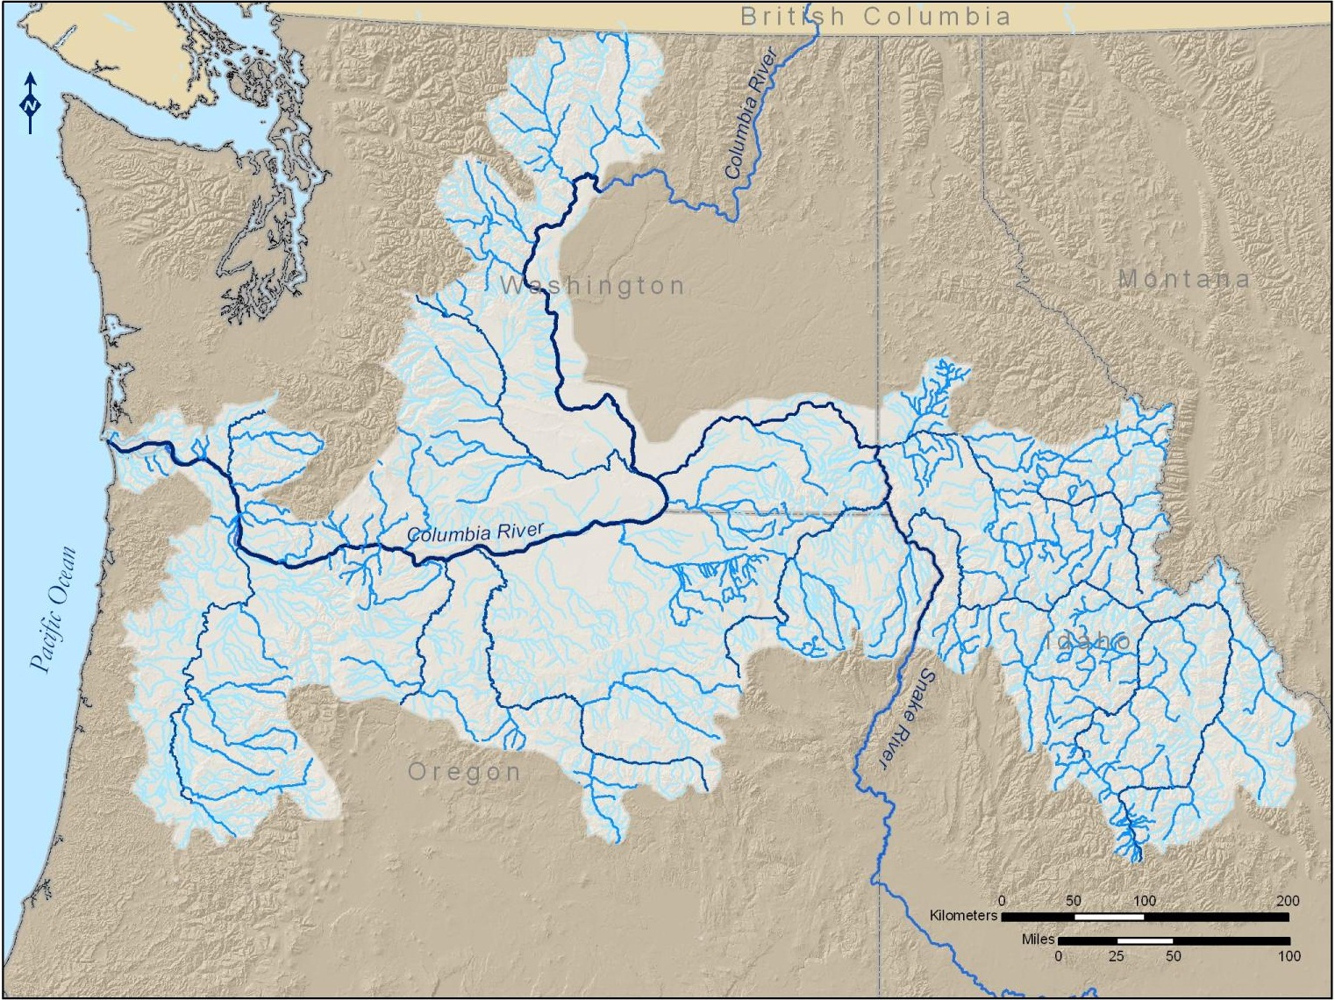
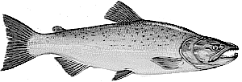
ZSL
WEL
RRH
RIS
WAN
PRD
LMN
LGS
LGR
PRO
IHR
MCN
BON
TDA
JDA
WLF
Notes:
PIT-tagged adult returns can be detected in the fish ladder at Willamette Falls; at Bonneville and McNary dams on the lower Columbia River; at Ice Harbor and Lower Granite dams on the lower Snake River; at Prosser Dam on the lower Yakima River; and at Priest Rapids, Rock Island, Rocky Reach, and Wells dams on the mid-Columbia River. Previously-tagged fish can be recovered, and un-marked fish can be tagged, in the adult traps at Bonneville, Lower Granite, and Priest Rapids dams.

Slide 31
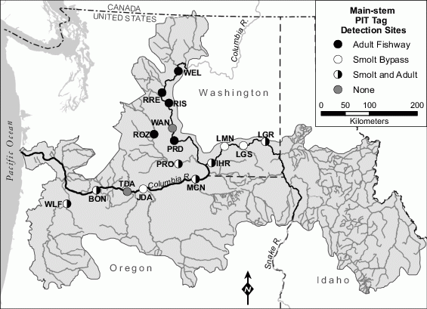
Notes:
Locations of permanent PIT tag interrogation systems at dams in the Columbia Basin. BON = Bonneville Dam; IHR = Ice Harbor Dam; JDA = John Day Dam; LGR = Lower Granite Dam; LGS = Little Goose Dam; LMN = Lower Monumental Dam; MCN = McNary Dam; PRD = Priest Rapids Dam; PRO = Prosser Dam; RIS = Rock Island Dam; ROZ = Roza Dam; RRE = Rocky Reach Dam; TDA = The Dalles Dam; WAN = Wannapum Dam; WEL = Wells Dam; WLF = Willamette Falls fishway and Sullivan Dam bypass. On the Columbia River, only The Dalles and Wannapum dams have no PIT tag detection capabilities.

Slide 32
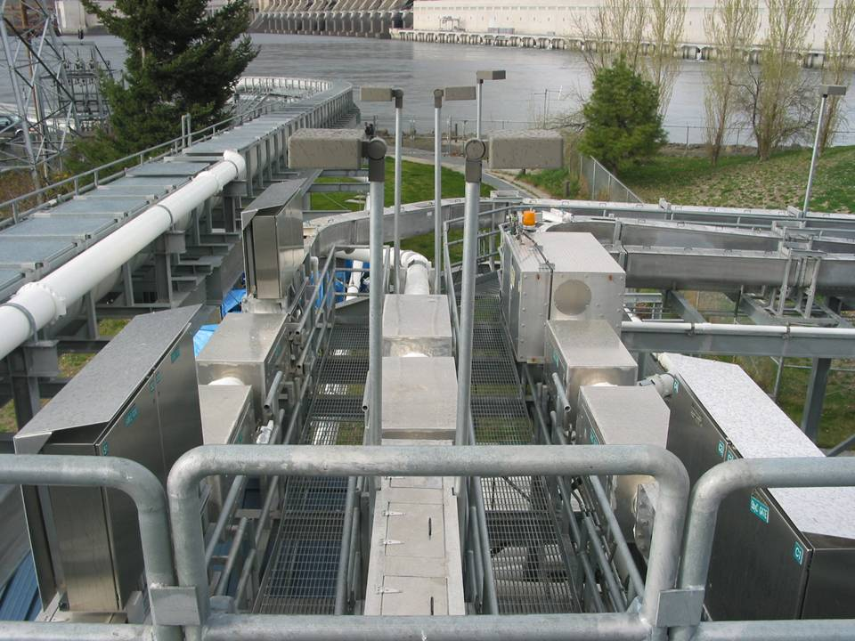
Notes:
The PIT tag detection and diversion components are directly integrated into the various passage routes, such as the smolt sampling facility at John Day Dam,
With redundant groups of antennas deployed on each of three parallel flumes, of which one antenna group controls…
A PIT tag diversion gate.

Slide 33
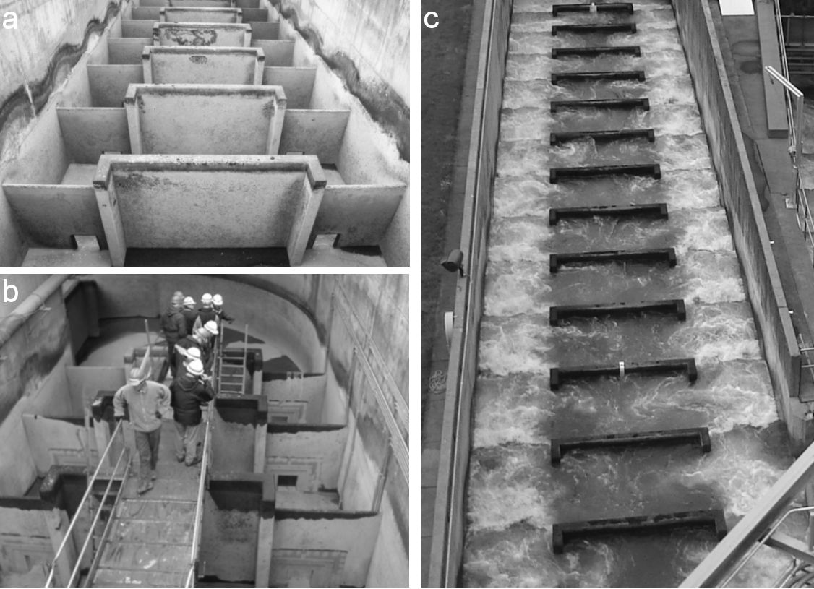
Notes:
Partial overflow weirs in one of the adult fish ladders at Bonneville Dam. Fish can pass over the notches in the top of the weir wall, or through the orifices at the base of the weir (a). PIT tag antennas were retro-fitted into the orifices at several of the weirs; the antenna inserts were designed to match the hydraulic characteristics of the original orifices (b). The ladder may remain in continuous operation for 12 months or more (c), during which time the PIT tag antennas are also expected to function continuously, as they cannot be accessed for repair or replacement.

Slide 34
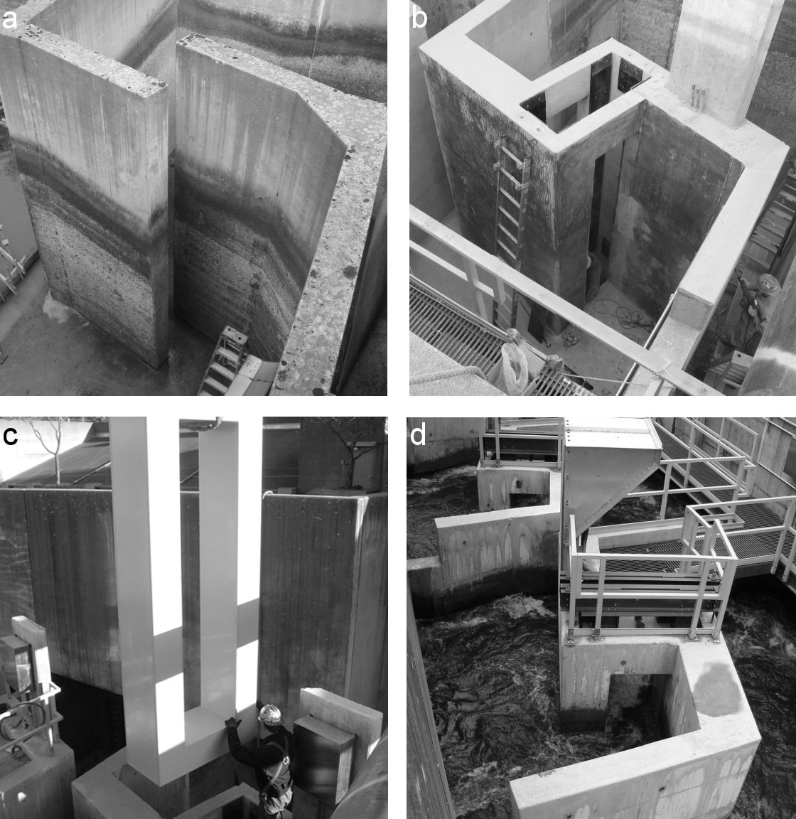
Notes:
One of four slotted weirs reconstructed with PIT tag detectors in an adult fishway at Bonneville Dam. In order to provide an electrically noise-free environment, the original steel-reinforced weir (a) was demolished and replaced with new concrete poured around fiberglass reinforcement bars secured with plastic ties (b). Custom antennas (71 cm wide and up to 3.5 m high, inside dimensions) mimic the dimensions of the original weir slots (c). All fish must pass through each of the four instrumented slotted weirs (d); this redundancy provides 100% detection capability for tagged fish ascending the ladder.

Slide 35
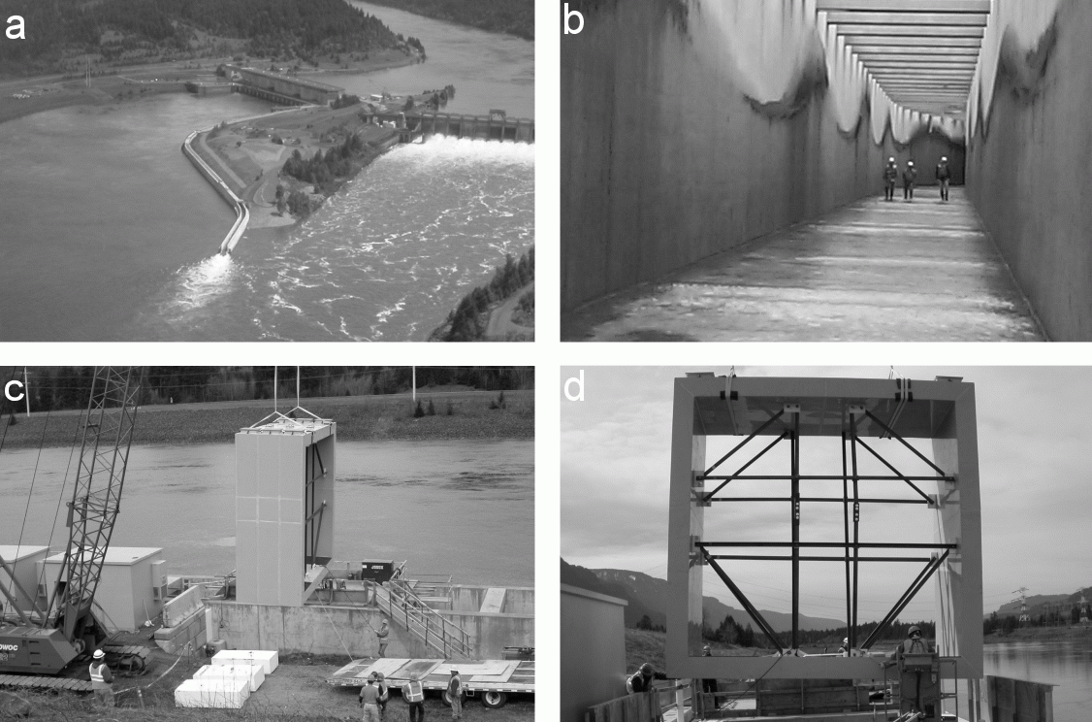
Notes:
The Bonneville Dam Second Powerhouse Corner Collector bypasses salmon and steelhead smolts from the forebay of the Second Powerhouse through a concrete flume downstream 850 m into the center of the river (a). The bypass flume is 4.6 m wide (b). A section of the concrete was demolished, electrically isolated, and reconstructed with nonferrous reinforcement, prior to the installation of a single highly-customized PIT tag antenna (c). This antenna, shown before the internal structural bracing was removed (d), spans the entire width of the flume and has a measured detection efficiency of 70%.

Slide 36
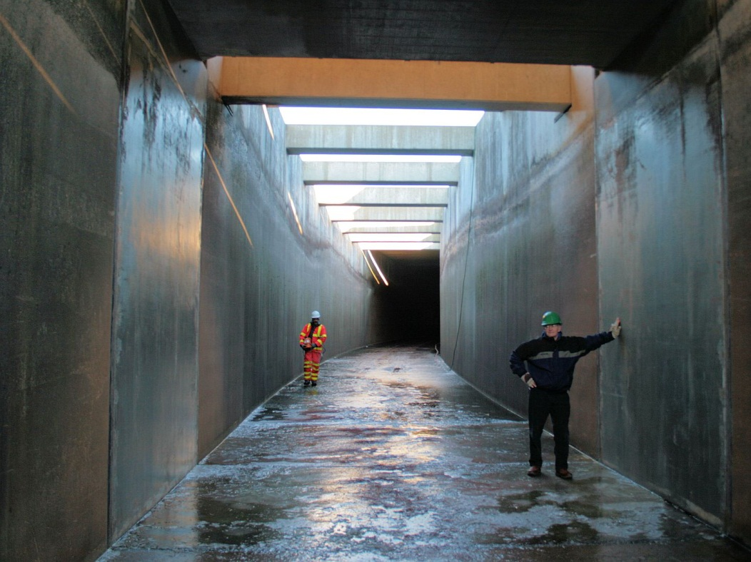
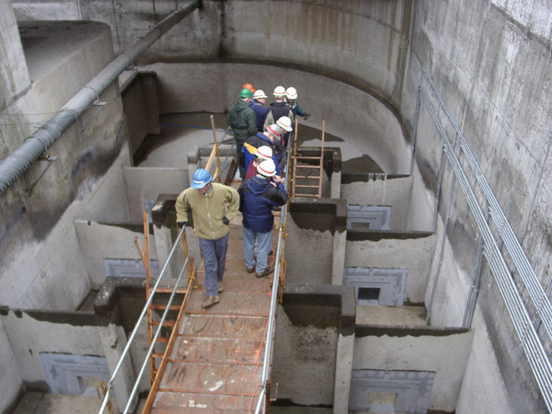

Notes:
The PIT tag detection systems in the mainstem juvenile bypass facilities and adult ladders are highly engineered to maximize detection capabilities while simultaneously minimizing delays or disruptions in fish passage.

Slide 37
SxC

Slide 38
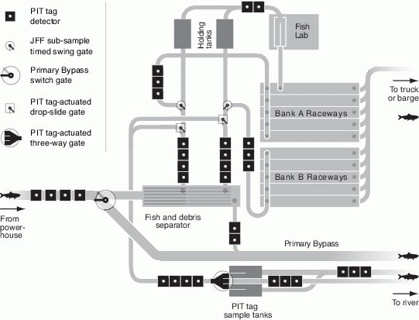
Notes:
Schematic of a typical juvenile fish collection and transportation facility. As they exit the powerhouse, fish in the large diameter (91–122 cm) primary bypass pipe pass through four PIT tag antennas. Fish directed over the fish and debris separator pass through at least two, and as many as 11, antennas as they are routed to their various destinations within the facility. The separation-by-code system allows the selective diversion of tagged fish at PIT tag-actuated gates. The diverted fish are typically routed directly back to the river, or collected and held for examination.

Slide 39
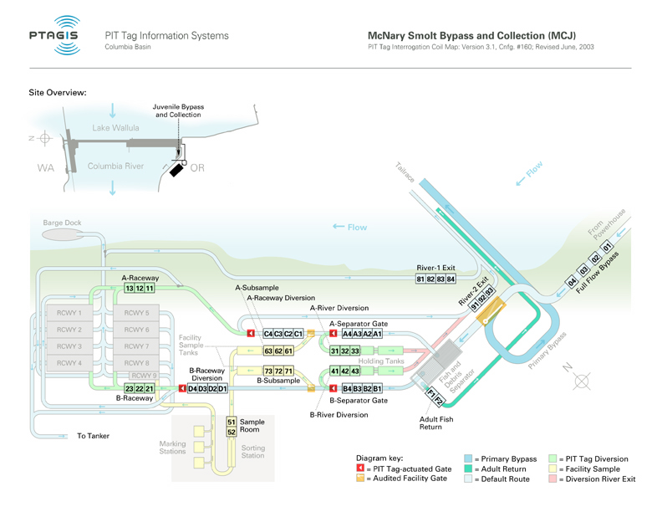
Notes:
At a transportation collection facility like McNary, fish can be routed to raceways, and/or directly loaded to barges.
They can be bypassed back to the river, either before or after passing over the separator.
Some fish are subsampled for enumeration and species composition.
And selected PIT-tags can be collected and held for observation.
At McNary, and certain other sites in the Basin, the route taken by PIT-tagged fish can be controlled, using what’s known as Separation by Code.

Slide 40
Instream
Detection

Slide 41
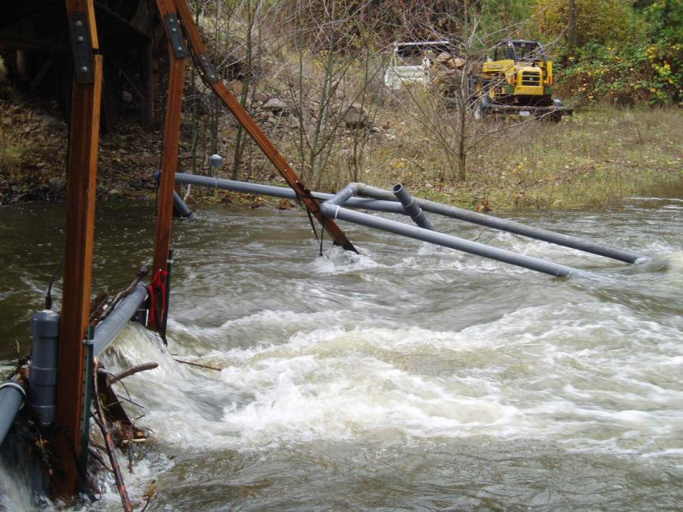
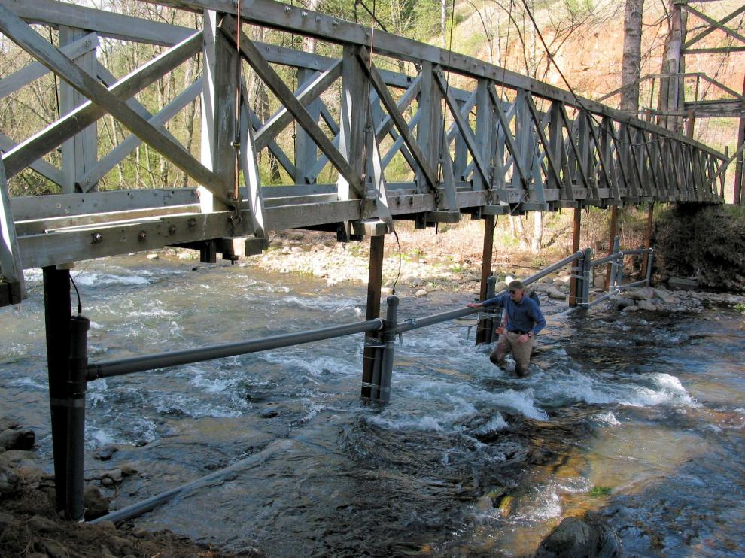
Notes:
At the Fish Tagging Forum meeting on 22-Mar-12, I referred to the construction and deployment of “disposable” antennas at some instream PIT tag detection sites. This was a poor choice of words on my part. I think it is more accurate to describe these antennas as being intentionally designed to “fail economically” under extreme environmental conditions. In this case on upper Mill Creek in the Walla Walla Basin, these pass-through antennas were moved from the foot bridge to a larger vehicle bridge to improve the durability of the deployment. In this case, the antennas and 4x4 supports were also engineered to break away from the bridge to avoid structural damage to the bridge during extreme flows.

Slide 42
Hybrid
Instream
Detection

Slide 43
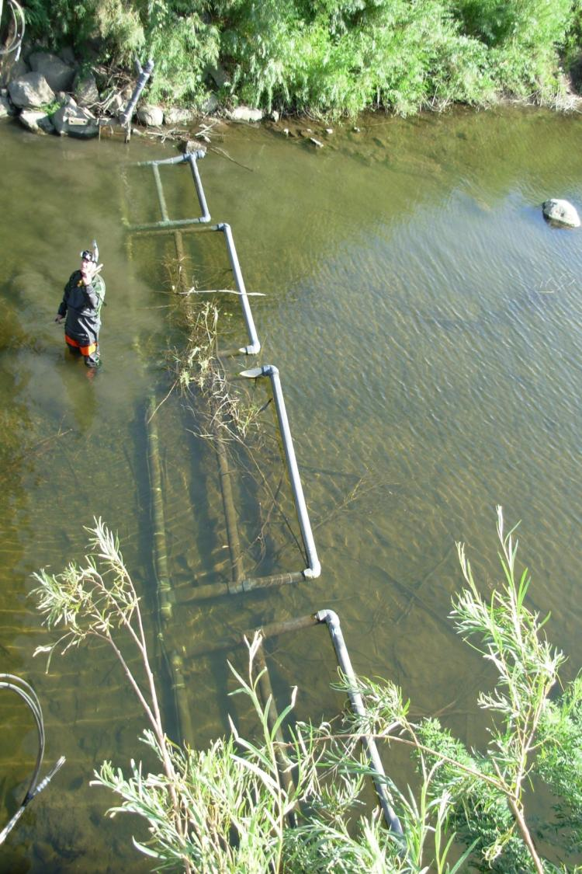
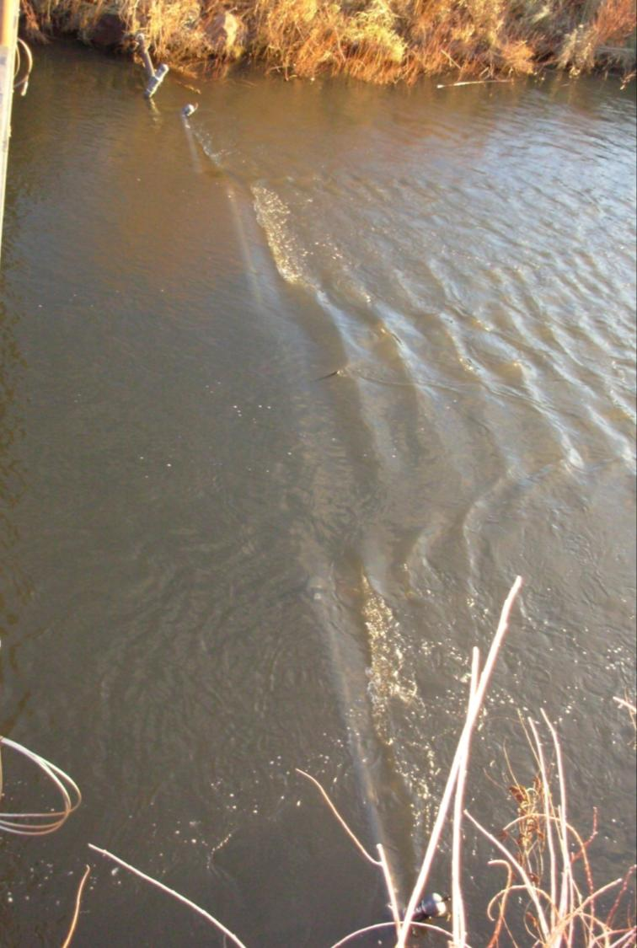
Photos courtesy of Ryan Koch, USFWS
Notes:
Slightly bouyant “hybrid” pass-over/pass-through antennas are designed to submerge and shed debris during high flows. This site, operated by USFWS, is located on the Walla Walla River.
43

Slide 44
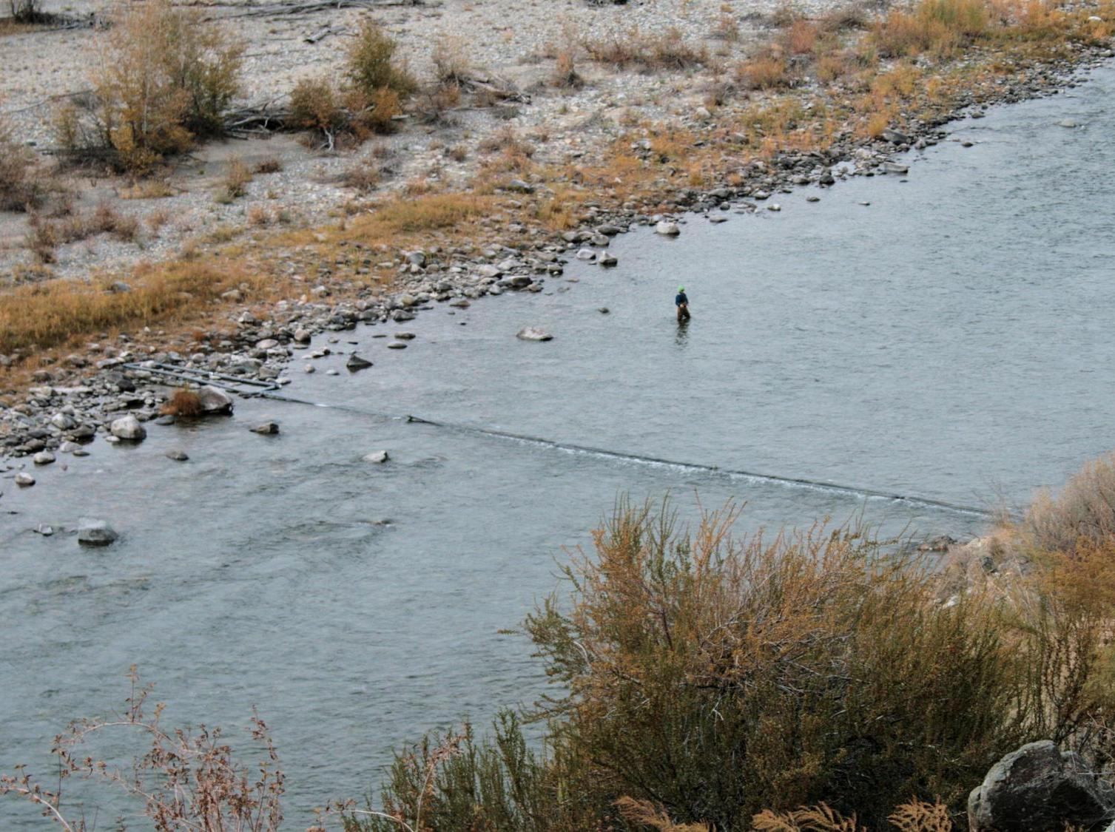
Notes:
In October, 2009, these hybrid antennas spanned the entire Methow River at its mouth near Pateros, WA.

Slide 45
Pass-over
Instream
Detection

Slide 46
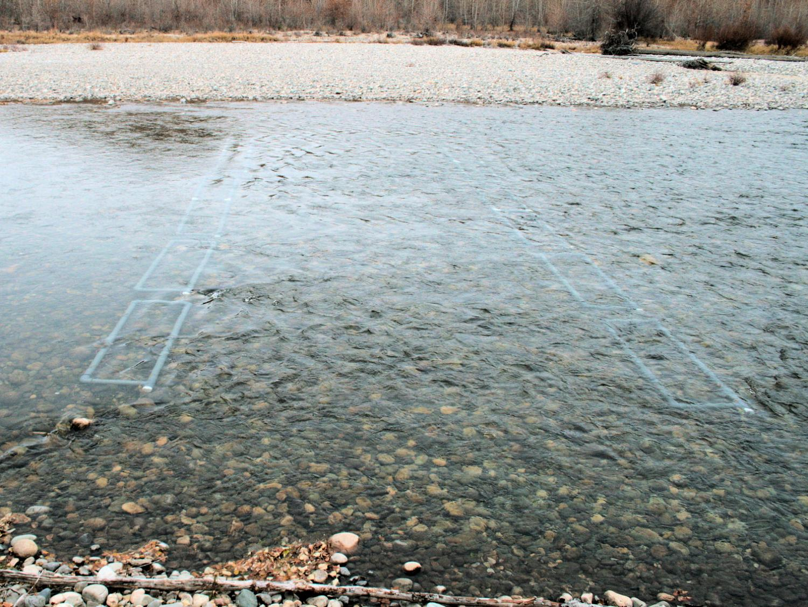
Notes:
These hybrid antennas, located on the upper Methow River near Winthrop, WA, are strapped down in a pass-over configuration. In this photo, taken in October, 2009, they covered about 90% of the width of the River.

Slide 47
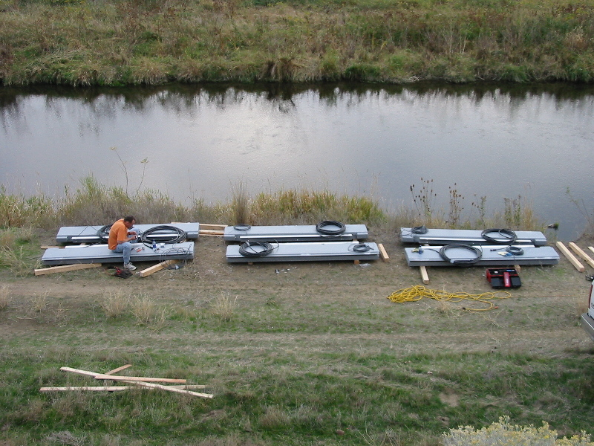
Photo courtesy of Steve Anglea, Biomark
Notes:
An alternative method of pass-over antenna construction is to build permanent “flat-plate” antennas that can be anchored into the stream bed. These flat-plate antennas typically have a read-range of about 18”, and work well when the tagged target fish are expected to pass during low flows.

Slide 48
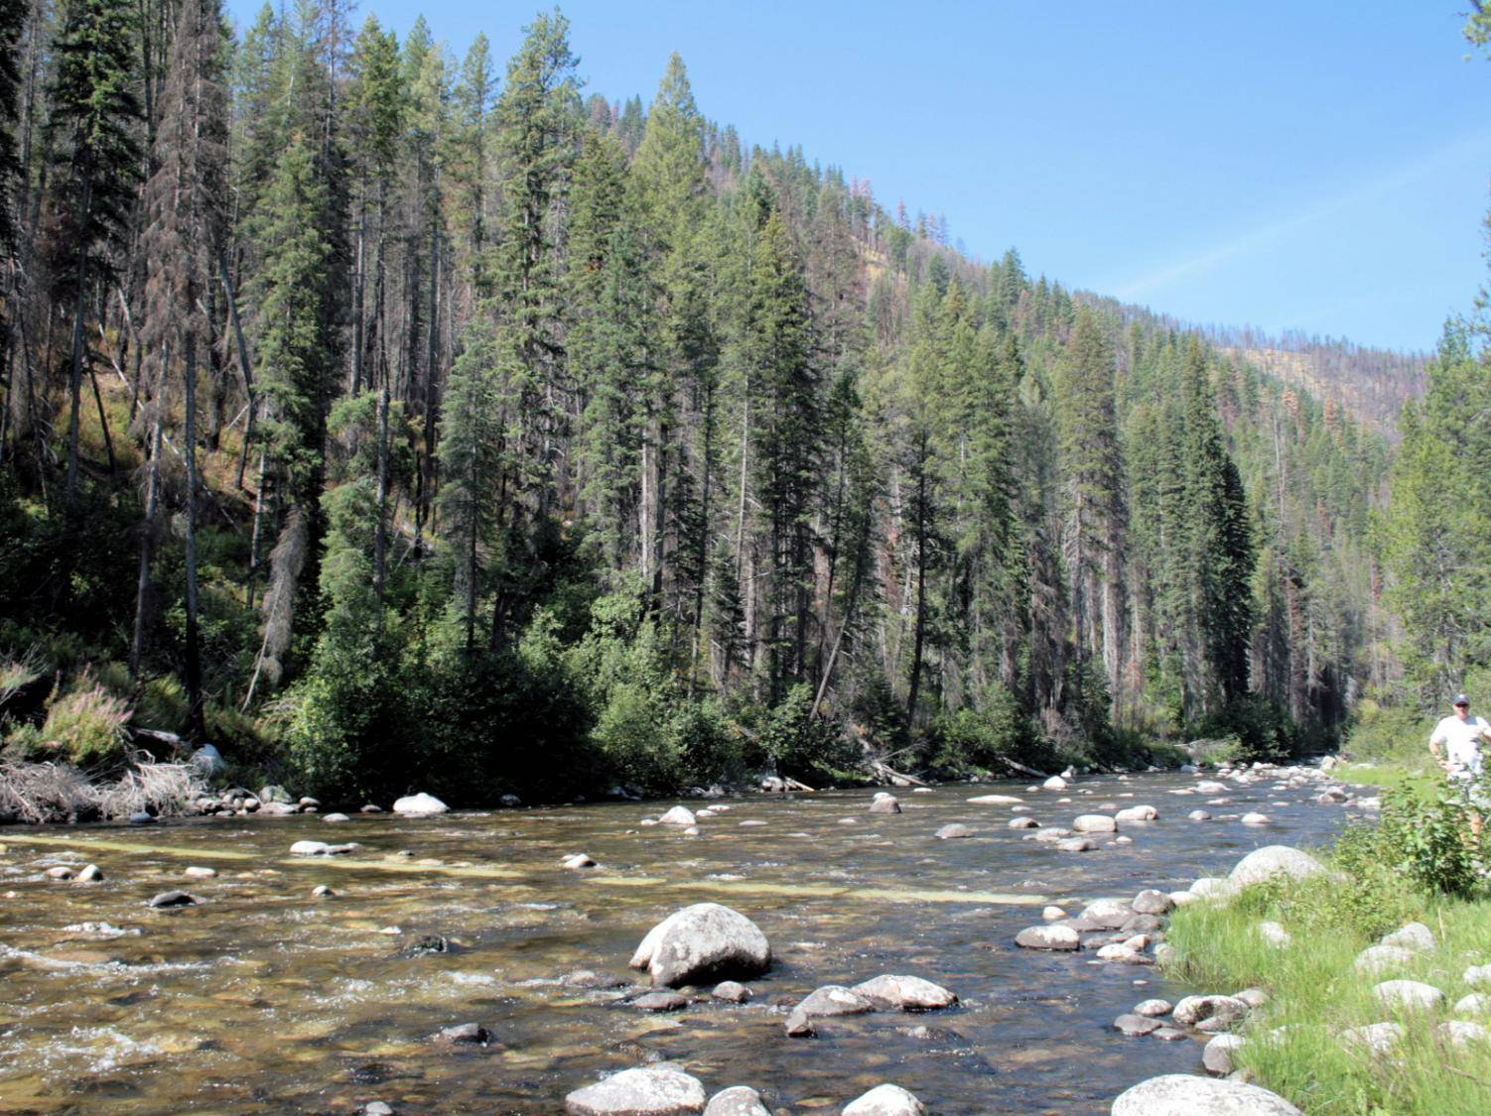
Notes:
These flat-plate PIT tag antennas covered about 90% of the width of the Secesh River in August, 2010. The river depth of 6-12” was easily within the read-range of the antennas.

Slide 49
PIT tag monitoring effort and participation

Slide 50
PTAGIS Data Contributors
Federal Management Agencies
NOAA National Marine Fisheries Service
U.S. Army Corps of Engineers
U.S. Bureau of Reclamation
U.S. Department of Agriculture
U.S. Fish and Wildlife Service
State Resource Management Agencies
Idaho Department of Fish and Game
Oregon Department of Fish and Wildlife
Washington Dept. of Fish and Wildlife
University Research Cooperatives
Idaho Coop. Fish & Wildlife Research Unit
Utah Coop. Fish & Wildlife Research Unit
Tribal Management Agencies
Columbia River Inter-Tribal Fish Comm.
Colville Confederated Tribes
Conf. Tribes of the Umatilla Indian Rsvn.
Conf. Tribes of the Warm Springs Rsvn.
Nez Perce Tribe
Okanagan Nation Alliance
Shoshone-Bannock Tribes
Yakama Nation
Other Government Entities
Columbia River Estuary Task Force
Fish Passage Center
Pacific States Marine Fisheries Comm.
Snake River Salmon Recovery Board
U.S. Geological Survey
Electric Utilities
Chelan County PUD
Douglas County PUD
Grant County PUD
Idaho Power Company
Portland General Electric
Other Entities
Biomark, Inc.
Ducks Unlimited
Kintama Research Corp.
Pacific Northwest National Laboratory
Quantitative Consultants, Inc.
Real Time Research, Inc.
Wild Fish Conservancy
Notes:
35 contributing agencies; the eight agencies in italics are charter members of the PIT Tag Steering Committee.

Slide 51
PIT Tag Marking Effort in the Columbia Basin
by Entities and Project Coordinators
Notes:
87-90: 14 Coords, 3 responsible for 56% of all tagging. Six agencies, NOAA Fisheries tagged 63%.
91-95: 39 Coords, 3 (different) responsible for 51% of all tagging. 15 agencies, NOAA Fisheries tagged 51%.
96-00: 79 Coords, 6 responsible for 55% of all tagging. 18 agencies; NOAA Fisheries and USFWS tagged 51%.
01-05: 108 Coords, 3 responsible for 52% of all tagging. 25 agencies; NOAA Fisheries and USFWS tagged 50%.
06-10: 129 Coords, 5 responsible for 50% of all tagging. 34 agencies; NOAA Fisheries, IDFG, and NPT tagged 52%.

Slide 52
Gravel to Gravel:
Monitoring PIT-tagged fish in the Columbia Basin
PIT tags provide comprehensive (but not complete!) monitoring of marked salmon and steelhead during their down- and up-stream migrations within the rivers and streams of the Columbia Basin.
  PIT tags are used to facilitate and complement other marking (telemetry) programs, and to extend or expand the scope of those programs.
PIT tag mark/recovery capabilities spur the development and refinement of research and monitoring programs in the Columbia Basin for salmonids and other species.
Innovative PIT tag techniques and technologies continue to provide new or improved capabilities to inform fisheries management and mitigation decisions.

