Slide 1
PLEXOS For Power Systems -
Advanced Simulation Topics
Northwest Power and Conservation Council
System Analysis Advisory Committee
January 25, 2013
Portland, OR
Gregory K. Woods
Regional Director – North America
Energy Exemplar, LLC

Slide 2
Energy Exemplar, LLC
PLEXOS for Power Systems Released in 1999
  Continuously Developed to meet Challenges of a Dynamic Environment
A Global Leader in Energy Market Simulation Software With Over 200 Installations in 17 Countries
Offices in Adelaide, Australia; London, UK; California, USA
High Growth Rate in Customers and Installations
Staff Expertise in Operations Research, Electrical Engineering, Economics, Mathematics, Statistics with over 20% Ph.Ds
North American Office:
  Consulting
  Customer Support
  Training
  Software Sales
  North American Datasets/WECC Term

Slide 3
Advanced Simulation Topics
Agenda
PLEXOS For Power Systems
Renewable Portfolio Expansion
OpenPlexos API
Integrated Stochastics
Stochastic Optimization
  Multi-Stage Optimization
  Stochastic Unit Commitment
Optimal Power Flow Issues
High Performance Computing (HPC)

Slide 4
PLEXOS for Power Systems
Power Market Simulation, Price Forecasting and Analysis
Operational Planning, Unit Commitment and Optimisation of Generation and Transmission
Trading and Strategic Decision Support
Integrated Resource Plan including Generation and Transmission Expansion and Investment Analysis
Renewable Integration Analysis and Intermittent Supply
Co-optimisation of Ancillary Services, Energy Dispatch and Emissions
Transmission Analysis and Congestion Management
Portfolio Optimisation and Valuation
Risk Management and Stochastic Optimisation

Slide 5
PLEXOS Algorithms
Mathematical Optimization
  Utilizes world-class commercial solvers
  Integrates Mixed Integer, Dynamic and Linear Programming Techniques to provide fast, accurate results
Simultaneous Co-optimization:
  Capacity Expansion, Reliability, Security Constraints, Unit Commitment and Economic dispatch, revenue adequacy and uplift
  Thermal, Hydro, Energy, Reserve, Fuel, and Emissions Markets
Integrated Stochastic Optimization
  Solves the Perfect Foresight Problem using a multi-stage optimizer that includes sample reduction for fast accurate results
User-defined constraints and decision variables
  Powerful formulation replaces the need for expensive custom programming
Both physical (primal) and financial (dual) results reported
  Shadow Pricing report the real operating costs in constrained environments
OpenPlexos allows customization and automation of PLEXOS through a standardized Application Programming Interface (API)
Confidential & Proprietary Information

Slide 6
PLEXOS Components
PLEXOS Desktop
PLEXOS Connect
  Client/Server
Import/Export Interface
PLEXOS Service Manager
PLEXOS Graphical User Interface
  Build and Maintain Input data
  View and Analyse Solution data
Customisation & Automation
  OpenPlexos API
Visualization
  Display Network Input and solution data in Maps and schematics
PLEXOS in the Cloud
  Execute on remote servers
External Input (EMS, LF)
PLEXOS Import/Export Interface
PLEXOS Service Manager
PLEXOS Connect
Server
External Output Database
PLEXOS GUI
PLEXOS Connect
Client
PLEXOS Engine

Slide 7
Simulation Features
- Conventional Generation
Over 150 technical and economic generation characteristics:
  Deterministic and stochastic unit commitment
  Random and scheduled outages - optimized maintenance
  Temperature-dependent operating characteristics
  Detailed ramping and start/stop profiles
  Multiple fuel optimisation with complex fuel transitions and operational modes
  Compartmentalised combined cycle modelling featuring non-convex heat rates
  Unit Dependencies

Slide 8
Simulation Features
- Hydro Modelling
Inflow
Full Cascading Hydro networks:
  GIS visualisation from Google Earth
  Multiple storage models:
    Potential Energy (GWh)
    Level (feet or meters)
    Volume (feet³ or meters³)
  Efficiency curves, head storage dependency, waterway flow delay times, spillways, evaporation
  Deterministic and stochastic water management policies:
    Long-term Multi-year rule-curve development
    Short-term optimization fully integrated with rule curves
    Shadow price based water value determination
    Integrated with external water value and/or rule curves
  Pumped storage energy and ancillary services market co-optimisation
Storage I
Inflow
~
~
~
Storage III
Inflow
P/S 1
P/S 2
P/S 3
~
~
Storage II
H 4
H 5
~
~
~
Storage VI
Inflow
H 1
H 2
H 3
Storage V
~
Sea
H 6
Notes:
In addition to simplified methods such as generation schedules and stochastic generation schedules

Slide 9
Simulation Features
- Additional
Ancillary services
  Co-optimised with generation dispatch and unit commitment and more features such as:
  Multiple reserve classes including spinning up and down, regulation up and down, and replacement services
  Detailed treatment of start-up and shutdown combined with ramping and reserve interaction over user-selectable intervals down to 1-minute
Emissions
  Co-optimized generation dispatch for emission limits, emission prices and/or allowances
  Emissions production on start/up, fuel use, and generation
  Multiple removal technologies including limestone, ammonia, activated carbon
  Flexible Emission constraints including plant, region, zone on any period including multi-year constraints
  Multiple Air District rules
Demand Side Management
  Supports multiple technologies such as distributed generation, demand response bidding, and curtail-able load
  Value DSM programs cost to the system, risk value, capacity value, and valuation

Slide 10
Simulation Features
- Transmission Modelling
Fully integrated transmission modelling capable of supporting extremely large networks
  Integrated with GIS and Google Maps to produce network diagrams, zonal and regional diagrams, and flow analysis
  Optimal power flow using a fully integrated DCOPF
  Losses computed using MLF, fixed, linear, quadratic and cubic formulations
  Large connection of multiple AC and DC networks supporting 10,000’s buses and lines
  Security and n-x contingency constraints (SCUC)
  AC and DC lines, transformers, phase shifters and interfaces
  Transmission aggregation and network reduction
  Nodal LMP pricing and decomposition into energy, congestion and marginal loss
  Computation of regional and zonal reliability indices

Slide 11
Simulation Features
- Gas Modelling
Fully integrated energy model co-optimises electricity and gas system dispatch. Includes models of:
  Gas fields, collection and processing, storages, LNG, tankers, pipelines, nodes and gas demands
  Integrates with long-term planning to produce expansion plans for gas and electric infrastructure
  Models constraints on short and mid-term gas supply and its impact on electricity production
  Compute and enforce hourly and daily pipeline limits and imbalance charges

Slide 12
Simulation Features
- Financial & Risk
Comprehensive financial reporting for Companies, Generators, Lines, Contracts (Physical, Financial, Fuel, Transmission rights) and Regions, including:
  Income Statement: Revenue, fuel, emission, transmission, VOM, FOM, Capital, taxes, spot purchases/sales
  Valuation: contract settlement, net revenue
  Cost of service: Cost to serve loads
Compute comprehensive risk metrics using deterministic and stochastic valuations:
  Risk Reduction Value of Plant and Portfolios
  Risk Premium
  Risk adjusted portfolio cost
  Risk adjusted IRP
Compute risk-adjusted markets based on dynamic bidding
  In capacity expansion planning, ensures markets are sustainable
  Using Bertrand and Cournot games to reflect market power
  Use empirical schemes such as Residual Supply Index (RSI)

Slide 13
Simulation Features
- Intermittent Resources
Wind and Solar are characterised by uncertain availability:
  Evaluate the full effect of intermittency on reliability indices, system operation, market prices, ancillary services, and generator valuation
  Evaluate Capacity Value using methods such as Effective Load Carrying Capacity (ELCC) determined using Stochastic Optimization
  Compute Risk Reduction Value
  User-selectable intervals from 1-minute to multiple hours
  Full ramping constraints
  Autoregressive sampling models for wind speed, solar radiation and natural inflows (autocorrelation, brownian motion, Box Jenkins (ARMA, ARIMA) with sample reduction
  Stochastic optimisation of forecast uncertainty, multi-stage scenario-wise decomposition algorithms
Notes:
In addition to simplified methods such as generation schedules and stochastic generation schedules

Slide 14
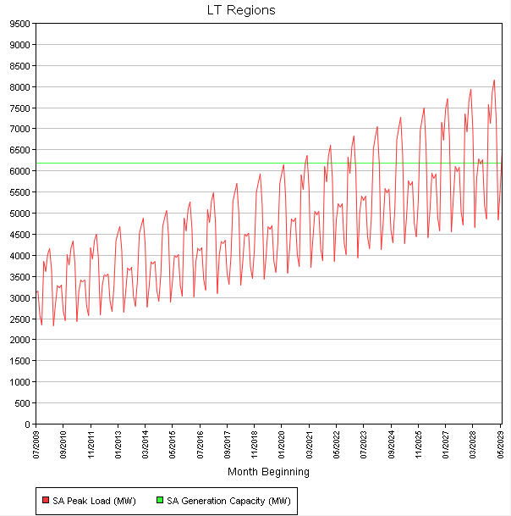
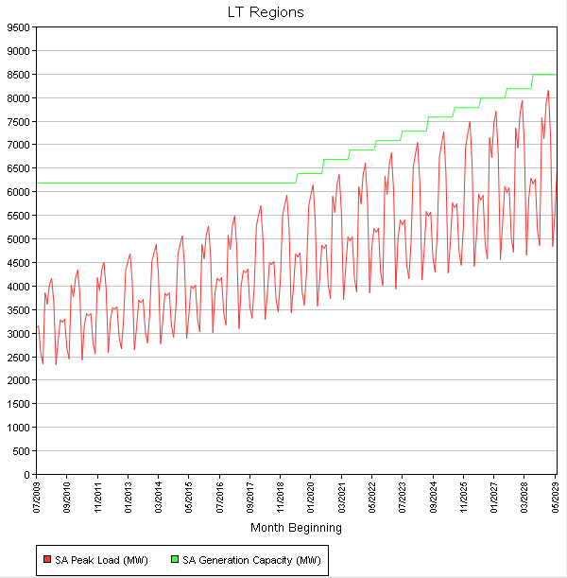
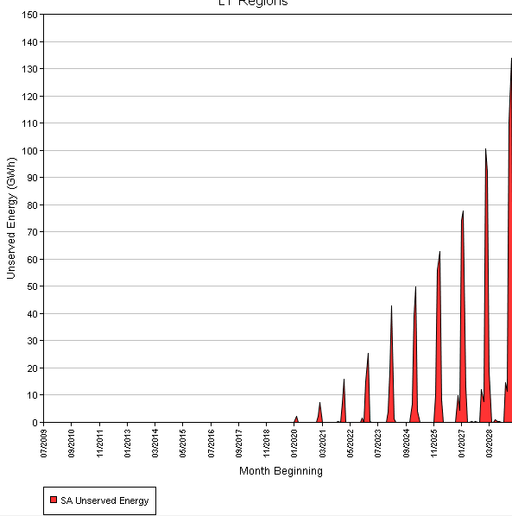
Capacity Expansion Planning -
Renewable Resource Portfolio
Generator | Build Cost ($/kW) | WACC (%) | Economic Life (years)
New_CCGT | 1750 | 12 | 25
New_GT | 1100 | 12 | 25
EXPANSION PLANNING
FIXED INSTALLED CAPACITY
USE

Slide 15
Transmission Expansion
General Description:
The planned addition/deletion of AC and DC lines from the system is supported by all OPF methods in PLEXOS using the Line [Units] property. PLEXOS automatically recomputes the shift factors required to cope with the changes in topography. LT Plan supports all types of transmission constraints including security-constrained optimal power flow.
Optimized transmission line expansion (using the [Max Units Built] property), retirement (using the [Max Units Retired] property) in LT Plan works in much the same way as generation expansion – with the restriction that only DC lines can be considered. This restriction exists due to computational burden that would be imposed by the need to recompute the OPF when considering combinations of AC line configurations. Expansion of the AC network can be approximated by:
  use of DC lines i.e. by removing the Line [Reactance] property from the expansion candidates; and/or
  using Interface expansion (see below) in which the underlying AC network is preserved and expansion in done in a continuous manner on selected flow branches

Slide 16
Introduction to OpenPlexos
What is OpenPlexos:
  API accessible through Visual Studio.NET
  API accessible through any CSI language
    http://en.wikipedia.org/wiki/List_of_CLI_languages
Uses:
  Custom Input
  Integration with Other Applications
  Control Execution: Triggers with SCADA, etc.
  Control Execution: Add additional Optimization Logic
  Control Execution: Custom Risk Logic
  Custom Reporting (Additional Properties, New Formats)
  Write to SQL Server or other DBMS

Slide 17
Application Programming Interface
COM - Microsoft Component Object Model technology.
  A Microsoft designed framework for program interoperability. Many programming environments allow COM compliant calls, including VBA in Office.
  PLEXOS COM provides functions to change input, execute models and projects, and query solutions
.NET - Microsoft .NET Framework.
  A programming framework for application development. Resulting programs are easier to produce and maintain, more consistent and less prone to bugs. They require .NET to run
  PLEXOS uses .NET
API - Application Programming Interface.
  A series of embedded system calls and a defined object model that allows programmers to access and modify applications. A good example is the Excel object model in VBA which allows programmers to modify the way Excel function by embedding code.
  PLEXOS has an API accessible through .NET compliant programming environments like Visual Studio
  PLEXOS API allows for customization and process control
AMMO - ActiveX Mathematical Modeling Objects
  Proprietary Optimization layer in PLEXOS.
  Interface AMMO to customize simulations using VS.NET
Many Microsoft and Other Windows-based environments allow connections to COM compliant applications including PLEXOS.
PLEXOS can be automated from many environments, including Office and SQLServer

Slide 18
OpenPlexos System Calls
Call | Function | When
MyRegion.price() | Overrides Regional pricing | Every Pricing Event
MyModel.afterinitialize | Add custom objects and/or constraints | Once per simulation phase after Built-in Objects are initialized
MyModel.AfterProperties | Modify constraint coefficients add custom Variables and Constraints | At least once per step after mathematical program is fully populated
MyModel.BeforeOptimize | Override Solver Settings | At least once per step before the solver is called
MyModel.AfterOptimize | Re-simulation Overrides. | At least once per step after the solver has completed
MyModel.OnWarning | Trap Warning/error conditions | When any warning message is raised
MyModel.EnforceMyConstraints | Check and enforce customized constraints | Called during Transmission Convergence
MyModel.BeforeRecordSolution | Overrides for generator bidding, uplift etc. which may call for re-optimization | Once per step after completion, but before output is written
MyModel.AfterRecordSolution | Customized reporting. | Once per step after the Model output is written

Slide 19
Integrated Stochastics
Expected Value: probability weighted average
Samples: series of outcomes
Error: difference between expected value and sample value
Distribution: shape of probability curve
  Normal, Lognormal, Uniform, Triangular, etc.
Standard deviation: measurement of spread of probability curve :
  +/- 1 stdev = 68.3% of errors
  +/- 2 stdev = 95.4% of errors
  +/- 3 stdev = 99.7% of errors
Volatility: time-base measurement of error
Correlation: measure of relative movement between separate variables
Autocorrelation: measurement of relative movement of variable over time
Brownian Motion with mean reversion: dampening of period-to-period change in random patterns
Box-Jenkins: Auto Regressive Integrated Moving Average (ARIMA), a two component dampening of period-to-period changes using an autoregressive and a moving average component
Confidential & Proprietary Information

Slide 20
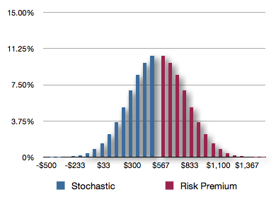
Introducing Risk
Risk Premium: expected increase in cost above mean value of the portfolio
Risk Adjusted Value: the expected value plus the risk premium
Risk Reduction Value is the difference in the risk adjusted value of portfolios
While the expected value of a renewable portfolio is higher than the cost of a traditional portfolio, renewables often come with risk attributes (i.e. low cost energy). The true cost of the renewable portfolio is less due to these risk attributes

Slide 21
Risk Adjusted Values
Measurement Issues:
Deterministic provides a measure of value at given conditions:
  Value of portfolio given average conditions
Stochastic measures values of all measured conditions weighted by probabilities
  Average value of portfolio given all conditions
Why use Risk in Planning Decisions?
It is likely that decisions made under deterministic planning, while optimal for the deterministic case, yield a decision which is costly under other known risks
What is the Risk Adjusted Value?
Notes:
This is a similar problem to determining the value of perfect information, but backwards.
In one case you use back casting to determine what you would have done if you knew the outcome and compare that to what you did.
In the other case, you try to value all future outcomes and choose a strategy which minimizes your “cost” of perfect information

Slide 22
Short-Comings of Deterministic Simulation
The Perfect Foresight Problem:
Stochastic Run is simply a deterministic (predictable) run using randomly drawn data
Optimization therefore assumes that you know the outcome, i.e. have perfect foresight
What if you need to make a decision (UC, Hydro schedule, Build/retire), based on an unknown future?
Stochastic Optimization makes the decision, then evaluates then runs stochastic optimizations, allowing the best decision to be determined

Slide 23
Stochastic Optimization (SO)
Fix perfect foresight issue
  Monte Carlo simulation can tell us what the optimal decision is for each of a number of possible outcomes assuming perfect foresight for each scenario independently;
  It cannot answer the question: what decision should I make now given the uncertainty in the inputs?
Stochastic Programming
  The goal of SO is to find some policy that is feasible for all (or almost all) of the possible data instances and maximize the expectation of some function of the decisions and the random variables
Scenario-wise decomposition
  The set of all outcomes is represented as “scenarios”, the set of scenarios can be reduced by grouping like scenarios together. The reduced sample size can be run more efficiently
Confidential & Proprietary Information

Slide 24
SO Theory
The most widely applied and studied stochastic programming models are two-stage linear programs
Here the decision maker takes some action in the first stage, after which a random event occurs affecting the outcome of the first-stage decision
A recourse decision can then be made in the second stage that compensates for any bad effects that might have been experienced as a result of the first-stage decision
The optimal policy from such a model is a single first-stage policy and a collection of recourse decisions (a decision rule) defining which second-stage action should be taken in response to each random outcome

Slide 25
SO Theory, Continued
Where the first (or second) stage decisions must take integer values we have a stochastic integer programming (SIP) problem
SIP problems are difficult to solve in general
Assuming integer first-stage decisions (e.g. “how many generators of type x to build” or “when do a turn on/off this power plant”) we want to find a solution that minimises the total cost of the first and second stage decisions
A number of solution approaches have been suggested in the literature
PLEXOS uses scenario-wise decomposition ...

Slide 26
SO Theory, Continued
Example:
Three Wind Periods:
  Morning
  Mid-day
  Night
If wind is low in any period:
  50% chance that wind remains low
  50% chance it increases to mid
If wind is mid in any period:
  33% chance decreases to low
  33% chance it remains mid
  33% chance it increases to high
If wind is high in any period:
  50% chance that wind remains high
  50% chance it decreases to mid
17 possible paths, or “scenarios”
H3
H2
M3
H1
H3
M2
M3
Initial “high”
L3
H3
H2
M3
H3
M1
M2
M3
L3
L2
M3
Initial “mid”
L3
H3
M2
M3
L2
L3
L2
M3
Initial “low”
L3

Slide 27
SO Theory, continued
H1
H2
H3
Paths are “decomposed” into discrete scenarios with discrete probabilities
Scenariowise decomposition assigns probabilities to each scenario
  Similar paths are combined
  Unlikely paths are removed
  Probabilities are recomputed
For example, it is unlikely that wind can be high during mornings (H1) and, therefore unlikely to be low during the day (M2).
H1
H2
M3
H1
M2
H3
H1
M2
M3
H1
M2
L3
M1
H2
H3
P(1)
M1
H2
H3
M1
H2
M3
P(2)
M1
H2
M3
M1
M2
H3
P(3)
M1
M2
H3
M1
M2
M3
M1
M2
M3
M1
M2
L3
M1
M2
L3
L1
M2
H3
M1
L2
M3
L1
M2
M3
M1
L2
L3
L1
M2
L3
L1
M2
H3
L1
M2
M3
p(9)
L1
M2
M3
L1
M2
L3
L1
M2
M3
L1
L2
L3

Slide 28
H1
H2
H3
H1
H2
M3
H3
H1
M2
H3
H2
M3
H1
H3
H1
M2
M3
M2
M3
H1
M2
L3
Initial “high”
L3
M1
H2
H3
M1
H2
H3
P(1)
H3
M1
H2
M3
M1
H2
M3
P(2)
H2
M3
P(3)
M1
M2
H3
M1
M2
H3
H3
M1
M2
M3
M1
M2
M3
M1
M2
M3
M1
M2
L3
L3
M1
M2
L3
M3
M1
L2
M3
L1
M2
H3
L2
L1
M2
M3
Initial “mid”
L3
M1
L2
L3
H3
L1
M2
H3
L1
M2
L3
M2
M3
L1
M2
M3
p(9)
L2
L3
L1
M2
M3
L2
M3
L1
M2
L3
Initial “low”
L3
L1
M2
M3
L1
L2
L3
Initial Problem
Scenarios
Sample Reduction

Slide 29
Multi-Stage Optimization
100 Simulations in DAM
  DA Hourly Wind and Load
  1-day Co-optimization
  1-Day Look-ahead
  Hourly Unit Commitment (long-run generators)
100 Simulations in HAM
  HA Wind and Load
  5-hour Co-Optimization
  Hourly Unit Commitment (long, medium, short run generators)
100 Simulations in RT
  Actual 5m Wind and Load
  65m co-optimization

Slide 30
SO in Unit Commitment
Consider the unit commitment decision:
Must make unit commitment decisions in Day-Ahead
  First Stage
Uncertainties such as load or wind:
  Unknown Day-Ahead
  More information Hour Ahead
  Real-time is what it is
Simulation using independent samples on the load and wind outcomes provides an optimal solution given each outcome
  Perfect Foresight
  UC Results differ in different scenarios
Simulation using Stochastic Optimization provides an optimal solution given all outcomes (held back case)
Cost of Perfect Information is the difference between a backcast case and the held back case

Slide 31

Day-ahead Unit Commitment Example
CAPACITY
-12hrs off
-8hrs on
[65] MW
100 [MW]
-4hrs on
-2hrs off
[10] MW
0-100 [MW]
uncertain
Must-run!
-
50$/MWh
10$/MWh
0$/MWh
TECHNICAL LIMITATIONS
MINIMUM PRODUCTION
PRODUCTION COST
2x100 [MW]
    How to efficiently schedule thermal power plants with technical restrictions if we don’t know how much wind (and/or load) is going to be available?

Slide 32
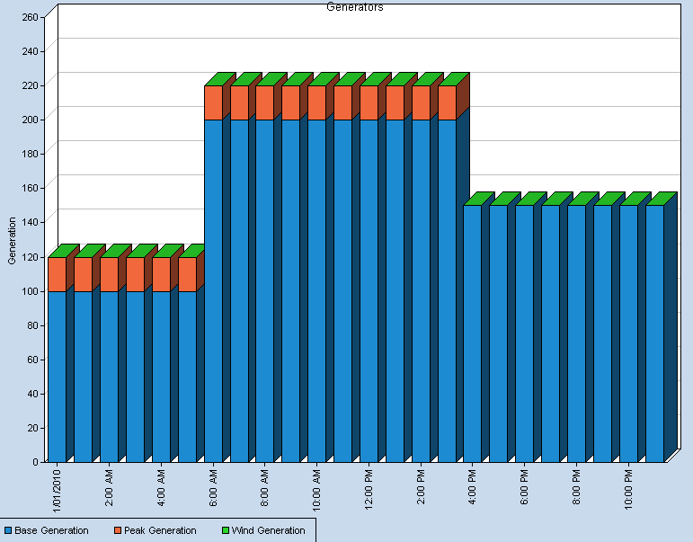
Day-ahead Unit Commitment, Continued
No wind generation is available
Assume for example a worst-case scenario analysis. First, the wind is absent during the entire day (pessimistic)
Two base load “slow” units can be scheduled
Fast units are required just in order to meet the load

Slide 33
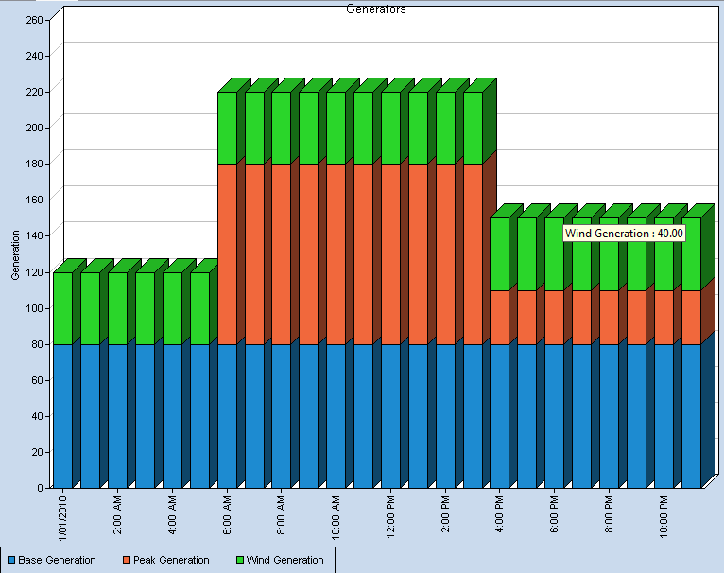

Day-ahead Unit Commitment, Continued
Now assume an optimistic scenario analysis. Wind is going to be available during the entire day
High wind resources
Fast units in order to avoid unserved energy
One base load “slow” unit pre-schedule
  The question is: If we don’t know how the wind is going to be… what to do? Dispatch one or two slow base units?

Slide 34
Day-ahead Unit Commitment, Continued
Stochastic Optimisation:
Two stage scenario-wise decomposition
Take the optimal decision 2
Expected cost of decisions 1+2
Is there a better Decision 1?
Take Decision 1
Reveal the many possible outcomes
Stage 1:
Commit 1 or 2 or none of the
“slow” generators
Stage 2:
There are hundreds of possible wind speeds. For each wind profile, decide the
optimal commitment of the other units and dispatch of all units
RESULT: Optimal unit commitment for “slow” generator

Slide 35
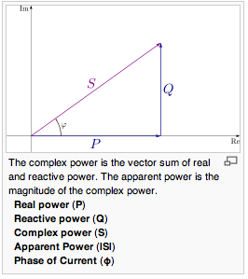
Alternating Current (AC)
Real (active) Power (P)
  Does the work
  Measured in Watts
  If loads are purely resistive, then 100% or real power is transferred to loads
Imaginary (reactive) Power (Q) (Wattless)
  Does no work
  Created by capacitance (leading) and inductance (lagging) and cancel each other
  Moves the angle between voltage and current, Φ_{VI}
  measured in kilovolt-amperes reactive (KVAR),
  If loads are purely reactive (i.e. voltage and current 90⁰ out of phase), there is 0 real power transfer to loads
Source: Wikipedia
Notes:
Economic incentive in industry to reduce Q as low as practical, typically to a 97% or greater Power Factor. Generation must meet Apparent power, losses on apparent power, therefore reducing wattless power is in everyone’s interest
As an example, at 97% (cos(ϕ), for 97 KW of real power, there are 24 kVAR of reactive sin(acos(0.97))*100

Slide 36
Alternating Current (AC)
Complex (Apparent) Power (S)
  Losses are based on Apparent Power
  Line Limits are based on apparent power
  Combination of real and reactive power, measured in Kilo-Volt Amperes (KVA).
Phase Angle (ϕ). Difference in phase between current and voltage:
  Sin (ϕ) = Q/S, asin(Q/S) = ϕ
  Cos(ϕ) = P/S = Power Factor, Acos(PF) = ϕ
Difference in Phase angles: Between two nodes, the voltage phase angles are different, active power flows between the difference in Φ_{V2} - Φ_{V1}
Source: Wikipedia
Active Power Correction: Transmission operators actively regulate reactive power flows to minimize system costs. Some controllable components:
  Capacitor Banks Phase Shifters
  Generator VAR Support Generator Voltage Support
Notes:
Economic incentive in industry to reduce Q as low as practical, typically to a 97% or greater Power Factor. Generation must meet Apparent power, losses on apparent power, therefore reducing wattless power is in everyone’s interest
As an example, at 97% (cos(ϕ), for 97 KW of real power, there are 24 kVAR of reactive sin(acos(0.97))*100

Slide 37

AC Power Flows
AC Power Flows for active and reactive Power injections at each node for a single phase system
Linearized power flows after simplifying assumptions, b^{y}(n,m) = reactance
AC Power flows are solved via iterative methods such as Newton-Raphson, but:
  Convergence is not guaranteed
  Subject to high degree of infeasibilities
  Extremely difficult to solve from cold-start
However, an AC-OPF can be simplified, if:
  Susceptance is large relative to impedance (resistance on circuit is small, relative to reactance)
  Phase Angle differences are small (i.e. power factors are corrected)
  Voltages are maintained at near identical magnitudes (hence voltage support)
Simplified equation is linear and more easily solved
  B^{y}(n,m) = susceptance (1/reactance) on line between nodes n,m
  ϕ_{n}-ϕ_{m} = difference in phase angles between nodes = cos(pf_{n}) - cos(pf_{m})
Notes:
AC Power Flows have a real (work) and imaginary components. Imaginary power flows (referring to the number system for depiction of the square root of a negative number or i) have a component based on the difference in magnitude of voltages between nodes and of differences in phase angles caused by reactance (inductance and capacitance)

Slide 38
AC Power Flows
Active power injection: the product of magnitude of the injected current |I|, voltage magnitude |V| at the bus and the cosine of the phase angle θ_{VI}
  P = |V| |I| cos θ_{VI}
Reactive Power Injection: the product of magnitude of the injected current |I|, voltage magnitude |V| at the bus and the sin of the phase angle θ_{VI}
  Q = |V||I|sinθ_{VI}
Active power flows from bus with larger voltage phase angle to bus with smaller voltage phase angle
Reactive power flows from the bus with higher voltage magnitude to those with lower voltage magnitude
  Reactive Flows not considered n DC-OPF
  Voltage is tightly controlled in power systems operations
Notes:
AC Power Flows have a real (work) and imaginary components. Imaginary power flows (referring to the number system for depiction of the square root of a negative number or i) have a component based on the difference in magnitude of voltages between nodes and of differences in phase angles caused by reactance (inductance and capacitance)

Slide 39
Loss Calculation - Challenges
Due to the complexity of original power flow equations, each loss model has certain implementation challenges:
Piecewise linear:
  Increase in LP size
  Non-physical losses
Quadratic:
  Most accurate method
  Most computationally intensive method
  Integer variables difficult (doesn’t work well in MIP)
Sequential Linear Programming
  Fast convergence
  Requires iteration against the solution.
  Difficulties with unit commitment (thus not suitable)

Slide 40
Non-Physical Losses (NPL)
(Piecewise Linear)
Each loss tranche becomes a separate decision variable
No built-in logic to be taken up in flow order.
Losses may not be minimized, when there is a Dump-energy condition due to over-generation.
  Typical Causes:
    Generator must-run constraints
    System security constraints
    Other constraints that force flows or generation against economic dispatch.
  The optimization then prefers to increase losses near the node
    Chooses higher loss tranches first “getting away” from the original quadratic loss function.
    Requires Integer variables
    Requires iterative solutions (time consuming)
These additional losses are referred to as non-physical losses
Notes:
Can be corrected using rotating cones

Slide 41

High Performance Computing
https://www.ornl.gov/modeling_simulation/posters/j_grosh.pdf

Slide 42
Energy Exemplar Ltd
Building 3, Chiswick Park
566 Chiswick High Road
Chiswick London W4 5YA, UK
Tel: +44 208 899 6500 www.energyexemplar.com
Questions
Gregory K. Woods
Regional Director – North America
Energy Exemplar, LLC
Energy Exemplar Pty Ltd
Suite 3, 154-160 Prospect Road
Prospect
SA 4082 Australia
Tel: +61 8 8342 9616
Energy Exemplar LLC
3013 Douglas Blvd, Ste. 120
Roseville, CA 95661
USA
Tel: +1 916 722 1484

