Slide 1
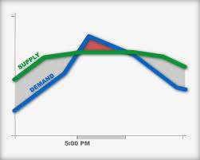
Demand Response Management
Briefing to PNDRP
Lee Hall
BPA Smart Grid and Demand Response Program Manager
January 23, 2014

Slide 2
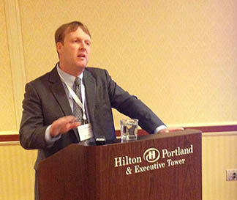
Demand response is a priority for BPA
Elliot Mainzer giving a key note speech on demand response at an EUCI conference last month:
The hydro system has been stretched to its physical margin,” Mainzer said. “Our task is to bring new and cost-effective, flexible capacity from outside of the hydro system.”
Part of Mainzer’s message was that demand response and energy storage can help utilities address their requirements to shave peak and defer infrastructure investments, as well as help the region reduce the need to build transmission and integrate the large amount of renewable energy in the Pacific Northwest.
Mainzer offered suggestions for moving forward by outlining the importance of determining supply curves; defining how reliable and dispatchable the DR tools are; and figuring out the physical and contractual capabilities, as well as how BPA will interface with utilities.
He also committed BPA to doing its part. “Demand response is a real opportunity, and BPA is mobilized to test and demonstrate it.”

Slide 3
Demand Response at BPA: 2013 In Review
BPA concludes innovative pilots (next page) across Northwest, e.g.:
  Thermal and process storage to support wind integration (10 min – load up and down)
  Tested oversupply strategy – e.g. aquifer recharge
  Joint use of end-loads by BPA and serving utility, e.g. peak and ancillary service
  Multiple load types with a variety of dispatch / algorithms
  Recognized by Peak Load Management Alliance (PLMA) with Innovative Application of Demand Response Award
Launches advanced “commercial” demonstrations
  Multi-type demonstrations: utility aggregation, third party aggregation
  Contracts signed to launch initial 30MW commercial demonstration with an industrial load
  Additional demonstrations in contract negotiation with expected launch in FY14 – FY15
Launches an initiative to put in place systems (DRMS)

Slide 4
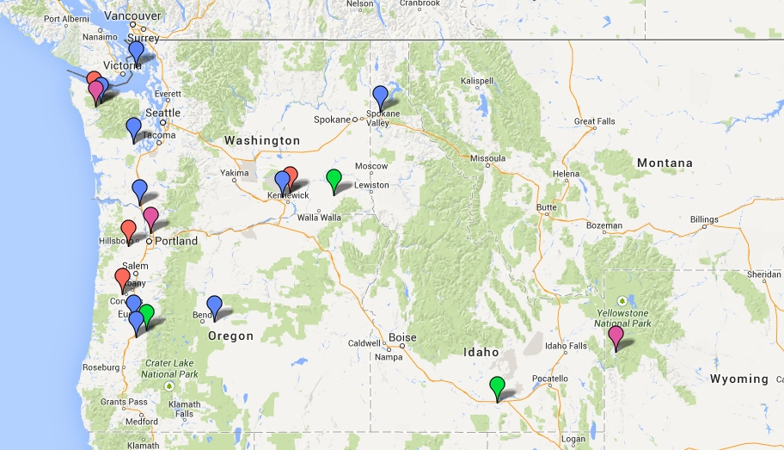
We have completed DR pilots with fifteen utilities across the region
Residential
Commercial
Agricultural
Industrial

Slide 5
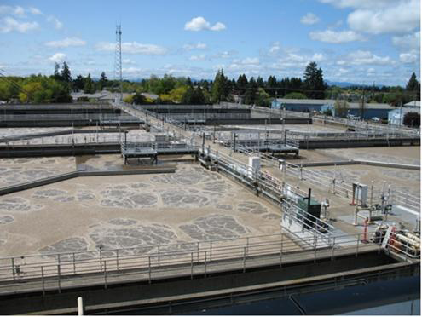
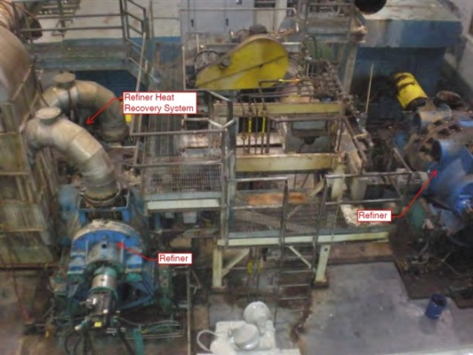
BPA Demand Response -- moving forward with a two-pronged approach
First prong: Research and Development through the TI program
Proof of concept research and development projects as part of BPA’s Technology Innovation program
Identify larger-scale, advanced DR projects to prove availability and reliability .
Building portfolio from 80-100MW of DR
R & D
Through TI Program
Second prong: DR Advanced Demonstrations
Advanced Demonstrations

Slide 6
The BPA Demand Response Advanced Demonstration Portfolio will be approximately 80-100 MW
Entity | Status | Megawatts | Product Demonstrated
City of Port Angeles | Contracted | 30 | INC
Group of Regional Utilities | In Negotiation | 15-20 | INC
Group of Regional Utilities | Proposed | 20-30 | Peak shifting
Commercial DR Aggregator | Upcoming RFP | 15 - 20 | Capacity, Transmission
Utility | Proposed | 3 – 5 | TBD
Total |  | ~ 80-100
* Does not include Alcoa

Slide 7
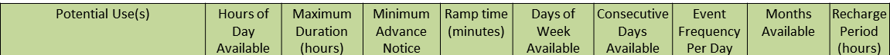
3 Prioritized Demand Response Products
INC Imbalance Reserves
10 Min Deployment for up to 90 minutes
Note: DECs tested in the past)
Superpeak Capacity
(e.g. 18 hour peak: 3 consecutive days – 3 to 6 hours)
Transmission Corridor Support
(e.g. 3 consecutive days – 3 to 6 hours)
Key Attributes of Products

Slide 8
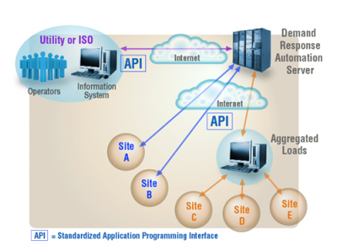
Demand Response Management System (DRMS)
A DRMS will allow BPA to manage available DR loads from utilities or ISOs, direct service loads, and aggregated loads utilizing Open Automated Demand Response (OpenADR) standards. DRMS functionality includes but is not limited to: load enrollment, automatic dispatch of DR events, and measurement and validation of load movement.

Slide 9
DRMS Approach
BPA is working in parallel on both short and long term solutions for a DRMS
Short term: Engaged with IT on selecting and implementing an off the shelf software as a service solution to support our DR demonstration projects through FY16.
Long term: BPA IT is using their formal Systems Lifecycle (SLC) process to perform an alternatives analysis, incorporate learning’s from the short term project, and to identify a solution to support DR activities in FY16 and into the future.

Slide 10
Look Ahead for FY14
BPA is looking to add an aggregator demonstration project with focus on commercial, industrial, and residential loads to use for peak shaving
Demand Response and Energy Efficiency coordination
EE Summit in May – Possible DR topics
Potential DR cross-share for utilities in summertime sponsored by BPA
Exploring creating a Utility DR Investment Toolkit built upon Ecofys experience and potentially looking for utility assistance
Exploring DRMS solutions to support DR demonstration projects and the long term DR program goals
Beginning demonstration testing of 30 MW with the City of Port Angeles

Slide 11
BPA Phased Implementation
> $10 M
IT DRMS Project Prepares BPA For This
BPA DR
Portfolio
MW Scale
Annual Cost
150+ MW
<10 MW
50-100 MW
<1 MW
1984-2008
2008-2009
2010-2012
2013-2015
2016 +
< $1M
Individual projects designed to address a specific research or operational objective
Not continuous
Two residential and one commercial proof-of-concept pilot project projects
Developed marketing materials and evaluation approach
Additional residential pilots
Added commercial and industrial pilots
Largely focused on utility peak
Introduced wind integration and load increase testing
Larger scale (10s of MWs)
Dedicated joint use projects
Multiple acquisition methods
Initial cost allocation methodology
Joint separate BPA/utility dispatch
Continue to scale larger based on evolving business needs
Routine cost allocation
Overview
Utilities /
Partners
Based on specific need or utility interest
Example: OPALCO submarine cable deferral in late ‘90s
Seattle City Light and LBNL
Kootenai Electric
Central Electric
12 additional utilities
Joint project with TI (Ecofys)
Many additional partners – commercial, academic, etc.
4-6 additional projects
Blend of customer types
Utility as aggregator and commercial aggregator trials
Utilities and Direct Customers
Select set of aggregators
Manual event dispatch/notification
Focused on peak load reduction
Commercial building management systems
Residential water heater and HVAC
Curtailment only
Added thermal storage, in-home displays, irrigation, cold storage and industrial processes
Curtailment, load increase, HLH to LLH load shift
Portfolio of projects rather than specific sectors or technologies
Heavy focus on commercial and industrial loads
Testing routine dispatchability
More sophisticated technologies
Sectors /
Technology
Spans all sectors
Production DR planning, dispatch, settlement, billing & reporting
Benefits /
Outcome
Successful projects ensured reliability during deferral
Technical feasibility
Programmatic lessons
Marketing refinement
Open Auto DR success
Technical feasibility and data
Programmatic lessons
Scalability assessment
Testing dispatch based on wind and balancing needs
Joint but dedicated use feasibility
Delivery of MWs for BPA needs
Significant regional DR learning
Test commercial arrangements
Program scaled to address multiple regional needs
Ongoing evolution
Emerging
Drivers
Transmission / distribution deferral
6th Power Plan encourages pilots
Oversupply
TRM price signals – utility peak demand
Generation imbalance reserves
Cost effective capacity

Slide 12
For more information, contact:
  Lee Hall
  Smart Grid and Demand Response Manager
  ljhall@bpa.gov
  503-230-5189

