Slide 1
Teaching The Duck To Fly
Pacific Northwest Demand Response Project
Portland, Oregon January 23, 2014
Jim Lazar
RAP Senior Advisor
January 23, 2014

Slide 2
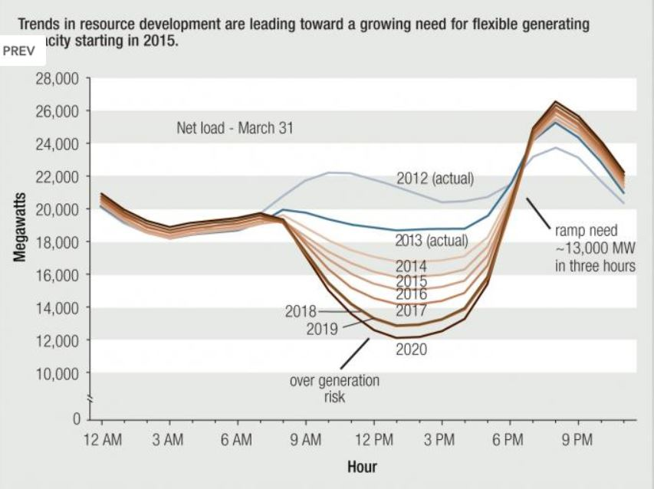
The California ISO “Duck Curve”:
Increasing solar means steep afternoon ramping.

Slide 3
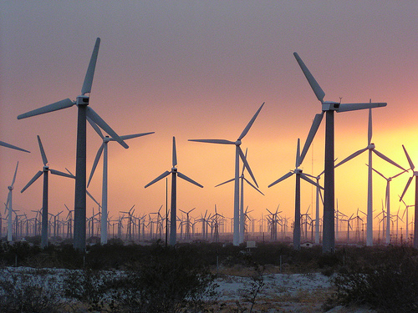

What Causes This Challenge?
Variable Loads: we’ve had those forever.
Wind: Variable supply.
Solar: Predictably NOT available for late PM peak demand.

Slide 4
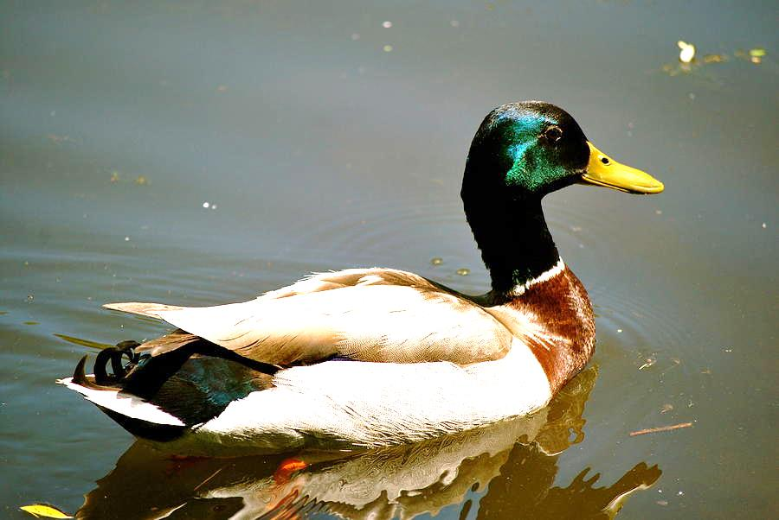

Guess What: Ducks Can Fly
A duck in water has very much the shape of the CAISO graphic. The “fat body” floats, and the tall neck breathes.
A duck in flight stretches out its body and straightens its neck in order to reduce wind resistance.
Our job is to straighten this duck out.

Slide 5
Ten Strategies To Align Loads to Resources
(and Resources to Loads) with Illustrative Values for Each
Targeted energy efficiency
Orient solar panels
Use solar thermal with storage.
Manage electric water heat
Require new large air conditioners to include storage
Retire older inflexible power plants
Concentrate demand charges into “ramping” hours
Deploy energy storage in targeted locations
Implement aggressive demand response programs
Use inter-regional exchanges of power
Not every strategy will be applicable to every utility.

Slide 6
Our Starting Point:
A California Utility’s Projected “Duck”
4,000 MW Peak Demand; 2,000 MW Minimum Demand;
73% Load Factor; Max 1-hour ramp: 400 MW
Forecast: 2,500 MW of wind and solar added 2012 – 2020; Predicted 63% Load Factor; Max 1-hour ramp: 550 MW

Slide 7
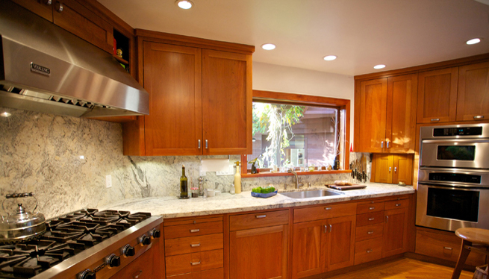
Strategy 1: Targeted Energy Efficiency
Focus efforts on EE measures with afternoon peak orientation.
5% of total usage by 2020;
3:1 ratio between on-peak and off-peak savings.
Kitchen lighting is a great example.

Slide 8
Strategy 1: Targeted Energy Efficiency
Focus efforts on EE measures with afternoon peak orientation.

Slide 9
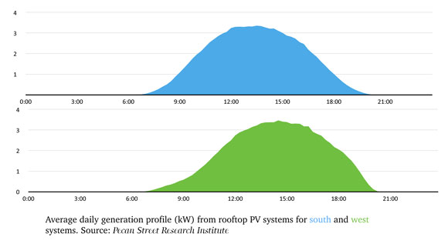
Strategy 2: Orient Solar Panels to the West
Fixed-axis solar panels produce a more valuable output if oriented to the West.
100 MW shift out of AM into PM hours, out of ~700 total rooftop solar assumed.
6 PM

Slide 10
Strategy 2: Orient Solar Panels to the West

Slide 11
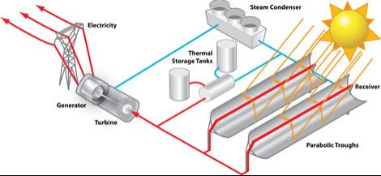
Strategy 3: Use Solar Thermal In Place of Some Solar PV
Solar thermal energy is more expensive, but can be stored for a few hours at low cost.
Substitute 100 MW of solar thermal for 100 MW of utility-scale PV, out of 1,500 MW of utility-scale solar total assumed.

Slide 12
Strategy 3: Use Solar Thermal In Place of Some Solar PV

Slide 13
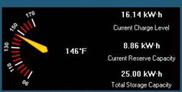
Strategy 4:
Control Electric Water Heating
Install grid control of electric water heating;
Supercharge during low-cost hours.
Illustrative utility has ~12% of state load; assume it can gain control over 5% of the electric water heaters in the state, for 300 MWh of load shifting.

Slide 14
Strategy 4:
Control Electric Water Heating

Slide 15
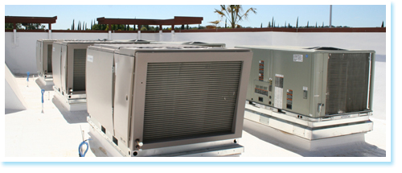

Strategy 5:
Require 2-hour Storage On New AC
Require new AC units over 5 tons to include at least 2 hours of storage, under grid control.
Move 100 MWh of AC load out of the 6 – 8 PM period into off-peak periods.

Slide 16
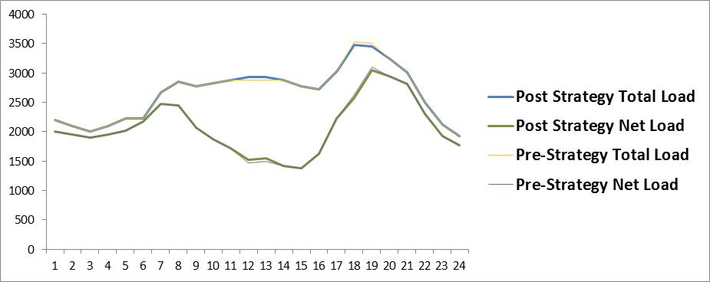
Strategy 5:
Require 2-hour Storage On New AC

Slide 17

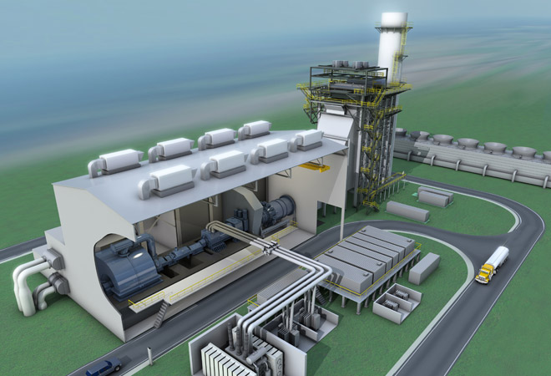
Strategy 6: Retire Older Inflexible Generating Plant
Older steam plants with night minimum loads and slow ramping are being replaced with gas “flex” units that ramp quickly.
GE Flex Combined Cycle Unit

Slide 18
Strategy 6: Retire Older Inflexible Generating Plant
No specific change attributed; assumed to be embedded in the 2020 forecast from the sample utility.

Slide 19
Strategy 7:
Concentrate Demand Charges
Concentrate utility prices into the “ramping” hours; hourly rates for large-volume customers.
New Rate
$10/month
$2/kW non-coincident
$12/kW 4PM – 7 PM
$.06/kWh off-peak
$.10/kWh mid-peak
$.25/kWh on-peak
Old Rate
$10/month
$10/kW
$.10/kWh

Slide 20
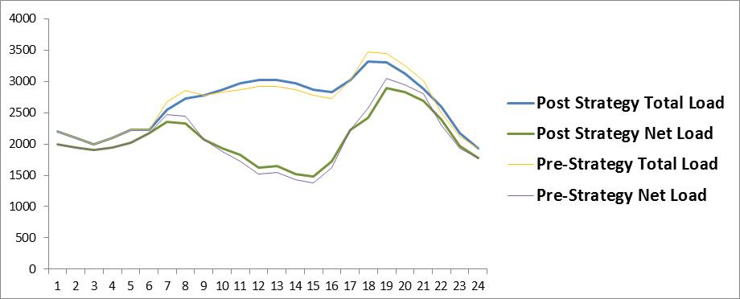
Strategy 7:
Concentrate Demand Charges

Slide 21
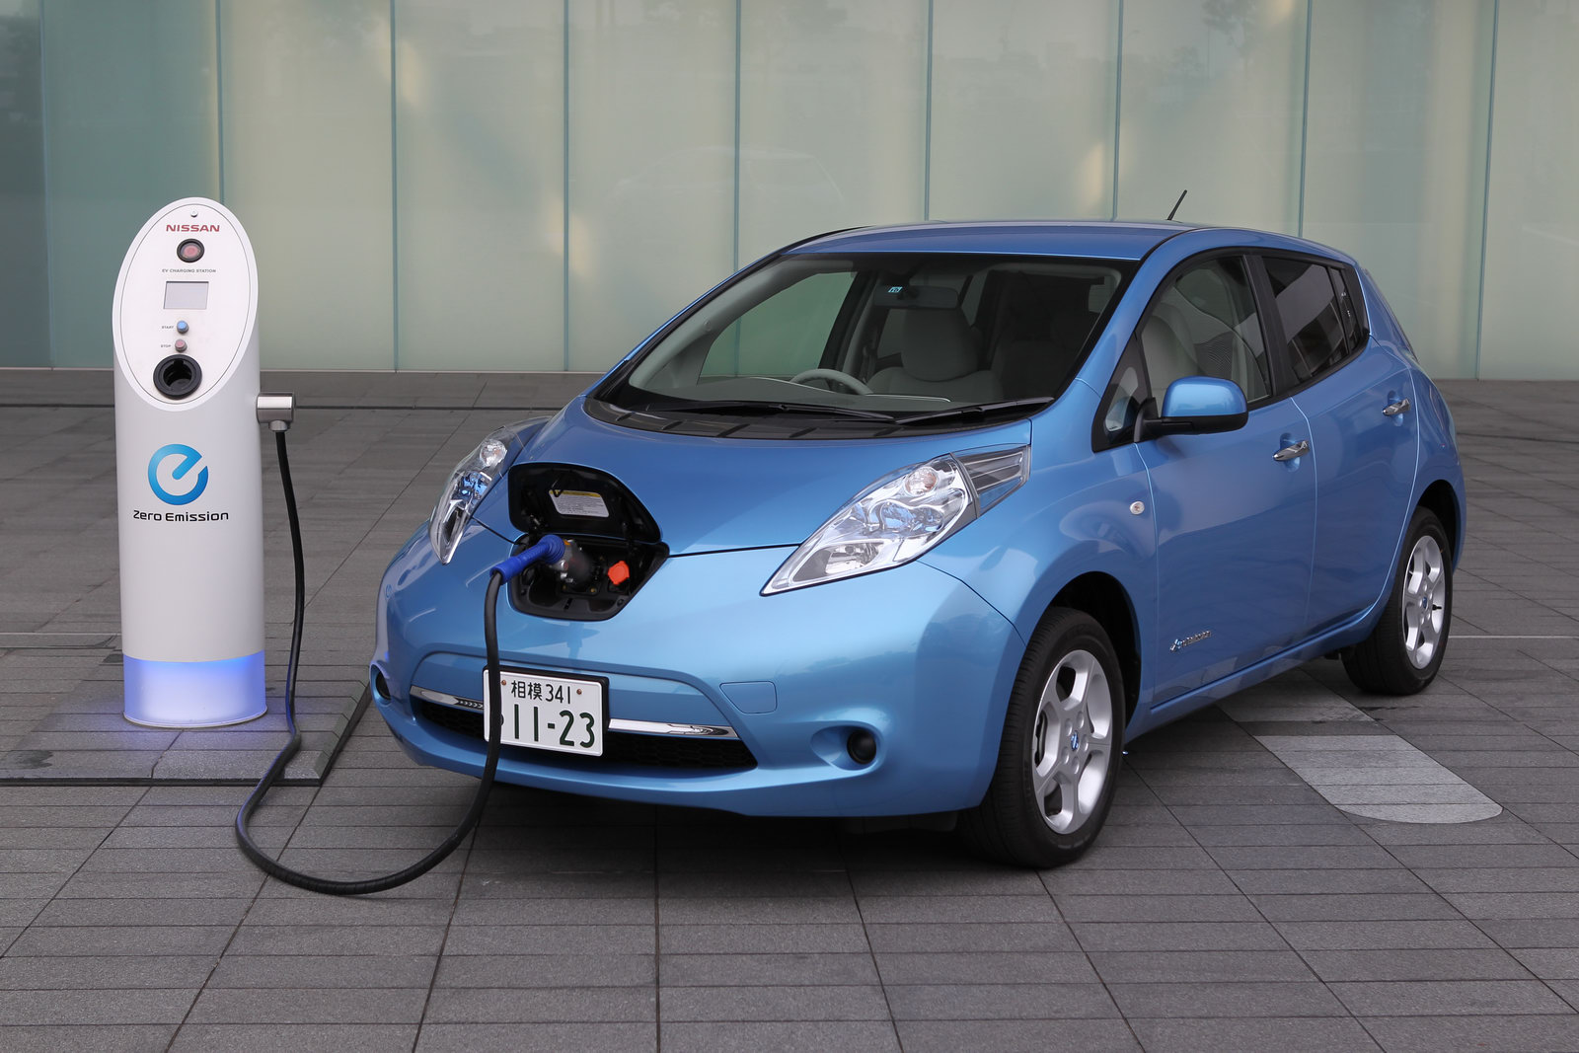
Strategy 8:
Deploy Electrical Storage
Selectively charge electric vehicle batteries; Add grid battery storage at strategic locations that help avoid T&D upgrade costs.
Storage equal to 1% of total load added.
100 MW capacity system-wide assumed.

Slide 22
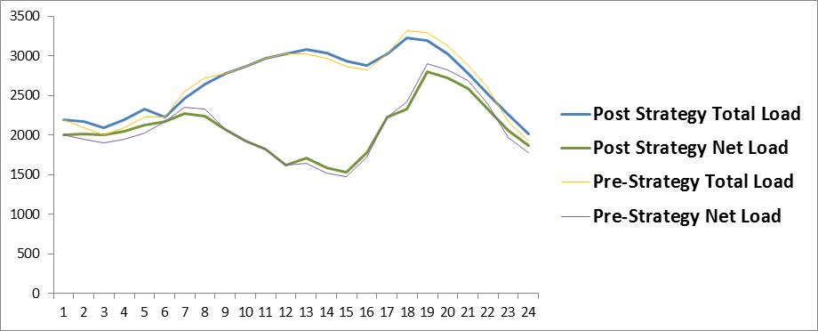
Strategy 8:
Deploy Electrical Storage

Slide 23
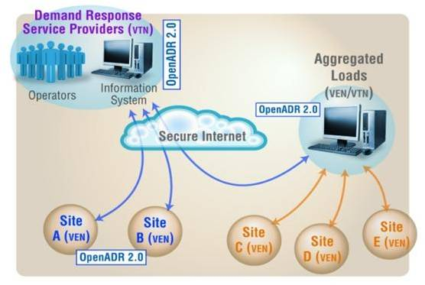
Strategy 9: Demand Response
Contract with customers for curtailment on an as-needed basis when the ramp is steep.
3% curtailment of peak demand on high-ramp days.
Currently ~8% at NEISO.

Slide 24
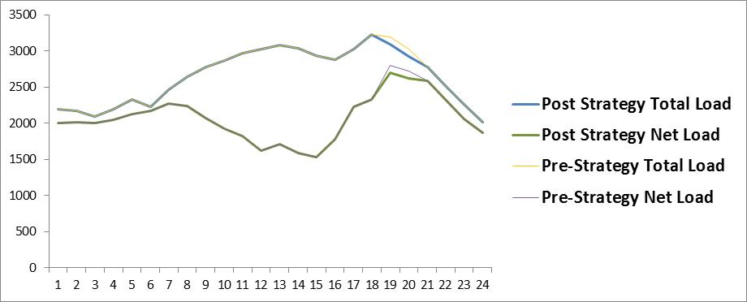
Strategy 9: Demand Response

Slide 25
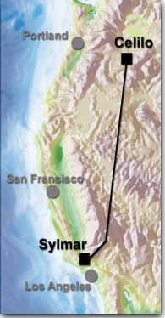
Strategy 10:
Inter-regional Power Exchanges
Take advantage of geographical diversity of loads, and geographical diversity of output from renewable resources.
Exchange 600 MWh per day from early to late evening using the existing inter-regional interties to Arizona, Nevada, Utah, and the Northwest

Slide 26
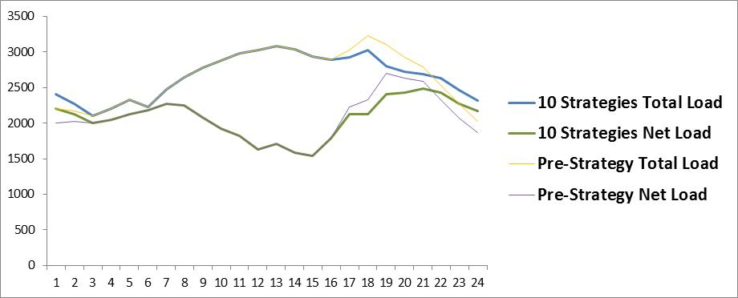
Strategy 10:
Inter-regional Power Exchanges
This duck is ready to spread his wings and fly.

Slide 27
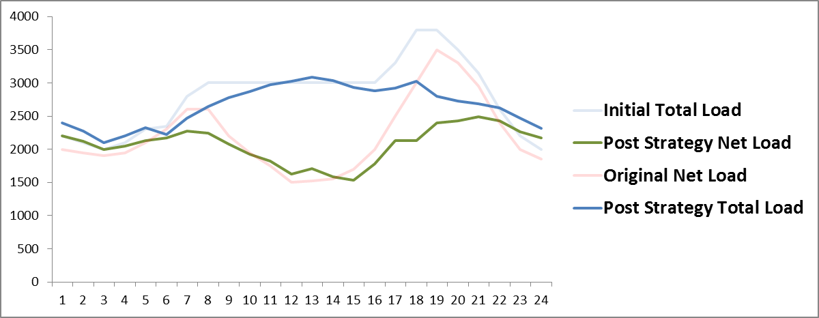
How Did We Do?
Pre-Strategy, without Solar/Wind: 73% LF
Pre-Strategy, with Solar/Wind: 63% LF
Post-Strategy, with Solar/Wind: 83% LF
Hourly Ramp: 340 MW vs. 400 today, and 550 w/o strategies

Slide 28

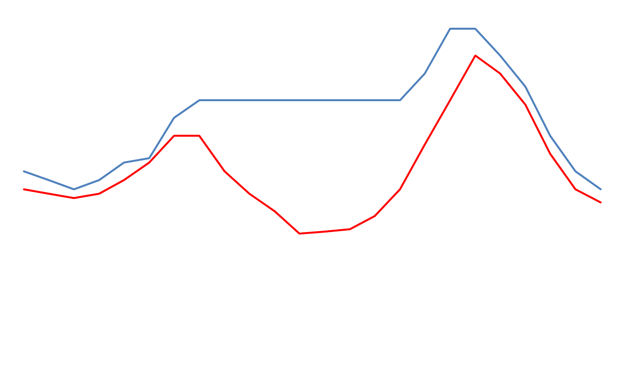
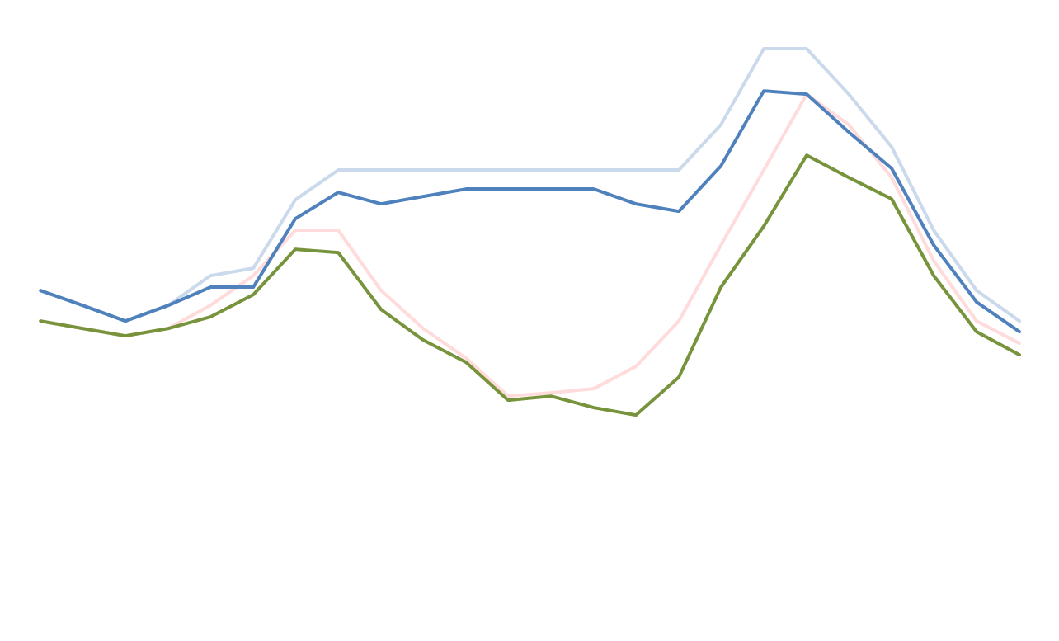
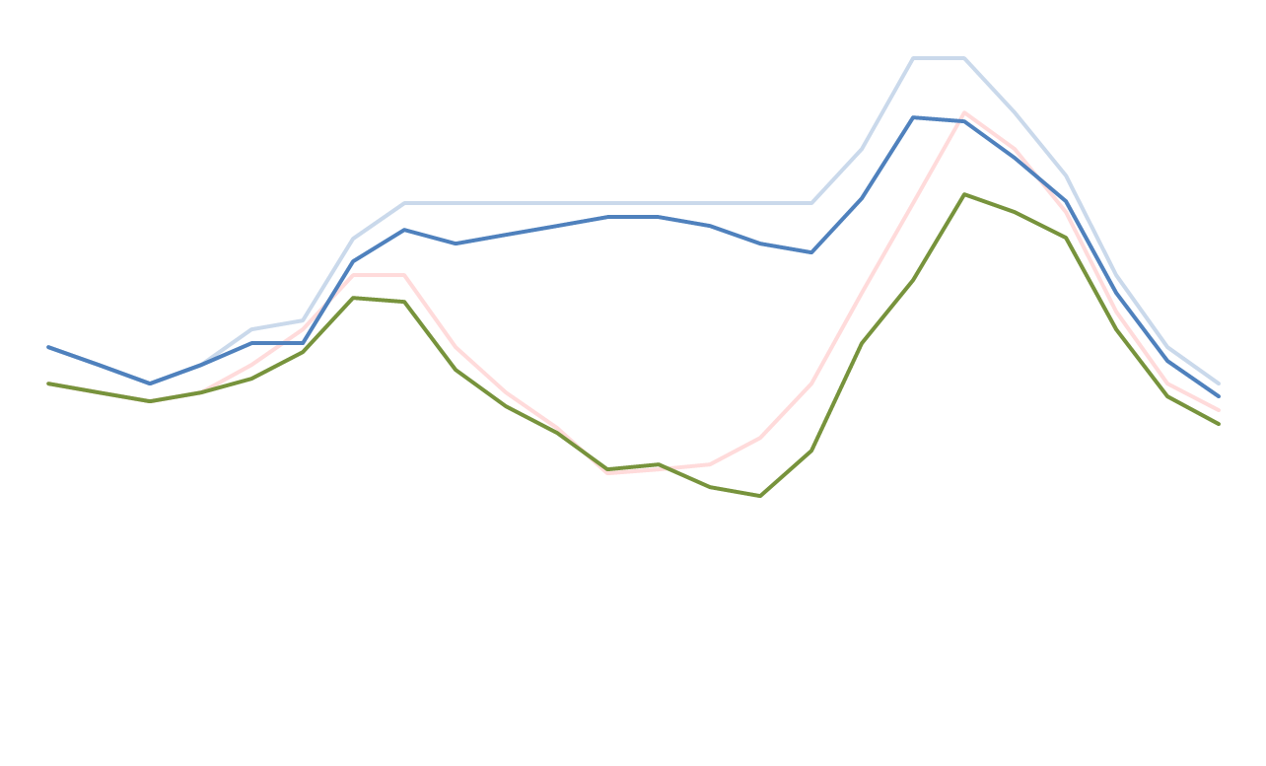
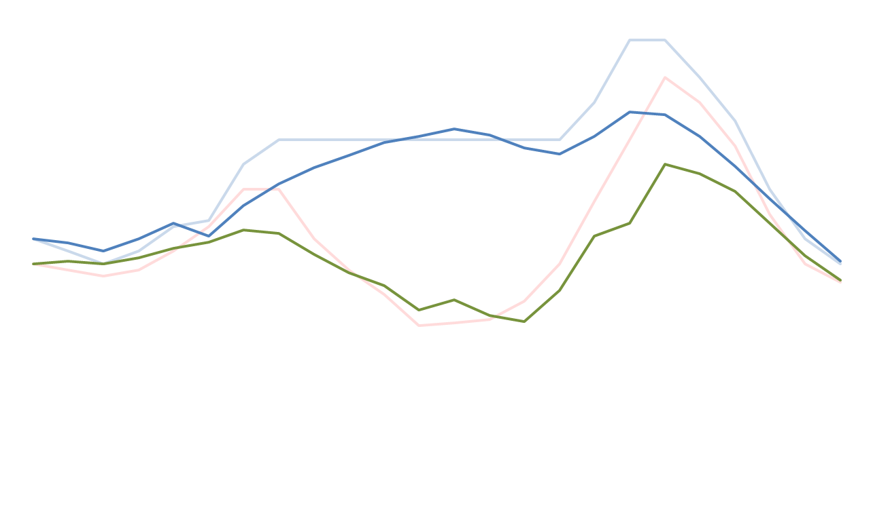
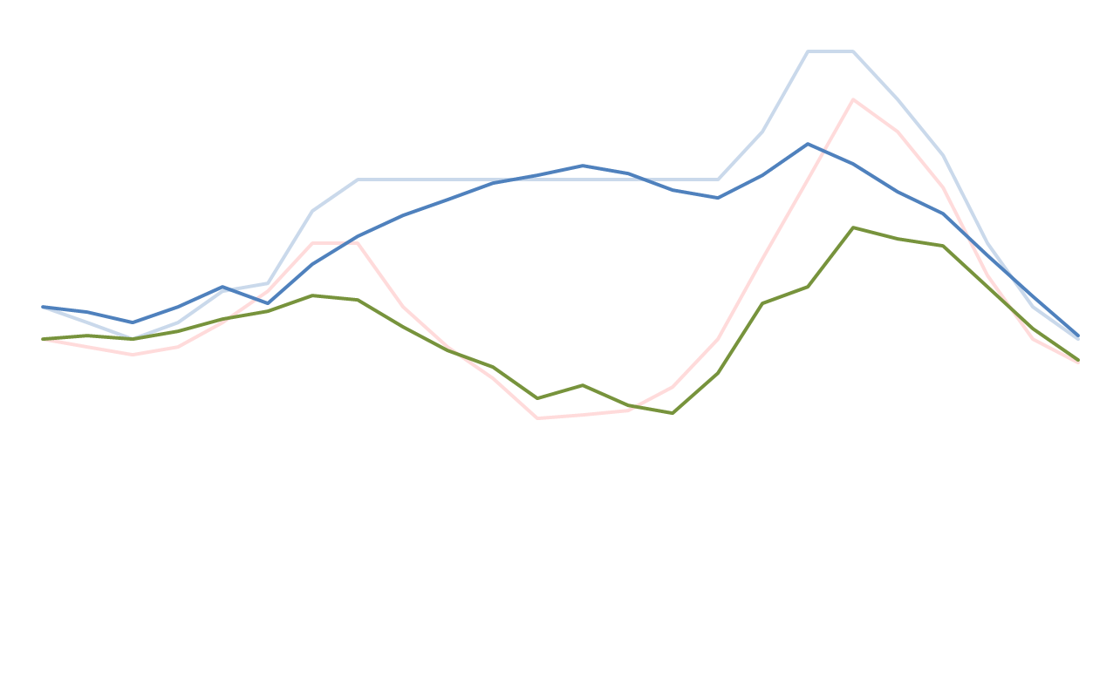
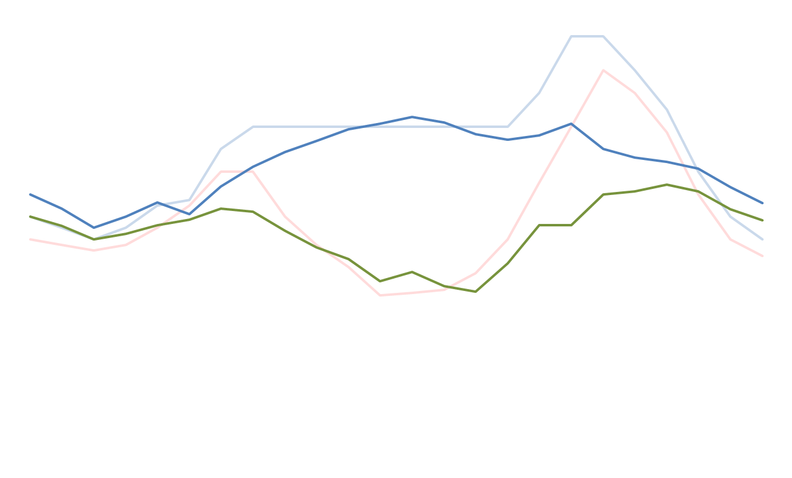
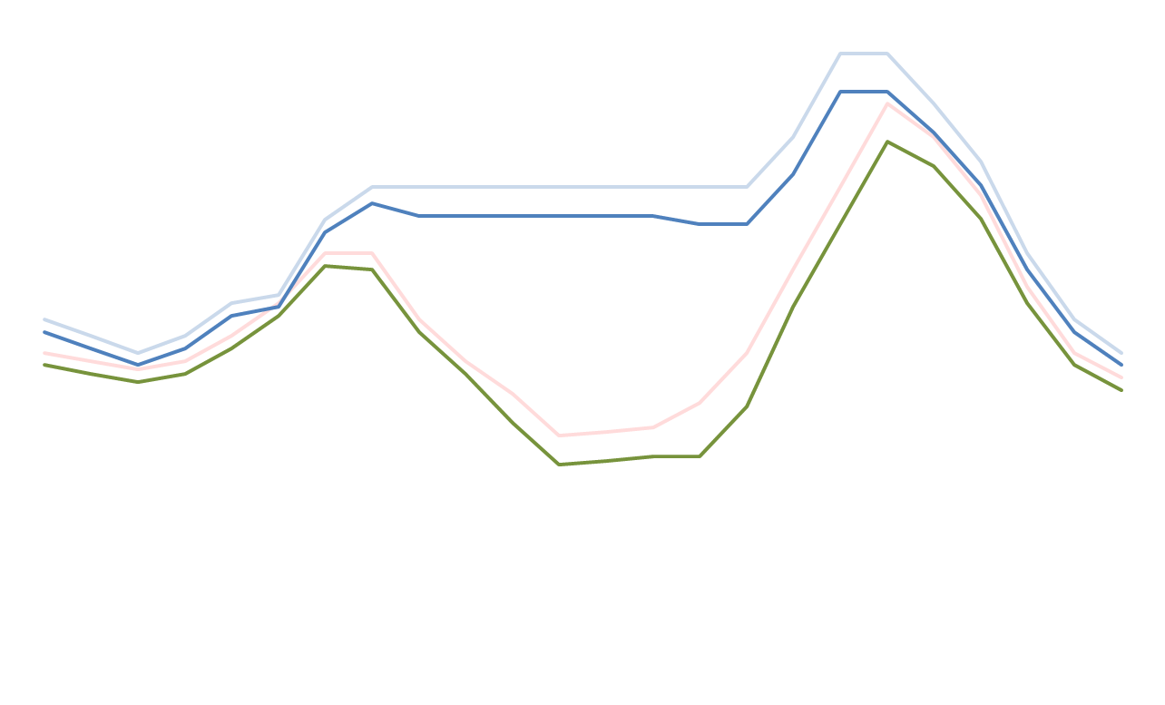
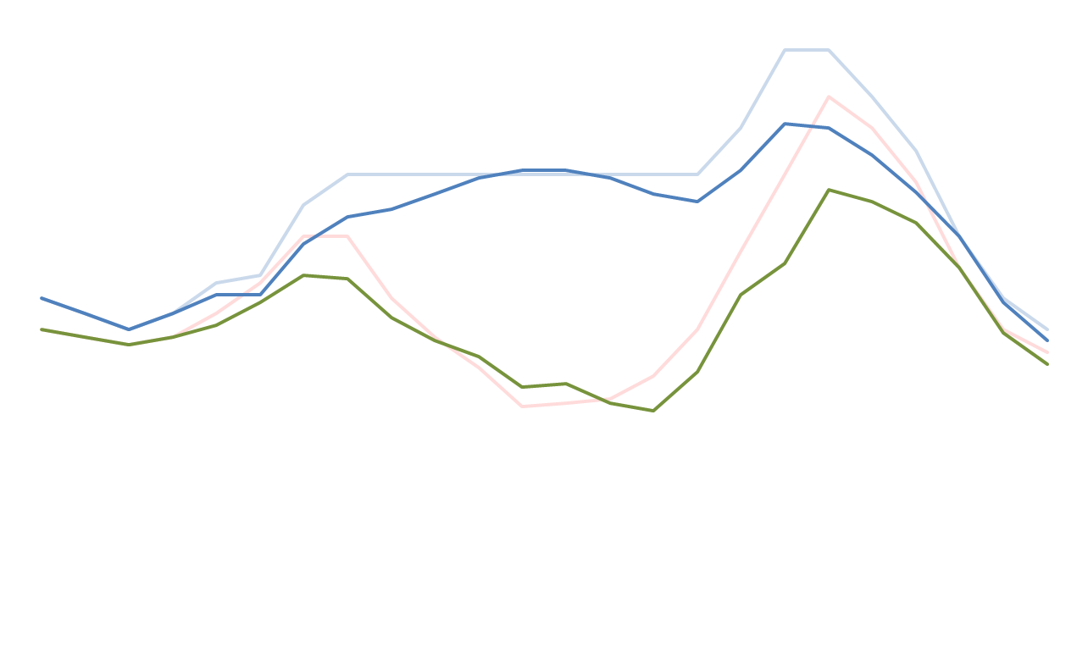

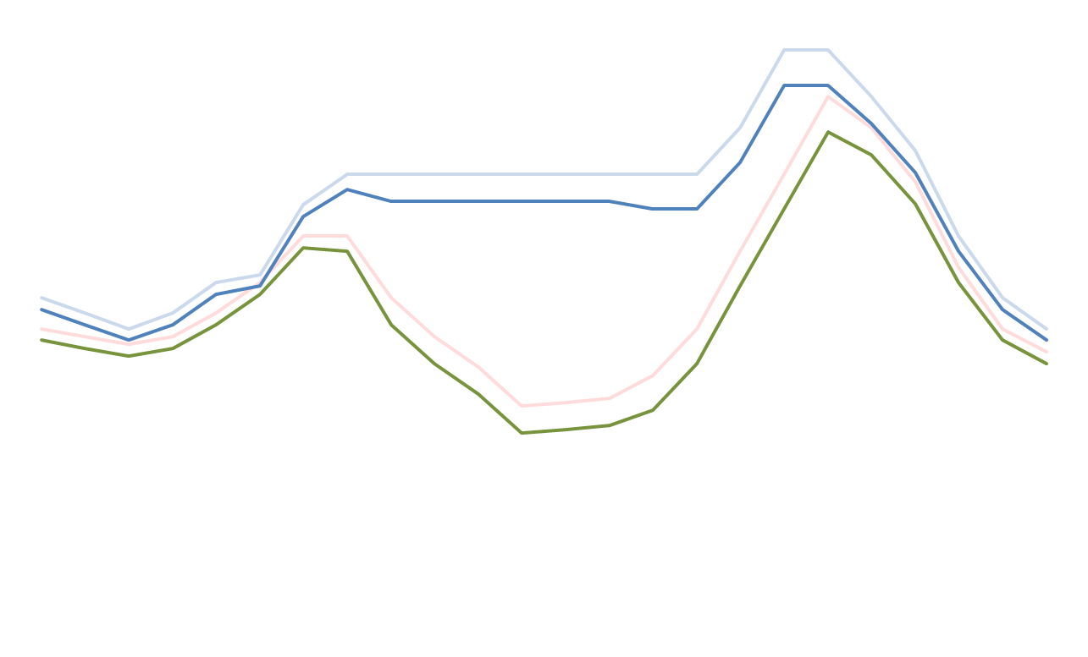
Teaching the Duck to Fly
Requesting Permission for Take-Off

Slide 29
jlazar@raponline.org
The Paper can be downloaded from:
http://www.raponline.org/document/download/id/6977

