Slide 1
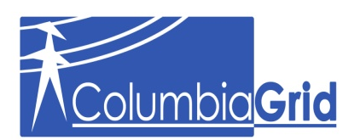
Northwest Wind Integration Forum
Policy Steering Committee Meeting January 6, 2010
WECC VGS--REC Impacts Work Team Update
Paul F Arnold—VP ColumbiaGrid

Slide 2
REC Impacts
Issue: How will REC definitions, requirement to deliver, and trading practices impact VG placement, energy marketing, and system reliability?
Activity: Review current reports and discussions of REC accounting and trading practices, develop a white paper that addresses appropriate recommendations

Slide 3
REC Impacts
  Work Team is at information gathering stage.
  Policy being made by other than operational and marketing types
  What impacts will emerge?
    Penetration levels in excess of load in off peak periods?
    Upward pressure on BA Reserve Requirements?
    More curtailments?
    Downward pressure on market prices, negative pricing, or price volatility?
    Lowering of GHG through displacement of thermal generation? Offset by need for balancing services?
    Less need for new long distance transmission to deliver VG?

Slide 4
REC Impacts
Work Team participation is open
  APS, BPA, Chelan PUD, RNP, SDG&E, PG&E, NPPC
  Next conference call is 3rd week in January
  Work Groups meet March 1-3
  VGS meets March 30

