Slide 1
Peak Capacity Cost & Demand Response
Pacific Northwest demand Response planning committee bill dickens
Tacoma Power
February 23, 2012

Slide 2
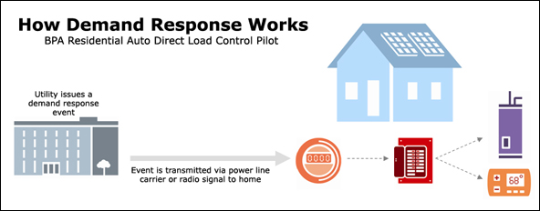
Demand Response: overview

Slide 3
ECONOMICS of DEMAND RESPONSE
Cost
$.MWh
Load
With DR
Power Supply
Load
Cost
No DR
------------------------------------------------------------------------------------
Cost
Reduction
Cost
With DR
-----------------------------------------------------
Peak Demand
Reduction
With DR
No DR
Capacity

Slide 4
Tacoma’s capacity margin: winter 1-hour

Slide 5
PEAK LOAD-RESOURCE BALANCE SUMMARY
Period | Peak Load | Peak Supply | Peak Load Planning Reserve Margin
1-hour | 1003 MW | 1266 MW | 26%
18-hour | 948 MW | 1266 MW | 36%
72-hour | 833 MW | 1178 MW | 41%

Slide 6
MID-C DOW JONES POWER PRICE INDEX

Slide 7
WHOLE-SALE POWER PRICE FORECAST

Slide 8

conclusion
Stars do not align
no thermal resources
No capacity constraints
No flexible rates
No rto/iso
Opportunities – wind integration
Qed

