Slide 1
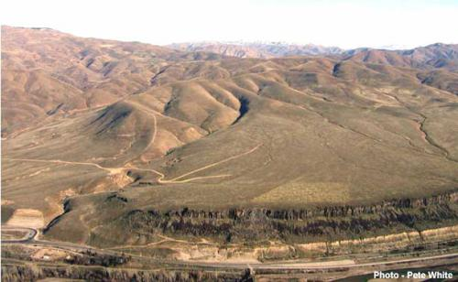
Proposed Southern Idaho Wildlife Settlement between Idaho and Bonneville
Northwest Power and Conservation Council
Wildlife
Advisory
Committee
August 19, 2014

Slide 2
Proposed Settlement
The 10-year wildlife mitigation agreement fully resolves half of all wildlife mitigation, “Idaho’s share,” associated with the construction, inundation, and operational impacts from Black Canyon, Anderson Ranch, Palisades, and Minidoka dams.
  The agreement also covers half of the estimated operational impacts on fish and wildlife habitat from Deadwood Dam.
The other 50% is addressed by the Shoshone-Bannock Tribes of the Fort Hall Indian Reservation and the Shoshone-Paiute Tribes of the Duck Valley Indian Reservation, and is not covered in this agreement.
The agreement would also provide habitat benefits for southern Idaho fish habitat.
The approach is similar to the 2010 Willamette Wildlife Agreement and builds on the efficiencies pioneered there.

Slide 3
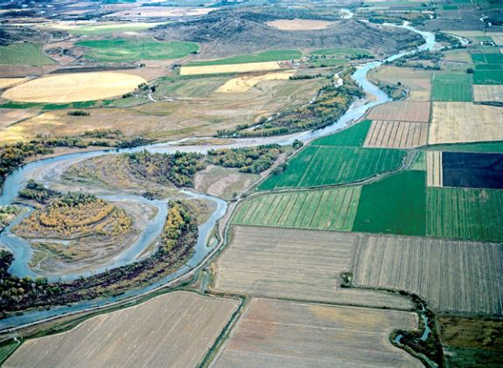
Council Program on Settlement Agreements
Measureable Objectives – Acres of habitat types, number of habitat units by species
Demonstration of consistency with policies, objectives and strategies of Program
Open public process
Protection of riparian habitat for both fish and wildlife, and high quality native habitat
Annual reports
Provision of long-term maintenance
Sufficient funding for substantial likelihood of achieving and sustaining objectives

Slide 4
Proposed Settlement
1. Measurable Objectives
Objectives would be stated in acres.
    Total acreage for construction and inundation losses is 33,290, of which 16,645 (50%) will be settled with Idaho.
    Idaho has acquired 8,722 acres to date.
    An additional 665 acres will be included to address operational losses, including those from Deadwood Dam.
Under this agreement, Idaho commits to protecting at least 8,588 acres.
BPA guarantees the total funding of this Settlement.
Idaho stipulates that this will satisfy the Federal wildlife mitigation obligation for southern Idaho dams.
Additional acres may be purchased, but costs would not exceed agreed amount.

Slide 5
Proposed Settlement
2. Demonstration of consistency with policies, objectives, and strategies of the Fish and Wildlife Program
  The ecosystem approach used by Idaho would be consistent with F&W program strategies benefiting wildlife and fish.
  Project selection would address wildlife limiting factors identified in subbasin plans.
  The Council recommends resolution of outstanding mitigation through settlement agreements.

Slide 6
Proposed Settlement
3. Open public process
  Planned public comment period opened August 15 for 30 days.
    http://www.bpa.gov/applications/publiccomments/OpenCommentListing.aspx
  Idaho will seek to leverage funding from other sources.
  Idaho would participate in the categorical or periodic assessments of wildlife habitat projects, including ISRP review.
  Idaho would coordinate its efforts under this agreement with the Shoshone-Bannock Tribes and the Shoshone-Paiute Tribes.

Slide 7
Proposed Settlement
4. Protection of habitat for both fish and wildlife
  Idaho will use an ecosystem approach to selecting acquisitions.
  In many cases, projects will provide dual benefits for both wildlife and fish.
  Priorities will be consistent with Fish and Game Land Acquisition Policy and informed by species management plans, state wildlife action plans, and subbasin plans.
  Projects may also benefit other species and resources of interest to regional stakeholders.

Slide 8
Proposed Settlement
5. Annual Reports
  Through 2024, Idaho would prepare an annual report for BPA and Council for wildlife mitigation funded under this agreement; Idaho would also use the BPA tracking system, PISCES.
  BPA and Idaho would meet annually to assess progress and discuss future project opportunities.
  Idaho would report to the Council as appropriate.

Slide 9
Proposed Settlement
6. Sufficient funding for substantial likelihood of achieving and sustaining objectives, including long term maintenance
  10-year agreement from FY15 – FY24.
  A total of $22 million for new acquisitions, ($5 million per/year for FY15 -17, $2.5 million per year for FY18 – FY19, and $2.0 million for FY20). Stewardship costs for the new acquisitions will also be covered by this fund.
  $14 million provided upfront at the initiation of the agreement for permanent stewardship of past acquisitions.
  $400,000 per year for 10 years for pre-acquisition costs and administration of Idaho’s SIWM program.

Slide 10
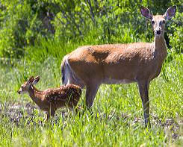
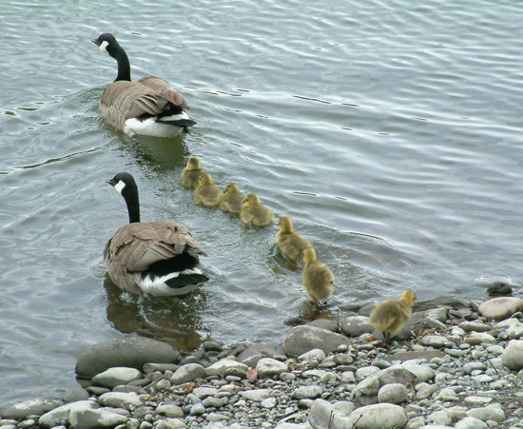
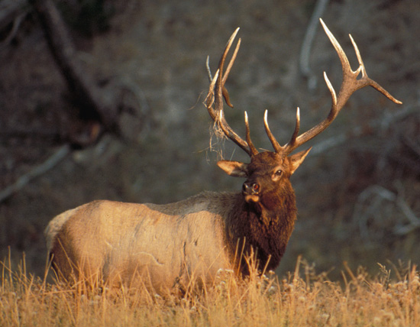
Next Steps
BPA and Idaho will continue refining the draft settlement agreement and consider public comments.
BPA and Idaho are continuing outreach to share the draft agreement with:
  Shoshone-Bannock Tribes of the Fort Hall Indian Reservation
  Shoshone-Paiute Tribes of the Duck Valley Indian Reservation
  Northwest Power and Conservation Council
  BPA Customers
30-day public comment period is now underway.

Slide 11
Southern Idaho Wildlife Mitigation to Date

