Slide 1

Developing the next 200 MW of Wind in Montana
(what we don’t export)
Ross Keogh, Sagebrush Energy
For the NW Power & Conservation Council, 1/12/2011

Slide 2
About Sagebrush Energy
A renewable energy development and consulting company founded in 2006 by Paul Kimball & Ben Ellis
Focused on developing 300 MW of wind in Idaho & Montana
Two 20 MW projects in Montana in late stage development (Mission & Norris)
Supported UAMPs on the 100 MW Horse Butte Wind Farm near Idaho Falls, ID
Developer for a joint partnership of the Shoshone-Bannock and Southern Ute Tribes on the 160 MW WheatGrass Ridge Wind Project near Pocatello, ID

Slide 3
Wind Energy Growth in Power Council States
2011 capacity reflects projects under construction at the end of the 3rd quarter 2010
Data is from AWEA’s project database, 9/30/2010

Slide 4
Wind Energy Penetration
 | Total Potential | 2011 Wind Capacity | Installed Capacity by Potential | 2008 aMW demand, EIA | % of load met by Wind
Idaho | 18,076 | 571 | 2.14% | 2,728 | 6.9%
Montana | 944,004 | 386 | 0.04% | 1,750 | 7.3%
Oregon | 27,100 | 2233 | 8.24% | 5,612 | 13.1%
Washington | 18,478 | 2771 | 14.99% | 9,971 | 9.2%
Montana lags behind in penetration the relatively resource poor states of OR & WA
How much wind does Montana need to meet OR & WA penetration?
Today | 7.3%
100 New MW | 9.2%
200 New MW | 11.1%
300 New MW | 12.9%
200 MW to meet the average of OR & WA penetration
Potential is from AWS Truewind and NREL, 2/2010 (http://www.windpoweringamerica.gov/pdfs/wind_maps/wind_potential_80m_30percent.pdf)

Slide 5
Demand Exists in Montana for 200 MW
Electrical COOPs in the state are building natural gas plants as sole resource solution:
  Southern Montana Electric: 46 MW (35 aMW)
  Basin Electric: 95 MW (72 aMW)
If 25% of aMW were derived from wind by COOPs :
  SME: 34.5 MW Gas & 23 MW Wind = 35 aMW
  Basin Electric = 71 MW Gas & 48 MW Wind = 95 aMW
= 71 MW
NorthWestern Energy’s 2009 IRP (released 2nd quarter 2010):
  Significant aggregate annual demand not met by contract resources 210 aMW in 2010
  Existing contract resources and Judith Gap (496 MW), fail to meet even average light load (602 MW)
If 130 MW of wind was added to NWE:
  50 aMW (24% of need)
  361 MW of contract + 265 MW Wind = 626 MW, 24 MW over average light load
  50 MW of wind under “MOU” for 2012 construction
= 130 MW

Slide 6
Key barriers to Wind Energy Development
Montana has demand and resource potential for 200 MW of wind, but development has stalled.
No new wind in NWE’s BAA since 2006.
Why?
Extraordinary Regulation Costs
Minimal Political Support
The Ghosts of Deregulation

Slide 7
Regulation Resource Costs in Montana
NWE requires 25-31 MW of RRR to balance Judith Gap (19-23% of nameplate)
RRR Costs | KW Month | Cost per MWh (20% RRR)
2008 NWE Contract Blend | $12.2 | $8.8
Mill Creek | $27.70? | $20.0
RRR cost in MT is the monetized PTC value going forward
Assumes 38% project capacity factor, no balancing energy, and $2.5/kW transmission cost for external resources.
Avista, PowerEx and Grant PUD rates are from 2008. No guarantee of future availability or price. Avista’s rate increased 15% from 2007 to 2008.
Need to draw RRR from Grant PUD and PowerEx (two wheel resources), shows highly inelastic RRR supply curve.
Mill Creek has been granted only interim approval by FERC, Settlement negotiations underway, decision expected 2nd quarter 2011.
Mill Creek is only an RRR solution for the next 300 MW of wind

Slide 8
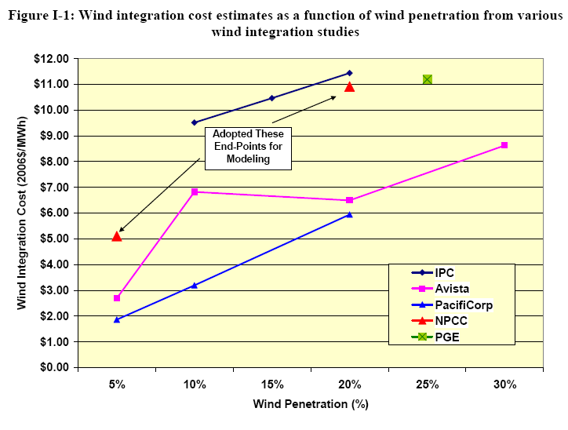
Regulation Resource Outside of Montana
PacifiCorp, 2010 Wind Integration Study, $8.85 per MWh (including cost of economic dispatch and day-ahead error)
BPA, 2010 Rate Case, $5.70 per MWh
NPCC, (p.14 of Appendix 1):

Slide 9
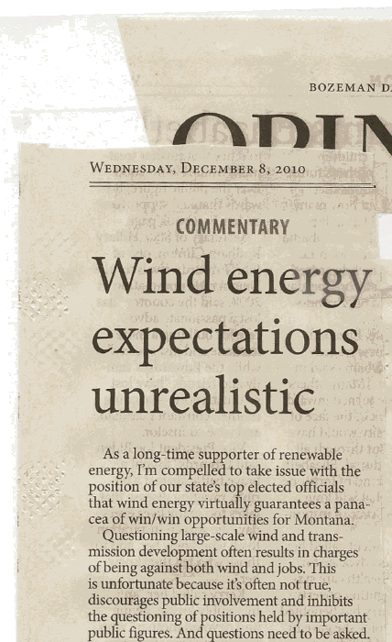
Minimal Political Support
LC1497, Jason Priest (R), would repeal MT RPS
LC 1618, Derek Skees (R), would also repeal the MT RPS
Three other bills to weaken or effectively eliminate the RPS (SB 109, LC0325, HB 59)
Democratic PSC Commissioner, John Vincent:
Republican PSC Commissioner, Travis Kavulla:
All Aboard the Green Bandwagon, Jon Tester Edition
Written by Travis Kavulla on 16 November 2010
Our junior senator ably proves in an op-ed yesterday why he’s considered one of the dimmer lightbulbs in the U.S. Senate. Barely a single number is quoted, at least one factual error is committed, and an obvious internal contradiction is left unresolved in a cliche-ridden piece of writing which reminds me what I never, ever must become in a public office: a panderer who cannot even muster a logically consistent argument.

Slide 10
The Ghosts of Deregulation
NorthWestern Energy was prohibited from owning generation assets until 2007
Resource Planning Process in Montana is weak
Most large industrial loads purchase energy from PPL Energy Plus (314 MW)
With no resources, NWE was truly stranded for capacity to regulate wind and load
BPA supported COOPs abandoned NorthWestern Energy for load regulation in 2009 (184 MW)
NorthWestern Energy was trying to sell out to BBI until 4th quarter 2007

Slide 11
Steps Forward
FERC NOPR on integrating VERs is significant and has real potential to lessen RRR need
Dialogue is important
Long-term subsidy solution (or real carbon cost) are persistent federal issues
BAA consolidation and RTO formation are long-term and real solutions to cost allocation and regulation issues that should not be forgotten…

Slide 12
Contact
Ross Keogh
Sagebrush Energy, Analyst
ross.keogh@sagebrushenergy.net
406-298-0991

