Slide 1
Shoshone-Bannock Tribes’ Fish Accord
Daniel Stone , Policy Analyst
Fish and Wildlife Department

Slide 2
Fish Accord Overview
Funding Commitment from Bonneville Power Administration for $61 million over 10 years.
Cover an integrated program for salmon restoration for the next decade.
Designed to take an active role in salmon recovery and protect the resources Tribal members rely on for harvest.
Part of a regional cooperative among “Accord Parties” to implement on-the-ground actions.

Slide 3
MOA
Agrees to adaptive management of the Federal Columbia River Power System and improving survival at every hydro project for migrating fish.
The Tribes agree not to pursue, initiate or join in litigation regarding the operation of the FCRPS.
The Tribes further agree to refrain from advocating for dam breaching for ten years to see if changes to the hydro system are providing working.

Slide 4
Accord Projects
Tribal Supplementation Project
Salmon River Enhancement Program
Yankee Fork Floodplain Restoration
Nutrient Enhancement Project
ESA Habitat Program
Southern Idaho Wildlife Mitigation Program
Snake River Sockeye Research Project
Crystal Springs Hatchery
Habitat Improvement and Enhancement on Fort Hall Bottoms

Slide 5
Tribal Supplementation Project
A decline in natural production of salmon and steelhead led to a listing under the ESA. The Tribes will initiate supplementation actions to improve runs, re-distribute fish and improve natural production.
Planting Snake River sockeye salmon eyed-eggs in Pettit Lake, November 2000.

Slide 6
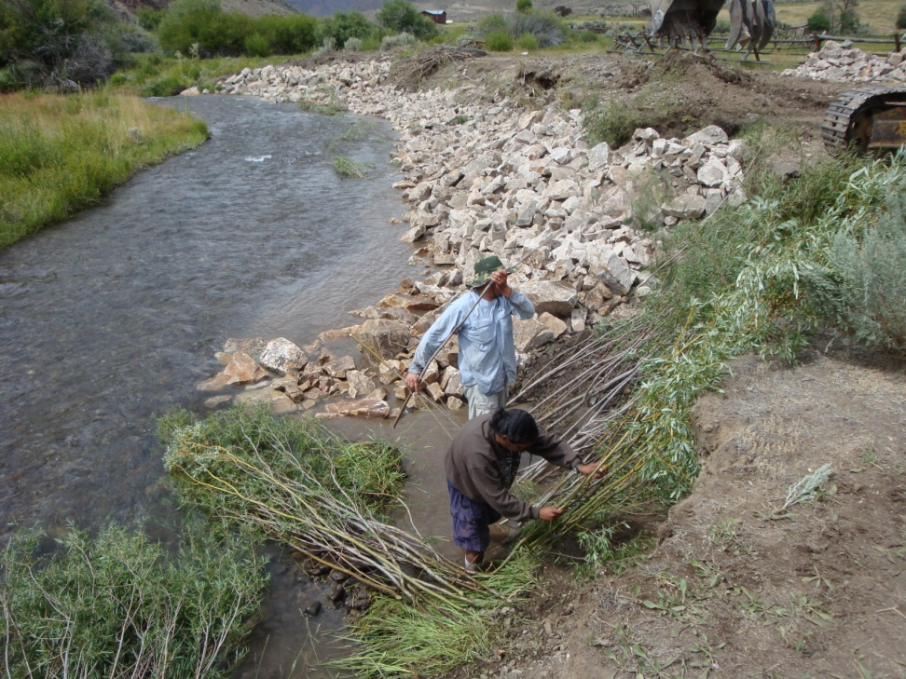
Salmon River Habitat Enhancement Program
The SRHE provides appropriate habitat management of the ecosystem through detailed monitoring of habitat projects and evaluating the response by natural populations to past actions.
Cooperative Habitat Restoration Work, Herd Creek

Slide 7
Yankee Fork Floodplain Restoration Project
The Yankee Fork was greatly impacted by dredge mining. The goal of the project is to restore natural river characteristics, floodplain function, hydraulic function and aquatic habitat in the dredged reach.
Yankee Fork Salmon River, Dredge Reach

Slide 8
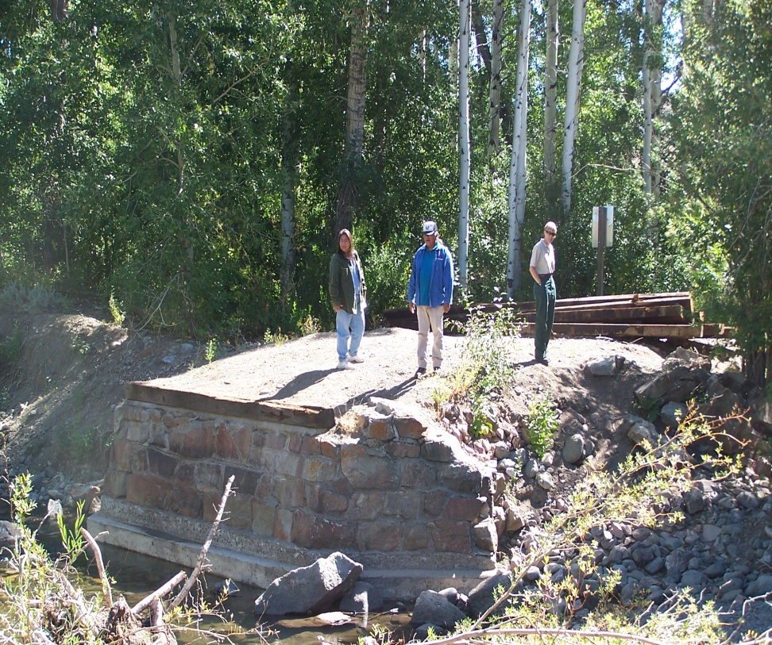
ESA Habitat
Project will fill identified gaps in the SCA habitat analysis; with a priority focus of funding Yankee Fork projects.

Slide 9
Nutrient Enhancement Project
Declines of historically abundant anadromous fish represent a loss of marine derived nutrients across Idaho. Nutrient enhancement help restore freshwater productivity and promote natural salmon recovery.
Nutrient Enhancement Equipment, Stanley Basin

Slide 10
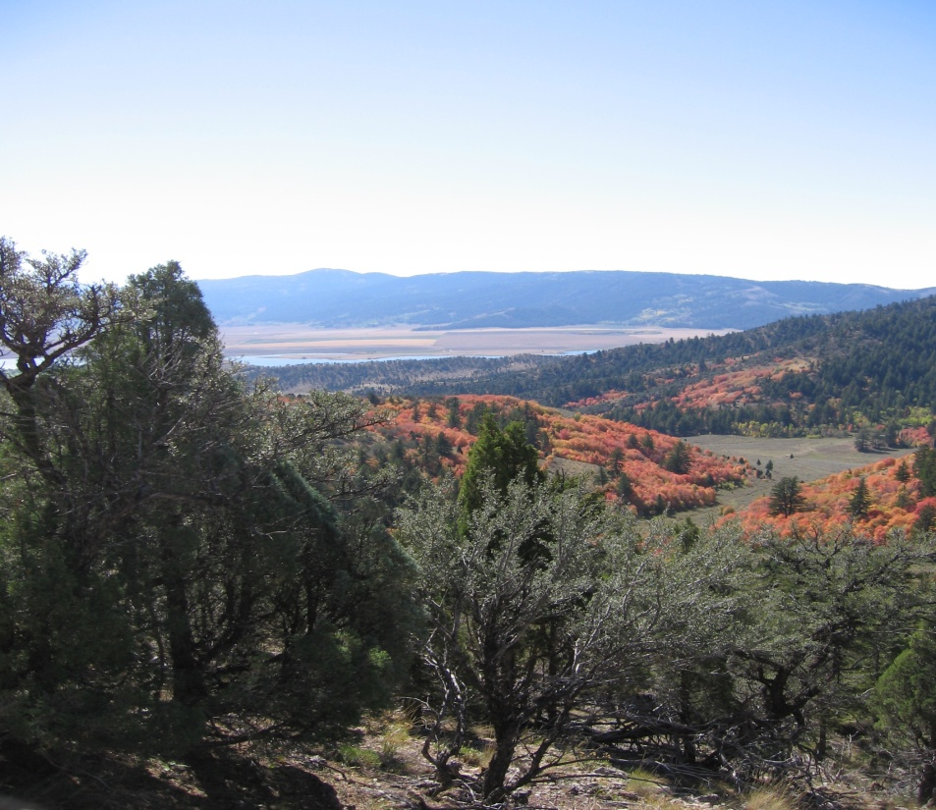
Southern Idaho Wildlife Mitigation Program
The SIWM program was created to mitigate for habitat losses associated with hydropower development in southern Idaho. The program works with BPA staff to acquire property or easements to benefit fish and wildlife in perpetuity.
Soda Hills Project

Slide 11
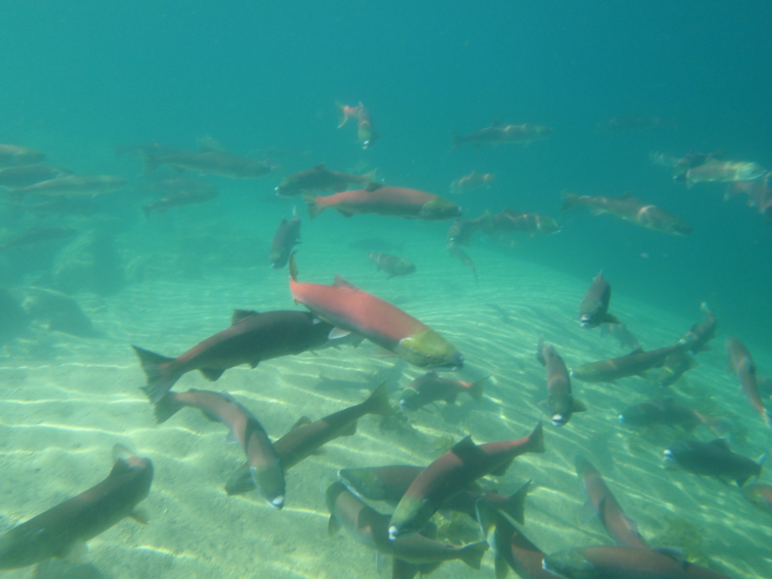
Snake River Sockeye Salmon Research Program
In 1990 the Tribes petitioned NMFS to list the Sockeye as endangered. The Tribal goal is to preserve the unique genetics of the species and promote recovery, eventually providing harvest.
Snake River sockeye salmon in Redfish Lake, October 2008. IDFG Mike Peterson photo.

Slide 12
Crystal Springs Hatchery
The Tribes secured a commitment of funding for construction of a Tribal hatchery at Crystal Springs and an associated adult trapping facility in the Salmon River basin.
The Tribes are diligently following the NPCC 3-Step process to ensure this project becomes reality.
The Tribes are in the process of contracting experts to design the hatchery and draft the associated scientific documents.

Slide 13
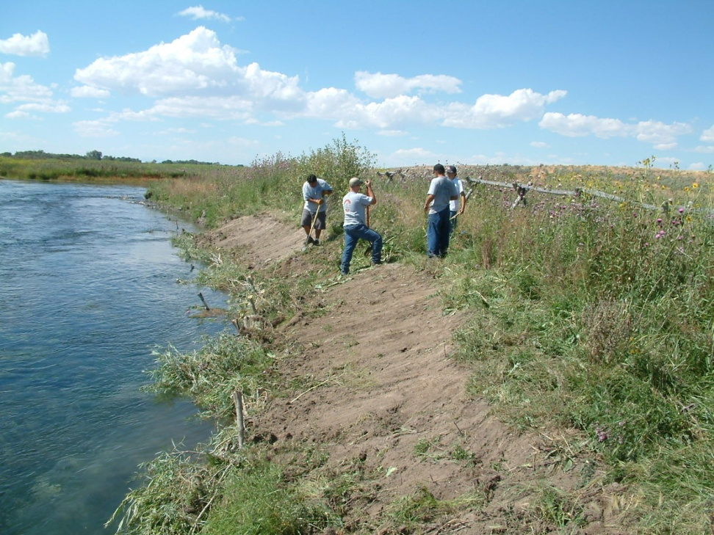
Fort Hall Habitat Improvement Project
The Bottoms has been negatively affected by hydropower influences and grazing. The Project goal is to rehabilitate habitat to promote recovery of native species.
Bank Sloping and Wetland Plantings, Fort Hall

Slide 14
Project Specific Funding
The Fish Accord commits funding for project specific actions, primarily designed to meet obligations from the 2008 FCRPS Biological Opinion.
These actions represent a component of the total Tribal effort in Columbia Basin Management.

Slide 15
Administration and Rights Protection
Tribal administrative and policy staff actively participate in various regional forums to protect Tribal rights and interests.
Regional coordination through groups such as the Upper Snake River Tribes, Columbia Basin Fish and Wildlife Authority and the US v. Oregon technical/policy working groups is essential to effective Fish and Wildlife co-management.

Slide 16
Thank You,
Questions?

