Slide 1
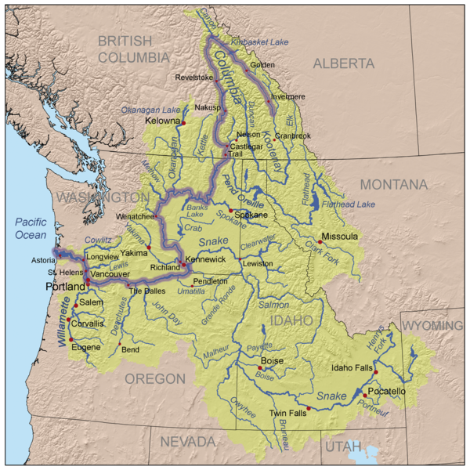
Columbia Basin Coordinated Anadromous Monitoring Strategy Workshop
Lower Columbia
Sub-Basin
October 20 & 21, 2009
Stevenson, WA

Slide 2
Outline
Background Information, e.g.:
    Number of MPGs
    Number of Populations
    Other
Factors that Affect the Strategy
    (e.g., landscape description, infrastructural opportunities, etc.)
Existing Work
    (Brief narrative describing overall level of effort)
Overall Strategy
    VSP
    BiOp Requirements
    Habitat Effectiveness
    Hatchery Effectiveness
Gaps and Adjustments

Slide 3
Lower Columbia
Number of MPGs – 3
Coast
Cascade
Gorge
Number of Populations – 111
Steelhead - 33
Chinook - 35
Coho – 25
Chum - 18

Slide 4
Desired Strategy
Recovery plan guides priorities
Monitoring template
  Annual GRTS or census–based surveys of natural and hatchery origin spawner abundance at population scale – facilitates productivity, diversity, & distribution assessments
  Annual GRTS-based snorkel surveys of juvenile densities at MPG scale (primarily coho and steelhead)
  IMWs where feasible
  Life cycle monitoring (adults in & smolts out) in at least one sub-watershed per MPG
  Assessment of survey methods above selected adult trapping sites to evaluate survey performance and provide calibrations (e.g. redd to spawner)
  Annual GRTS-based habitat surveys at MPG scale
  5 year GRTS-based habitat surveys at population scale

Slide 5
Gaps (Highest Priority)
Chum re-establishment monitor
Expanded juvenile outmigrant monitoring (more sampling locations higher precision)
Expanded fish in/fish out (ditto)
Expanded monitoring of abundance, distribution, & diversity of coho spawners GRTS-based steelhead redd surveys.
Periodic GRTS-based habitat monitoring at population scale in wadeable streams.
Habitat monitoring in non-wadeable streams.
Data management and access.
Improved understanding of accuracy harvest estimates
Expanded coded wire tagging for identification of hatchery origin

Slide 6
Additional Priorities
Maintain existing projects
  CWT recovery and analysis
  Hood River
  Chum monitoring (Washington)
Fund ISTM project
Coordination and identification of habitat effectiveness studies (e.g., Wind River)

