Slide 1
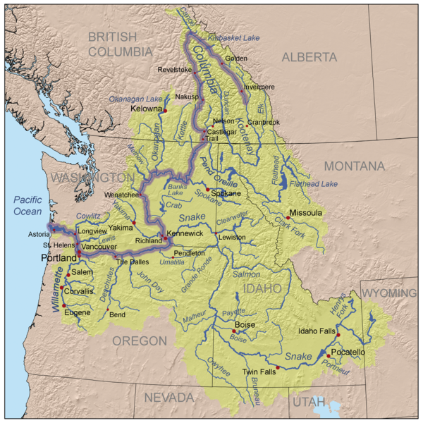
Columbia Basin Coordinated Anadromous Monitoring Strategy Workshop
Snake River
Sub-Basin
October 20 & 21, 2009
Stevenson, WA

Slide 2
Outline
Background Information, e.g.:
    Number of MPGs
    Number of Populations
    Other
Factors that Affect the Strategy
    (e.g., landscape description, infrastructural opportunities, etc.)
Existing Work
    (Brief narrative describing overall level of effort)
Overall Strategy
    VSP
    BiOp Requirements
    Habitat Effectiveness
    Hatchery Effectiveness
Gaps and Adjustments

Slide 3
1. Background Information
    Snake River Spring Summer Chinook ESU
    Number of MPGs = 7
    Number of Populations = 36 (includes Clearwater that’s not listed)

Slide 4
2. Factors that Affect the Strategy

Slide 5
3. Existing Work
VSP
  Extensive VSP monitoring, many are low precision, only few that are high precision
  High precision are mostly weir/count based
Habitat
  1 IMW
  Various past habitat assessments with inconsistent methodology
  Extensive flow and temperature monitoring
Hatchery effectiveness
  Johnson Creek, LSRCP, ISS, Idaho Power, Grande Ronde Imnaha supplementation, Tucannon supplementation
  Includes some reference populations, supplementation evaluation, and traditional hatchery effectiveness monitoring

Slide 6
4. Overall Strategy
VSP:
BiOp:
Habitat Effectiveness:
Hatchery Effectiveness:

Slide 7
5. Gaps and Adjustments

