Slide 1
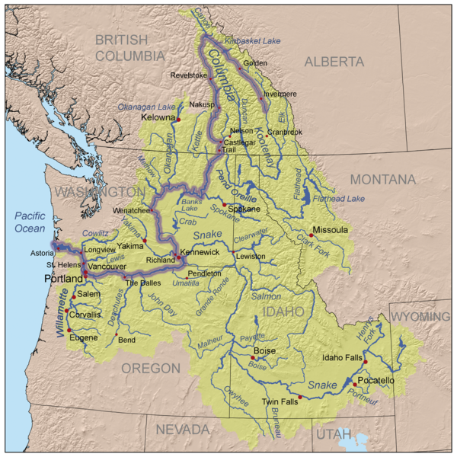
Columbia Basin Coordinated Anadromous Monitoring Strategy Workshop
Upper Columbia
Sub-Basin
October 20 & 21, 2009
Stevenson, WA

Slide 2
Outline
Background Information, e.g.:
    Number of MPGs
    Number of Populations
    Other
Factors that Affect the Strategy
    (e.g., landscape description, infrastructural opportunities, etc.)
Existing Work
    (Brief narrative describing overall level of effort)
Overall Strategy
    VSP
    BiOp Requirements
    Habitat Effectiveness
    Hatchery Effectiveness
Gaps and Adjustments

Slide 3
1. Background Information
MPG’s: 1 steelhead, 1 Chinook
Pop’s: 4 steelhead, 3 Chinook
Other: All are “must have viable” based on TRT criteria

Slide 4
2. Factors that Affect the Strategy
Infrastructure: 3 PUD’s;
  2 (coordinated HCP’s) and 1 settlement agreement.
  2 tribes (YN; CCT)
  Ongoing programs under the HCP’s, ISEMP, OBMEP, Recovery Plan
  Coordinated monitoring strategy (Hillman 2006)
  -standardized protocols
  UCSRB/ISEMP/OBMEP---coordinated data management

Slide 5
3 and 4. Existing Work and
Overall Strategy
VSP: abundance and spatial structure: census redd surveys; dam counts & radio telemetry;
Productivity: smolt traps; abundance and bio-data from carcass surveys and trap/dam broodstock collection
Diversity: genetics for most pops through HCP
Habitat Effectiveness: Population level randomize design status and trend are being executed in the Okanogan and Wenatchee. Expanded IMWs to get at specific treatment type impacts at the reach scale are underway in the Entiat (ISEMP) and Methow (USBR).
Hatchery Effectiveness: HCP hatchery evaluation programs, detailed studies ongoing.
  RSS- Wen Spr Chk & stlhd; Okan Stlhd
  kelt reconditioning in Okanogan;

Slide 6
Overall Strategy: Cont.
Biop Requirements: are addressed and incorporated into the UC RM&E Strategy.
Maintain VSP monitoring
Supporting fish in and fish out for VSP and habitat effectiveness
Supporting IMW and integrated habitat monitoring for habitat effectiveness through ISEMP and BOR studies
Kelt reconditioning
Methow Steelhead RRS
Development of local broodstock (upstream of Wells)

Slide 7
Gaps and adjustments:
RPA workgroup recommendations are consistent with sub-regional highest priority gaps
(see tables 1 &2)
VSP
1) increase accuracy and precision of smolt estimates
2) increase pit tags and detection arrays
3) estimate precision and accuracy of redd surveys
4) radio tracking for steelhead
Other: Methow Habitat Status and Trend (wait until we learn more from other subbasins;

