Slide 1
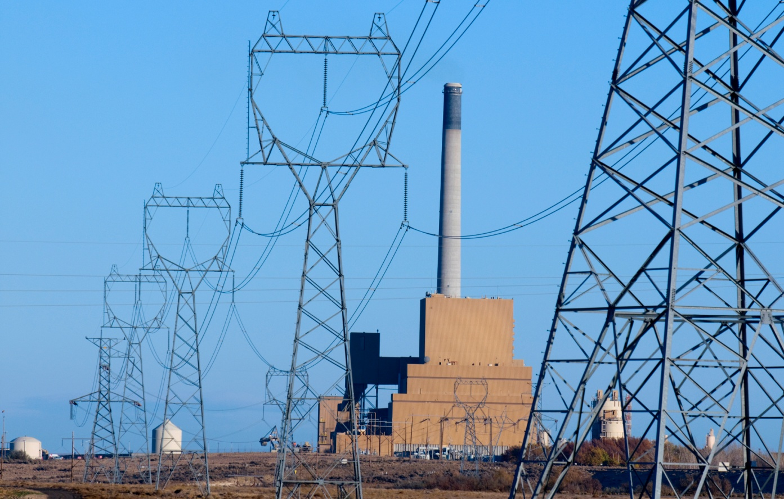
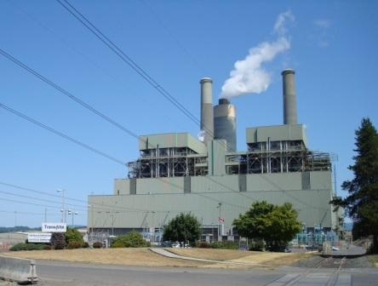
Announced Coal Unit Retirements: Effect on Regional Resource Adequacy
Centralia
Boardman
Council Meeting January 16, 2013
Portland, Oregon

Slide 2
Assignment
At the October Council meeting, Member Rockefeller asked:
‘How will the announced closure of coal units at Boardman and Centralia in 2020 affect regional resource adequacy?’

Slide 3
Analysis Performed
Assessed regional resource adequacy in 2021 after Boardman and Centralia 1 are closed
Estimated how much additional dispatchable resource capacity is needed to make the regional power system adequate¹ ¹The Council’s adequacy standard sets a maximum limit of 5 percent for the power supply’s loss of load probability.

Slide 4
Summary of Projected Changes From now to 2021
Changes that Increase Need | Notes
Net Load Growth | 1,210 MWa or 0.6% growth rate, with 2,900 MWa of EE savings removed¹
Boardman Retires | 510 MWa² (601 MW nameplate)
Centralia 1 Retires | 620 MWa² (730 MW nameplate)
¹Percent of load growth met with EE is 71%.
²Assuming an 85% availability factor for coal-fired plants.

Slide 5
Sixth Plan Target Efficiency Levels
Year | Incremental Savings (MWa) | Cumulative Savings from 2010 (MWa) | Cumulative Savings from 2013 (MWa)
2010 | 200 | 200
2011 | 220 | 420
2012 | 240 | 660
2013 | 260 | 920 | 260
2014 | 280 | 1,200¹ | 540
2015 | 300 |  | 840
2016 | 320 |  | 1,160
2017 | 340 |  | 1,500
2018 | 350² |  | 1,850
2019 | 350 |  | 2,200
2020 | 350 |  | 2,550
2021 | 350 |  | 2,900
¹Council’s target for 2014 is 1,200 MWa. ²EE savings past 2017 are limited by assumed ramp rates.

Slide 6
Summary of Projected Changes From now to 2021
Changes that Reduce Need | Notes
Hydro Upgrades | 350 MWa
Thermal Resources | 115 MWa¹ (124 MW nameplate)
RPS Resources | 1,200 MWa (4,000 MW nameplate)
¹Assuming a 92% availability factor for gas-fired turbines.

Slide 7
Generating Resource Additions In the Analysis (Cumulative)

Slide 8
Loss of Load Probability
-1,130 MWa Coal (1,330 MW)
+ 1,840 MWa New (2,000 MW)
+1,210 MWa Load +115 MWa Gas +350 MWa Hydro +1,200 MWa Wind

Slide 9
Conclusions
2021 adequacy without Boardman, Centralia 15.3% LOLP
Additional dispatchable resource capacity needed to bring LOLP back to 5%: 2,000 megawatts

Slide 10
Planned Resources Not in the Analysis (Cumulative)
Source: PNUCC

Slide 11
Additional Slides

Slide 12
Adequacy Milestones
Year LOLP
2013 < 5%
2015 5%
2017 6.6%
2021 with coal units 8.3%
2021 without coal units 15.3%
2021 without coal, with 2,000 MW 5%

Slide 13
Results
Step | Description | LOLP
0 | 2017 LOLP | 6.6%
1 | 2021 LOLP with Boardman and Centralia | 8.3%
2 | 2021 Without Boardman and Centralia | 15.3%
3 | 2021 Without Boardman and Centralia With 2,000 MW new dispatchable capacity | 5.0%

