Slide 1
Cost-effectiveness for Fish Tagging: Some Concepts
Independent Economic Analysis Board (IEAB)
John Duffield, U Montana
Susan Hanna, OSU
Daniel Huppert, U Washington
William Jaeger, OSU
Roger Mann (Chair), RMann Economics
Noelwah Netusil, Reed College
JunJie Wu, OSU
Tony Grover, Director F&W Division
Council Coordinator

Slide 2
Cost effectiveness analysis:
Generally: compares alternative activities that achieve similar outcomes, but at different costs
For fish tagging: there are multiple desired outcomes (quantitative indicators addressing management questions) and multiple possible activities (technologies)

Slide 3
Start with the simplest case
Simple example: indicator Z requires 1 million tags/yr
  Technology A: 1 million tags/yr costs $5m/yr
  Technology B: 1 million tags/yr costs $3m/yr
  If data (quality) is similar, B is more cost-effective than A -- $3/tag versus $5/tag
Notes:
Segue…but with fish tagging it’s not that simple…..there are a number of complicating factors…

Slide 4
Complication #1:
Costs involve fixed and variable costs
  Fixed costs are independent of # of tags (infrastructure to produce tags, tag fish, retrieve tags, compile data, etc.)
  Variable costs vary with # of tags (tagging, retrieving)
Example:
Hypothetical costs:

Slide 5
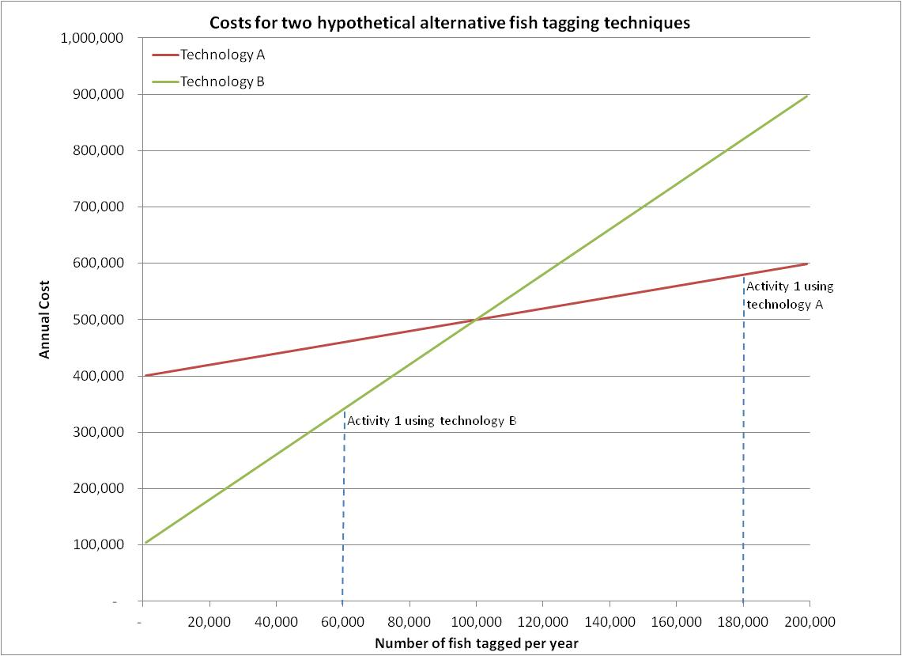
When fixed and variable costs differ:
Notes:
For activity 1 (needing 60,000 tags) technology B is more cost-effective, but not if 180,000 tags are needed.

Slide 6
Complication #2:
Some activities can share technologies, and therefore share costs (economies of scale)
Example:
  Activity 1 uses technology A
  Activity 2 uses technology B
  Activity 3 uses technology C

Slide 7
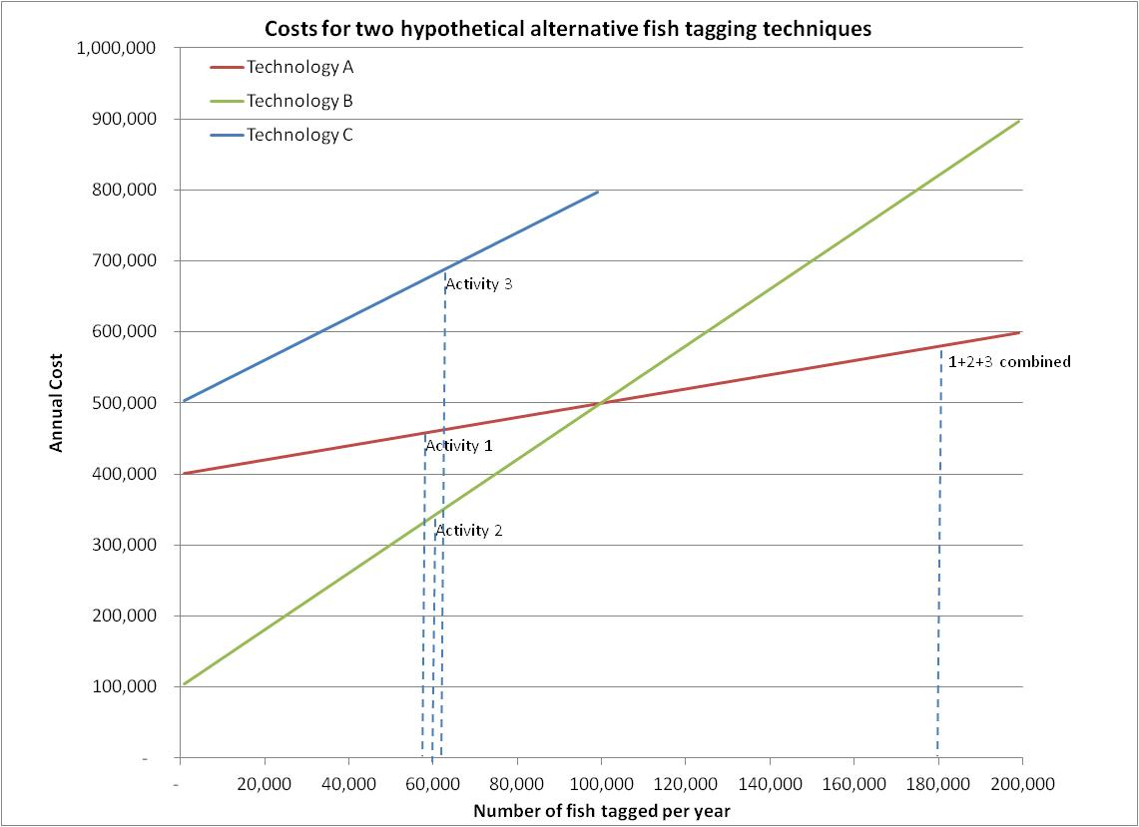
Combining activities can be cost effective
Notes:
If multiple activities use the same technology, then fixed costs are lower, as is total cost

Slide 8
Economists think of “inputs and outputs”:
Level 1: Data (raw) is collected
Level 2: Indicators are estimated/computed
Level 3: Management questions are addressed
Another way to look at it: to achieve outcomes:
Specific activities (data collection & processing) are undertaken
Technologies are chosen for each activity

Slide 9
Complication #3:
Data quality may differ across activities, depending on the indicator and management question at issues,
so the number of tags needed to adequately answer a given question will differ across technologies
Example: 1m tags for technology A equals 0.5m tags using technology B (when estimating indicator x for species z at confidence interval j)

Slide 10
Quantifying Inputs, Outputs, and Their Linkages
Use one or more technologies a, b, c, d, e, f
To compute indicators 1, 2, 3, 4, 5
To address questions A, B, C, D, E, F, G, across species and geography
Incurring costs for each technology
While recognizing:
  data quality and other differences among technologies
  # of tags needed is function of technology
Notes:
Suggest you use concrete (oral) examples for these letters and numbers as much as possible. If don’t use slide 3 (production function terminology) can substitute “activities, outcomes” for “inputs, outputs” in this slide title

Slide 11
A model or matrix can help us “organize what we know” about these interconnected options:
Fixed and variable costs for each technology
Ability (productivity) of each technology in producing desired indicator
  For each relevant type of tag
  For each species and location
Quality differentiation by technology
Relative importance of questions
Information about priorities

Slide 12
IEAB proposed approach
Where appropriate, work alongside/with FTF process
Assemble cost information; estimate future costs for alternatives
Frame cost-effectiveness questions, and produce a flexible “model” for evaluating alternative combinations of technologies
Make model, analyses available to others
Notes:
Bullet 2: provide an oral example?
Conclude with comment about what’s in it for them – how they could benefit from this information

Slide 13
There can be levels connecting data, indicators, management questions, and “higher level” questions:
Population status recovery
Abundance
Data A
Data B
Composition
Data C

