Slide 1
Some observations on interpreting fish tagging costs
– and model development updates
Bill Jaeger
IEAB & Oregon State University
March 19, 2013

Slide 2
Current model version: tag/detections for juvenile & adult dam passage, SAR (no harvest recovery, escapement detections)
– with 100 detections required at major dams
tag/detections for juvenile & adult dam passage
SAR
no harvest recovery, escapement detections yet
100 detections required to estimate survival between major dams

Slide 4
How can we interpret data on PIT tag costs per tag, or per detection, or per unique detection?
For this model result, “binding” detection requirements = 7,200
But total tags inserted are 2.4 million, at a cost of $9.4 million .

Slide 5
“Activity” cost estimates – current numbers in IEAB programming model

Slide 6
Harvest tagging: Cost tradeoff between marking, sampling, recovering (data)

Slide 7
Harvest tagging: Cost tradeoff between marking, sampling, recovering (data) – part II

Slide 8
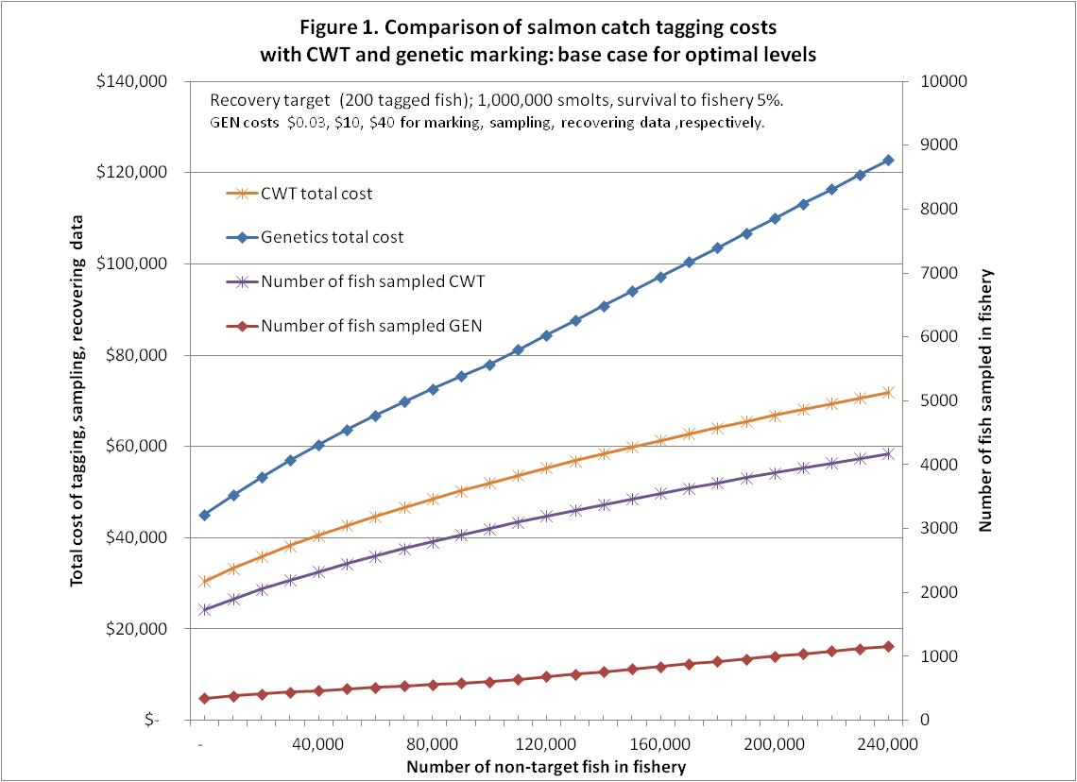

Slide 9
