Slide 1
Genesys Shell development
Input-side development progress

Slide 2
Genesys Shell development
Why update the shell?
  Incorporate additional features in Genesys
  Move away from unsupported add-ons
Input side
  Manage numerous input files
Output side
  Manage and present results

Slide 3
Genesys Shell development
What exactly does the shell do?
  Interfaces with an input database – user can view and change the input parameters
  Writes to and saves changes to the database
  Creates input files formatted for Genesys and based on data in the input database

Slide 4
Genesys Shell development
Appearance of shell is mostly unchanged
Some new inputs and forms added
  Wind, specific water and load year sequences
Remaining tasks for input side
  Finish up file-writing for all input files
  Incorporate convenience features like toolbar buttons and context menus, adjust the layouts and screen size
  Error checking

Slide 5
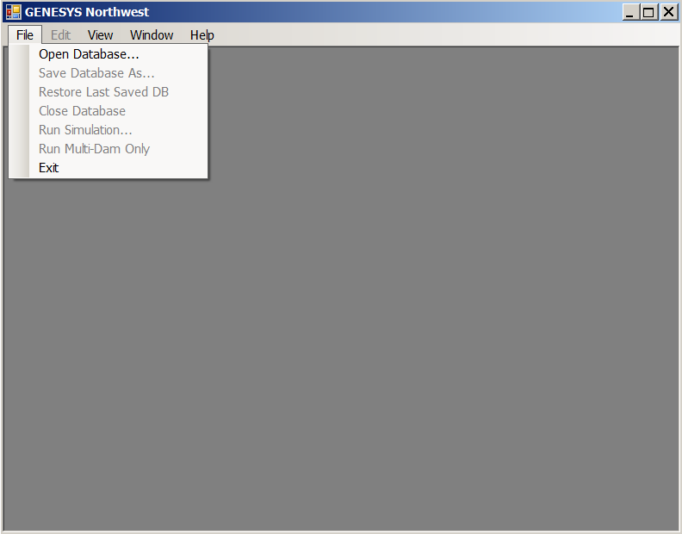
Genesys Shell development
The start up screen is the same. Some menu items are not available (greyed out) unless a database is loaded.
Menu items that are applicable to the output side of the shell, while present, are not yet active.

Slide 6
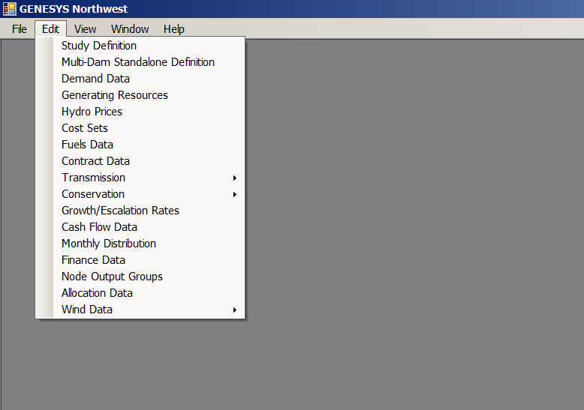
Genesys Shell testing
Once a database is opened, the Edit menu is active.
The “Edit” menu is basically the same as in the previous version, with the addition of wind.

Slide 7
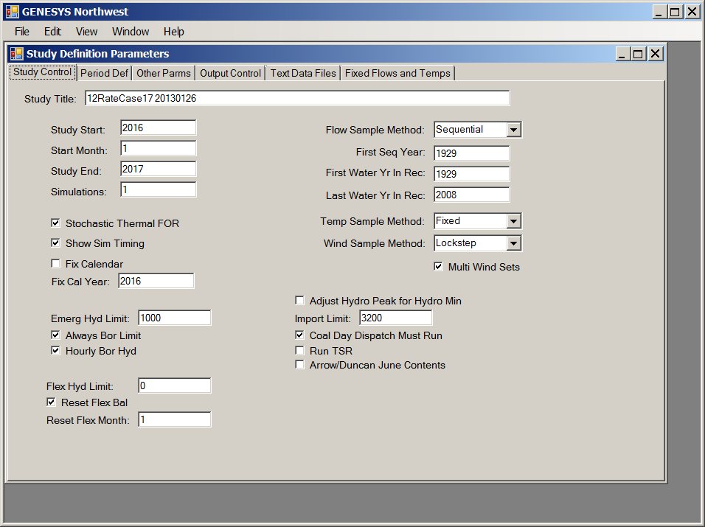
Genesys Shell development
The Study Definition form has a few new inputs and an additional tab, but otherwise it is quite similar to the earlier version.
Each of the tabs has groups of related inputs.
May continue to rearrange some items for a better layout

Slide 8
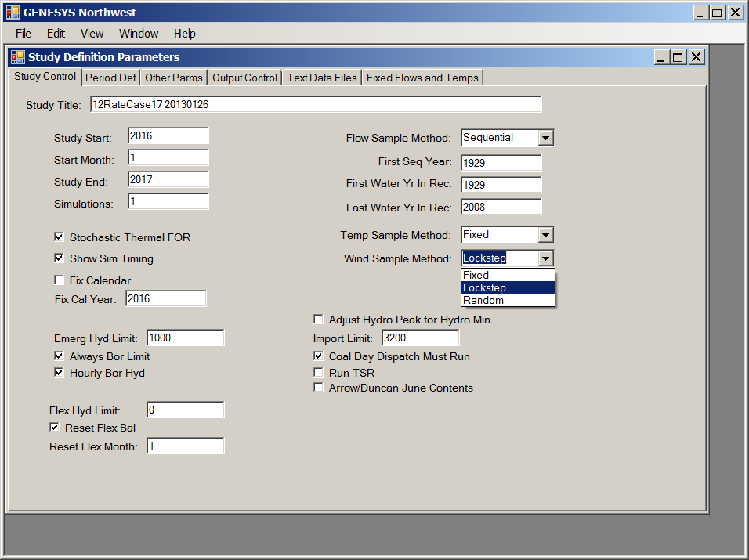
Genesys Shell development
The input fields may be restricted to specific values (e.g. “drop-down” inputs are linked to other tables of values).
“Textbox” input fields may have restrictions on the data type (number) and the range that can be entered

Slide 9
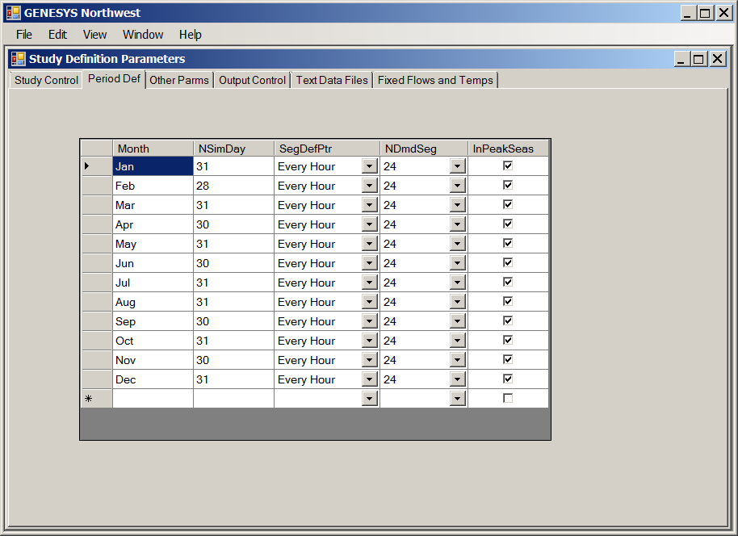
Genesys Shell development
Most screens have been designed to be as close as possible to the previous version of the shell.
This one for the period definition is identical to the previous version

Slide 10
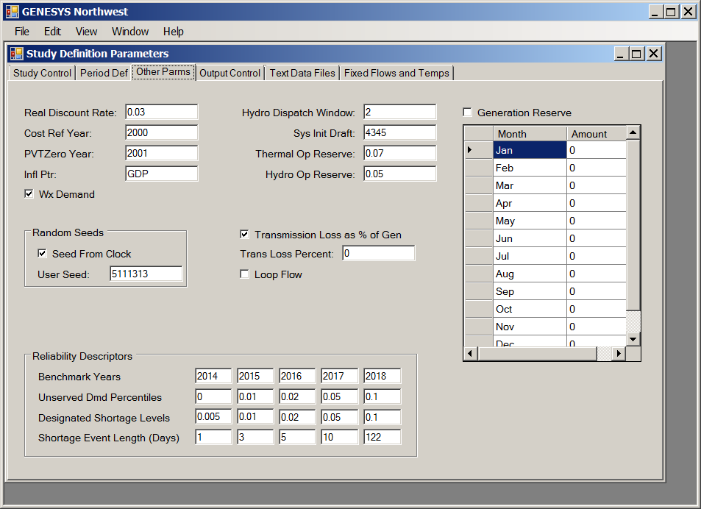
Genesys Shell development
The Other Parms tab has several new items – the transmission losses and the monthly generation reserves

Slide 11
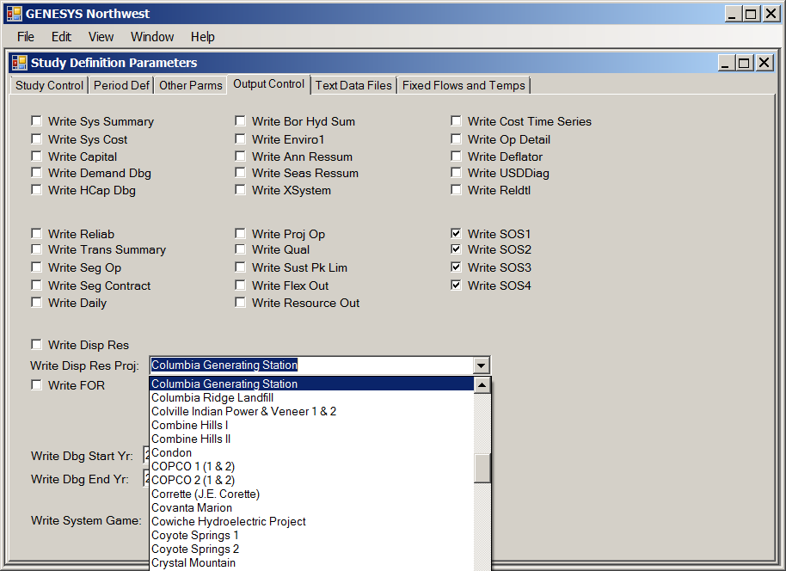
Genesys Shell development
The Outputs tab serves the same purpose as before – picking the desired output files. There are a few new options.
Note the example for writing dispatch info for a specific generating resource – to facilitate selection of the resource, the input field is linked to the list of resource names, and the user can select from the list rather than typing in a name (this helps to eliminate errors)

Slide 12
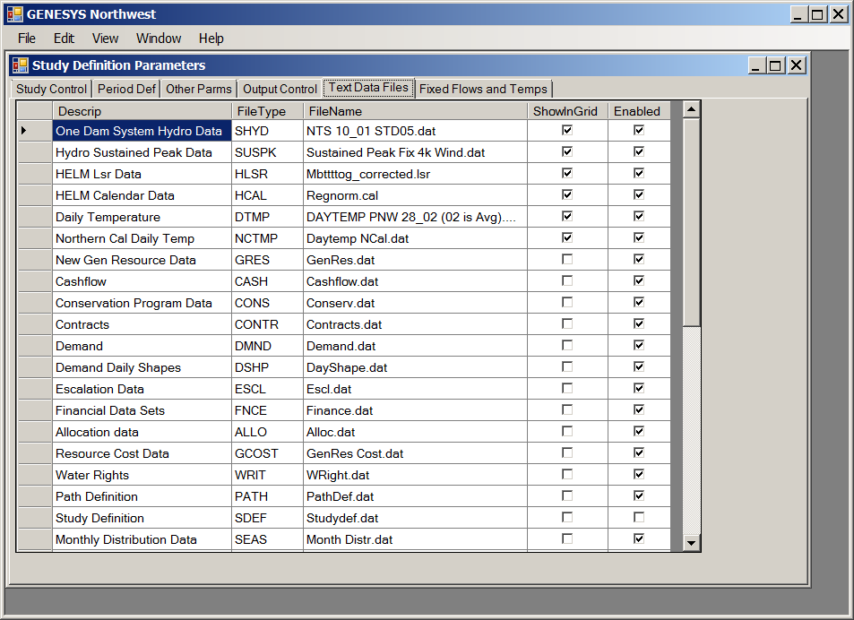
Genesys Shell development
The file list tab is pretty much the same – there are additional files required for new Genesys features are listed toward the end of the file list.
Additional file management features (e.g. the ability to browse for a file) are planned.

Slide 13
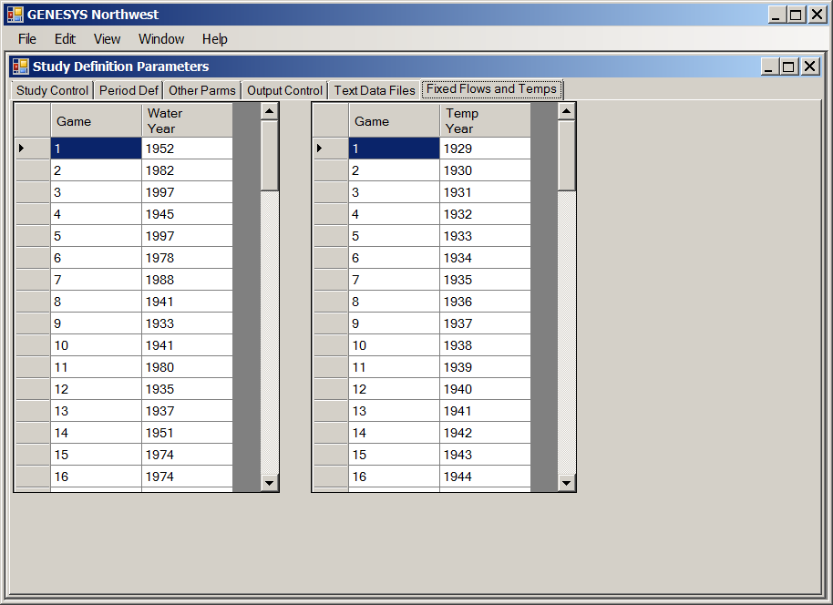
Genesys Shell development
New screens, like this one for the specific (fixed) sequence of water and/or load years are included as new tabs or new menu items
For “grid” type inputs, context menus for copy/paste facilitate bringing in large amounts of data from a spreadsheet.

Slide 14
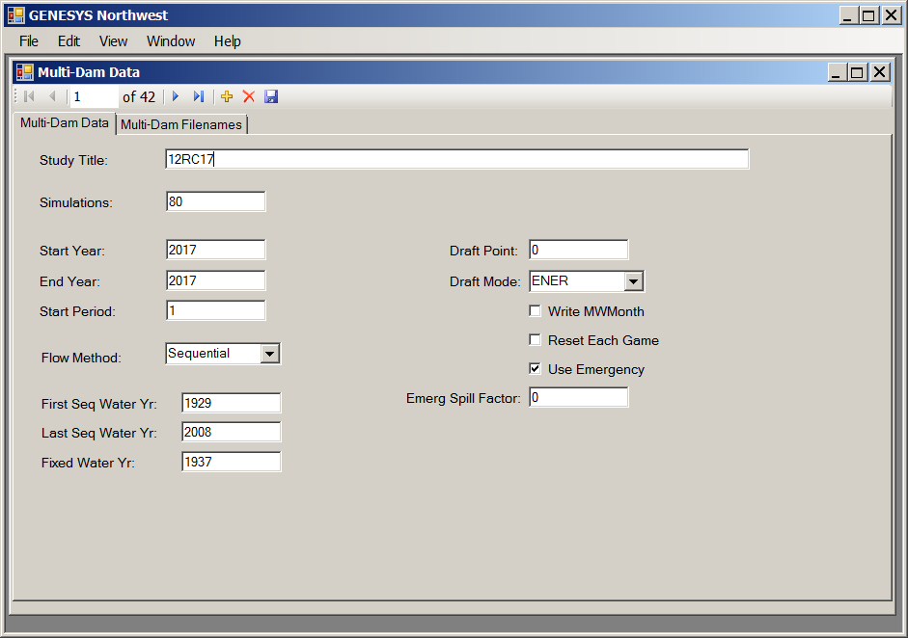
Genesys Shell testing
The screen for the multi-dam data has fewer tabs than before.
Previously, there were several tabs for Hydsim utilities, which shall be addressed in a separate menu item.

Slide 15
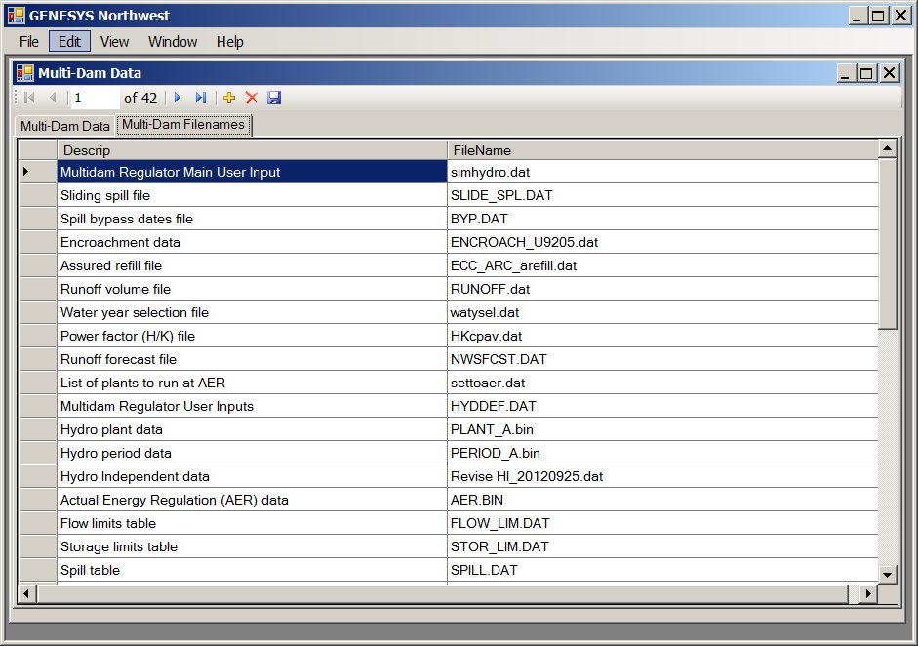
Genesys Shell testing
The multi-dam files tab is unchanged from the previous version.
Additional file management features (e.g. browse for filename) are planned.

Slide 16
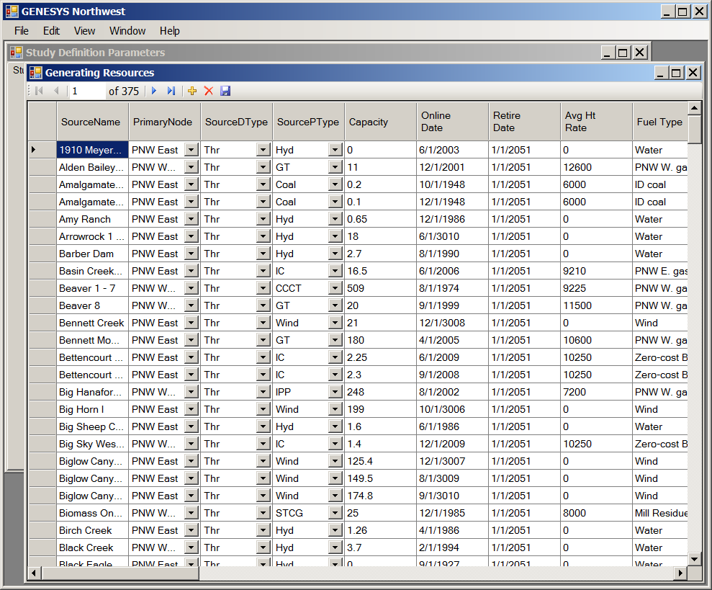
Genesys Shell testing
This screen for editing the generating resources is essentially unchanged (there are several new columns)

Slide 17
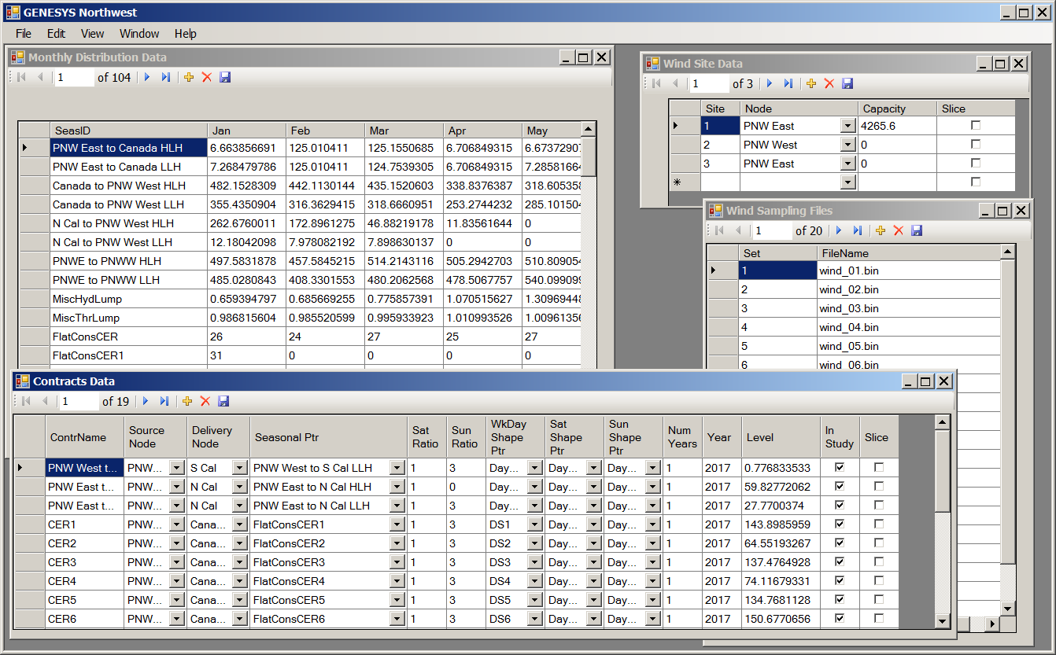
Genesys Shell testing
As in the previous version, multiple forms may be opened and worked with at a time.
Changes to forms can be saved to the database when the form is closed.

Slide 18
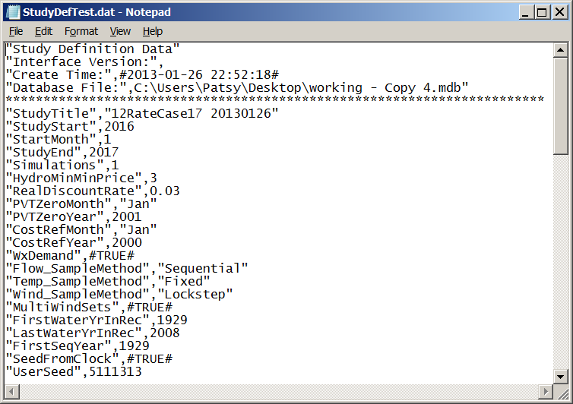
Genesys Shell development
Besides management of changes to inputs, the shell updates the database and writes out the files in the correct format for Genesys

Slide 19
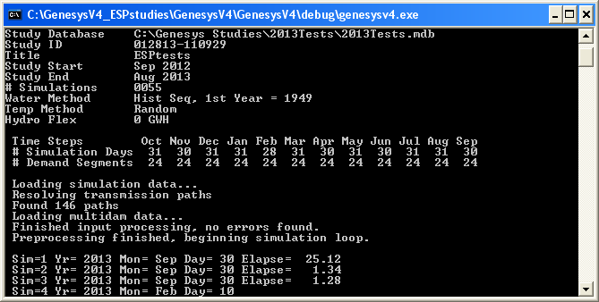
Genesys Shell development
Program execution is carried out in the same method as the previous version – by clicking the “Run Simulation” menu item or toolbar button

Slide 20
Genesys Shell development
What about the output side?
  Intent is to develop with focus on the results required for the State of the System report
  For graphical results, exploring methods to open an instance of Excel rather than using third-party graphing utilities

