Slide 1


Genetic tagging technology for the management of hatchery and wild Chinook salmon and steelhead in the Columbia River basin
Matthew Campbell (IDFG) and Shawn Narum (CRITFC)
Presentation to the
Fish Tagging Forum
Northwest Power and Conservation Council
February 9th, 2012
Idaho Department of Fish and Game
Columbia River Inter-Tribal Fish Commission

Slide 2
Genetic Tools for managing and conserving salmon and steelhead populations
Long history of using genetic tools to study salmonids
  Variety of applications
    Determine distinct population segments and ESUs
    Evaluate hatchery impacts on wild stocks
    Parentage analyses to test fitness
    Identify local adaptation
    Determine candidate genes underlying specific traits
    Stock Assessment
      Genetic stock identification (GSI)
      Parentage based tagging (PBT)

Slide 3
PBT is a relatively new technology but GSI has been in use for several decades
GSI studies began with BPA funding in the 1970’s with the intent of identifying stock proportions in mixed stock fisheries
Studies have continued over the years and developed further as technology has advanced enabling estimates of individual fish origins (genetic markers and statistical procedures)
Coastwide there are many on-going projects using GSI technology to address conservation and management issues
  Distribution, migration, harvest patterns of adult salmon in ocean fisheries (e.g., project CROOS 2007; Habicht et al. 2007; Moran and Tuttle 2011)
  Survival and migration patterns of juvenile Chinook salmon and sockeye salmon in the estuary and ocean (e.g., Teel et al. 2009; Tucker et al. 2009; Daly et al. 2011; Seeb et al. 2011)
  In-river harvest and dam passage (Winans et al. 2004; Narum et al. 2008; Hess et al. 2011)

Slide 4

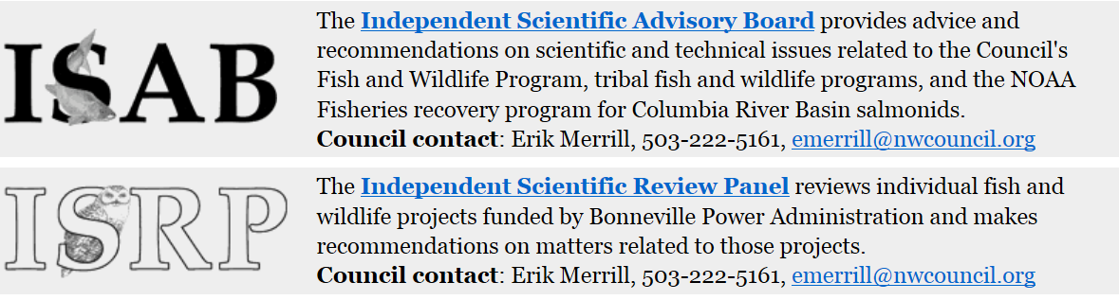
Introduction
In 2008/2009 the Council requested that the ISRP and ISAB complete a comprehensive review of Columbia River Basin fish tagging technologies and programs. As part of that review, the Council requested how, through its Fish and Wildlife Program, to best encourage the development and use of new, innovative tagging technologies to address program RM&E needs

Slide 5
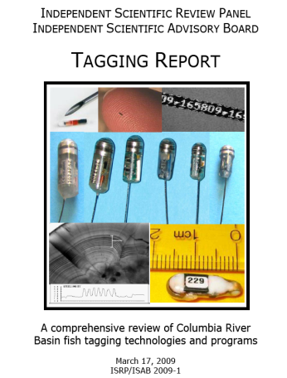
Introduction
In response to this request, the ISRP/ISAB completed the “Tagging Report” and indicated that two genetic tagging methods (Genetic Stock Identification and Parentage Based Tagging) offered the potential to augment, or in some cases replace, CWT data to address basin-wide questions related to harvest and hatchery management. Recommendations regarding the development evaluation of these genetic tagging technologies included:
The endorsement of the development of standardized single nucleotide polymorphism (SNP) marker sets for all Columbia River salmon and steelhead ESUs for GSI purposes
The endorsement of pilot and proof-of-concept trials for Parentage Based Tagging of hatchery populations of salmon and steelhead

Slide 6
Overview
Our presentation today will summarize the BPA funded genetic projects that CRITFC and IDFG has worked on over the last several years that use these technologies and specifically address recommendations from the tagging report.
Parentage Based Tagging (Campbell)
  What is it?
  How does it work?
  What advantages does it have over other tagging methods?
  Overview of IDFG/CRITFC PBT project in the Snake River basin on PBT (BPA funded project)
Genetic Stock Identification (Narum)
  What is it?
  How does it work?
  Overview of CRITFC/IDFG GSI projects in the Columbia and Snake River basins

Slide 7
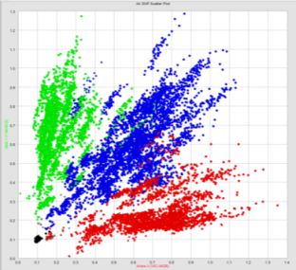
Parentage Based Tagging in the Snake River Basin:
Evaluation and Implementation

Slide 8
Parentage Based Tagging
In the “Tagging Report” the ISRP/ISAB indicated that a new genetic tagging technology called Parentage Based Tagging had the potential to provide the same types of information now obtained using the CWT system.
“This approach has the potential to provide information sufficient for cohort reconstruction and stock-age-fishery exploitation rates.”

Slide 9
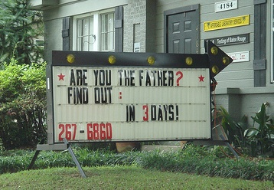
What is Parentage Based Tagging?
Parentage-based genetic tagging - PBT
(Anderson and Garza 2005)
Parentage-based tagging uses similar DNA techniques as those used in human parentage testing

Slide 10
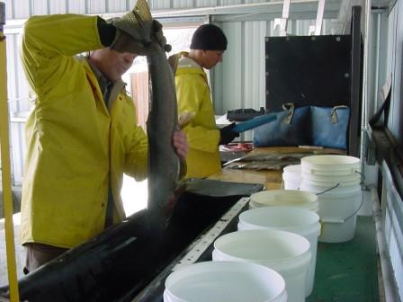
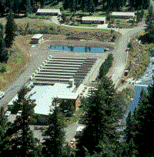
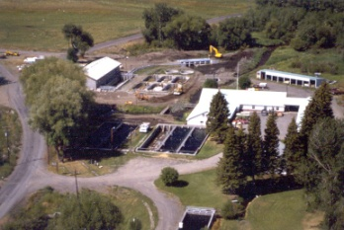
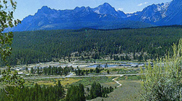
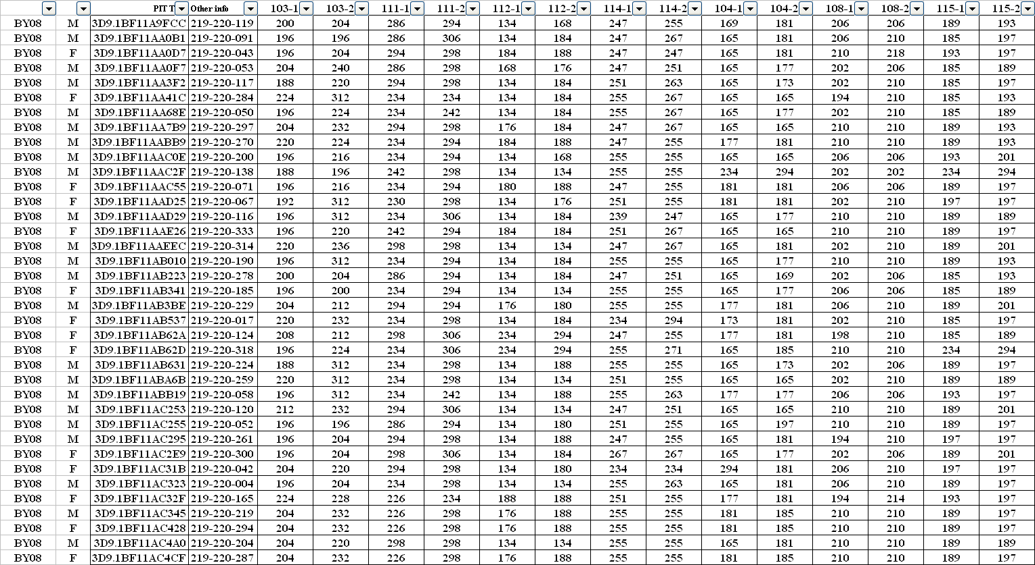
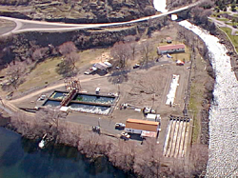
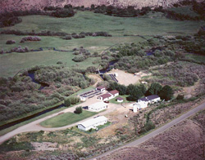

Genetic information can be obtained from all hatchery fish (broodstock) that are spawned
Wallowa
Lookinglass
Sawtooth
Oxbow
Pahsimeroi
Dworshak/Clearwater

Slide 11
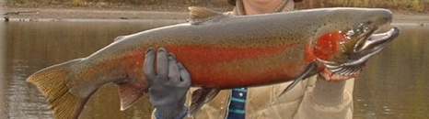
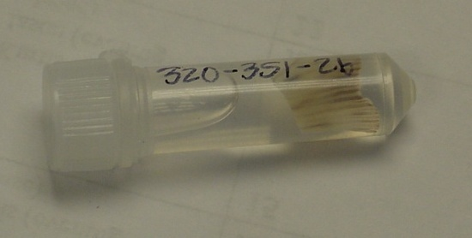
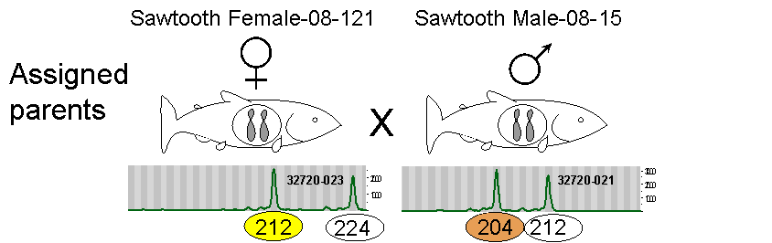
Offspring from any of these parents (either collected as juveniles or returning adults) could be assigned back to their parents, thus identifying their origin and age
Sawtooth BY2008

Slide 12
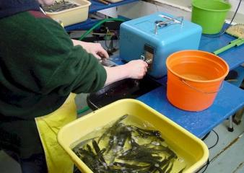
Benefits of PBT
Provides same information as CWTs (stock and cohort)
  Run reconstruction (age, sex, stock of returning adults)
  Harvest estimates
Tag recovery rates vastly improved over other methods (90-100% tagging rate of hatchery fish)
Many issues associated with other tagging methods eliminated
  Tag loss
  Tag detectability
  Handling mortality
  Differential mortality

Slide 13
Additional benefits of PBT
PROS:
It is a passive mark (no handling of juveniles needed)
“Tagged” offspring can be non-lethally interrogated at any stage in their life cycle
  Fin-clip
  Scales
  Biopsy hook

Slide 14
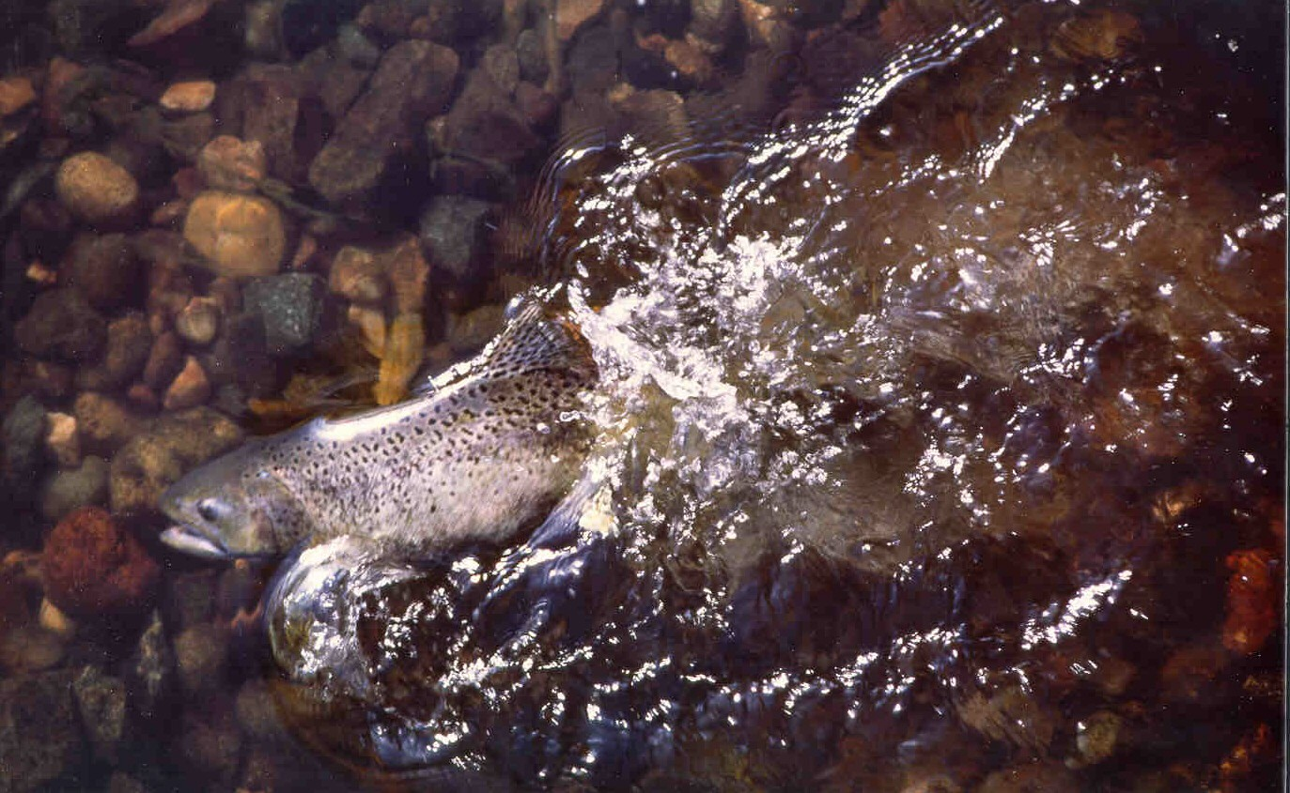
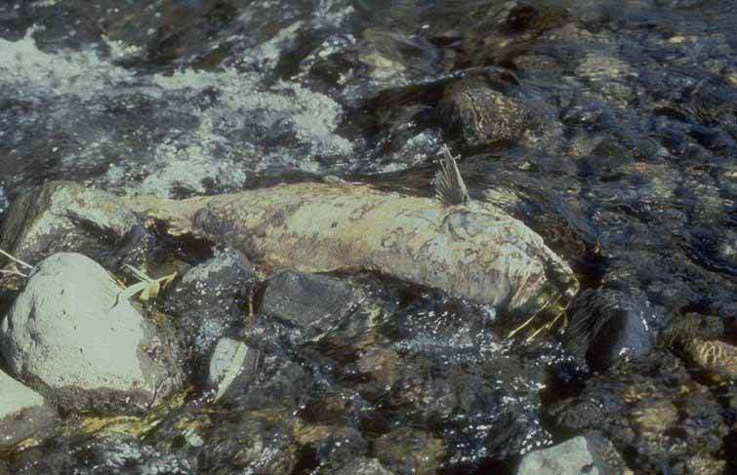
Versatility of PBT
PROS:
These qualities make it highly versatile
Can potentially provide much more information than stock and cohort of origin
Can be used to address a host of other life history, ecological and quantitative genetic questions

Slide 15

Examples of where you might like to non-lethally interrogate “tagged” fish:
Versatility of PBT
• Origin of hatchery juveniles sampled and/or used in other studies
Identify hatchery stock, sex
Differentiate unclipped hatchery juveniles from wild juveniles

Slide 16
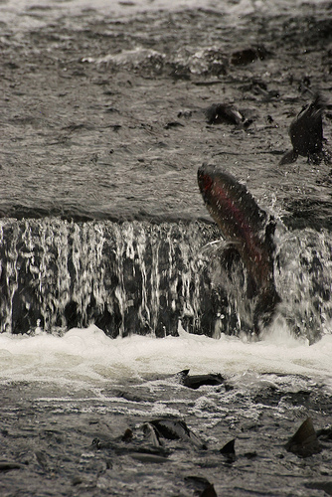
Examples of where you might like to non-lethally interrogate “tagged” fish:
Versatility of PBT
• Origin of adult salmon and steelhead passing dams
PBT program can easily be integrated into existing sampling/genetic programs at Bonneville & L. Granite Dams
Where are they from?
Stock specific run-timing?
How old are they?
Sex ratio?

Slide 17
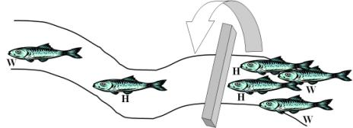
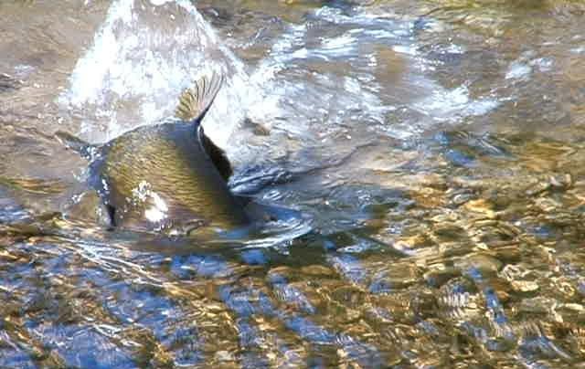
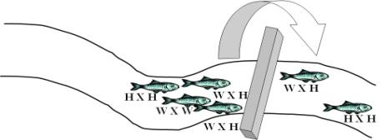
Examples of where you might like to non-lethally interrogate “tagged” fish:
Versatility of PBT
• Hatchery reform (Integrated programs)
What is the reproductive success of hatchery-origin/wild-origin spawners?
(both in the wild and in the hatchery)
Hatchery reform (Segregated programs)
Concern that straying hatchery fish reduce the fitness of wild populations
Is it possible to manage a hatchery program so that it is truly “segregated” from wild populations?
PBT technology can identify where straying hatchery fish were released, their stock of origin, and age

Slide 18
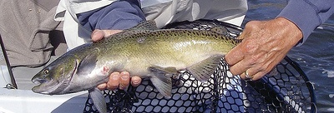
Versatility of PBT
• Heritability estimates
To what extent are physical or behavioral traits (e.g. size and age of returning adults) controlled by genetics, environment or interactions between the two?
Are hatchery spawning practices selecting for younger age at maturity in hatchery Chinook salmon populations
Hankin et al (2009) recommended that in the hatchery male length ≥ female length
Notes:
Hankin et al 2009 recommended that in the hatchery male length ≥ female length.

Slide 19
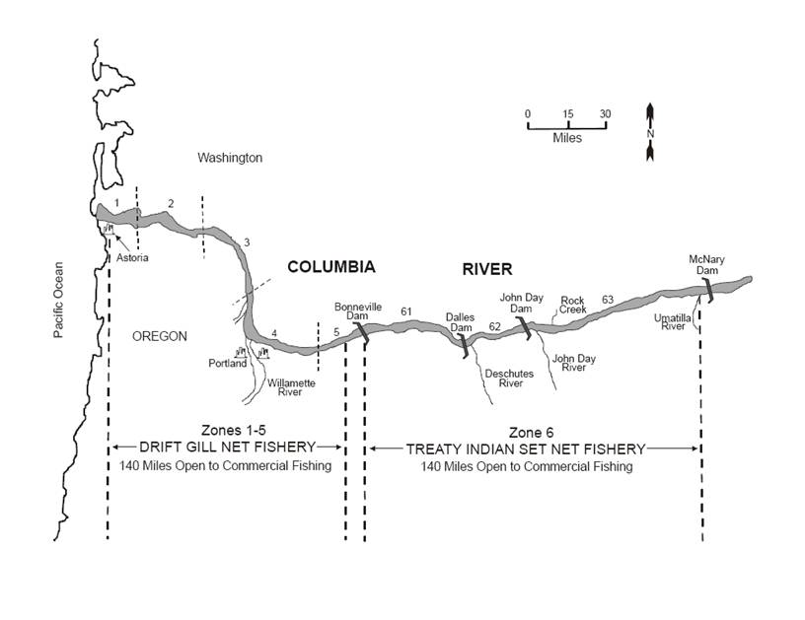
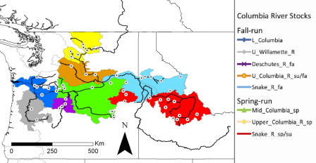
Versatility of PBT
• PBT program can easily be integrated into existing sampling/genetic programs for fish harvested in lower Columbia & Zone 6 fisheries (CRITFC)
Expect much higher tag recovery rate than with CWTs due to 90-100% tagging rate of hatchery fish
Bonneville Chinook weekly stock composition
(2004-2006)

Slide 20
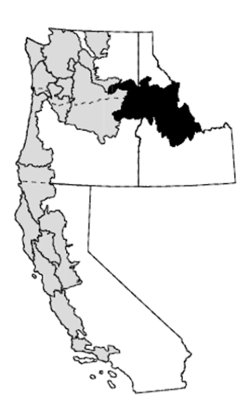
PBT sounds great!!!....
However, it has been largely theoretical up to this point…
Needs to be empirically tested and validated on a large scale
Snake River ESU

Slide 21

As mentioned previously, these types of evaluations have been directly called for by both the Pacific Salmon Commission and the Independent Scientific Review Panel and Advisory Boards

Slide 22
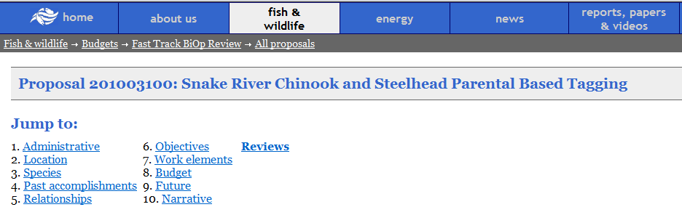
Snake River Chinook and Steelhead Parentage Based Tagging-Proposal #201003100
Perfect timing to conduct a large-scale test of this technology in the basin….

Slide 23
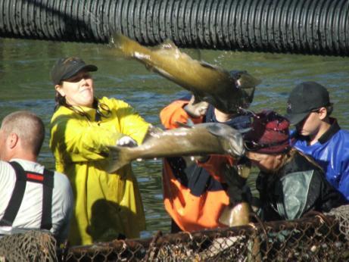
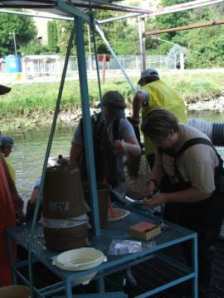
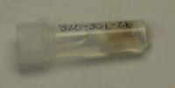
Support from multiple agencies and hatchery managers throughout ID, WA, OR for broodstock sampling:
  (8 hatcheries, both species-steelhead and spring/summer Chinook salmon
  ~15,000 samples a year

Slide 24
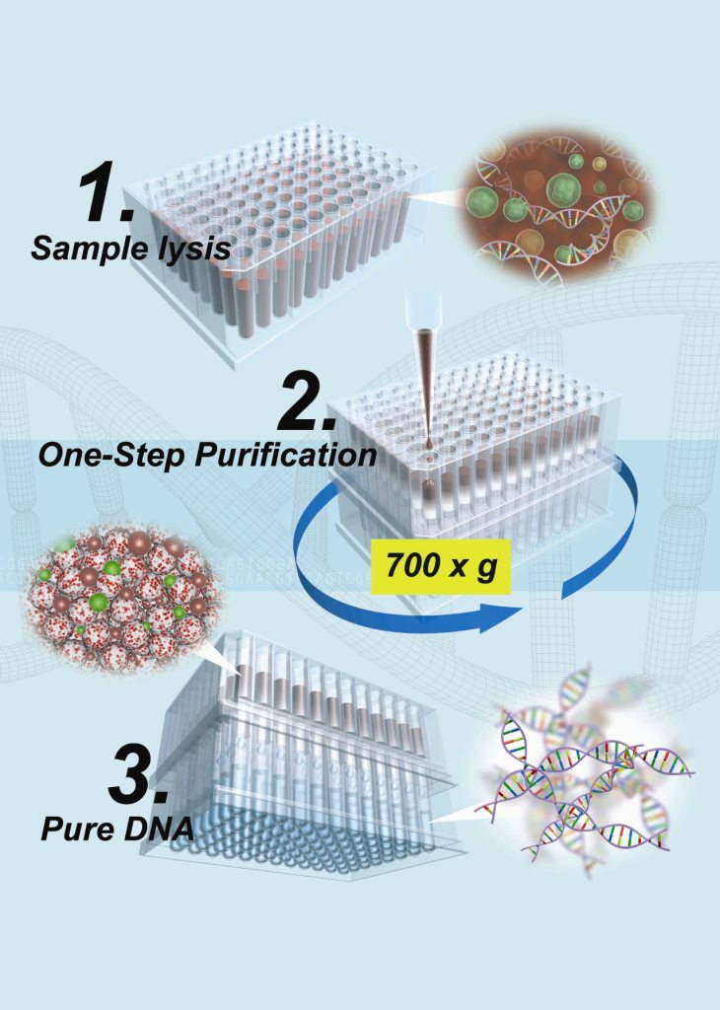
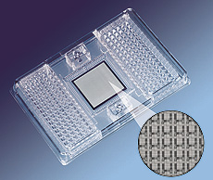

Advancements in genetic technology:
New genetic instruments and techniques allow more samples to be run at a quicker rate and for lower costs
96 samples genotyped for 96 SNPs
in each run!
Notes:
Genetic advancements allow us to sample and screen fish much faster and at a reduced cost

Slide 25
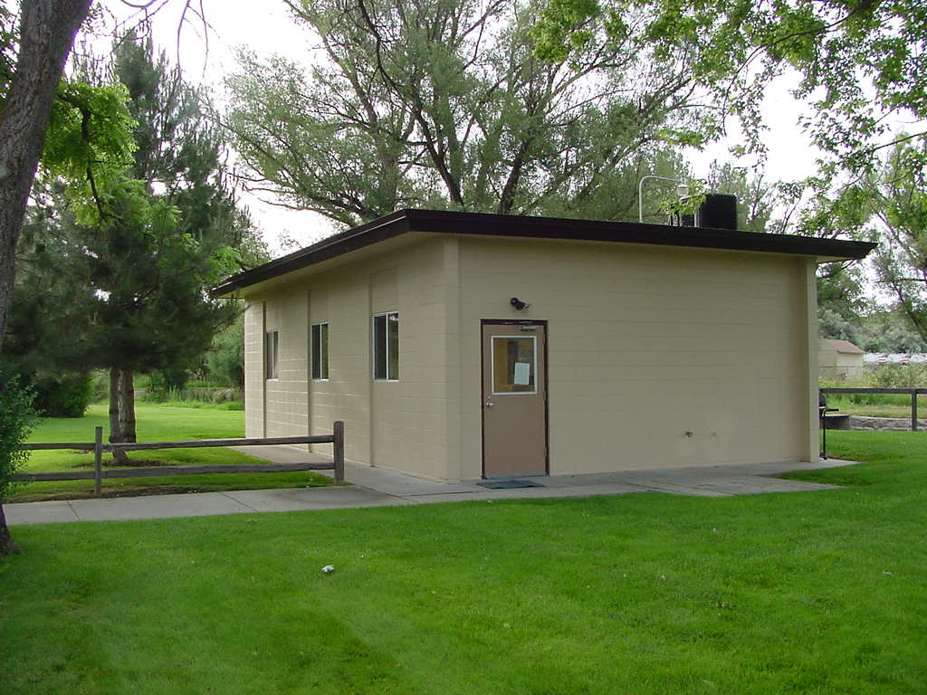
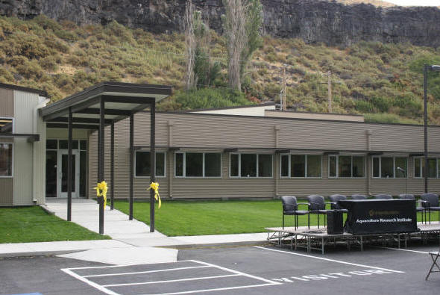
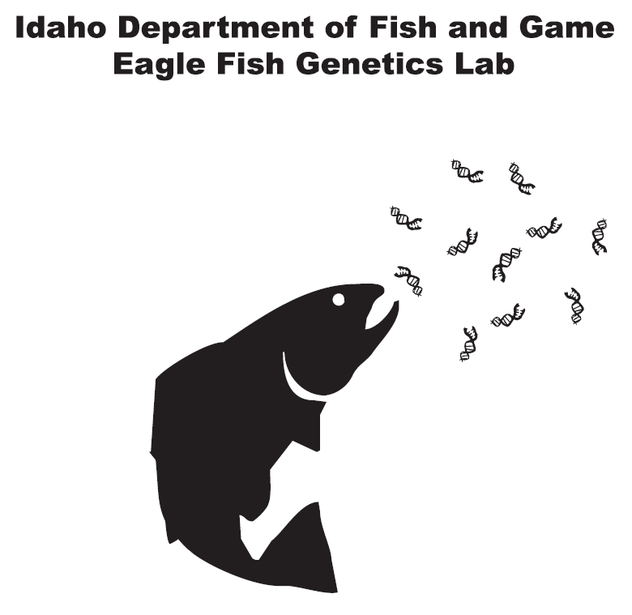

Strong collaboration among labs and the ability to standardize genetic marker sets:
Allows multiple labs to process samples and share data
Eagle Fish Genetics Lab
Eagle, ID
Collaborative Center for Applied Fish Science
Hagerman, ID

Slide 26
Objectives for PBT project:
Annually sample tissue from all hatchery Chinook and steelhead broodstock in the Snake River basin.
Concern:
ISRP/ISAB and some geneticists wondered if it was logistically feasible to sample the large numbers of broodstock required for PBT.
Identify a sufficient number of SNP loci for both Chinook salmon and steelhead that will provide a false negative rate of less than 10% (meaning that 90% of PBT-tagged fish could be assigned to parent pairs) and a false positive rate of less than 1% (meaning that less than 1% of PBT tagged individuals would be assigned to an incorrect parent pair).
Concern:
Although simulations suggested that 60-100 SNPs would be necessary to achieve high assignment success and accuracy, this had not been demonstrated empirically. Special concern was for highly related stocks that were not genetically distinct.

Slide 27
Objectives for PBT project:
Integrate SNP marker sets for PBT and GSI in the Snake and Columbia River basins for both steelhead and Chinook salmon.
Concern:
PBT marker sets may not be able to contribute to GSI baselines.
Complete genotyping requirements: Construct the first PBT baselines in the Snake River basin
Concern:
Huge genotyping workload, standardization among labs.

Slide 28
Objectives for PBT project:
Demonstrate the utility of PBT in addressing multiple research questions and management issues throughout the Snake and Columbia River basins for both steelhead and Chinook salmon.
Concern:
Utility of this technology needs to be demonstrated beyond simple “tagging” fish.

Slide 29
  What progress have we made thus far in meeting these objectives?

Slide 30
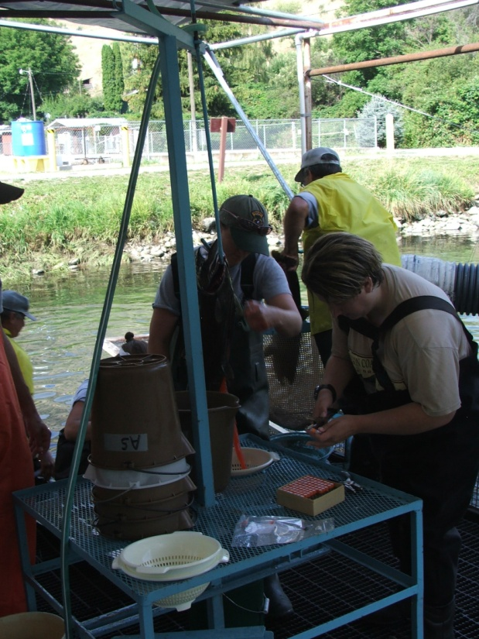

PBT sampling:
PBT Sampling completed for SY2008-SY2011
>20,000 hatchery steelhead (~5K per year)
>35,000 hatchery Chinook salmon (~9K per year)
All hatcheries record spawn dates, sex
Many hatcheries provide length and spawn cross
*Estimated

Slide 31
How many fish are we tagging?
Steelhead
Of all of the steelhead that migrate out of the Columbia River each year ~70% are hatchery fish
14.9 million hatchery steelhead released in the Columbia River basin each year
Of these, 9.1 million are Snake River origin (~61%)
The 14.9 million hatchery steelhead are probably produced from only ~9500 total parents!
Spring/Summer Chinook salmon
Of all of the spring/summer Chinook salmon that migrate out of the Columbia River each year >70% are hatchery fish
36.2 million hatchery spring/summer Chinook salmon released in the Columbia River basin each year
Of these, 12.4 million are Snake River origin (~34%)
The 36.2 million hatchery spring/summer Chinook salmon are probably produced from only ~30,000 total parents!
Snake River spring/summer Chinook salmon represent ~12% of all hatchery Chinook salmon

Slide 32
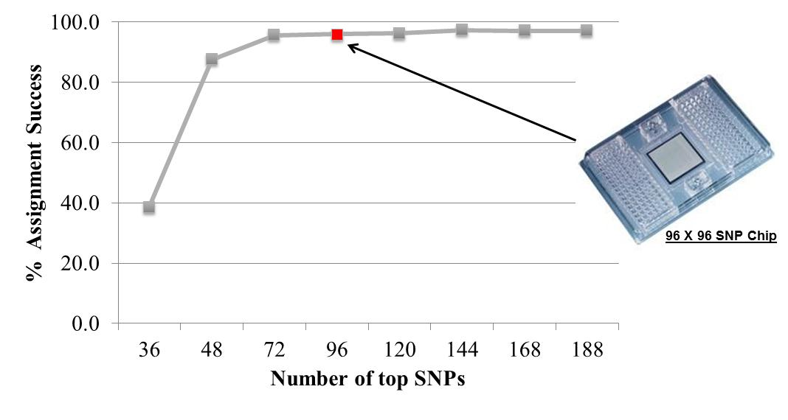
Single Nucleotide Polymorphic (SNPs) marker development:
2010/2011: We identified 96 SNP marker sets for both species that provide sufficient power for accurate parentage assignments
Same 96 SNP marker set developed for spring/summer Chinook salmon also demonstrated to be equally powerful in Fall Chinook (broodstock sampling for PBT at Lyons Ferry & NPTH successfully completed in 2011)
Even when tens of thousands of possible parents are included!!!

Slide 33
Demonstrating accuracy:
PILOT STUDY – Steelhead Results
Results: SNPs
High number of juveniles assigned (97.3%)
100% accuracy to stock
Hatchery Stock | Juveniles Genotyped | Juveniles Assigned |  | % assigned correctly to stock
Squaw Crk | 92 | 92 |  | 100.0%
Sawtooth | 93 | 91 |  | 100.0%
Dworshak | 93 | 93 |  | 100.0%
EF Salmon | 94 | 88 |  | 100.0%
Pahsimeroi | 93 | 88 |  | 100.0%
G.R. Cott. | 93 | 91 |  | 100.0%
Lyons Ferry* | 93 | 0 |  | ----
* Test for Individuals with no parents in the database

Slide 34
Demonstrating accuracy:
Evaluating False Positives
  Pilot study :
Tried to assign Lyon’s Ferry individuals (93) to non-parents (1205)
Resulted in no false assignment of the 93 Lyon’s Ferry individuals
  Experimental Assignments:
Tried to assign 2008 broodstock (5107) to 2009 broodstock (5672)
Resulted in no false assignment of the 5107 individuals broodstock

Slide 35
Demonstrating accuracy:
Single Nucleotide Polymorphic (SNPs)
Another way of considering the power of these current SNP marker sets:
Event | Odds
Death and Taxes | 1:1
Being born with an identical twin | 1:90
Having appendicitis | 1:488
Being dealt a royal flush | 1:649,350
Being killed by lightning | 1:2,320,186
Winning the Powerball jackpot | 1:196,078,431
Avg. odds of 2 Chinook salmon having same genotype at 96 PBT SNPs | 1:6,880,000,000,000,000,000,000,000²³
Avg. odds of 2 Steelhead having same genotype at 96 PBT SNPs | 1:418,000,000,000,000,000,000,000,000,000²⁹

Slide 36
SNP marker set integration and standardization:
For both species, a single 96-SNP marker set was identified for PBT purposes.
These same sets of markers are also useful for GSI projects and used in conjunction with a second set of GSI SNP markers to provide additional resolution and accuracy.
This integration of SNPs allows stock composition of wild fish sampled in the Columbia River to be determined as well as stock composition and cohort of any sampled Snake River hatchery fish.
Our PBT SNP set for Chinook salmon overlaps with 93/96 (~97%) of SNPs being evaluated by U of W/WDFW for PSC use range-wide.
Inter-lab (CRITFC/IDFG) SNP standardization and accuracy checks have demonstrated >99.8% genotyping concordance.

Slide 37

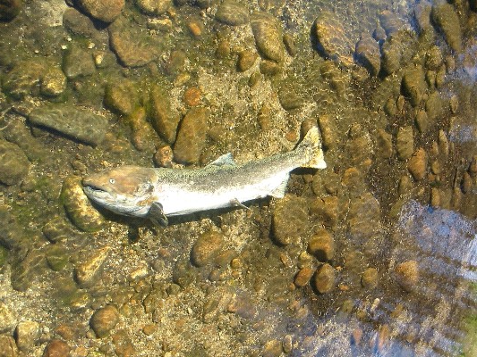
Some additional notes on current SNP sets:
Steelhead sex marker 98.4% accurate on known sex adults.
Chinook salmon sex marker 96.1% accurate on known sex adults.
Initial testing indicates that the steelhead SNP set is very powerful in detecting intraspecific hybridization and introgression (hybridization from non-native rainbow trout).
Genotyping success of 96 PBT SNPs on Chinook carcass samples stored in ethanol was 85.9% (IDFG, unpublished data)
  Other published studies also indicate high genotyping success on carcass samples (Baumsteiger and Kerby 2011; Copeland et al. 2009; Campbell and Narum 2008)

Slide 38
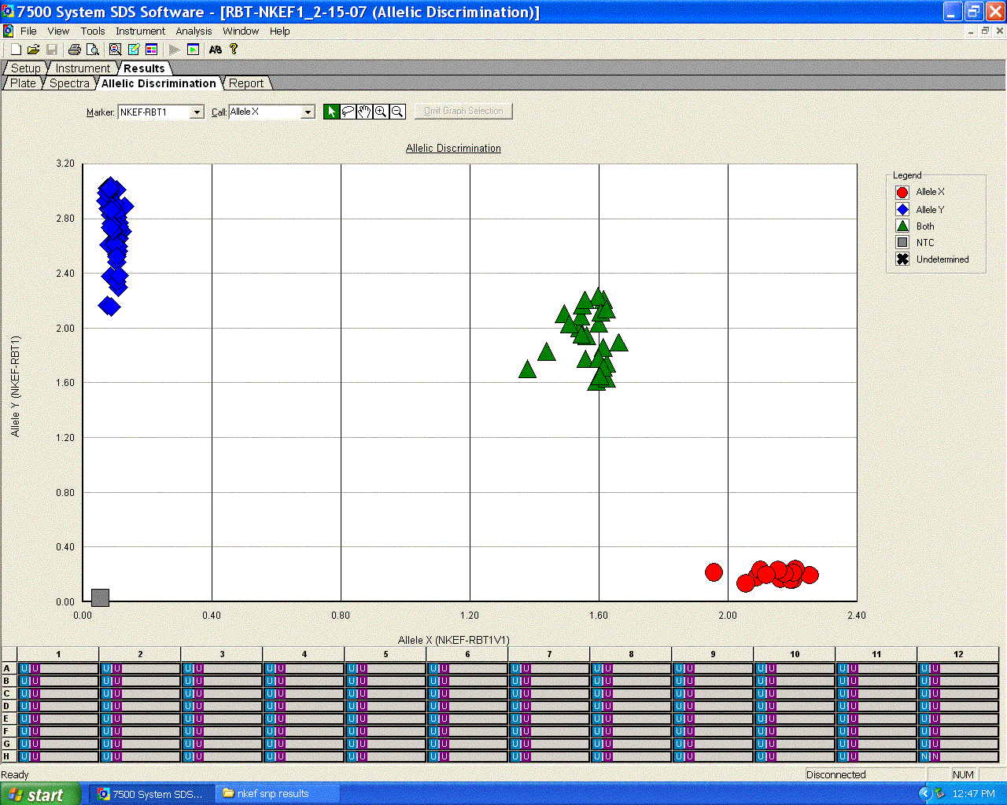
Snake River Basin PBT genotyping Milestones:
FY2011 - Genotyped 2008 and 2009 broodstock for :
Chinook salmon-
2008 = 10,630/10,836 = 98.1%
2009 = 8,188/8,849 = 92.5%
Steelhead-
2008 = 5,070/5,151 = 98.4%
2009 = 5,636/5761 = 97.8%
FY2012 – Genotyping 2010 and 2011 broodstock for:
Chinook (2010 = 8,400, 2011 = underway)
Steelhead (2010 = ~5,700; 2011 = ~5,700)

Slide 39
Demonstrating the utility of PBT:
  Projects utilizing PBT baselines in 2011
    Origin of hatchery strays
    Origin of hatchery kelts
    Juvenile outmigrants
Upcoming work
  L. Columbia & Zone 6 fisheries
  Stock composition of steelhead hatchery adults over Bonneville & L. Granite Dam

Slide 40
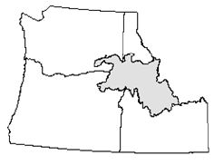
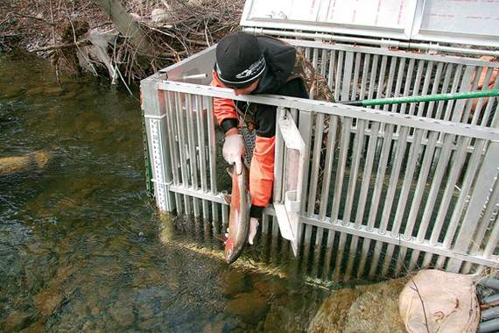
Origin of hatchery steelhead strays in the Deschutes R. USFWS/Abernathy lab (Smith and Hawkins)
115 hatchery steelhead were captured at two tributaries with adult weirs in the Deschutes River in 2011 (Bakeoven and BuckHollow Creeks)
Objective: Determine origin of 3 yr old hatchery strays
Parentage assignment to 2008 PBT baseline
Deschutes River
Weir on Buckhollow Creek
Smith et al. 2011

Slide 41
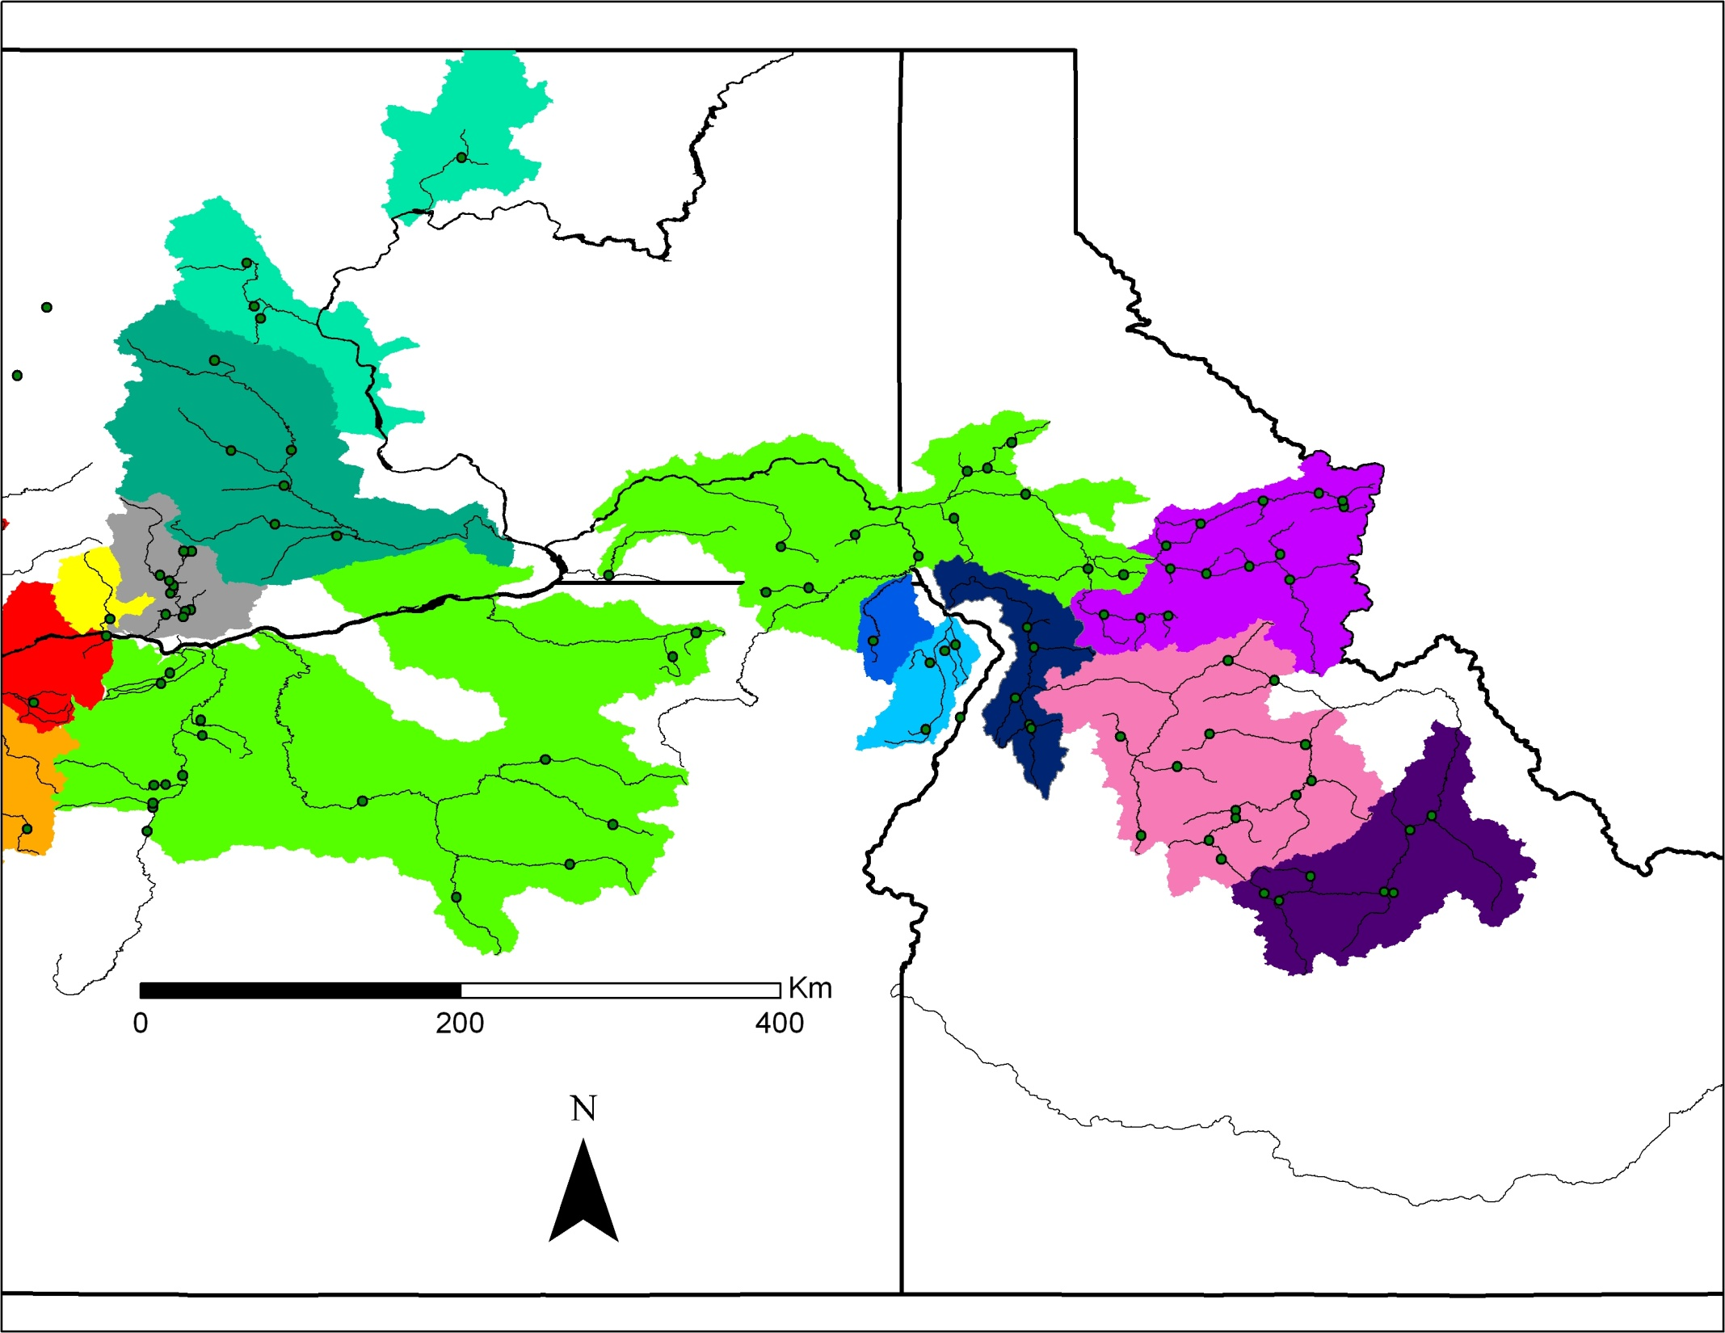
Of the 115 hatchery-origin returns, 37 (~32%) assigned to the 2008 Snake River basin PBT baseline
Pahsimeroi contributed ~73% of Snake River strays, full-sibling identified
Dworshak, n=1
Pahsimeroi, n=27
Grande
Ronde, n=1
Bakeoven
Deschutes
Oxbow, n=5
Squaw Creek, n=1
Sawtooth, n=2
Smith et al. 2011

Slide 42
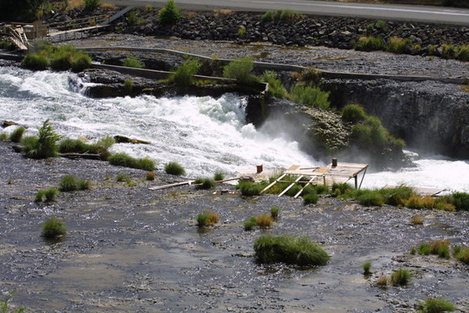
Origin of hatchery steelhead strays in the Deschutes R. (cont.)
ODFW/CRITFC
462 hatchery steelhead sampled at Sherars Falls, Deschutes River in 2011
(unknown portion of 3 year old genetically tagged fish)
Portion of strays from the Snake River basin?
Snake River basin
2008 PBT baseline
Deschutes River
Steelhead sampled by Rod French ODFW and genotyped by CRITFC
Sampling continuing in 2012
Hess et al. in prep

Slide 43
Of the 462 hatchery-origin returns, 138 (~30%) assigned to the 2008 Snake River basin PBT baseline
Pahsimeroi contributed ~24% of Snake River strays
Dworshak, n= 29
Pahsimeroi, n= 33
Grande
Ronde, n= 1
Sherars Falls
Squaw
Creek,
n= 7
Oxbow, n= 36
Sawtooth, n= 31
EFSR, n= 1
Hess et al. in prep

Slide 44
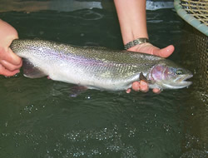
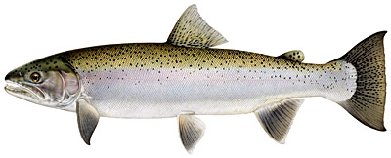
Origin of Hatchery Kelts (IDFG)
403 hatchery kelts genotyped from LGR (spring 2011)
  139 Assigned (34.5%)
  264 Unassigned (65.5%)
Steele et al. in prep

Slide 45
Unassigned fish expected:
PBT sampling of broodstock started in 2008
No parents in PBT baseline for 2-ocean fish, 4 year old adults
Missed some early Dworshak egg-takes in 2008
Broodstock sampling from Grande Ronde stocks (Wallowa, Little Sheep) didn’t start until 2009
Broodstock sampling for Lyons Ferry, Touchet, and Tucannon stocks didn’t start until 2009
Steele et al. in prep
X

Slide 46
PBT Assigned kelts:
139 Assigned (no mismatches)
Dworshak (BY2008) 4 (2.9%)
G.R.-Cottonwood(BY2008) 15 (10.8%)
Oxbow (BY2008) 18 (12.9%)
Pahsimeroi (BY2008) 48 (34.5%)
Sawtooth (BY2008) 53 (38.1%)
Sawtooth (BY2009) 1 (0.8%, 540 FL; June 27th)
-matched cross records, early return for SY2012?
Steele et al. in prep
X

Slide 47
Interesting results thus far:
All Snake River hatchery stocks are contributing to kelt production
Some initial evidence that Pahsimeroi, Sawtooth and Oxbow stocks may contribute disproportionally
Evidence that Grande Ronde stocks may be contributing substantially to kelts (G.R.-Cottonwood contributed 10.8% of assigned kelts but only represented 2.8% of run)
 | Expected | PIT/LGR | Observed | Kelts
Pahsimeroi | 26,308 | 51.1% | 48 | 40.3% | -10.8%
Sawtooth | 14,506 | 28.2% | 53 | 44.5% | 16.3%
Oxbow | 10,625 | 20.7% | 18 | 15.1% | -5.5%
 | 51,439 |  | 119
Steele et al. in prep
X

Slide 48
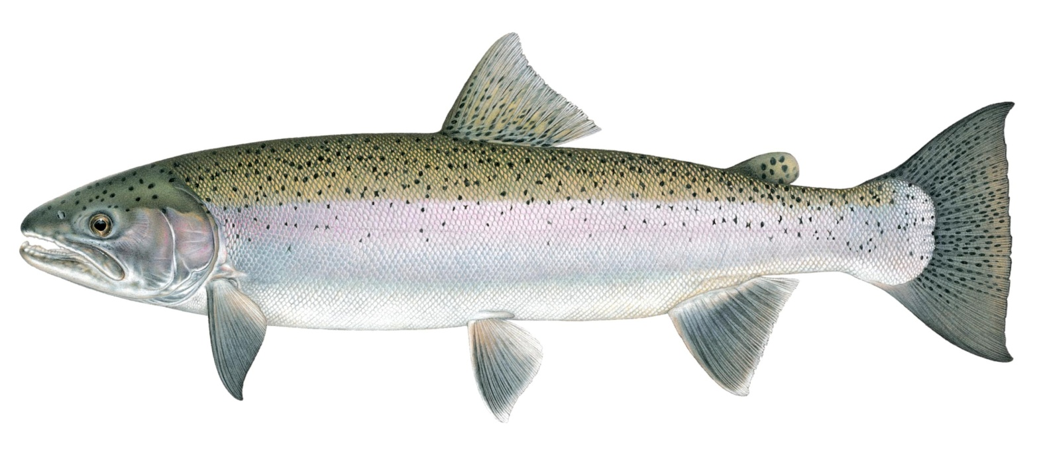
Tracking to release site…
Starting with BY2011 most kelts can be tracked to release site:
Clearwater/Dworshak (BY2011) – 7 release sites:
  Meadow/Peasley Cr.
  Red House Hole
  Newsomse Cr.
  Clear Crk.
  Lolo
  Little Salmon R.
  Dworshak
Pahsimeroi – 5 release sites:
  Colston Corner
  Shoup Bridge
  Red Rock
  Little Salmon R.
  Pahsimeroi
Sawtooth – 3 release sites:
  Yankee Frk.
  McNabb Point
  Sawtooth
Oxbow – 2 release sites
  Little Salmon R.
  Hells Canyon Dam
Upper Salmon B – 1 release site
  Squaw Crk./Pahsimeroi
E. Frk. Natural Stock – 1 release site
  E. Frk. Trap
Steele et al. in prep

Slide 49
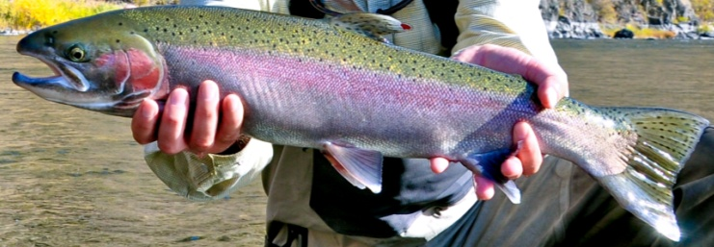
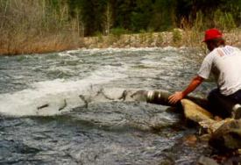

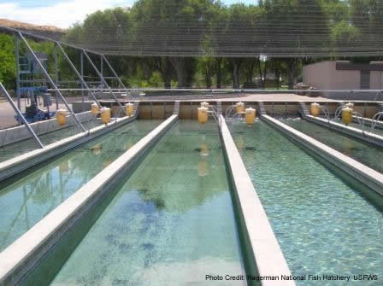
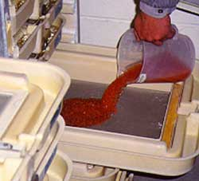
Ultimate goal:
All hatchery salmon and steelhead hatchery in the Columbia River basin!!!!
http://www.flickr.com/photos/natekay/4319654380/sizes/o/
Identify parents
Stock and age
Where it incubated
Where it reared
Where and when it was released
SEX
Diet
Disease
Rearing density
Temperature
Sawtooth Fish Hatchery
This will require the development of similar types of databases that currently exist for CWTs and PIT tags.

Slide 50
Costs of Expanding PBT
Current Snake River PBT funded at ~$1 million annually
Approximately $45-50/sample
Expanding PBT for Columbia R. basin (parent genotyping)
  Steelhead estimate: ~$250K
  Spring Chinook estimate: ~$1 million

Slide 51
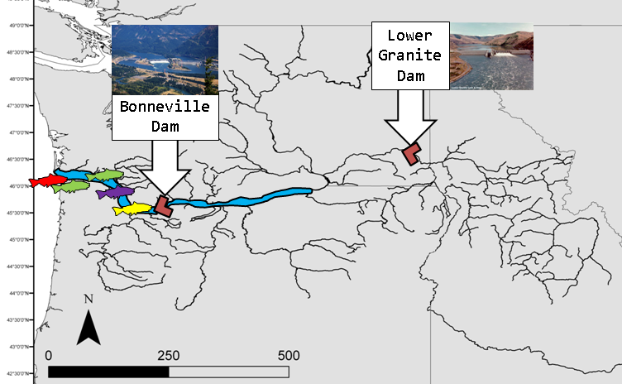
Genetic Stock Identification (GSI) of mixed stocks in the Columbia River Basin

Slide 52

Introduction
Abundance is a primary metric needed for monitoring the status of salmon and steelhead populations (McElhany et al. 2000)
Estimates of abundance (combined with age and sex data) over time allows estimation of population growth and productivity parameters
Estimates of these metrics provide indicators of the resiliency and viability of populations and allows extinction risk assessment
GSI offers the potential to estimate abundance of “wild” stocks in addition to hatchery reared fish
Notes:
As part of the viable salmonid populations (or VSP) concept established by NOAA in 2009, it was determined that abundance is the primary metric needed for monitoring the status of Pacific salmonids (including steelhead)
Further, if abundance (combined with age structure and sex data) can be estimated over time, you can start to make estimates of population growth and productivity parameters
And all of this information combined provides indicators of the resiliency and viability of populations and also allows us to conduct extinction risk assessments

Slide 53

GSI of Salmonids in the Columbia River Basin
Fishery
Fishery
Lower
Granite
Dam
Bonneville
Dam
Adult fish
Basin-wide Stock Composition of Lower Mainstem Harvest (CH)
Adult fish
Interior Columbia River Stock Abundance and Run-Timing (CH/ST)
Adult fish
Interior Columbia River Stock Composition of Zone 6 Harvest (CH/ST)
Adult fish
Snake River Stock Abundance and Run-Timing (CH/ST)
Adult fish
Stock Composition of Kelts (ST)
Notes:
We have multiple sources for unknown mixtures of salmonids and can estimate stock of origin to address various questions:
Proportions of all Columbia River Basin stocks that comprise the Lower Columbia mainstem harvest (Chinook salmon)
Non-lethal sampling at Bonneville Dam to a estimate abundance and run-timing of interior Columbia River stocks (Chinook salmon and steelhead)
Proportions of all interior Columbia River stocks that comprise the Zone 6 harvest (Chinook salmon and steelhead)
Non-lethal sampling at Lower Granite Dam to a estimate abundance and run-timing of Snake River stocks (Chinook salmon and steelhead)
Non-lethal sampling at Lower Granite Dam and Yakima River to estimate proportions of stocks that comprise kelts (Steelhead)
(Different colors of fish for different stocks)

Slide 54
GSI of Salmonids in the Columbia River Basin
Lower
Granite
Dam
Bonneville
Dam
Juvenile fish
Snake River Stock Composition of Out-Migrants (CH/ST)
Juvenile fish
Interior Columbia River Stock Composition of Out-Migrants (CH)
Notes:
We have multiple sources for unknown mixtures of juvenile salmonids and can estimate stock of origin to address various questions:
Non-lethal sampling at Bonneville Dam and Lower Granite Dam to a estimate stock proportions of out-migrating juveniles (Chinook salmon and Steelhead)
Collaborations with Kintama (Canadian-based private company) to examine early ocean migration patterns of interior Columbia River Chinook salmon stocks

Slide 55
Genetic Stock Identification
GSI uses allele frequencies from baseline populations (from all major contributing stocks), and genotypes from mixture samples, to estimate stock proportions within mixed stock fisheries (Anderson et al 2008)

Slide 56

Steelhead SNP baseline:
Snake R: 49 populations, 2,506 samples, 187 SNP loci
10 REPORTING REGIONS
WA
Lower Mainstem Salmon
Lower Granite Dam
Upper Mainstem Salmon
MF Salmon
MT
SF Salmon
Upper Clearwater
SF Clearwater
Lower Clearwater
OR
Imnaha
Grande Ronde
ID
Tucannon (BLWLGR)
Ackerman et al. 2011
Notes:
Two stocks are included below Lower Granite Dam, since fish from these areas may stray above LGD or ascend LGD and then fallback downstream

Slide 57



Methods – Adult Steelhead
Lower Granite Dam sampling:
SY2009 = 1,083 samples
SY2010 = 1,938 samples
Biological data collected for each individual
  length
  tissue = genetics/gender
  scale = age
Analysis
187 SNP loci
including genetic sex
  Y-chromosome specific assay
  >98% accurate
Ackerman et al. 2011

Slide 58
Stock escapement at Lower Granite Dam
Grande Ronde River
SY2009: 23.2%
SY2010: 30.9%
Salmon River
SY2009: 33.8%
SY2010: 34.7%
25,764
42,708
Clearwater River
SY2009: 28.6%
SY2010: 18.7%
Ackerman et al. 2011
Notes:
The upper and lower main salmon reporting groups were combined for individual assignments based on the results of LOO tests.
We observe a tremendous amount of variation in the contribution of stocks to the adult escapement at Lower Granite Dam.
With the largest contributions coming from the Grande Ronde River and Mainstem Salmon, and much smaller contributions from reporting groups like the MF/SF Salmon Rivers and Lower Clearwater River.
We observe significant temporal differences in the contributions of different stocks/reporting groups:
Stocks in the Clearwater River drainage, while not significantly changing in adult escapement numbers, contributed significantly less to the total escapement over LGR (28.6% to 18.7% drop from 2009 to 2010). We also observed a significant change in the contribution of the Grande Ronde reporting group from 23.2% in SY2009 to ~31% in SY2010. While significantly more adults returned to reporting groups in the salmon river in SY2010, there was not a change in their overall contribution to the adult escapement.

Slide 59



Sex ratios
  SY2009
  Males = 32%
  Females = 68%
  SY2010
  Males = 38%
  Females = 62%
Male
Female
Ackerman et al. 2011
Notes:
Sex for both years is heavily skewed towards females (68% in SY2009 and 62% in SY2010). Again, we see a fair amount of variation in sex ratios across stocks (78% high in SF Salmon River; lower 60%s in other stocks) and we see significant differences among years within the same stock (Lower Clearwater, 73% in SY2009 and 57% in SY2010).

Slide 60


“A-run” versus “B-run” steelhead
In lieu of more detailed basin-level stock specific information, managers have relied primarily on a two stock classification system for Snake River steelhead adults characterized by life history variations in size and age at return, timing of migration into freshwater, spawn timing and spawning distribution
Stock | Ocean Residence | Timing over Bonneville | Size at return | Distribution | Spawn Timing
A-run | 1 year | June 1 to August 25 | < 78 cm | Tucannon, Grande Ronde, and Imnaha rivers, upper Salmon River, Snake River | March-April
B-run | 2 years | August 25 and October 31 | > 79 cm | Clearwater River, S.F./M.F. Salmon Rivers | Late April-May
“A-run” steelhead
Lower Snake River
“B-run” steelhead
S.F. Clearwater
Ackerman et al. 2011

Slide 61


Proportion of “A-Run” (blue) and “B-run” (red) sized fish returning to these reporting groups in SY2010
  Generally, length patterns conformed with A-run/B-run expectations, with proportionately smaller fish returning to areas that we consider
  “A-run” (Imnaha, Grande Ronde, Upper Salmon), and proportionately larger fish returning to areas we consider to be “B-run” (S.F. Clearwater, S.F. Salmon).
Proportion of 1-ocean (blue), 2-ocean (red) and 3-ocean (green) age adults returning to these reporting groups in SY2010
  Similar patterns to what we saw before, but these results emphasize what some biologists have recognized for some time, that 2-ocean fish do not strictly return “B-run” sized fish. For example, in SY2010, although the composition of 2-ocean adults from the Imnaha and Grande Ronde Rivers was ~30-35%, less than 5% of the adults met “B-run” size length requirements.
Ackerman et al. 2011
Notes:
Generally, length patterns conformed with A-run/B-run expectations, with proportionately smaller fish returning to areas that we consider “A-run” (Imnaha, Grande Ronde, Upper Salmon), and proportionately larger fish returning to areas we consider to be “B-run” (S.F. Clearwater, S.F. Salmon).
The first 2 years of results emphasize what some biologists have recognized for some time, that 2-ocean fish do not strictly return “B-run” sized fish. For example, in SY2010, although the composition of 2-ocean adults from the Imnaha and Grande Ronde Rivers was ~30-35%, less than 5% of the adults met “B-run” size length requirements.

Slide 62


Major Findings: “A-run” versus “B-run”
Drainage based differences in A-Run vs. B-Run composition (based on length)
  A-Run: Upper Salmon, Grande Ronde, Imnaha
  B-Run: Upper Clearwater, SF Clearwater, SF Salmon
  BUT, all regions appear to produce both smaller size/younger age returning adults (A-run) and larger size/older age returning adults (B-run)
Relationship between run type (A vs. B) based on length and saltwater age (1-ocean vs. 2-ocean) not clear-cut
  we report a higher proportion of 2-ocean steelhead than >=78 cm fish in all regions
Ackerman et al. 2011

Slide 63

Combination of GSI & PBT
Run-of-river yearling Chinook smolts (≥130 mm FL)
Collected at Bonneville (n=596) and Lower Granite (n=200) dams in 2011
  91% from Bonneville Dam were ad-clipped fish
  95% from L. Granite Dam were ad-clipped fish
Small tissue clip for SNP markers for PBT & GSI
Rechiscky et al. in prep

Slide 64
How do PBT results match up with expectations?
Expectations for PBT:
1) Most of the 190 ad-clipped fish from L. Granite Dam should assign to hatchery parents (~88% based on tagging rate for BY2009 Chinook)
2) Some of the 544 ad-clipped fish from Bonneville should assign to hatchery parents (only Snake R. parents)
3) Some unmarked fish may assign to hatchery parents (hatchery origin fish that were not marked with ad-clip)
163 (86%) fish from LGD assign to 2 hatchery parents
59 (11%) of fish from Bonneville assign to 2 hatchery parents
3 LGR fish assign to two hatchery parents
2 Bonneville fish assign to two hatchery parents
All 5 validated w/cross records from hatcheries
Rechiscky et al. in prep

Slide 65
SF_Salmon
Upper_Salmon
RapidR/Clearwater
Rechiscky et al. in prep

Slide 66
SF_Salmon
Upper_Salmon
RapidR/Clearwater
Rechiscky et al. in prep

Slide 67
SF_Salmon
Upper_Salmon
RapidR/Clearwater
Rechiscky et al. in prep

Slide 68
2011/2012 Projects w combo of GSI & PBT
Adult returns at Bonneville and L. Granite Dams (Chinook and steelhead)
Adults sampled in L. Columbia and Zone 6 fisheries (Chinook and steelhead)
Juveniles outmigrating at L. Granite Dam (Chinook)
Origin of stray hatchery fish in other basins (e.g., Deschutes R., Klickitat R., John Day R.)
Several other studies with collaborating agencies (NOAA, USFWS, WDFW)

Slide 69


Efforts to standardize markers
2003-2007 – Consortium of genetics labs formed to standardize genetic markers
2008: Initial panel of 75 SNP markers established for Chinook salmon by consortium of genetics labs
2008-2010: Additional SNP markers needed for many applications (SNP discovery process)
2010-present: Coastwide standardization of 96 SNPs for Chinook salmon
Efforts to standardize SNP panels for other species is underway
Chinook Technical Committee (CTC)

Slide 70

Database challenges
Multi-agency database was created to house standardized microsatellite genetic data
Currently no funding to maintain and update database
Strong need for a centralized database to store genetic data for multiple species
  Baselines for GSI applications
  Parent baseline for PBT
  Genome information

Slide 71
Acknowledgements
Funding:
  Bonneville Power Administration
  Pacific Coast Salmon Recovery Fund
  Pacific Salmon Commission (CTC)
  Idaho Power Corporation
Samples
  Darren Ogden (NOAA)
  IDFG Scale Aging Lab (Kristin Ellsworth)
  IDFG, IPC, ODFW, WDFW, USFWS hatchery personnel
  CRITFC staff (Bonneville Dam)
  Joe Hymer, WDFW, PSMFC
Data
  Jesse McCane
  Lynn Schrader
  Jeff Stephenson
Laboratory
  Carlos Camacho
  Dylan Kovis
  Laura Redfield
  Thea Vanderwey
  Heather Hoyt
  Amanda Matala
  Lori Maxwell
  Stephanie Harmon
  Vanessa Morman
  Megan Moore
  Analyses
  Andrew Matala
  Jon Hess
  Maureen Hess
  Nate Campbell
  Craig Steele
  Mike Ackerman

Slide 72
Questions???

