Slide 1

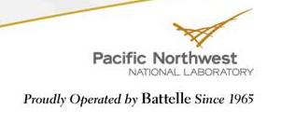
Geochemical Analysis of Scales and Fin Rays to Identify Wenatchee Basin Spring Chinook Populations
Tim Linley, Kenneth Ham, Jill Janak, Tom Farmer,
Martin Liezers, and Geoff McMichael
Pacific Northwest National Laboratory, Richland, Washington
Russell Langshaw, Todd Pearsons
Public Utility District #2 of Grant County. Ephrata, WA

Slide 2
Wenatchee Basin Spring Chinook Hatchery Programs
Segregated
  Leavenworth
Integrated
  Chiwawa River
  Nason Creek
  White River
Recent Hatchery Reform Efforts

Slide 3
Proportionate Natural Influence (PNI)
Active Adult and Broodstock Management
Tributary trapping (e.g. weirs)
  Suitable site
  Permitting
  Effects on ESA listed fish
Centralized trapping (e.g. Tumwater Dam)
  Determine origin
  Effects on ESA listed fish

Slide 4
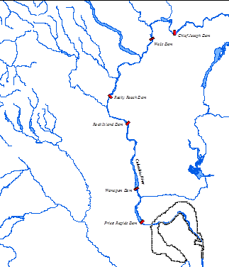
Parental Based Tagging
Use genetics and spawning ground monitoring to determine origin
Feasibility studies 2010-11
Appears feasible
Concerns
  High sample rate
  Assignment rate
Notes:
Will get better map – walk through the process from initial tagging/sampling at Tumwater and through next generation
Appears feasible but still not as good as hoping for - May try GSI for better genetics

Slide 5
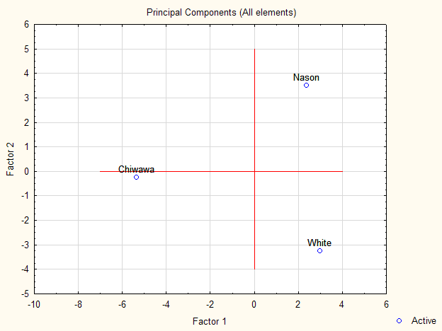
Laser Ablation
Use natural geochemical signatures to determine origin
Initial feasibility study 2011
  Water (3)
  Scales (30)
  Juvenile fin rays (?)
PCA – r² = ???
ANOVA – P <0.05
Notes:
General concept
Main point – Many elements with varying levels and three distinct water sources

Slide 6
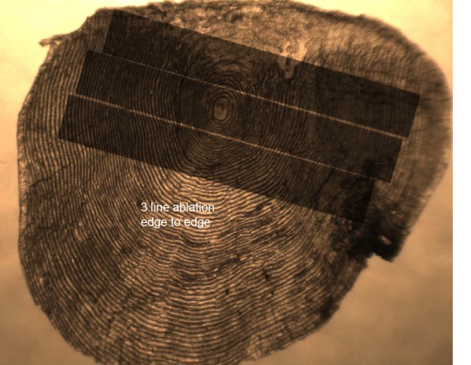
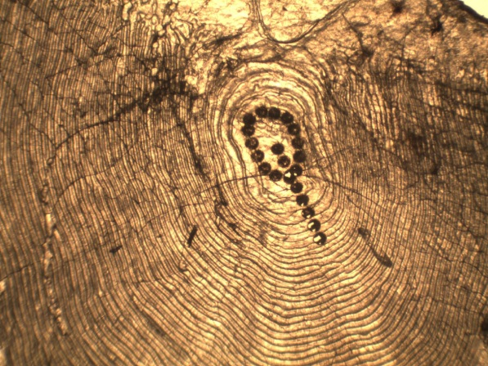
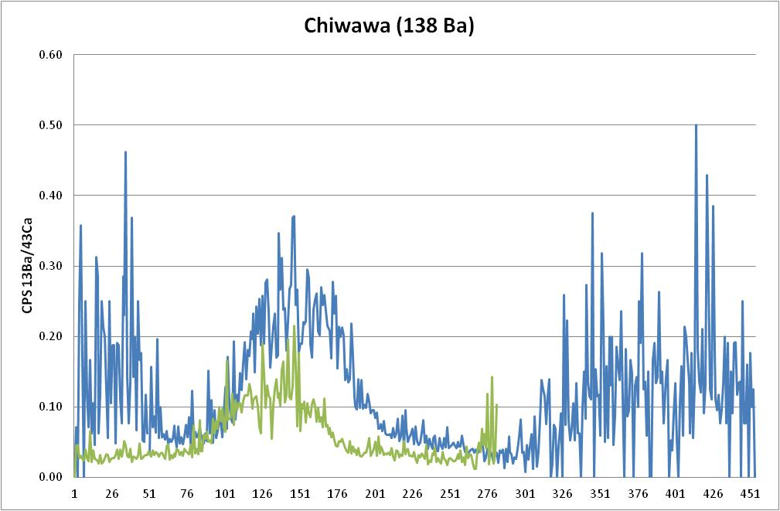
Scales – Ring, Line, Continuous
Notes:
What are the two lines?

Slide 7
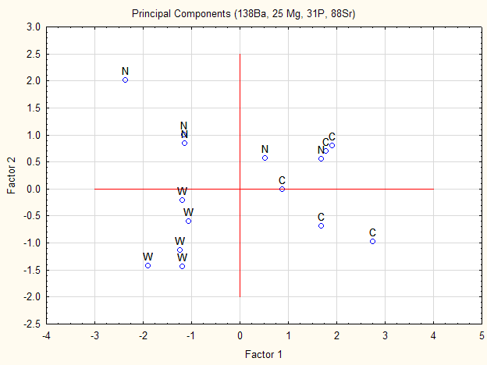
Statistically Significant Difference
PCA – r² = 0.36-0.74???
NMS – r² = 0.97
MRPP – P = 0.0006
Notes:
Walk through ordination and MRPP
Not sure how PCA was run and why it was selected – need clarification

Slide 8
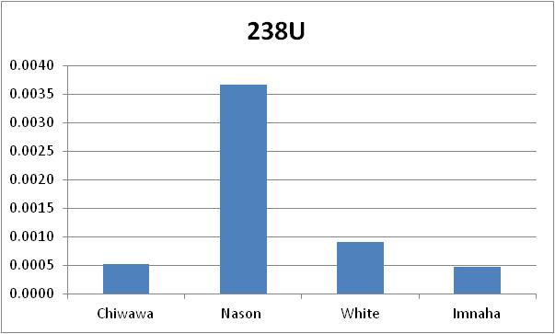
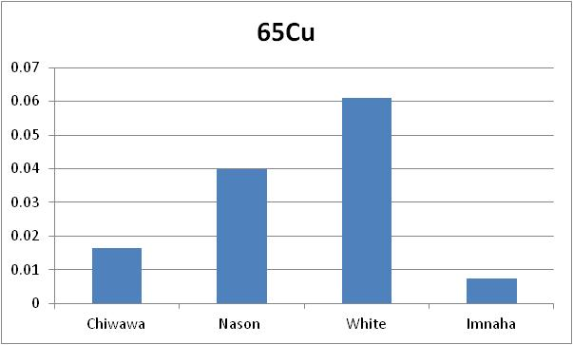
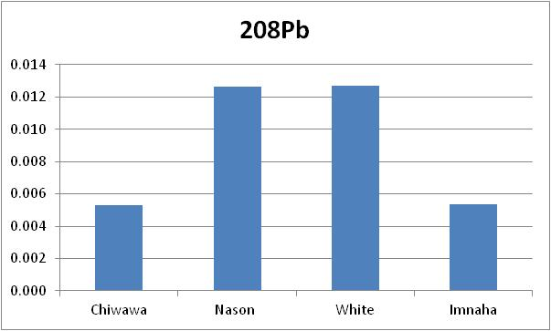
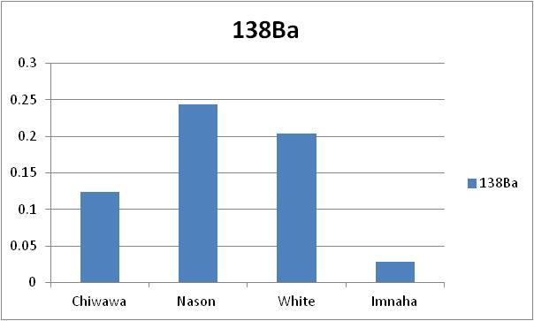
Juvenile Fin Rays
Notes:
Need to get fin ray data so I can run PCA and NMS

Slide 9
Objectives – 2012 & 13
Increase sample size, identify best methods, quantify assignment certainty
Line
    Less sensitivity and more processing time
Disolution
    Greater sensitivity and more elements
    No temporal information
Fin rays
    Elements less mobile?
    Less variable?
May include
    Otoliths for comparisons purposes
    A pilot study for marking with feed
    Straying and subyearling rearing
Notes:
General objectives, pros/cons,

Slide 10
Conclusions
Initial results very promising
  Statistically significant
  Additional methods likely improve assignment certainty
Likely provide additional options for adult and broodstock management
Implementing in 2012 may provide immediate backup if PBT doesn’t work
If assignment is accurate enough it may provide for reduced trapping and handling

