Slide 1
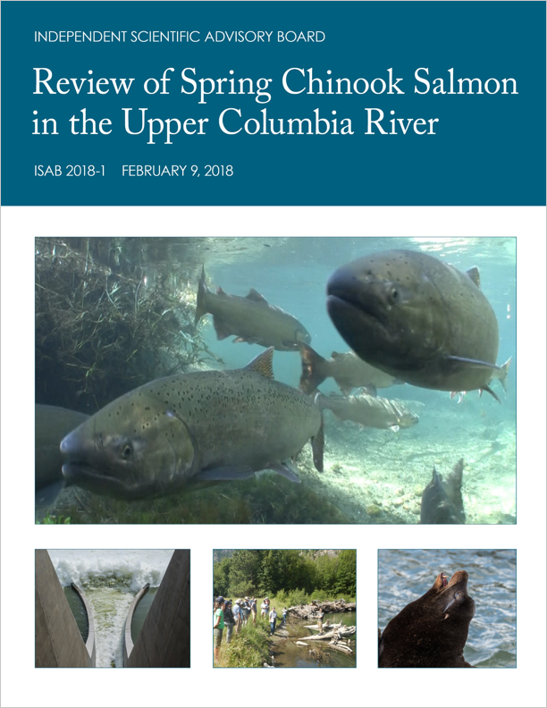
ISAB Review of Spring Chinook Salmon in the Upper Columbia River
Drs. Stan Gregory, steve Schroder, Alec Maule (chair)
Independent Scientific Advisory Board
Drs. Stan Gregory and Steve Schroder, ISAB March 6, 2018

Slide 2
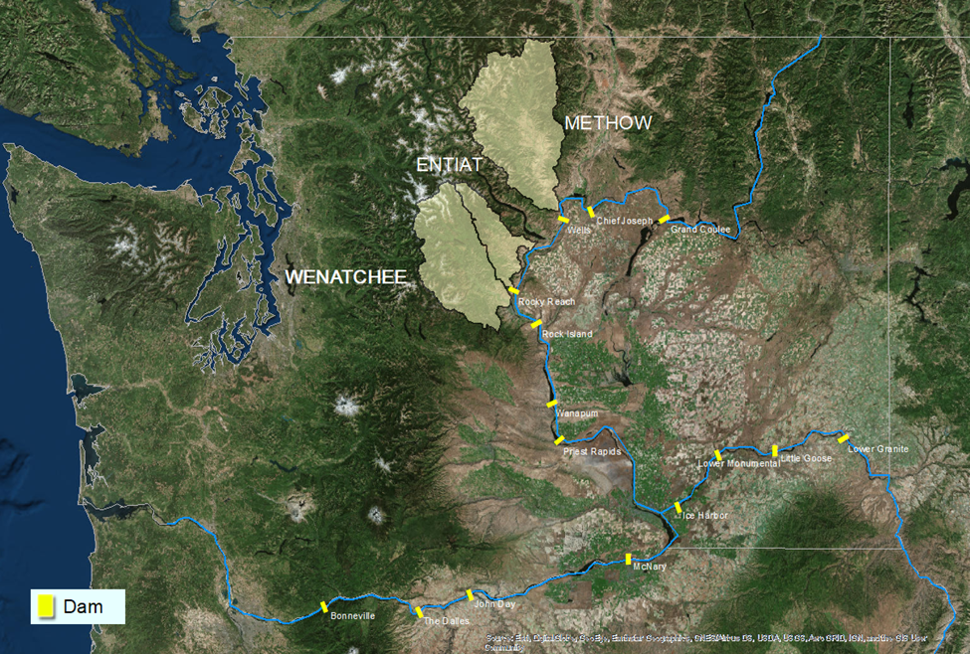

Slide 3
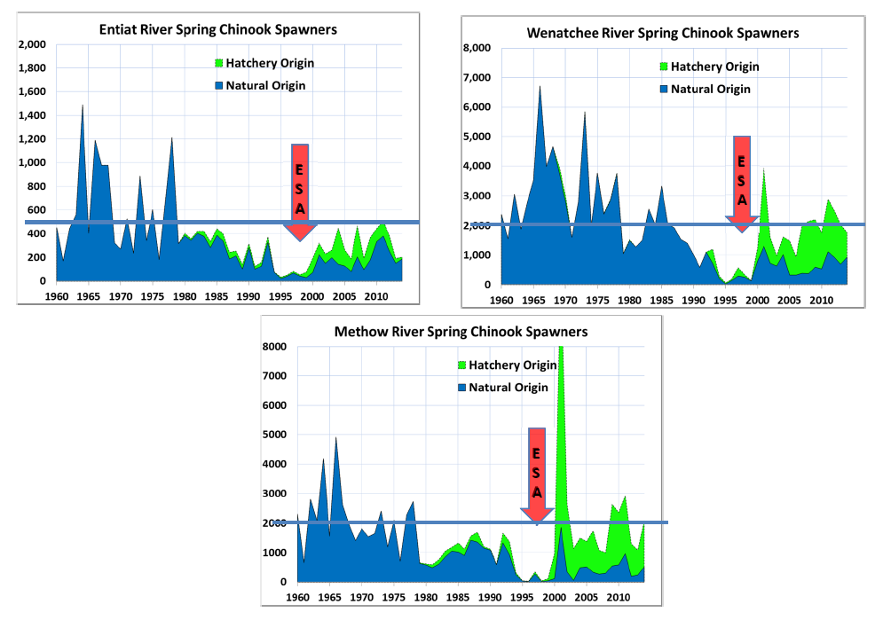
Status Trends
Upper Columbia Spring Chinook Salmon
Graphs from Mike Ford, NOAA Fisheries

Slide 4
Major Questions
  Snake River spring Chinook vs UCR spring Chinook
  Limiting factors assessment
  Evidence of habitat improvement
  Prioritization of habitat recovery actions
  Adequacy of research, monitoring, and evaluation
  Life-cycle and habitat models
  Coordination
Notes:
The Administrative Oversight Panel—The Council, NOAA Fisheries, Columbia River Inter-Tribal Fish Commission—asked ISAB to address several major questions about the status of Upper Columbia River spring Chinook salmon and actions for recovery of their populations.

Slide 5
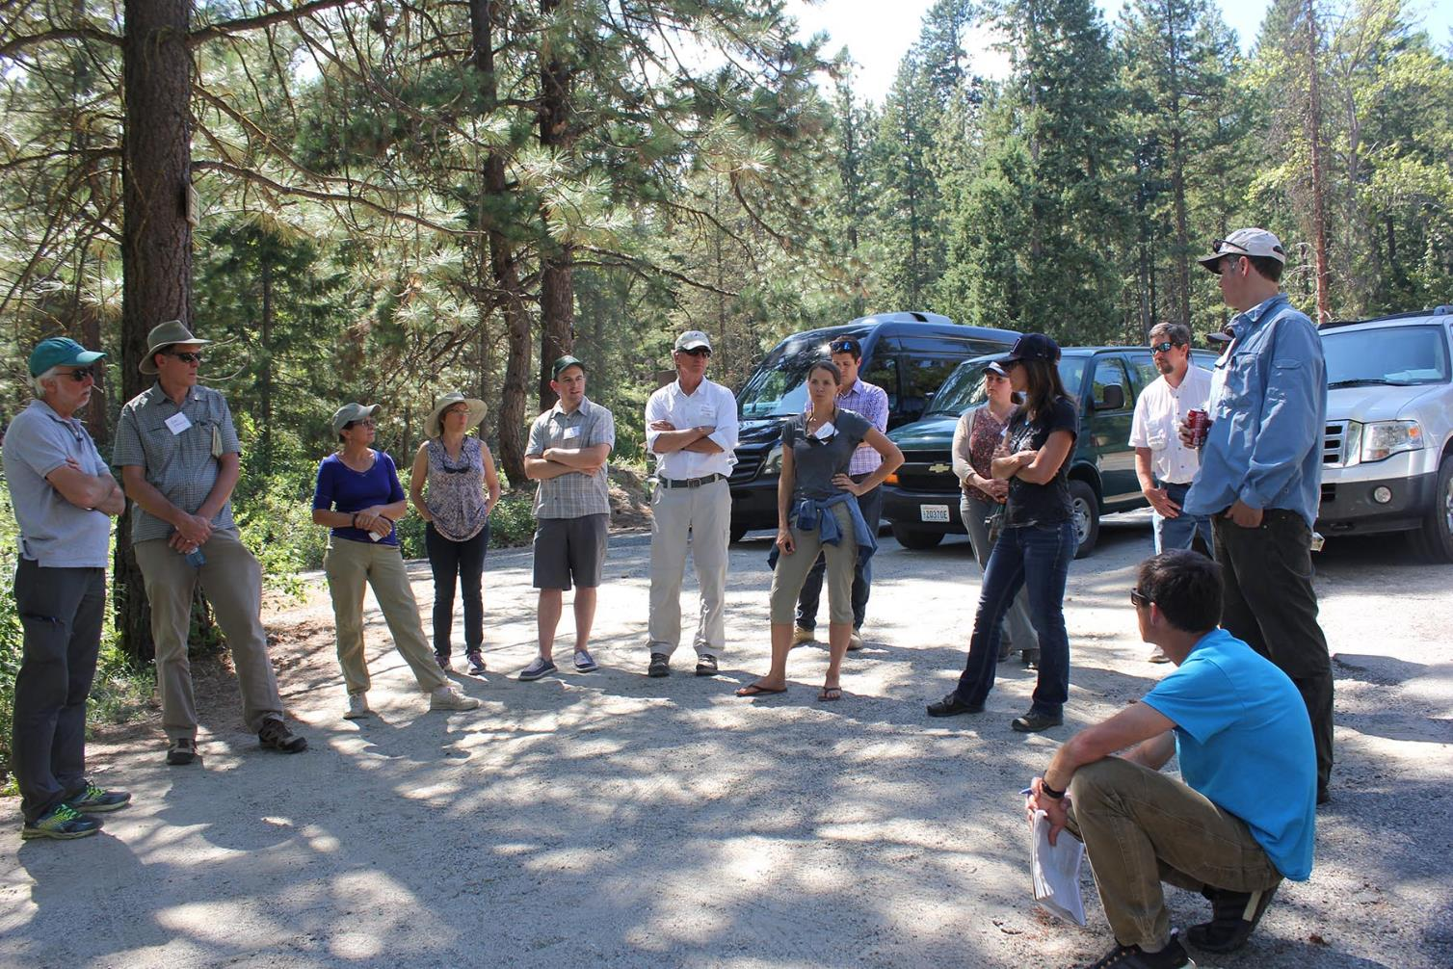

Slide 6
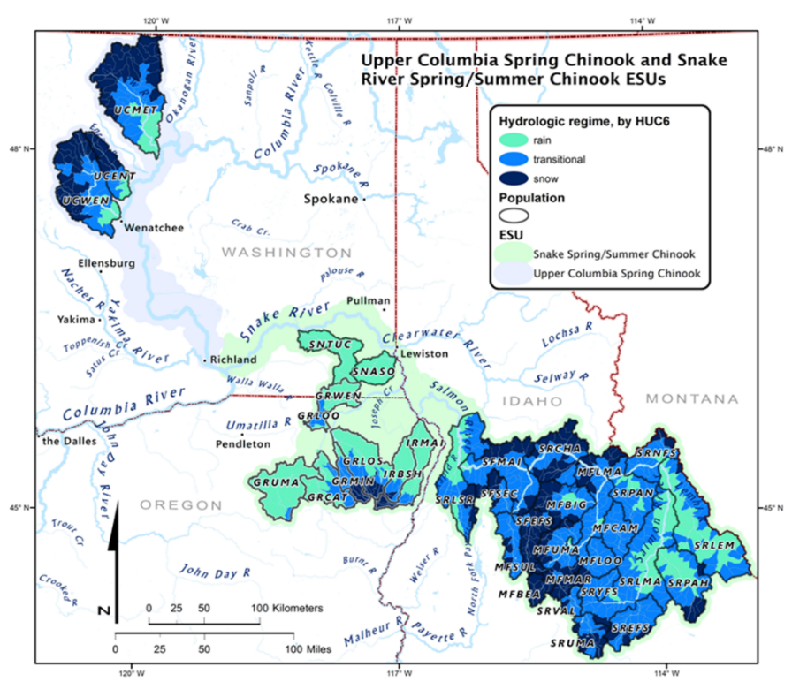
Upper Columbia River ESUs and Snake River ESUs
Spatial Diversity
Hydrologic regime
Snow
Transition
Rain
NWFSC 2015, ISAB 2018-1
Notes:
Spawning elevation UCR 1500- 3000; SNR 1500 – 7100

Slide 7
Abundance
(2010 – 2014 versus 2005 – 2009)
UCR SNAKE
Number of populations 3 26
Average abundance 1,475 11, 347
Average change 74% 154%
Range 12% to 105% -2% to 426%
NWFSC 2015

Slide 8
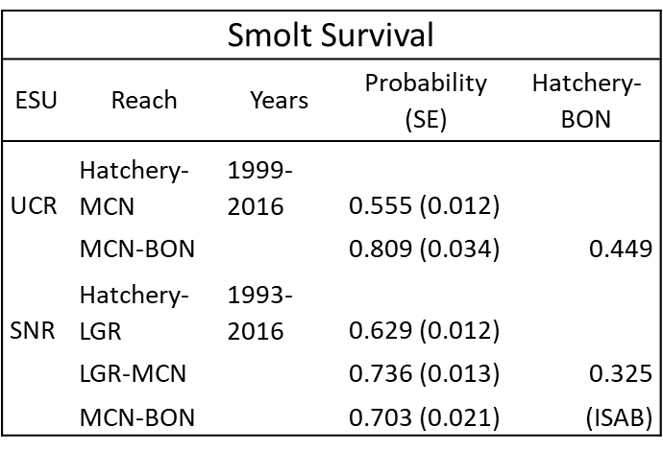
Survival to Bonneville
45%
33%
CSS 2017, ISAB 2018-1

Slide 9
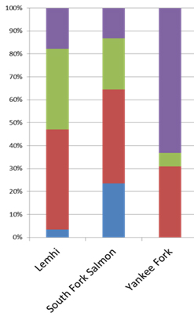
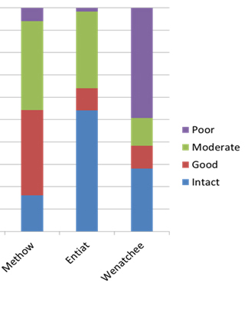
Geomorphic conditions based on CHaMP analyses
SNR
UCR
100%
50%
Habitat (%)
versus
Poor
Moderate
Good
Intact
0%
Lemhi
Methow
Entiat
S. F. Salmon
Yankee Fork
Wenatchee
From M. Ford, NOAA Fisheries, data from C. Jordan

Slide 10
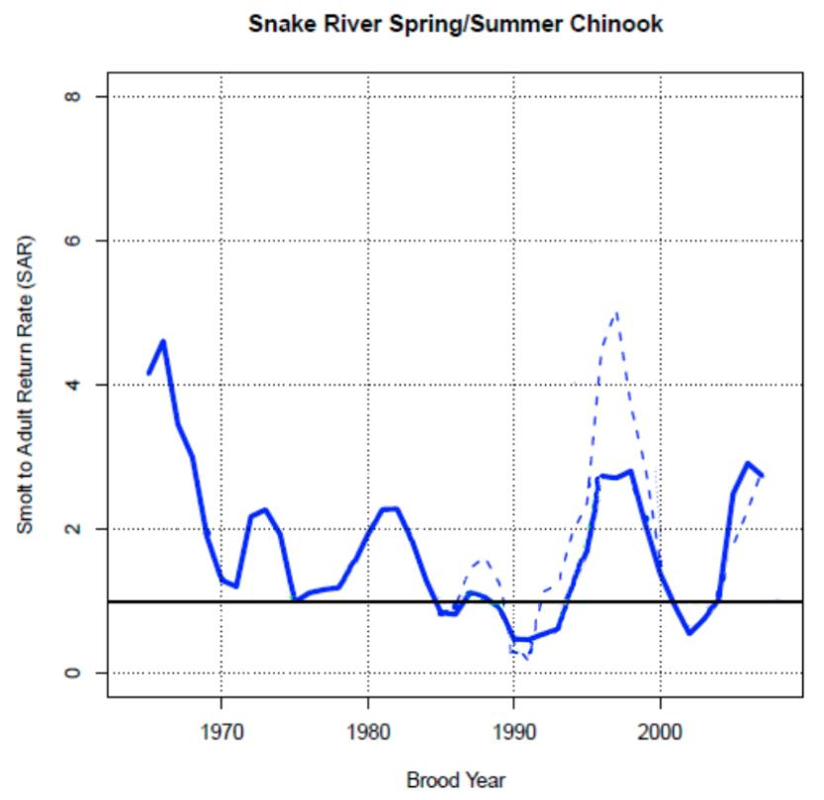
Smolt – Adult Return Rates
(SARs)
SNR sp/sum Chinook
UCR spring Chinook
3-year moving average
NWFSC (NOAA-F) 2015

Slide 11
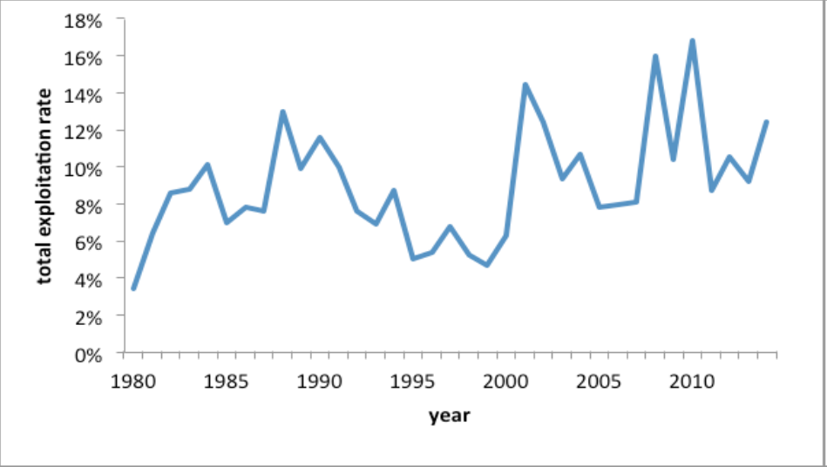
Total Harvest Rate
Average
10%
NWFSC, 2015

Slide 12
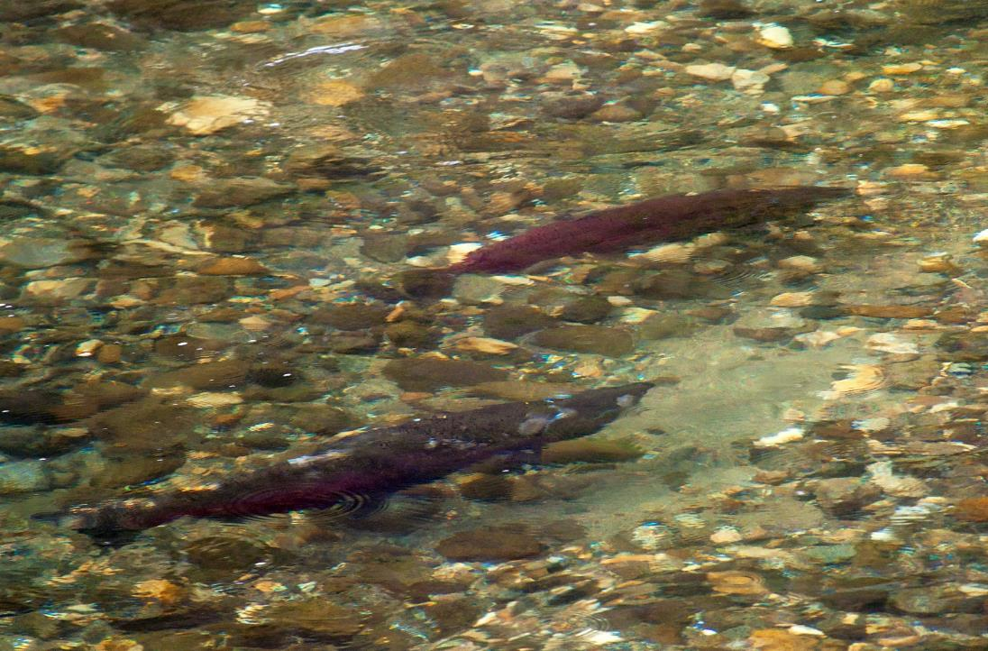
Limiting Factors

Slide 13
Limiting Factors
Scientific principles and methods for identifying factors limiting the recovery of Upper Columbia spring Chinook salmon are generally sound.

Slide 14
Limiting Factors
Adaptive Management
Recovery Plan and Actions
Limiting Factors Analysis
Presentation by Tom Kahler, July 2017

Slide 15
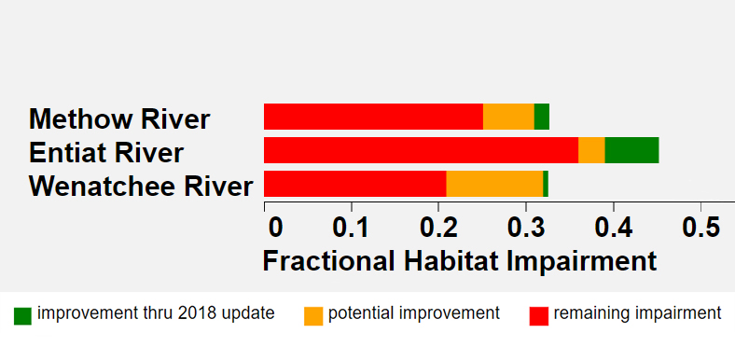
UCR Habitat Impairment
Remand Habitat Workgroup
www.onefishtwofish.net/viz/HabitatLimitingFactors1d.html

Slide 16
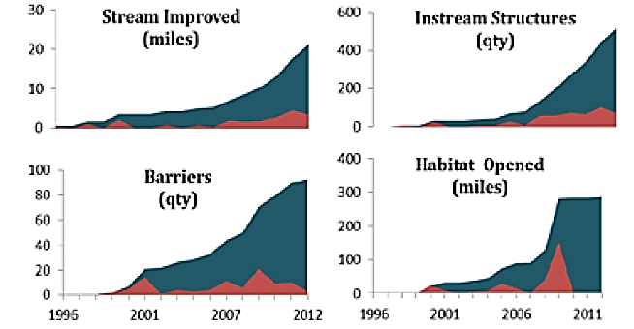
Tracking Progress

Slide 17
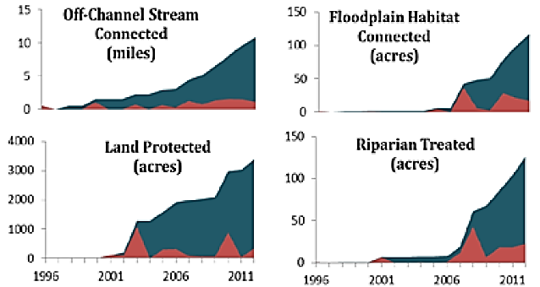
Tracking Progress

Slide 18
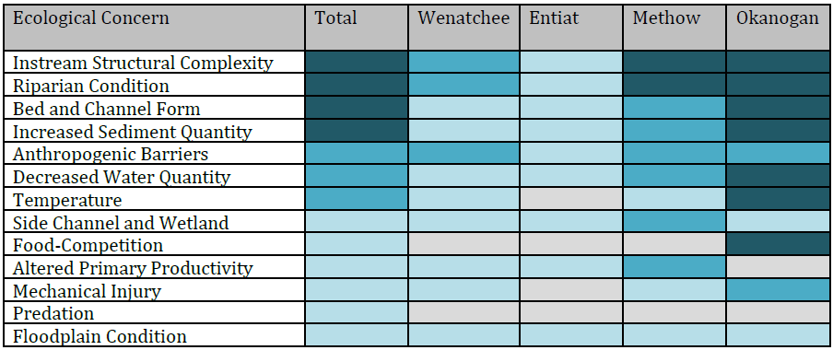

Rankings of Ecological Concerns
UCSRB 2014

Slide 19
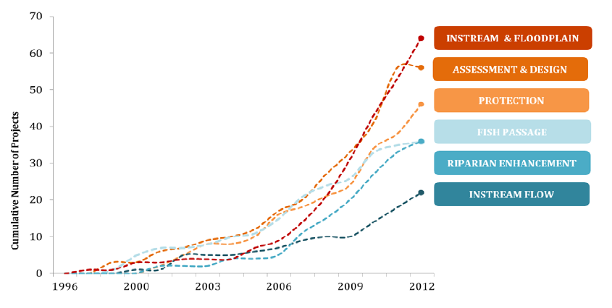
Cumulative habitat projects implemented
1996-2012
UCSRB 2014

Slide 20
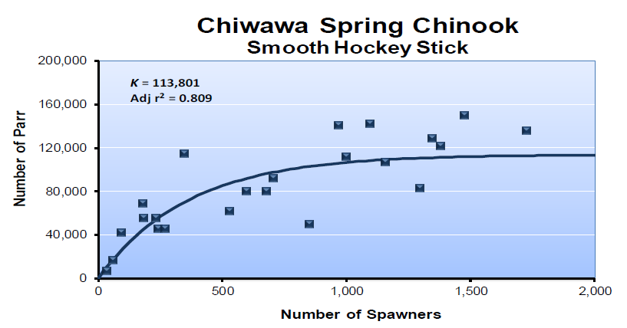
Density Dependence

Slide 21

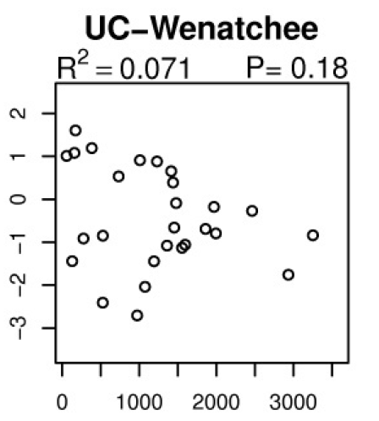
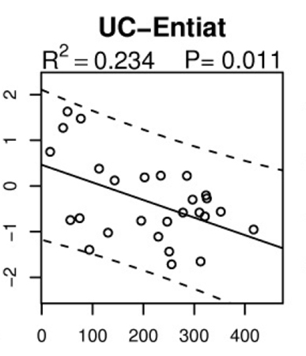
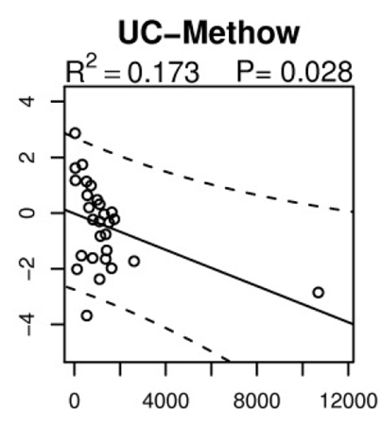
Density Dependence
SPAWNERS
Density Dependence Report ISAB 2015-1

Slide 22
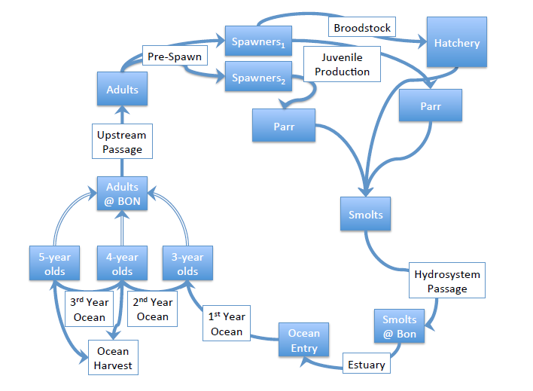
Wenatchee Life-Cycle Model

Slide 23
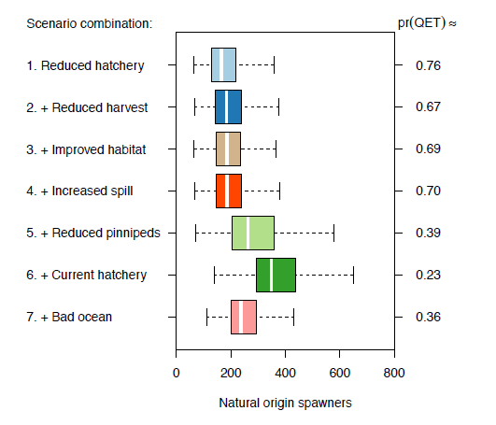
Habitat restoration actions were a small subset of the actions being implemented
Jorgensen et al. 2017

Slide 24
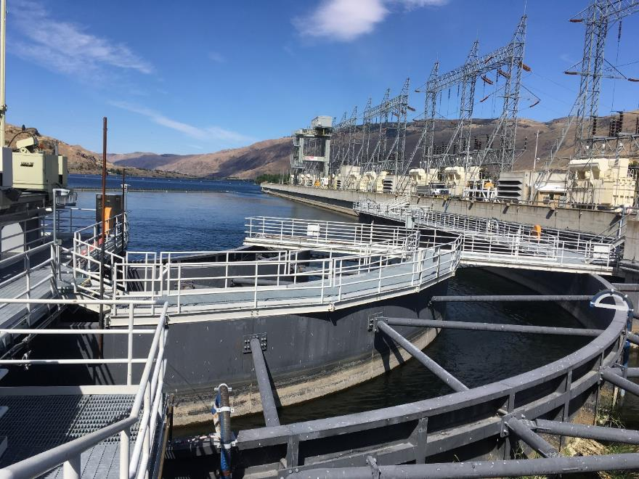
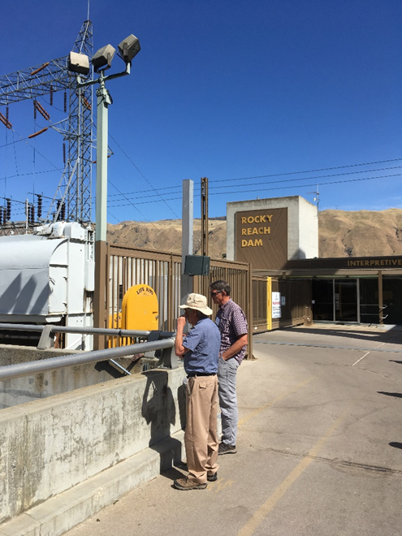
Hydrosystem

Slide 25
Harvest
Average
10%
NWFSC, 2015

Slide 26
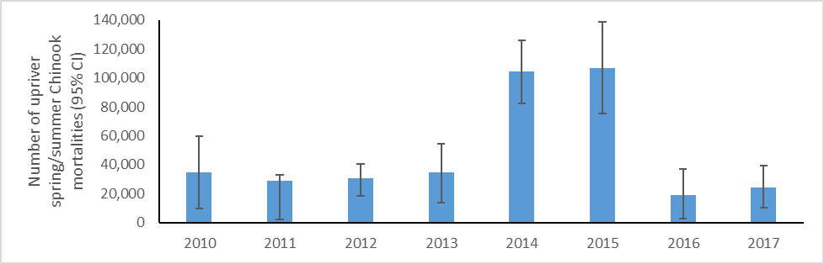
Pinniped Predation
The estimated number of upriver spring/summer Chinook mortalities (95% confidence interval) in the Columbia River below Bonneville Dam
Wargo Rub et al. presentation to ISAB, December 8, 2017

Slide 27
Are pinnipeds potentially significant source of mortality
for UCR spring Chinook?
Yes, but population-specific estimates of impacts
not available.
Can the effect of pinniped predation be quantified?
Yes, but more tagging studies and
coast-wide bioenergetics/life-cycle modeling are needed.

Slide 28
Habitat Action Effectiveness
Is there evidence that past projects have improved habitat for this ESU?
Removing barriers to connectivity
Reconnecting floodplains, side channels, and off-channel habitats
Restoring habitat complexity using log or boulder structures
Increasing streamflow
Managing fine sediment
Restoring nutrients
Controlling nonnative species

Slide 29
Effectiveness of wood structures
Hillman et al. 2016, after Roni et al. 2015
Juvenile Adult Non-
Habitat Salmonids Salmonids Salmonids Invertebrates

Slide 30
Restoring habitat complexity using log or boulder structures
Higher numbers of juvenile Chinook during early and mid-summer
Higher total abundance, not just moved fish around
Polivka et al. 2015

Slide 31
Sample Design
For Before and After studies, adding 1 year of pre-treatment measurements increased the power to detect differences more than including up to 100 years of post-treatment data (O’Neal et al. 2016).

Slide 32
Evidence for Effectiveness
Habitat protection
Removing barriers
Reconnecting floodplains and side channels
Increasing habitat complexity

Slide 33
Prioritization
Are habitat recovery actions being prioritized and sequenced strategically, given existing knowledge and data gaps?

Slide 34
Regional Technical Team Ranking
Primary Ecological Concerns 20%
Location and Scale 25%
Temporal Effects 20%
Methods 10%
Benefits to FW Survival/Capacity 20%
Cost Effectiveness 5%

Slide 35
Citizens’ Advisory Committee Ranking
Benefits to Fish 30%
Project Longevity 20%
Project Scope 10%
Community Support 17%
Economics 13%

Slide 36
Prioritization Based on Cost Effectiveness
The procedure for characterizing costs and effectiveness is simplistic and the results are weighted such that they have little or no influence on project priorities.
The ISAB recommends using a transparent, quantitative cost-effectiveness analysis of each proposed project.

Slide 37
Example Process
Step 1: Estimate the effect of the project during four different
time periods
Step 2: Estimate the initial cost of the project in dollars.
If there will be ongoing costs, discount costs.
Step 3: Sum the average values in Step 1 across all time periods
Divide the total by the cost estimate from Step 2.
The result is biological effectiveness per dollar of cost.
Step 4: Repeat with low and high estimates of effectiveness to
assess sensitivity of estimate.
Notes:
1. Such as the average annual increase in number of smolts during years 1-10, 11-25, 26-50, and 51-100.

Slide 38
RME
Is a research, monitoring, and evaluation (RME) framework in place that can adequately address the questions above?

Slide 39
RME
Methods of the UCSRB’s Regional Technical Team, public utility districts, and regional fisheries agencies are generally appropriate and can be used to answer questions about effects of hatcheries and the hydrosystem.
Currently, the RME Plan does not encompass all Hs and their related working groups.
The ISAB recommends developing an integrated RME Plan that encompasses all Hs and the Upper Columbia’s related working groups.

Slide 40
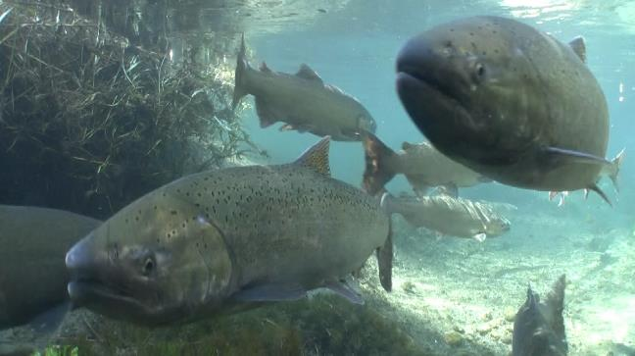
More wild summer than spring Chinook: Why?
Answers & analyses from UCR researchers
Photo by Michael Humling, USFWS
Graph & data from Andrew Murdoch, WDFW
Notes:
The right hand graph shows that for the past 30 years, ten to twenty times more wild summer Chinook have returned to the UCR subbasins than spring Chinook. We asked why.

Slide 41
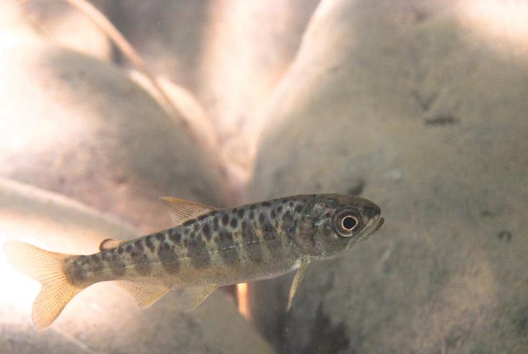
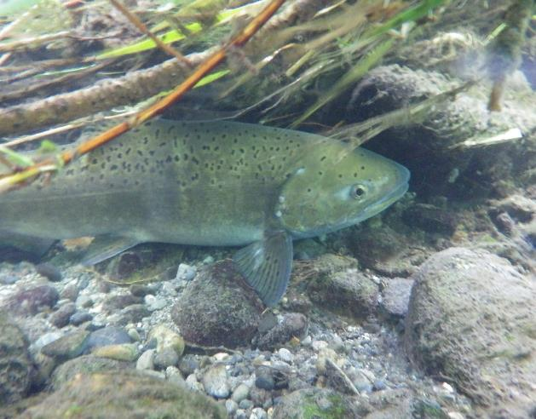
Spring vs. Summer Chinook
Examining Differences at the Adult and Juvenile Stages
in Freshwater Habitats
Photo courtesy of Greer Maier UCRSRB
Photo NOAA-Fisheries
Notes:
To answer that question differences between the two races of Chinook were examined at the adult and juvenile stages when the fish were in the Columbia Basin

Slide 42
Arrival Timing at Bonneville Dam
Average Cumulative %
% of Run | Spring | Summer | Difference in Days
5 | Apr 20 | Jun 13 | 54
25 | May 1 | Jun 24 | 54
50 | May 13 | Jul 4 | 52
75 | Jun 4 | Jul 21 | 47
90 | Jun 25 | Aug 5 | 41
---Spring Chinook
---Summer Chinook
Graph & data from Andrew Murdoch, WDFW
Notes:
Maturing Spring Chinook enter the Columbia River earlier than summer Chinook. Here you can see that 75% of the spring Chinook have already passed over the Bonneville Dam by the time the first summer Chinook have done so.

Slide 43
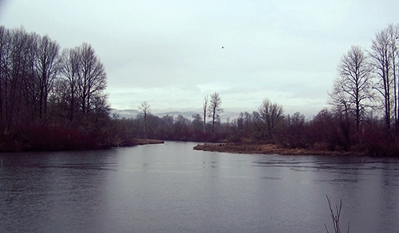
Seasonal Affects On Adult Chinook Transit Times
In The Lower River
Residency In The Lower River
Date | Transit Time
Late Mar | 30 to 40 Days
Mid Jun | 5 to 10 Days
www.lowercolumbiariver.org
Data from Sorel et al. 2017
Notes:
Also it takes spring Chinook longer to pass through the lower Columbia than summer Chinook. Individuals arriving in late Mar and early Apr may spend over a month in the lower river. Because of their arrival timing, summer Chinook may spend just 10 days or less in this portion of the Columbia River.

Slide 44
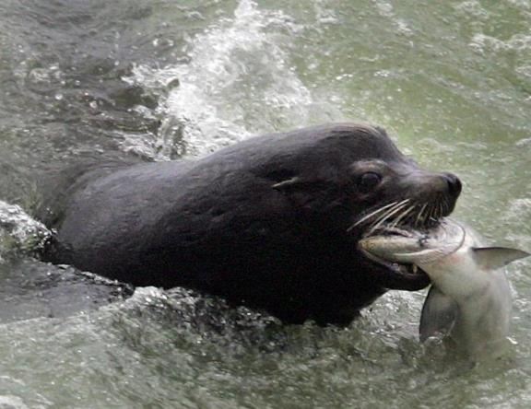
Survival in the Lower River
by Arrival Timing
Timing | Population | Survival
 |  | 2010-12 | 2013-15
Early | Methow | 69 - 81% | 50 – 70%
Intermediate | Entiat | 79 – 88% | 67 – 85%
 | Wenatchee
Late | Imnaha | 84 – 92% | 83 – 92%
 | Lostine
Photo: Spokesman.com
Data from Sorel et al. 2017
Notes:
Their early arrival and longer tenure in the lower River make spring Chinook more vulnerable to pinniped predation

Slide 45
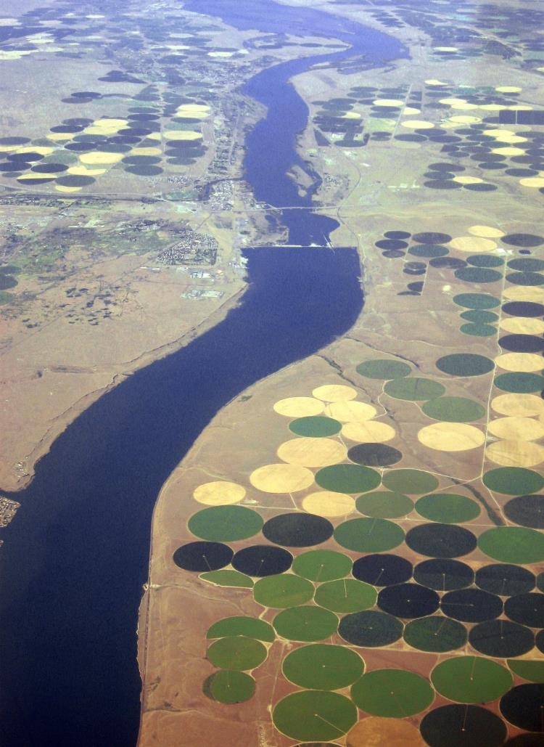
Adult Survival
In the Mainstem
(McNary to Rocky Reach Dam ~ 291 Rkm)
2010-2017
Subbasin | Race | Mean Survival
Entiat | Spring | 94%
 | Summer | 89%
Above Wells Dam | Spring | 97%
 | Summer | 85%
spokesman.com
Data from Tom Kahler, Douglas County PUD
Notes:
Because they enter the mainstem earlier than summer Chinook, spring Chinook migrate at times with higher flows and colder water temperatures. Nevertheless they appear to have better or equal survival rates to summer Chinook

Slide 46
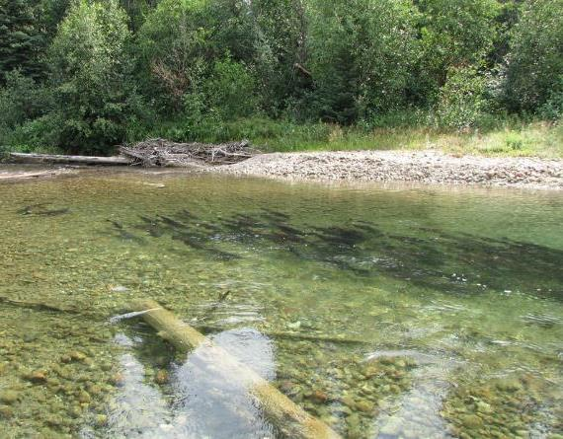
Pre-Spawning Mortality
Holding Location | 50% Arrival Date | Mean Survival
Spring Chinook Upper River Refuges | Early to Mid May | 54%
Summer Chinook Main River Pools | Mid July | 85%
Photo from: Oceanmdx,skyscrapercity.com
Data from Andrew Murdoch, WDFW
Notes:
Spring Chinook enter their natal streams earlier than summer Chinook. They tend to migrate and hold in the upper reaches of their spawning streams. Later arriving summer Chinook hold in large pools in the mainstem of their natal streams. Under current conditions pre-spawning mortality in spring Chinook can approach 50% while for summer Chinook it is around 15%

Slide 47
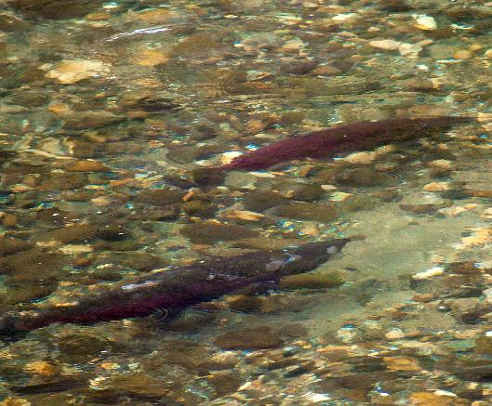
Influence of Hatchery Spawners
(1989 – 2016)
River | Race | pHOS | pNOB | PNI
Wenatchee | Summer | 14% | 92% | 0.87
 | Spring | 45% | 55% | 0.55
Methow | Summer | 33% | 74% | 0.69
 | Spring | 57% | 37% | 0.39
Photo: Mike Cushman, Cascadia Conservation District
Data from Andrew Murdoch, WDFW
Notes:
Because of their low abundance relatively few wild spring Chinook are used as hatchery broodstock and high percentages of hatchery fish are allowed to spawn in nature. Spring Chinook stocks are thus potentially more susceptible to domestication selection than summer stocks.

Slide 48
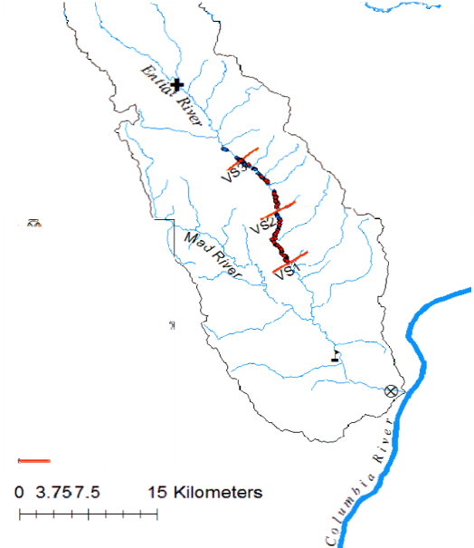
Redd Superimposition & Hybridization
(Entiat Subbasin)
Summer Chinook Redds
Spring Chinook Redds
~19% Superimposition: Summers on Springs
~14% Possible Hybridization
>3.2% Juvenile Hybrids Detected
Data & Map from: Tom Desgroseillier et al., PPT 2017, USFWS
Notes:
When there is spatial overlap between spawning spring and summer Chinook, summer Chinook may superimpose their redds on top of those produced by spring Chinook, destroying their recently deposited eggs
When there is spatial and temporal overlap, hybridization may occur which would likely reduce productivity

Slide 49
Summary of Adult Differences
(Springs Compared to Summers)
Higher pinniped predation
Higher or similar mainstem survival
Lower pre-spawning survival
Greater potential for hatchery domestication
Subject to redd Superimposition
  Redd superimposition could be a factor
  in the Wenatchee & Methow
Notes:
Summary of the differences seen

Slide 50
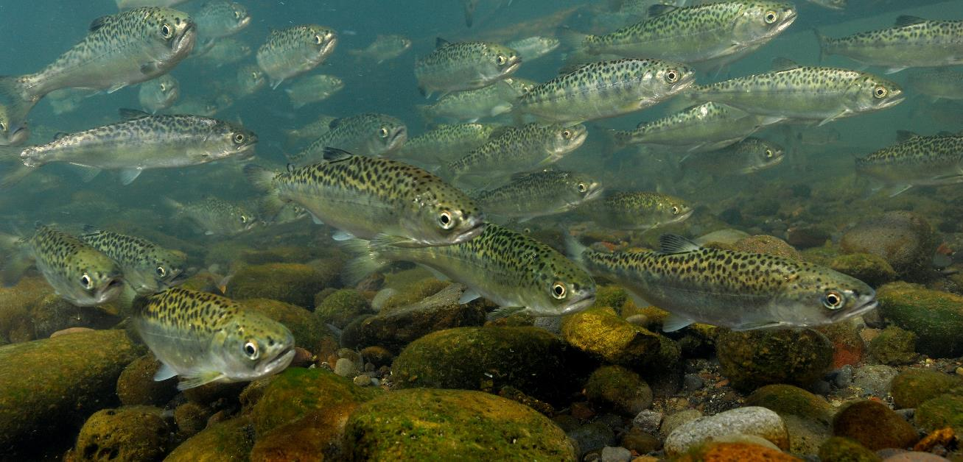
Differences Between Juvenile Spring & Summer Chinook
Image from Hakai Magazine Photo by Mark Conlin/SuperStock/Corbis
Notes:
Intro slide for differences detected between juvenile summer and spring Chinook

Slide 51
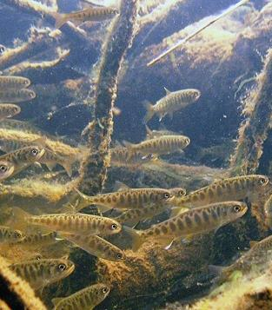
Juvenile Life History Strategies
Juvenile Life History | Summer Chinook | Spring Chinook
Sub-Yearling To Estuary
Spring | ✔ | -
Summer | ✔ | -
Fall | ✔ | -
Winter | - | -
Yearlings to Estuary
Spring-- from Reservoirs | ✔ | Few
Spring-- from Natal Subbasin | ✔ | ✔
Photo: Togiak National Wildlife Refuge USFWS
Data from Desgroseillier et al. 2017 PPT
Notes:
Summer Chinook have more diverse juvenile life histories. They may enter the estuary as subyearlings in the spring, summer, and fall. Some may over winter in mainstem reservoirs or in their natal streams and enter the estuary as yearling smolts. Spring Chinook typically remain in their natal streams and migrate as yearling smolts.

Slide 52
Figure from Andrew Murdoch, WDFW
Notes:
Migration timing of the juveniles is different. About 90% of summer Chinook smolts migrate during the spring spill regime while only 40% of the spring migrants do so.

Slide 53
Summary of Juvenile Differences
(Springs Compared to Summers)
Less life history diversity
Narrower time span and range in body sizes at estuary entrance
Possibly smaller % of mainstem out-migration during spill regime
Increased susceptibility to avian predation due to larger size
Subject to capacity and survival bottlenecks in tributaries due to
longer tenure in upper Columbia subbasins
Notes:
Summary of differences between summer and spring Chinook juveniles

Slide 54
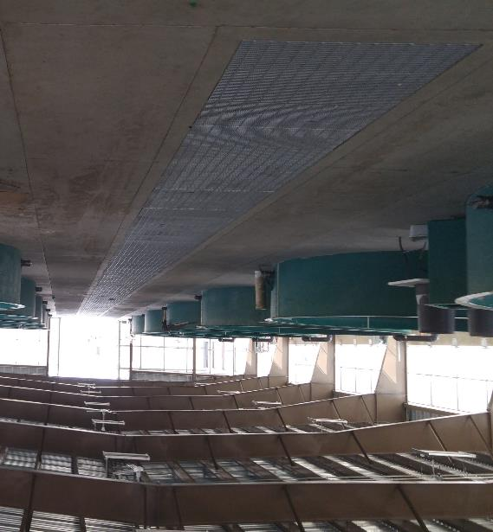
Research Monitoring & Evaluation
(hatchery questions)
Have past and ongoing hatchery programs affected
the fitness of UCR spring Chinook?
Are current supplementation programs providing
demographic benefits?
Can the present RM&E program answer the
above questions?
Wells Hatchery
Data and analyses from Murdoch et al. 2011 and Hillman et al. 2017
Notes:
RM&E questions related to past and current hatchery operations
Have past and current hatchery programs affected fitness?
Are the current supplementation programs providing demographic benefits?
Can the present RM&E program answer these questions?

Slide 55
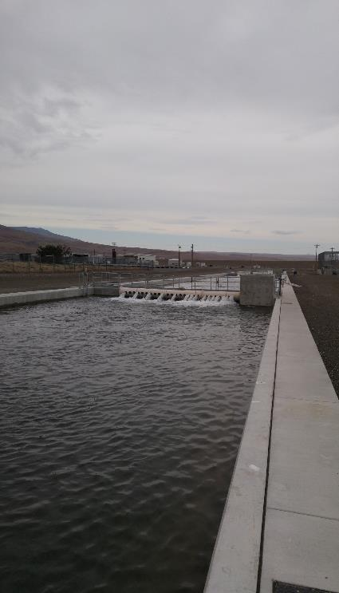
Research Monitoring & Evaluation
(hatchery questions)
Can the present RM&E program answer questions about current hatchery effects and demographic benefits?
Yes, a comprehensive RM&E program is in place with an adaptive management component.
Priest Rapids Rearing Channel
Notes:
Yes, the existing RM&E program can assess how current supplementation programs are influencing fitness and demographic parameters

Slide 56
Research Monitoring & Evaluation
(speculations on past hatchery effects)
Have past hatchery programs affected the fitness of UCR spring Chinook?
Productivity (R/S)
  Initial decrease due to out-of-basin transplants
Abundance
  Broodstock mining
Genetic diversity was likely altered via:
  Broodstock mining
  Straying
  Use of out-of-basin stocks
1899 State Hatchery Upper Wenatchee
Photo from Wahle and Pearsons 1984
Notes:
Have to speculate about the effects of past hatchery practices. Given what we know the first 50 years of hatchery operations likely reduced productivity, abundance, and altered genetic diversity….

Slide 57
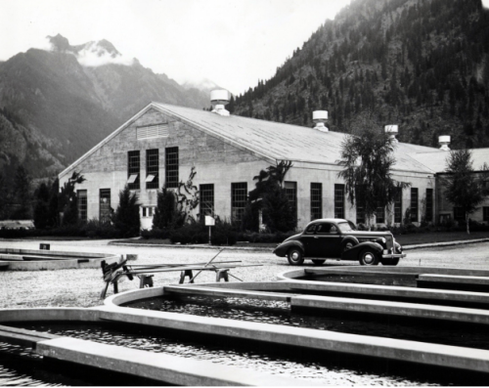
Research Monitoring & Evaluation
(speculation on past hatchery effects)
Have past hatchery programs affected the fitness of UCR spring Chinook?
Spatial structure was likely reduced by:
  Straying of hatchery fish
  Broodstock mining
  Transplants of out-of-basin stocks
    Grand Coulee Fish Maintenance Project
    Importation of lower river stocks
  Homogenization of in-basin stocks
Leavenworth Hatchery 1940
http://usfwspacific.tumblr.com/post/127730300805
Notes:
……and reduced spatial structure

Slide 58
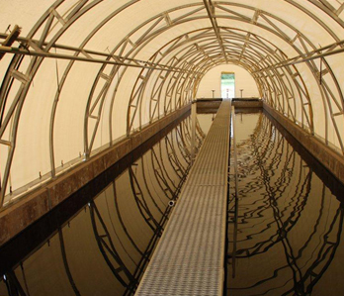
Research Monitoring & Evaluation
(current hatchery effects on genetics)
Genetic Differences
Pre-Supplementation v. Post-Supplementation
Methow & Wenatchee
No change in genetic diversity
  Allelic richness
  Heterozygosity
No change in Effective Population Size
Straying is reducing genetic differences among Methow, Chewuch & Twisp stocks in the Methow
Large amount of geneflow among Chiwawa, Nason, and White River stocks in the Wenatchee
Methow Hatchery
Photo: Grant County PUD
Notes:
Genetic analyses performed on fish samples collected before and after 4 to 5 generations of the current supplementation programs showed:
No decrease in genetic diversity
No decrease in Effective Population Size
That straying of spring Chinook in the Methow programs is reducing stock differences, and
That considerable geneflow is occurring among the Chiwawa, Nason, and White River stocks in the Wenatchee.

Slide 59
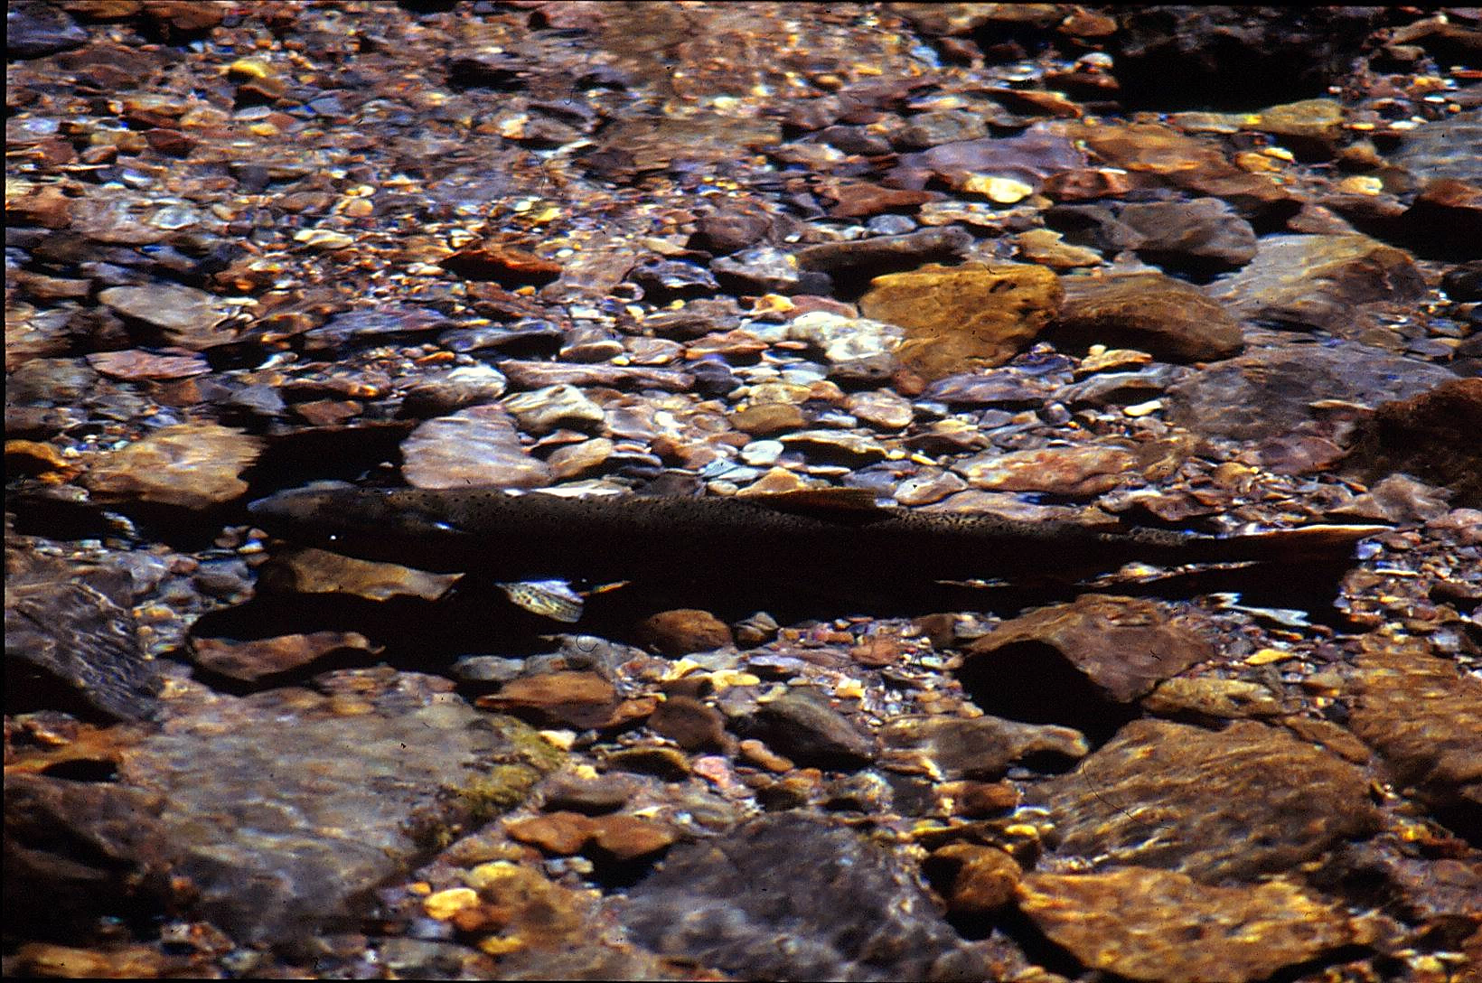
Research Monitoring & Evaluation
(current hatchery effects on demographics
when compared to Reference Streams)
Demographic Effects of Supplementation
Population Attribute | Methow | Wenatchee
Overall Abundance | No Change | No Change
Wild Abundance | No Change | No Change
Productivity (R/S) | No Change | No Change
Notes:
When compared to reference populations (i.e. non-supplemented populations that were judged to be similar to the UCR stocks)
No differences were seen in overall abundance, NOR (wild) abundance, or in productivity

Slide 60
Models
Are the life-cycle and habitat models for the Upper Columbia ESU useful for identifying, prioritizing, and evaluating restoration actions?

Slide 61
Models
In general, the life-cycle models will be useful to investigate the relative impacts of restoration actions.
Life-cycle models can be used to scale up management actions to larger spatial (entire river and ocean) and temporal scales (full life cycle).

Slide 62
Models
At this point, the models are useful for ranking the relative benefit of management actions at the population level but may not perform well when predicting the exact benefits.
The life-cycle models should be continually refined and improved.

Slide 63
Coordination
The UCSRB has developed a useful process for coordinating recovery actions.
Currently, there is no process for integrating the separate coordinating committees and working groups across the three subbasins.
The ISAB encourages the UCSRB and the tribal, state, federal agencies and the public utility districts to develop a systematic, collective process for coordinating actions, monitoring, and decision-making.

Slide 64

QUESTIONS

