Slide 1
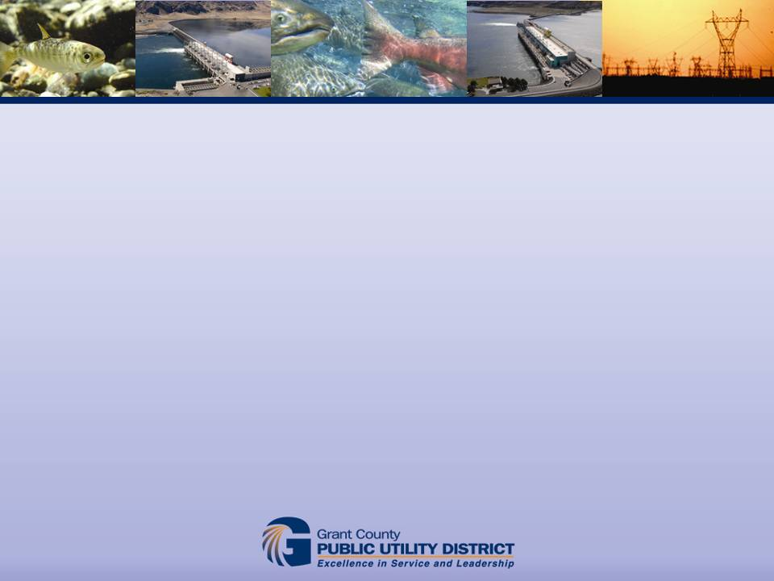
Comparison of results from Otolith and CWT marking at Priest Rapids Hatchery
August 29, 2012
Portland, OR
Paul Hoffarth, Todd Pearsons, and Russell Langshaw

Slide 2
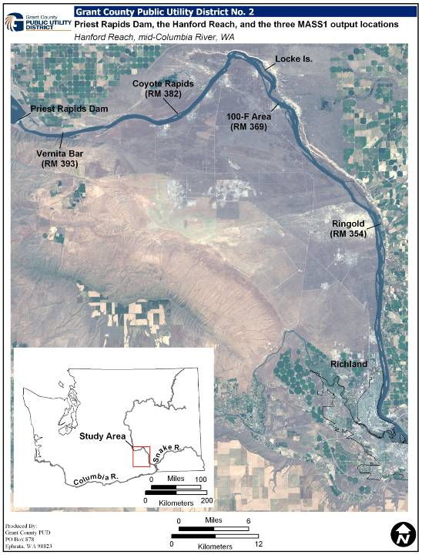
Hanford Reach
Unimpounded for 52 river miles
Largest naturally spawning Chinook population in Columbia River
Limited access/development because of USDOE Hanford Site and is now a National Monument protected by Presidential Proclamation
Notes:
Point out PDX, PRD, PRH, Tricities, Vernita Bar, Locke Island
Hatchery production in the HR but expectation is that is less than 10% of spawning escapement
PRH currently releases ~6.7 million subyearling smolts
Additional 3.5 million FCS released from Ringold springs

Slide 3
Priest Rapids Hatchery
Supply URB eggs to several regional hatcheries
Release ~ 6.7 million sub-yearling fall Chinook
Historically marked with CWT + ad-clip ~ 200K
Renovating and increasing production
M&E plan and broodstock management
  Otolith – 100%
  CWT ~ 600K
  CWT + ad-clip ~ 600K
  Ad-clip ~ 3.3M
Notes:
Egg collection ranged 5.1-24.1M
Released 4.5-7.1M
Various marking but CWT+ad-clip primary - some additional CWT, branding, otolith, PIT, etc.
New license and hatchery reform efforts led to renovation, M&E plan, broodstock management
Additional tagging to support changes

Slide 4
Data collection
Volunteers trapped at hatchery outfall
  Broodstock or surplus
Carcass surveys throughout HR
Scanned for tags and systematically subsampled for M&E
Age composition determined with scales and/or marks
Notes:
All fish scanned for CWT – in mouth around head. Working on protocol to implement this year to investigate source of bias
Carcass surveys - 3 crews daily from early Nov through early/mid December otolith

Slide 5
Hatchery volunteers
 | Age-2 | Age-3 | Age-4 | Age-5 | Total
2010 | 2,668 | 14,598 | 1,074 | 829 | 19,169
PRH - CWT | 57 | 410 | 1 | 15 | 483
Otolith | 183 | 1,362 |  |  | 1,545
2011 | 3,229 | 5,954 | 11,546 | 94 | 20,823
PRH - CWT | 628 | 124 | 280 |  | 1,032
Otolith | 178 | 549 | 977 |  | 1,704
Carcass recoveries
 | Age-2 | Age-3 | Age-4 | Age-5 | Age-6 | Total
2010 | 783 | 2,448 | 3,721 | 2,839 | 0 | 9,791
PRH - CWT |  | 7 |  | 3 |  | 10
Otolith | 32 | 555 |  |  |  | 587
2011 | 215 | 1,032 | 5,995 | 1,376 | 20 | 8,637
PRH - CWT | 8 | 6 | 6 |  |  | 20
Otolith | 42 | 221 | 640 |  |  | 903
Notes:
Otoliths sampled and PRH origin CWT recoveries

Slide 6
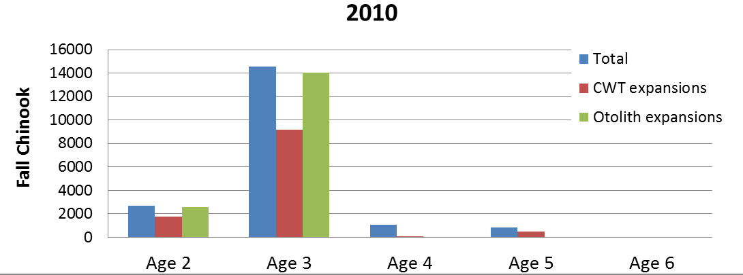
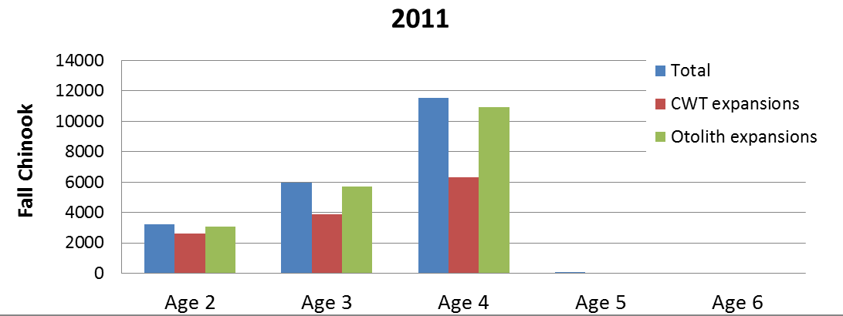
Volunteers to PRH
Notes:
These CWT results consistent with historical data. 1997-present mean - PRH origin is 67%
Precision is ~ +/- 10%

Slide 7
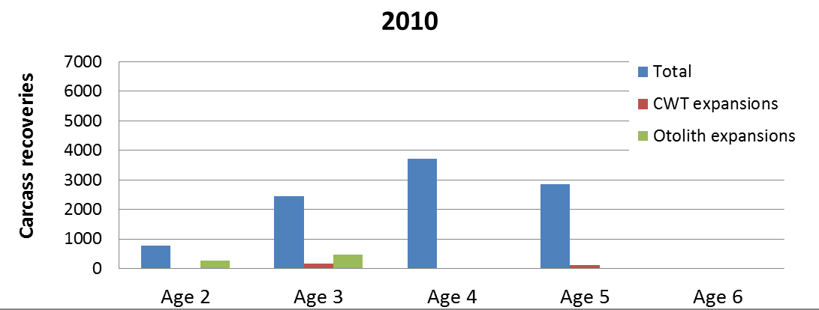
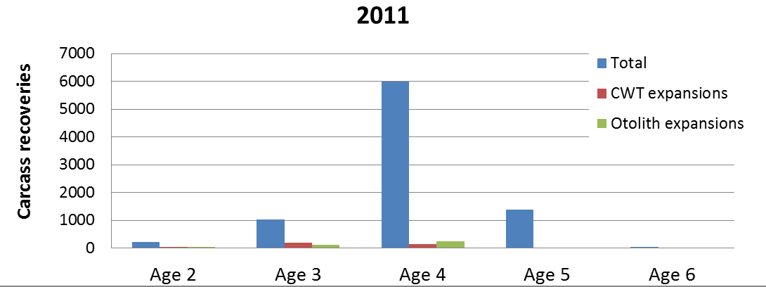
Carcass recoveries

Slide 8
Studies using otoliths
Age & growth
Combine with DNA or elemental analyses
Origin
  Hatchery vs. Natural
Movement patterns
  Spatial and temporal
Habitat use
  Effects of flow fluctuations
Survival
  Size dependent events
Notes:
Age & growth most common
Very powerful when combined with other analyses
Origin – broodstock management or spawning ground composition
Movement patterns – timing & duration of migration & rearing. Stream-type Chinook – What is relative survival of fall & spring emigrants; Subyearling that overwinter in reservoirs; estuary rearing etc
Habitat use – Examine the effects of hydro operations & fluctuations on growth
Size dependent mortality events (fry that are smaller at hatch have higher mortality rates ) or look for evidence of lifestages with density dependence

Slide 9
Potential future studies relating to fall Chinook in the Hanford Reach
Evidence for density dependence in the Hanford Reach
Differential survival of fish exposed to contaminants from the Hanford Site
Habitat use by juveniles
Refine spawning habitat models
Notes:
URB - Strong relationship between survival, size, and plume volume – could examine growth rates for evidence of when or where freshwater growth may be limited
Hanford Site – currently working on NRDA and could look for evidence of differential survival for fish spawned or rearing in contaminant plumes
Differential survival – for particular rearing locations or habitat types
Spawning habitat models for HR notoriously over-predict habitat use. Look for signatures related to connectivity, upwelling, down-welling, etc

Slide 10
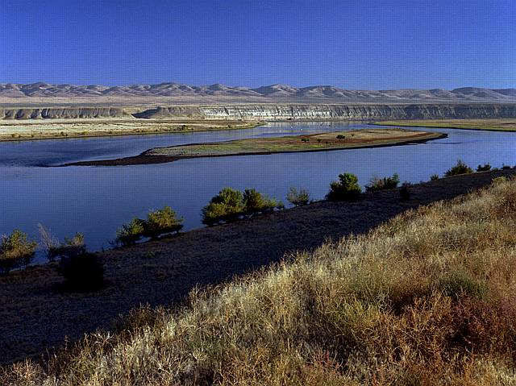
Questions?
Image provided by Battelle

