Slide 1
Capacity Impacts of Energy Efficiency
What We Know
and
What We Don’t Know
March 11, 2014

Slide 2
We Know That Winter Peaks Aren’t Growing, While Summer Peaks Probably Are
Notes:
This trend shows the actual peak loads by year since 2005. The peak loads vary due to the weather and utilities plan for peak demands based on extreme temperatures, not “normal” temperatures, so weather normalization is not appropriate.
Neither actual winter or summer peaks have grown since 2005. This a function of a combination of the actual temperature extremes experienced since 2005 as well as reflection of the underlying change in load characteristics.

Slide 3
We Know The PNW System’s Daily Load Profile
Has Not Changed Significantly Since 1995
Winter System Peak:
8 – 9 AM
7 – 8 PM
Summer System Peak:
5 – 6 PM

Slide 4
We Know That Since 1995 PNW Utilities Have Acquired Over 2,700 Average Megawatts of Conservation Savings

Slide 5
We Don’t Know What Impact (If Any) Did These Energy Savings Have On the Region’s Need for Capacity Resources
However:
We Do Know That Improvements in Energy Efficiency also change hourly demands
  Savings shape matches end use load profile:
    If a device uses 20% less total energy over the course of the year, it uses 20% less each hour of the year (e.g., installation of lower wattage lighting)
  Savings shape is the difference between the pre-case end-use profile and the post-case end-use load profile
    If a device uses 20% less total energy over the course of the year, but the reduction in uses in not proportional across all hours (e.g., occupancy sensors for lighting turn lights off during business hours)
We Do Know That End Use and Energy Efficiency Savings Load Profiles Are Needed to Assess Capacity Impacts

Slide 6
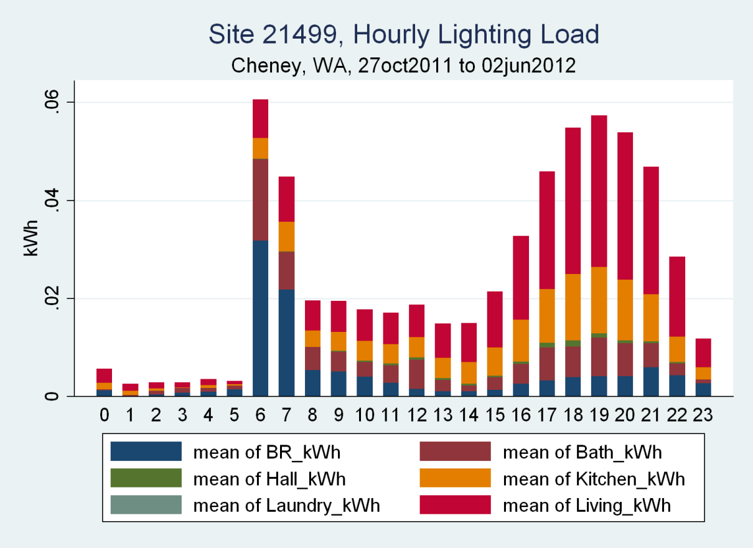
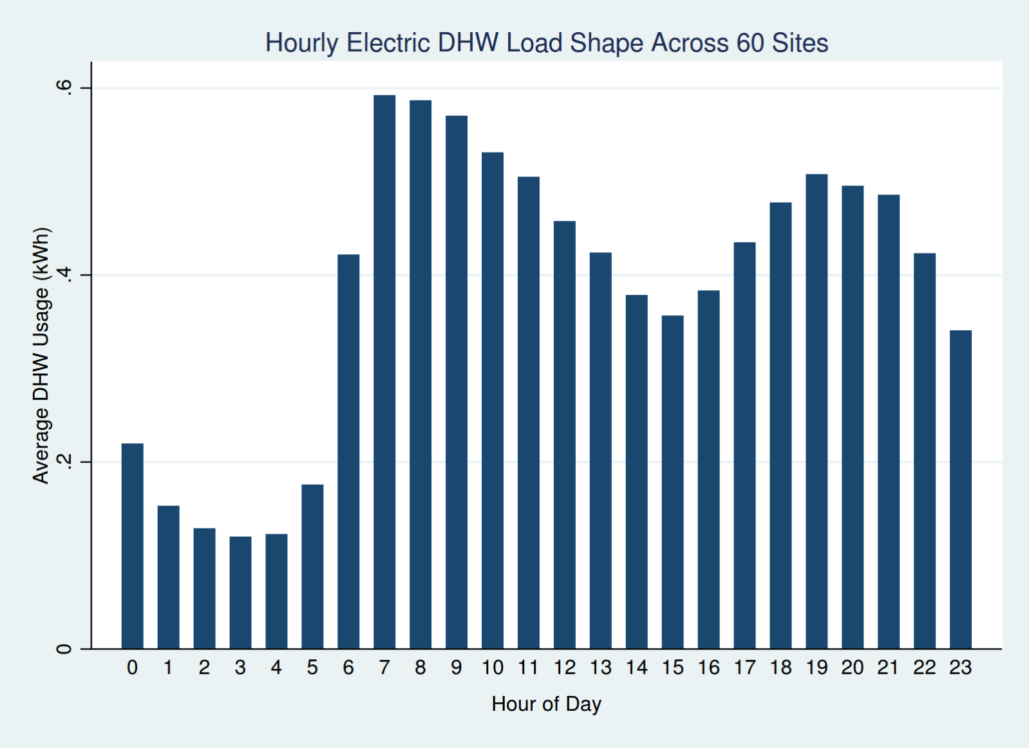
What Is End-Use Data?
NEEA RBSA metering data provided by Ecotope

Slide 7
We Know The Current State of End Use Load Research
The Good News - Bonneville conducted a comprehensive End Use Load Research (EULR) project, the End-Use Load and Consumer Assessment Program (ELCAP)*
The Bad News – This year marks the 25th anniversary of when the last ELCAP data was collected
  There have been no comparable studies in the US or Canada since then
  There are none planned
*The ELCAP was later designated as the Regional End-Use Metering Project (REMP)

Slide 8
We Know What Was Collected in ELCAP
ELCAP began in 1983 and ended in 1991
ELCAP’s Goal – Collect a comprehensive set of customer characteristics and hourly end-use electricity consumption and weather data from residential and commercial sector consumers
ELCAP’s Product - Created hourly (8760) load profiles at the individual end use and building level along with associated customer characteristics and weather data

Slide 9
We Know The Concerns Raised About
ELCAP and Existing EULR Data Sources*
They’re Old
  The last ELCAP data was collected in 1989
They Don’t Reflect Current Building and Equipment Stock
  Appliance characteristics and usage have changed (e.g., increased efficiency standards);
  There are new emerging/growing technologies (e.g., computers, plasma TVs, Electric Vehicles, variable speed drives, demand controlled loads, LED’s, etc.);
  New appliances, lighting and equipment are “electronic” and may have differ Power Factors than existing “resistance” based appliance, lighting and equipment
They Don’t Provide Energy Savings Load Shapes
  Energy Efficiency measure savings, especially controls, do not have the same shapes as their end-use load shapes (e.g., occupancy sensors are designed to turn off lights during the day when no one is present)
*Results of a RTF Regional and National Review of the Business Case for End Use Load Research

Slide 10
We Don’t Know If These Concerns Warranted
To Test This Premise Staff Compared ELCAP Data To More Recent, But Less Comprehensive Studies
The Northwest Energy Efficiency Alliance (NEEA) Research
  Residential Building Stock Assessment “Test Bed”
    EULR study of approximately 100 single family homes
    Preliminary (1st year) results are now available
  Ductless Heat Pump Pilot Program
    Detailed 5 minute interval data on approximately 100 ductless heat pumps
  Heat Pump Water Heater Pilot Program
    Detailed 5 minute interval data on approximately 50 heat pump water heaters
While not as comprehensive as ELCAP these studies do provide some insights into what’s changed and what hasn’t, but only in the residential sector

Slide 11
Five Tests of the ELCAP Data
Electric water heating
  What impact did improvements in efficiency since 1990 that reduced annual energy consumption from 4,700 kWh/yr to 3,000 kWh/yr have on winter peak demands?
Residential Refrigerators
  What impact did improvements in efficiency since 1990 that reduced annual energy consumption from 1,500 kWh/yr to less than 500 kWh/yr have on winter peak demands?
Residential space heating
  What impact will supplementing existing zonal electric heating systems (e.g. baseboard, radiant ceiling, wall heaters) with Ductless Heat Pumps have on winter and summer peak demands?
Residential lighting
  What impact will federal efficiency standards that are changing the mix of lighting technologies from primarily (90%) incandescent lamps to over primarily (60% - 80%) fluorescent (CFLs) /solid state (LED) lamps have on winter peak demands and power factor?
Total System Impacts
  Is ELCAP data “good enough”? (i.e., Is there a significant difference between using ELCAP load profiles and more recent data to estimate the impact of energy efficiency measures on system peaks?)

Slide 12
ELCAP Residential Water Heating Load Shape
System Winter Peak Hours

Slide 13
We Know That Residential Water Heating Load Profiles Have Changed
System Winter Peak Hours

Slide 14
We Know That PNW Residential Water Heating Hourly Demand Has Decreased
System Winter Peak Hour Savings

Slide 15
We Know That Capacity Savings From Residential Water Heating Efficiency Improvements Between 1990 and Today Were Three Times Their Annual Energy Savings
 | 1990 | 2012
Annual Use (kWh) | 4,700 | 3,000
Savings/Unit (kWh) |  | 1,700
Water heater stock <55g | 2,701,000 | 3,489,700
Water heater stock >55g | 300,100 | 337,800
Water heater stock - Total | 3,001,200 | 3,827,500
Annual Load (aMW) | 1,610 | 1,310
PNW 2012 Savings (aMW) |  | 300
Coincident Peak Load (MW) | 2,940 | 2,035
Coincident Peak Savings (MW) |  | 905

Slide 16
We Know That Current Water Heating Load Factors Now Higher

Slide 17
We Now Know That Using Old (ELCAP) Load Profiles Understate the Capacity Impact of Changes in Water Heater Efficiency
 | 1990 | 2012 – ELCAP Load Shape | 2012 – RBSA Load Shape
Annual Use (kWh) | 4,700 | 3,000 | 3,000
Savings/Unit (kWh) |  | 1,700 | 1,700
Water heater stock <55g | 2,701,000 | 3,489,700 | 3,489,700
Water heater stock >55g | 300,100 | 337,800 | 337,800
Water heater stock - Total | 3,001,200 | 3,827,500 | 3,827,500
Annual Load (aMW) | 1,610 | 1,311 | 1,311
PNW 2012 Savings (aMW) |  | 300 | 300
Coincident Peak Load (MW) | 2,940 | 2,370 | 2,035
Coincident Peak Savings (MW) |  | 570 | 905

Slide 18
We Know That Federal Standards Will Decrease Water Heating Energy Use
Further Altering This End Use’s Load Shape
Winter System Peak Hours

Slide 19
Capacity Impact of Changes in Water Heater Efficiency Due to New Federal Standards
 | 2012 ER | 2012 HPWH
Annual Use (kWh) | 3,000 | 2,000
Savings/Unit (kWh) |  | 1,000
Water heater stock >55g | 337,815 | 337,815
Annual Load (aMW) | 115 | 75
PNW 2012 Savings (aMW) |  | 40
Coincident Peak Load (MW) | 175 | 110
Coincident Peak Savings (MW) |  | 65
We Know That Without More Recent End Use Load Research We Would Not Be Able to Estimate the Capacity Impacts of Heat Pump Water Heaters.

Slide 20
We Know That Compared to the Stock in 1990 the Current Stock of Refrigerators Uses One-Third the Energy and Requires One-Half the Capacity
Winter System Peak Hours
Today’s better insulated refrigerators are less sensitive to ambient air temperature

Slide 21
We Know That Since Refrigerator Load Profiles Have Not Changed Significantly ELCAP Data Is Still A Reasonable Representation of Capacity Impacts
 | 1990 | 2012 – ELCAP Load Shape | 2012 – RBSA Load Shape
Annual Use (kWh) | 1,500 | 500 | 500
Savings/Unit (kWh) |  | 1,000 | 1,000
Water heater stock - Total | 4,635,880 | 7,148,900 | 7,148,900
Annual Load (aMW) | 795 | 410 | 410
PNW 2012 Savings (aMW) |  | 385 | 385
Coincident Peak Load (MW) | 760 | 390 | 390
Coincident Peak Savings (MW) |  | 370 | 370

Slide 22
On the Other Hand, There Are Subtle “Within Hour” Differences That Might Matter for Demand Response
Note difference in use following “defrost” cycle
Defrost Cycle

Slide 23
We Know That Ductless Heat Pumps Have Both Energy and Capacity Benefits

Slide 24
We Know That Ductless Heat Pumps Capacity Benefits
Even On Extreme Winter Peak Days
Peak Day Savings

Slide 25
We Know That Ductless Heat Pump Provide Air Conditioning – So Summer Peak Loads Will Increase

Slide 26
Potential System Impacts from Ductless Heat Pumps
 | Electric Zonal Heat | Electric Zonal w/DHP Supplement | Electric Zonal Extreme Peak | Electric Zonal w/DHP Supplement
Annual Use (kWh) | 9,680 | 6,360 | 6.2 (KW) | 2.7 (KW)
Savings/Unit (kWh) |  | 3,320 |  | 3.46 (KW)
Existing Baseboard Heated Stock | 542,600 | 542,600 | 542,600 | 542,600
Annual Load (aMW) | 600 | 395 | N/A | N/A
Potential Savings (aMW) |  | 205 |  | N/A
Winter Coincident Peak Load (MW) | 1,725 | 485 | 3,345 | 1,465
Winter Coincident Peak Savings (MW) |  | 1,245 |  | 1,880
Summer Coincident Peak Load (MW) | 45 | 115
Summer Coincident Peak Savings (MW) |  | (70)

Slide 27
Lighting Energy Use
Scenario | LPD (W/ft^2) | Annual Energy (kWh/yr)
ELCAP | 3.54 | 4500
Current Survey (RBSA) | 1.40 | 1845
Full EISA Compliance w/ EISA targets | 1.18 | 1555
Full EISA Compliance w/ CFLs | 0.85 | 1120
Four scenarios
  1990 – Lighting load as measured in ELCAP
  2012 – Lighting load as measured in RBSA
  Full EISA compliance with EISA targets assume all currently non-complying, non-exempt lamps are replaced with their minimum compliance equivalents
  Full EISA compliance with CFLs assumes all non-complying, non-example lamps replaced with CFL equivalents
Annual energy use is for 2,006ft² house with 1.8 hours per day of on-time (Source: RBSA sample house size and lighting on-time metering)

Slide 28
Residential Lighting Load Profiles
Lighting Is Now Contributing Significantly Less to Both Morning and Evening Peaks
System Winter Peak Hours

Slide 29
Historical and Forecast System Impacts from Residential Lighting Efficiency Improvements
 | Lighting Loads (ELCAP) - 1990 Stock & Efficiency | Lighting Loads (ELCAP load shape, 2012 stock & efficiency) | RBSA Lighting Load Shape - 2012 Stock & Efficiency | Post-EISA 2020 Lighting Standards Loads (2012 Stock)
Annual Use (kWh) | 4,500 | 1,770 | 1,770 | 1,080
Savings/Unit (kWh) |  | 2,730 | 2,730 | 690
Single Family Residential Stock | 4,021,700 | 5,798,220 | 5,798,220 | 5,798,220
Total Annual Lighting Loads (aMW) | 2,065 | 1,170 | 1,170 | 715
PNW 2012 Savings (aMW) |  | 895 | 895 | 455
Coincident Peak Load (MW) - Morning | 2,080 | 1,180 | 1,230 | 750
Coincident Peak Load (MW) - Evening | 2,885 | 1,640 | 1,850 | 1,135
Coincident Peak Load Savings (MW) - Morning |  | 900 | 850 | 480
Coincident Peak Load Savings (MW) - Evening |  | 1,245 | 1,030 | 725

Slide 30
What’s All This Mean
The region’s development of energy efficiency resources also has capacity impacts
Our knowledge of the relationship between energy and capacity savings is largely based on data collected 25 years ago
Let’s see just how much difference using updated data for just two end uses makes

Slide 31
2010 -2012 Utility Efficiency Program Savings

Slide 32
January Day Hourly Savings Change with Updated Data

Slide 33
Updating Load Profile Data Annual Energy and Winter Capacity Savings from 2010-2012 Utility Efficiency Programs
120 Lower Peak

