Slide 1
Defining the RTF’s Role in Research
Jennifer Anziano
Regional Technical Forum
May 15, 2015

Slide 2
Objectives for Today’s Discussion
Today we are seeking guidance on how best to bound the RTF’s role in research. Specific questions include:
How should the RTF approach unfunded RTF-related research questions (who convenes potential funders)?
How narrowly (or broadly) do we focus a clearinghouse (or coordination function) of regional research?
These questions also start to raise broader regional coordination challenges…

Slide 3
Previous PAC Guidance
The RTF should:
Not do primary research
Let utilities prioritize based on value to them
Not play a regulatory role
Limit the role in impact evaluation review, if asked

Slide 4
Reliability in the RTF
Planning
Provisional
Proven
Small Saver
Savings too small to warrant quality standards of Proven
Least reliable predictor of energy savings
Most reliable predictor of energy savings
Evaluation burden

Slide 5
RTF Research Needs
Non-Proven Measures
Identification of deficiencies in measure reliability
Proven Measures
Development of a clearinghouse of evaluation research
Development of research plans to address those deficiencies
Reliance on the region to conduct the research
Leveraging regional research (and beyond) to inform measure updates
Reliance on the region to define, conduct, and inform on related research

Slide 6
RTF Role in Research:
Non-Proven Measures

Slide 7
Value of Non-Proven Measures
Provide flexibility, enabling implementers to move forward with programs while data is collected to improve the reliability of the savings estimate
Research Plan provides direction and clarity about what is needed to bring measure to Proven
RTF development and review provides credibility and conveys regional importance

Slide 8
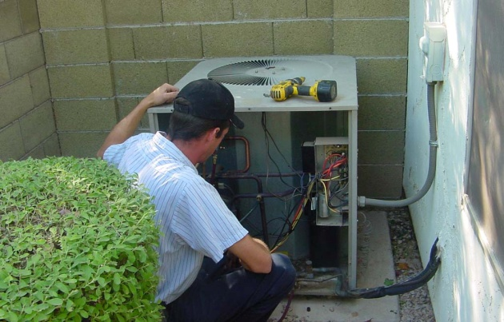


RTF Struggles with Research Plans
Research plan ownership and funding (or lack thereof) has created challenges in the past
When there are no funders or owners:
Potential funders struggle with approving a Research Plan that might fall into their lap with no prior consideration
Research plans often feel too “baked” before getting to funders
When there is a funder:
What does it mean for the RTF to approve a research plan?
Puts RTF into a quasi-policing role (threat of deactivating measure if research isn’t carried out)
Risk approving something that programs use to claim savings, but research is never initiated/ completed
Scientific
Irrigation
Scheduling
Commissioning Controls
and Sizing
Grocery Refrigeration
Notes:
Image Sources:
http://dashservice.com/hvac-repair/need-to-replace-your-heat-pump-nows-the-perfect-time
http://www.gelighting.com/LightingWeb/na/case-studies/food-city.jsp
http://rkirrigation.net/

Slide 9
A New Approach for Non-Proven Measures
Based on feedback from the RTF members and stakeholders, the staff proposed a new approach to research plan development for non-proven measures
Key change: Difference between Planning and Provisional based solely on whether there is an identified sponsor/funder for required research

Slide 10
Proposed Changes for Planning and Provisional Measures
 | Planning | Provisional
Funders | Funder(s) not identified | Funder(s) identified
RTF Role | Description of research needs and general scoping of work (estimate cost range) | Description of how RTF would use funded research to move measure with acknowledgement of research limitations and challenges
RTF Approval Means | Agreement that approach provides a reasonable way to move the measure to Proven Recognition that research design may be altered | Agreement that data collection and analysis would help to meet some or all of the research goals Agreement that results can be used to evaluate the measure
Reliability Standards | No change. Remains “low”. | Same as Planning (i.e. becomes “low”)
Evaluation Requirements | No change. When evaluated, include full impact evaluation with savings estimation. | No change. Delivery verification can be combined with results of RTF research.
Addresses “Grocery Refrigeration” challenge
Addresses “SIS” and “CC&S” challenge

Slide 11
RTF Reaction?
The RTF was generally supportive of this new approach being a step in the right direction, but identified a few areas that still need to be ironed out:
Concerns about unfunded mandates sitting on the RTF books
Concerns about potentially losing something by removing the reliability distinction between Planning and Provisional

Slide 12
Whose Job is it to Secure Funding for RTF Related Research Questions?
Proposal
RTF PAC: Prioritizes and secures funding for unfunded/sponsored research projects
  Right body for identifying funders
  Will require good connection with RTF representatives
RTF Staff: Support annual check ins on the status of non-proven measures with the RTF
  Allows the RTF to weigh all measures at one time to determine priorities (and potentially deactivate measures if there is no interest)
  Keeps measures on the radar of potential funders

Slide 13
Reliability Distinction Between Planning and Provisional
Current standard in Guidelines |  | Quality Standards/Reliability of Savings
 |  | Low | Medium | High
Evaluation Burden | High | Planning
 | Medium |  | Provisional
 | Low |  |  | Proven
With Proposed Changes |  | Quality Standards/Reliability of Savings
 |  | Not High | High
Evaluation Burden | High | Planning
 | Medium | Provisional
 | Low |  | Proven
Expressed Concern: This removes a distinction between Planning and Proven that may be useful, but is hard to draw a line around
Example: Heat pump water heaters currently “Planning” yet we know these savings well compared to advanced power strip

Slide 14
RTF Role in Research:
Proven Measures

Slide 15
Research and Our Proven Measures
RTF relies on regional research to continually improve the reliability of our savings estimates
Research—broadly defined—includes:
  Program evaluations and focused parameter research
  Market studies (ex: RBSA, sales data)
To date, this role has been framed around a “clearinghouse” role for regional collaboration and impact evaluation
  Particular focus on RTF measure related research

Slide 16
PAC Guidance on Bounding the RTF’s Research Coordination Role?
The RTF added a dedicated resource for research and evaluation coordination:
  Develop a clearinghouse of evaluation (and potentially other) research related to RTF measures
  Convene researchers to discuss projects and work to identify topics that benefit from collaboration
Cautions to the approach
  “Research” is a broad term that covers a variety of different projects (emerging tech studies, market studies, evaluations, etc)
  Different types of research are likely to require different types of engagement (different individuals, timing, etc)
  Some research directly relates to RTF measures today, while other research may become valuable to a future RTF measure early engagement
  There are many coordinators/conveners in this region and we need to be mindful about covering the right gap while avoiding duplication

